Slide 1
Solving the Game of Racetrack
Graham Wright
Will.He.Is De Witt

Slide 2
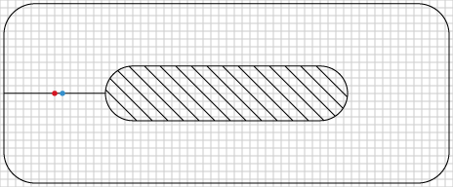
Racetrack
You need a grid with a boundary in the middle and/or along the outside
The line represents the start/finish line
The person to make it to the finish first wins

Slide 3
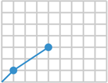
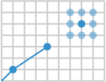
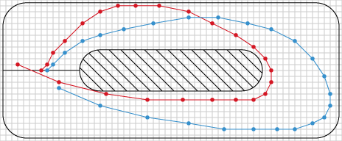
Racetrack (Cont)
The car must move the same distance as its last move plus or minus one unit on the y axis and/or x axis
Up 2
Over 3

Slide 4
Goals of the Program
Given a starting point and a racetrack, generate a path that reaches the finish line in the smallest number of turns
Display the “fastest” path on the track in a visual representation
Develop the algorithm in a way that generalizes to any racetrack

Slide 5
Components of the Program (Java)
Classes
GraphicsMain – Paints the grid and runs the program
Point – Defines an (x, y, dx, dy) point
Boundaries – Defines a racetrack map
Line – Defines a (Point), (Point) line
Solver – Contains the algorithms
Path – Defines a path containing a list points
Graphics2D, Jframe objects; Math class

Slide 6
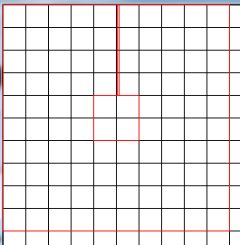
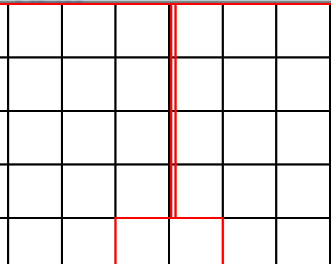
Processing and Visualizing the Track Itself
The origin is in the upper left hand corner
The coordinate system is reflected across the y axis
The coordinate grid goes by 25s

Slide 7
Processing and Visualizing the Path Itself
A track is just a set of lines
However, the finish line is a bit more complicated
We needed a “safety line” in addition to the finish line so that, in a looping track, the program will not try to cross back over from the start to the finish line
They are off center to start correctly

Slide 8
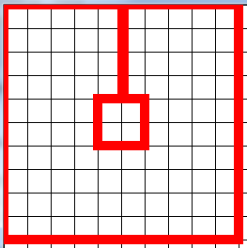
Processing and Visualizing the Path Itself
“Safety Line”
x = 126
Finish Line
x = 128
Starting Point
(125, 50)

Slide 9
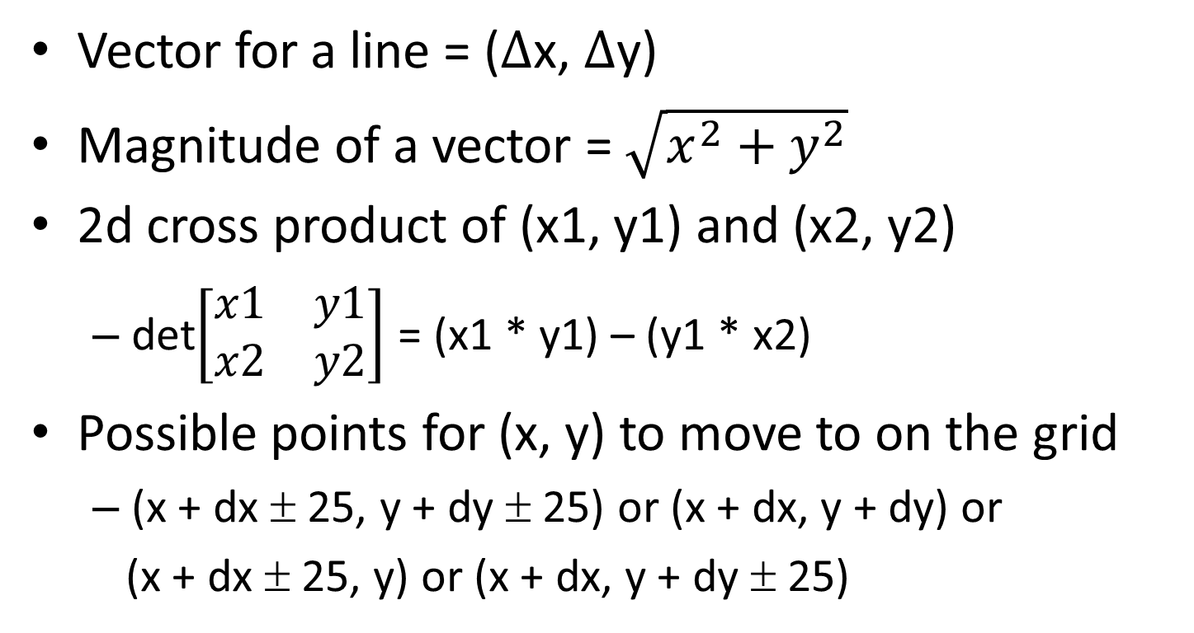
Some Required Maths
Vector for a line = ($∆$x, $∆$y)
Magnitude of a vector = $\sqrt{x^{2}+y^{2}}$
2d cross product of (x1, y1) and (x2, y2)
det$\left[\begin{matrix}x1 & y1 \\ x2 & y2\end{matrix}\right]$ = (x1 * y1) – (y1 * x2)
Possible points for (x, y) to move to on the grid
(x + dx ± 25, y + dy ± 25) or (x + dx, y + dy) or
(x + dx ± 25, y) or (x + dx, y + dy ± 25)

Slide 10

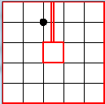
Finding Possible Points to Move to
(4, 3) dx = 3 dy = 2
Possible point (7, 5)
(7 ± 1, 5 ± 1)
(7, 5 ± 1) and (7 ± 1, 5)
(50, 25) dx = 0 dy = 0
p.generatePossiblePoints()
(25, 25)
(25, 50)

Slide 11
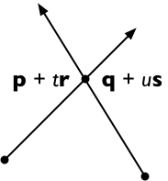
Some Required Maths
Line Intersection Algorithm
r and s are vectors for the lines
p + t r = q + u s
(p + t r) × s = (q + u s) × s
t(r × s) = (q − p) × s
t = (q − p) × s / (r × s)
u = (q − p) × r / (r × s)
If t and u are between 0 and 1 inclusive or if they are collinear, the lines intersect
x = determinant of the formed matrix, cross

Slide 12
Deciding a finish
Crosses boundary FIRST
NOT a valid finish
Crosses boundary SECOND
IS a valid finish
“Safety Line”
x = 126
Finish Line
x = 128

Slide 13
Developing our algorithm
There are too many possible paths to store, so we needed a way to print them as it goes, basing every new path found off of one path that is constantly being added to or taken away from
Call generatePossiblePoints() on a point
Construct a path turn by turn by looking at the first point that can be moved to that has not been used

Slide 14
Developing our Algorithm
Look for paths of size 1. If there are no complete paths of size 1, start over and look for paths of size 2. Repeat until a finished path is found; find all complete paths in this target size.
Pros: No need for user input or guessing
Cons: Program is repeating searches by overlapping

Slide 15
Our Algorithm
The racecar
Did not finish and no more moves left
Reached finish line; PRINT
Point on grid inside the track
Starting point

Slide 16
Optimization
Looking for every possible path is very demanding and not the most efficient; gets much slower for longer tracks
The most effective time cutter:
Find the max distance the current path can reach in the remaining turns
If this is less than the shortest distance between the current point and the finish, go back one point
Disallow crossing its own path, using a point twice

Slide 17
The Program in Action
Various Tracks and code

Slide 18
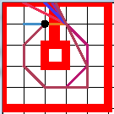
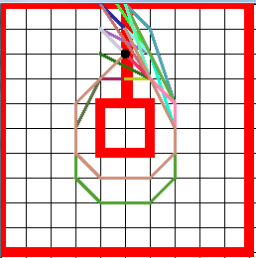
Solutions so Far
5x5
10x10
# of turns: 8
Count: 11
# of turns: 9
Count: 46

Slide 19
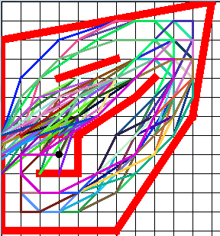
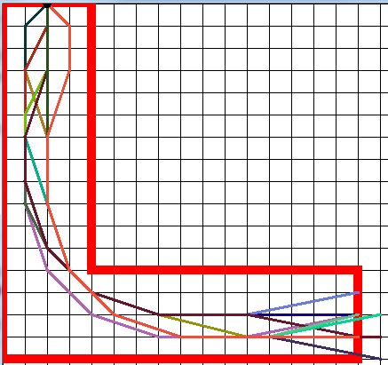
Solutions so Far
Weird Pentagon
The L
# of turns: 9
Count: 67
# of turns: 14
Count: 1927

Slide 20
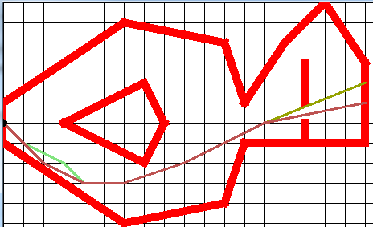
Solutions so Far
Fish?
# of turns: 7
Count: 4

Slide 21
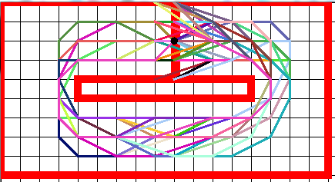
Rectangle
# of turns: 15
Count: 6971

Slide 22
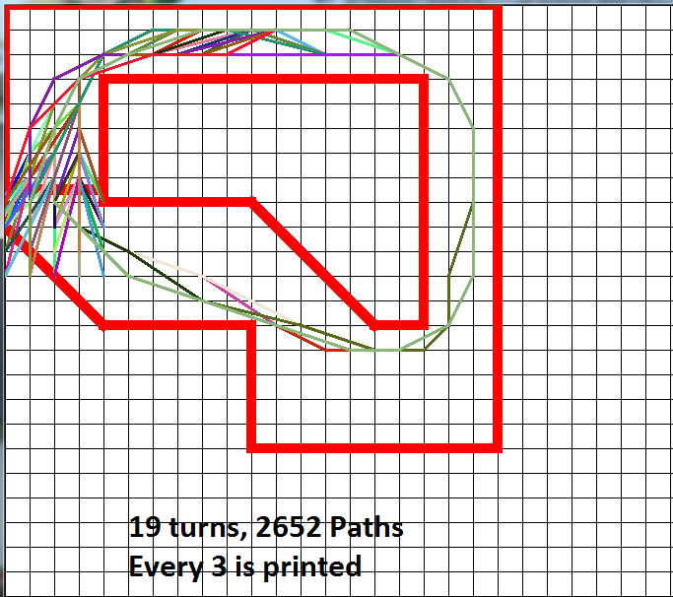
“Aaron’s Track”

Slide 23
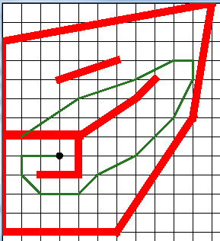
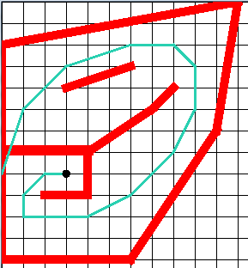
Trends in Solutions
Acceleration is a crucial component of Racetrack
Hugging corners is not always optimal if given more time to accelerate otherwise

Slide 24
Branching at Finish and Straightaways
Finish Branching
Straightaway

