Slide 1
04. The Abstraction: The Process
임종범
jblim@kpu.ac.kr

Slide 2
How to provide the illusion of many CPUs?
CPU virtualizing
The OS can promote the illusion that many virtual CPUs exist.
Time sharing: Running one process, then stopping it and running another

Slide 3
A Process
A process is a running program.
Comprising of a process:
Memory (address space)
Instructions
Data section
Registers
Program counter
Stack pointer

Slide 4
Process API
These APIs are available on any modern OS.
Create
Create a new process to run a program
Destroy
Halt a runaway process
Wait
Wait for a process to stop running
Miscellaneous Control
Some kind of method to suspend a process and then resume it
Status
Get some status info about a process

Slide 5
Process Creation
Load a program code into memory, into the address space of the process.
Programs initially reside on disk in executable format.
OS perform the loading process lazily.
Loading pieces of code or data only as they are needed during program execution.
The program’s run-time stack is allocated.
Use the stack for local variables, function parameters, and return address.
Initialize the stack with arguments → argc and the argv array of main() function

Slide 6
Process Creation (Cont.)
The program’s heap is created.
Used for explicitly requested dynamically allocated data.
Program request such space by calling malloc()and free it by calling free().
The OS do some other initialization tasks.
Input/output (I/O) setup
Each process by default has three open file descriptors.
Standard input, output and error
Start the program running at the entry point, namely main().
The OS transfers control of the CPU to the newly-created process.

Slide 7
Loading: From Program To Process
CPU
Memory
code
static data
heap
stack
Process
Loading:
Takes on-disk program
and reads it into the address space of process
code
static data
heap
Program
Disk

Slide 8
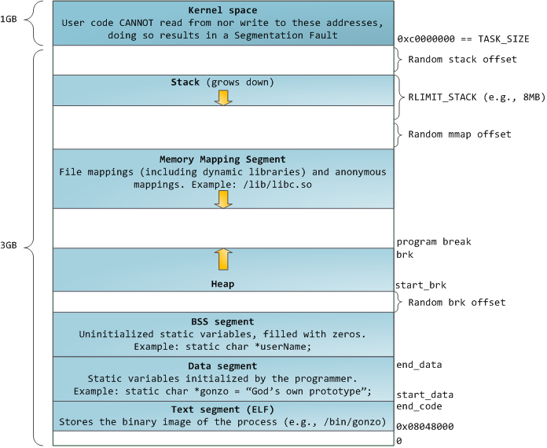
virtual address space

Slide 9
Process States
A process can be one of three states.
Running
A process is running on a processor.
Ready
A process is ready to run but for some reason the OS has chosen not to run it at this given moment.
Blocked
A process has performed some kind of operation.
When a process initiates an I/O request to a disk, it becomes blocked and thus some other process can use the processor.

Slide 10
Process State Transition
Running
Ready
Descheduled
Scheduled
I/O: initiate
I/O: done
Blocked

Slide 11
Data structures
The OS has some key data structures that track various relevant pieces of information.
Process list
Ready processes
Blocked processes
Current running process
Register context
Process Control Block (PCB)
A C-structure that contains information about each process.

Slide 12
Example) The xv6 kernel Proc Structure
// the registers xv6 will save and restore
// to stop and subsequently restart a process
struct context {
int eip; // Index pointer register
int esp; // Stack pointer register
int ebx; // Called the base register
int ecx; // Called the counter register
int edx; // Called the data register
int esi; // Source index register
int edi; // Destination index register
int ebp; // Stack base pointer register
};
// the different states a process can be in
enum proc_state { UNUSED, EMBRYO, SLEEPING,
RUNNABLE, RUNNING, ZOMBIE };

Slide 13
Example) The xv6 kernel Proc Structure (Cont.)
// the information xv6 tracks about each process
// including its register context and state
struct proc {
char *mem; // Start of process memory
uint sz; // Size of process memory
char *kstack; // Bottom of kernel stack
// for this process
enum proc_state state; // Process state
int pid; // Process ID
struct proc *parent; // Parent process
void *chan; // If non-zero, sleeping on chan
int killed; // If non-zero, have been killed
struct file *ofile[NOFILE]; // Open files
struct inode *cwd; // Current directory
struct context context; // Switch here to run process
struct trapframe *tf; // Trap frame for the
// current interrupt
};

Slide 14
05. Interlude: Process API
임종범
jblim@kpu.ac.kr

Slide 15
The fork() System Call
Create a new process
The newly-created process has its own copy of the address space, registers, and PC.
p1.c
#include <stdio.h>
#include <stdlib.h>
#include <unistd.h>
int main(int argc, char *argv[]){
printf("hello world (pid:%d)\n", (int) getpid());
int rc = fork();
if (rc < 0) { // fork failed; exit
fprintf(stderr, "fork failed\n");
exit(1);
} else if (rc == 0) { // child (new process)
printf("hello, I am child (pid:%d)\n", (int) getpid());
} else { // parent goes down this path (main)
printf("hello, I am parent of %d (pid:%d)\n",
rc, (int) getpid());
}
return 0;
}

Slide 16
Calling fork() example (Cont.)
Result (Not deterministic)
prompt> ./p1
hello world (pid:29146)
hello, I am parent of 29147 (pid:29146)
hello, I am child (pid:29147)
prompt>
or
prompt> ./p1
hello world (pid:29146)
hello, I am child (pid:29147)
hello, I am parent of 29147 (pid:29146)
prompt>

Slide 17
The wait() System Call
This system call won’t return until the child has run and exited.
p2.c
#include <stdio.h>
#include <stdlib.h>
#include <unistd.h>
#include <sys/wait.h>
int main(int argc, char *argv[]){
printf("hello world (pid:%d)\n", (int) getpid());
int rc = fork();
if (rc < 0) { // fork failed; exit
fprintf(stderr, "fork failed\n");
exit(1);
} else if (rc == 0) { // child (new process)
printf("hello, I am child (pid:%d)\n", (int) getpid());
} else { // parent goes down this path (main)
int wc = wait(NULL);
printf("hello, I am parent of %d (wc:%d) (pid:%d)\n",
rc, wc, (int) getpid());
}
return 0;
}

Slide 18
The wait() System Call (Cont.)
Result (Deterministic)
prompt> ./p2
hello world (pid:29266)
hello, I am child (pid:29267)
hello, I am parent of 29267 (wc:29267) (pid:29266)
prompt>

Slide 19
The exec() System Call
Run a program that is different from the calling program
p3.c
#include <stdio.h>
#include <stdlib.h>
#include <unistd.h>
#include <string.h>
#include <sys/wait.h>
int main(int argc, char *argv[]){
printf("hello world (pid:%d)\n", (int) getpid());
int rc = fork();
if (rc < 0) { // fork failed; exit
fprintf(stderr, "fork failed\n");
exit(1);
} else if (rc == 0) { // child (new process)
printf("hello, I am child (pid:%d)\n", (int) getpid());
char *myargs[3];
myargs[0] = strdup("wc"); // program: "wc" (word count)
myargs[1] = strdup("p3.c"); // argument: file to count
myargs[2] = NULL; // marks end of array
…

Slide 20
The exec() System Call (Cont.)
p3.c (Cont.)
…
execvp(myargs[0], myargs); // runs word count
printf("this shouldn’t print out");
} else { // parent goes down this path (main)
int wc = wait(NULL);
printf("hello, I am parent of %d (wc:%d) (pid:%d)\n",
rc, wc, (int) getpid());
}
return 0;
}
Result
prompt> ./p3
hello world (pid:29383)
hello, I am child (pid:29384)
29 107 1030 p3.c
hello, I am parent of 29384 (wc:29384) (pid:29383)
prompt>

Slide 21
All of the above with redirection
p4.c
#include <stdio.h>
#include <stdlib.h>
#include <unistd.h>
#include <string.h>
#include <fcntl.h>
#include <sys/wait.h>
int
main(int argc, char *argv[]){
int rc = fork();
if (rc < 0) { // fork failed; exit
fprintf(stderr, "fork failed\n");
exit(1);
} else if (rc == 0) { // child: redirect standard output to a file
close(STDOUT_FILENO);
open("./p4.output", O_CREAT|O_WRONLY|O_TRUNC, S_IRWXU);
…

Slide 22
All of the above with redirection (Cont.)
p4.c
…
// now exec "wc"...
char *myargs[3];
myargs[0] = strdup("wc"); // program: "wc" (word count)
myargs[1] = strdup("p4.c"); // argument: file to count
myargs[2] = NULL; // marks end of array
execvp(myargs[0], myargs); // runs word count
} else { // parent goes down this path (main)
int wc = wait(NULL);
}
return 0;
}
Result
prompt> ./p4
prompt> cat p4.output
32 109 846 p4.c
prompt>

Slide 23
CPU registers and instructions
x86 is a CISC architecture with hundreds of instructions defined
General instruction categories
General Purpose instructions
Floating-Point instructions
Program Flow-related instructions
Hardware-related instructions
Simple x86 instructions:
MOV AX, BX
ADD AX, CX
15
0
AX
BX
CX
DX
BP
SI
DI
SP
General-Purpose Registers
0
2C
55
0
0
0
0
FFFF
2C
(BX => AX)
2Ch (AX)
+ 55h (CX)
---------------
81h (AX)
(CX+AX => AX)
81
ADD CX, AX (AX+CX => CX)
Note: intel syntax (destination, source)

Slide 24
CPU registers and instructions
A number of the x86 instructions have multiple variants. Here are a few variants of the MOV and ADD instructions as examples:
MOV SI, 7000h ; move immediate to register
MOV BX, AX ; move ax register to bx register
MOV BX, [SI] ; move memory data to register
MOV [SI], BX ; move register data to memory
ADD AX, BX ; register to register add
ADD AX, [BX] ; memory to register add
ADD [BX], AX ; register to memory add
ADD AX, 20 ; immediate to register add
MOV 7000h, SI
MOV [7000h], SI √
MOV [SI], [BX]

Slide 25
CPU registers and instructions
A small sampling of the general-purpose and floating-point x86 instructions are shown below:
ADD
SUB
INC
DEC
MUL
DIV
XOR
NOT
NEG
SHL
MOV
MOVS
XCHG
FADD
FMULP
FSIN
FXSAVE
PADDB
PAVGW
PCMPEQB
ADDPS
SUBSD
MULPD
DIVSS
CVTPI2PD
SQRTPS
[ ]
x87 instructions
BX
BX
AX
( ? * BX)
MMX instructions
DX : AX
SIMD operations
(Single Instruction Multiple Data)
Upper
16 bits
Lower
16 bits
SSE instructions

Slide 26
CPU registers and instructions
Here is a small subset of the x86 instructions related to program flow:
JMP
JNZ
LOOP
CALL
RET
INT
IRET
IP
~~~~~~~~~~~~ ~~~~~~~~~~~~ Label1: ~~~~~~~~~~~~ ~~~~~~~~~~~~ ~~~~~~~~~~~~ ~~~~~~~~~~~~ ~~~~~~~~~~~~ JMP Label 1 ~~~~~~~~~~~~
/ 1
DEC CX ; CX = 2
/ 0
LOOP Lable1
JNZ Label 1

Slide 27
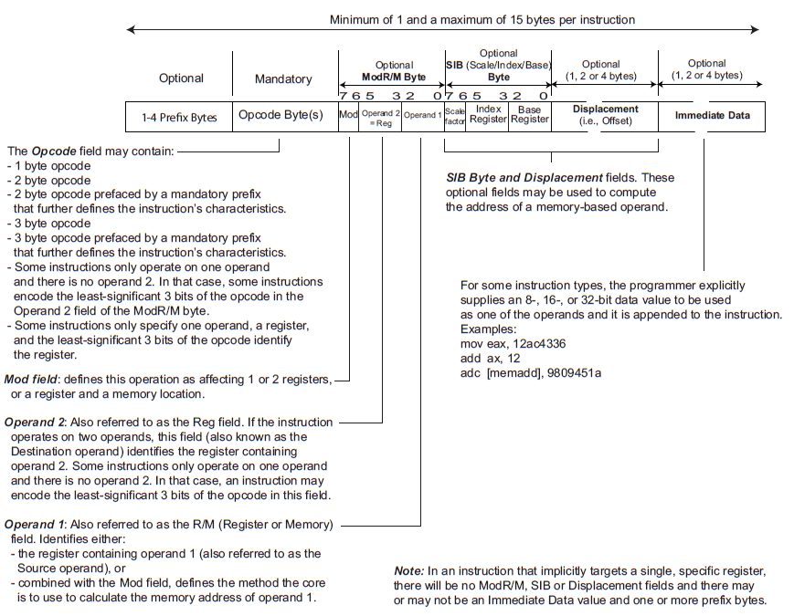
CPU registers and instructions

Slide 28
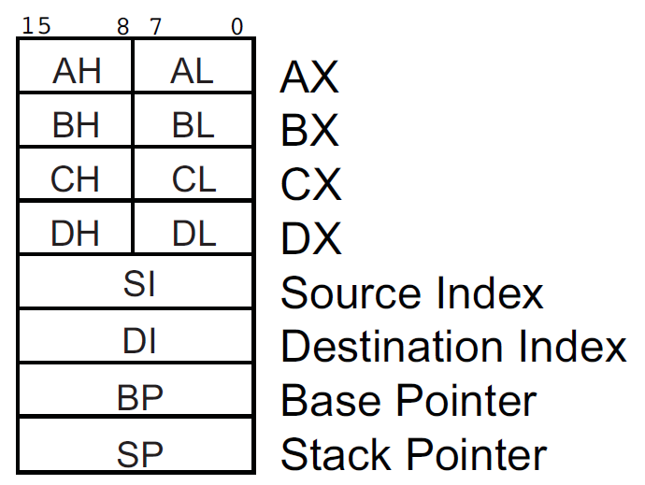
CPU registers and instructions
General-Purpose Registers (GPRs)
(Accumulator)
(Base)
(Counter)
(Data)
"L" means the Low byte
"H" means the High byte

Slide 29
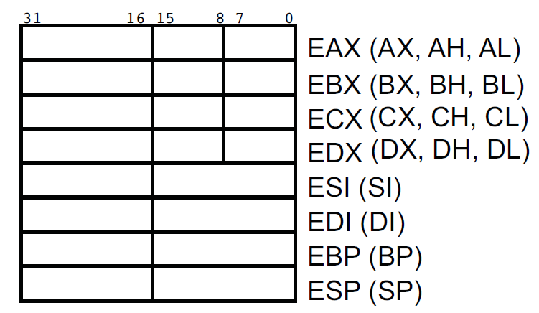
CPU registers and instructions
General-Purpose Registers (GPRs)

Slide 30
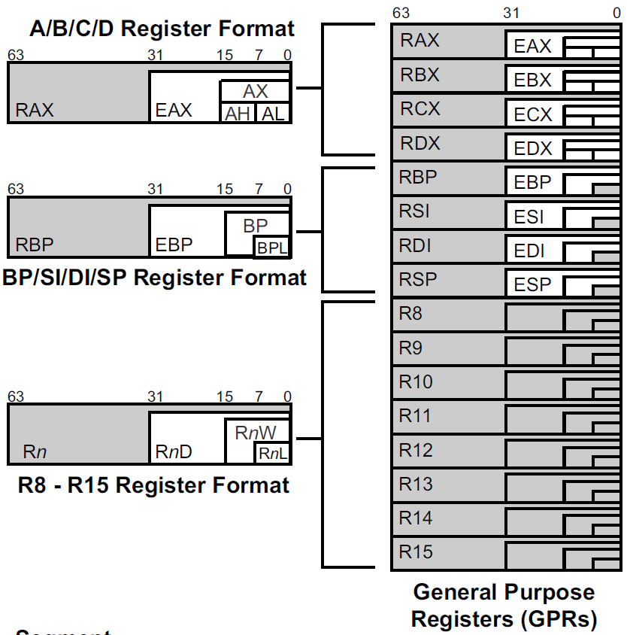
CPU registers and instructions
R8D
("D" means a Doubleword access)
Dword = 4 bytes
R8W
("W" means a Word access)
Word = 2 bytes
R8B
("B" means a Byte access)
Quadword = Qword = 8 bytes

Slide 31
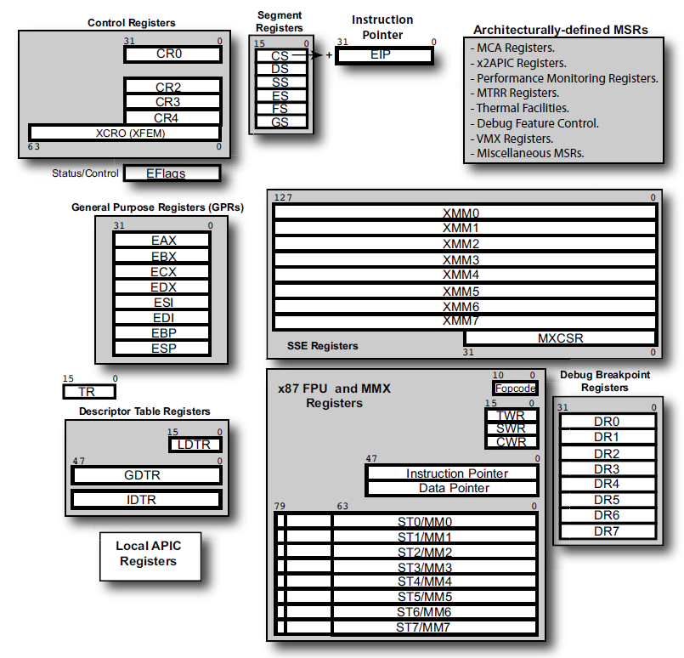
CPU registers and instructions

Slide 32
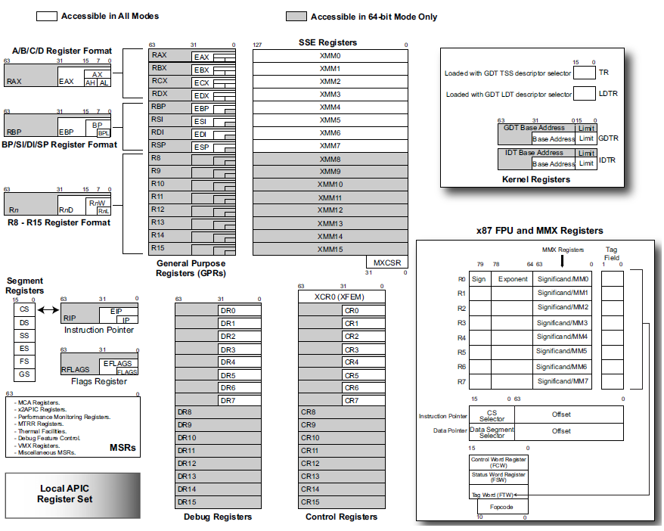
CPU registers and instructions

Slide 33
CPU registers and instructions
Sized Operations with GPRs
8-bit Operations
ADD AL, BL
ADD AL, AH
ADD R8B, AL
ADD R8B, AH
32-bit Operations
ADD EAX, EBX
ADD EAX, R8D
ADD R9W, EAX
16-bit Operations
ADD AX, BX
ADD AX, R8W
ADD R9W, R8W
64-bit Operations
ADD RAX, RBX
ADD RAX, R8
ADD RAX, RAX
You cannot perform a byte operation using a high register
(AH, BH, CH, DH) and one of the new registers (R8B – R15B).
The operand sizes must match on most x86 instructions

Slide 34
CPU registers and instructions
ADD AL, 24h
63
31
15
7
0
63
31
15
7
0
8 | 8 | 8 | 8 | 8 | 8 | 8 | 8 | 8 | 8 | 8 | 8 | 8 | 8 | 8 | 8
8 | 8 | 8 | 8 | 8 | 8 | 8 | 8 | 8 | 8 | 8 | 8 | 8 | 8 | A | C
ADD AH, 96h
63
31
15
7
0
63
31
15
7
0
8 | 8 | 8 | 8 | 8 | 8 | 8 | 8 | 8 | 8 | 8 | 8 | 8 | 8 | 8 | 8
8 | 8 | 8 | 8 | 8 | 8 | 8 | 8 | 8 | 8 | 8 | 8 | 1 | E | 8 | 8
ADD AX, 96h
63
31
15
7
0
63
31
15
7
0
8 | 8 | 8 | 8 | 8 | 8 | 8 | 8 | 8 | 8 | 8 | 8 | 8 | 8 | 8 | 8
8 | 8 | 8 | 8 | 8 | 8 | 8 | 8 | 8 | 8 | 8 | 8 | 8 | 9 | 1 | E
ADD EAX, 242424h
63
31
15
7
0
63
31
15
7
0
8 | 8 | 8 | 8 | 8 | 8 | 8 | 8 | 8 | 8 | 8 | 8 | 8 | 8 | 8 | 8
0 | 0 | 0 | 0 | 0 | 0 | 0 | 0 | 8 | 8 | A | C | A | C | A | C
The upper 32 bits are cleared when Performing a Dword operation.

Slide 35
CPU registers and instructions
Little Endian – the least significant byte goes in the littlest address
mov esi, 4000h
mov ax, 1234h
mov [esi], ax
Memory
4003h
4002h
1 2
3 4
4001h
4000h
63
31
15
7
0
3FFFh
1 | 2 | 3 | 4
3FFEh
AH AL
3FFDh
AX
3FFCh
EAX
RAX

Slide 36
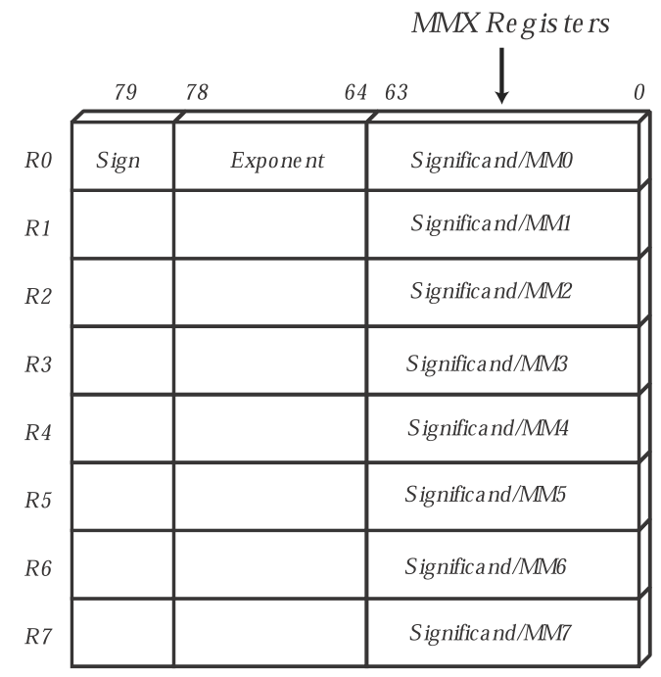
Single Instruction Multiple Data (Simd)
x87 FPU Register Set
The MMX registers are the same physical registers as the x87 registers
MMX instructions perform the same operation on multiple pieces of data packed into registers
SIMD operations
Targeted at multimedia and communication applications
Only supports integer operations

Slide 37
Single Instruction Multiple Data (Simd)
63
55
47
39
31
23
15
7
0
Packed
Bytes
Byte | Byte | Byte | Byte | Byte | Byte | Byte | Byte
63
47
31
15
0
Packed
Words
Word | Word | Word | Word
63
31
0
Packed
Double
Words
DoubleWord | DoubleWord

Slide 38
Single Instruction Multiple Data (Simd)
PADDB MM0, MM1
63
55
47
39
31
23
15
7
0
F0h | 2h | 17h | 1Eh | 23h | 4Ch | 9Ah | 5h
MM0
+
+
+
+
+
+
+
+
63
55
47
39
31
23
15
7
0
F0h | 0h | FFh | 55h | 23h | 3h | 14h | 4h
MM1
63
55
47
39
31
23
15
7
0
E0h | 2h | 16h | 73h | 46h | 4Fh | AEh | 9h
MM0

Slide 39
Single Instruction Multiple Data (Simd)
PADDSB
Packed Add Bytes
Signed, Saturating
PADDUSB
Packed Add Bytes
Unsigned, Saturating

Slide 40
Single Instruction Multiple Data (Simd)
PADDUSB MM0, MM1
63
55
47
39
31
23
15
7
0
F0h | 2h | 17h | 1Eh | 23h | 4Ch | 9Ah | 5h
MM0
+
+
+
+
+
+
+
+
63
55
47
39
31
23
15
7
0
F0h | 0h | FFh | 55h | 23h | 3h | 14h | 4h
MM1
63
55
47
39
31
23
15
7
0
FFh | 2h | FFh | 73h | 46h | 4Fh | AEh | 9h
MM0

Slide 41
Single Instruction Multiple Data (Simd)
PCMPEQW MM5, MM2
63
47
31
15
0
F41Dh | 5h | 1234h | 7788h
MM5
compeq
compeq
compeq
compeq
63
47
31
15
0
7521h | 5h | FEDCh | 7789h
MM2
63
47
31
15
0
0h | FFFFh | 0h | 0h
MM5

Slide 42
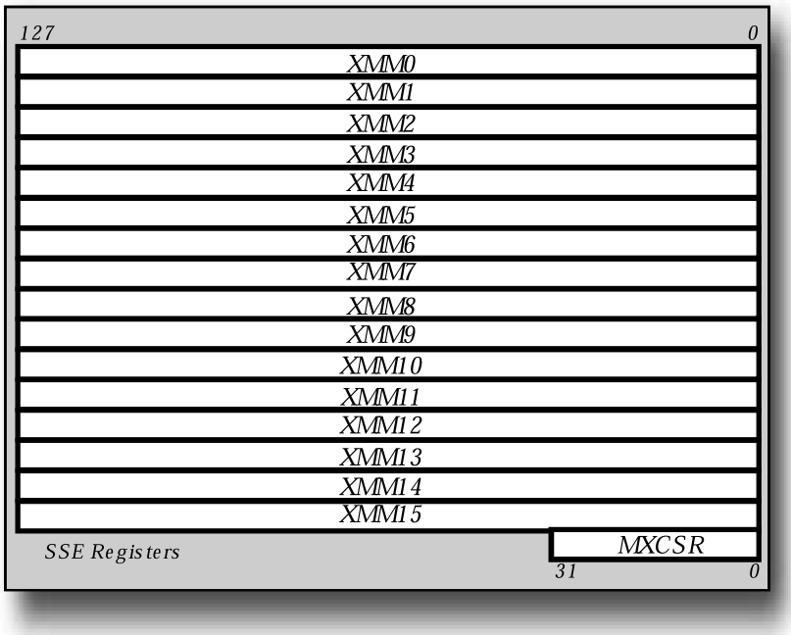
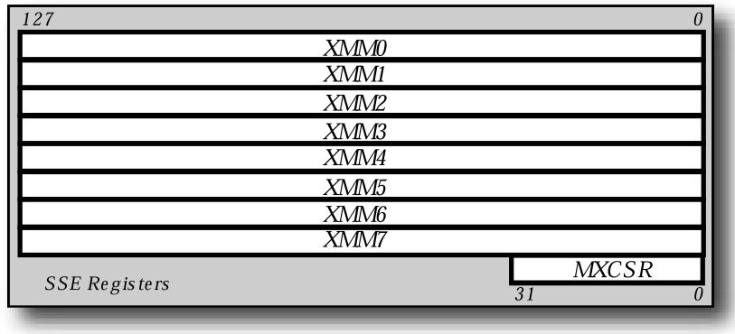
Single Instruction Multiple Data (Simd)
XMM Registers
used by SSE instructions
SSE: Single-precision support
SSE2: Double-precision, integer support
SSE3, SSE4: Added functionality
(MXCSR: control/status register)

Slide 43
Single Instruction Multiple Data (Simd)
127
95
63
31
0
Packed
SP
Single-precision | Single-precision | Single-precision | Single-precision
127
63
0
Packed
DP
Double-precision | Double-precision
127
119
111
103
95
87
79
71
63
55
47
39
31
23
15
7
0
Packed
Bytes
Byte | Byte | Byte | Byte | Byte | Byte | Byte | Byte | Byte | Byte | Byte | Byte | Byte | Byte | Byte | Byte
127
111
95
79
63
47
31
15
0
Packed
Words
Word | Word | Word | Word | Word | Word | Word | Word
127
95
63
31
0
Packed
Dwords
Doubleword | Doubleword | Doubleword | Doubleword
127
95
63
31
0
Packed
Qwords
Quadword | Quadword

Slide 44
Single Instruction Multiple Data (Simd)
ADDPS XMM0, XMM1
add packed single-precision
127
95
63
31
0
3.14159 | 6.022 | 32.987 | 12.45
XMM0
+
+
+
+
127
95
63
31
0
2.5 | 8.74 | 1.0 | 0.259
XMM1
127
95
63
31
0
5.64159 | 14.762 | 33.987 | 12.709
XMM0

Slide 45
Single Instruction Multiple Data (Simd)
ADDSS XMM0, XMM1
add scalar single-precision
127
95
63
31
0
3.14159 | 6.022 | 32.987 | 12.45
XMM0
+
127
95
63
31
0
2.5 | 8.74 | 1.0 | 0.259
XMM1
127
95
63
31
0
3.14159 | 6.022 | 32.987 | 12.709
XMM0

Slide 46
Single Instruction Multiple Data (Simd)
ADDPD XMM5, XMM2
add packed double-precision
127
95
63
31
0
42.85 | 16.026
XMM5
+
+
127
95
63
31
0
18.145 | 44.12
XMM2
127
95
63
31
0
60.995 | 60.146
XMM5

Slide 47
06. Mechanism: Limited Direct Execution
임종범
jblim@kpu.ac.kr

Slide 48
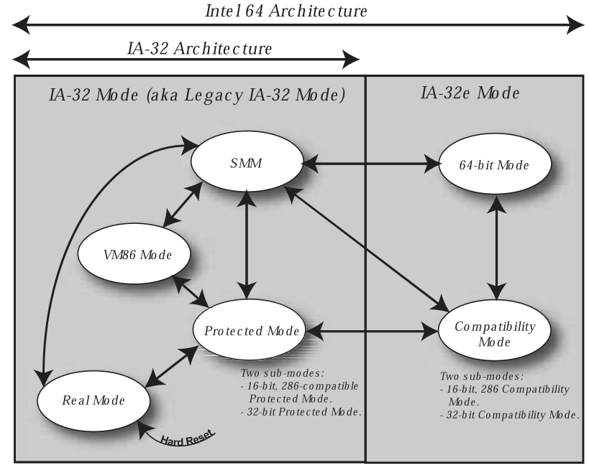
OS Execution mode

Slide 49
real mode
All x86-based processors start in Real Mode when reset
16-bit operating environments with 20-bit of address space
Memory address space is divided into segments
64kB in size
Base address in on any 16-byte boundary in the 20-bit address space
Multiple segments can be active at a time
CS – Code Segment
SS – Stack Segment
DS – Data Segment (Default)
ES, FS, and GS – additional data segments
No concepts of paging or virtual memory
No protection – any program has free access to all of memory and can directly access I/O ports

Slide 50
Segmented memory in real mode
Memory
There can be six active segments of memory at a time
Each segment register defines an active segment
The segment registers hold the upper 16-bit of the 20-bit base address of the segment
F_FFFF h
ES
Segment
D_FFFF h
64 kB
D_0000 h
SS
Segment
9_FFFF h
64 kB
15 0
9_0000 h
Code Segment (CS)
Stack Segment (SS)
Default Data Segment (DS)
Extra Data Segment (ES)
Additional Data Segment (FS)
Additional Data Segment (GS)
1 0 0 0
0 h
9 0 0 0
0 h
FS
Segment
5_320F h
64 kB
2 0 0 0
0 h
4_3210 h
D 0 0 0
0 h
4 3 2 1
0 h
DS
Segment
2_FFFF h
64 kB
2_0000 h
CS
Segment
1_FFFF h
64 kB
1_0000 h
0 h

Slide 51
Segmented memory in real mode
Memory
MOV AX, 2000h
MOV DS, AX
MOV AX, 4321h
MOV ES, AX
MOV EBX, DS:[100h]
MOV EBX, ES:[1124h]
F_FFFF h
Same as MOV EBX, [100h]
DS Segment Register
2 0 0 0
0 h
Segment base address
Offset within the segment
Target memory address
ES
Segment
5_320F h
+ 1 0 0 h
---------------------
2 0 1 0 0 h
64 kB
4_3210 h
ES Segment Register
4 3 2 1
0 h
Segment base address
Offset within the segment
Target memory address
+ 1 1 2 4 h
---------------------
4 4 3 3 4 h
DS
Segment
2_FFFF h
64 kB
2_0000 h
0 h

Slide 52
protected mode
Protected Mode was implemented to handle the problems that exist with a multitasking environment
Providing memory protection across applications
Managing I/O transactions from a central entity (OS)
Controlling access to OS resources and tools
Verifying an application’s request to disable/enable interrupt
Protected Mode introduced several new topics to handle the above issues
Segment Descriptors
Task Switching
Software Privilege Levels
Virtual Memory and Paging
Interrupt Descriptors

Slide 53
Privileged Instructions
Some instructions can only be executed at the highest privilege level (ring 0)
because they could affect the state of some shared resource
Examples:
CLI
STI
INVLPG
WBINVD
MOV (Control/Debug Register N)
RDMSR
WRMSR

Slide 54
Protected Mode
Memory Address Space
In Protected Mode, OS can assign attributes and access right to each segment
Base address
Size of segment
Privilege Level
Read/Write permissions
Mode of operation
16-bit, 32-bit, or 64-bit
Each segment has an 8-byte descriptor for attributes
All defined segment descriptors are held in either Global Descriptor Table (GDT) or Local Descriptor Table (LDT)
The descriptor tables live in memory and are managed by OS
Data Segment
(PL=0, Read, Size, …)
Data Segment
(PL=3, Read/Write, Size, …)
Code Segment
(PL=3, 16-bit, Size, …)
Code Segment
(PL=0, 64-bit, Size, …)
Data Segment
(PL=3, Read, Size, …)

Slide 55
Virtual-8086 Mode
Virtual-8086 Mode enables Real Mode applications to run efficiently under the Protected Mode
Virtual-8086 Mode emulates the Real Mode environment
16-bit operating environment
20-bit address space
It enables the processor to watch for operations that would be disruptive in a multitasking environment
e.g., enabling/disabling interrupt handling
It triggers an exception if a disruptive operation is attempted allowing the OS to handle the event

Slide 56
System Management Mode (SMM)
System Management Mode (SMM) is used to handle system-specific activities
Power management, security, platform management
This mode can only be entered by receiving a System Management Interrupt (SMI)
When entering SMM, the processor automatically saves the state of the machine and enters a state that is transparent to the OS
Operates in a special region called SMRAM

Slide 57
Long Mode (IA-32e mode)
Long Mode is comprised of 2 sub-modes
64-bit Mode
Compatibility Mode
Must be enabled by a 64-bit capable OS
Provides the ability for 64-bit applications, as well as existing 32-bit and 16-bit Protected Mode applications to be run in this mode
Provides a very low latency transition between a 32-bit environments (Compatibility Mode) and a 64-bit environment (64-bit Mode)
Implements the x86-64 extensions
Intel 64, AMD64, and x64

Slide 58
64-bit Mode
64-bit Mode is a sub-mode of Long Mode, which runs native 64-bit applications
Allows software to support larger address space
Provides the ability to support up to a 64-bit virtual address space
Modern x86-64 based processors implement a 48-bit virtual address space
Enables the processor to support up to a 52-bit physical address space
Modern x86-64 based processors implement a 40- or 48-bit physical address space
Removes a lot of the antique legacy mechanisms not used by modern software
Segmentation and hardware task switching

Slide 59
Compatibility Mode
A sub-mode of Long Mode, which runs binary compatible 16- and 32-bit Protected Mode applications under 64-bit system software
To an application, Compatibility Mode looks just like Legacy Protected Mode
32-bit virtual address space
8 General-purpose registers (GPRs)
GPRs are 32-bit wide
All system software semantics are still 64-bit
Interrupt and Exception handling cause the processor to transit into 64-bit Mode

Slide 60
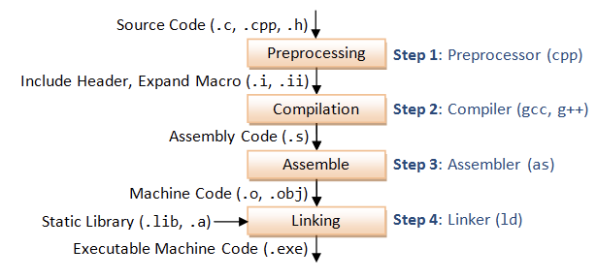
Compile process

Slide 61
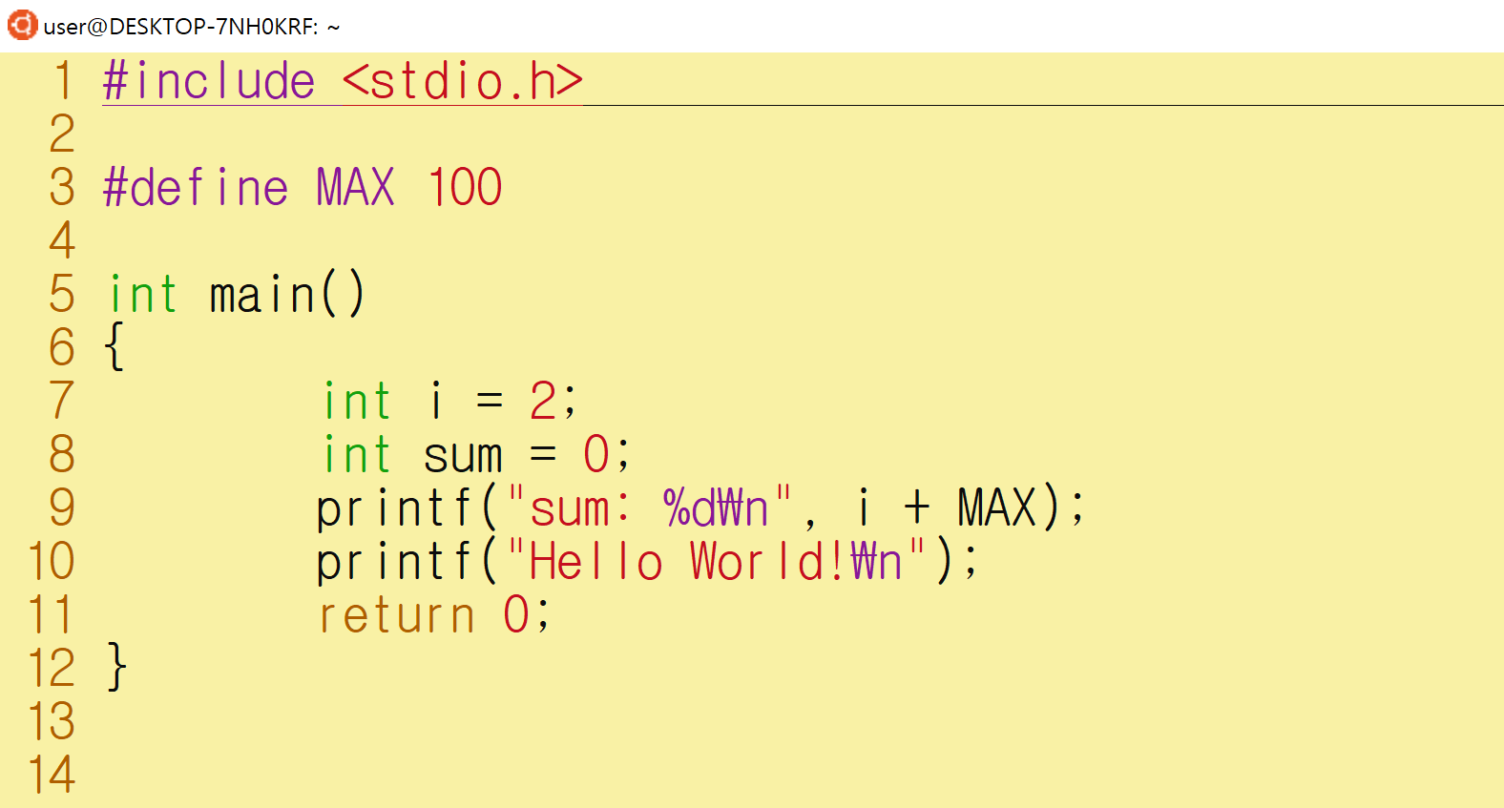
Compile process

Slide 62
Compile process
cpp hello.c hello.i
gcc -S hello.i -masm=intel
as hello.s -o hello.o
ld -dynamic-linker /lib64/ld-linux-x86-64.so.2 -o hello hello.o /lib/x86_64-linux-gnu/libc.so.6 /usr/lib/x86_64-linux-gnu/crt*.o -lc

Slide 63
The elf binary format
file hello
file hello.o
readelf -h hello
readelf -h hello.o
readelf -l hello
readelf -l hello.o
readelf -S hello
readelf -S hello.o
nm hello.o
nm hello
readelf -r hello.o
readelf -s hello
readelf -d hello
objdump -d hello.o -M intel
objdump -d hello -M intel

Slide 64
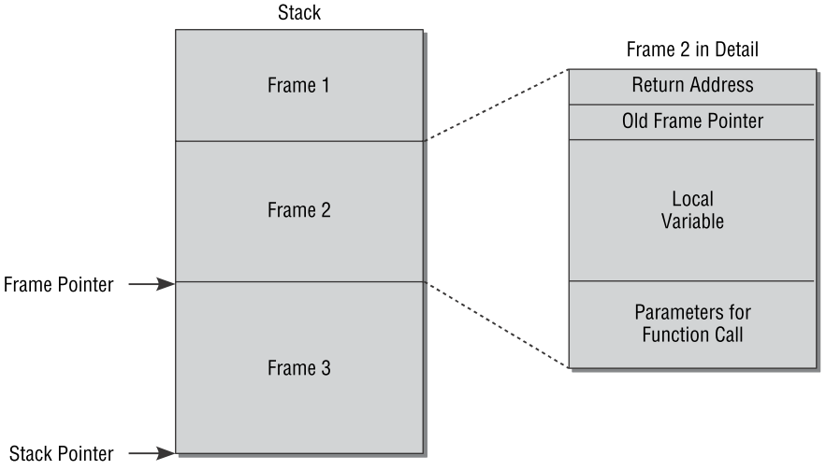
Procedure call
The stack is a memory area at the end of the address space of a process
It grows from top to bottom when elements are pushed on to it
It is used to provide memory for the local variables of the function
It also supports parameter-passing when functions are invoked
If nested procedures are called, the stack grows from top to bottom and accepts new activation records that hold all data needed for one procedure
The activation record of the procedure currently executing is delimited at the top by the frame pointer and at the bottom by the stack pointer

Slide 65
Procedure call
Two stack manipulation commands
Push places a value on the stack and decrements the stack pointer by the number of bytes in memory required by the value
The end of the stack is moved down to lower addresses
Pop removes a value from the stack and increments the value of the stack pointer accordingly
The end of the stack is moved up

Slide 66
Procedure call
To invoke and exit functions, the following two commands are provided – they automatically manipulate the stack
call pushes the current value of the instruction pointer onto the stack and branches to the start address of the function to be called
return pops the bottom value from the stack and branches to the specified address
Procedures must be implemented so that return is the last command and the address placed on the stack by call is at the bottom

Slide 67
Procedure call
A procedure call therefore consists of the following two steps
Build a parameter list in the stack
The first argument to be passed to the called function is placed last on the stack
This makes it possible to pass a varying number of arguments that can be popped from the stack one after the other
Invoke call, which causes the current value of the instruction pointer (pointing to the instruction that follows call) to be pushed onto the stack and delegates code flow to the invoked function

Slide 68
Procedure call
The procedure called is responsible for managing the frame pointer and performs the following steps
The previous frame pointer is pushed onto the stack, thus moving the stack pointer down
The frame pointer is assigned the current value of the stack pointer and now marks the start of the stack area for the function to be executed
The code of the function is executed
When the function terminates, the stored frame pointer is at the bottom of the stack
Its value is popped from the stack and saved in the frame pointer that now again points to the start of the stack area of the previous function
The return address saved when the function was called is now located at the bottom end of the stack
Invoking return causes the return address to be popped from the stack
The processor branches to the return address, thus returning the code flow to the calling function

Slide 69
Procedure call
#include <stdio.h>
int add (int a, int b) {
return a+b;
}
int main() {
int a,b;
a = 3;
b = 4;
int ret = add(a,b);
printf("Result: %u\n", ret);
exit(0);
}

Slide 70
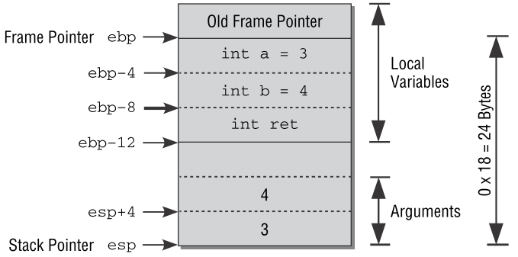
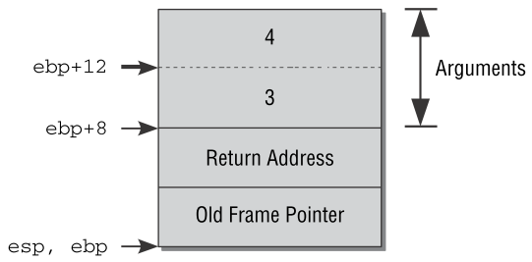
Procedure call
<main>:
01: push ebp
02: mov ebp,esp
03: sub esp,0x18
04: mov eax,0x0
05: mov DWORD PTR [ebp-4],0x3
06: mov DWORD PTR [ebp-8],0x4
07: mov eax,DWORD PTR [ebp-8]
08: mov DWORD PTR [esp+4],eax
09: mov eax,DWORD PTR [ebp-4]
10: mov DWORD PTR [esp],eax
11: call <add>
12: mov DWORD PTR [ebp-12],eax
13: mov eax,DWORD PTR [ebp-12]
14: mov DWORD PTR [esp+4],eax
15: mov DWORD PTR [esp],0x0
16: call <printf>
17: mov DWORD PTR [esp],0x0
18: call <exit>
<add>:
19: push ebp
20: mov ebp,esp
21: mov eax,DWORD PTR [ebp+12]
22: add eax,DWORD PTR [ebp+8]
23: pop ebp
24: ret

Slide 71
Stack overflow protection
-fno-stack-protector
No protection code is included for stack smashing attacks.
-fstack-protector
Emit extra code to check for buffer overflows, such as stack smashing attacks.
This is done by adding a guard variable to functions with vulnerable objects.
This includes functions that call alloca(), and functions with buffers larger than 8 bytes.
-fstack-protector-all
Like -fstack-protector except that all functions are protected.
#include <stdio.h>
int test_function(int a, int b, int c, int d) {
int flag;
char buffer[10];
flag = a + b + c + d;
buffer[0] = 'A';
buffer[1] = 'B';
buffer[2] = 'C';
buffer[3] = 'D';
buffer[4] = 'E';
buffer[5] = 'F';
buffer[6] = 'G';
buffer[7] = 'H';
buffer[8] = 'I';
buffer[9] = 'J';
return flag;
}
int main() {
int ret;
int a, b;
a = 5;
b = 6;
ret = test_function(1, 2, 3, 4);
ret = ret + a + b;
return ret;
}

Slide 72
Memory
High Address
rbp
 | 0x00000000
0x7fffffffe650 | 0x00000000
 | 0x00000006
 | 0x00000005
 | 0x00007fff
0x7fffffffe640 | 0xffffe730
 | 0x00000000
 | 0x00400542
 | 0x00007fff
0x7fffffffe630 | 0xffffe650
 | 0x0000000a
 | 0x00404a49
 | 0x48474645
 | 0x44434241
 | 0x00000001
 | 0x00000002
 | 0x00000003
 | 0x00000004
Stack
rsp
rbp, rsp
Low Address

Slide 73
Memory
High Address
rbp
 | 0x00000000
0x7fffffffe650 | 0x00000000
 | 0x00000000
 | 0x00000005
 | 0x00000006
0x7fffffffe640 | 0xffffe730
 | 0x00000000
 | 0x004005e9
 | 0x00007fff
0x7fffffffe630 | 0xffffe650
 | 0xff1da3e9
 | 0x69414000
 | 0x00007fff
0x7fffffffe620 | 0xf7a69aa8
 | 0x00000000
 | 0x00404a49
 | 0x48474645
0x7fffffffe610 | 0x44434241
 | 0x0000000a
 | 0x0040042b
 | 0x00000000
0x7fffffffe600 | 0x00000000
 | 0x00000001
 | 0x00000002
 | 0x00000003
0x7fffffffe5f0 | 0x00000004
Stack
rsp
rbp
canary
Variables
are
rearranged
rsp
Low Address

Slide 74





Software Privilege Levels
The concept of assigning
privilege levels to code and data
structures was introduced in
Protected Mode
Level 0 - highest privilege level
For OS kernel
Level 1 - second highest privilege level
For OS Services and high-privileged device drivers
Could be used for debuggers
Level 2 - third highest privilege level
For lower-privileged device driver
Level 3 - lowest privilege level
For application programs
Ring 0
Ring 1
Ring 2
Ring 3
Modern Operating Systems typically use privilege levels 0 and 3 only

Slide 75
Privilege (protection) Rings
The x86 systems use privilege levels, the mechanism whereby the OS and CPU conspire to restrict what user-mode programs can do
0 (most privileged) to 3 (least privileged)
For memory, I/O ports, machine instructions
Ring 3
Ring 2
Ring 1
Ring 0

Slide 76
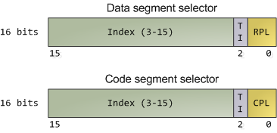
Privilege (protection) Rings
About 15 instructions are restricted by the CPU to ring 0
These instructions can subvert the protection mechanism
An attempt to run them outside of ring 0 causes a general-protection exception
CPU keeps track of the current privilege level, which involves the segment selectors, e.g.,:
Requested Privilege Level (RPL)
Current Privilege Level (CPL)

Slide 77
Privilege (protection) Rings

Slide 78
Privilege (protection) Rings
Keep in mind that the CPU privilege level has nothing to do with OS users
Whether you’re root, administrator, guest, or a regular user, it does not matter
All user code runs in ring 3, all kernel code runs in ring 0
regardless of the OS users on whose behalf the code operates
Due to restricted access to memory and I/O ports, user mode can do almost nothing to the outside world without calling the kernel
All of the data structures that control such things – memory, open files, etc. – cannot be touched directly by user code

Slide 79
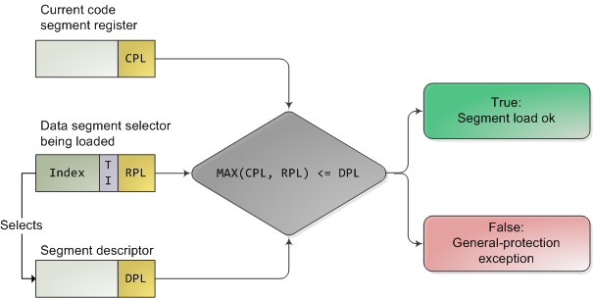
Privilege (protection) Rings
The CPU protects memory at two crucial points:
When a segment selector is loaded
When a page of memory is accessed with a linear address
When a data segment selector is being loaded, the check below takes place:

Slide 80
Privilege (protection) Rings
Useful memory protection is done in the paging unit when a linear address is converted into a physical address
Each memory page is a block of bytes described by a page table entry containing two fields related to protection:
Supervisor flag
Read/write flag
The supervisor flag is the primary x86 memory protection mechanism used by kernels
When it is on, the page cannot be accessed from ring 3

Slide 81
Privilege (protection) Rings
While the read/write flag isn’t as important for enforcing privilege, it’s still useful
When a process is loaded, pages storing binary images (code) are marked as read only, thereby catching some pointer errors if a program attempts to write to these pages
This flag is also used to implement copy on write when a process is forked in Unix
Upon forking, the parent’s pages are marked read only and shared with the forked child
If either process attempts to write to the page, the processor triggers a fault and the kernel knows to duplicate the page and mark it read/write for the writing process

Slide 82
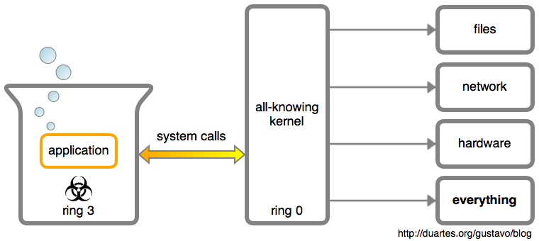
System calls in detail
Every interaction with the outside world is mediated by the kernel through system calls
If an application saves a file, writes to the terminal, or opens a TCP connection, the kernel is involved
These system calls are function calls from an application into the kernel

Slide 83
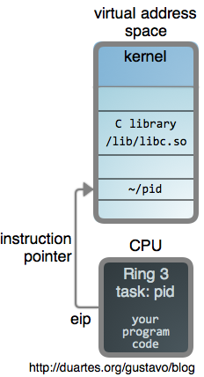
System calls in detail
#include <sys/types.h>
#include <unistd.h>
#include <stdio.h>
int main()
{
pid_t p = getpid();
printf("pid_t: %d\n", sizeof(pid_t));
printf("%d\n", p);
}

Slide 84
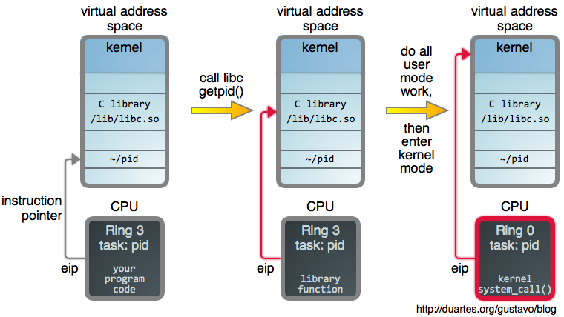
System calls in detail

Slide 85
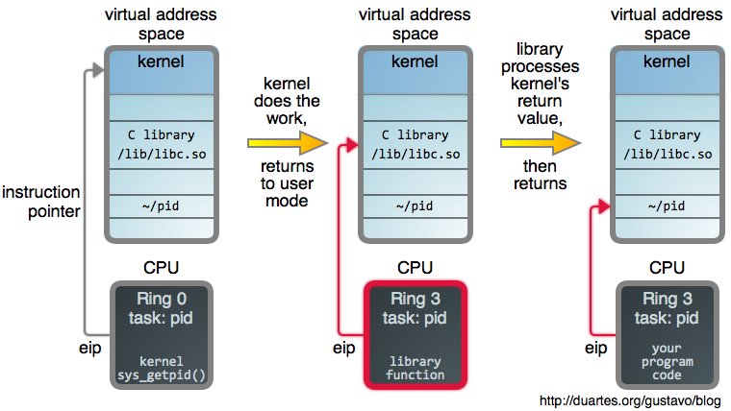
System calls in detail

Slide 86
System calls in detail
It all starts with a call to the C library’s getpid(), which is a wrapper for the system call
Once the wrapper has done its initial work it’s time to jump into the kernel
The mechanics of this transition vary by processor architecture
In Intel processors, arguments and the syscall number are loaded into registers, then an instruction is executed to put the CPU in privileged mode and immediately transfer control to a global syscall entry point within the kernel
The kernel then uses the syscall number as an index into sys_call_table, an array of function pointers to each syscall implementation
https://thevivekpandey.github.io/posts/2017-09-25-linux-system-calls.html

Slide 87
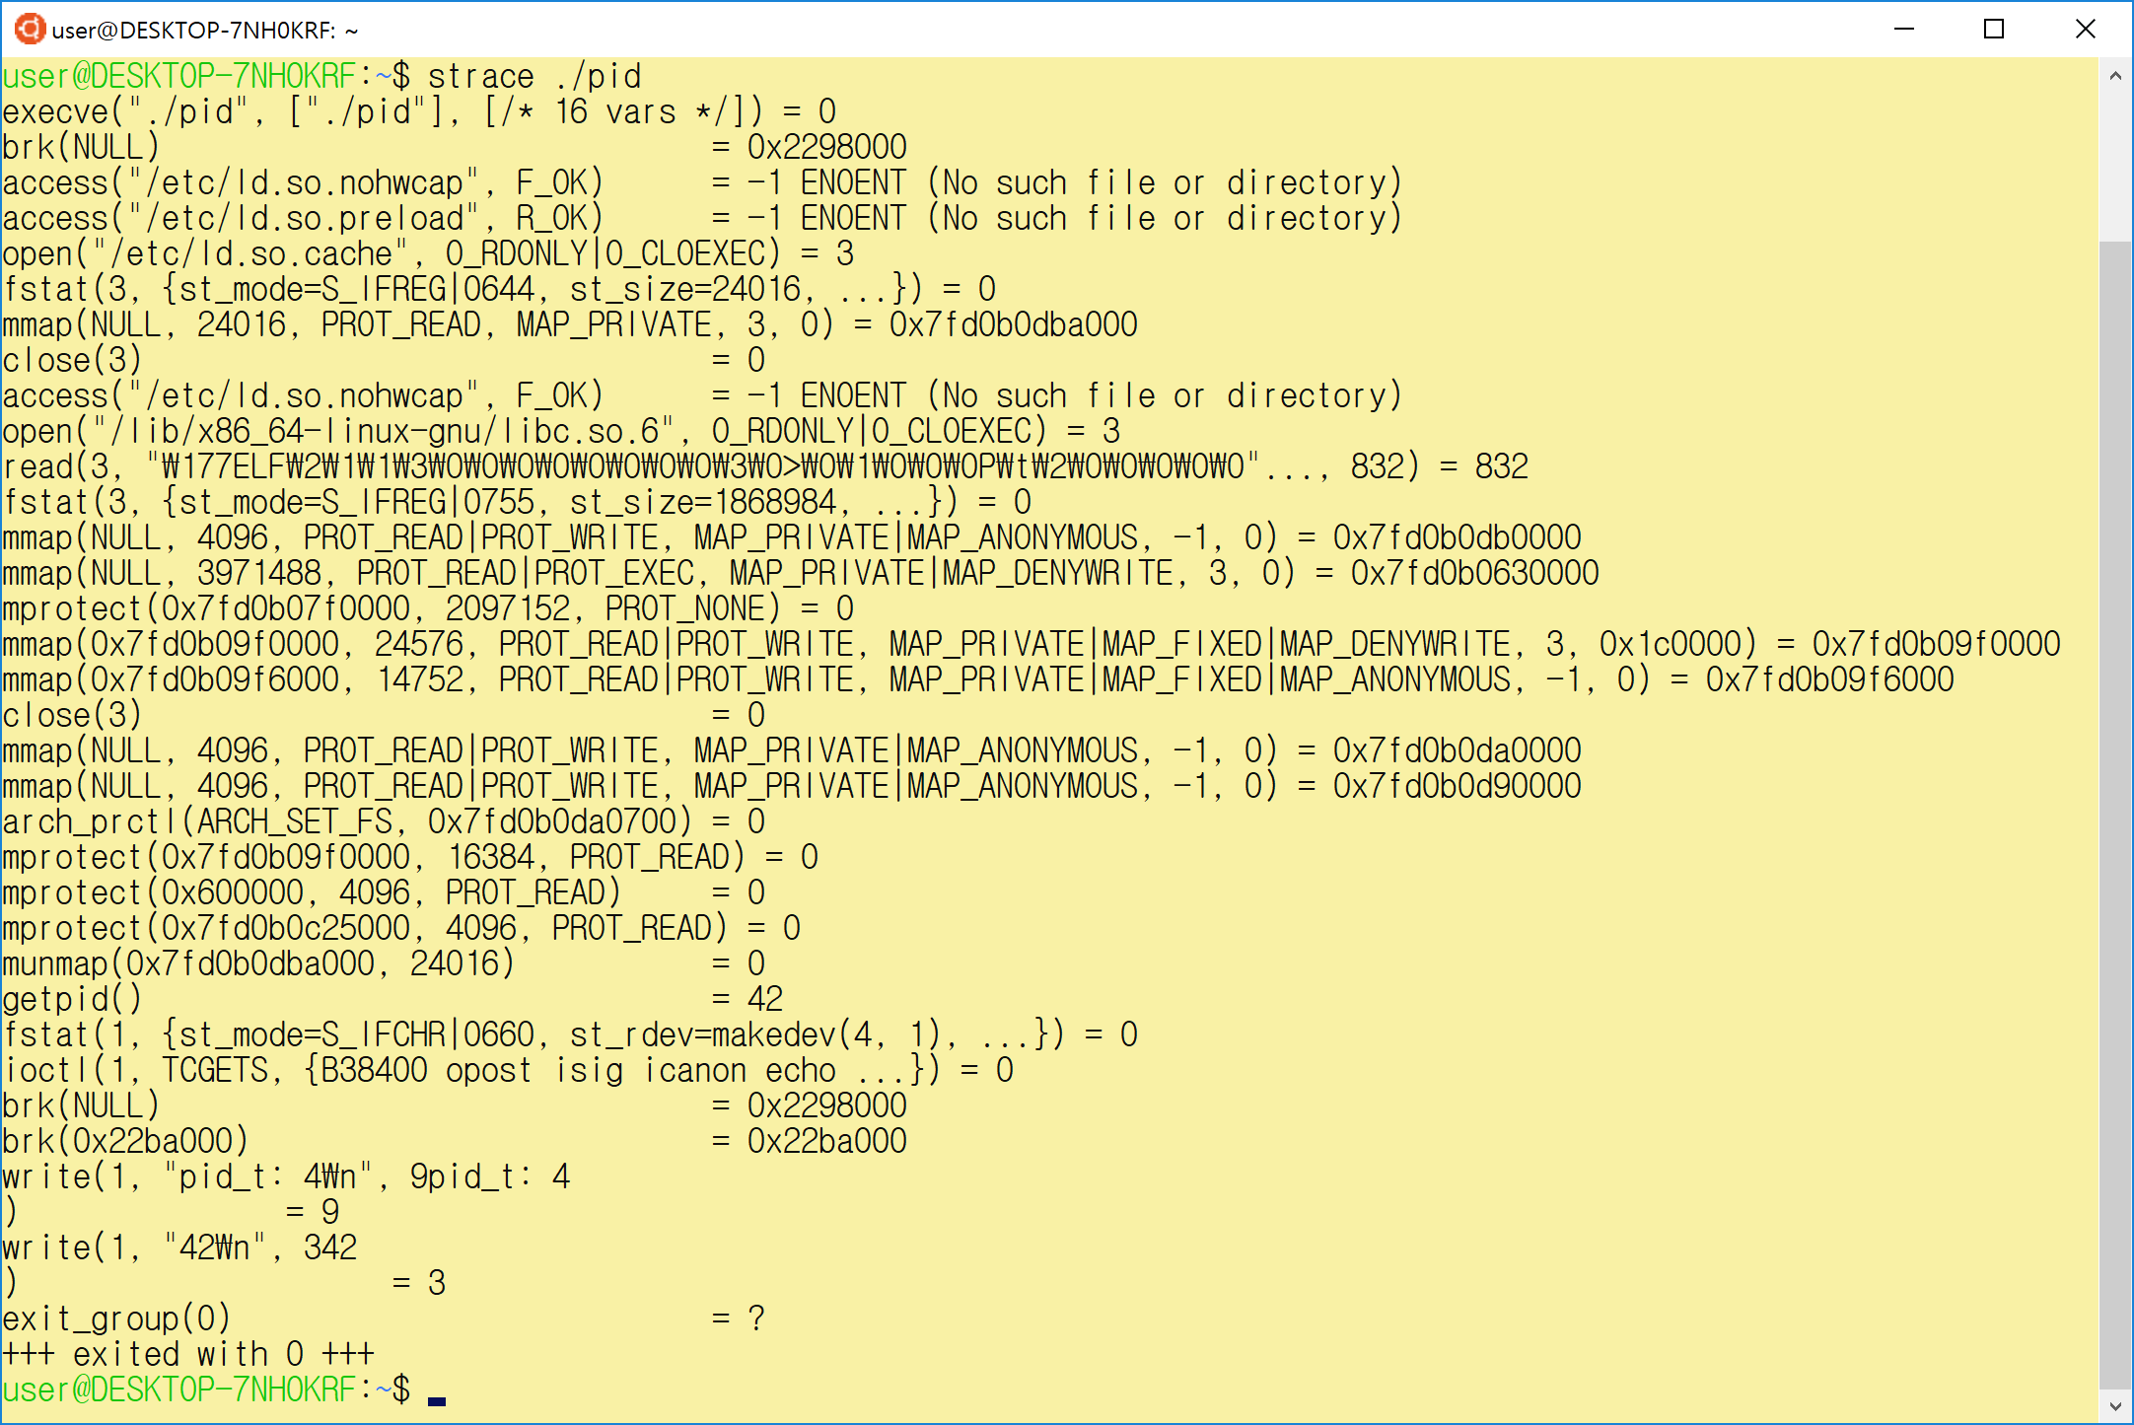
System calls in detail

Slide 88
How to efficiently virtualize the CPU with control?
The OS needs to share the physical CPU by time sharing.
Issue
Performance: How can we implement virtualization without adding excessive overhead to the system?
Control: How can we run processes efficiently while retaining control over the CPU?

Slide 89
Direct Execution
Just run the program directly on the CPU.
OS | Program
1. Create entry for process list 2. Allocate memory for program 3. Load program into memory 4. Set up stack with argc / argv 5. Clear registers 6. Execute call main() 9. Free memory of process 10. Remove from process list | 7. Run main() 8. Execute return from main()
Without limits on running programs,
the OS wouldn’t be in control of anything and
thus would be "just a library"

Slide 90
Problem 1: Restricted Operation
What if a process wishes to perform some kind of restricted operation such as …
Issuing an I/O request to a disk
Gaining access to more system resources such as CPU or memory
Solution: Using protected control transfer
User mode: Applications do not have full access to hardware resources.
Kernel mode: The OS has access to the full resources of the machine

Slide 91
System Call
Allow the kernel to carefully expose certain key pieces of functionality to user program, such as …
Accessing the file system
Creating and destroying processes
Communicating with other processes
Allocating more memory

Slide 92
System Call (Cont.)
Trap instruction
Jump into the kernel
Raise the privilege level to kernel mode
Return-from-trap instruction
Return into the calling user program
Reduce the privilege level back to user mode

Slide 93
Limited Direction Execution Protocol
OS @ boot
(kernel mode)
Hardware
initialize trap table
remember address of …
syscall handler
OS @ run
(kernel mode)
Hardware
Program
(user mode)
Create entry for process list
Allocate memory for program
Load program into memory
Setup user stack with argv
Fill kernel stack with reg/PC
return-from -trap
restore regs from kernel stack
move to user mode
jump to main
Run main()
…
Call system
trap into OS

Slide 94
Limited Direction Execution Protocol (Cont.)
OS @ run
(kernel mode)
Hardware
Program
(user mode)
(Cont.)
save regs to kernel stack
move to kernel mode
jump to trap handler
Handle trap
Do work of syscall
return-from-trap
restore regs from kernel stack
move to user mode
jump to PC after trap
…
return from main
trap (via exit())
Free memory of process
Remove from process list

Slide 95
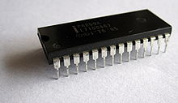
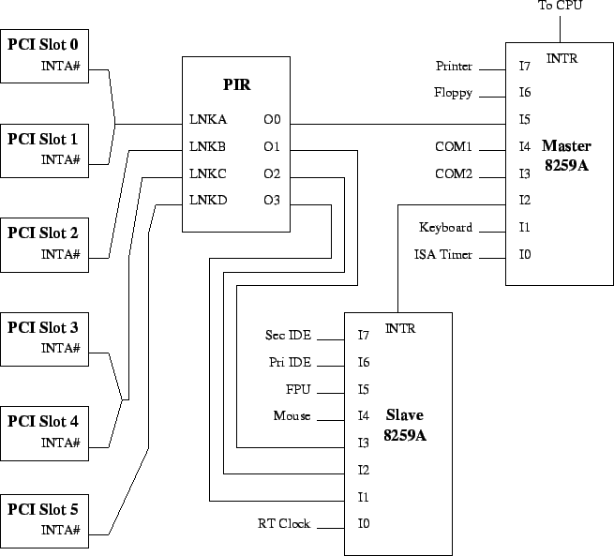
interrupt service routine (ISR)
An interrupt is an event that causes the currently executing code to be effectively paused while the event is serviced.
There are two main categories of interrupts:
Hardware interrupts
Asynchronous
Software interrupts
Synchronous
Programmable Interrupt Controller (PIC)

Slide 96
Hardware Interrupts
External interrupts from a IO devices, chipset components or other processors
Local interrupts
Thermal sensor, performance monitor counter interrupts, etc.
Special case interrupts:
NMI: Non-Maskable Interrupt
SMI: System Management Interrupt
Processor Processor
Interrupt
Interrupt
Chipset
Component
LAN _{Timer}
PCIe
NIC
Interrupt

Slide 97
Hardware Interrupts
Most hardware interrupts go through an interrupt controller (e.g. Local APIC) before being delivered to the target core.
NMIs and SMIs are not handled by an interrupt controller.
These are delivered directly to the target core.
Software running on one core can program that core’s local APIC to fire an interrupt targeting another core (or set of cores)
Commonly referred to as IPIs (Inter-Processor Interrupts)

Slide 98
Software interrupts
Interrupts may also occur via dedicated software instructions.
Each time an interrupt instruction (INT xx) is executed by the processor, the xx value (an 8-bit operand) causes the CPU to run the requested interrupt service routine.
INT 21h for various DOS services
DOS read, write, write string, terminate program, etc.
INT 80h (x86) and syscall (x86_64) for system calls
Software interrupts do NOT interact with any interrupt controller (e.g. Local APIC).
These are handled entirely within the core executing the instruction.

Slide 99
Processor Exceptions
An exception is typically an unexpected internal event and generally occurs when the CPU executes an instruction requiring additional attention
Some exceptions are error conditions, some are not:
Integer divide by zero attempt (an error exception)
Page fault
when attempting to access a memory address that isn't present in DRAM
Stack overflow, etc.
Exceptions do NOT interact with any interrupt controller (e.g. Local APIC).
These are handled entirely within the core that detected the exception.

Slide 100
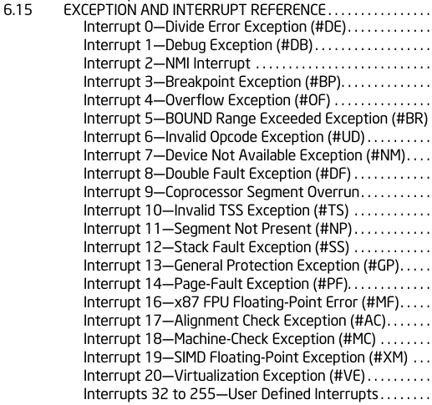
interrupt service routine (ISR)
Interrupt Vector
255
.
.
.
.
2
1
0
Each unique interrupt and exception is represented by a vectors (aka interrupt vector).
CPU uses the vector to locate and execute the appropriate handler, also referred to as the interrupt service routine (ISR)
The x86 architecture supports an 8-bit interrupt vector (0 –255)
In multi-processor/core systems, there can be more than 256 unique interrupts.
Each logical processor supports 256 vectors.

Slide 101
interrupt service routine (ISR)
Memory
Interrupt Descriptor Table
(IDT)
ISR 14
Page Fault
255 (FF h)
128 (80 h)
119 (77 h)
50 (32 h)
33 (21 h)
14 (0E h)
0
ISR 128
14
Vector of
Interrupt Event
ISR 119
IDT Register (IDTR)
ISR 50
ISR 0
Divide by 0
ISR 33
Keyboard ISR

Slide 102
interrupt service routine (ISR)
ISR 33
MOV EAX, [EBP+ECX]
ADD EAX, EBX
DEC ECX
AND EAX, ECX
PUSH EAX
SUB EDX, ECX
PUSH EAX
PUSH EBX
.
.
.
POP EBX
POP EAX
IRET
Interrupt
(Vector 33)
Upon entering an ISR, the processor automatically saves info about the state of the interrupted program:
SS, SP, Flags, CS, IP, etc.

Slide 103
Non-maskable interrupt (NMI)
A computer processor interrupt that cannot be ignored by standard interrupt masking techniques in the system
When response time is critical or when an interrupt should never be disabled during normal system operation
Typically used to signal attention for non-recoverable hardware errors
These errors include
Non-recoverable internal system chipset errors
Corruption in system memory such as parity and ECC errors
Data corruption detected on system and peripheral busses
From users
Hardware and software debugging interfaces
System reset buttons

Slide 104
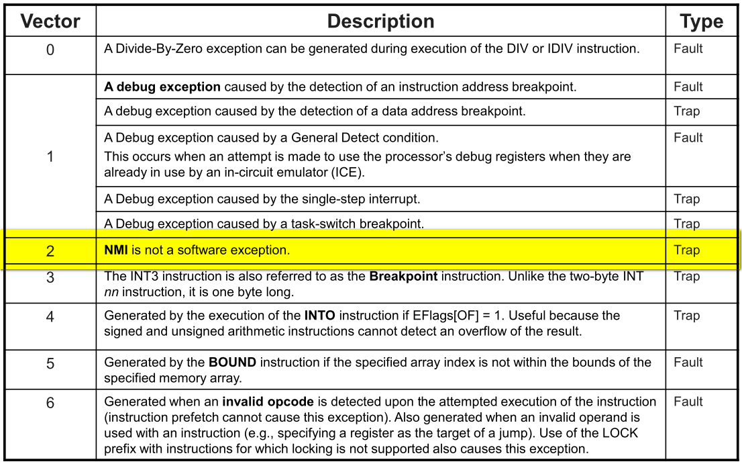
Non-maskable interrupt (NMI)
NMI Status Bits
Port | Bit | Function
61h | 7 | 1 = RAM parity error
61h | 6 | 1 = I/O Channel parity error
461h | 7 | 1 = Watchdog timeout
461h | 6 | 1 = Bus timeout
461h | 5 | 1 = I/O port status

Slide 105
Problem 2: Switching Between Processes
How can the OS regain control of the CPU so that it can switch between processes?
A cooperative Approach: Wait for system calls
A non-cooperative Approach: The OS takes control

Slide 106
A cooperative Approach: Wait for system calls
Processes periodically give up the CPU by making system calls such as yield.
The OS decides to run some other task.
Application also transfer control to the OS when they do something illegal.
Divide by zero
Try to access memory that it shouldn’t be able to access
Ex) Early versions of the Macintosh OS, The old Xerox Alto system
A process gets stuck in an infinite loop.
→ Reboot the machine

Slide 107
A Non-Cooperative Approach: OS Takes Control
A timer interrupt
During the boot sequence, the OS start the timer.
The timer raise an interrupt every so many milliseconds.
When the interrupt is raised :
The currently running process is halted.
Save enough of the state of the program
A pre-configured interrupt handler in the OS runs.
A timer interrupt gives OS the ability to
run again on a CPU.

Slide 108
System Timers
Intel 8253/8254 - Programmable Interval Timers (PITs)
Timer 0 (System Timing): 1.1932 MHz
Timer 1 (DRAM Refresh): 1.1932 MHz
Timer 2 (General Use and Speaker): 1.1932 MHz
Timer 3 (Watchdog Timer): 298.3 KHz
Timer 4 (Not Implemented)
Timer 5 (CPU Speed Control)
Newer motherboards also include a counter through
Advanced Configuration and Power Interface (ACPI)
Local Advanced Programmable Interrupt Controller (Local APIC)
High Precision Event Timer
The CPU itself also provides the Time Stamp Counter (TSC)

Slide 109
Saving and Restoring Context
Scheduler makes a decision:
Whether to continue running the current process, or switch to a different one.
If the decision is made to switch, the OS executes context switch.

Slide 110
Context Switch
A low-level piece of assembly code
Save a few register values for the current process onto its kernel stack
General purpose registers
PC
Kernel stack pointer
Restore a few for the soon-to-be-executing process from its kernel stack
Switch to the kernel stack for the soon-to-be-executing process

Slide 111
Limited Direction Execution Protocol (Timer interrupt)
OS @ boot
(kernel mode)
Hardware
initialize trap table
remember address of …
syscall handler
timer handler
start interrupt timer
start timer
interrupt CPU in X ms
OS @ run
(kernel mode)
Hardware
Program
(user mode)
Process A
…
timer interrupt
save regs(A) to k-stack(A)
move to kernel mode
jump to trap handler

Slide 112
Limited Direction Execution Protocol (Timer interrupt)
OS @ run
(kernel mode)
Hardware
Program
(user mode)
(Cont.)
Handle the trap
Call switch() routine
save regs(A) to proc-struct(A)
restore regs(B) from proc-struct(B)
switch to k-stack(B)
return-from-trap (into B)
restore regs(B) from k-stack(B)
move to user mode
jump to B’s PC
Process B
…

Slide 113
The xv6 Context Switch Code
1 # void swtch(struct context **old, struct context *new);
2 #
3 # Save current register context in old
4 # and then load register context from new.
5 .globl swtch
6 swtch:
7 # Save old registers
8 movl 4(%esp), %eax # put old ptr into eax
9 popl 0(%eax) # save the old IP
10 movl %esp, 4(%eax) # and stack
11 movl %ebx, 8(%eax) # and other registers
12 movl %ecx, 12(%eax)
13 movl %edx, 16(%eax)
14 movl %esi, 20(%eax)
15 movl %edi, 24(%eax)
16 movl %ebp, 28(%eax)
17
18 # Load new registers
19 movl 4(%esp), %eax # put new ptr into eax
20 movl 28(%eax), %ebp # restore other registers
21 movl 24(%eax), %edi
22 movl 20(%eax), %esi
23 movl 16(%eax), %edx
24 movl 12(%eax), %ecx
25 movl 8(%eax), %ebx
26 movl 4(%eax), %esp # stack is switched here
27 pushl 0(%eax) # return addr put in place
28 ret # finally return into new ctxt

Slide 114
Worried About Concurrency?
What happens if, during interrupt or trap handling, another interrupt occurs?
OS handles these situations:
Disable interrupts during interrupt processing
Use a number of sophisticate locking schemes to protect concurrent access to internal data structures.

Slide 115
Hardware vs. Software Context Switching
Context switching can be performed primarily by software or hardware
Hardware-based Context Switching
Use Task State Segment
Does not save all the registers
Only general purpose registers
Not floating point registers
Slow!
Software-based Context Switching
Used by modern Operating Systems
Windows
Linux

Slide 116
Task-Related Data Structures
Task-state segment (TSS)
The processor state information needed to restore a task is saved in this segment.
TSS descriptor
The TSS, like all other segments, is defined by a segment descriptor. TSS descriptors may only be placed in the GDT
Task-gate descriptor
A task-gate descriptor provides an indirect, protected reference to a task. It can be placed in the GDT, an LDT, or the IDT
Task register
The task register holds the 16-bit segment selector and the entire segment descriptor.
NT flag in the EFLAGS register

Slide 117
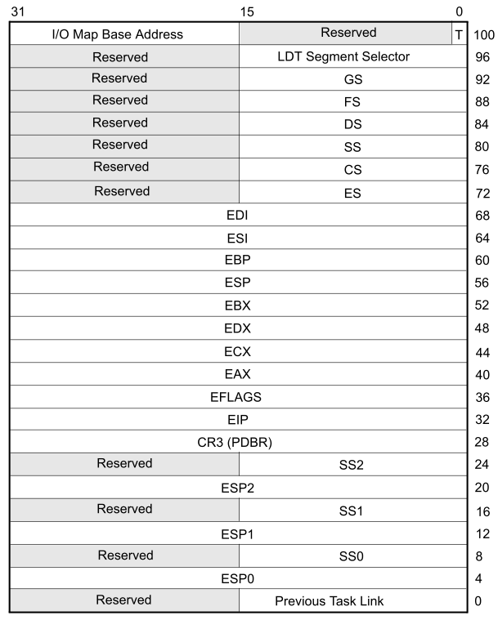
Task-state segment (TSS)

Slide 118
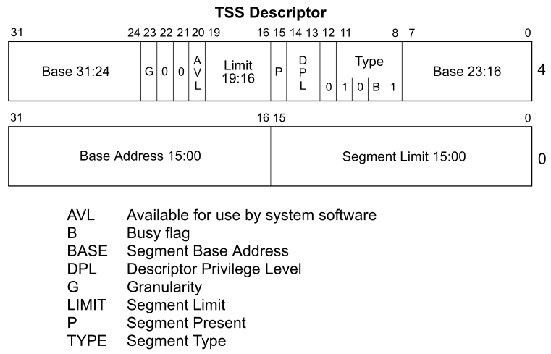
TSS descriptor

Slide 119
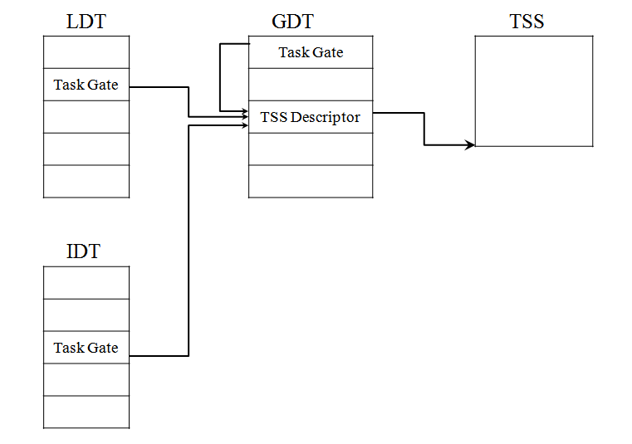
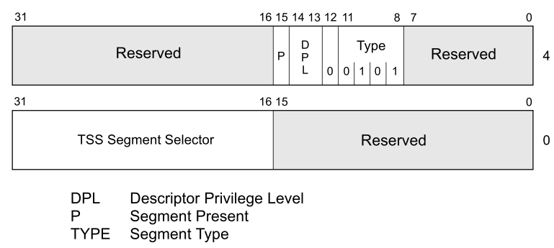
Task-gate descriptor

Slide 120
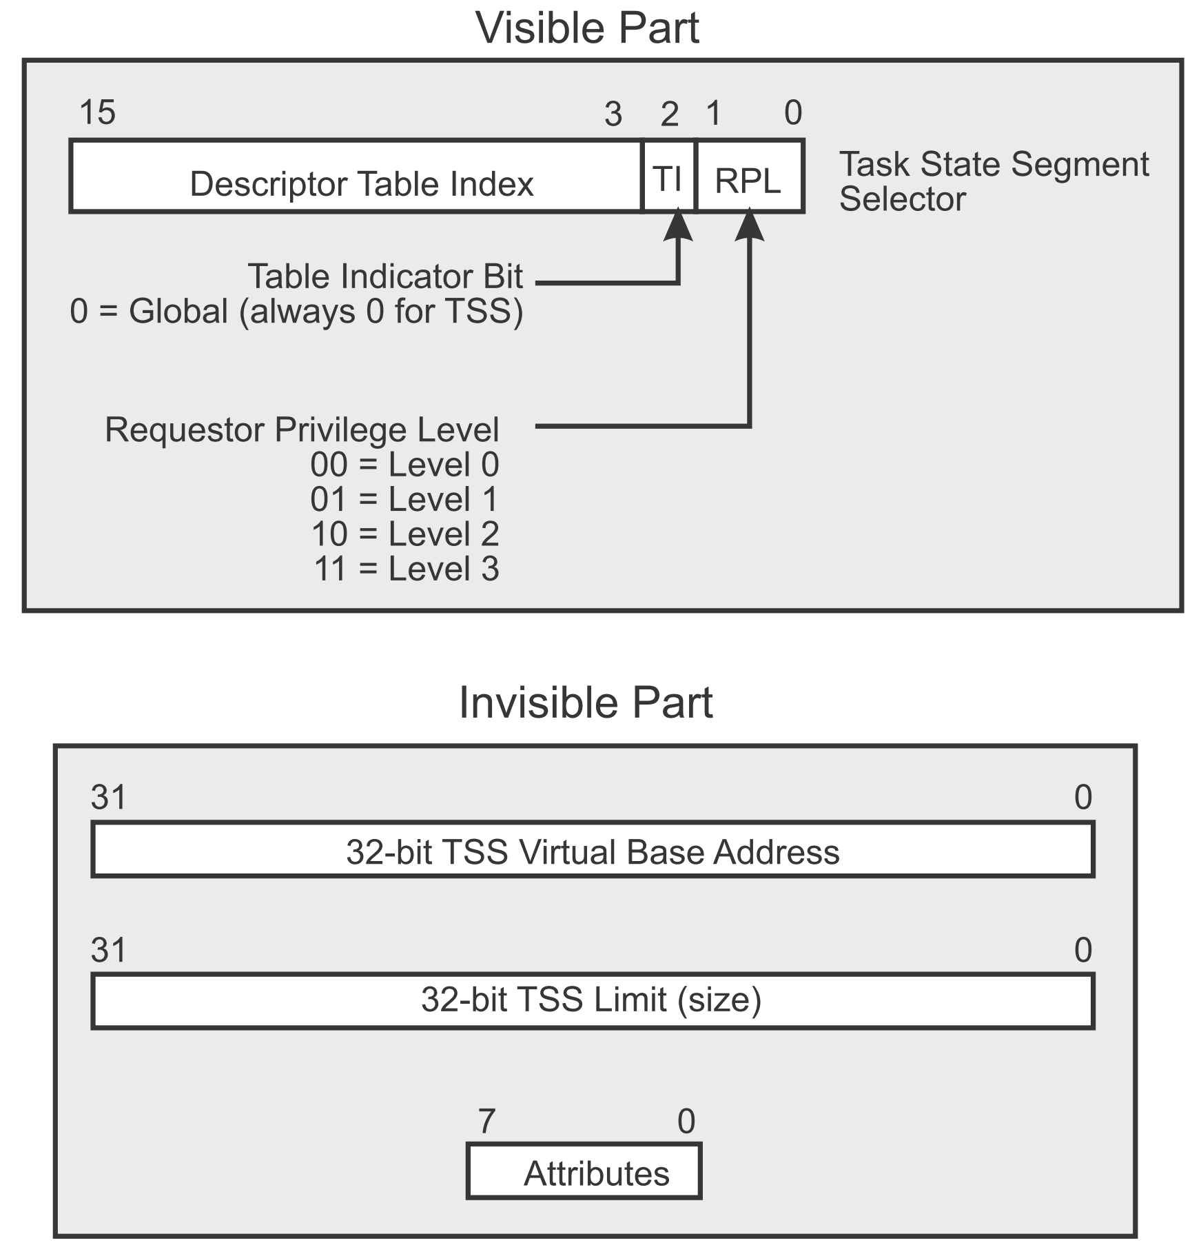
Task register

Slide 121
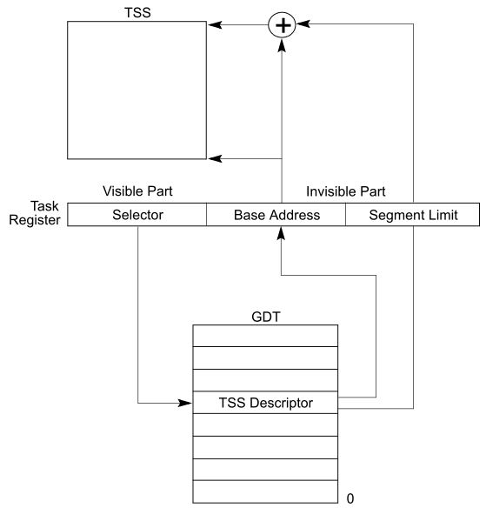
Task register

Slide 122
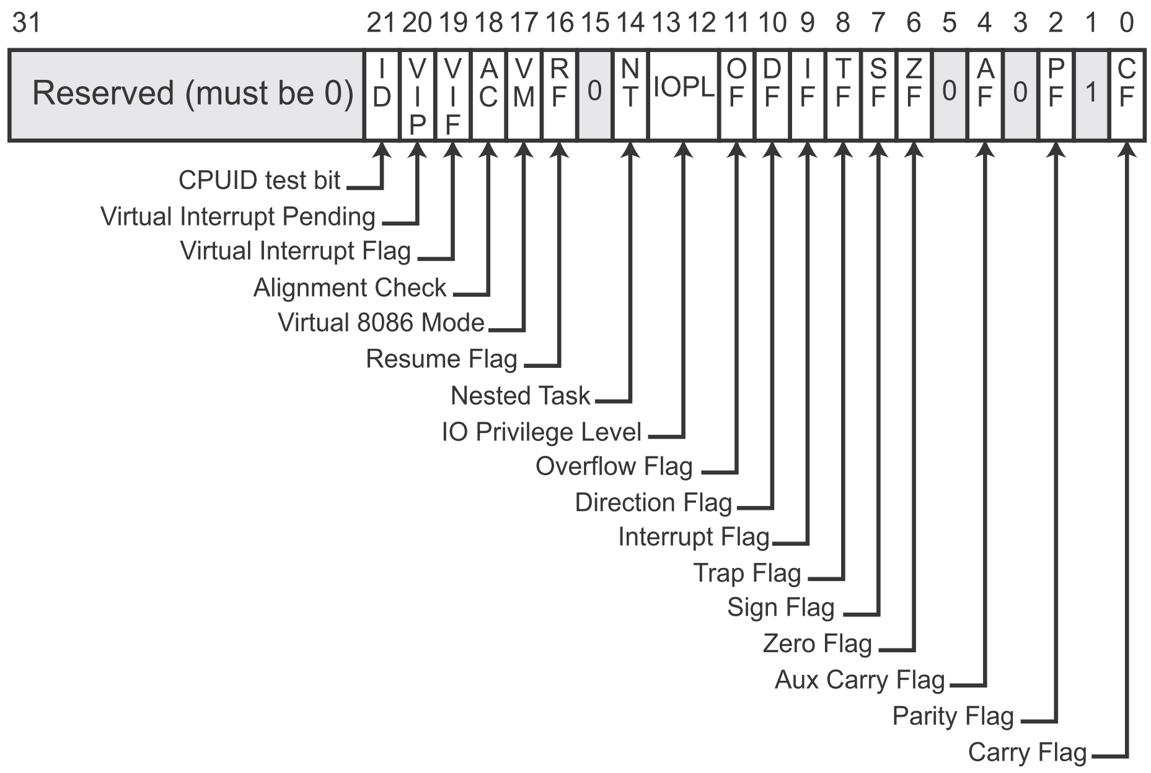
Eflags register

Slide 123
Events that Cause a Task Switch
The CS portion of a Far Call/Far jump branch target address selects TSS descriptor in GDT
The CS portion of a Far Call/Far jump selects Task Gate descriptor in the GDT or LDT
INT nn where nn selects a Task Gate in IDT
Hardware interrupt selects a Task Gate in IDT
Software exception selects a Task Gate in IDT
IRET execution when Eflags[NT] bit set

Slide 124
Process 1’s Code
Process 1’s Stack
EIP
a = b + 1;
switch();
b--;
Top Frame
Return addr
Saved EAX
…
Saved EDX
ESP
OS Code
<switch>:
push eax
push ebx
…
push edx
mov [cur_esp], esp
mov esp, [saved_esp]
pop edx
…
pop ebx
pop eax
ret
switch() means that (in this context) OS determined context switching
(i.e., not actual code for processes)
OS Memory
Saved ESP for Process 1
Saved ESP for Process 2
Process 2’s Stack
Top Frame
Return addr
Saved EAX
…
Saved EDX
Process 2’s Code
puts(my_str);
switch();
my_str[0] = ‘\n’;
i = strlen(my_str);
switch();

Slide 125
07. Scheduling: Introduction
임종범
jblim@kpu.ac.kr

Slide 126
Scheduling: Introduction
Workload assumptions:
Each job runs for the same amount of time.
All jobs arrive at the same time.
All jobs only use the CPU (i.e., they perform no I/O).
The run-time of each job is known.

Slide 127

Scheduling Metrics
Performance metric: Turnaround time
The time at which the job completes minus the time at which the job arrived in the system.
Another metric is fairness.
Performance and fairness are often at odds in scheduling.
$$T_{turnaround}=T_{completion}−T_{arrival}$$

Slide 128

First In, First Out (FIFO)
First Come, First Served (FCFS)
Very simple and easy to implement
Example:
A arrived just before B which arrived just before C.
Each job runs for 10 seconds.
A
B
C
0
20
40
60
80
100
120
Time (Second)
$$Average turnaround time=\frac{10+20+30}{3}=20 sec$$

Slide 129
Why FIFO is not that great? – Convoy effect
Let’s relax assumption 1: Each job no longer runs for the same amount of time.
Example:
A arrived just before B which arrived just before C.
A runs for 100 seconds, B and C run for 10 each.
A
B
C
0
20
40
60
80
100
120
Time (Second)
$$Average turnaround time=\frac{100+110+120}{3}=110 sec$$

Slide 130

Shortest Job First (SJF)
Run the shortest job first, then the next shortest, and so on
Non-preemptive scheduler
Example:
A arrived just before B which arrived just before C.
A runs for 100 seconds, B and C run for 10 each.
B
C
A
0
20
40
60
80
100
120
Time (Second)
$$Average turnaround time=\frac{10+20+120}{3}=50 sec$$

Slide 131
SJF with Late Arrivals from B and C
Let’s relax assumption 2: Jobs can arrive at any time.
Example:
A arrives at t=0 and needs to run for 100 seconds.
B and C arrive at t=10 and each need to run for 10 seconds
[B,C arrive]
A
B
C
0
20
40
60
80
100
120
Time (Second)
$$Average turnaround time=\frac{100+\left(110−10\right)+(120−10)}{3}=103.33 sec$$

Slide 132
Shortest Time-to-Completion First (STCF)
Add preemption to SJF
Also knows as Preemptive Shortest Job First (PSJF)
A new job enters the system:
Determine of the remaining jobs and new job
Schedule the job which has the least time left

Slide 133
Shortest Time-to-Completion First (STCF)
Example:
A arrives at t=0 and needs to run for 100 seconds.
B and C arrive at t=10 and each need to run for 10 seconds
[B,C arrive]
A
B
C
A
0
20
40
60
80
100
120
Time (Second)
$$Average turnaround time=\frac{(120−0)+\left(20−10\right)+(30−10)}{3}=50 sec$$

Slide 134

New scheduling metric: Response time
The time from when the job arrives to the first time it is scheduled.
STCF and related disciplines are not particularly good for response time.
$$T_{response}=T_{firstrun}−T_{arrival}$$
How can we build a scheduler that is
sensitive to response time?

Slide 135
Round Robin (RR) Scheduling
Time slicing Scheduling
Run a job for a time slice and then switch to the next job in the run queue until the jobs are finished.
Time slice is sometimes called a scheduling quantum.
It repeatedly does so until the jobs are finished.
The length of a time slice must be a multiple of the timer-interrupt period.
RR is fair, but performs poorly on metrics
such as turnaround time

Slide 136


RR Scheduling Example
A, B and C arrive at the same time.
They each wish to run for 5 seconds.
A
B
C
$$T_{average response}=\frac{0+5+10}{3}=5sec$$
0
5
10
15
20
25
30
Time (Second)
SJF (Bad for Response Time)
A
B
A
B
A
B
A
B
A
C
C
C
C
B
C
$$T_{average response}=\frac{0+1+2}{3}=1sec$$
0
5
10
15
20
25
30
Time (Second)
RR with a time-slice of 1sec (Good for Response Time)

Slide 137
The length of the time slice is critical.
The shorter time slice
Better response time
The cost of context switching will dominate overall performance.
The longer time slice
Amortize the cost of switching
Worse response time
Deciding on the length of the time slice presents
a trade-off to a system designer

Slide 138
Incorporating I/O
Let’s relax assumption 3: All programs perform I/O
Example:
A and B need 50ms of CPU time each.
A runs for 10ms and then issues an I/O request
I/Os each take 10ms
B simply uses the CPU for 50ms and performs no I/O
The scheduler runs A first, then B after

Slide 139
Incorporating I/O (Cont.)
A
A
A
A
A
B
B
B
B
B
CPU
I/O
0
20
40
60
80
100
120
140
Time (msec)
Poor Use of Resources
A
B
A
B
A
B
A
B
A
B
CPU
I/O
Maximize the
CPU utilization
0
20
40
60
80
100
120
140
Time (msec)
Overlap Allows Better Use of Resources

Slide 140
Incorporating I/O (Cont.)
When a job initiates an I/O request.
The job is blocked waiting for I/O completion.
The scheduler should schedule another job on the CPU.
When the I/O completes
An interrupt is raised.
The OS moves the process from blocked back to the ready state.

Slide 141
08. Scheduling: Multi-Level Feedback Queue
임종범
jblim@kpu.ac.kr

Slide 142
Multi-Level Feedback Queue (MLFQ)
A Scheduler that learns from the past to predict the future.
Objective:
Optimize turnaround time → Run shorter jobs first
Minimize response time without a priori knowledge of job length.

Slide 143
MLFQ: Basic Rules
MLFQ has a number of distinct queues.
Each queues is assigned a different priority level.
A job that is ready to run is on a single queue.
A job on a higher queue is chosen to run.
Use round-robin scheduling among jobs in the same queue
Rule 1: If Priority(A) > Priority(B), A runs (B doesn’t).
Rule 2: If Priority(A) = Priority(B), A & B run in RR.

Slide 144
MLFQ: Basic Rules (Cont.)
MLFQ varies the priority of a job based on its observed behavior.
Example:
A job repeatedly relinquishes the CPU while waiting IOs → Keep its priority high
A job uses the CPU intensively for long periods of time → Reduce its priority.

Slide 145
MLFQ Example
[High Priority]
Q8
Q7
Q6
Q5
Q4
Q3
Q2
Q1
A
B
C
[Low Priority]
D

Slide 146
MLFQ: How to Change Priority
MLFQ priority adjustment algorithm:
Rule 3: When a job enters the system, it is placed at the highest priority
Rule 4a: If a job uses up an entire time slice while running, its priority is reduced (i.e., it moves down on queue).
Rule 4b: If a job gives up the CPU before the time slice is up, it stays at the same priority level
In this manner, MLFQ approximates SJF

Slide 147
Example 1: A Single Long-Running Job
A three-queue scheduler with time slice 10ms
Q2
Q1
Q0
0
50
100
150
200
Long-running Job Over Time (msec)

Slide 148
Example 2: Along Came a Short Job
Assumption:
Job A: A long-running CPU-intensive job
Job B: A short-running interactive job (20ms runtime)
A has been running for some time, and then B arrives at time T=100.
Q2
A:
Q1
B:
Q0
0
50
100
150
200
Along Came An Interactive Job (msec)

Slide 149
Example 3: What About I/O?
Assumption:
Job A: A long-running CPU-intensive job
Job B: An interactive job that need the CPU only for 1ms before performing an I/O
Q2
A:
Q1
B:
Q0
0
50
100
150
200
A Mixed I/O-intensive and CPU-intensive Workload (msec)
The MLFQ approach keeps an interactive job at the highest priority

Slide 150
Problems with the Basic MLFQ
Starvation
If there are "too many" interactive jobs in the system.
Lon-running jobs will never receive any CPU time.
Game the scheduler
After running 99% of a time slice, issue an I/O operation.
The job gain a higher percentage of CPU time.
A program may change its behavior over time.
CPU bound process ←→ I/O bound process

Slide 151
The Priority Boost
Rule 5: After some time period S, move all the jobs in the system to the topmost queue.
Example:
A long-running job(A) with two short-running interactive job(B, C)
Q2
Q2
Q1
Q1
Q0
Q0
0
50
100
150
200
0
50
100
150
200
A:
B:
C:
Without(Left) and With(Right) Priority Boost

Slide 152
Better Accounting
How to prevent gaming of our scheduler?
Solution:
Rule 4 (Rewrite Rules 4a and 4b): Once a job uses up its time allotment at a given level (regardless of how many times it has given up the CPU), its priority is reduced(i.e., it moves down on queue).
Q2
Q2
Q1
Q1
Q0
Q0
0
50
100
150
200
0
50
100
150
200
Without(Left) and With(Right) Gaming Tolerance

Slide 153
Tuning MLFQ And Other Issues
The high-priority queues → Short time slices
E.g., 10 or fewer milliseconds
The Low-priority queue → Longer time slices
E.g., 100 milliseconds
Lower Priority, Longer Quanta
Q2
Q1
Q0
0
50
100
150
200
Example) 10ms for the highest queue, 20ms for the middle,
40ms for the lowest

Slide 154
The Solaris MLFQ implementation
For the Time-Sharing scheduling class (TS)
60 Queues
Slowly increasing time-slice length
The highest priority: 20msec
The lowest priority: A few hundred milliseconds
Priorities boosted around every 1 second or so.

Slide 155
MLFQ: Summary
The refined set of MLFQ rules:
Rule 1: If Priority(A) > Priority(B), A runs (B doesn’t).
Rule 2: If Priority(A) = Priority(B), A & B run in RR.
Rule 3: When a job enters the system, it is placed at the highest priority.
Rule 4: Once a job uses up its time allotment at a given level (regardless of how many times it has given up the CPU), its priority is reduced(i.e., it moves down on queue).
Rule 5: After some time period S, move all the jobs in the system to the topmost queue.

Slide 156
09. Scheduling: Proportional Share
임종범
jblim@kpu.ac.kr

Slide 157
Proportional Share Scheduler
Fair-share scheduler
Guarantee that each job obtain a certain percentage of CPU time.
Not optimized for turnaround or response time

Slide 158
Basic Concept
Tickets
Represent the share of a resource that a process should receive
The percent of tickets represents its share of the system resource in question.
Example
There are two processes, A and B.
Process A has 75 tickets → receive 75% of the CPU
Process B has 25 tickets → receive 25% of the CPU

Slide 159
Lottery scheduling
The scheduler picks a winning ticket.
Load the state of that winning process and runs it.
Example
There are 100 tickets
Process A has 75 tickets: 0 ~ 74
Process B has 25 tickets: 75 ~ 99
Scheduler’s winning tickets:
63 85 70 39 76 17 29 41 36 39 10 99 68 83 63
Resulting scheduler:
A
B
A
A
B
A
A
A
A
A
A
B
A
B
A
The longer these two jobs compete,
The more likely they are to achieve the desired percentages.

Slide 160
Ticket Mechanisms
Ticket currency
A user allocates tickets among their own jobs in whatever currency they would like.
The system converts the currency into the correct global value.
Example
There are 200 tickets (Global currency)
Process A has 100 tickets
Process B has 100 tickets
User A → 500 (A’s currency) to A1 → 50 (global currency)
→ 500 (A’s currency) to A2 → 50 (global currency)
User B → 10 (B’s currency) to B1 → 100 (global currency)

Slide 161
Ticket Mechanisms (Cont.)
Ticket transfer
A process can temporarily hand off its tickets to another process.
Ticket inflation
A process can temporarily raise or lower the number of tickets is owns.
If any one process needs more CPU time, it can boost its tickets.

Slide 162
Implementation
Example: There are there processes, A, B, and C.
Keep the processes in a list:
Job:A
Tix:100
Job:B
Tix:50
Job:C
Tix:250
head
NULL
1 // counter: used to track if we’ve found the winner yet
2 int counter = 0;
3
4 // winner: use some call to a random number generator to
5 // get a value, between 0 and the total # of tickets
6 int winner = getrandom(0, totaltickets);
7
8 // current: use this to walk through the list of jobs
9 node_t *current = head;
10
11 // loop until the sum of ticket values is > the winner
12 while (current) {
13 counter = counter + current->tickets;
14 if (counter > winner)
15 break; // found the winner
16 current = current->next;
17 }
18 // ’current’ is the winner: schedule it...

Slide 163
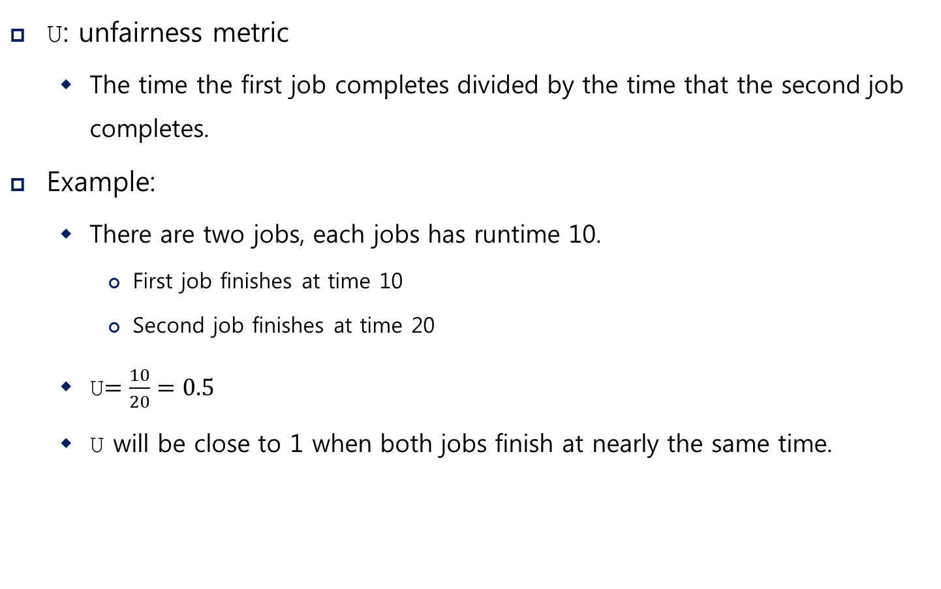
Implementation (Cont.)
U: unfairness metric
The time the first job completes divided by the time that the second job completes.
Example:
There are two jobs, each jobs has runtime 10.
First job finishes at time 10
Second job finishes at time 20
U$=\frac{10}{20}=0.5$
U will be close to 1 when both jobs finish at nearly the same time.

Slide 164
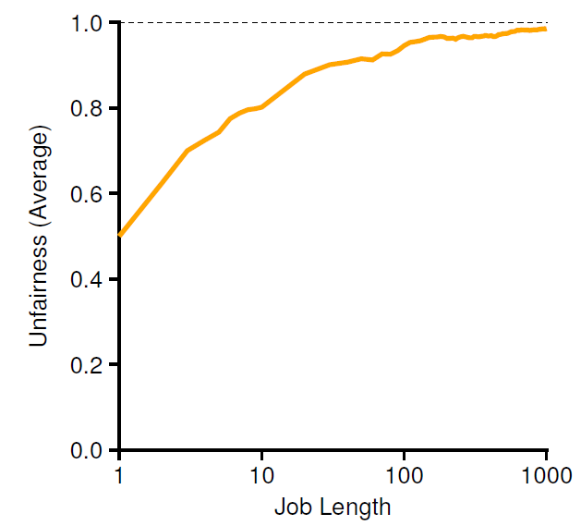
Lottery Fairness Study
There are two jobs.
Each jobs has the same number of tickets (100).
When the job length is not very long,
average unfairness can be quite severe.

Slide 165
Stride Scheduling
Stride of each process
(A large number) / (the number of tickets of the process)
Example: A large number = 10,000
Process A has 100 tickets → stride of A is 100
Process B has 50 tickets → stride of B is 200
A process runs, increment a counter(=pass value) for it by its stride.
Pick the process to run that has the lowest pass value
current = remove_min(queue); // pick client with minimum pass
schedule(current); // use resource for quantum
current->pass += current->stride; // compute next pass using stride
insert(queue, current); // put back into the queue
A pseudo code implementation

Slide 166
Stride Scheduling Example
Pass(A)
(stride=100)
Pass(B)
(stride=200)
Pass(C)
(stride=40)
Who Runs?
0
100
100
100
100
100
200
200
200
0
0
200
200
200
200
200
200
200
0
0
0
40
80
120
120
160
200
A
B
C
C
C
A
C
C
…
If new job enters with pass value 0,
It will monopolize the CPU!

Slide 167
10. Multiprocessor Scheduling (Advanced)
임종범
jblim@kpu.ac.kr

Slide 168
Multiprocessor Scheduling
The rise of the multicore processor is the source of multiprocessor-scheduling proliferation.
Multicore: Multiple CPU cores are packed onto a single chip.
Adding more CPUs does not make that single application run faster. → You’ll have to rewrite application to run in parallel, using threads.
How to schedule jobs on Multiple CPUs?

Slide 169
Single CPU with cache
CPU
Cache
Small, fast memories
Hold copies of popular data that is found in the main memory.
Utilize temporal and spatial locality
Cache
Memory
Main Memory
Holds all of the data
Access to main memory is slower than cache.
By keeping data in cache, the system can make slow memory appear to be a fast one

Slide 170

Cache coherence
Consistency of shared resource data stored in multiple caches.
0. Two CPUs with caches sharing memory
1. CPU0 reads a data at address 1.
CPU 0
CPU 1
CPU 0
CPU 1
Cache
Cache
Cache
$$D$$
Cache
Bus
Bus
Memory
Memory
0
1
2
3
0
1
2
3

Slide 171





Cache coherence (Cont.)
2. $D$ is updated and CPU1 is scheduled.
3. CPU1 re-reads the value at address A
CPU 0
CPU 1
CPU 0
CPU 1
Cache
$$D′$$
Cache
Cache
$$D′$$
Cache
$$D$$
Bus
Bus
Memory
Memory
0
1
2
3
0
1
2
3
CPU1 gets the old value $D$
instead of the correct value $D′$.

Slide 172
Cache coherence solution
Bus snooping
Each cache pays attention to memory updates by observing the bus.
When a CPU sees an update for a data item it holds in its cache, it will notice the change and either invalidate its copy or update it.

Slide 173
Don’t forget synchronization
When accessing shared data across CPUs, mutual exclusion primitives should likely be used to guarantee correctness.
1 typedef struct __Node_t {
2 int value;
3 struct __Node_t *next;
4 } Node_t;
5
6 int List_Pop() {
7 Node_t *tmp = head; // remember old head ...
8 int value = head->value; // ... and its value
9 head = head->next; // advance head to next pointer
10 free(tmp); // free old head
11 return value; // return value at head
12 }
Simple List Delete Code

Slide 174
Don’t forget synchronization (Cont.)
Solution
1 pthread_mtuex_t m;
2 typedef struct __Node_t {
3 int value;
4 struct __Node_t *next;
5 } Node_t;
6
7 int List_Pop() {
8 lock(&m)
9 Node_t *tmp = head; // remember old head ...
10 int value = head->value; // ... and its value
11 head = head->next; // advance head to next pointer
12 free(tmp); // free old head
13 unlock(&m)
14 return value; // return value at head
15 }
Simple List Delete Code with lock

Slide 175
Cache Affinity
Keep a process on the same CPU if at all possible
A process builds up a fair bit of state in the cache of a CPU.
The next time the process run, it will run faster if some of its state is already present in the cache on that CPU.
A multiprocessor scheduler should consider cache affinity
when making its scheduling decision.

Slide 176
Single queue Multiprocessor Scheduling (SQMS)
Put all jobs that need to be scheduled into a single queue.
Each CPU simply picks the next job from the globally shared queue.
Cons:
Some form of locking have to be inserted → Lack of scalability
Cache affinity
Example:
Possible job scheduler across CPUs:
Queue
A
B
C
D
E
NULL
CPU0
A | E | D | C | B
… (repeat) …
CPU1
B | A | E | D | C
… (repeat) …
CPU2
C | B | A | E | D
… (repeat) …
CPU3
D | C | B | A | E
… (repeat) …

Slide 177
Scheduling Example with Cache affinity
A
B
C
D
NULL
Preserving affinity for most
Jobs A through D are not moved across processors.
Only job E Migrating from CPU to CPU.
Implementing such a scheme can be complex.
Queue
E
CPU0
A | E | A | A | A
… (repeat) …
CPU1
B | B | E | B | B
… (repeat) …
CPU2
C | C | C | E | C
… (repeat) …
CPU3
D | D | D | D | E
… (repeat) …

Slide 178
Multi-queue Multiprocessor Scheduling (MQMS)
MQMS consists of multiple scheduling queues.
Each queue will follow a particular scheduling discipline.
When a job enters the system, it is placed on exactly one scheduling queue.
Avoid the problems of information sharing and synchronization.

Slide 179
MQMS Example
With round robin, the system might produce a schedule that looks like this:
Q0
A
C
Q1
B
D
CPU0
A | A | C | C | A | A | C | C | A | A | C | C
…
CPU1
B | B | D | D | B | B | D | D | B | B | D | D
…
MQMS provides more scalability and cache affinity.

Slide 180
Load Imbalance issue of MQMS
After job C in Q0 finishes:
After job A in Q0 finishes:
Q0
A
Q1
B
D
CPU0
A | A | A | A | A | A | A | A | A | A | A | A
…
CPU1
B | B | D | D | B | B | D | D | B | B | D | D
…
A gets twice as much CPU as B and D.
Q0
Q1
B
D
CPU0
…
CPU1
B | B | D | D | B | B | D | D | B | B | D | D
…
CPU0 will be left idle!

Slide 181
How to deal with load imbalance?
The answer is to move jobs (Migration).
Example:
Q0
Q1
B
D
The OS moves one of B or D to CPU 0
Q0
D
Q1
B
Or
Q0
B
Q1
D

Slide 182
How to deal with load imbalance? (Cont.)
A more tricky case:
A possible migration pattern:
Keep switching jobs
Q0
A
Q1
B
D
CPU0
A | A | A | A | B | A | B | A | B | B | B | B
…
CPU1
B | D | B | D | D | D | D | D | A | D | A | D
…
Migrate B to CPU0
Migrate A to CPU1

Slide 183
Work Stealing
Move jobs between queues
Implementation:
A source queue that is low on jobs is picked.
The source queue occasionally peeks at another target queue.
If the target queue is more full than the source queue, the source will "steal" one or more jobs from the target queue.
Cons:
High overhead and trouble scaling

Slide 184
Linux Multiprocessor Schedulers
O(1)
A Priority-based scheduler
Use Multiple queues
Change a process’s priority over time
Schedule those with highest priority
Interactivity is a particular focus
Completely Fair Scheduler (CFS)
Deterministic proportional-share approach
Multiple queues

Slide 185
Linux Multiprocessor Schedulers (Cont.)
BF Scheduler (BFS)
A single queue approach
Proportional-share
Based on Earliest Eligible Virtual Deadline First (EEVDF)

Slide 186
I/O-Bound VS. Processor-Bound Processes
Processes can be classified as either I/O-bound or processor-bound
The former is characterized as a process that spends much of its time submitting and waiting on I/O requests
Consequently, such a process is runnable for only short durations, because it eventually blocks waiting on more I/O
Any type of blockable resource, such as keyboard input or network I/O, and not just disk I/O
Most graphical user interface (GUI) applications are I/O-bound, even if they never read from or write to the disk
They spend most of their time waiting on user interaction via the keyboard and mouse

Slide 187
I/O-Bound VS. Processor-Bound Processes
Conversely, processor-bound processes spend much of their time executing code
Programs that perform a lot of mathematical calculations
ssh-keygen, MATLAB, etc.
They tend to run until they are preempted because they do not block on I/O requests very often
A scheduler policy for processor-bound processes, therefore, tends to run such processes less frequently but for longer durations

Slide 188
I/O-Bound VS. Processor-Bound Processes
The scheduling policy must satisfy two conflicting goals
Fast process response time (low latency)
Maximal system utilization (high throughput)
Linux, aiming to provide good interactive response and desktop performance, optimizes for process response (low latency), thus favoring I/O-bound processes over processor-bound processors

Slide 189
Process Priority
A common type of scheduling algorithm is priority-based scheduling
The goal is to rank processes based on their worth and need
Both the user and the system can set a process’s priority to influence the scheduling behavior
Processes with a higher priority run before those with a lower priority
Processes with the same priority are scheduled round-robin
On some systems, processes with a higher priority also receive a longer timeslice
The runnable process with timeslice remaining and the highest priority always runs

Slide 190
Process Priority
The Linux kernel implements two separate priority ranges
The first is the nice value, a number from –20 to +19 with a default of 0
Processes with a lower nice value (higher priority) receive a larger proportion of the system’s processor compared to processes with a higher nice value (lower priority)
Nice values are the standard priority range used in all Unix systems
In other Unix-based systems, such as Mac OS X, the nice value is a control over the absolute timeslice allotted to a process
In Linux, it is a control over the proportion of timeslice

Slide 191
Process Priority
The second range is the real-time priority
The values are configurable, but by default range from 0 to 99, inclusive
Opposite from nice values, higher real-time priority values correspond to a greater priority
All real-time processes are at a higher priority than normal processes
Linux implements real-time priorities in accordance with the relevant Unix standards, specifically POSIX.1b
All modern Unix systems implement a similar scheme

Slide 192
Process Priority
Priority | Class | Policy | Description
1 | stop | - | Special class for stopped CPUs. Such CPUs cannot execute any threads. (Used in SMP systems, for load balancing and cpu hotplug)
2 | rt | SCHED_RR | Implements cyclic scheduling using round-robin or FIFO policies
 |  | SCHED_FIFO
3 | fair (CFS) | SCHED_NORMAL (SCHED_OTHER) | Default policy for most kernel and user threads
 |  | SCHED_BATCH | Similar to SCHED_NORMAL, but process which was recently waken up won't try to dispatch on CPU which is more fittful for batch tasks
4 | idle | SCHED_IDLE | Idle threads –- picked only when other classes do not have runnbalbe threads.

Slide 193
Timeslice
The timeslice is the numeric value that represents how long a task can run until it is preempted
The scheduler policy must dictate a default timeslice
Too long timeslice causes to have poor interactive performance
It will no longer feel as if applications are concurrently executed
Too short a timeslice causes significant amounts of processor time to be wasted on the overhead of switching processes
The conflicting goals of I/O-bound versus processor-bound processes arise
I/O-bound processes do not need longer timeslices
Processor-bound processes crave long timeslices

Slide 194
Timeslice
It would seem that long timeslice would result in poor interactive performance
In many OSes, the default timeslice is rather low (e.g., 10 milliseconds)
Linux’s CFS scheduler, however, does not directly assign timeslices to processes
Instead, CFS assigns processes a proportion of the processor
The nice value acts as a weight, changing the proportion of the processor time each process receives
Higher nice values → a smaller proportion of the processor
Smaller nice values → a larger proportion of the processor

Slide 195
Timeslice
Linux operating system is preemptive, that is, when a process enters the runnable state, it becomes eligible to run
Based on the process’s priority and available timeslice
In Linux, under the new CFS scheduler, the decision is a function of how much of a proportion of the processor the newly runnable processor has consumed
If it has consumed a smaller proportion of the processor than the currently executing process, it runs immediately
If not, it is scheduled to run at a later time

Slide 196
Example scenario
Consider a system with two runnable tasks
(1) text editor, (2) video encoder
The text editor is I/O-bound because it spends nearly all its time waiting for user key presses
When the text editor does receive a key press, the user expects the editor to respond immediately
The video encoder is processor-bound
The encoder spends all its time applying the video codec to the raw data, easily consuming 100% of the processor
The video encoder does not have strong time constraints on when it runs
If it started running now or in half a second, the user would not care
The sooner it finishes the better, but latency is not a primary concern

Slide 197
Example scenario
In this scenario, ideally the scheduler gives the text editor a larger proportion of the available processor than the video encoder, because the text editor is interactive
We have two goals for the text editor
(1) We want it to have a large amount of processor time available to it
Not because it needs a lot of processor (it does not) but because we want it to always have processor time available the moment it needs it
(2) We want the text editor to preempt the video encoder the moment it wakes up (say, when the user presses a key)
This can ensure the text editor has good interactive performance and is responsive to user input

Slide 198
Example scenario
On most OSes, these goals are accomplished by giving the text editor a higher priority and larger timeslice than the video encoder
Instead of assigning the text editor a specific priority and timeslice, it guarantees the text editor a specific proportion of the processor
If the video encoder and text editor are the only running processes and both are at the same nice level, this proportion would be 50%
Because the text editor spends most of its time blocked, waiting for user key presses, it does not use near 50% of the processor
Conversely, the video encoder is free to use more than its allotted 50%, enabling it to finish the encoding quickly

Slide 199
Example scenario
When the editor wakes up, CFS notices that it is allotted 50% of the processor but has used considerably less
Attempting to give all processes a fair share of the processor, it then preempts the video encoder
The text editor runs, quickly processes the user’s key press, and again sleeps, waiting for more input
As the text editor has not consumed its allotted 50%, we continue in this manner, with CFS always enabling the text editor to run when it wants and the video encoder to run the rest of the time

Slide 200
Process Scheduling in Unix Systems
On Unix, the priority is exported to user-space in the form of nice values
This sounds simple, but in practice it leads to several pathological problems
First, mapping nice values onto timeslices requires a decision about what absolute timeslice to allot each nice value
This leads to suboptimal switching behavior
For example, let’s assume we assign processes of the default nice value (0) a timeslice of 100 milliseconds and processes at the highest nice value (+19, the lowest priority) a timeslice of 5 milliseconds
The default-priority process thus receives 20⁄21 (100 out of 105 milliseconds)
The low priority process receives 1/21 (5 out of 105 milliseconds)

Slide 201
Process Scheduling in Unix Systems
Now, what happens if we run exactly two low priority processes?
We’d expect they each receive 50% of the processor
But they each enjoy the processor for only 5 milliseconds at a time
5 out of 10 milliseconds each!
That is, instead of context switching twice every 105 milliseconds, we now context switch twice every 10 milliseconds
Conversely, if we have two normal priority processes, each again receives the correct 50% of the processor, but in 100 millisecond increments
Neither of these timeslice allotments are necessarily ideal

Slide 202
Process Scheduling in Unix Systems
A second problem concerns relative nice values
Say we have two processes, each a single nice value apart
Let’s assume they are at nice values 0 and 1
This might map to timeslices of 100 and 95 milliseconds
These two values are nearly identical, and thus the difference here between a single nice value is small
Now, instead, let’s assume our two processes are at nice values of 18 and 19
This now maps to timeslices of 10 and 5 milliseconds
The former receiving twice the processor time as the latter!

Slide 203
Process Scheduling in Unix Systems
Third, if performing a nice value to timeslice mapping, we need the ability to assign an absolute timeslice
This absolute value must be measured in terms the kernel can measure
This means the timeslice must be multiple of the timer tick
The minimum timeslice has a floor of the period of the timer tick
10 milliseconds or 1 millisecond
The system timer limits the difference between two timeslices
Successive nice values might map to timeslices as much as 10 milliseconds or as little as 1 millisecond apart

Slide 204
Process Scheduling in Unix Systems
The final problem concerns handling process wake up in a priority-based scheduler that wants to optimize for interactive tasks
In such a system, you might want to give freshly woken-up tasks a priority boost by allowing them to run immediately, even if their timeslice was expired

Slide 205
Completely fair scheduling (CFS)
The Completely Fair Scheduler (CFS) is a process scheduler
Merged into the 2.6.23 release of the Linux kernel and is the default scheduler
Maximize overall CPU utilization while also maximizing interactive performance
CFS does not use the old data structures for the runqueues, but it uses a time-ordered red black tree to build a "timeline" of future task execution
In CFS the virtual runtime is expressed and tracked via the per-task
p->se.vruntime
nanosec-unit
uint64_t get_nanoseconds_since_epoch(void) { TSC_now = RDTSC(); time_now = last_time_for_this_CPU + (TSC_now - TSC_last_time_for_this_CPU) * TSC_speed_for_this_CPU; last_time_for_this_CPU = time_now; TSC_last_time_for_this_CPU = TSC_now; return time_now; }

Slide 206
Completely fair scheduling (CFS)
CFS is based on a simple concept
Model process scheduling as if the system had an ideal, perfectly multitasking processor
In such a system, each process would receive 1/n of the processor’s time
CFS will run each process for some amount of time, round-robin, selecting next the process that has run the least
CFS calculates how long a process should run as a function of the total number of runnable processes
Instead of using the nice value to calculate a timeslice, CFS uses the nice value to weight the proportion of processor a process is to receive:
Weight is calculated as 1024 / (1.25 ^ nice_value) in CFS

Slide 207
Completely fair scheduling (CFS)
Each process then runs for a "timeslice" proportional to its weight divided by the total weight of all runnable threads
To calculate the actual timeslice, CFS sets a target for its approximation of the "infinitely small" scheduling duration
This target is called the targeted latency
Smaller targets yield better interactivity and a closer approximation to perfect multitasking, at the expense of higher switching costs and thus worse overall throughput

Slide 208
Completely fair scheduling (CFS)
Assume the targeted latency is 20 milliseconds and we have 2 runnable tasks at the same priority
Each will run for 10 milliseconds before preempting the other
If we have 4 tasks at the same priority, each will run for 5 milliseconds
If there are 20 tasks, each will run for 1 millisecond
As the number of runnable tasks approaches infinity, the assigned timeslice approaches zero
As this will eventually result in unacceptable switching costs, CFS imposes a floor on the timeslice assigned to each process
This floor is called the minimum granularity
By default it is 1 millisecond
Thus, even as the number of runnable processes approaches infinity, each will run for at least 1 millisecond

Slide 209
Completely fair scheduling (CFS)
Now, let’s again consider the case of two runnable processes with dissimilar nice values
One with the default nice value (0)
One with a nice value of 5
These nice values have dissimilar weights and thus our two processes receive different proportions of the processor’s time
The weights work out to about a 1⁄3 penalty for the nice-5 process
If our target latency is again 20 milliseconds, our two processes will receive 15 and 5 milliseconds each of processor time, respectively
What would be the allotted timeslices?
Again 15 and 5 milliseconds each!
Absolute nice values no longer affect scheduling decisions
Only relative values affect the proportion of processor time allotted

Slide 210
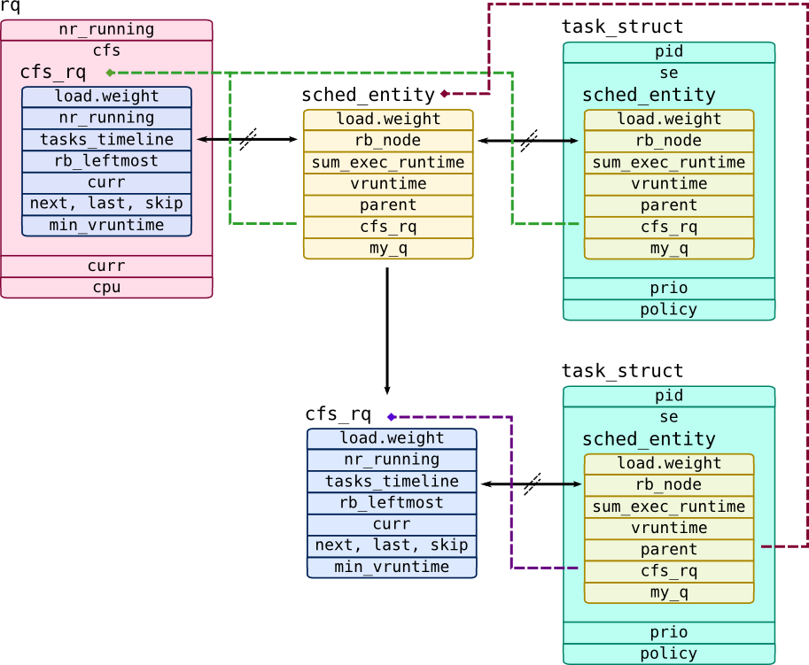
CFS implementation

Slide 211
CFS implementation
CFS's task picking logic is based on this p->se.vruntime value
It always tries to run the task with the smallest p->se.vruntime value (i.e., the task which executed least so far)
The left most node of the scheduling red-black tree is chosen and sent for execution
If the process completes execution, it is removed from the system and scheduling tree
If the process reaches its maximum execution time or is otherwise stopped it is reinserted into the scheduling tree based on its new spent execution time
The new left-most node will then be selected from the tree, repeating the iteration

Slide 212
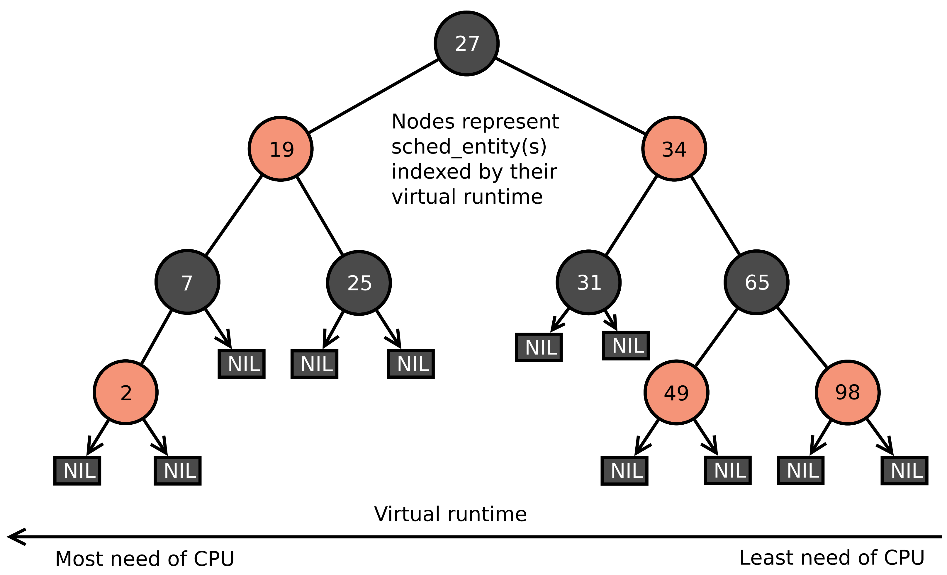
CFS implementation

Slide 213
CFS implementation
https://www.kernel.org/doc/Documentation/scheduler/sched-design-CFS.txt
https://elixir.bootlin.com/linux/v4.5/source/include/linux/sched.h#L1250
https://elixir.bootlin.com/linux/v4.5/source/include/linux/sched.h#L1389
https://elixir.bootlin.com/linux/v4.5/source/kernel/sched/fair.c#L5334
https://elixir.bootlin.com/linux/v4.5/source/kernel/sched/fair.c#L3314
https://elixir.bootlin.com/linux/v4.5/source/kernel/sched/fair.c#L534
https://elixir.bootlin.com/linux/v4.5/source/lib/rbtree.c#L450

Slide 214
Backup slides

Slide 215
context switch in linux
https://elixir.bootlin.com/linux/v4.5/source/kernel/sched/core.c#L2766
https://elixir.bootlin.com/linux/v4.5/source/arch/ia64/include/asm/switch_to.h#L60
https://elixir.bootlin.com/linux/v4.5/source/arch/x86/kernel/process_64.c#L273

Slide 216
Stack
Stack
Stack
Process X user memory
Process Y user memory
Process Z user memory
Stack
Stack
Stack
tss->esp0
TSS of CPU i
task_struct
task_struct
task_struct
Process X kernel stack and task_struct
Process Y kernel stack and task_struct
Process Z kernel stack and task_struct
Kernel memory

Slide 217

#1 – kernel stack after any system call, before context switch
prev
ss
esp
eflags
cs
eip
orig_eax
es
ds
eax
ebp
edi
esi
edx
ecx
ebx
User Stack
…
User Code
TSS
…
…
tss->esp0
Schedule() function frame
esp
Saved on the kernel stack during transition to kernel mode by int80 and by SAVE_ALL macro
task_struct
thread.esp0

Slide 218
#2 – stack of prev before switch_to macro in schedule() func
prev
…
Schedule() saved EAX, ECX, EDX
Arguments to contex_switch()
Return address to schedule()
TSS
Old (schedule’s()) EBP
…
tss->esp0
esp
task_struct
thread.eip
thread.esp
thread.esp0

Slide 219
#3 – switch_to: save esi, edi, ebp on the stack of prev
prev
…
Schedule() saved EAX, ECX, EDX
Arguments to contex_switch()
Return address to schedule()
TSS
Old (schedule’s()) EBP
…
tss->esp0
ESI
EDI
EBP
esp
task_struct
thread.eip
thread.esp
thread.esp0

Slide 220
#4 – switch_to: save esp in prev->thread.esp
prev
…
Schedule() saved EAX, ECX, EDX
Arguments to contex_switch()
Return address to schedule()
TSS
Old (schedule’s()) EBP
…
tss->esp0
ESI
EDI
EBP
esp
task_struct
thread.eip
thread.esp
thread.esp0

Slide 221
#5 – switch_to: load next->thread.esp into esp
prev
next
…
…
Schedule() saved EAX, ECX, EDX
Schedule() saved EAX, ECX, EDX
Arguments to contex_switch()
Arguments to contex_switch()
Return address to schedule()
TSS
Return address to schedule()
Old (schedule’s()) EBP
Old (schedule’s()) EBP
…
tss->esp0
…
ESI
ESI
EDI
EDI
EBP
EBP
esp
task_struct
task_struct
thread.eip
thread.eip
$1f
thread.esp
thread.esp
thread.esp0
thread.esp0

Slide 222
#6 – switch_to: save return address in the prev->thread.eip
prev
next
…
…
Schedule() saved EAX, ECX, EDX
Schedule() saved EAX, ECX, EDX
Arguments to contex_switch()
Arguments to contex_switch()
Return address to schedule()
TSS
Return address to schedule()
Old (schedule’s()) EBP
Old (schedule’s()) EBP
…
tss->esp0
…
ESI
ESI
EDI
EDI
EBP
EBP
esp
task_struct
task_struct
$1f
thread.eip
thread.eip
$1f
thread.esp
thread.esp
thread.esp0
thread.esp0

Slide 223
#7 – switch_to: save return address on the stack of next
prev
next
…
…
Schedule() saved EAX, ECX, EDX
Schedule() saved EAX, ECX, EDX
Arguments to contex_switch()
Arguments to contex_switch()
Return address to schedule()
TSS
Return address to schedule()
Old (schedule’s()) EBP
Old (schedule’s()) EBP
…
tss->esp0
…
ESI
ESI
EDI
EDI
EBP
EBP
esp
$1f
task_struct
task_struct
$1f
thread.eip
thread.eip
$1f
thread.esp
thread.esp
thread.esp0
thread.esp0

Slide 224
#8 – __switch_to func: save the base of next’s stack in TSS
prev
next
…
…
Schedule() saved EAX, ECX, EDX
Schedule() saved EAX, ECX, EDX
Arguments to contex_switch()
Arguments to contex_switch()
Return address to schedule()
TSS
Return address to schedule()
Old (schedule’s()) EBP
Old (schedule’s()) EBP
…
tss->esp0
…
ESI
ESI
EDI
EDI
EBP
EBP
esp
$1f
task_struct
task_struct
$1f
thread.eip
thread.eip
$1f
thread.esp
thread.esp
thread.esp0
thread.esp0

Slide 225
#9 – back in switch_to: eip points to $1f instruction label
prev
next
…
…
Schedule() saved EAX, ECX, EDX
Schedule() saved EAX, ECX, EDX
Arguments to contex_switch()
Arguments to contex_switch()
Return address to schedule()
TSS
Return address to schedule()
Old (schedule’s()) EBP
Old (schedule’s()) EBP
…
tss->esp0
…
ESI
ESI
EDI
eip
EDI
EBP
1:
esp
EBP
task_struct
task_struct
$1f
thread.eip
thread.eip
$1f
thread.esp
thread.esp
thread.esp0
thread.esp0

Slide 226
#10 – switch_to: restore esi, edi, ebp from the stack of next
prev
next
…
…
Schedule() saved EAX, ECX, EDX
Schedule() saved EAX, ECX, EDX
Arguments to contex_switch()
Arguments to contex_switch()
Return address to schedule()
TSS
Return address to schedule()
Old (schedule’s()) EBP
Old (schedule’s()) EBP
…
tss->esp0
…
esp
ESI
EDI
EBP
task_struct
task_struct
$1f
thread.eip
thread.eip
$1f
thread.esp
thread.esp
thread.esp0
thread.esp0

