Slide 1
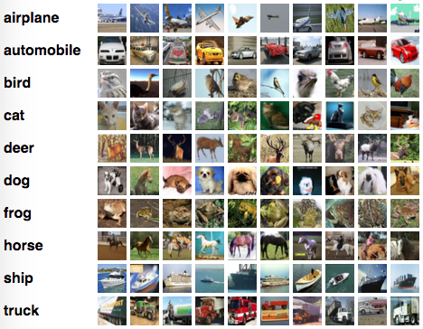
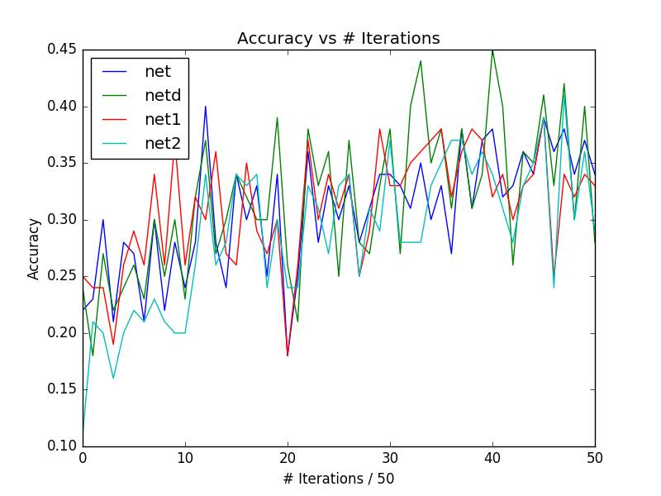
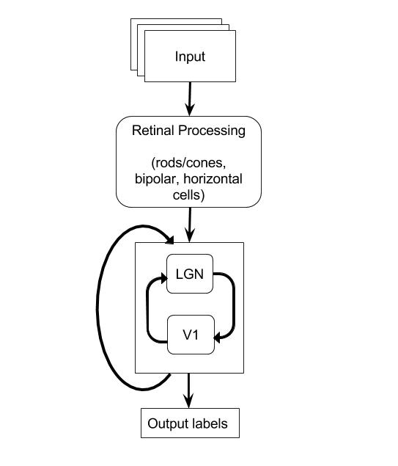
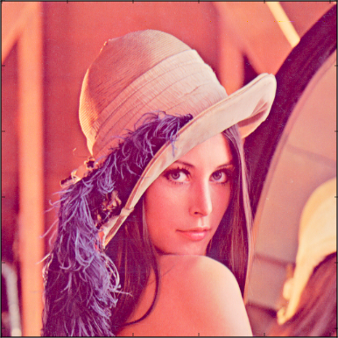
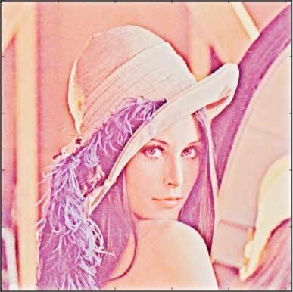
Investigating Feedback Loops between a Simulated V1 and LGN
Garrett Thomas, Mariah Rogers, Sayan Gul, Mukunda Satchidanand, Travis Dickey
Abstract
Process
Results
We were aware that there is a feedback loop between the Visual Cortex and the LGN (Lateral Geniculate Nucleus), where some of information from the V1 is sent back to the LGN. We wanted to investigate what effect this feedback loop might have on the visual processes that occur in V1, and did this by simulating said loop in the form of a neural network. Our preliminary findings were inconclusive, although we’re still testing this loop on better datasets.
Our initial task is doing basic object recognition. We used CIFAR-10 dataset for this purpose. This dataset contains small 32x32x3 images labeled with one of the 10 different classes.
In investigating the role of feedback loops in the visual pathway, we used the model outlined below:
The results are very noisy between different iterations, however, we can observe a general upwards trend. Preliminary results are inconclusive about the role of feedback loops in improving the accuracy of object recognition.
Background
The retina is a light-sensitive layer of tissue in the eye, containing in photoreceptor cells called cones and rods, which mediate color and black-and-white vision, respectively. The signals from the photoreceptor cells are sent to the LGN(Lateral Geniculate Nucleus), a sensory relay nucleus on the thalamus, through a series of layers of cells. At the LGN, P(Parvocellular) and M(Magnocellular) cells recognize color/edges and depth/motion, respectively. After all of these attributes of an image are determined, information (mostly from the P cells) is sent to the primary visual cortex.
We used an OpenCV module, bioinspired, in order to transfer raw image data into what the parvo stream would output for those images.
Further Experimentation
Original
Parvo
We would like to use larger images in the future, for the sake of time, we have been using 32x32 pixel images - it is possible that the size of the image is not allowing for optimal results. It is thought that the connections between the V1 and the LGN de-noise the images, we think that additional layers between them might be useful in achieving this and helping with object recognition. We would also like to use a deeper network by adding additional pooling and fully connected layers on top of the V1 layers to allow for better object recognition. We would also want to analyze the neural networks by studying their weights and try to determine their meaning. Fixed weights from other networks might be useful in improving upon our V1 layers. Due to our implementation's utilization of Recurrent Neural Networks, sequential experiments are in order. A logical next step might be object recognition in a video, this would allow us to use our recurrence more effectively.
We then fed the transformed images as input into neural networks with different architectures with layers corresponding to LGN, and layers of V1, and an ouput layer. We ran several different versions of these architectures that differed in the feedbacks they utilized. We can list these 4 different architectures we have tried so far as:
Net - Feedback loops between LGN-first layer of V1, and first-second layers of V1
NetD - No feedback loops
Net1 - Feedback loop between LGN-1st
Net2 - Feedback loop between LGN-2nd
These nets were then trained to recognize the images' labels. We then compared the results from these different architectures in order to better understand how the recurrence impacted the net's accuracy.
The V1 area of the brain, part of the ventral stream in the visual pathway, receives input from the parts of the Lateral Geniculate Nucleus that sends input to the ventral pathway. The V1 area also sends information back to the Lateral Geniculate Nucleus, and it’s unclear why.

