Slide 1
Deep Scheduling
By Deep (Ratnadeep Bhattacharya); Scheduled
Internet of Things – Systems and Security
Spring 2020, Dr. Gabriel Palmer

Slide 2
Problem Introduction
There’s always one around!

Slide 3


Load Balancing With A Single Source
Where should the next request go?
Trivia: Can you think of an English word where the letter `q` is followed by a letter other than `u`?
Load Balancer
Nodes

Slide 4
Words Starting With qi And qo
Qoph – The 19th letter of the Hebrew alphabet
Qanat – An ancient irrigation system developed in Persia
Qabala – A body of mystical teachings of rabbinical origin
Qindar – Albanian currency
Qadi – A judge in a Muslim community
Qi – A variant of chi
Qat – A variant of the plant khat
Qiviut - The soft wool lying beneath the long coat of the musk ox

Slide 5
Join the Shortest Queue (JSQ)
JSQ is a popular load balancing algorithm.
A 2007 paper “Analysis of join-the-shortest-queue routing for web server farms”, Gupta et al studied JSQ as a queuing problem and concluded that:
JSQ is insensitive to work size distribution (how long will the job take)
It’s unlikely for another algorithm to do better by more than 10%
Should we give up?
Notes:
https://blog.acolyer.org/2014/10/23/analysis-of-join-the-shortest-queue-routing/
http://www.cs.cmu.edu/~harchol/Papers/peva07.pdf

Slide 6
Multiple Source? Heterogeneous Nodes?
Where should the next request go?
Hint: Not a trivial issue
Pointer: Think whether “express checkout” lines or equivalently “less than x item” lines at retail outlets actually work?
Nodes
Load Balancers

Slide 7
What’s this to IoT?
Why am I talking about this in an IoT class?

Slide 8
How To Respond Fast In An Emergency?
Imagine there are several people wearing smart watches and carrying smart phones in a room and an IoT edge device that connects to various cloud infrastructure.
There is a notorious criminal, in the room, about to commit a ghastly act!
The edge device runs a program that can:
identify the criminal by some biometric or other indicators.
choose to use any compute cluster consisting of the watches, phones or cloud infrastructure to do so.
However, while this nifty program runs, racing against time, it needs to avoid panic and thus cannot significantly choke other applications.

Slide 9
An Intuitive Result from Queuing Theory
It’s really simple!

Slide 10
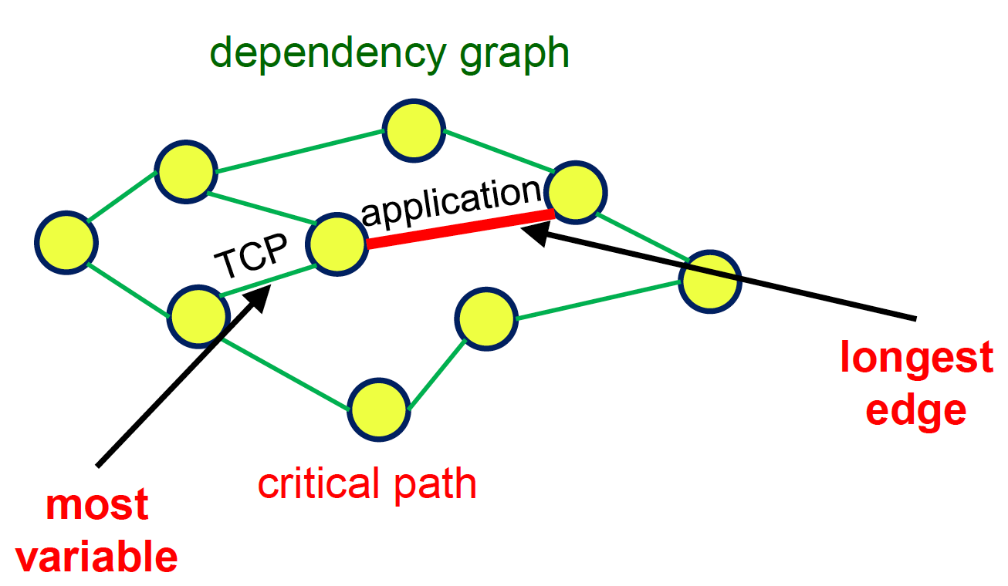
Variability
How would we ensure that end-to-end latency stays within some upper bound?
Hint: Think how the data moves through the critical path. What can be changed easily?
Pointer: Can we reduce the latency upper bound by reducing latency at each stage?
Notes:
http://2019.middleware-conference.org/assets/mw19_tutorial1.pdf

Slide 11
A teeny bit of Reinforcement Learning
I promise to make it fast!

Slide 12
What The Value!
-1 | 5 | 4
7 | 6 | -10
2 | -3 | 200
D, 6 | R,5 | D,4
L,7 | L,1 | D,190
U,7 | R,197 | 200
State-value function
What is the maximum reward that can be obtained starting from this state and following some pre-defined policy?
Action-value function
What is the maximum reward that can be obtained starting from this state, by taking this action and then following some pre-defined policy?

Slide 13
Q-Learning
Walk through each state (cell in a maze) of the problem
Find the best action at each state that will lead to the highest possible reward
Reward is based on an estimate of what can be achieved
Deep Q Learning (DQN) is simply when the action to be taken is decided by a neural network.

Slide 14
Episodic vs Continuous
The maze problem in the example is what is known as an episodic task.
There is a clearly defined end state
Once that end state is reached, the episode is over
Load balancing, on the other hand, is a continuous task.
There are desired states
Once such a state is reached, the system needs to stay in that state
Q-Learning is designed for episodic problems.
For continuous problems, actor-critic methods are more suitable

Slide 15
Research Goals
It all started when …

Slide 16
Bin Packing? Nah!
Most work looking at using RL in scheduling/load balancing use RL to solve a bin packing problem.
However, that involves dealing with each request individually.
But essentially, what we are trying to do is find out which server is likely to serve a particular class of request (think job size) in the shortest time.
Thus, I am using weighted round robin to do the actual load balancing and using DQN to figure out the weights for the servers for each request type.

Slide 17
Weighted Round Robin
It is a ratio of how many requests to send where!
In case of the orange requests, the top node handles more than the middle node and the middle node handles more than the bottom node.
For the green requests, they will be equally divided.
(5, 1, 3)
(3, 1, 5)
(1, 1, 1)

Slide 18
Experimental Setup
Hey! Hold on! Didn’t I just say this system is pretty much solved!
Think generalization!
Multiple load balancers can submit to the WRR queue.
End nodes can be containers which might be experiencing different resource pressures even if deployed from the same image.
(5, 1, 3)
(3, 1, 5)
(1, 1, 1)

Slide 19
Making Things Easier!
Keep the state-space finite (State aggregation)
This allows to treat multiple states as a single class
Also allows to generalize from observed behavior to behavior not seen yet
Keep the action-space finite (weights in WRR)
5 – high load; 3 – medium load; 1 – low load
Using prime numbers makes it slightly easier to prevent duplicate action
For example, (1, 1, 2) and (2, 2, 4) are exactly the same action
We still need to watch out for (1, 1, 1) and (5, 5, 5) or (1, 1, 5) and (3, 3, 5)

Slide 20
Some Theory
After all, we do need a little!

Slide 21
Tardiness
I am treating this system as a soft real time system.
Thus it is allowed to miss deadlines.
Tardiness is the maximum time by which deadline was missed.
tardiness := max[0, (t - d)]
t => total time spent in the system by a job
d => deadline for the process.
Notes:
https://github.com/gwu-iot/20_deep_scheduling/blob/master/plan.pdf

Slide 22
Phase I
How does the data look!

Slide 23
There Are Other Intricacies
Ok so I want to reduce variability. But how should variability be defined?
So I looked at the system under significant load for hours and collected all kinds of data. Namely:
How many requests are currently queued on the load balancer?
Response time – for the server for the request type
So on.
Note: All the data was collected without querying any of the nodes; only the load balancer.

Slide 24
Gauss To The Rescue
I clustered the data into discrete states
Two major reasons for this:
One, it allowed to define variability very nicely in a generic and reusable manner.
Secondly, it allows generalization of the states – i.e. states are put into buckets and these buckets are associated with a variation and a reward.
The states were arranged into buckets using Gaussian Mixture Models (GMM).

Slide 25
Why Gauss, Why!
GMMs are a clustering model that allows a little more flexibility in bucketing states than simpler models like K-Mean Square (KNN).
Another interesting method would have been Density-based Spatial Clustering of Applications with Noise (DBSCAN).
However, this methods needs deeper inspection of the data.
GMM acts as a function that aggregates the states together. Such aggregation associates a distribution with each state and thus a natural definition of statistics like mean and standard deviation.

Slide 26
What’s the reward?
Cluster all observed states into classes
Compute the mean and variability of the class.
Compute the spread of response times in each class assuming a Gaussian spread (we did use GMM for clustering)
Spread = mean + 3 * standard deviation
Rank each class according to its spread; higher the spread, higher the rank
The reward for each class is simply the negative of its rank
For more details look at the `plan` pdf on the project’s GitHub repo
Notes:
https://github.com/gwu-iot/20_deep_scheduling/blob/master/plan.pdf

Slide 27
Phase II
Is this worth the effort!

Slide 28
Walk in the Park
Park (GitHub and paper link below) is an open source project that attempts to reproduce OpenAiGym like environments for systems researchers.
They have a “load balance” environment
This is a simulation of 10 heterogeneous service with vastly different service rates being fed by a single load balancer.
The environment runs the algorithm for 1000 steps and gives a final reward
Pure bin packing problem!
Notes:
https://papers.nips.cc/paper/8519-park-an-open-platform-for-learning-augmented-computer-systems.pdf
https://github.com/park-project/park
https://github.com/park-project/park/tree/master/park/envs/load_balance

Slide 29
What’s the reward here?
The load balance environment in Park provides a reward at each step (think discrete time ‘n’)
Reward is defined as the negative time elapsed for each job in the system since last action.
For example, the time was 0 for the last action, 4 jobs were in the system.
Job 1 finished at time 1, job 2 finished at time 2.4 and job 3 and 4 are still running at the next action at time 5.
Then the reward is - (1 * 1 + 1 * 2.4 + 2 * 5) - (waiting + processing) time for all jobs.

Slide 30
I Got JSQ Beat Hands-down!
I built three algorithms in this environment
Join the Shortest Queue (JSQ)
Very simple; very effective – Jackie Chan of algorithms
Deep Queue Learning (DQN)
Uses two neural networks
Significantly better performance than JSQ (needs more verification)
Advantage Actor-Critic (A2C)
Two full blown neural networks; with different learning rates; one criticizing the other – think “Inception”
This is still in the works!

Slide 31
The Algorithms
Battle of the Robots!

Slide 32
Deep Q Learning (DQN)
DQN uses two neural networks
The q-network
The target-network
The target network looks at a new state and tells the agent what action to take.
These states are stored in memory.
The q-network trains itself with these.
At the end of training, the q-network weights are transferred to the target-network.

Slide 33
Advantage Actor-Critic (A2C)
Again, there are two neural networks.
The actor-network
The critic-network
The actor network selects an action and the critic network tells how good the action was.
This means that the critic network needs to train faster than the actor network.
The advantage is that A2C can handle both continuous (read infinite) state space and continuous action-space, unlike DQN.

Slide 34
Phase III
Putting it all together!

Slide 35
This Is Really Hard!
State detection
Run the load generator
Built it from scratch
Generates completely random load
Based off wrk
Get the data and cluster the observed states
Associate a reward (negative) with each state
Run the algorithm
Train the neural network to generate better actions
Predict action for next step

Slide 36
The Nightmare!
The things that need figuring out!

Slide 37
How Many Buckets?
The difference between GMM and DBSCAN, in terms of parameterization of the algorithms, is that one either needs to decide how many clusters make sense (GMM) or how close together the data is (DBSCAN)!
In my experiment, there are 3 servers and 3 request types. So I chose 3^3 = 27 clusters. This is an arbitrary choice.
I really didn’t want to spend half a semester figuring out how close the data points are.
Furthermore, if you shift from GMM to DBSCAN, the gaussian assumption becomes invalid; so reward needs to be redefined.

Slide 38
Action Space Blows Up
3 servers for each request class; 3 request classes
3*3 = 9 positions
3 choice of weights for each server
Thus, 3 choices for each position
That is equal to 3^9 possible weight combinations; after eliminating duplicates there are 1120 choices (between 3^6 and 3^7).
Don’t ask me how! I did not get the math all worked out. And I am not sure I understand the code anymore!

Slide 39
Tensorflow Piles On!
How do we get the neural network to output 9 digits corresponding to the 9 different weights?
Have not figured this one out
The other option is to use an output layer where the number of neurons is equal to the cardinality of the action space.
If the output from the 10th neuron is maximum, then we choose the 10th weight combination.
In our simplistic case that number is 1120.

Slide 40
To Network Or Not To Network!
The problem at this stage is how to put the software together?
Do I place components all over the place?
Or do I put them all together as a monolith?
I decided on the latter because I wanted to save the trouble of networking everything together.
But now the meat of my software is in a file containing 400+ lines of extremely convoluted Python using non-standard libs
And it does not work!

Slide 41
Possible Future Directions
Do math or write code?

Slide 42
Theory or Practice?
Queuing Theory approach:
We can generalize the conditions from the 2007 paper and see if the results still hold.
Reinforcement Learning approach:
“Real Time Scheduling Via Reinforcement Learning Paper” is a great paper to look at for ideas to expand on that work.
Experimental Approach
Conduct experiments to figure out the parameters
What happens when the requests have different priorities?
What happens if WRR is replaced with Weighted Least Requests or Weighted Response Time?
Notes:
https://event.cwi.nl/uai2010/papers/UAI2010_0078.pdf

Slide 43
End Notes
It’s all about rewards!

Slide 44
Rewards is an Amazing Concept
Rewards is a core RL concept, but it can be used for evaluation.
It can provide immediate numerical comparison between two algorithms, even outside the scope of reinforcement learning.
Rewards can encapsulate different attributes of comparison:
Are we looking to reduce variability?
Are we looking to reduce mean response time?
However, it also means that rewards need to be carefully designed.
But it is easier to fix reward definition than to redesign an experiment.

Slide 45
summary
Generalized load balancing under heterogeneous conditions and multiple source of load
Phase I: State aggregation and statistic extraction
Phase II: Testing the idea in a simulator on a bin packing problem and comparing performance to JSQ
Phase III: Working on putting it all together.

