Slide 1
CSci 3410:
Systems Programming
Gabe Parmer

Slide 2
Gabe

Slide 3
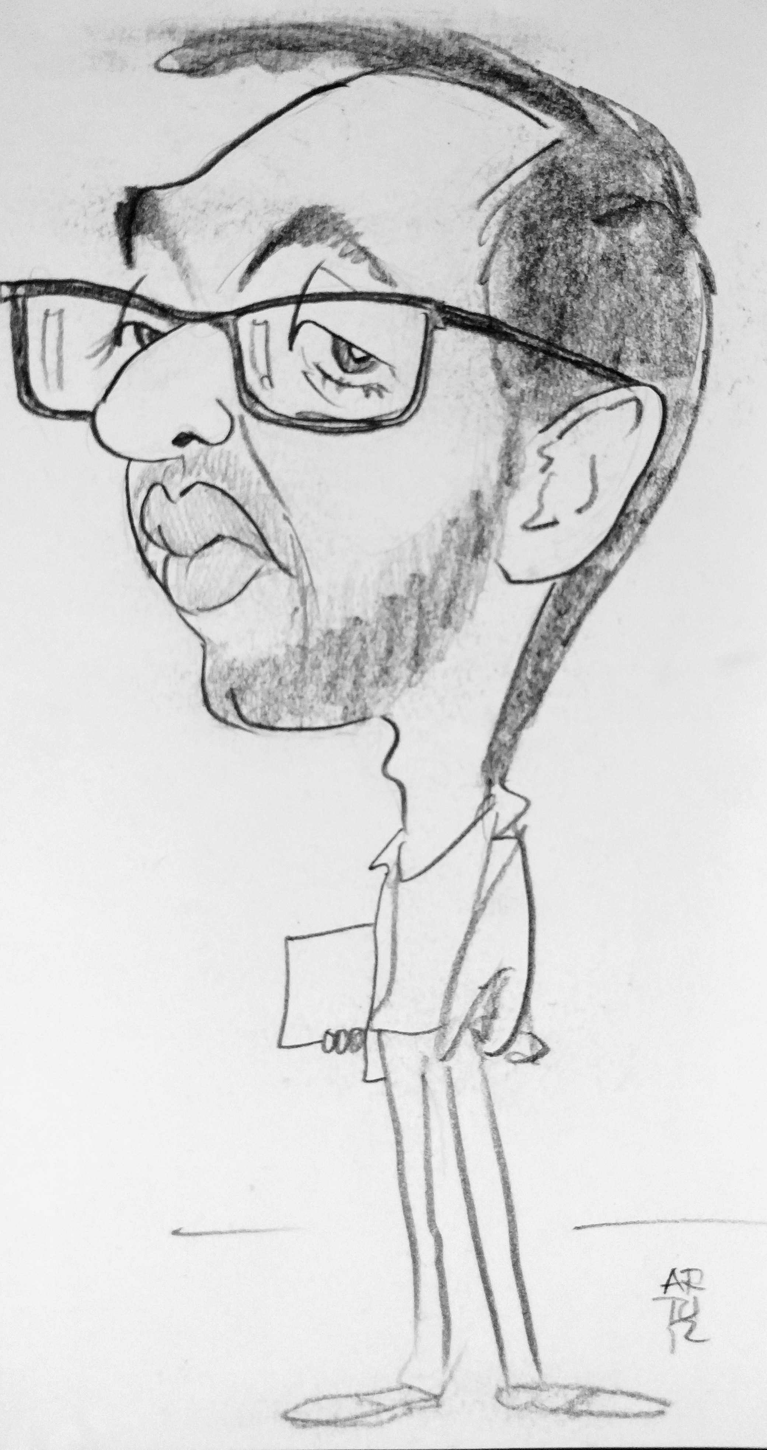
Gabe
blahblahblahSystemsblahblahblahOSesblahblahblahAbstractionsblahblahblah

Slide 4
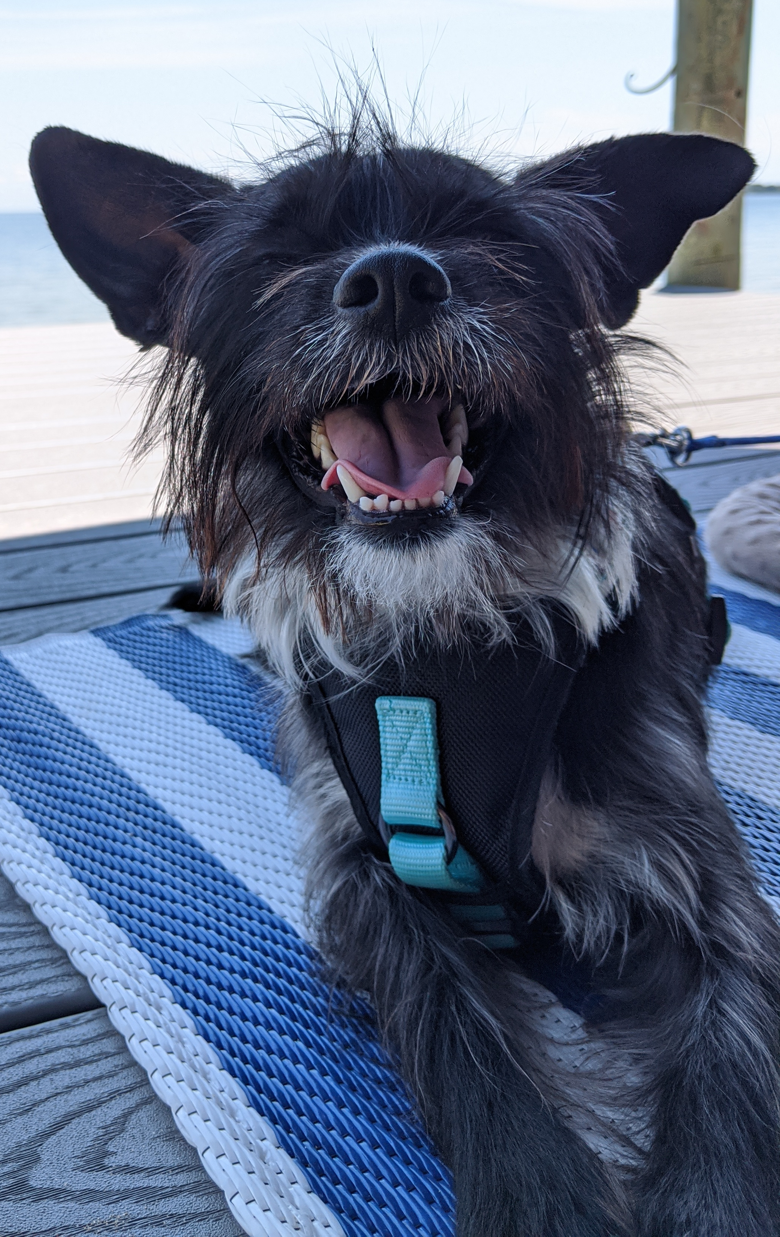
Gabe
Ruff

Slide 5
Gabe
TAs:
Sreya Nalla (Sr.)
Graham Schock (Sr.)
Bite Ye (5y MS)

Slide 6
Where?
See course webpage!
  Syllabus – HWs, Labs, OHs, etc…
Forget the URL?
  google “gabriel parmer”
  > “Teaching” tab
  > “Systems Programming”

Slide 7
Class Setup
Class lectures – SEH, gwu-cs-sysprog.github.io
Class Labs – SEH, bring laptop, group work
Communication –
  Discord (sync short form),
  Piazza (async, longer questions)
Homeworks – github & ubuntu-vlab01.seas.gwu.edu
Signup for Piazza, find TODO post (discord, survey, HW0...)

Slide 8
Lectures
Normal, in-person lectures
  Come with your brain, and your enthusiasm
  Interrupt and ask questions at any point
  Active engagement required! Participation points.
Group tasks
  In class/lab – smaller C programs

Slide 9
Labs
Goal: boot you up to be able to accomplish the homeworks!
Mandatory
  quizzes
Some of the best UTAs I could ever ask for
  Don’t ask them about grades
  Treat them with respect

Slide 10


Homework
Goal: Demonstrate ability to apply knowledge
Homeworks: HW0-6 across 13 milestones, 1/week
  Individual
  No code sharing
  Idea sharing/discussion
Schedule/Deadlines – HWs due Mondays
  See webpage
  Note: EC for not procrastinating, EC lowest milestone grade
  Office hours: Tuesday through Friday (not Mondays!)

Slide 11
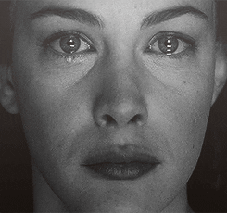
Tests/Quizzes
Goal: Demonstrate understanding of material
Weekly, multiple choice, 5 min quizzes on class/lab material
Final during final period

Slide 12
Instructional Staff Goals
Deliver a curriculum that is
  challenging,
  best prepares you, and
  gives you broad context.
We’re here to enable your success
We’re still in a challenging situation, so if you have any complications, just let me know
  exposure + vaccine = test ASAP
  pervasive masks indoors

Slide 13
? || /* */

