Slide 1
Fun With Interaction Features – VW Meetup 2015.12.16

Slide 2
Agenda
Introduction - What makes model good ?
Vw options for interactions / feature engineering
Low rank quadratic – in nutshell
Some data / demo with Movie-lens dataset (for –lrq option)

Slide 3

What Makes Model (Regression / Classification) Good ?
Data (no brainer?)
Hyperparameters Tuning?
Features?
(first step - Just throw data at vw / model)
Models only as good as their features
Good features?
Interactions
Low rank features / factorization machines
GBDT
….

Slide 4
Vw Options For Modeling Interactions
-q (pairwise interactions)
vw -d data.vw -q nn
-q ::
-cubic (cubic interactions)
vw -d data.vw --cubic nnn
-interactions / permutations
-stage_poly
Vw –d data.vw –stage_poly
-lrq
-lrqdropout
Manual / all feature interactions
DEMO
Selected interactions
Low rank quadratic interactions

Slide 5
Intelligent Interactions
Stage_poly (stagewise polynomial features)
Progressively create interactions of ‘important’ features
Vw –d data.vw –stage_poly --batch_sz 0 --batch_sz_no_doubling
--sched_exponent arg1 ( = 1.0)
How many features to update (s^arg1)
exponent controlling quantity of included features
--batch_sz arg2 ( = 1000)
When to update (if 0, features added only at end of a pass)
multiplier on batch size before including more features
--batch_sz_no_doubling
Gradually slow down adding features
batch_sz does not double
Agarwal et al, 2014, Scalable Non-linear Learning with Adaptive Polynomial Expansions, NIPS
https://github.com/JohnLangford/vowpal_wabbit/wiki/poly.pdf

Slide 6

A Word Of Caution
With interactions:
Model complexity / Number of parameters
E.g –q n1n2 will produce ^{n1}C₂
Data Sparsity
Pay extra attention to l, l1, l2
Mindful of hash collisions (-b)

Slide 7
LRQ - Are Simple Interactions Enough?
What if your data looks like this:
Objective : For a new user / movie estimate movie ratings
Simple linear model ?
Interactions ?
Cold starts ?
Common situation for recommendation systems (and many other problems where dataset is sparse)
4 4|user 5256 |movie 2321
4 4|user 4344 |movie 529
5 5|user 2380 |movie 1136
4 4|user 5501 |movie 991
2 2|user 482 |movie 2144
4 4|user 1209 |movie 2407
5 5|user 1650 |movie 858
5 5|user 788 |movie 3033
5 5|user 3145 |movie 2010
4 4|user 1135 |movie 3927
MovieLens Dataset
http://files.grouplens.org/papers/ml-10m-README.html

Slide 8
-lrq (And its variants)
Low rank quadratic
Factorization machines
Factorization machines (And Field aware)
Hot favorite At Kaggle competitions
Peter Norvig (Director Research, Google) picked “Rendel (2010)” as one of the most influential papers (http://blog.teamleada.com/2014/08/ask-peter-norvig/)
And vw has support for it:
-lrq, -lrqdropout, -lrqhogwild
Steffen Rendle (2010): Factorization Machines, in Proceedings of the 10th IEEE International Conference on Data Mining (ICDM 2010), Sydney, Australia

Slide 9
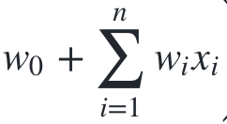
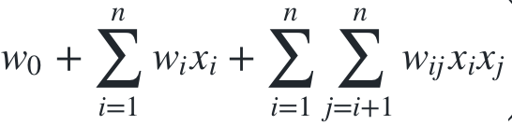
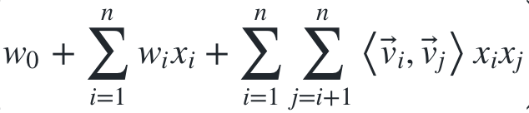
Low Rank Quadratic / FM – In Nutshell
Simple Linear model
(learn coeff for each feature)
Linear model with interactions
(learn coeff for each feature and pairwise interaction)
LRQ – Linear model with low rank quadratic
(learn coeff for each feature and lower dim vectors for each interaction)
Steffen Rendle (2010): Factorization Machines, in Proceedings of the 10th IEEE International Conference on Data Mining (ICDM 2010), Sydney, Australia

Slide 10
LRQ / FM Options For VW
Learn from ‘similar’ interactions (in dot product space)
Instead of learning weight for each interaction ‘independently’
Even if you haven’t seen interaction in data, its ok (as long as there is a similar interaction)
-lrq k
https://github.com/JohnLangford/vowpal_wabbit/blob/master/demo/movielens/README.md
-lrqdropout k
While training drop features with probability 0.5
While testing use all features with weight * 0.5
Equivalent of building many models and taking their geometric mean (https://www.cs.toronto.edu/~hinton/absps/JMLRdropout.pdf)
-lrqhogwild k
https://github.com/JohnLangford/vowpal_wabbit/wiki/lrq_hogwild.pdf

Slide 11
Keep In Mind..
New hyper-parameter – ‘k’ for rank of lower dimensional vectors
Non-convex loss function
Won’t work in non-online / batch setting
Sensitive to l2 regularization
Don’t use – normalized option
https://github.com/JohnLangford/vowpal_wabbit/wiki/lrq_hogwild.pdf

Slide 12
DEMO – Movielens
https://github.com/JohnLangford/vowpal_wabbit/tree/master/demo/movielens
Run ‘make shootout’ to run the demo

