Slide 1
Reinforcement Learning Using VW – VW Meetup 2016.07.28

Slide 2
Agenda
Reinforcement Learning
Introduction – the problem
MDP – Formalism
Solution Approaches
Where VW fits in?
Case-study of Gridworld
The problem
Solution approach / methodology
Challenges

Slide 3
Reinforcement Learning - Context
Google Deepmind Atari, AlphaGo etc.
DQN (Deep Q Network)
Atari 2600 games – http://arxiv.org/abs/1312.5602
Stanford self-flying helicopter
https://www.youtube.com/watch?v=M-QUkgk3HyE
Google Robotic farm, self driving cars, drones, humanoid assistants, AI chat bots …

Slide 4
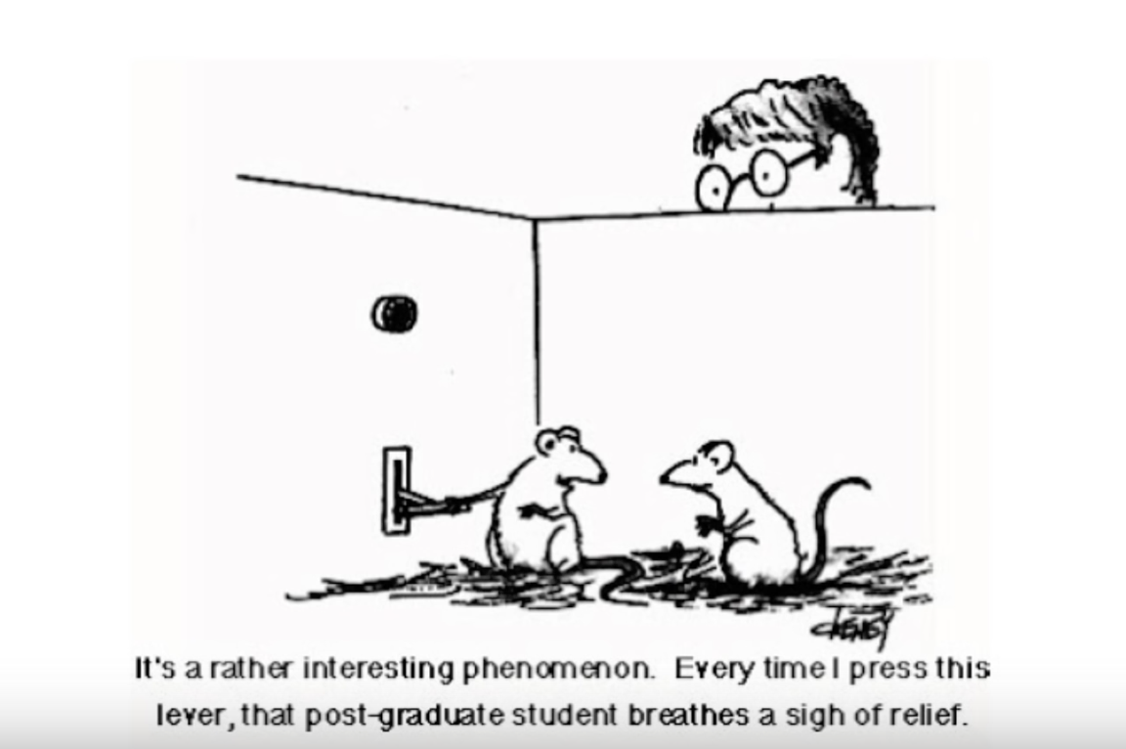
Reinforcement Learning
Reinforcement learning
Reward based learning inspired from psychology / neuroscience, animal learning
Training an agent to take actions in environment and receive rewards
Agent does legwork to collect training data
Unlike traditional ML approaches
Goal is to find policy (for agent) that maximizes rewards

Slide 5
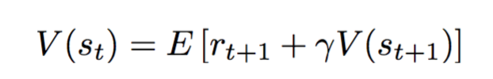

Reinforcement Learning – Key Ideas
Time – continuous, sequential interaction with environment
For supervised learning we throw out time
Issues of time delayed rewards / credit assignment problem!
(short term) reward and (long term) value
Pong: beating / losing AI single time vs winning game
Gridworld: not dying (after taking an action) vs winning game
Sampling (of state space)
Trial-and-error learning
Monte-Carlo rollouts, solution to huge state space e.g. for pong state-space (210x160)P3 !!!!
Explore – Exploit!, multi-arm bandits!
Bootstrapping (for long term estimate)
Use estimate of future reward (instead of waiting to observe actual reward)
Bellman equation / Q learning
Vs
Deconstructing Re-enforcement Learning – Richard Sutton (ICML 2009)

Slide 6
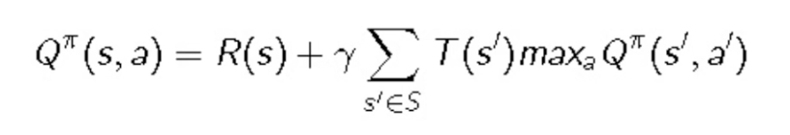
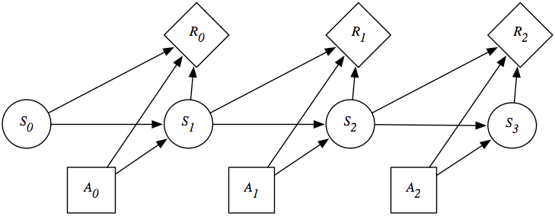
Markov Decision Processes – Model of Sequential Environments
Discrete, Observable states S (and state transition probability T)
Control over actions A (as opposed to Markov chains, HMM)
Scalar rewards R
Define long-term value
Find optimal behavior (policy): choose A_{t} = argmax Q(S_{t}, a)
T_{(s1)}
T_{(s2)}
T_{(s3)}
<S₀, A₀, R₀, S₁>
<S₁, A₁, R₁, S₂>
<S₂, A₂, R₂, S₃>

Slide 7

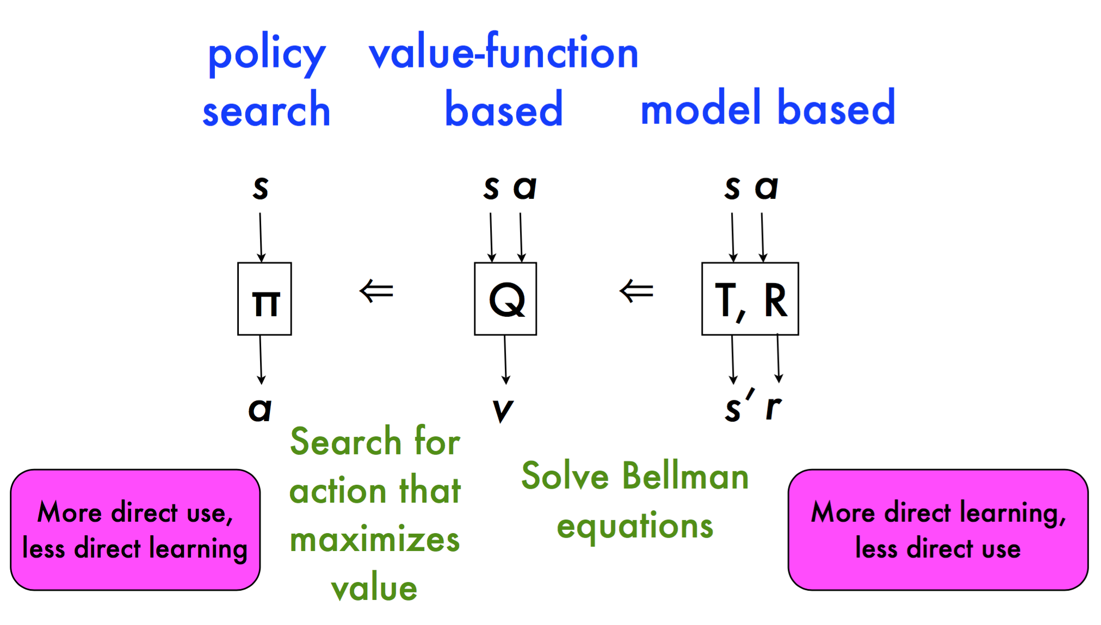
Reinforcement Learning – How To Solve MDP
RL – Family of Approaches
Model Based Re-enforcement Learning – Micheal Littman(NIPS 2009)

Slide 8
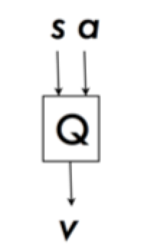
How to Make “Learning” work? VW – Where It Fits In?
Q (“quality of state”) function approximation?
Deep Q network estimates reward for each action for a state
Can simple (shallow) regressor fit the bill?
Estimate Q with online SGD, sparse representation of state-action interactions
Leverage DQN tricks
asynchronous multi-threaded learning
Batteries included, excellent python wrapper, suited for online learning (very lightweight)
Interaction options like nn, lrq, lrq-dropout, staged-poly, q and save resume..
VW

Slide 9
Consider Gridworld…
4 x 4 grid, 4 objects (player, wall, pit, win)
State space 16P4 (grid initializes randomly)
State - <player position, wall, death, win>
Action – [up, down, left, right]
Goal – reach the reward without dying
Trained vw agent should choose actions to eventually win

Slide 10
Gridworld - Simple To Train??
Consider Gridworld with 4 objects:
4 X 4 (43,680 states) – trained in 30 sec
5 x 5 (303,600 states) – trained in 3-5 minutes
6 x 6 (1,413,720 states) – trained in 8-10 minutes
7 x 7 (5,085,024 states) – trained in 4-6 hours
8 x 8 (15,249,024 states) -….
10 x 10 (94,109,400 states) .....
....
210 x 160 (for Atari pong / breakout etc!!)
Increasingly sparse rewards, bigger state-space

Slide 11
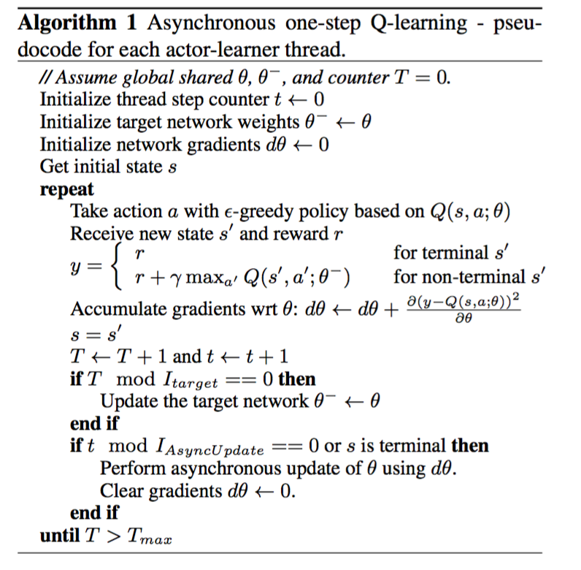
Methodology – Multi-threaded Asynchronous Learning (No Experience-replay anymore)
If vw model exists, get reward predictions for each action, choose an action with max reward
Train Global / shared VW
Mnih et el 2016, Asynchronous Methods for Deep Reinforcement Learning, Proceedings of the 33rd ICML, New York, NY, USA, 2016 (http://arxiv.org/abs/1602.01783)

Slide 12
Model and Example Feature Vectors
state namespace: one hot encoded pixels + one feature for a state
decision namespace: one hot encoded features for each action
low rank quadratic features
no need to model interactions explicitly
chance to work with partially observable states or huge state-spaces
Initially, responses for all feature vectors except terminal state are useless, eventually they get better
Discounted Future Reward (bootstrapped)
‘State’ namespace with one hot pixel features
‘decision’ namespace with one hot action feature
-1.206 1|state player-2-3 pit-2-2 wall-3-2 win-0-3 state_1276526537 |decision action_down
10 1|state player-1-3 pit-2-2 wall-3-2 win-0-3 state_1237197379 |decision action_down

Slide 13
Results So Far…
4x4 (95% wins, 4 latent factors, 8k epochs, 8 threads) vs random player 48%
5x5 (90% wins, 4 latent factors, 12k epochs, 16 threads) vs random player 36%
6x6 (90% wins, 8 latent factors, 30k epochs, 16 threads) vs random player 25%
7x7 (around 60% on 7x7, 40 latent factors, 100k epochs, 16 threads) vs random player 15%

Slide 14
Unsatisfying….
No goal oriented learning
learning is only about given state-action what is the quality of that pair
No transfer learning, no abstraction
once trained on 4x4 grid, cannot solve 5x5 grid (the opposite is true btw, just because state space is a subset)
Not learning policy directly (no parameterized policy)

Slide 15
Demo / Code
https://github.com/joshiatul/game_playing

Slide 16
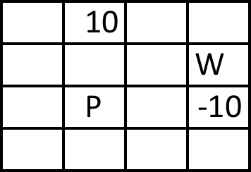
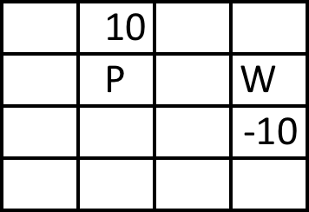
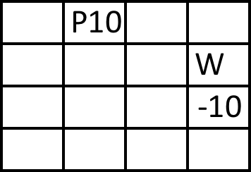
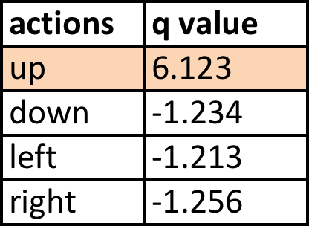
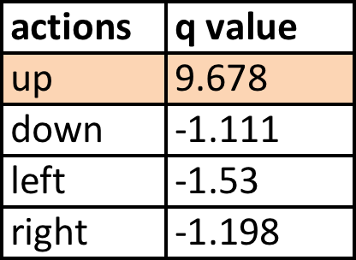
MDP After N Time-steps
Q = 6.234
Q = 9.678
-1
10
UP
UP
Chosen action ‘UP’ since Q value for this state-action pair is the highest (and epsilon is small)
Chosen action ‘UP’ since Q value for this state-action pair is the highest (and epsilon is small)

