Slide 1
Security and Privacy Perceptions of Third-Party Application Access for Google Accounts
David G. Balash, Xiaoyuan Wu, Miles Grant,
Irwin Reyes, Adam J. Aviv

Slide 2
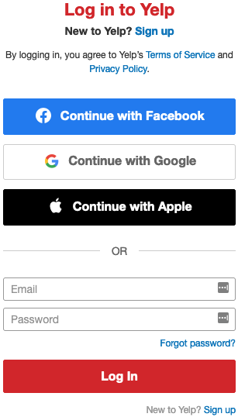
Notes:
Have you seen a login prompt such as this while browsing online?
And have you ever used one of these “Continue with” buttons to take advantage of their single sign on capability?
This is a popular and convenient way to leverage an existing account to share basic account information and login to various websites.

Slide 3
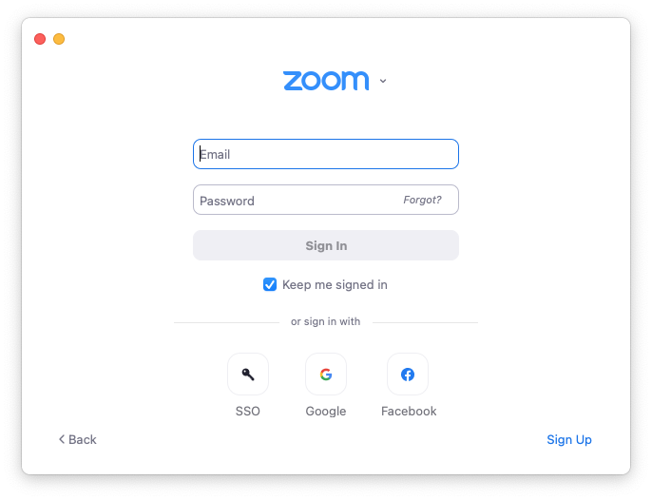
Notes:
There are similar SSO prompts on desktop applications such as Zoom.

Slide 4
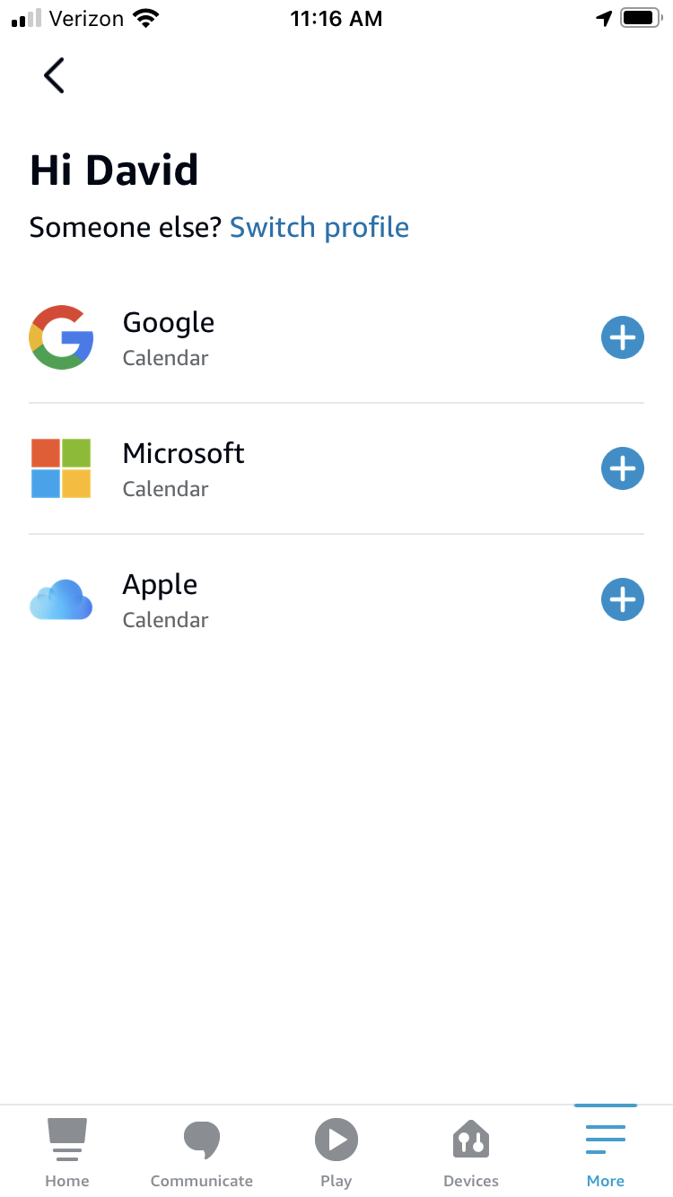
Notes:
And on mobile device apps such as Amazon Alexa.
The Alexa app is also authorized to connect to a calendar application programming interface, or API, to provide users with calendar notifications and the ability to create new calendar events.

Slide 5
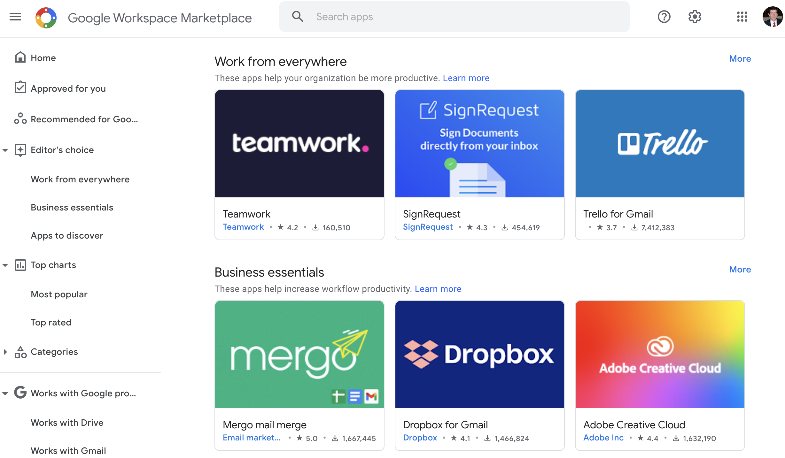
https://workspace.google.com/marketplace
Notes:
In fact, there’s a whole ecosystem of software products that request access to Google user data, like email and calendar apps, Google document editors that save to Google Drive, and Add-ons that work with Google Docs, Slides, and Forms.
This is the Google Workspace Marketplace, a convenient centralized repository of third-party apps that integrate with Google APIs.

Slide 6
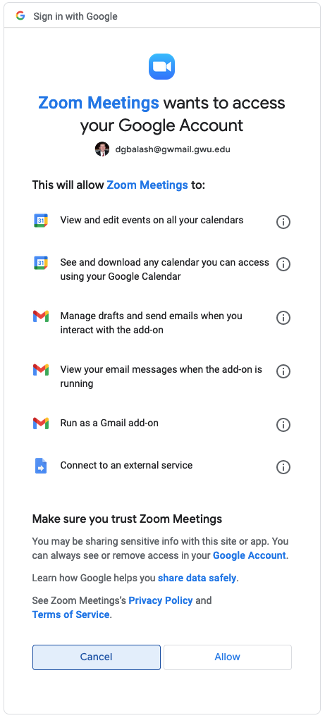
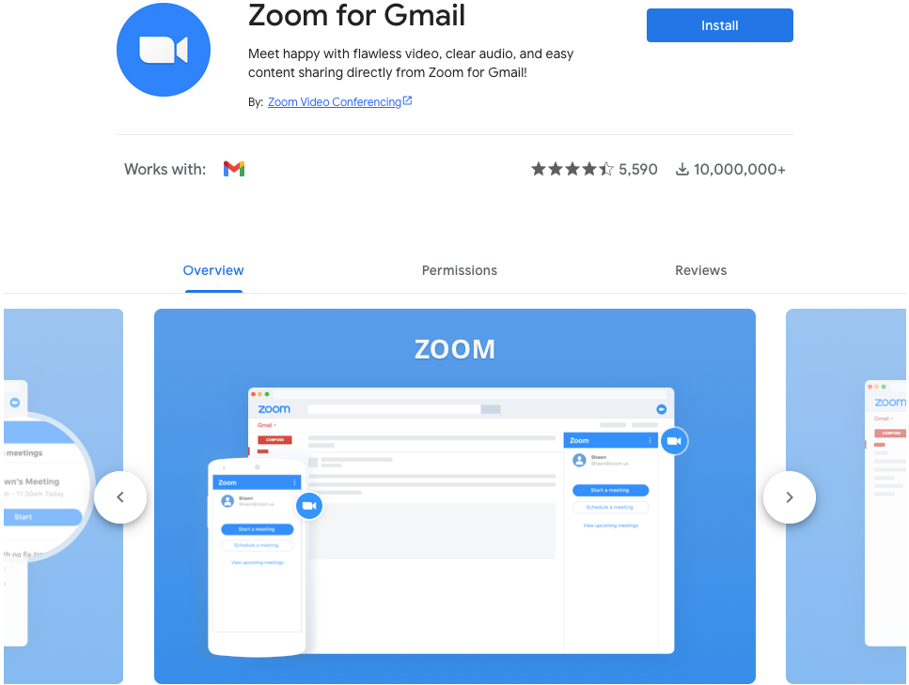
https://workspace.google.com/marketplace/app/zoom_for_gmail/585972765488
Notes:
When a user clicks to install a third-party app.
For example, the popular Zoom Meetings app.
They are presented with a Sign in with Google prompt.
This prompt details the account access permissions that this sign in is authorizing.

Slide 7
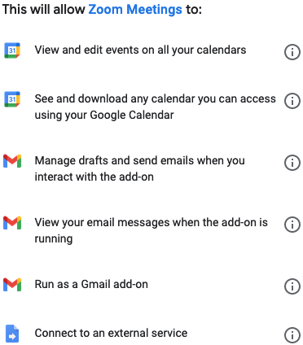
Notes:
Here we see that Zoom Meetings is requesting permission to access the Google Calendar API, the Gmail API, and to connect to an external service.

Slide 8






Notes:
Google offers numerous APIs that give third-party services and applications access to a user’s account data for tasks such as single sign-on (SSO),
calendar integration, and sending email on behalf of the user, among others.
This is just a small sample.
Despite the many benefits.
Granting programmatic access to one’s online account can pose security and privacy risks.

Slide 9
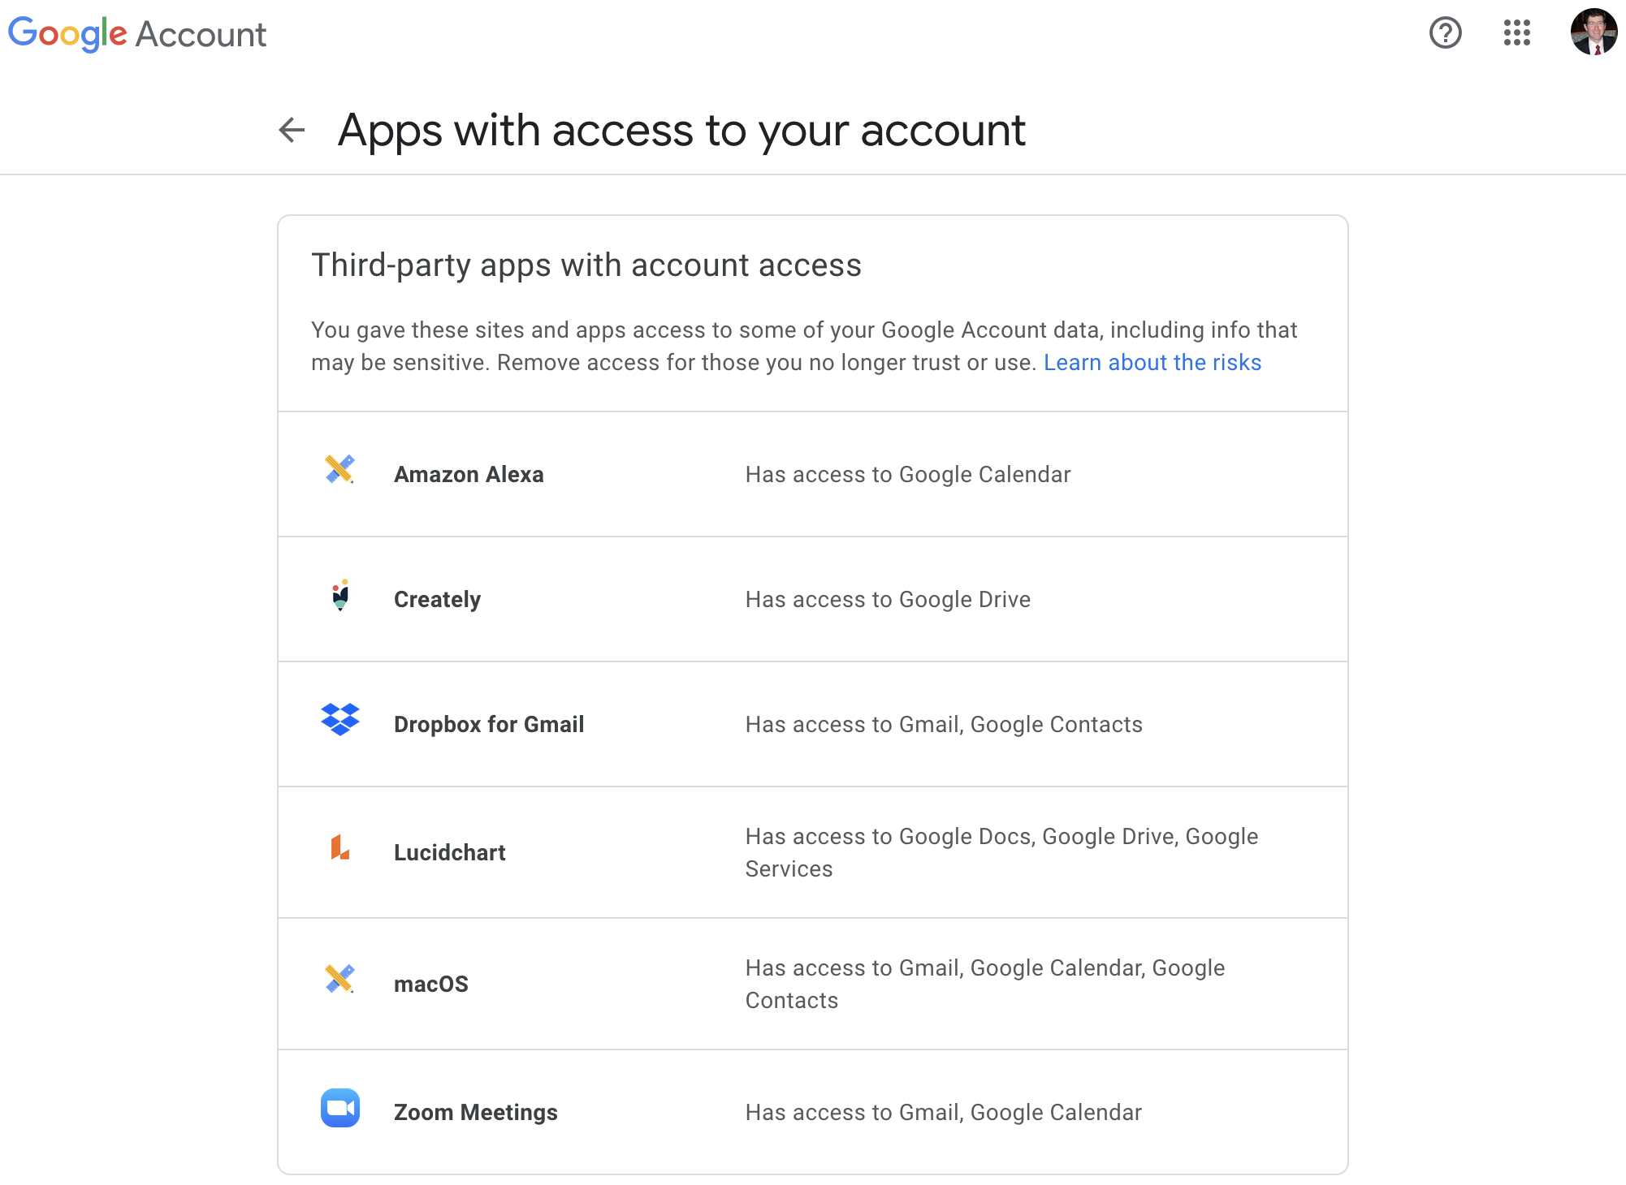
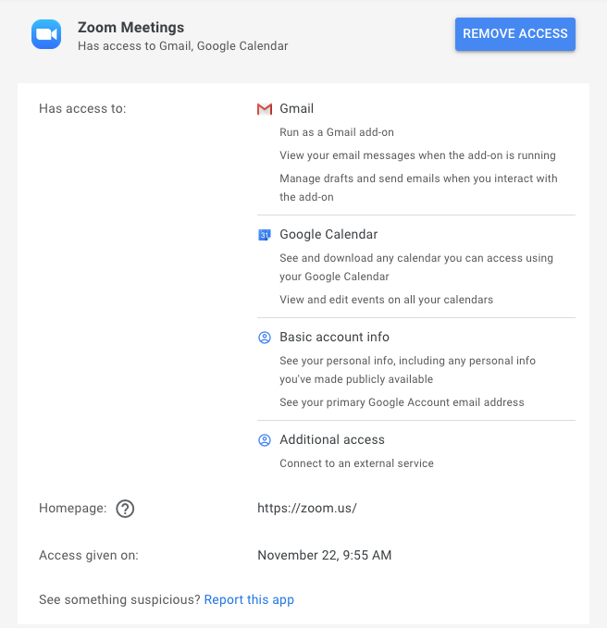
https://myaccount.google.com/permissions
Notes:
To help users manage existing apps with API access, Google provides the “Apps with access to your account web page”
This web page can be found under a user’s Google account settings, and it lists all the third-party apps that have been authorized to access a user's Google account via Google APIs.
If you click on a third-party app it will expand to show you the permissions details, the date the access was granted, and a button to remove third-party app account access.

Slide 10
Our Study
Notes:
In our study we wanted to explore how users consider security and privacy in light of third-party API access to their Google accounts given the disclosure and control mechanisms currently available.

Slide 11
Research Questions
What are users’ perceptions and concerns regarding third-party apps that integrate with online APIs?
Why do users authorize or remove API access?
How would users like to be informed and manage their API authorizations?
Notes:
With that in mind we set up three research questions:
First, we wanted to understand users’ perceptions and concerns regarding these third-party apps with API access to their accounts.
Second, we wanted to find out why users authorize or remove API access?
This includes measuring users’ existing third-party app use and which APIs those apps are authorized to use.
And third, we wanted to know how users would like to manage their existing API authorizations?

Slide 12





Study Design
First Survey
Second Survey
432 Participants
Recall Prior SSO and Apps
Recruitment: Prolific
214 Participants
Custom Browser Extension
Review Authorized Apps
Notes:
Our study design consists of two online surveys.
The first survey focused on asking participants to recall prior experiences with third-party apps and SSOs.
Recruitment for both surveys was done via Prolific during the month of April 2021.
For the second study we created a custom browser extension that participants installed in order to complete the survey.
The browser extension collected in-the-wild data about users’ actual SSOs and authorized apps.
The browser extension was also used to display participants' specific SSOs and third-party apps directly in the survey so we could ask questions about these apps.

Slide 13
Results
Notes:
We will now look at some of the key results from our study.

Slide 14
SSO and App Access is Widely Used
89%
52%
Notes:
We found that almost 90% of our participants recall using a Google Account to sign in to a third-party app or service.
We also found that over half recall granting a third-party app access to their account.

Slide 15



Single Sign-On Usage
86% of participants have at least one SSO linked
We observed a total of 1,010 unique SSOs
Average of 13 SSOs per participant
Notes:
With the data collected from our browser extension we found that 86% of participants had at least one SSO linked to their Google account.
We observed a total of 1,010 unique SSOs.
And of those who have at least one SSO the average number of SSOs per participant was 13.

Slide 16


Usage of Third-Party Apps with Account Access
67% of participants have at least one third-party app
We observed a total of 455 unique third-party apps
Average of 6 third-party apps per participant
Notes:
With the data collected from our browser extension we found that 67% of participants had at least one third-party app with Google account access.
We observed a total of 455 unique third-party apps
And of those who have at least one third-party app the average number of third-party apps per participant was 6.
We also recorded the date on which the third-party apps were authorized and found that on average apps have been authorized for over 285 days.

Slide 17
Considerations Before Granting App Access
81%
76%
47%
Notes:
We asked respondents what they considered before authorizing a third-party app to their Google account data.
75% reported that they considered how secure the app is, and how the app will use their data.
Less than half said they consider if the app will tell them if something changes.

Slide 18
Concern and Benefit of App Access
22%
54%
22%
59%
28%
51%
Notes:
As a part of the second survey, we used the browser extension to present to the participants their newest third-party app by install date, the oldest, and a random third-party app.
And then we asked a series of questions regarding those apps.
When asked if they were concerned about the app having account access, a quarter of participants agreed that they were concerned.
When asked if the access was beneficial, over half agreed that it was beneficial.

Slide 19
Reasons for concern
“I didn’t know that they could see and download my contacts. That is a bit concerning because I don’t know what they do with that data.”
(P61, oldest app, Quora)
“As with any app that requires having access to send emails, I’m always worried about something unauthorized being sent.”
(P63, oldest app, Boomerang for Gmail)
Notes:
When asked to explain their reasons for concern,
Participant 61 when responding to the Quora app permissions said quote,
“I didn’t know that they could see and download my contacts. That is a bit concerning because I don’t know what they do with that data.”
And Participant 63 when explaining their concern about the Boomerang for Gmail app said quote:
“As with any app that requires having access to send emails, I’m always worried about something unauthorized being sent.”
Common response themes included:
concerns about access to personal or sensitive information
unnecessary access
the ability to delete data
and access to contacts and email

Slide 20
Review of Past Authorizations
78%
80%
Notes:
We found that people never or rarely review their single sign-on
or third-party app authorizations.

Slide 21
Stale Account Access
“I have removed the app from my phone, and I don’t see why the app still has to have these permissions.”
(P137, oldest app, Adidas Training)
“I don’t use it anymore and they still have access to my photos.”
(P16, random app, Chatbooks - Print Family Photos)
Notes:
And this can lead to concerns about stale account access.
Participant 137 complained about their Adidas training app quote:
“I have removed the app from my phone, and I don’t see why the app still has to have these permissions.”
And Participant 16 said of the Chatbooks app, quote,
“I don’t use it anymore and they still have access to my photos.”

Slide 22
Change Settings and Review Apps
49%
71%
Notes:
We had participants interact with their Google Apps with access to your account page.
And almost half reported they would change their settings after completing the survey.
And 71% reported that they would review their third-party apps with account access in 6 months.

Slide 23
Review and Change Settings
“I would definitely remove many of the apps that I do not use anymore. They absolutely do not need to be linked to my Google account anymore.”
(P23)
“I would look for any unexpected or new third parties and just make sure that all of them have very limited access to my personal information.”
(P138)
Notes:
When asked what they would change or review:
Participant 23 said quote:
“I would definitely remove many of the apps that I do not use anymore.”
And Participant 138 said quote:
“I would look for any unexpected or new third parties and just make sure that all of them have very limited access to my personal information.”
Common response themes included:
Removing account access from unused apps or apps they no longer recall authorizing
And changing specific permission access (which is not allowable with the current interface)

Slide 24
New Features Participants Would Like
“I think it would be useful for them to show when I last used an app and when the app last used my data.”
(P17)
“Auto removal of apps after 3 months of no use.”
(P156)
Notes:
When asked what new features they would like to help manage third-party app access to their Google account participant 17 said quote:
“I think it would be useful for them to show when I last used an app and when the app last used my data.”
And participant 156 responded quote:
“Auto removal of apps after 3 months of no use.”
Common new feature requests included:
Detailed permission explanations
App usage history
Data access logs
And permissions level control

Slide 25
Takeaways
Notes:
The following are some key takeaways from our study.

Slide 26



Handling Stale Account Access
80% of participants rarely review third-party account access
Nearly 50% of participants wanted to modify access
Strong support for email reminders (95%)
and for reapproval of account access (91%)
Notes:
This research identifies the need for limiting account access for unused, forgotten, or removed third-party apps.
Participants either had not recently used or were unsure when they had last used one in five third-party apps in our study.
And most participants rarely or never reviewed third-party account access.
At the same time, nearly half of participants wanted to modify access after the study.
Participants also expressed strong support for email reminders to review their third-party apps at least once a year.
Google could send the reminders with additional details regarding unused third-party apps.
Participants also highly favored a requirement to reapprove account access at least once a year.

Slide 27



All Or Nothing Permissions
Users must approve all permission requests for apps or none
Tradeoff between privacy and the benefits of third-party apps
Participants stated a desire for permission level controls
Notes:
Users must approve all permission requests for third-party apps or none, after granting access, Google offers no permission-level control to limit account access; the only option is to completely remove access.
Our qualitative data shows that this practice is forcing users to consider a tradeoff between their personal privacy and the benefits of third-party apps or the convenience of SSOs.
When prompted to describe new features, participants stated a desire for permission level controls.
We recognize such a feature could have negative impacts on the functionality of third-party apps.
However, we recommend providing permissions level control for users’ personal data which likely are not used for app functionality.

Slide 28



Possible Design Improvements
Ability to designate specific account data as inaccessible
Adding a recent activity log
Improvements to the permission descriptive text
Notes:
Nearly 90% of participants suggested that Google should provide users with the ability to designate specific account data as private and inaccessible to third-party apps.
For instance: certain emails, individual contacts, and particular calendar events.
Adding a recent activity log that includes data access details would allow users to determine the frequency with which they use a third-party app.
Improvements to the permission descriptive text could also include specific details about which parts of the users’ Google account data are accessible.
For example, instead of “See your personal info,” the personal info available to see should be enumerated.
Contextual information could also be included, such as identifying the reasons a third-party app is requesting a certain permission.
For instance, “Zoom has access to your Google calendar to schedule and modify Zoom meeting times,” instead of simply noting it has access to the calendar.

Slide 29









Security and Privacy Perceptions of Third-Party Application Access for Google Accounts
gwusec.seas.gwu.edu
@gwusec
David G. Balash Xiaoyuan Wu Miles Grant Irwin Reyes Adam J. Aviv
dgbalash@gwu.edu wxyowen@gwu.edu milesgrant@gwu.edu irwin.reyes@twosixtech.com aaviv@gwu.edu

Slide 30
Top Ten Single Sign-On Authorizations
Notes:
Here are the top ten most authorized SSOs among survey respondents.
Six of which are authorized to access more than basic account information.

Slide 31
Top Ten Third-Party Apps with Account Access
Notes:
Here are the top ten most authorized third-party apps among survey respondents.
We also recorded the date on which the third-party apps were authorized and found that on average apps have been authorized for over 285 days.

Slide 32
Permission Perceptions
61%
39%
44%
28%
Notes:
We presented the account access permissions associated with the participant’s apps and asked if those permissions were necessary for the app to function.
Among the six most prevalent permissions, participants reported the permission to View Personal Information to be the most unnecessary.
This is followed by the permission to Modify Contacts.
Likewise, among the six most prevalent permissions, participants reported the permissions to View Personal Information and to Modify Contacts to be the most concerning.

Slide 33
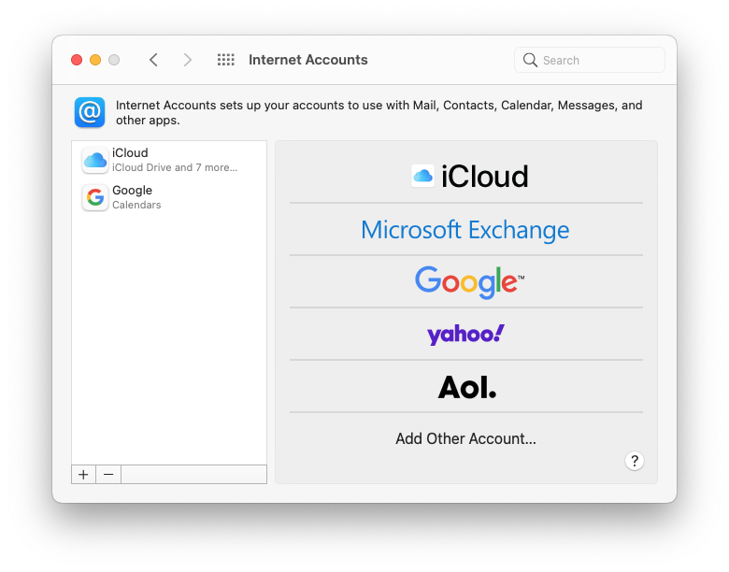
Notes:
It is also possible for users to authorize an operating system, such as MacOS, to access various account APIs.

Slide 34
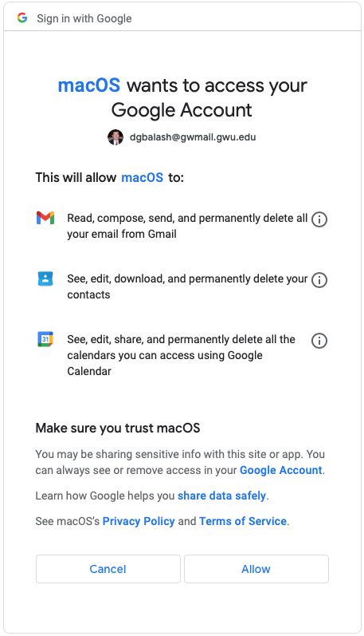
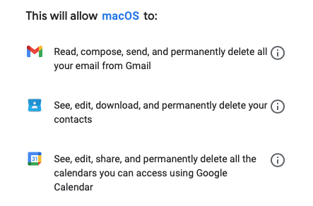

Slide 35
New Features and Design Changes
53%
89%

Slide 36
Remind and Reapprove Authorizations
55%
59%

Slide 37
Recall and Awareness of App Access
74%
65%
44%
81%
67%
25%
79%
67%
40%

Slide 38
Top Ten Third-Party App Authorized Permissions

Slide 39
Frequency of App Use

