Slide 1
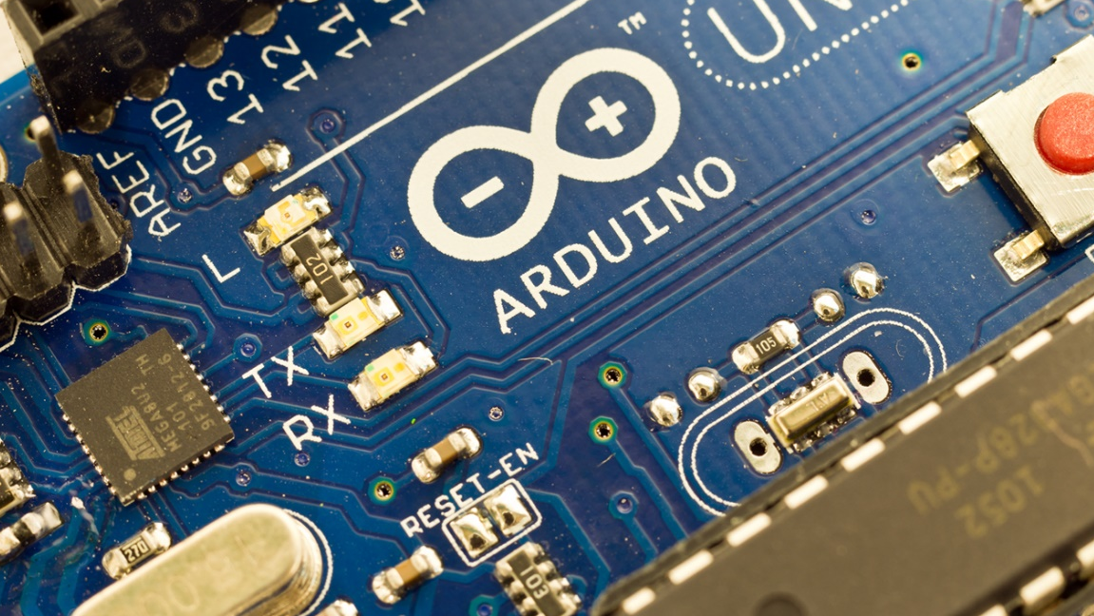
Making Music with Arduino

Slide 2

Making Music With Arduino
Me, Who?
I’m Gregg.
I’m a designer on HoloLens (Shell UX).
And a long-time Maker.

Slide 3




Making Music With Arduino
Why Me?
I used to be a musician.
With crazy hair.
I try to use music as a base
when learning about any
new technology or platform.

Slide 4
Making Music With Arduino
Learn using
what you love,
and you’ll love
what you learn.

Slide 5
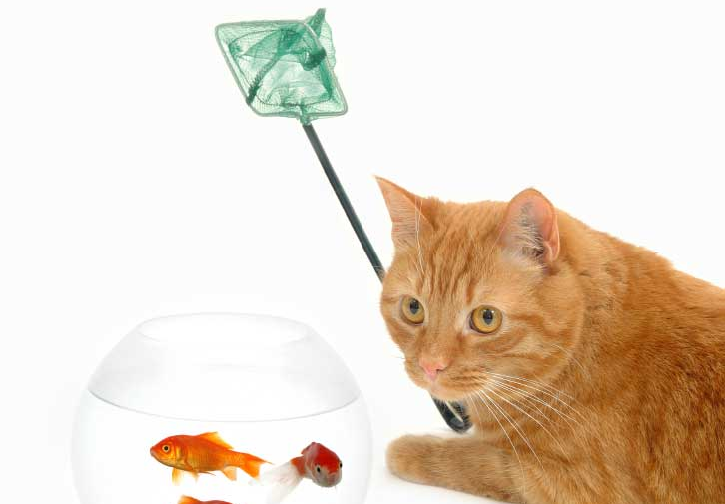
Learn using what you love, and you’ll love what you learn.

Slide 6
Making Music With Arduino
Enough about me
Let’s get started!

Slide 7
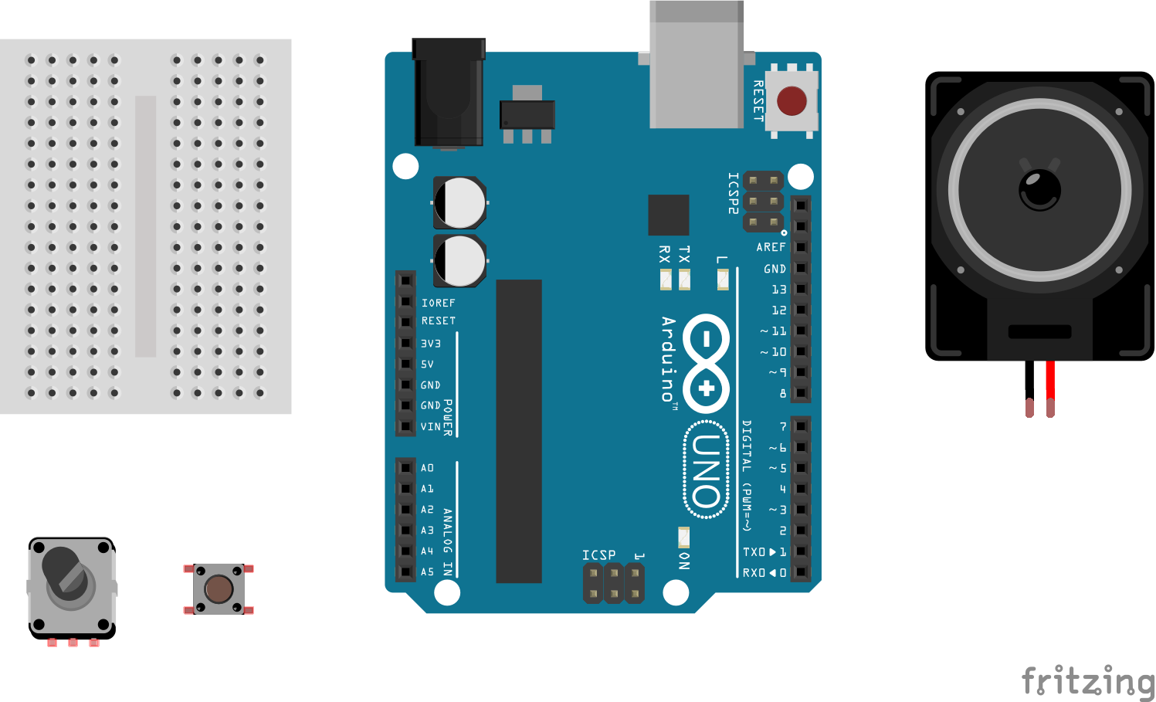
Making Music With Arduino
What we got here?
Arduino
Mini Breadboard
Speaker
Big Button
One Input Device
Knob
Slider
Light sensor

Slide 8
Making Music With Arduino
First things first! (well, third at this point)
Visit http://arduino.cc
Select “Learn Arduino” on the left side of the page
In the “Installation” section, select the link appropriate for your laptop’s OS
We’ll walk through setup all the way to making a LED blink
If you already have Arduino working on your laptop, hang tight! ☺

Slide 9
Making Music With Arduino
Don’t forget to save!
If you haven’t already been asked to save your file into a new location, let’s go ahead do so.
Select File->Save As…
Name your file something clever, like “ArduinoMusic”.

Slide 10
Making Music With Arduino
Everyone is blinking!
The Blink example turns a LED on for 1000 milliseconds, then off for 1000 milliseconds. This is the code that tells how long the LED stays on or off:
delay(1000);
1000 milliseconds = 1 second

Slide 11
Making Music With Arduino
Go faster!
Let’s turn our LED on for ½ second, then off for ½ second.
If 1 second = 1000 milliseconds…
½ second = 500 milliseconds

Slide 12
Making Music With Arduino
Go faster!
Change each instance of this:
delay(1000);
To this:
delay(500);

Slide 13
Making Music With Arduino
On, Off, On, Off
Let’s look at our code in a different way.

Slide 14
Making Music With Arduino
On, Off, On, Off
Let’s look at our code in a different way.
delay(1000);
delay(1000);
digitalWrite(13, HIGH);
digitalWrite(13, LOW);

Slide 15
Making Music With Arduino
On, Off, On, Off
Let’s look at our code in a different way.
delay(1000);
delay(1000);
digitalWrite(13, HIGH);
digitalWrite(13, LOW);

Slide 16
Making Music With Arduino
On, Off, On, Off
Let’s look at our code in a different way.
delay(1000);
delay(1000);
digitalWrite(13, HIGH);
digitalWrite(13, LOW);

Slide 17
Making Music With Arduino
On, Off, On, Off
Let’s look at our code in a different way.

Slide 18
Making Music With Arduino
On, Off, On, Off
Let’s look at our code in a different way.
This repetition creates a waveform.

Slide 19
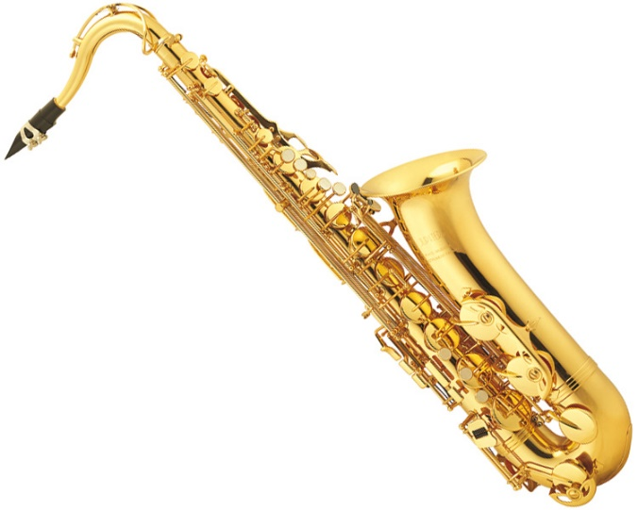
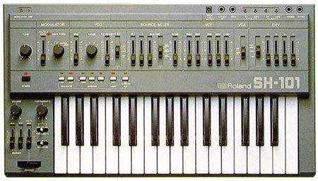
Making Music With Arduino
Waveforms make music!
All audio is made from waveforms, from guitars to saxophones to synthesizers.

Slide 20
Making Music With Arduino
Rectilinear bliss
The shape of our waveform is specific – it’s called “square”

Slide 21
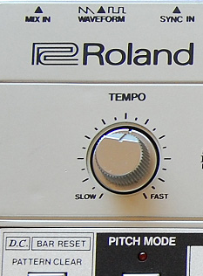
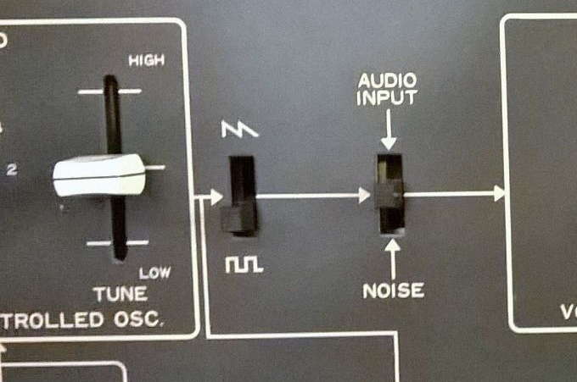
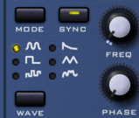
Making Music With Arduino
Square waveforms make cool music!
Square waveforms are foundational to many popular and famous synthesizers.

Slide 22
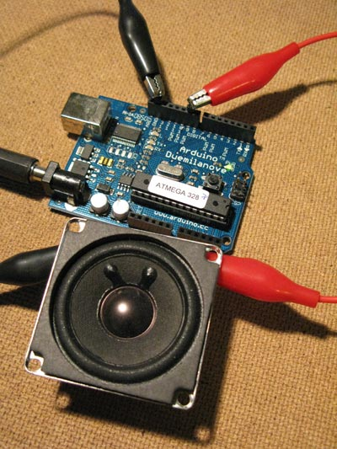
Making Music With Arduino
This means Arduinos are synthesizers!
Very simple synthesizers.

Slide 23

Making Music With Arduino
But Gregg… How do we turn blinking into music?

Slide 24
Making Music With Arduino
Back to the code!
In the Blink code, change each instance of this:
delay(500);
To this:
delay(50);

Slide 25
Making Music With Arduino
Faaaaaasssssssterrrrr!
Finally change each instance of this:
delay(50);
To this:
delay(5);

Slide 26
Making Music With Arduino
Always On
The LED now just appears to be on. What’s up with that?
The LED is blinking so fast, it just appears solid!

Slide 27
Making Music With Arduino
Audio Math 101
Our code turns on the LED for 5 milliseconds, then off for 5 milliseconds. If we add the time on (5) with the time off (5), we can say the cycle of our waveform is 10 milliseconds long.
If we divide the number of milliseconds in a second (1000) by the length of our cycle (10) we get the frequency of our square waveform: 100. Frequency is written in hertz (Hz)

Slide 28
Making Music With Arduino
Eyes are slow
Our eyes process images much slower than our brain can handle, so we can’t discern visual frequencies faster than roughly 40 – 60 cycles per second (Hz).
Thus, our LED blinking at 100Hz appears to just be on.

Slide 29

Making Music With Arduino
Ears are fast
Our ears, however, can process audio frequencies many times faster than our eyes can process visual frequencies.
Humans can hear frequencies starting around 20Hz all the way up to 20,000Hz (20kHz)!
Did you know: Chickens can only hear frequencies above ~200Hz.

Slide 30
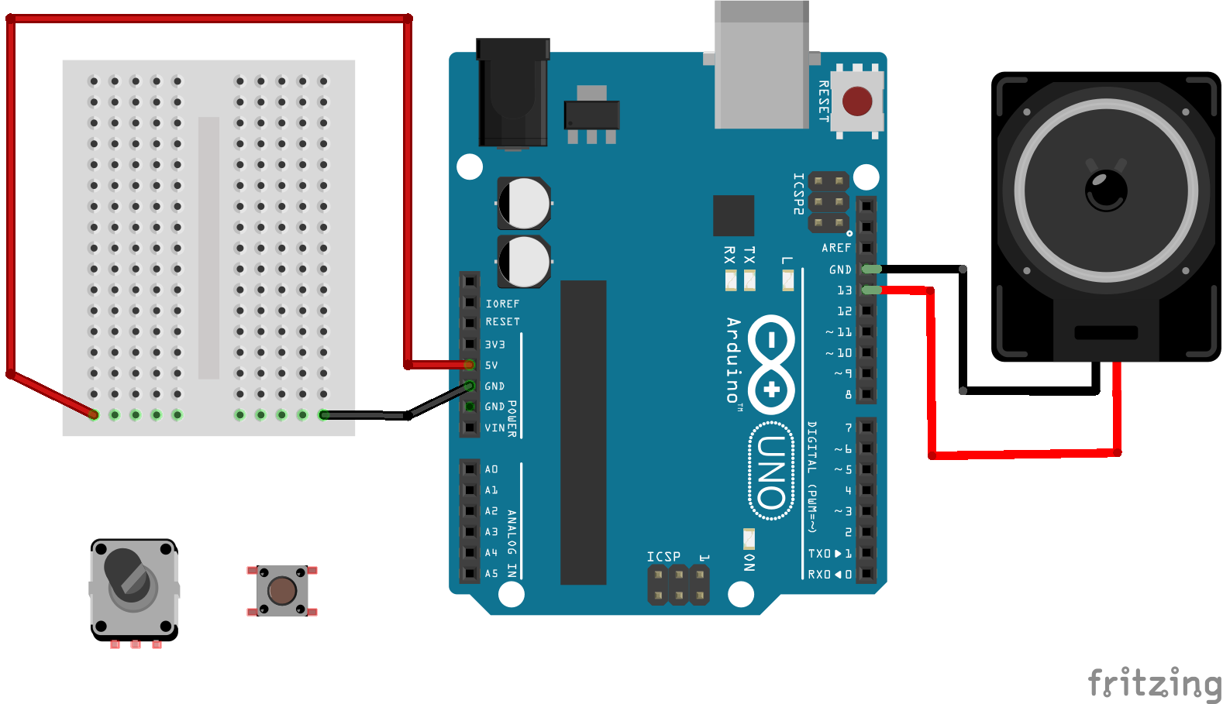
Making Music With Arduino
Hear the Blink
Let’s hook up a speaker to our Arduino.

Slide 31
Making Music With Arduino

Slide 32
Making Music With Arduino
All about the Benjamin
We can hear 100Hz!

Slide 33
Making Music With Arduino
Audio Math 102
But how do we change the frequency to make a note we can recognize and name?
# of ms in a second / cycle time in ms = frequency
# of ms in a second / frequency = cycle time in ms

Slide 34
Making Music With Arduino
Audio Math 102
Middle C’s frequency is 261.6 Hz (seriously, Google it)
# of ms in a second / frequency = cycle time in ms
1000 / 261.6 = 3.82262

Slide 35
Making Music With Arduino
Audio Math 102
Remember, a cycle is turning on the LED and turning off the LED, so we need to divide our cycle time in half to get the number of milliseconds to put into our code.
1000 / 261.6 = 3.82262 / 2 = 1.91ms

Slide 36
Making Music With Arduino
See… C!
In our code, let’s change each instance of this:
delay(5);
To our new delay time:
delay(1.91);

Slide 37
Making Music With Arduino
Hear the C
Plug our cable back into pin 13 and let’s hear our new note.

Slide 38
Making Music With Arduino

Slide 39
Making Music With Arduino
Not all that…
It’s a pain to write four lines of code and calculate delay times just to make a sound. Luckily, there exists an easier way to make tones.
There is an Arduino function that will allow us to input the frequency of a note and automatically cycle at the appropriate rate!

Slide 40
Making Music With Arduino
One simple line
It’s the tone() function.
It’s written like this:
tone(pin, frequency);
or
tone(pin, frequency, duration);

Slide 41
Making Music With Arduino
Make it so!
Let’s change our code to look like this:
void loop() {
tone(13, 262); // Middle C rounded up
}

Slide 42
Making Music With Arduino
Hear the Sea
Plug our cable back into pin 13 and let’s hear our new note.

Slide 43
Making Music With Arduino

Slide 44
Making Music With Arduino
Blink for our ears
Now, let’s turn our tone on and off, like our LED:
void loop() {
tone(13, 262, 500);
delay(500);
noTone(13);
delay(500);
}

Slide 45
Making Music With Arduino
OOONTZ OOONTZ OOONTZ!
Congratulations! You’ve just made music!
Bland, monotonous, repetitive music.
Kind-of like bad techno.

Slide 46
Making Music With Arduino
Start to take control
Plugging in and unplugging the speaker is annoying. Let’s use that big button you’ve got in front of you.

Slide 47
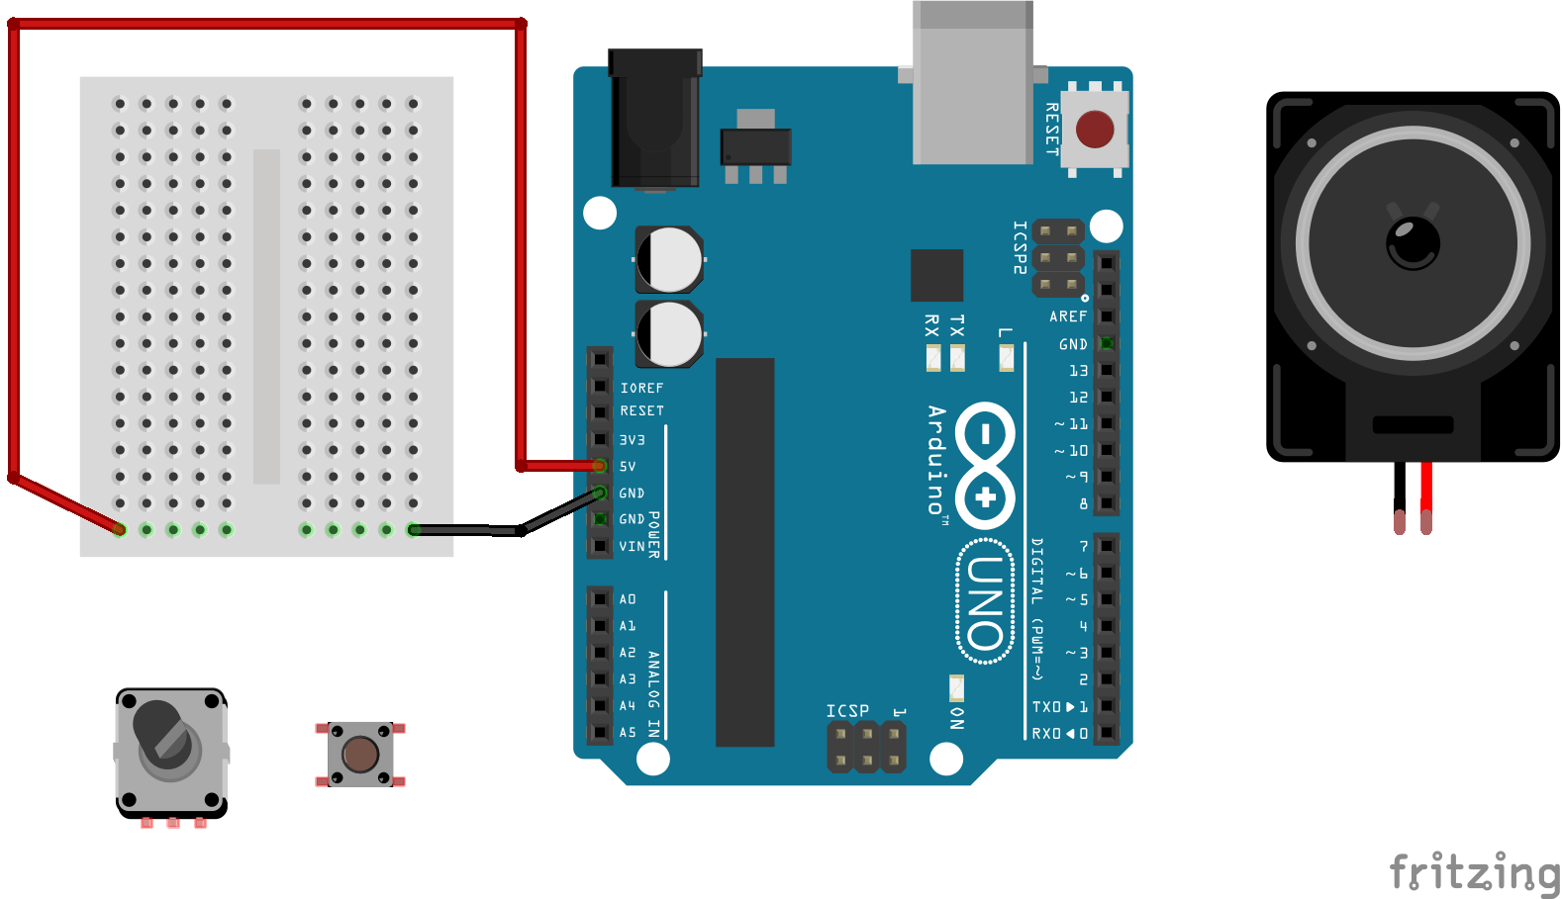
Making Music With Arduino
Start to take control
Set up the breadboard.

Slide 48
Making Music With Arduino

Slide 49
Making Music With Arduino
5v
GND

Slide 50
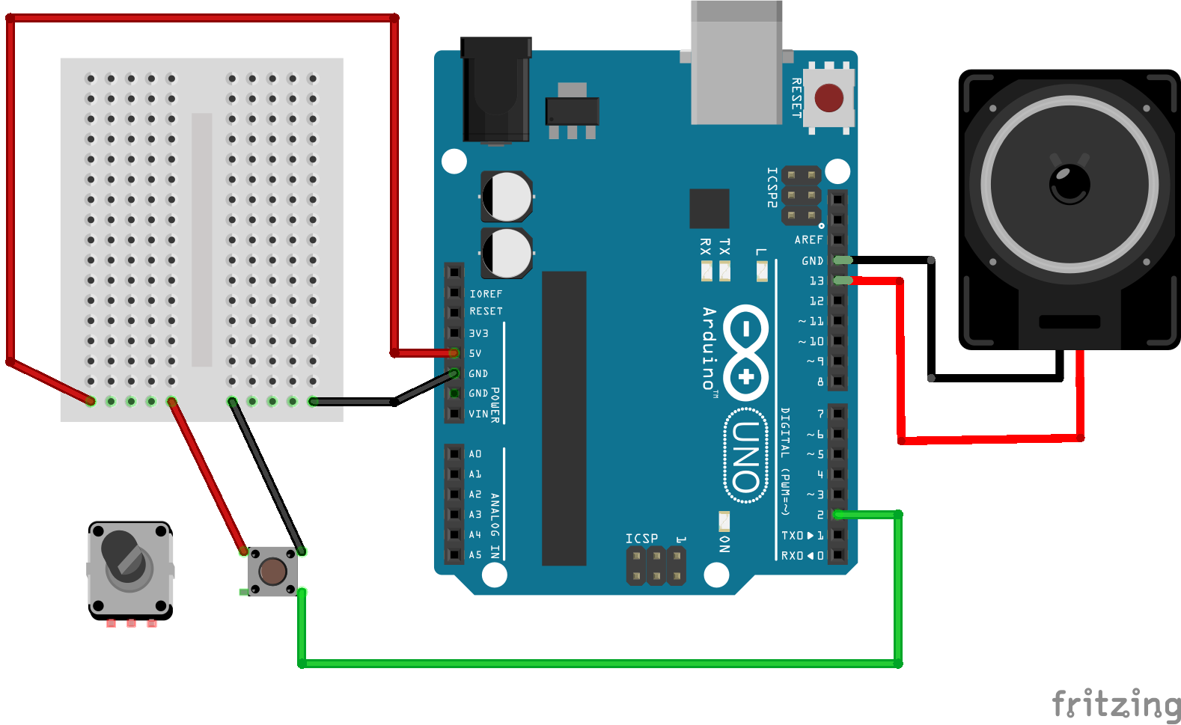
Making Music With Arduino
Start to take control
Plug in the button and speaker

Slide 51
Making Music With Arduino
KEEP THIS UNPLUGGED!!

Slide 52
Making Music With Arduino
Take control
Change our code to:
void loop() {
if (digitalRead(2) == HIGH) {
tone(13, 262);
} else {
noTone(13);
}
}

Slide 53
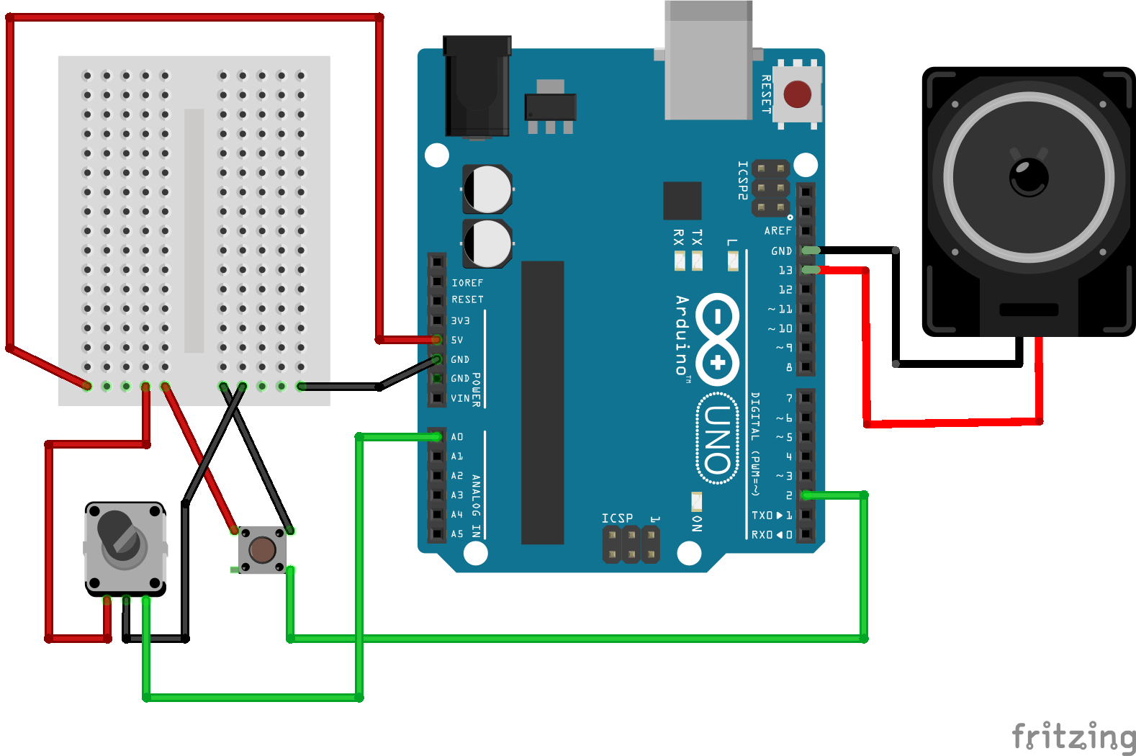
Making Music With Arduino
Change my pitch up
Middle C is lame. Let’s wire up that sensor you’ve got just sitting there so we’re no longer lame:

Slide 54
Making Music With Arduino

Slide 55
Making Music With Arduino
Ups and Downs
Change our code to:
void loop() {
if (digitalRead(2) == HIGH) {
tone(13, analogRead(0));
} else {
noTone(13);
}
}

Slide 56
Making Music With Arduino
Boom!
It’s like a magical, electronic slide whistle!
And just about as annoying.

Slide 57
Making Music With Arduino
Scaly build-up
Change our code to:
int notes[] = { 100, 200, 300, 400, 500, 600, 700, 800 };
void loop() {
int note = map(analogRead(0),0,1024,0,8);
if (digitalRead(2) == HIGH) {
tone(13, notes[note]);
} else {
noTone(13);
}
}

Slide 58
Making Music With Arduino
From C to shining C
Let’s put some real musical note frequencies into our array:
int notes[] = { 131, 147, 165, 175, 196, 220, 247, 262 };

Slide 59

Making Music With Arduino
Wut?
How are we supposed to remember what the frequencies of all these musical notes are?
Do we have to Google Bing
everything?

Slide 60
Making Music With Arduino
Pitch, please!
There is a freely available file, pitches.h, that contains a list of all of the pitches in the musical scale, along with the frequencies of those notes!
It contains code that looks like this:
#define NOTE_C4 262
It came with the Arduino software, so you already have it! Yay!

Slide 61
Making Music With Arduino
Pitches in the Mix
Let’s add pitches.h to your file.
Select Sketch->Add File…
In the dialog that opens, navigate to the folder where you installed or unzipped the Arduino software.
Then find the folder: Examples/02.Digital/toneMelody
Then select: pitches.h

Slide 62
Making Music With Arduino
All inclusive
We need to let the Arduino software know we’re going to use the pitches.h file.
At the top of your code, add this line:
#include “pitches.h”

Slide 63
Making Music With Arduino
From NOTE_C to shining NOTE_C
With the inclusion of pitches.h, we can now change our code to something more understandable:
int notes[] = { NOTE_C3, NOTE_D3, NOTE_E3, NOTE_F3,
NOTE_G3, NOTE_A3, NOTE_B3, NOTE_C4 };

Slide 64



Making Music With Arduino
Harmoniousness
The pentatonic scale is a collection of notes that all work well with each other. If you’ve ever used a “tone matrix” app on your phone, you’ve heard a pentatonic scale.

Slide 65
Making Music With Arduino
Five at 5
Plug the notes for a pentatonic scale into our code:
int notes[] = { NOTE_C3, NOTE_D3, NOTE_E3, NOTE_G3,
NOTE_A3, NOTE_C4, NOTE_D4, NOTE_G4 };

Slide 66
Making Music With Arduino
Sixteen at 5
Let’s up the number of notes we can create:
int notes[] = { NOTE_C3, NOTE_D3, NOTE_E3, NOTE_G3,
NOTE_A3, NOTE_C4, NOTE_D4, NOTE_G4,
NOTE_A4, NOTE_C5, NOTE_D5, NOTE_G5,
NOTE_A5, NOTE_C6, NOTE_D6, NOTE_G6 };

Slide 67
Making Music With Arduino
Reading the map
One more change:
void loop() {
int note = map(analogRead(0),0,1024,0,16);
if (digitalRead(2) == HIGH) {
tone(13, notes[note]);
}
}

Slide 68
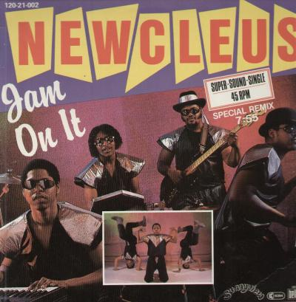
Making Music With Arduino
Jam on it!

Slide 69
Making Music With Arduino
Thanks!

