Slide 1
ISKOLARIA
A Containerized Scholarship Application System with Automated Docker and Jenkins CI/CD Pipeline
Cabral, Bea Mei • David, Nigel James • Serrano, Bianca Gabrielle • Soriano, Den Mark
Architecture , Pipeline, and Demonstration
Notes:
Good day, everyone. Today, we will present Iskolaria and its CI/CD pipeline. We will briefly explain the system architecture and technologies, then demonstrate how Jenkins tests, builds, and deploys code changes. We will also show how the pipeline handles a failed test, how data persists during redeployment, and how a previous image version can be restored.

Slide 2
System Overview & Main Modules
Students apply for scholarships and administrators review them.
Frontend
Auth Service
Scholarship API
Student & admin web interface
Registration, login and JWT
Programs and eligibility checks
Application API
Upload Service
Worker
Submission and review workflow
Document validation and storage
Queued notifications
Notes:
Iskolaria is a scholarship-management system with a frontend for users and administrators and backend services that handle different responsibilities. The frontend provides the web interface. The authentication service handles identity and access, the scholarship API handles scholarship and eligibility-related operations, the application API handles application workflows, and the upload service validates and stores uploaded documents. A worker processes queued notification jobs.

Slide 3
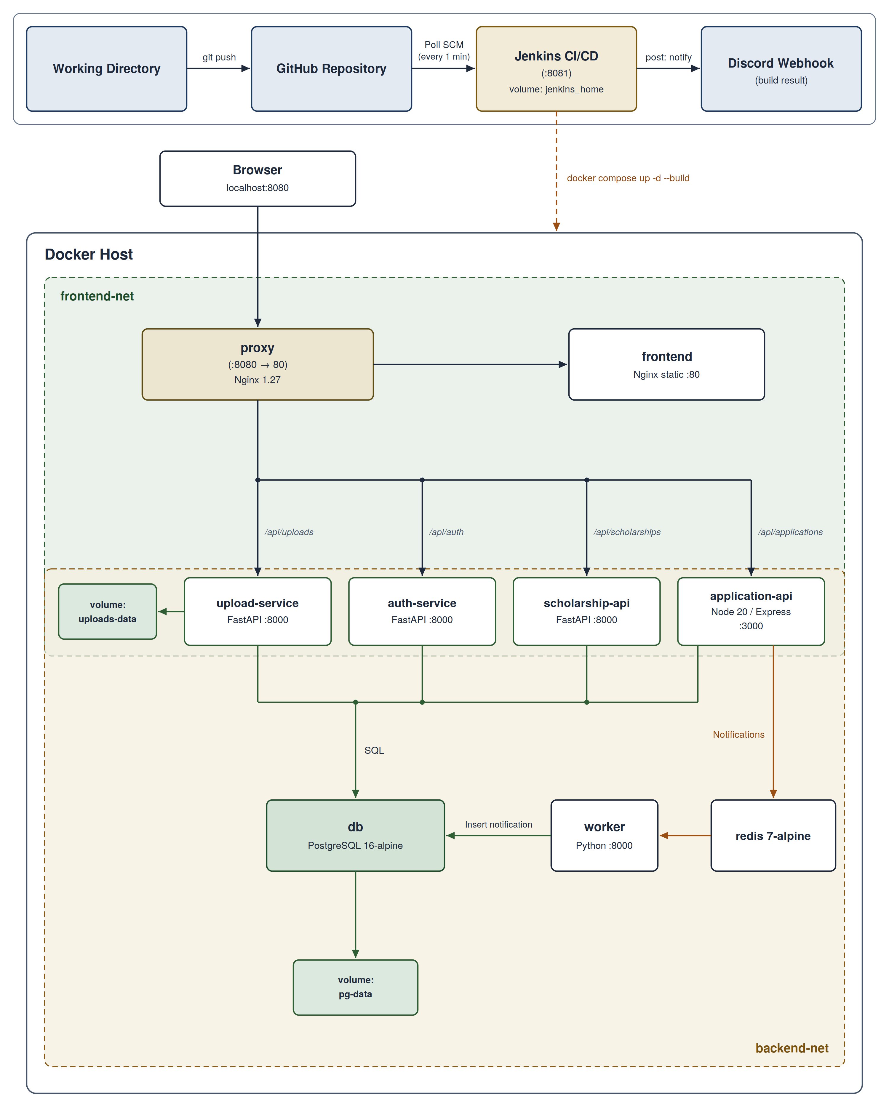
Architecture, Networks & Volumes
Three Callouts around it: Only the reverse proxy is published (port 8080).
Frontend-net and backend-net separate the services.
Named volumes pg-data and uploads-data preserve data across redeploys.
Notes:
The system runs as Docker containers coordinated by Docker Compose. Users access the website through the reverse proxy, which is the only published application port in the Compose configuration. The proxy routes requests to the frontend and the required backend services. The frontend-facing and backend networks separate service communication. PostgreSQL stores structured application data, Redis supports queued work, and named Docker volumes preserve database data and uploaded files across container replacement. This separation makes the services easier to deploy and maintain.

Slide 4
Technology Choices
Docker + Compose
Jenkins
Container packaging and orchestration
Automated CI/CD pipeline
HTML / CSS / JS
Node.js + Express
Lightweight static frontend
Application workflow API
Python + FastAPI
PostgreSQL + Redis
Auth, scholarship and upload APIs
Relational storage and notification queue
Nginx
Single reverse-proxy entry point
Notes:
The project uses Docker and Docker Compose to package and run services consistently. Jenkins automates the pipeline. The frontend uses HTML, CSS, and JavaScript. The application API uses Node.js and Express, while the authentication, scholarship, upload, and worker services use Python-based components. PostgreSQL provides persistent relational storage, Redis supports queued notifications, and the reverse proxy exposes the application through a single entry point.

Slide 5
Jenkins Pipeline & Testing Strategy
01
02
03
04
05
→
→
→
→
CHECKOUT
TEST
BUILD IMAGES
DEPLOY
SMOKE TEST
Test Coverage: 40 total tests
Trigger and Safety
Auth: Token and Passwords
Scholarship: Eligibility Checks
Application: Status Transitions
Upload: File signatures and the 2 MB Limit
Worker: Job Validation
Poll SCM checks the repository every minute.
A failed test stops the pipeline before Build Images and Deploy, so the running version stays in place.
Images are tagged with the build number, which makes rollback possible.
Notes:
Our Jenkins pipeline has five main stages: Checkout, Test, Build Images, Deploy, and Smoke Test. Checkout retrieves the repository code. Test builds the test targets for the backend services and runs their automated checks. These tests cover authentication and token behavior, scholarship eligibility rules, application status transitions, upload file signatures and size limits, and notification-job validation. If a test fails, Jenkins stops before image building and deployment, leaving the previously running version in place. If tests pass, Docker images are built and deployed, and smoke tests check the proxy, health endpoints, and homepage. The pipeline tags images by build number so an earlier compatible version can be selected for rollback.
Transition: We have explained the main architecture and pipeline. We will now demonstrate the process live, beginning with Jenkins itself.

