Slide 1
COMPANY · 2026
ServiceNow – Dynatrace Integration
Osama has opened Pandora’s box:
Build an offering package to clients to clean/enhance their CMDB based on Dynatrace data. Dynatrace/ServiceNow integration is one of the top 3 pipeline generation use cases for this year at Dynatrace. Same for the ServiceNow ITOM team.
But much more than this...
01
CONFIDENTIAL DRAFT

Slide 2
Key Points
What the customer needs
Expect problems within a model and between models
Multi-source CMdb is important in model hygiene
Expect Service Mapping to be difficult, but important in order to reason about CIs
Initial focus only on tag-based discovery

Slide 3
What does the Customer Need?
A more accurate, complete, CMdb (hygiene)
Multi-source CMdb can increase model hygiene
Identify errors of omission
Routing of incidents to the right teams
Map CMdb CI to CSDM CI in Event → Incident promotion
Incidents should be on application services
Network and other incidents mapped to other services
Mapping of DT problems to SN events with the right CI
Enhance portfolio management
Incidents per business service
Incidents per business application
Business Application
Business Service
Business Service
Application Service
Application Service
Application Service
Application Service
Application Service
Application Service

Slide 4
ServiceNow Dynatrace Integration⁺
ServiceNow
Dynatrace
Incident + CSDM CI
Event + CMdb CI
SGC
Davis
Davis
Problems
CSDM
CMdb
Smartscape
Traces
Logs Metrics
Events
CSDM Injector
Tag Gaps
DT-SN
Comparator
Discovery
OneAgent
CSDM Specs
Model Comparison
Application Environment
K8s
Docker
Relationship
Data Flow

Slide 5
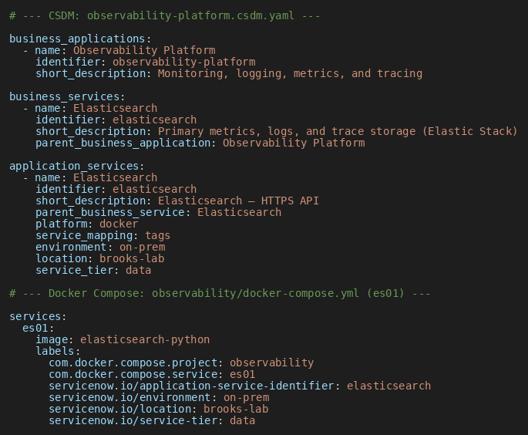
CSDM Injector
Specification generated CSDM objects
Business Applications
Business Services
Application Services
Application Service is the key

Slide 6
Environment Models
Expect inconsistencies and incompleteness within a model
Expect mismatches between models
Automate CMdb Dynatrace comparisons
The Environment
CMdb
Dynatrace
CSDM
Application Services

Slide 7
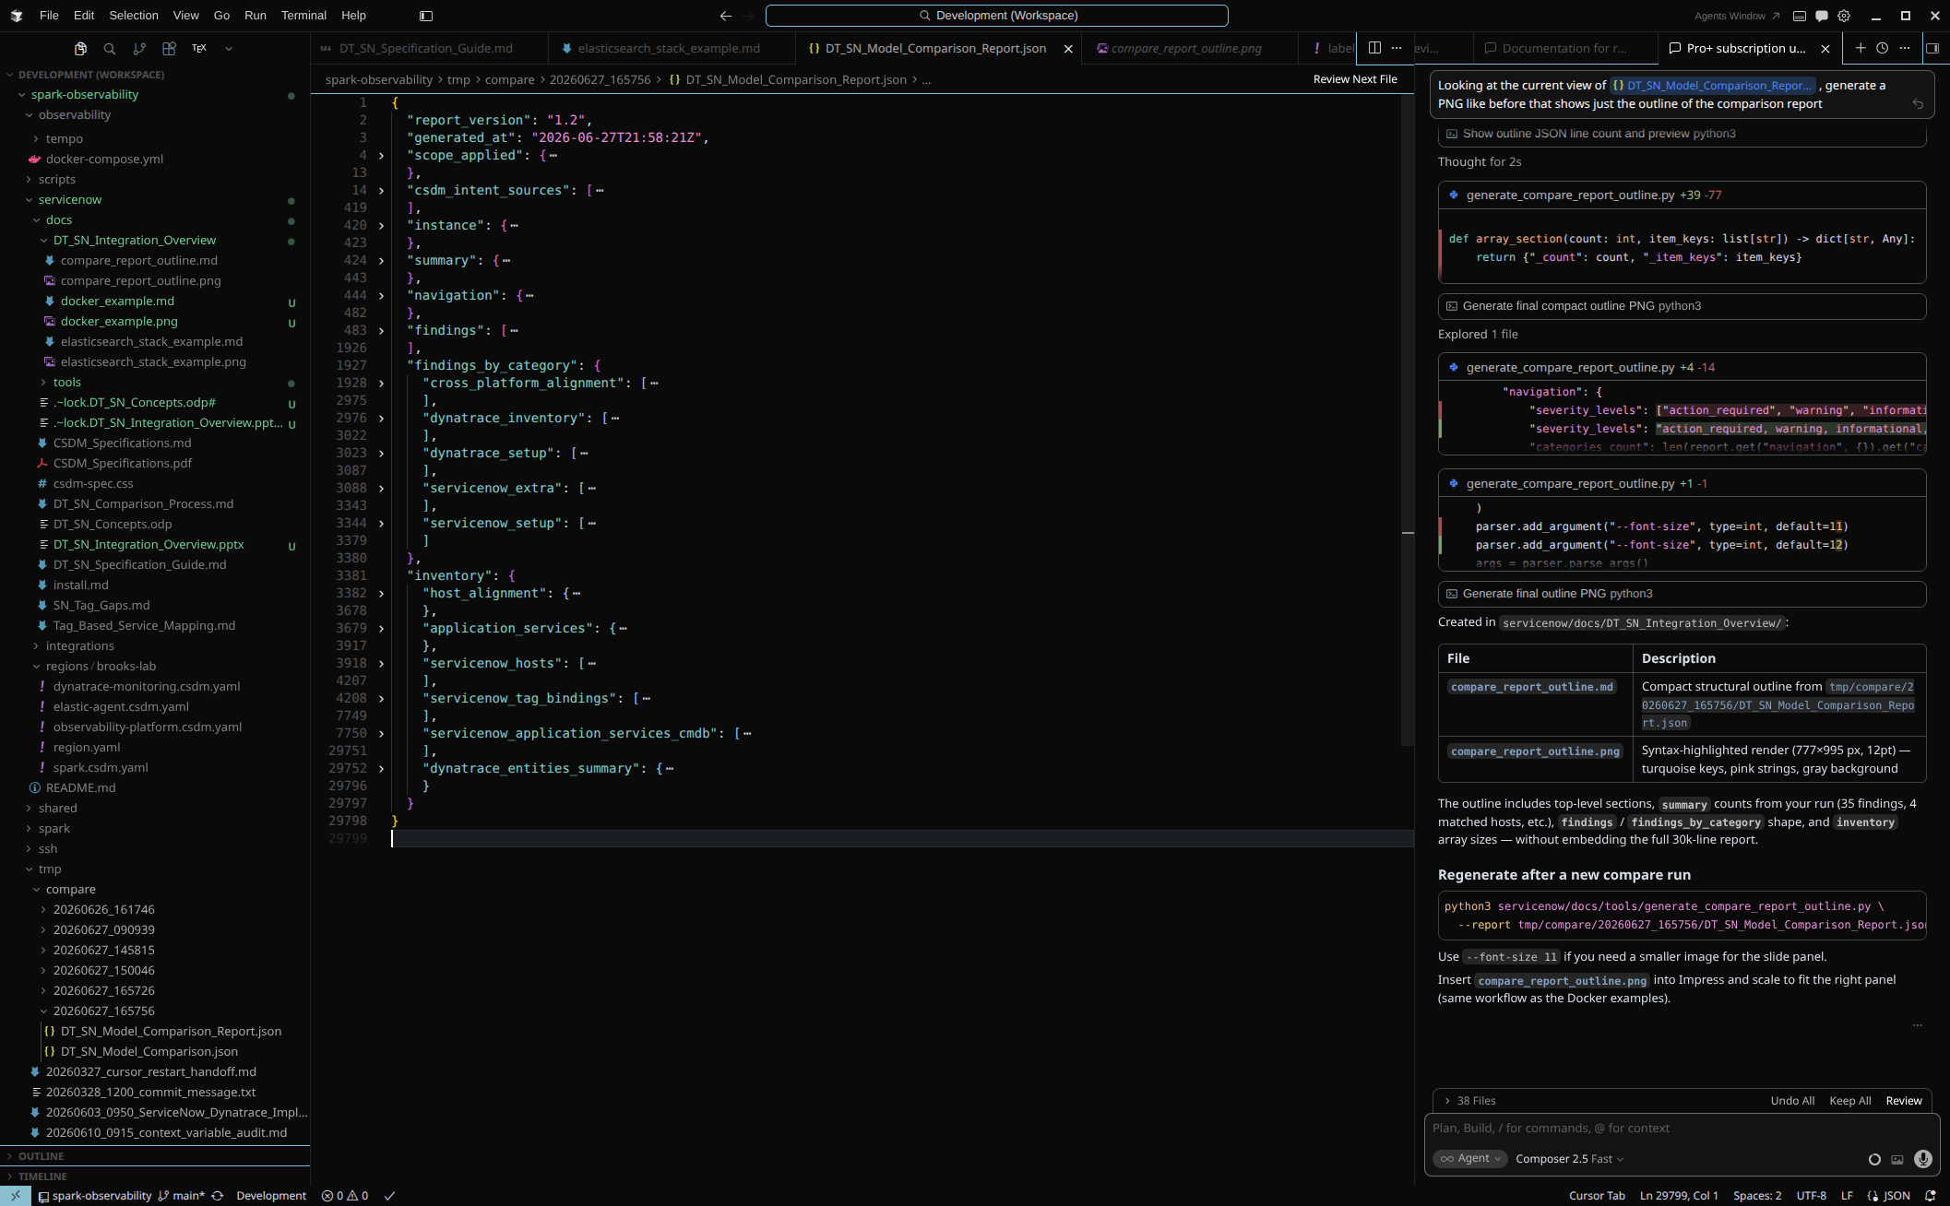
Automated Comparison
5.5

Slide 8
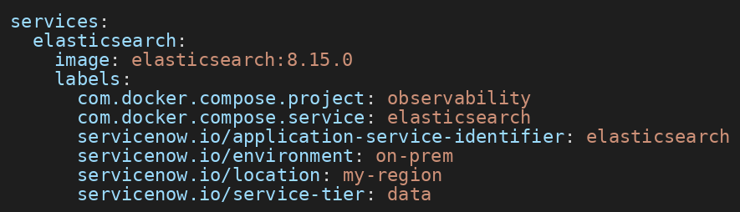
Tag Gap in ServiceNow
ServiceNow’s Docker Pattern horizontal discovery creates container CIs and process relationships
Does not copy custom Compose labels into cmdb_key_value
Especially servicenow.io/*tags

Slide 9
My Next Steps
Better understand the Dynatrace model
Better understand the mapping of Dynatrace entities into CMdb objects via IRE rules
Best practices for mapping problems to events
Improve cross correlation across systems
What does multi-source have to offer?
Probably port logic from Ansible to Python
Pod Bindings
Monitoring as code into event management

