Slide 1

Pitch Deck
Connected mobility for a cleaner future
#reCyclers
by Sophie Schmidt, Eunice Bernardo, Emanuel Eissfeldt, Leonhard Meyer, Jannis Heimerl, Manuel Genster

Slide 2
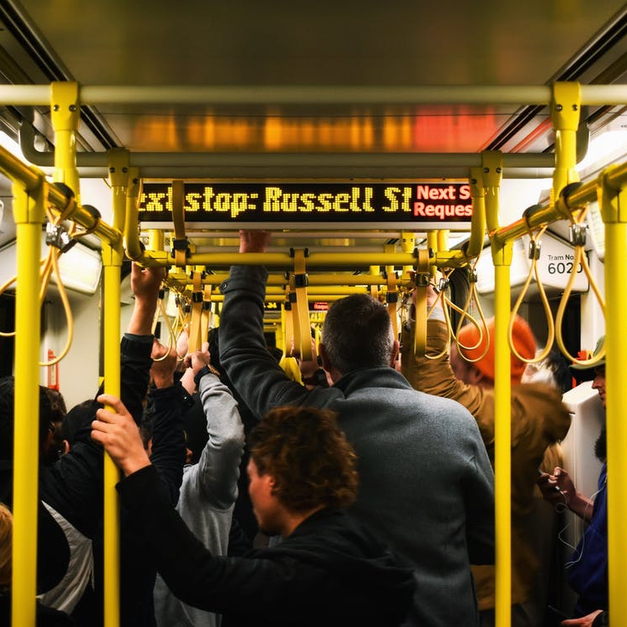
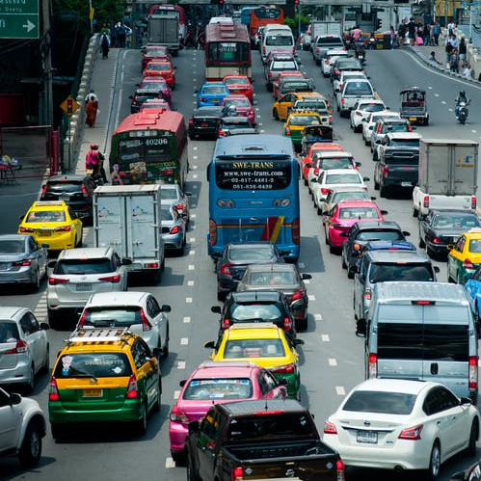
Challenges
Less space
Interlink travel experience
In public transportations
For commuters

Slide 3

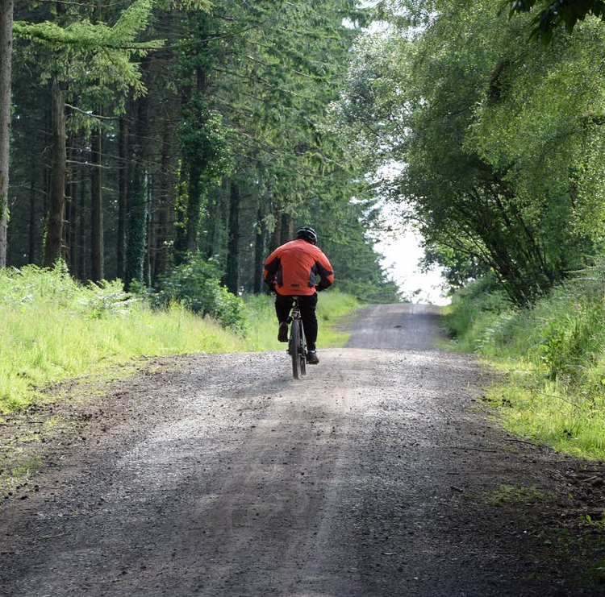
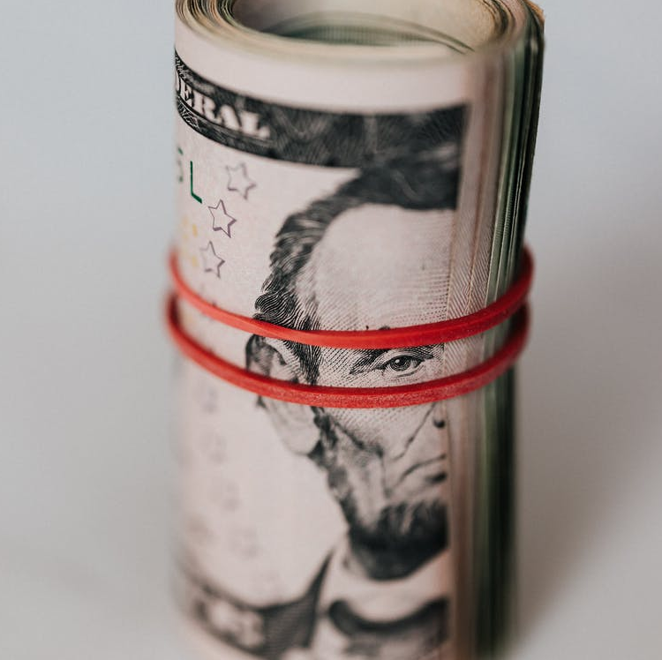
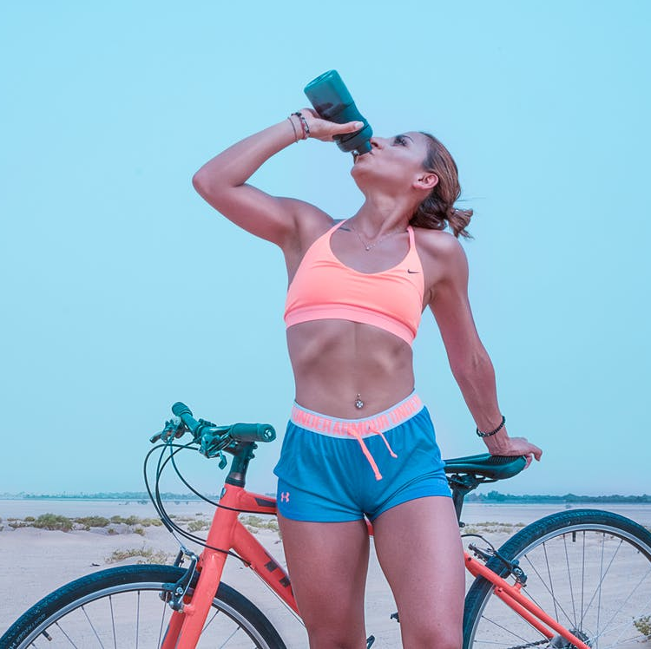
We want to become Eco Friendly by reducing the carbon footprint of nearly 13 million commuters.
Solution
Connect existing models with folding bikes
We want to offer an Affordable product by creating an inexpensive alternative to other modes of transport.
Focus on 3 main value segments we want to contribute:
In addition, we want to promote the Health Aspects as employees are motivated to train regularly.

Slide 4


Business Model
We sell our bikes to environmentally aware companies with office space:
#1
Short Term
#2
Long Term
200 € / month for normal bikes
350 € / month for E-Bikes
100 € / month for normal bikes
200 € / month for E-Bikes
Agreement on a monthly fee, based on the number of folding bikes
Minimum term from 6 months
Lockers are provided for 15 € / month per locker
One-time fee for using the folding bikes for an agreed period (2 years)
Train tickets will also be included in the agreement
Lockers are provided for 15 € / month per locker

Slide 5
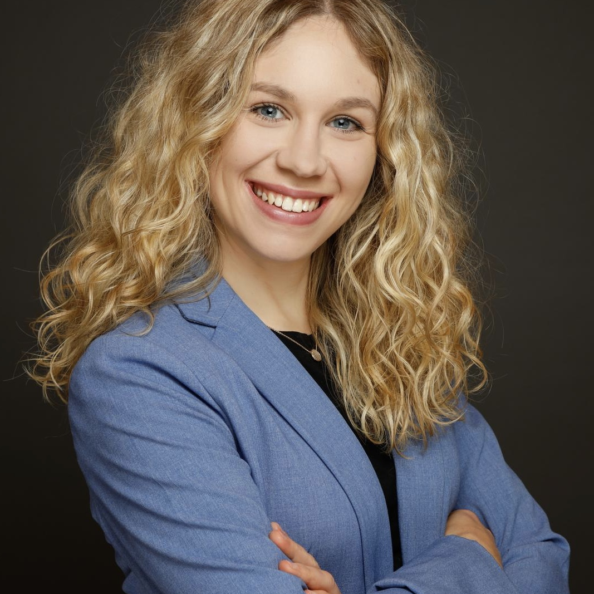
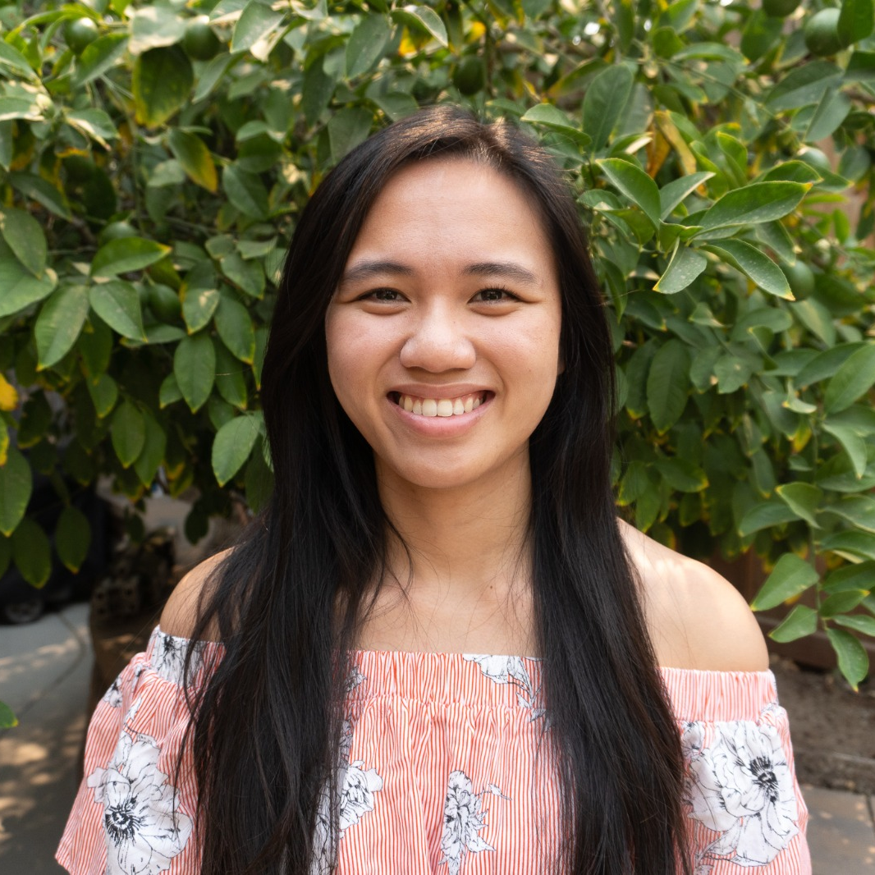
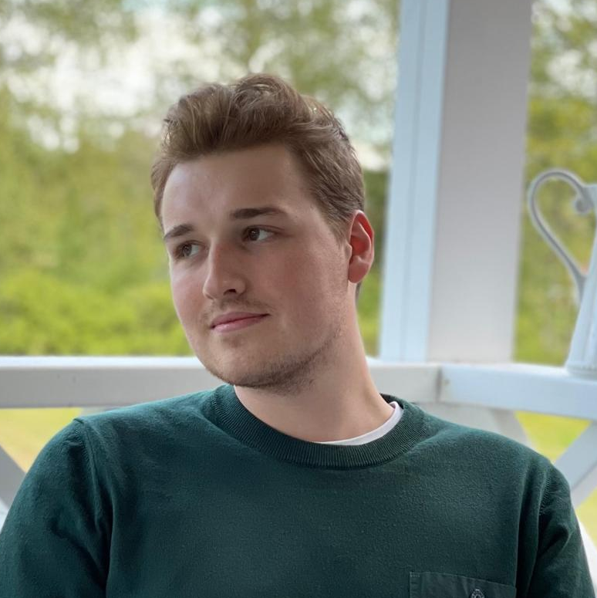
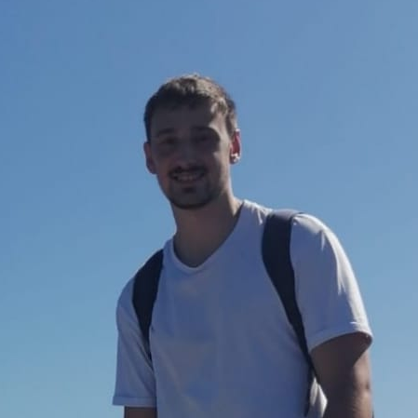
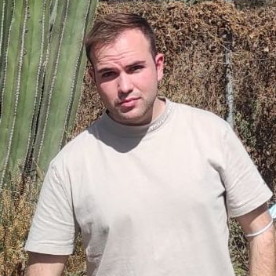
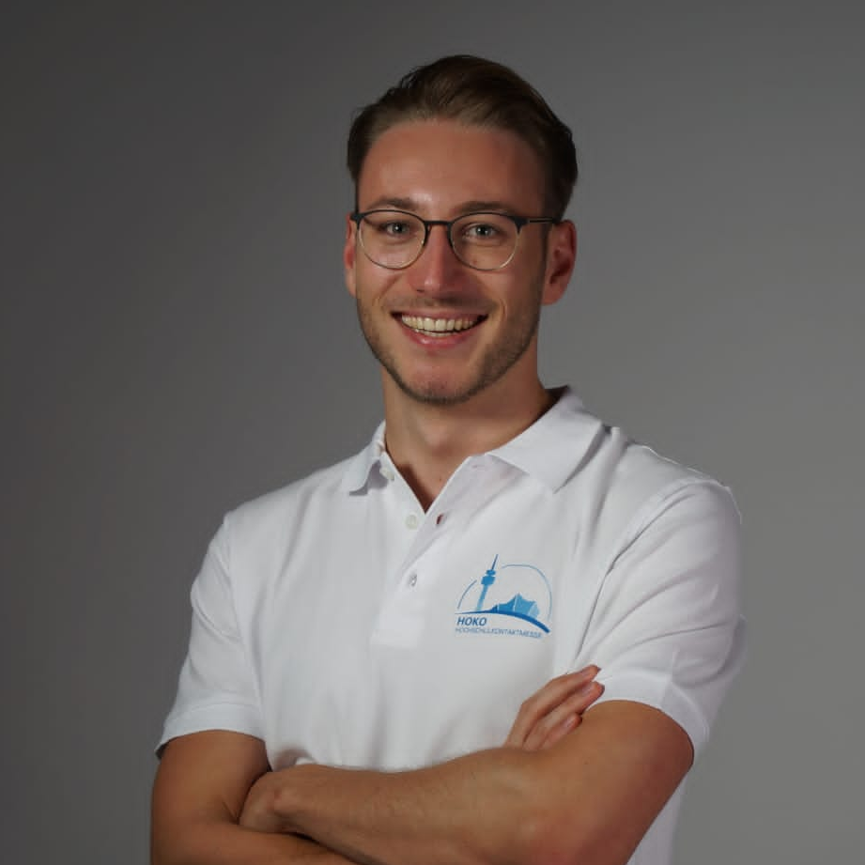
Team #reCyclers
Sophie Schmidt
Eunice Bernardo
Project Manager (Overview, Facilitate, Git-Hub - Know project task)
Research & Development, Present the assignment
Emanuel Eissfeldt
Leonhard Meyer
Research & Development, Wiki Administrator
Research & Development
Jannis Heimerl
Manuel Genster
Research & Development, Design
Research & Development, German/English Presenter

Slide 6
Journey of #reCyclers
10/2021
11/2021
11/2021
11/2021
Kick-off and founding of #reCyclers
Prototyping a solution in two iterations
Work out the Business Model Canvas
Getting a first feedback from DB
12/2021
01/2022
06/2022
07/2022
Pitch and presentation of the developed prototype
Presentation of the Business Plan
First “Minimum Viable Product” (MVP)
Launch of the new Folding Bike Model in Germany

Slide 7

Thank you for listening
#reCyclers

