Slide 1
Team 21 - Pacemakers
International Virtual Innovation Challenge Spring 21

Slide 2


Agenda
The challenge contribution of Boostive
Digital Solution: Boostive app
Business model canvas of boostive
Value of our contribution to the challenge
Gained experience from the GXC challenge

Slide 3
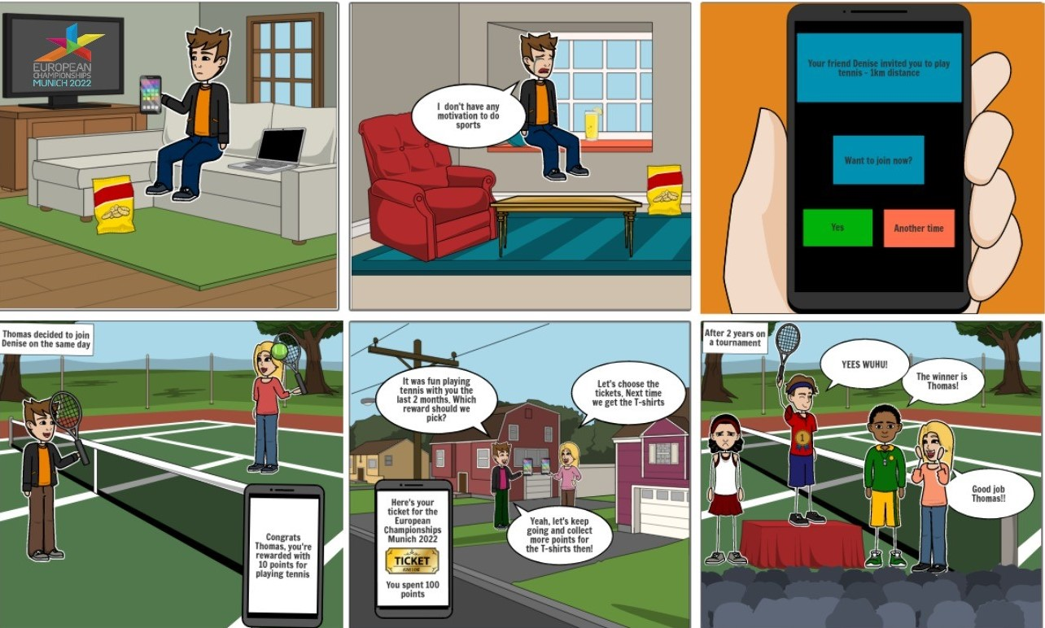
Storyboard

Slide 4







Digital Solution: Key Feature
For each Activity that is offered on the App you will receive Coins and Boosts
Gain Coins and Boosts for joining Activities
You’ll pay with your Coins in the Shop. Choose your Reward which can be Coupons, Services and sustainable Products.
Redeem Coins in the Boostive Reward Shop
It can be demotivating to do sports alone that’s why you should invite your Friend to the Activity you want to attend to
Invite your Friends to Activities and do Sports together
Compete with your Friends and your local Community through Boosts
To motivate yourself more, you compete with your Friends and your local Community through a Ranking. That Ranking functions through the collected Boosts. That means whoever does more Activities will be on the 1st Place

Slide 5
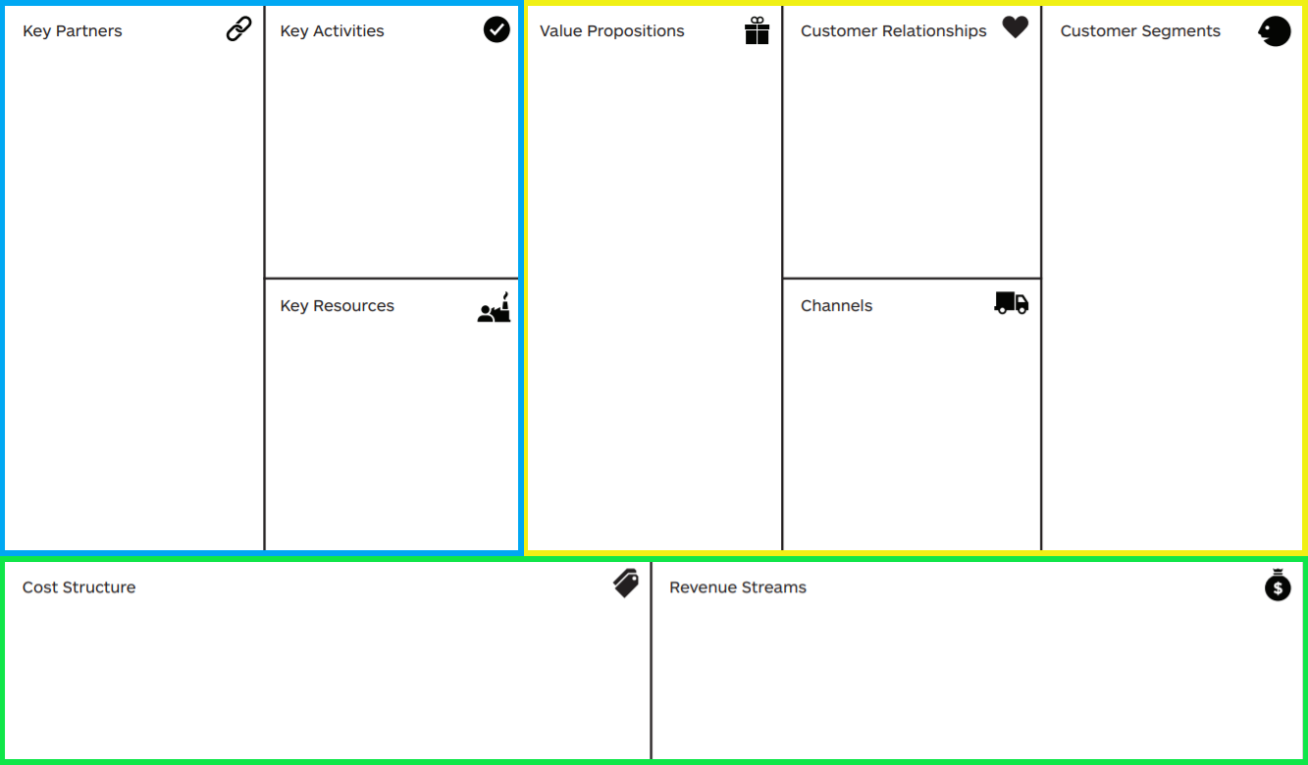
Business model canvas - BMC
implementing the app
build cooperations
offer activities
community
connect to sports
planning assistant
sport-clubs
cooperating companies
event organizer
B2B:
inactive people
event visitors
B2C:
event organizer
sport company
motivation
gamification
event
activity
rewards
physical
human
intellectual
finance
social media
invitation to the app
advertising
moste expensive: app
fixed costs
variable costs
paid partnerships
advertisements
sponsors

Slide 6
Value of our contribution to the challenge

Slide 7

Gained experience from the GXC challenge
Teamwork
Cooperation in international and locally distributed teams
Using github as a team → communication via issues
Hands on mentality
Improving oral english communication skills
Coaching in course setting
Professional coaching/input from with different experts
Advantages of external team coaching
Experience in virtual course
Presenting and ideating in virtual environment
Use of tools for virtual work
Work location → everywhere you want/ no classroom felling

