Slide 1
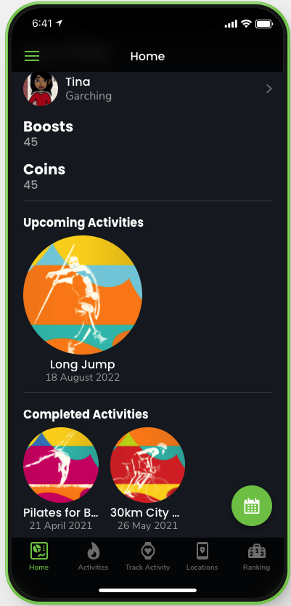

What is the problem?
Many digital natives don’t have
enough intrinsic motivation
to get active
Our Solution
Boostive creates motivation by
community, gamification and rewards

