Slide 1


OurVoice
Founded by PTY (Power to the Youngsters) Startup
PTY : Felipe, Sydney, Glory , Michael
Notes:
Hello Everyone,
I am please to present you our brilliant Idea to empower the youth. This is our recently lauched App Our Voice.

Slide 2

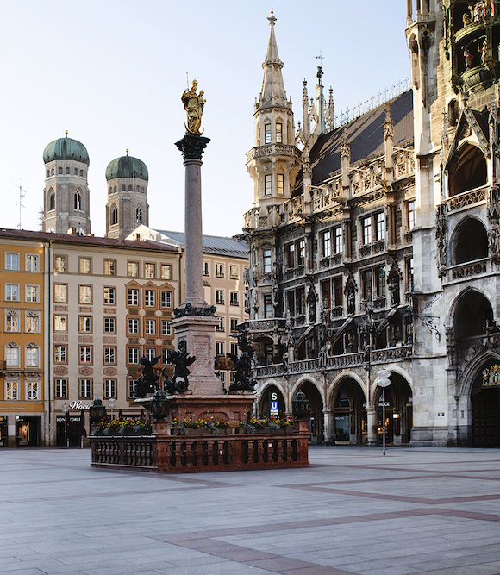
Define the Problem
The Corona Pandemic
Lockdown
Loneliness
Limitation
Notes:
This bild on the right is Marienplatz. It is usually a very crowded place, but as you can see it, there is no one on the picture. This is just to illustrate the problem we are facing during this period of pandemic. young people feel lonely, abandonned t their own.

Slide 3

Describe the Solution Approach
The Digital Transformation
Process digitalization
New forms of Engagement
Right Tool
Notes:
But besides the pandemic, that has boost the digital transformation, we als need to accomodate ouself to the changing environment. The World goes digital and we need to digitalize the processes in all domain. There are new forms of engagement from the youth, who try to mobilize, to gather their strenght via social media to make the change they want to see in the world. For that purpose, we can#t only use social media that are too wide and less specific. We need the right tool.

Slide 4

Describe the Solution
OurVoice
Notes:
That's why we are presenting you OurVoice. This an app that bridges youngsters around the world through social justice groups, resources, and strategies to mobilize change in their local communities.

Slide 5
Target User (Persona): Lisa Musterfrau
Age : 19
University Student
Digital Native
Spends freetime at KJR
Is a young Change Maker
Notes:
This is our target. people that not only want to see change in the world, but also ready to make that change.

Slide 6

Target Market
Munich City District Youth Association : 70 Youth associations and Communities
Social organizations
Non gouvernmental organizations
The Youth : ca. 300 000 between 10 and 29 according to the Munich Office for Statistics
Notes:
For the beginning we start and focus on KJR. After we will extend our Martket and features.

Slide 7
Unique Selling Proposition
Adress specific needs
Customisable Features
Focus on Youth and Youth Engagement
digital hub for community and hope-building

Slide 8
Main Features
Voting Polls for Organizations
Interest Group
News Feed
Start an initiative

Slide 9
Why we need this ?
Youth has the power to lead positively
globalized knowledge of skillsets, resources, and strategies for decision-making
focus on a variety of social causes
empowers and amplifies youth voices

Slide 10

Thank You !
© Power to the Youngsters, Inc
pty-ourvoices@pty.com

