Slide 1
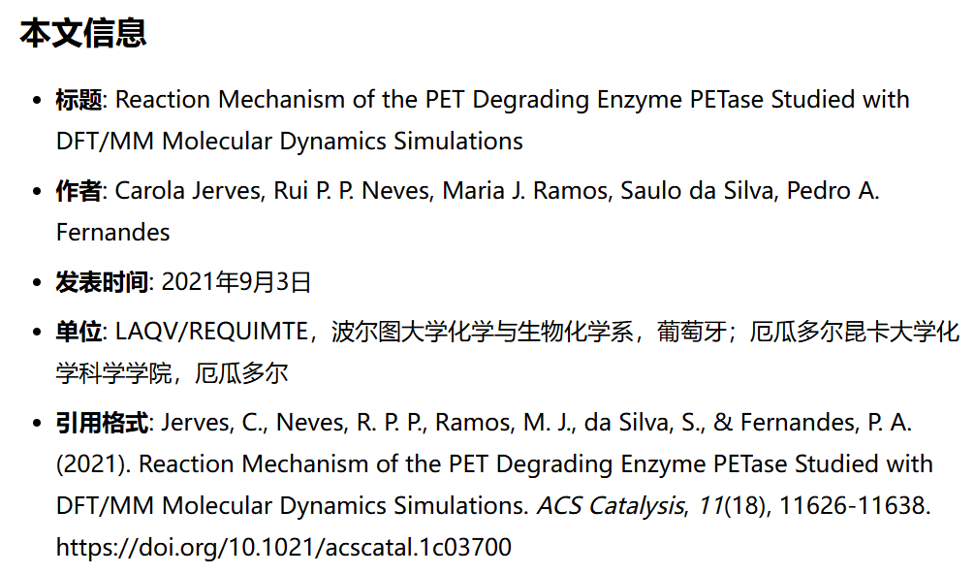
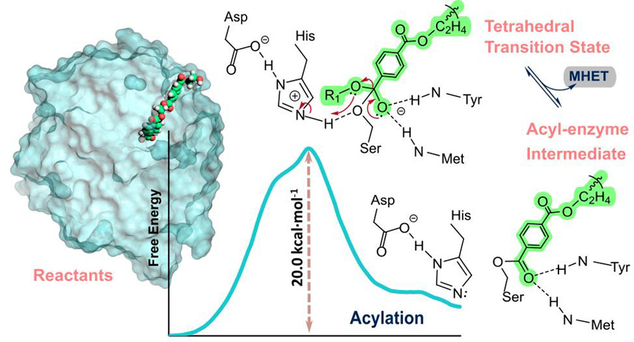
Reaction Mechanism of the PET Degrading Enzyme PETase Studied with DFT/MM Molecular Dynamics Simulations
https://mp.weixin.qq.com/s/cFj0yuJpCb5X_RouKbMz2g
https://mp.weixin.qq.com/s/AfP5Cw8lSBrSWJ6x-n9_aA
Reporter: 高旭帆
Date: 2025.12.15

Slide 2
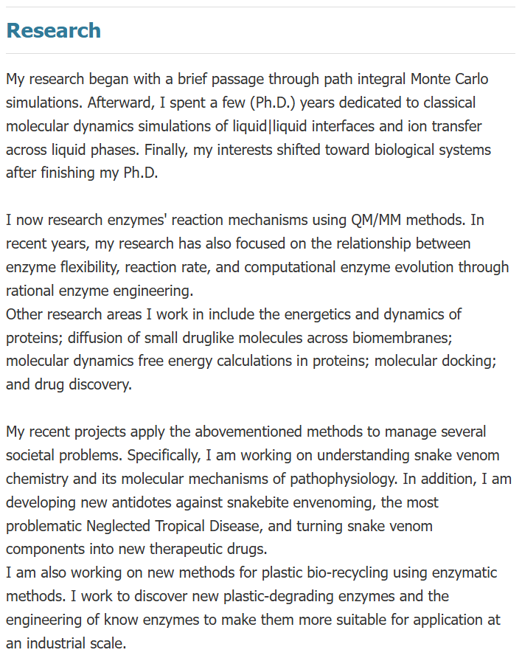
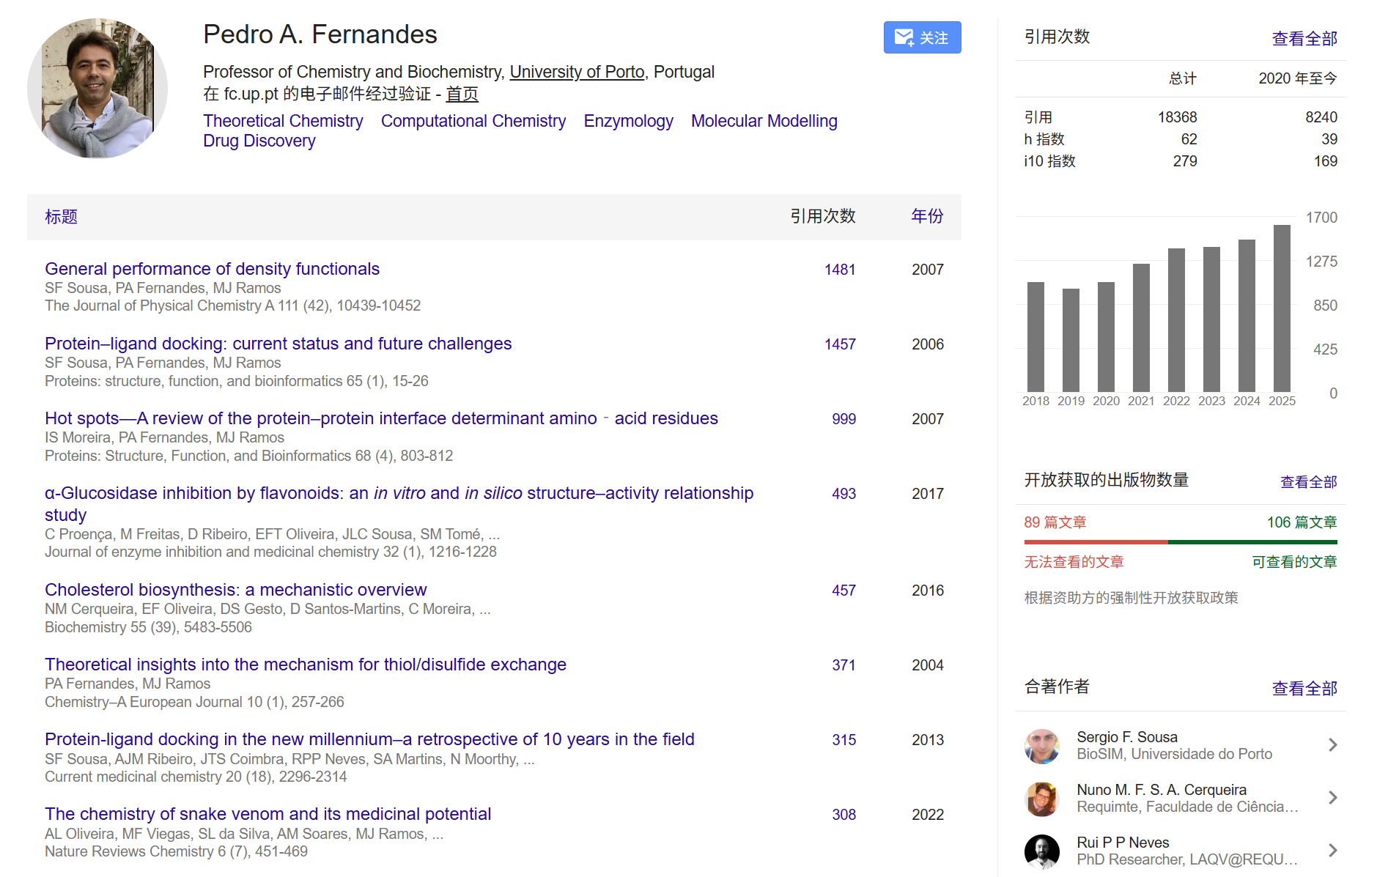
Authors
Introduction
31 papers in 2025!
https://www.fc.up.pt/pessoas/pafernan/

Slide 3
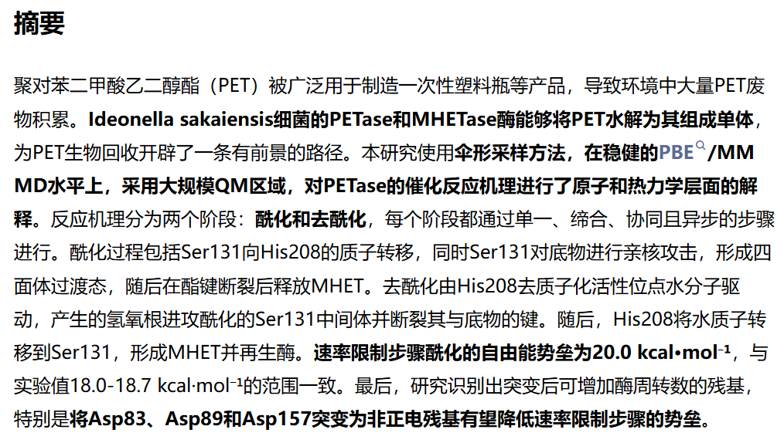
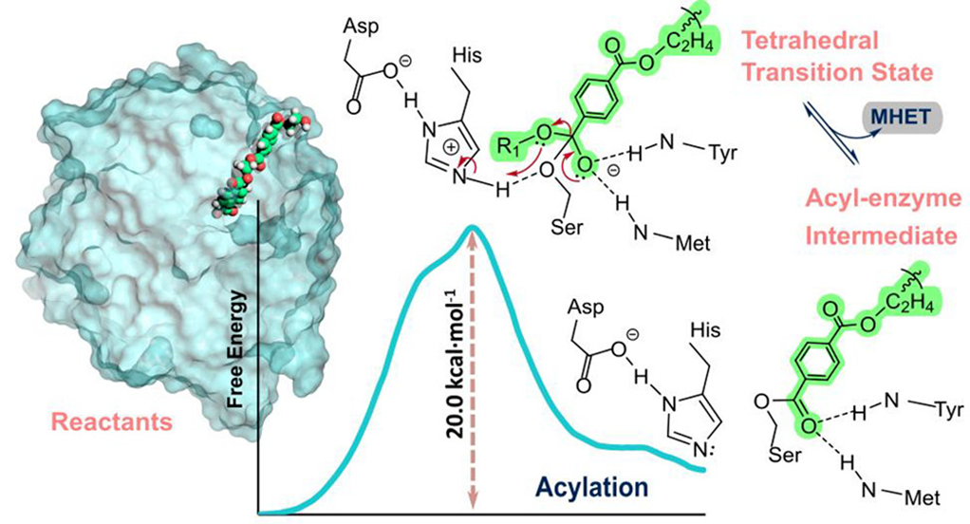
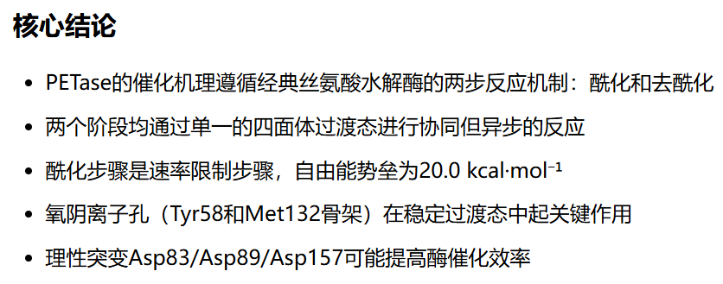
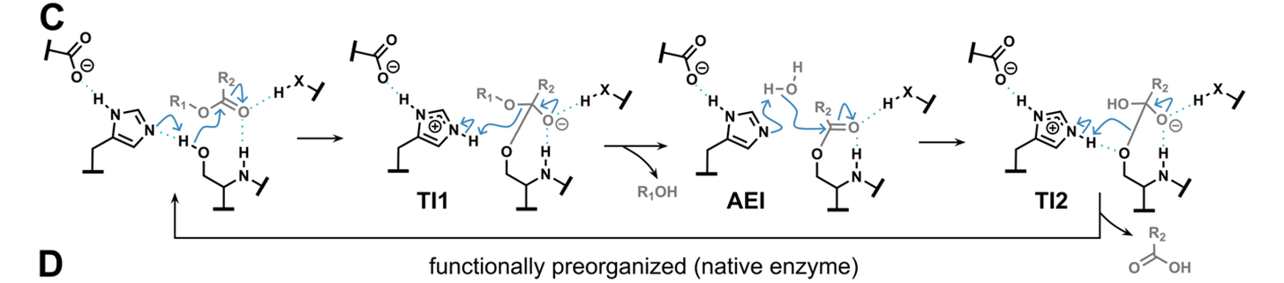
Overview
Introduction

Slide 4
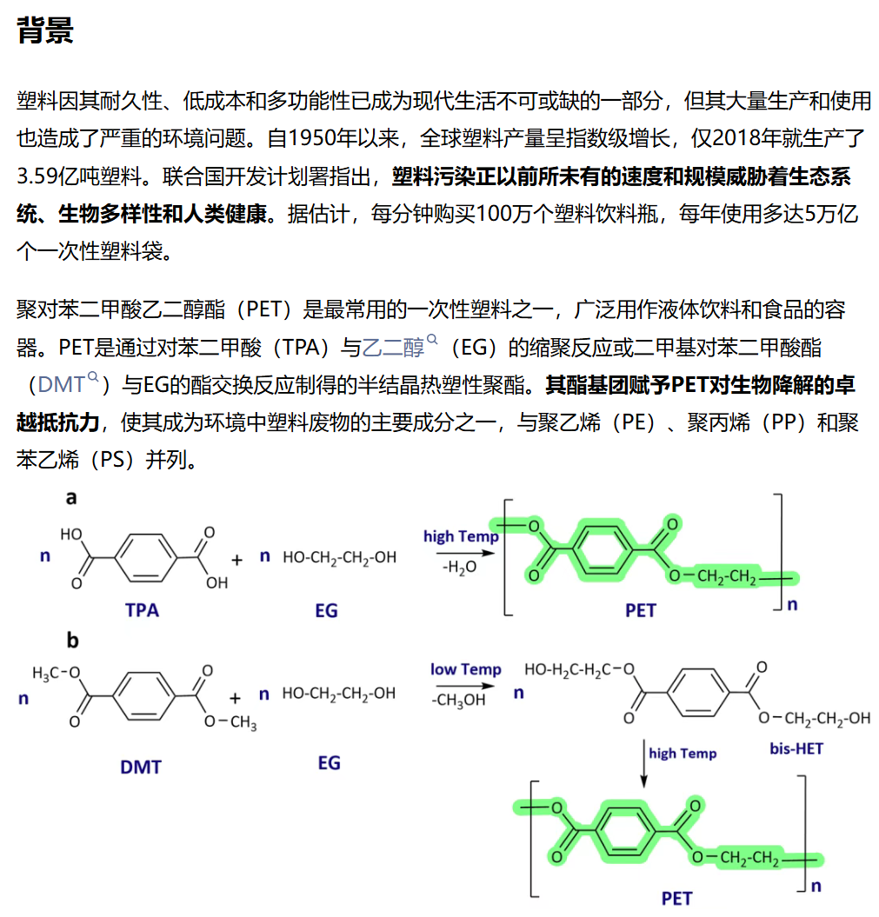
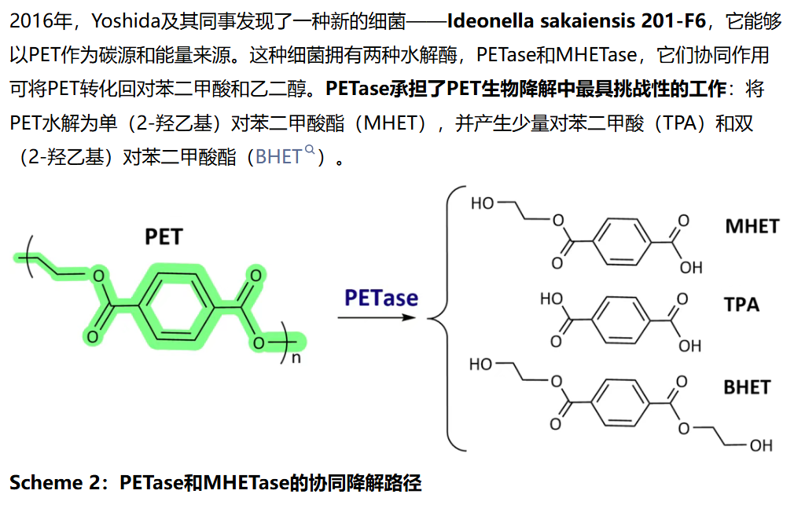
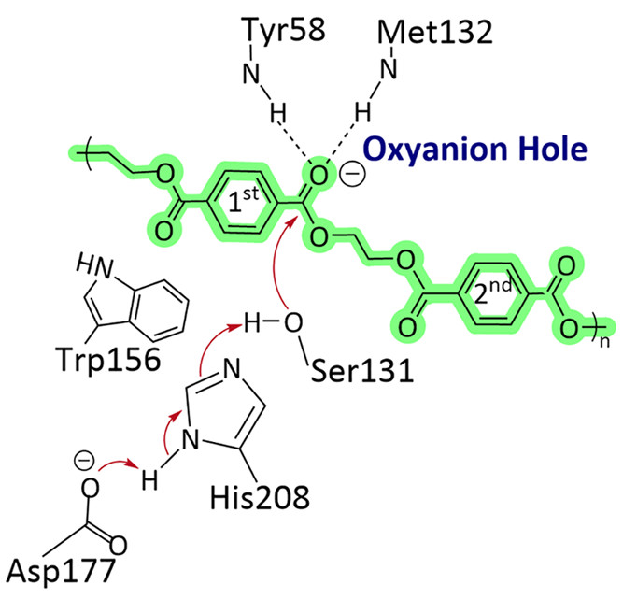
What does PETase do?
Background
基于晶体结构和诱变实验，Han等人提出PETase可能遵循经典丝氨酸水解酶的催化机制，涉及Ser131-His208-Asp177催化三联体。然而，该机理的详细原子过程、过渡态结构和能量学特征仍需要高精度理论计算来验证和补充。本研究正是在此基础上，使用QM/MM方法提供完整的热力学和动力学描述。

Slide 5
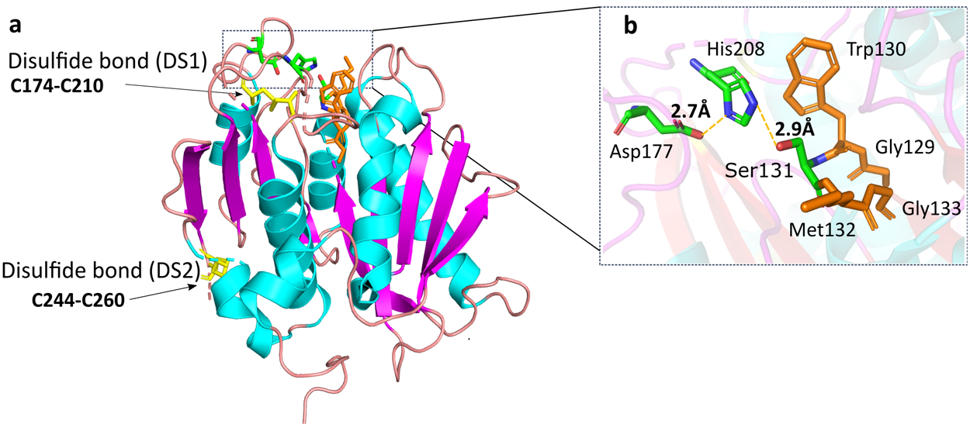
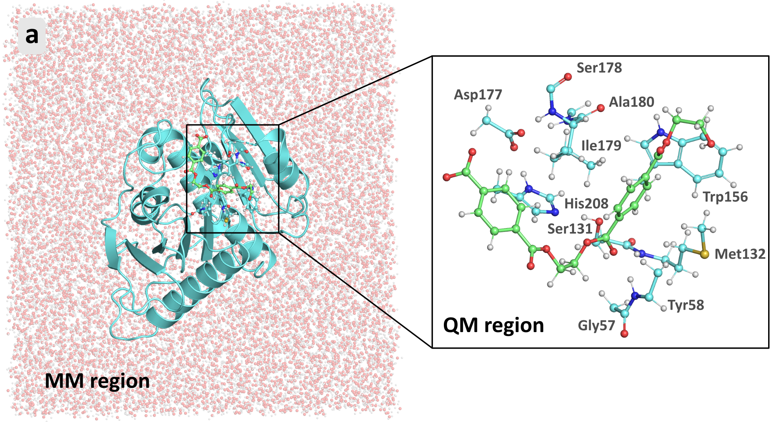
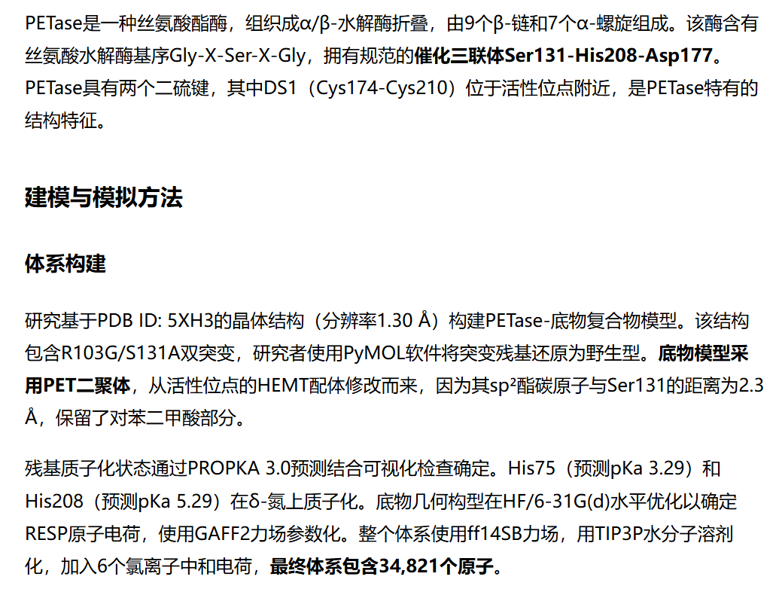
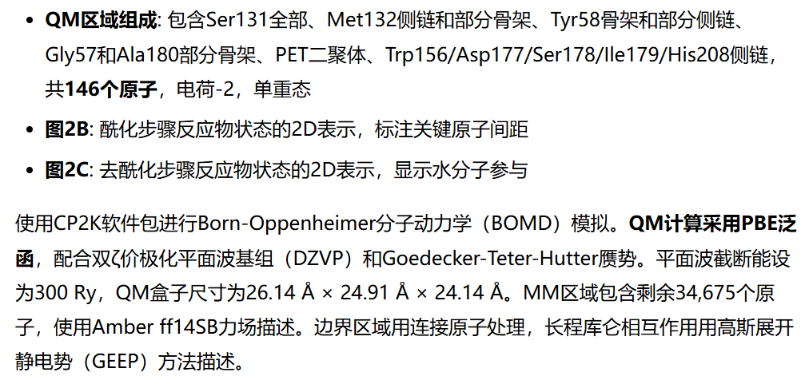
DFT/MM MD simulation
Methods
Notes:
GEEP（Gaussian Expansion of Electrostatic Potential）是CP2K中QM/MM耦合的一种方法。 QM/MM耦合的问题 在QM/MM模拟中，QM区域和MM区域的静电相互作用是最关键的： - QM区的电子密度是连续分布的 - MM区的电荷是点电荷 如何高效计算两者之间的静电作用？ GEEP的解决方案 将MM区的点电荷产生的静电势展开为一系列高斯函数的叠加： $$ V_{\text{MM}}(\mathbf{r}) \approx \sum_{i=1}^{N_{\text{Gauss}}} c_i \text{Erf}(r/r_c) / r $$ - 优点1：高斯函数的积分在DFT中可以解析计算，速度快 - 优点2：支持周期性边界条件（PBC），适合溶剂化体系 - 优点3：可以同时计算QM-QM和QM-MM的相互作用力

Slide 6
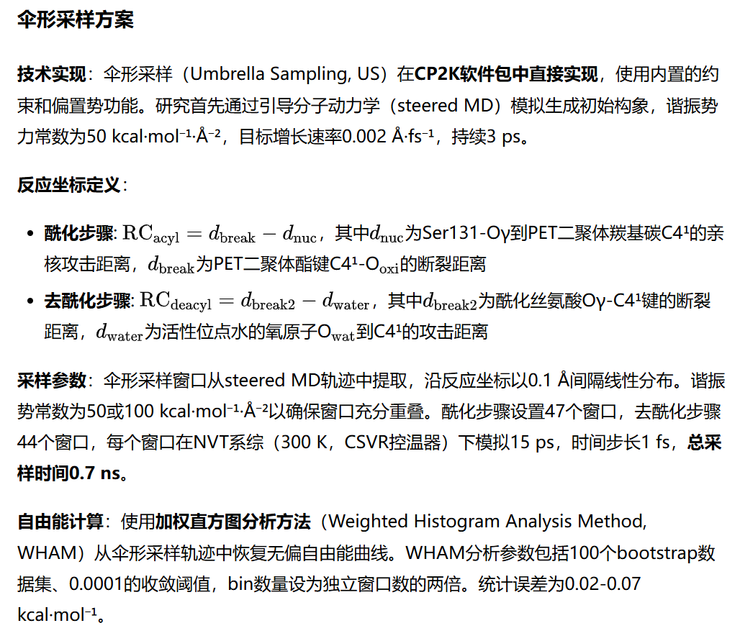

Umbrella sampling and CV choice
Methods

Slide 7
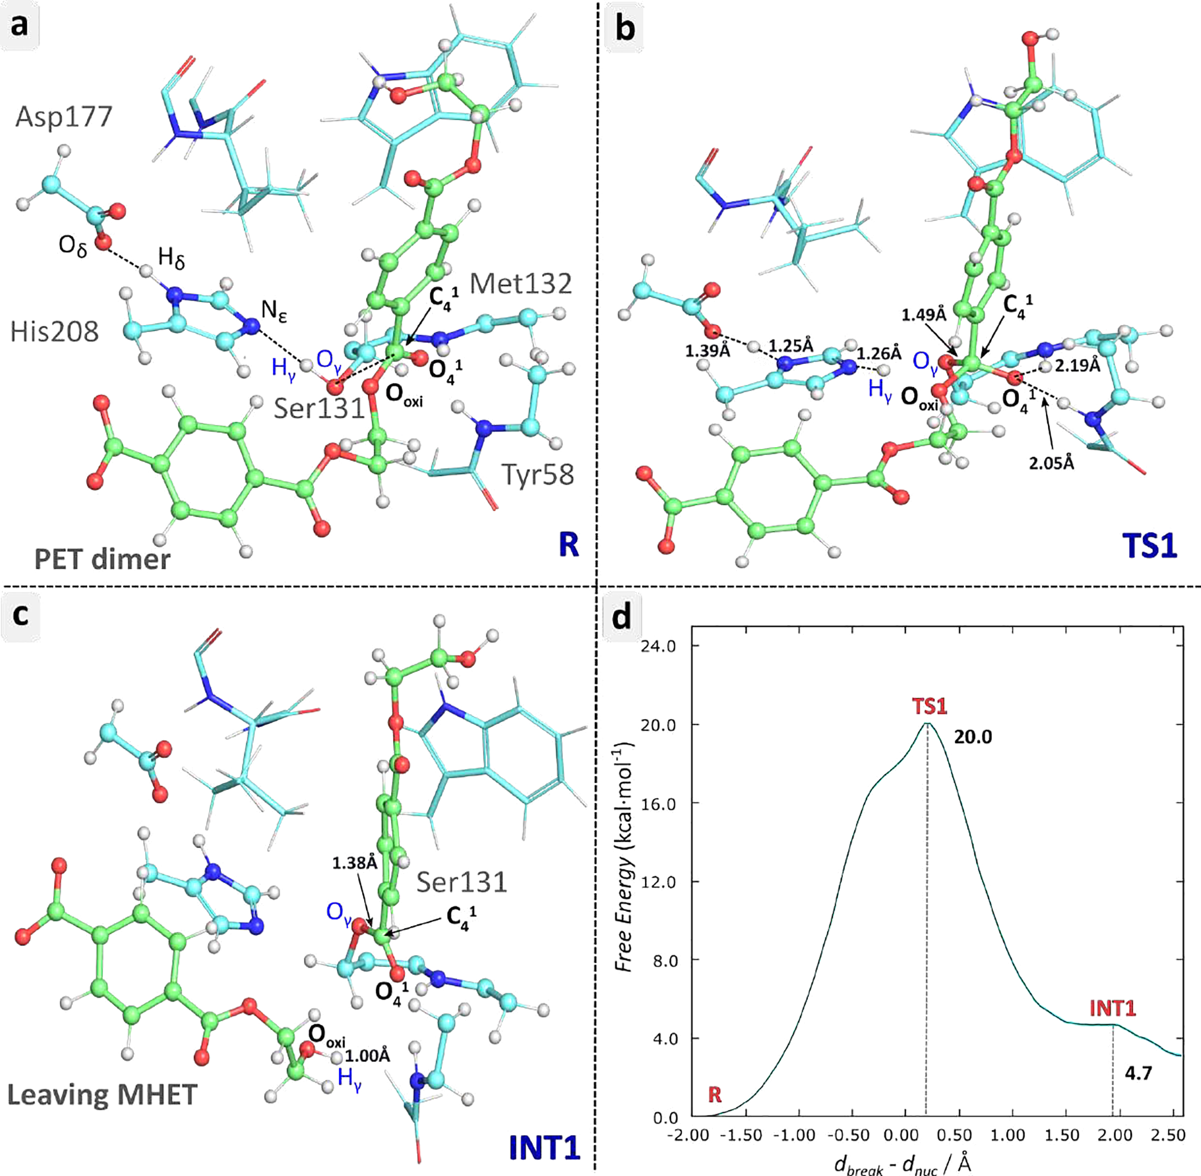
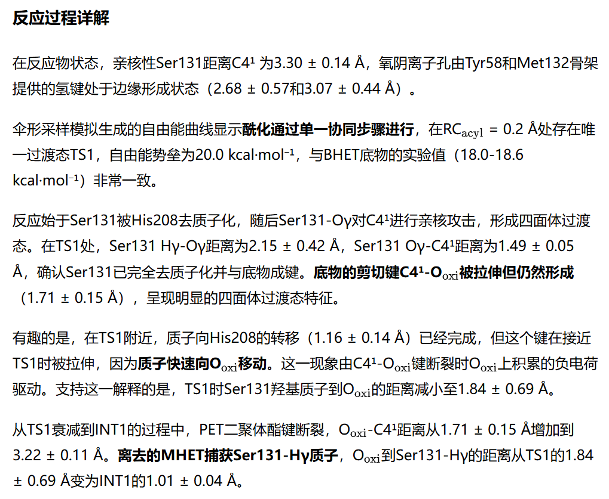
The acylation process
Results

Slide 8
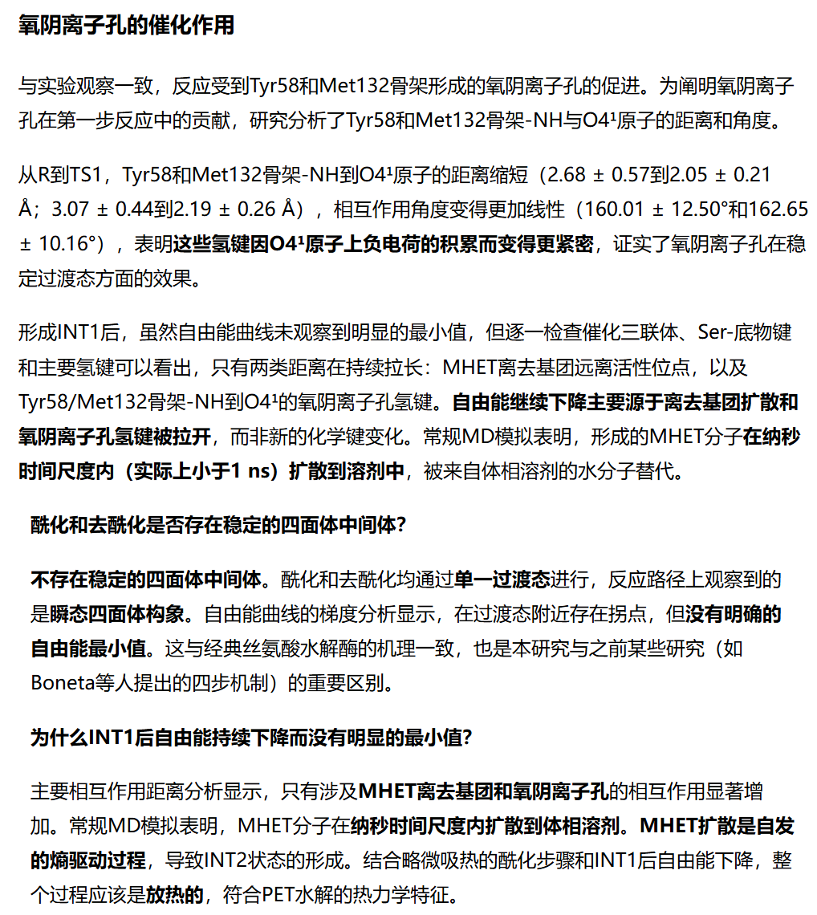
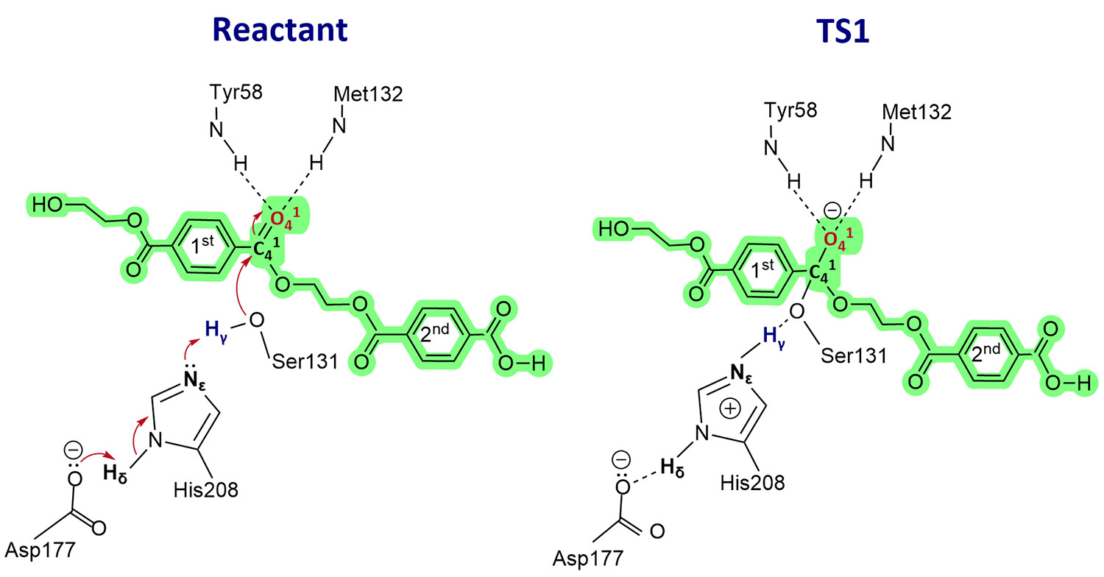
The acylation process
Results

Slide 9
The acylation process
Results

Slide 10
The acylation process
Results

Slide 11
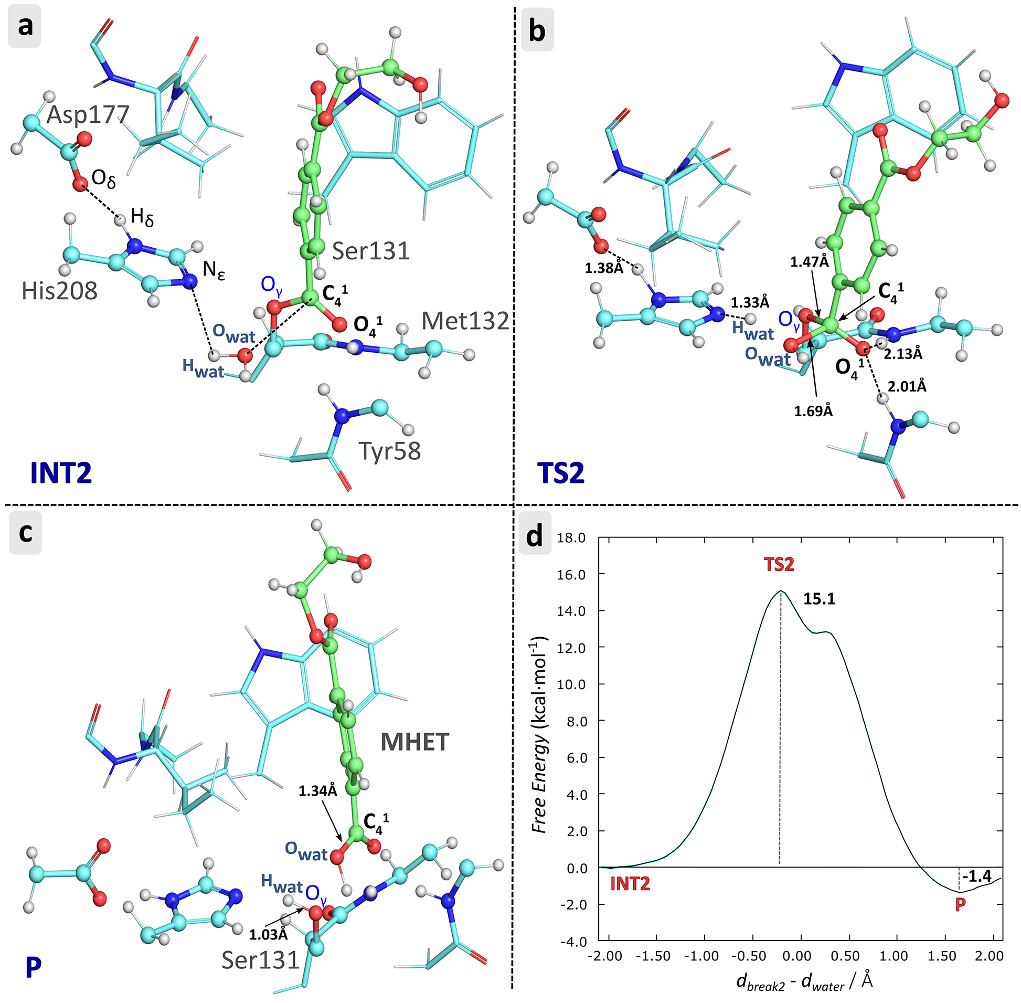
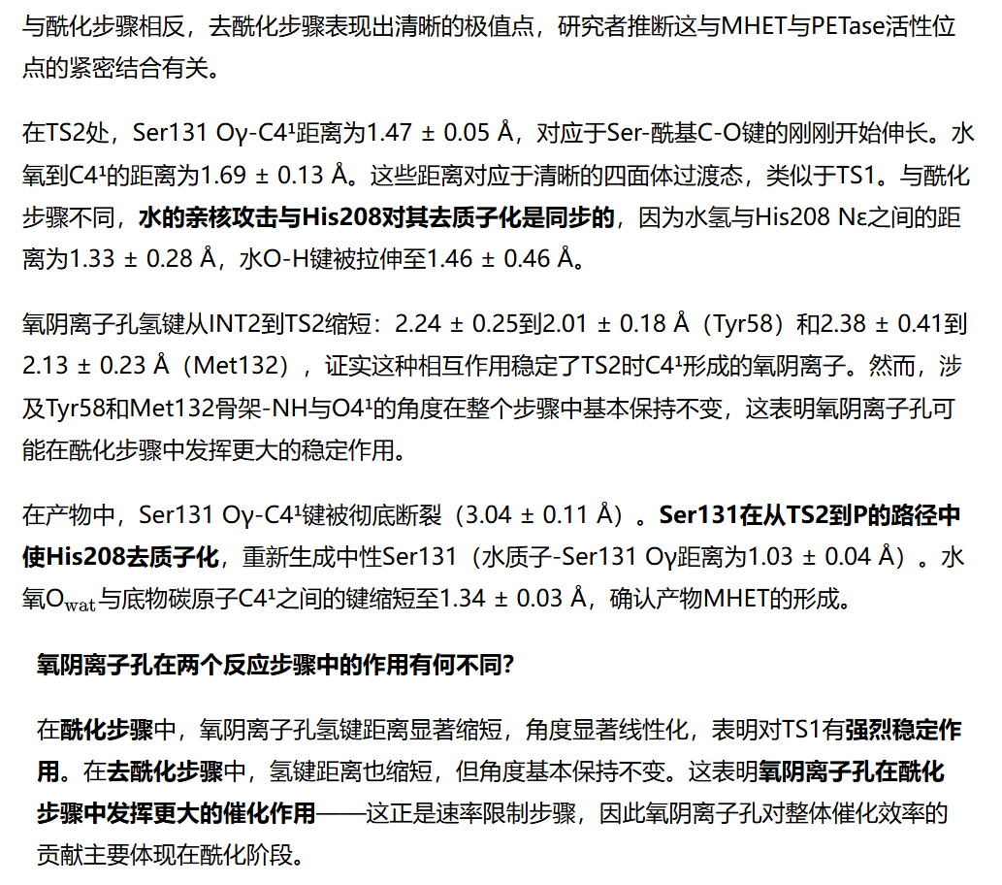
The deacylation process
Results

Slide 12
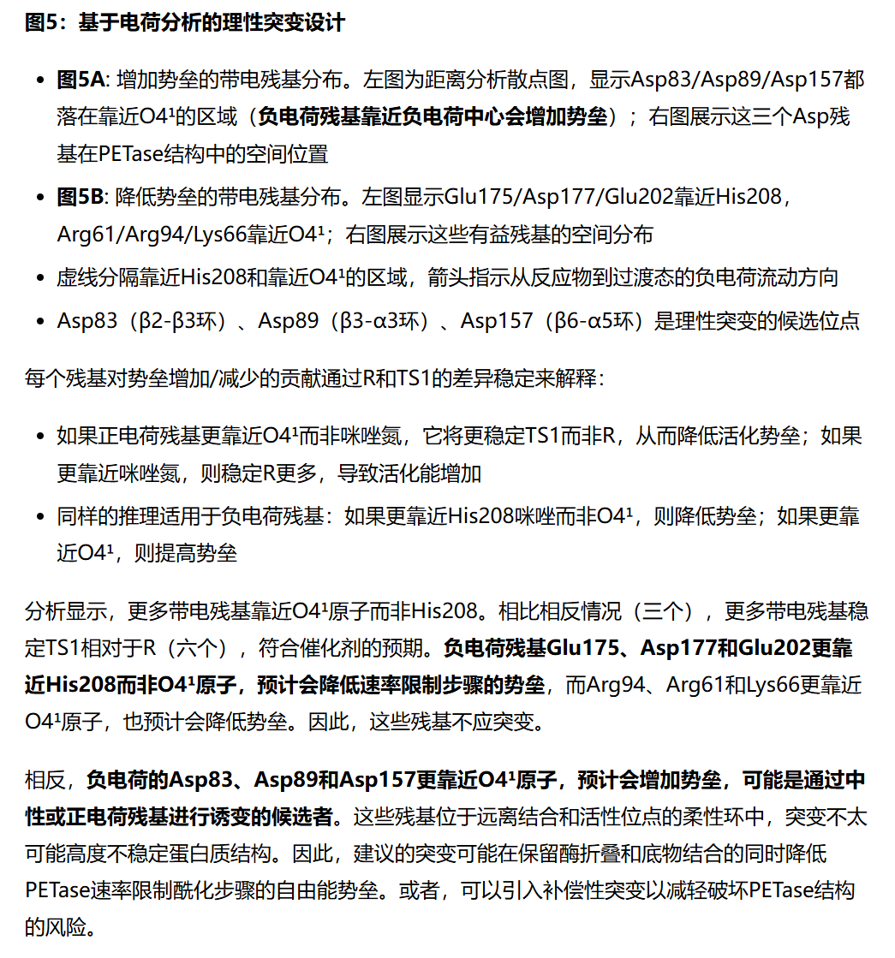
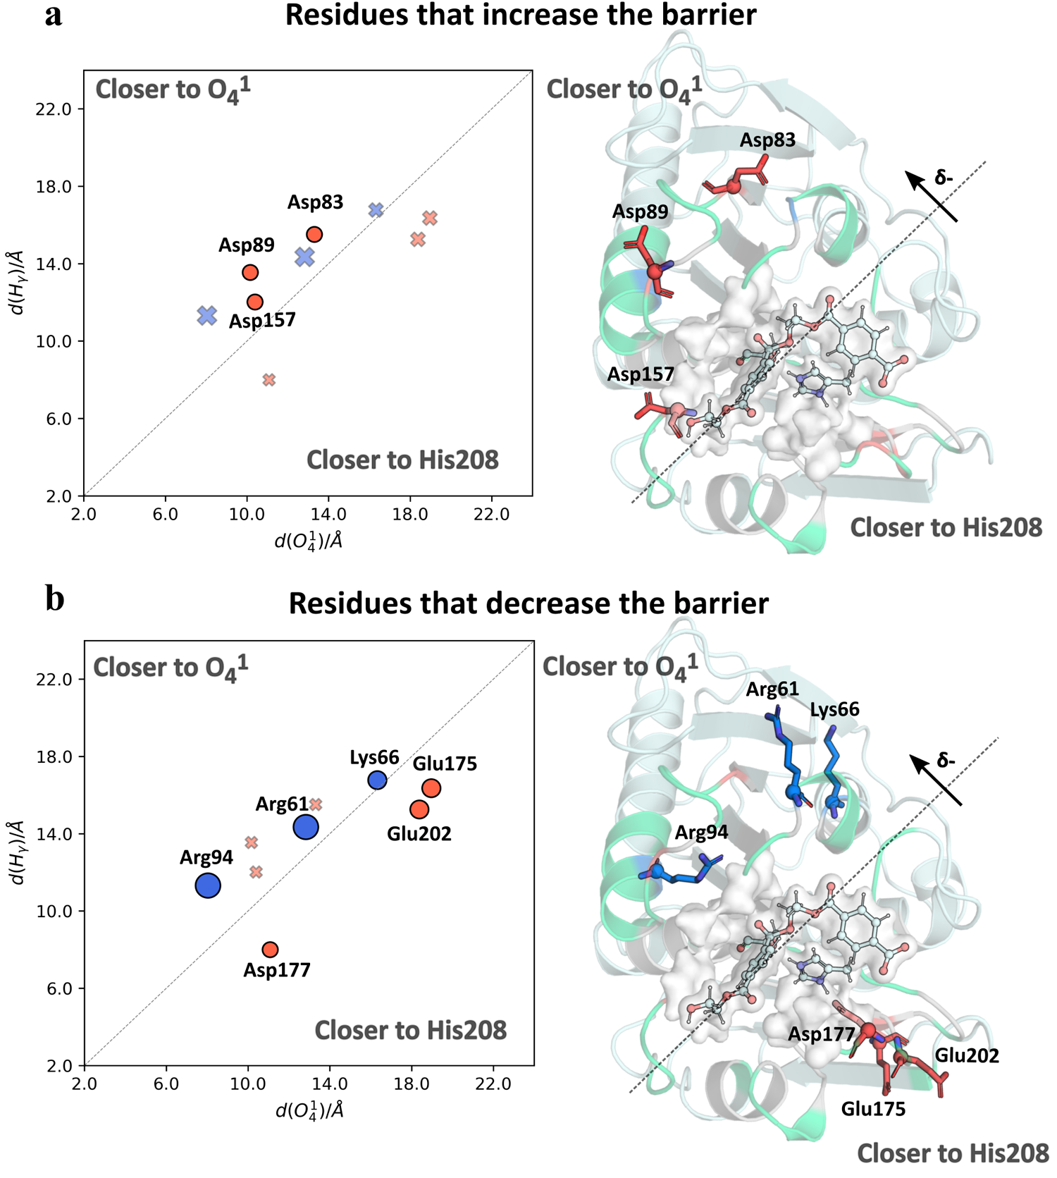
Engineering of PETase to Increase the Reaction Rate
Results

Slide 13
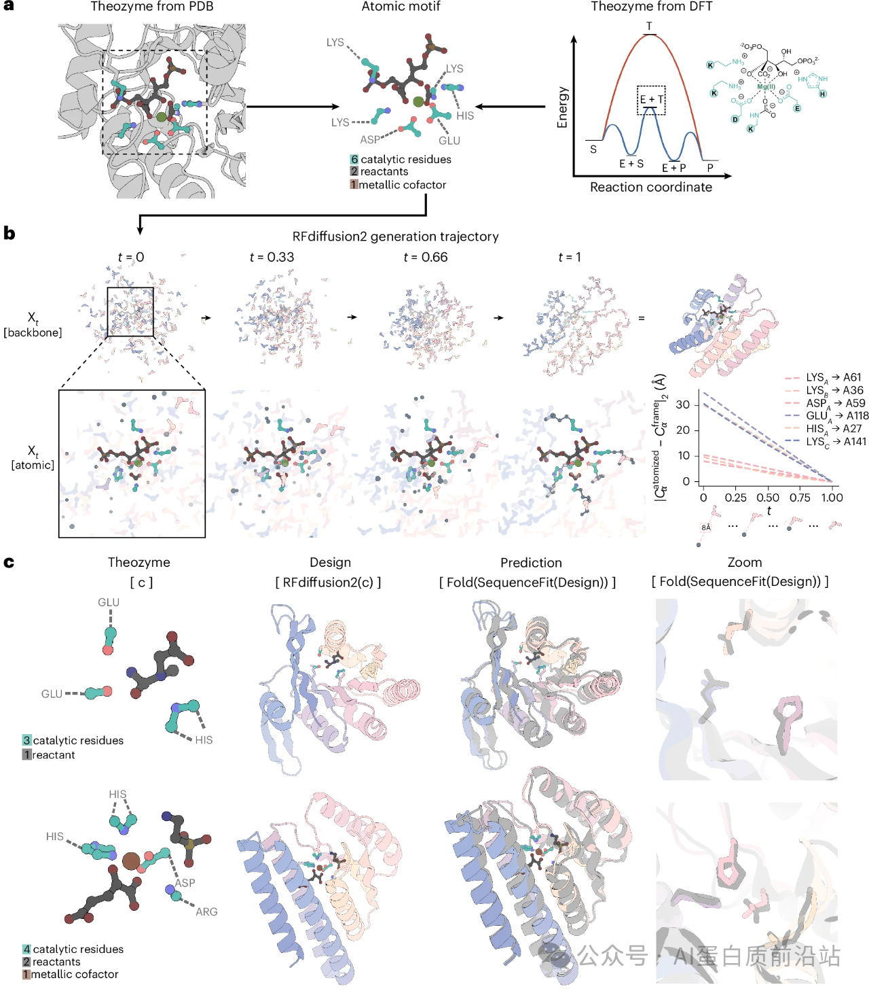
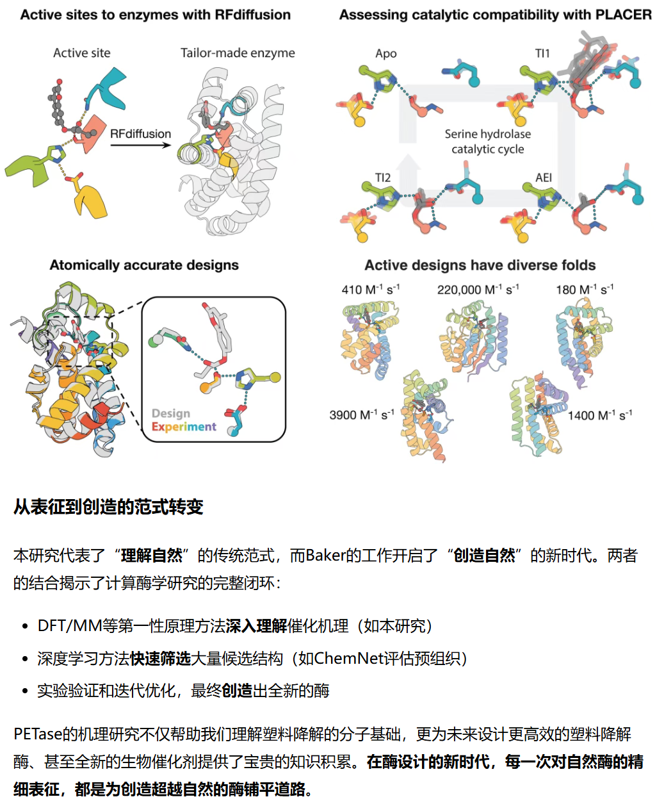
Frontiers in AI enzyme design
Discussion

Slide 14
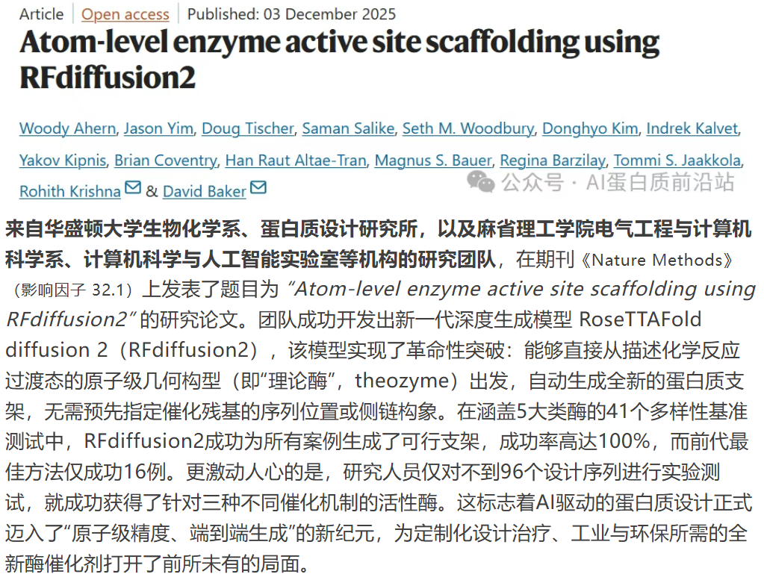
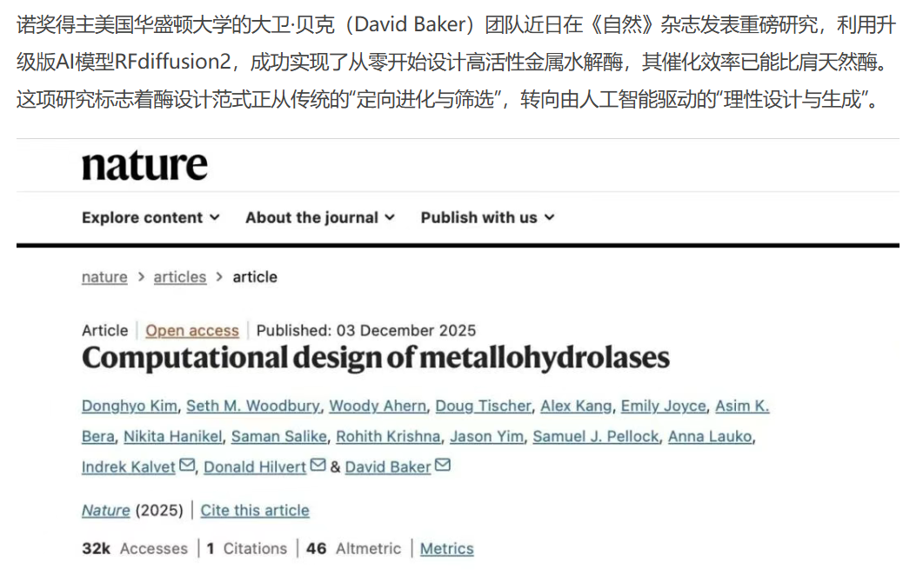
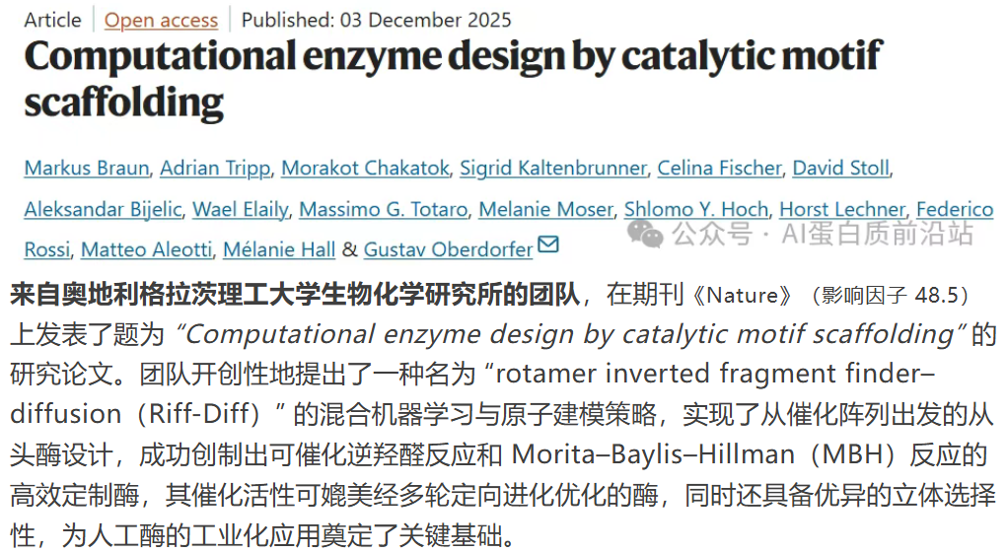
Frontiers in AI enzyme design
Discussion
AI enzyme design: pros and cons
Provide candidates so fast
New scaffolds
Multi-objective optimization
No subatomic accuracy: cannot beat the nature
Requires detailed molecular modeling
A complex process! Lacking pocket dynamics etc.

Slide 15

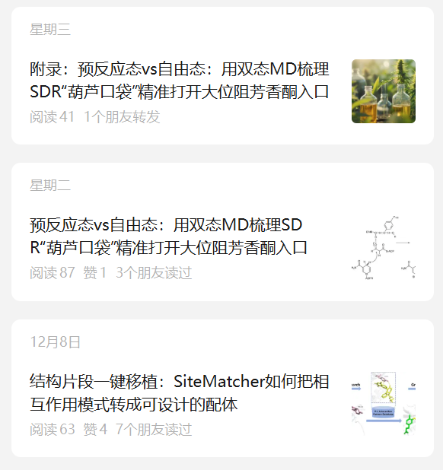
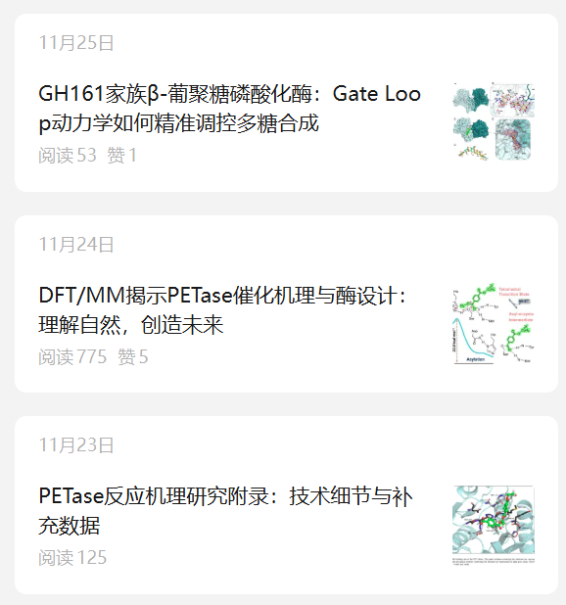
Thanks for listening!

Slide 16
Take-home messages & thoughts
Summary
Results and Limitations
far higher than previously reported catalytic triad-based serine hydrolase designs
able to design enzymes for any scaffold
still orders of magnitude slower than native hydrolases (3.8 x 10³)
the oxyanion hole identities and geometries differ slightly from those in native structures (for some, mutation does not affect the activity)
Inspirations
motif scaffolding works better than traditional scaffold searching
still strictly following natural designs
the catalytic residues themselves might not be enough…
the more restraint added, the better success rate is
enzymes are intricate machines; more mechanism studies are required…

