Slide 1
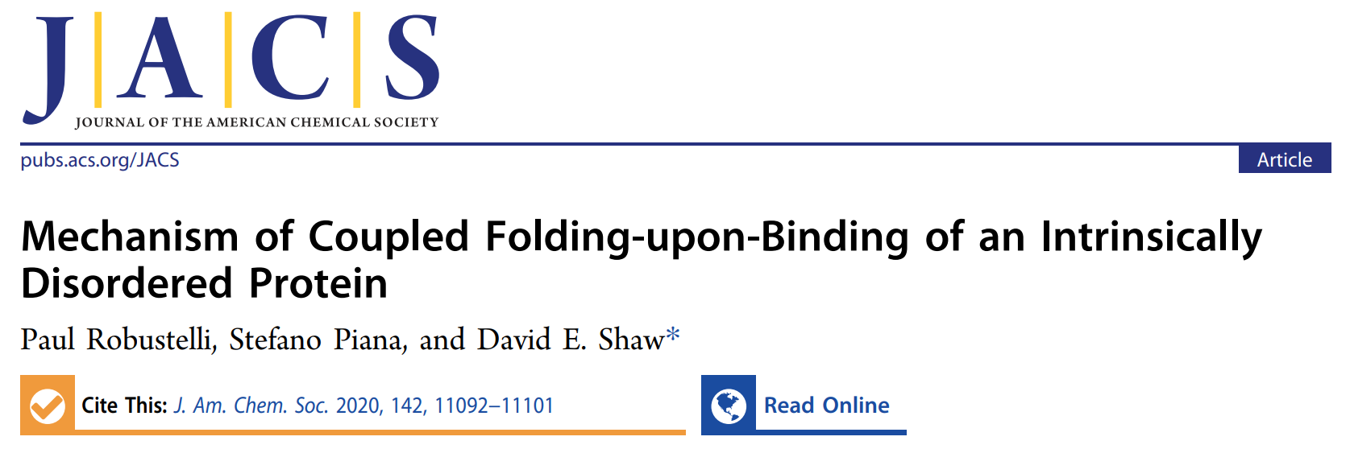
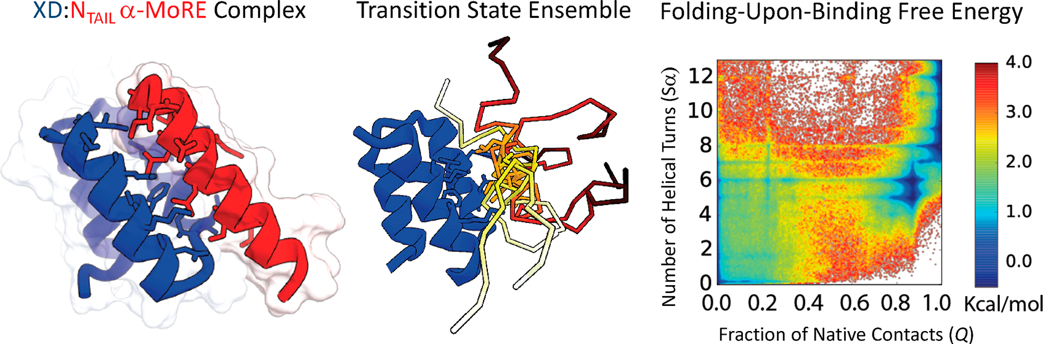


Reporter: 高旭帆
Date: 2023.11.24
Paul
D.E. Shaw
Notes:
https://mp.weixin.qq.com/s/HhAks-FIDMD0a60AfNYYxw

Slide 2
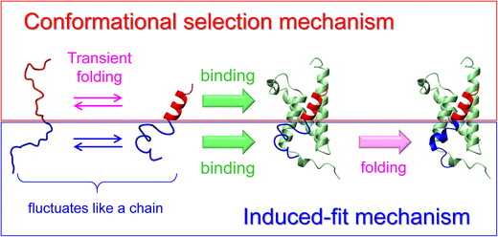

Background
Folding-upon-binding
Also known as coupled folding and binding, binding-induced folding, disorder-to-order transitions
Induced fit vs conformation selection
Highlights:
200-μs unbiased all-atom MD simulation with Anton
folding-upon-binding primarily occurred through induced-folding pathways
conformations with more helical content were more likely to unbind than with intermediate helical content
the transition state ensemble
just a few key intermolecular contacts
highly structurally heterogeneous
Biophys Rev 2018, 10, 2, 163–81.

Slide 3
Minimums | Sα Range | Percentage in Ensemble
Disordered State | Sα < 1 | 39.8%
Compact State | 3 < Sα < 4 | 13.0%
Complete Helix | Sα > 12 | 0.3%
 | IDPs | Ligand/Globular proteins
Mechanism | Induced-fit | Conformation selection
Reason | Slow folding in free form | Rapid conformational change

Slide 4
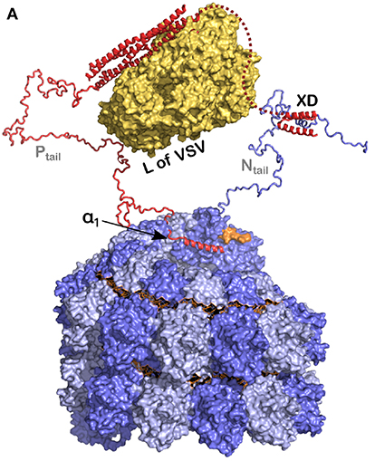
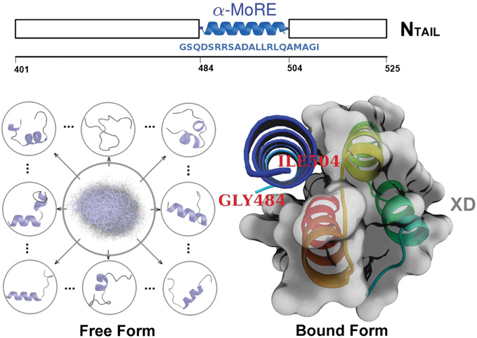
Methods
System setup
α-helical molecular recognition element
X domain （458-506）
measles virus (麻疹病毒)
A classical system to investigate folding-upon-binding (PDB id: 1T6O)
FF: a99SB-disp protein+water, CHARMM22 ions
2.5 fs time step, 1:2 RESPA scheme
Front Microbiol 2019, 10.
Proc Natl Acad Sci 2013, 110, 40.
Notes:
484-504

Slide 5
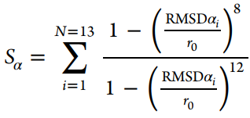
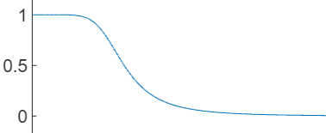
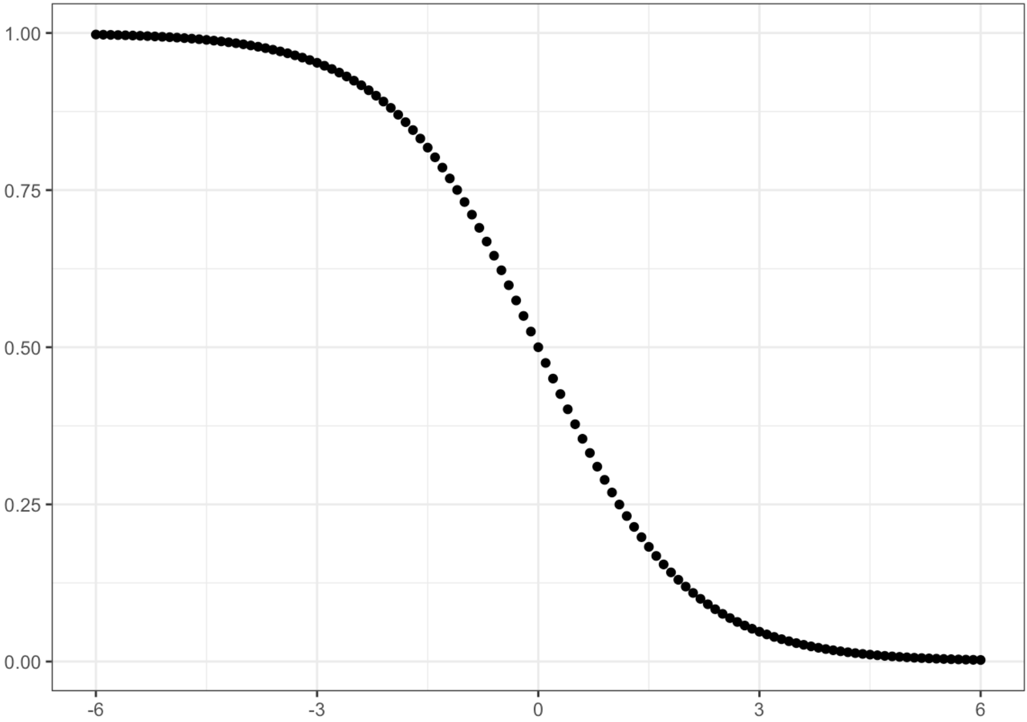

Methods
Definitions and reaction coordinates
S_{α} is α-helical folding order parameter
Larger S_{α}: more helical content.
RMSD_{αi}: RMSD of the backbone atoms of the 6-residue fragment i from an ideal α-helical geometry; r₀ = 0.8 Å.
Sum over all consecutive 6-residue segments. Ranges from 0~13.
Q is the fraction of native intermolecular contacts
cutoff x₀ = 5 Å
Native contacts were defined as those in crystal structure PDB 1T6O
Binding and unbinding events were determined as transitions between states where Q = 0 and Q > 0.95
where values of Q were smoothed using a running average with a 2 ns window.
Each frame in the trajectory was assigned as either belonging to a transition path or not.
Notes:
True if any two atoms in a pair of residues are within 5 Å.
Enough to represent folding propensity with these variables
, using a dual-cutoff approach

Slide 6
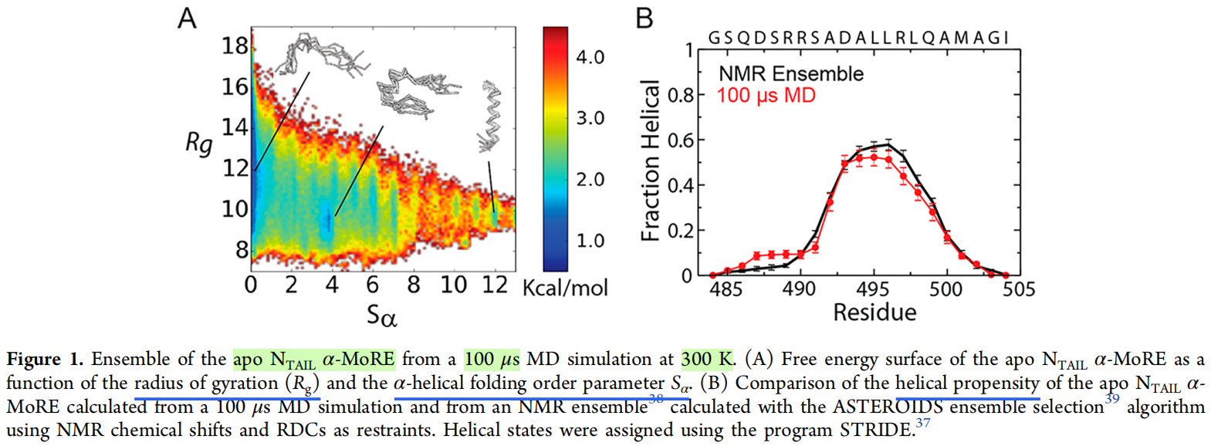
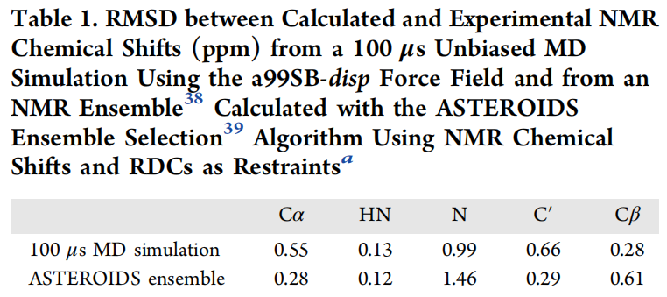
Results
Validation of methods with apo α-MoRE
A: more expanded than previously reported NTAIL α-MoRE MD ensembles calculated with the CHARMM22* force field.
B: in rough agreement with experiments
helical propensity
NMR chemical shifts
residual dipolar couplings (RDCs)

Slide 7
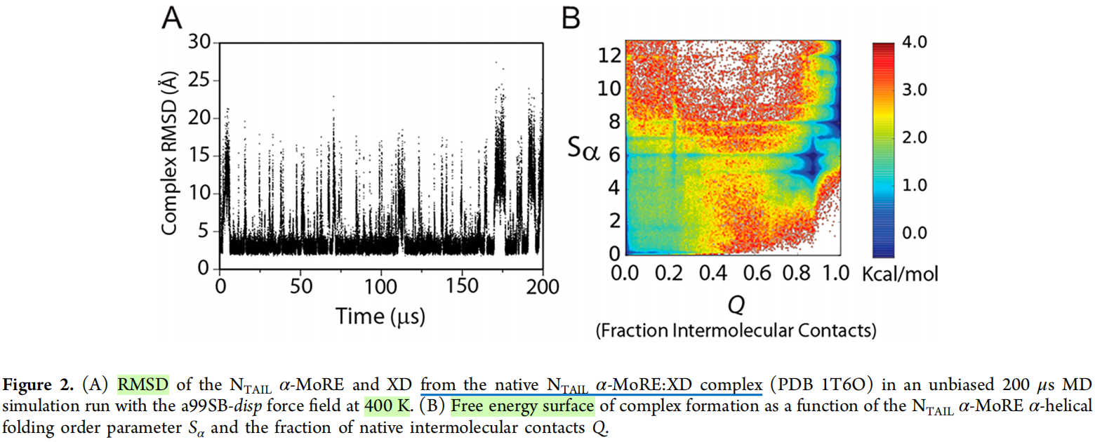
Results
Contact formation and folding occur concurrently
Why 400K?
XD domain remained folded, but melted α-MoRE
Frequent (72) binding and unbinding transitions
For 0 < Q < 0.1, low helical content (average S_{α} = 3.7)
A free-energy minimum at Q = 0.85 and S_{α} = 5
more helical content only after Q > 0.95
No conformation selection
Just induced folding
Notes:
Or before

Slide 8
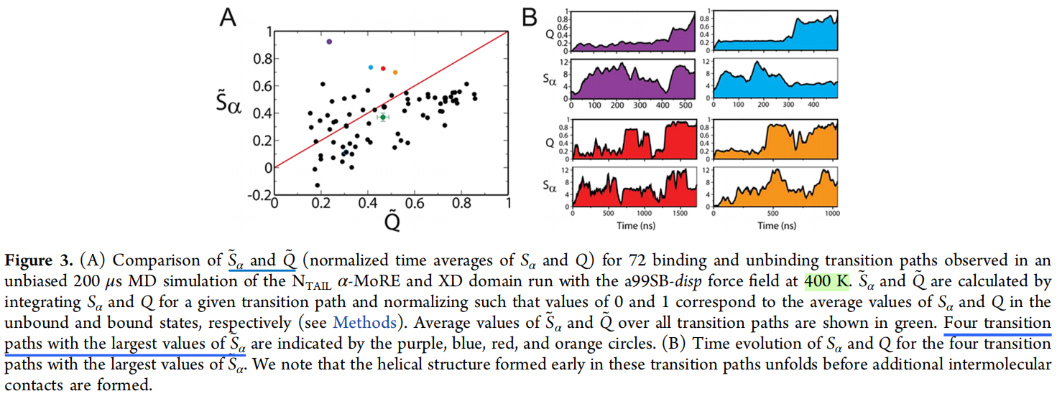
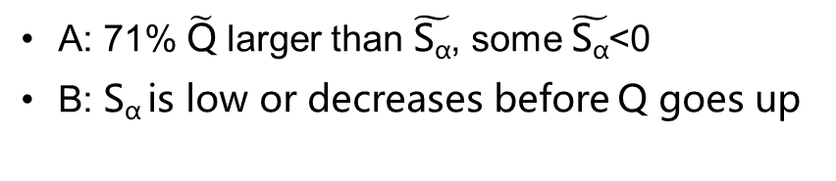

Results
$\tilde{\text{Q}}$ and $\tilde{\text{S}\text{α}}$ in transition paths indicates induced folding
normalized time averages of Q and S_{α}
$\tilde{\text{Q}}$, $\tilde{\text{S}\text{α}}$=0: apo MD average
$\tilde{\text{Q}}$, $\tilde{\text{S}\text{α}}$=1: native complex
Each color represents a path
On average, formation of contacts is earlier than helices
unfold-to-bind mechanism? No clear ordering
A: 71% $\tilde{\text{Q}}$ larger than $\tilde{\text{S}\text{α}}$, some $\tilde{\text{S}\text{α}}$<0
B: S_{α} is low or decreases before Q goes up
Notes:
have even more of an induced-folding character at 300 K.

Slide 9
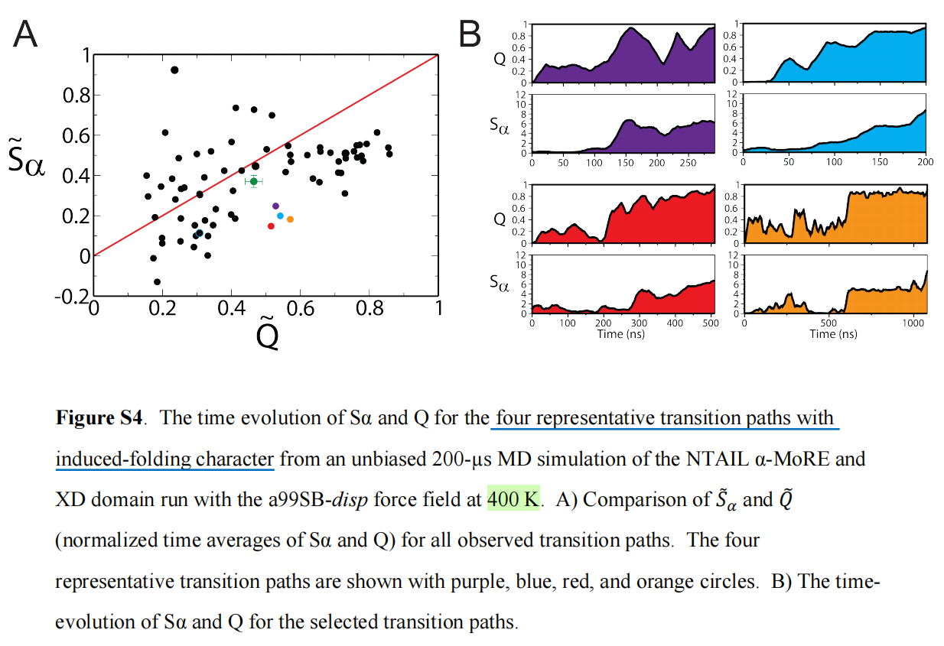
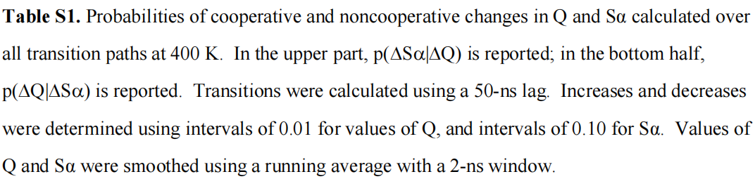
Results
Normalized Q and S_{α} in transition paths
 | Q Increases | Q Decreases | Q Equal
Sα Increases | 0.66 | 0.24 | 0.11
Sα Decreases | 0.42 | 0.37 | 0.21
Sα Equal | 0.55 | 0.26 | 0.19
 | Sα Increases | Sα Decreases | Sα Equal
Q Increases | 0.62 | 0.26 | 0.12
Q Decreases | 0.42 | 0.46 | 0.12
Q Equal | 0.33 | 0.49 | 0.18
Notes:
have even more of an induced-folding character at 300 K.

Slide 10
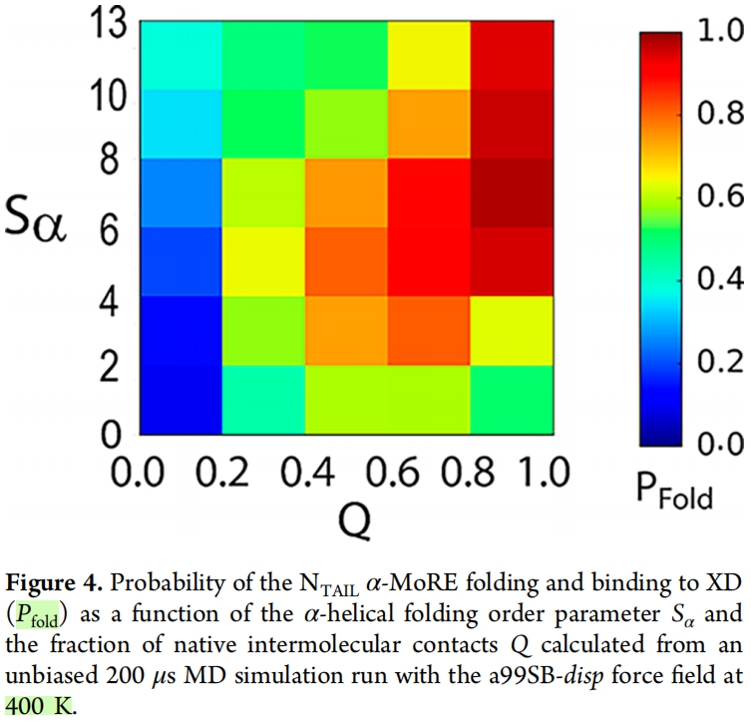
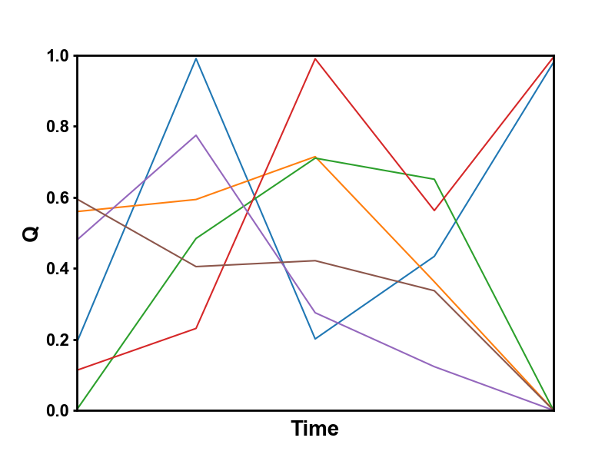

Results
Higher level of helicity isn’t always better for folding
P_{fold}= $\frac{2}{6}≈0.33$
bound
free
Probability of folding and binding for every frame
States with 0.2 < Q < 0.6, S_{α} > 6 were less likely to fold than states with 0.2 < Q < 0.6, 4 < S_{α} < 6
states with intermediate levels of helicity are more likely to make additional intermolecular contacts and ultimately form the stable native complex
Notes:
P_{fold} was computed as the probability that the trajectory started from one of the frames of that bin would reach values of Q > 0.95 before dissociating (Q = 0.0).
states with intermediate levels of helicity and more conformational flexibility are more likely to make additional intermolecular contacts and ultimately form the stable native complex

Slide 11
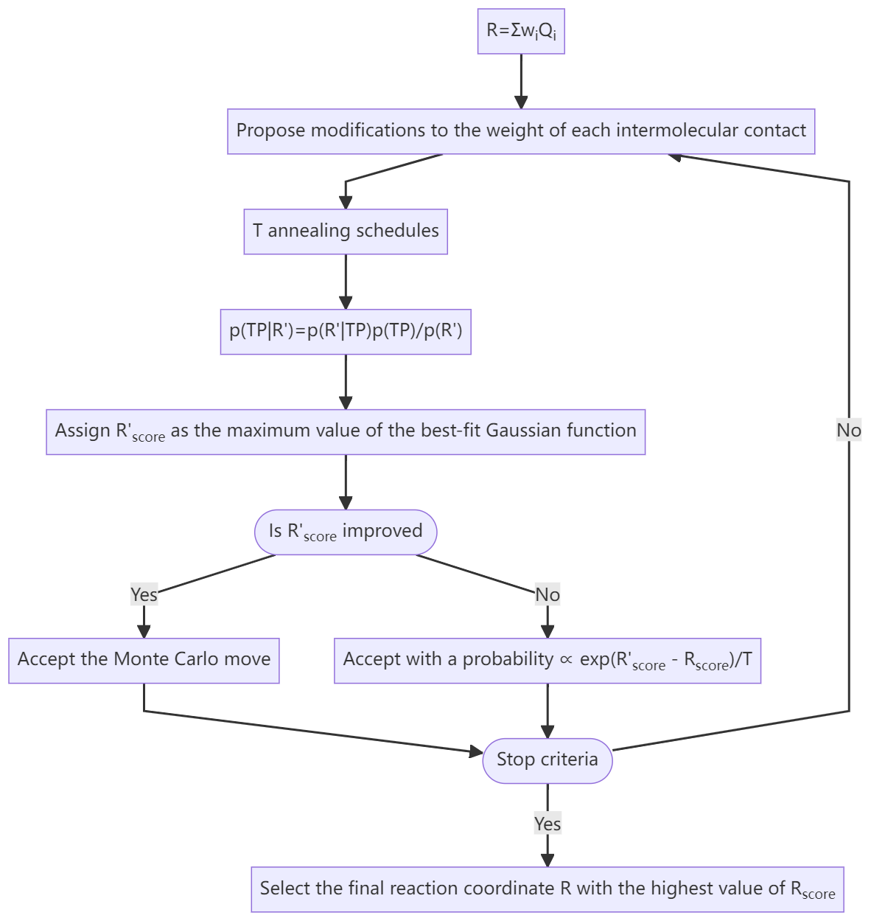
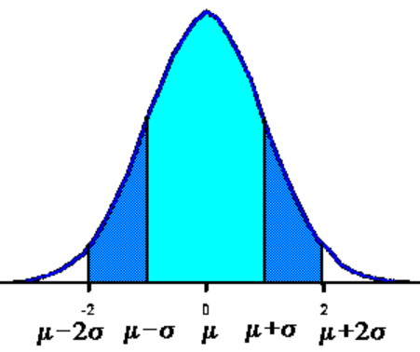
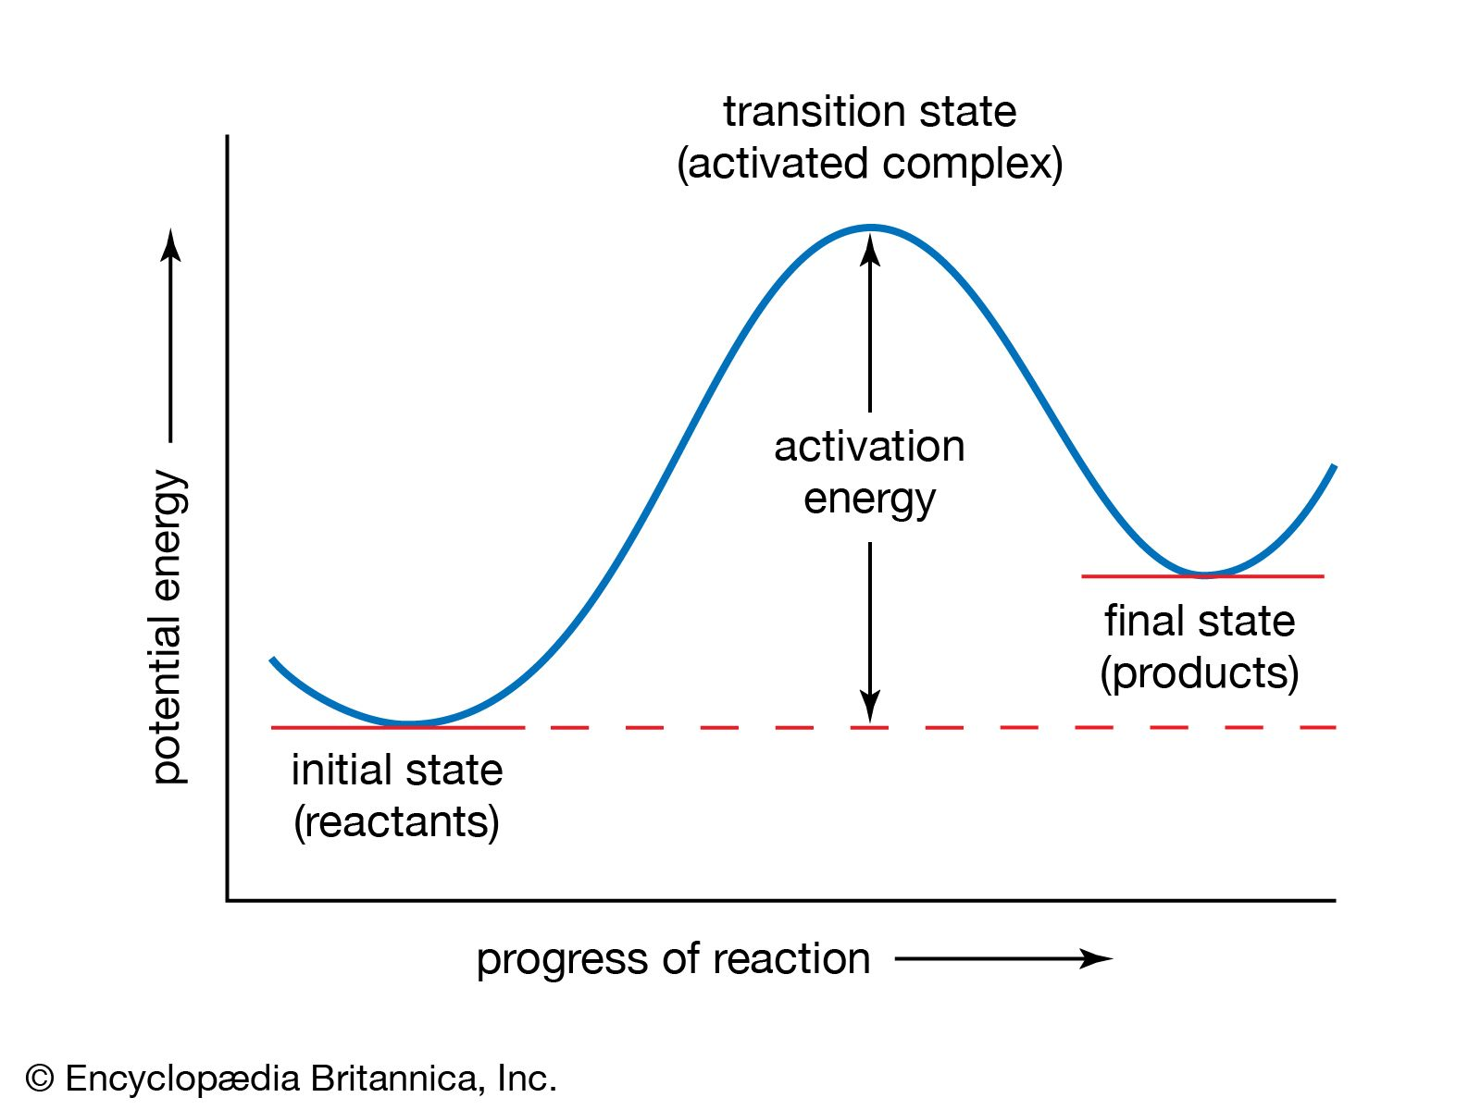
Results
Optimization of Reaction Coordinate Q into R
Variational optimization algorithm
Modification to the weight w_{i} was drawn from a Gaussian distribution centered at 0 with a standard deviation of 0.2
For an ideal reaction coordinate, p(TP|R) would resemble a Gaussian distribution with a maximum value of 0.5.

Slide 12
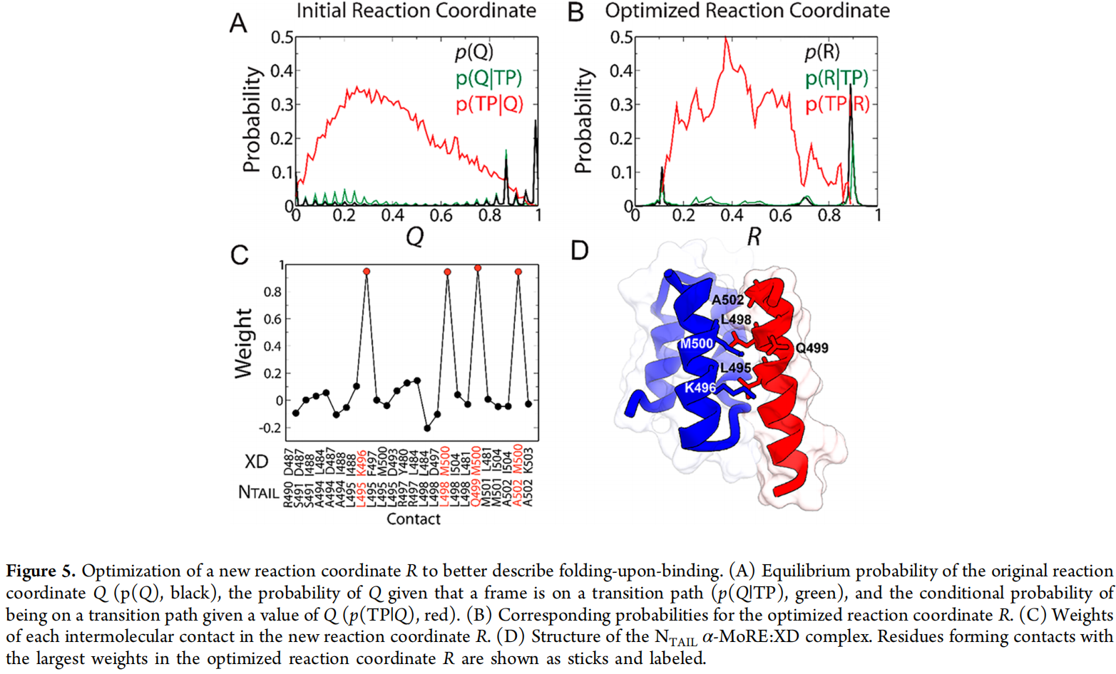
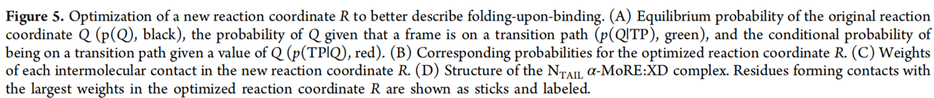
Results
Optimization of Reaction Coordinate Q into R
Most weights are close to 0
Key contacts: insertion of residues of L495 and L498 into the XD biding groove

Slide 13
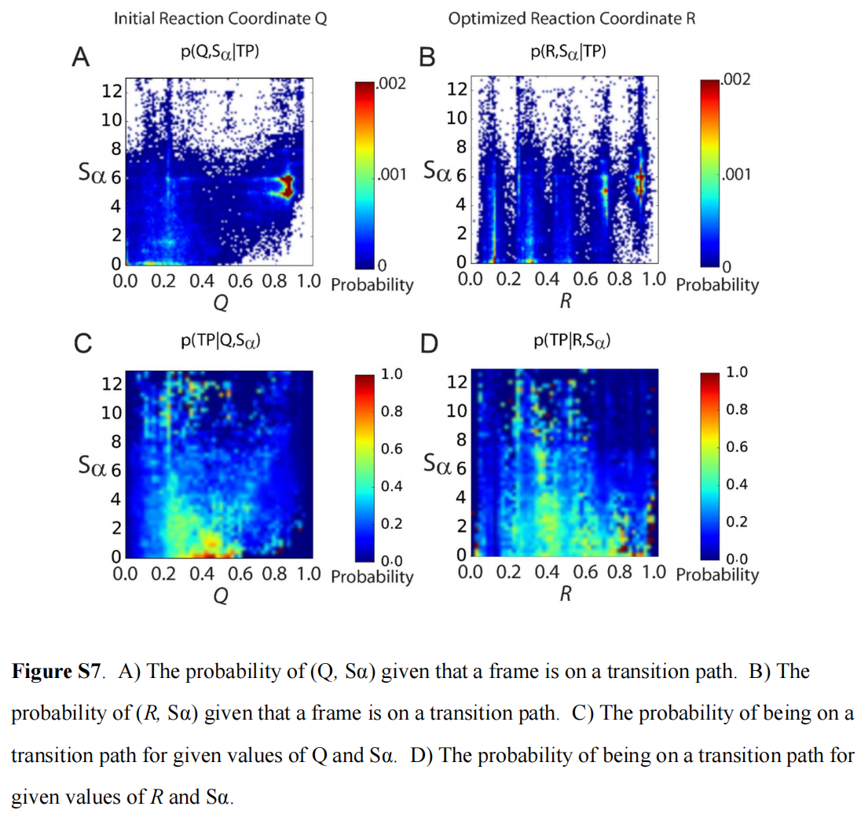
Results
Optimization of Reaction Coordinate Q into R
Notes:
AB says nothing?

Slide 14
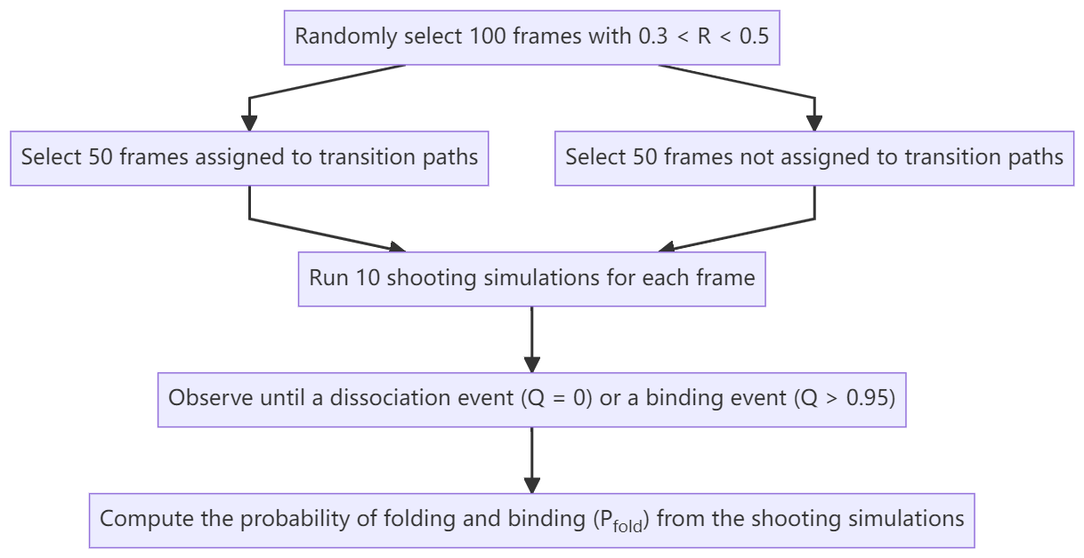
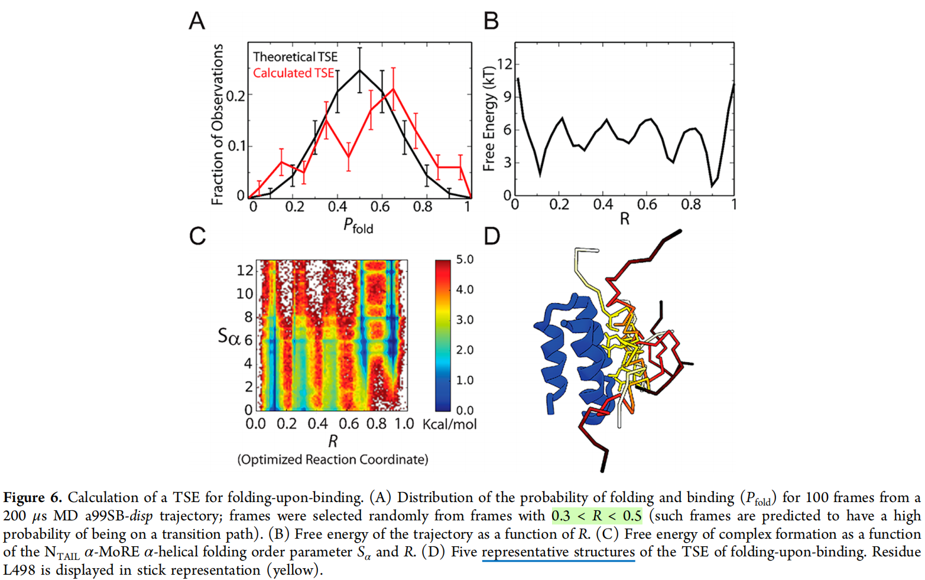
Results
Heterogeneous Transition State Ensemble (TSE) with R
R is a good reaction coordinate
structure and relative orientation of the NTAIL α-MoRE are highly heterogeneous.
A: In reasonable agreement with binomial distribution
C,D: no preferred structure/orientation
Notes:
In the TSE, the relative helicity of each residue was very similar to its helicity in the apo ensemble.
The unifying feature of the TSE appears to be the insertion of L498 and L495 in the binding groove of XD, while the structure and relative orientation of the NTAIL α-MoRE are highly heterogeneous.

Slide 15
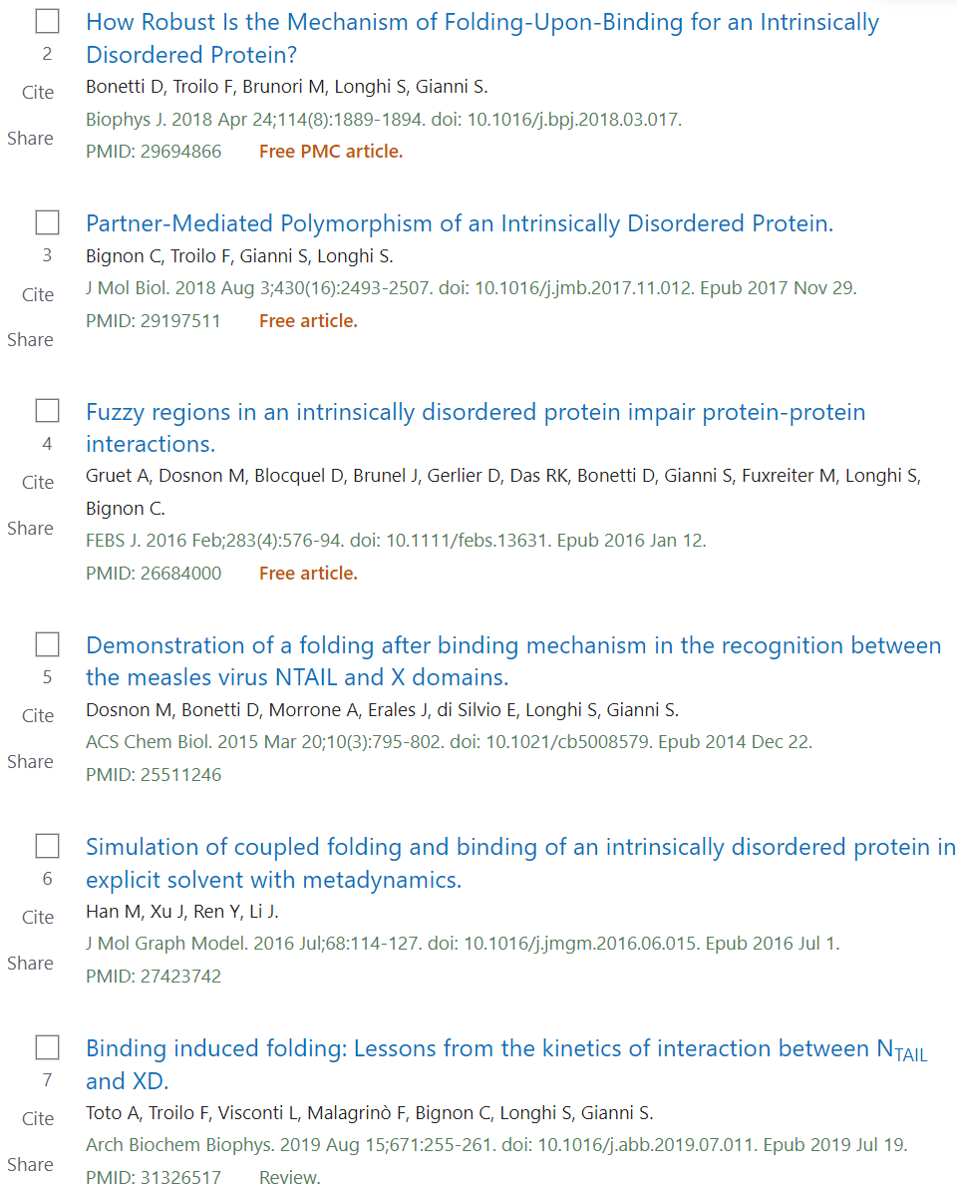
Summary
Discussion
Papers on the same topic/system
Using a state-of-the-art physics-based force field that overcomes recently documented deficiencies in descriptions of the secondary structure propensities and dimensions of disordered proteins.
The reasonably large number of folding and unfolding events observed in our simulation ensures that the observations made in this study are statistically meaningful
The dominance of pathways with more induced-folding character, in which folding occurs late in the transition path
Disordered regions may have a kinetic advantage over folded regions in progressing from an encounter complex to the stable bound state
The transition state ensemble is structurally extremely diverse, featuring helical and nonhelical structures and a range of different orientations of the peptide backbone chain
……
Notes:
Early formation of large amounts of secondary structure does not significantly facilitate progress along folding-upon-binding transition paths

Slide 16
The end
Thanks for listening!

