Slide 1
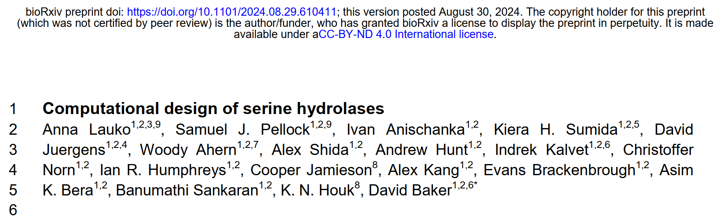
Reporter: 高旭帆
Date: 2024.12.17

Slide 2
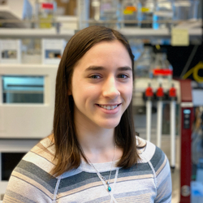

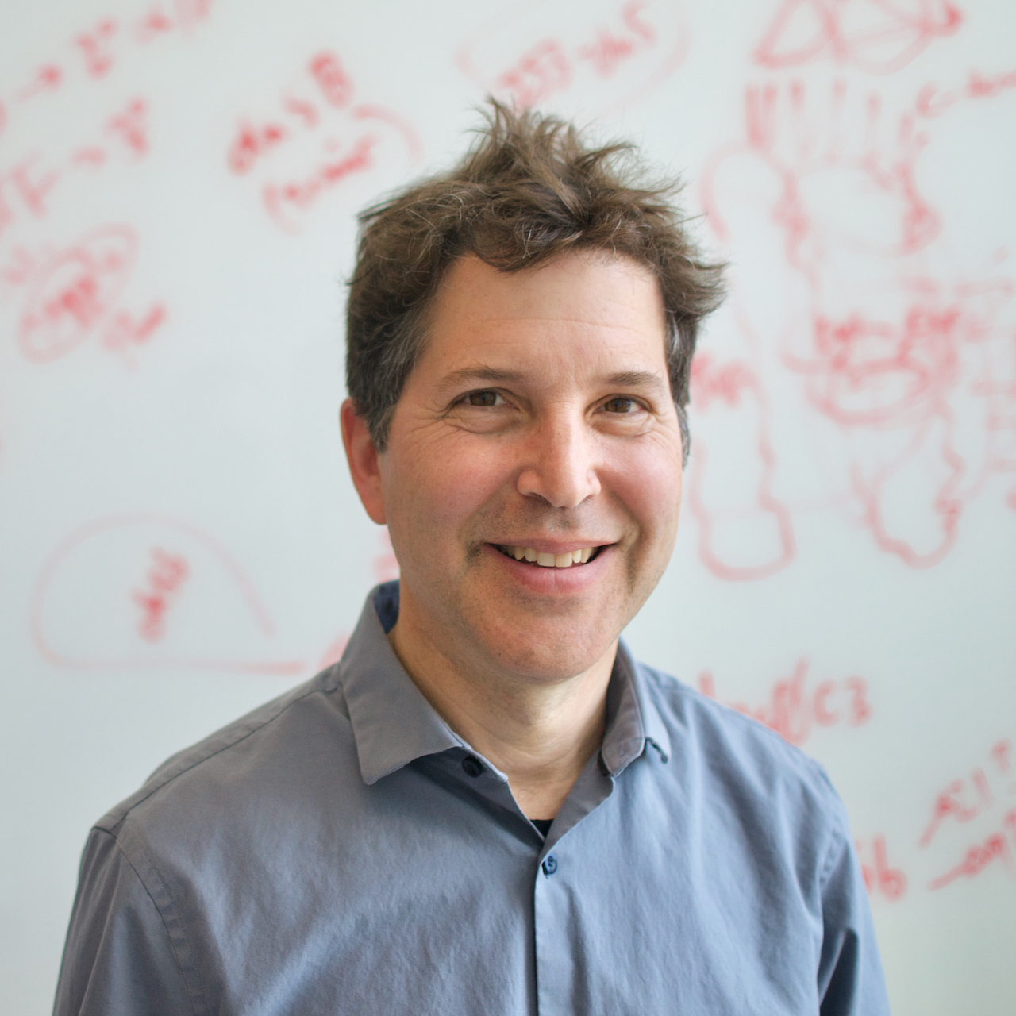
Authors
Introduction
Anna Lauko, Postdoc
Research: designing new enzymes
Samuel J. Pellock, previous postdoc
Research: de novo design of functional proteins
new experimental approaches to measure function rapidly
Highlights
A model system to study multi-step reactions
Designed serine hydrolases with folds distinct from nature
The importance of active site preorganization
David Baker, PhD
Director, Institute for Protein Design, School of Medicine, University of Washington
Investigator, Howard Hughes Medical Institute
Member of the National Academy of Sciences
2024 Nobel Prize in Chemistry
The world’s 100 Most Influential People in health

Slide 3
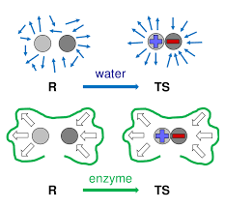
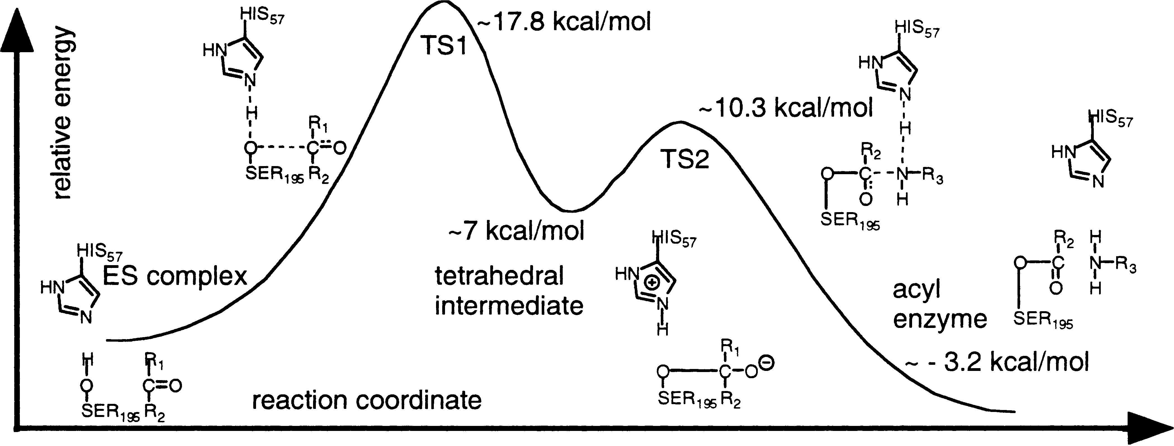
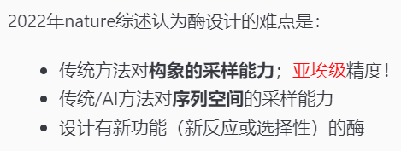
Theoretical basis of computational enzyme design
Background
Enzymes reduce activation energy by stabilizing the transition state (TS)
Enzymes provide an energetically favorable environment with no reorganization required
Multistep reaction mechanisms often utilize complex, polar active sites
Borrowing the active site from nature
serendipity?
Nature 2022, 606, 7912, 49–58.
https://www.uv.es/biophys/sbe/6/PDFsite/SimulatingEnzymeCatalysis.pdf
3
Notes:
酶的特点
设计的理论依据：过渡态理论，构象预组织
活性位点难以从头设计，基本上是learn from nature
偶然发现…

Slide 4
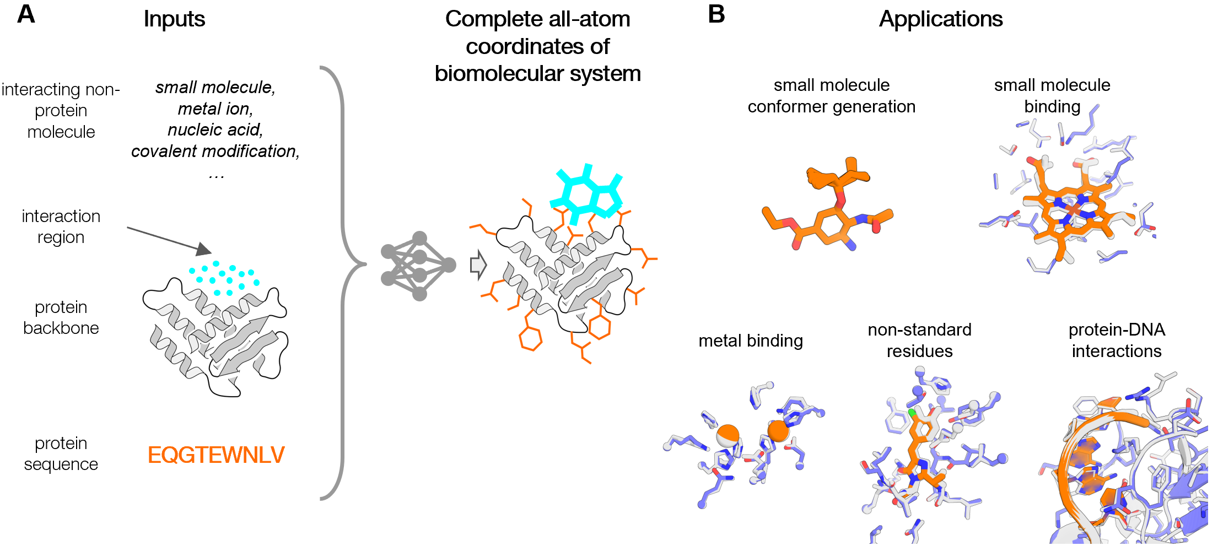
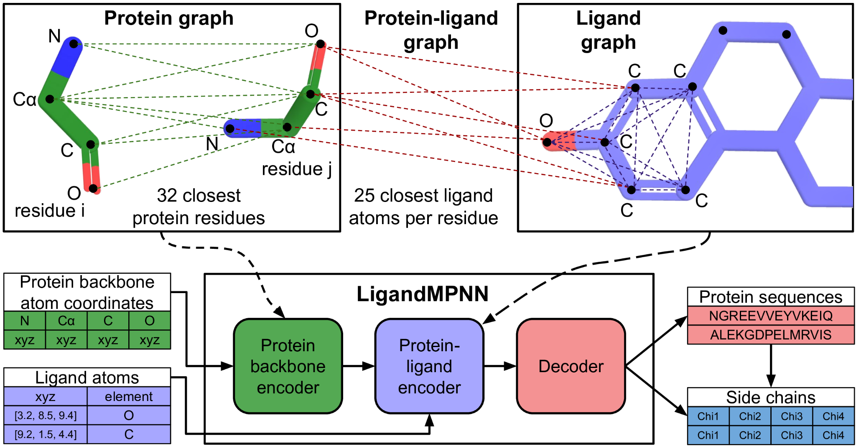
Computational tools used in this work
Background
RFdiffusion: Used to generate protein backbones for scaffolding catalytic motifs.
a newly trained variant of RFAA: CA RFdiffusion
ChemNet: Generates side chain conformation ensembles to evaluate preorganization.
AlphaFold2 (AF2): Predicts the structure of designed proteins
LigandMPNN: Designs protein sequences, optimizing interactions with the catalytic site.
Rosetta FastRelax: Iteratively relaxes protein structures to optimize geometry and stability.
ChemNet: bioRxiv 2024, 2024.09.25.614868.
LigandMPNN: bioRxiv 2023, 2023.12.22.573103.
4
Notes:
Baker组的系列工具。别人的就先不说了
给定小分子和backbone，也知道是什么残基，产生合适的侧链坐标

Slide 5
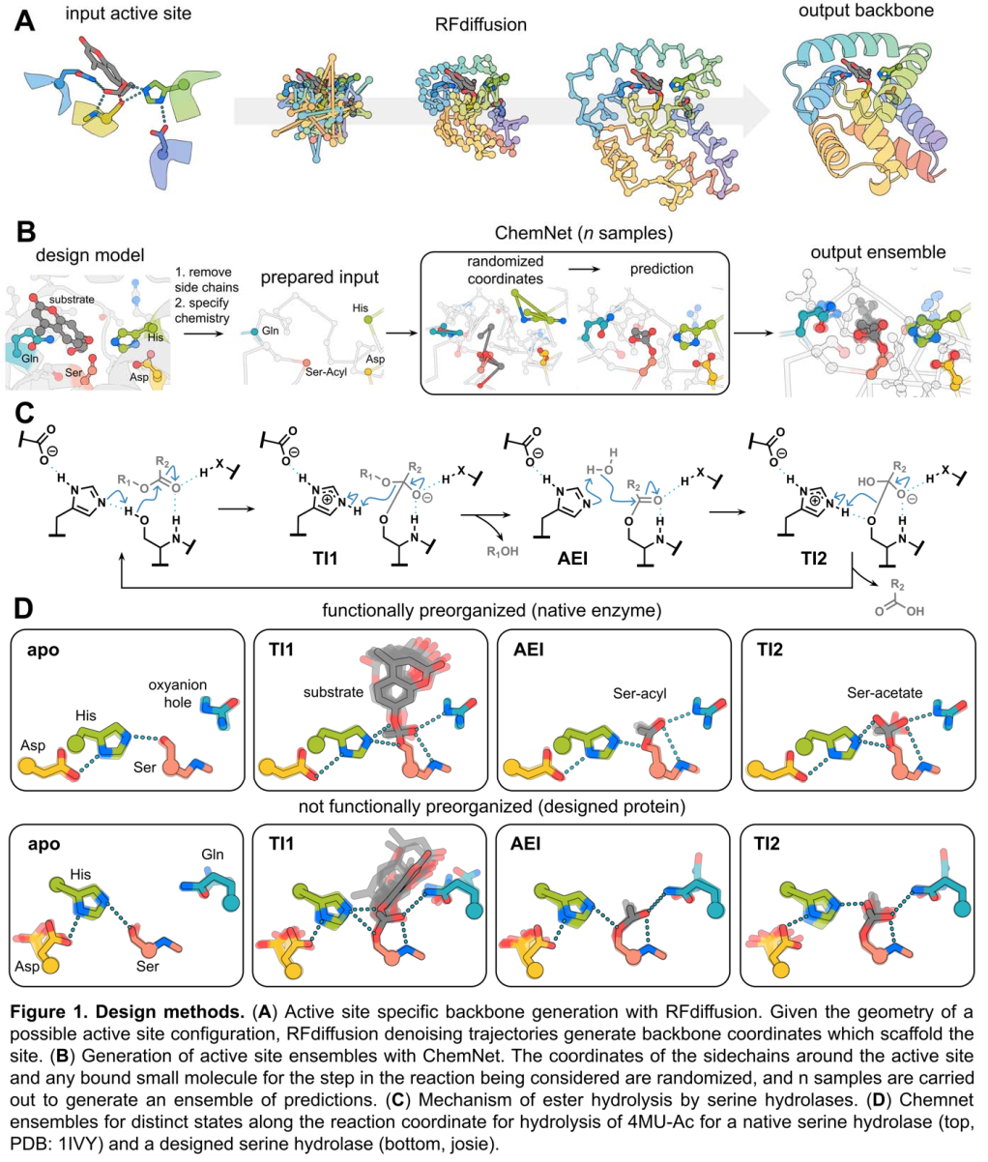
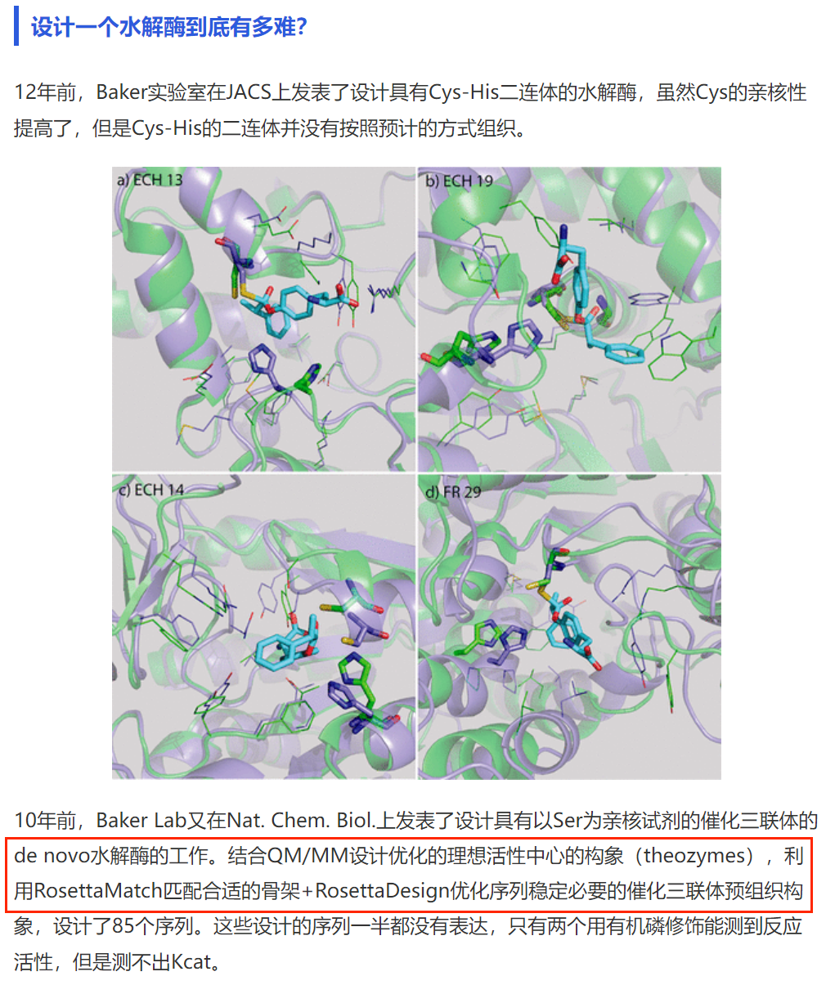
Motif scaffolding with generative AI models
Background
Past: crafting an active site to a known protein scaffold
Now: generate a protein backbone containing specified motifs
Previous designs don’t show good preorganization
Notes:
过去vs现在的策略，概述

Slide 6
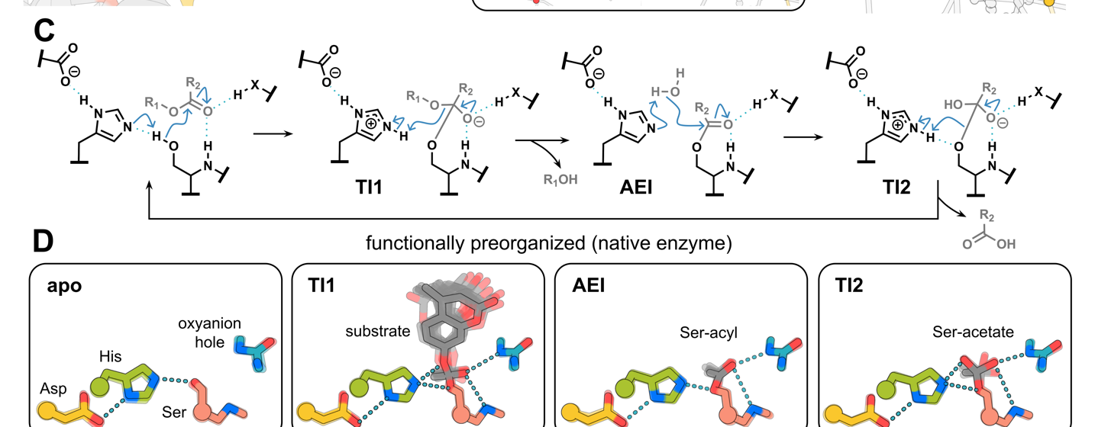
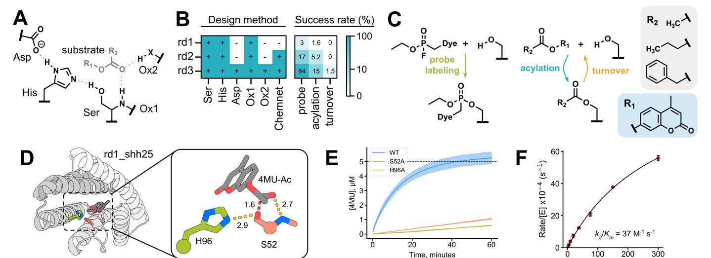
Introduction to serine hydrolases
Background
Glossary
TI: tetrahedral intermediate
AEI: acyl-enzyme intermediate
ES: enzyme-substrate
4MU: R₁-OH, a fluorogenic product
R₁-acyl: no fluorescence
Theozyme: a specification of arrangements of catalytic residues around the reaction transition state
catalytic triad
D/E tunes pKa of histidine
H deprotonates serine/water; protonate the product
S attacks the ester carbonyl
oxyanion hole (C=O, Q, T, etc.)
stabilizes the negatively-charged intermediates
6
Notes:
J Am Chem Soc 2003, 125, 39, 12035–48.

Slide 7
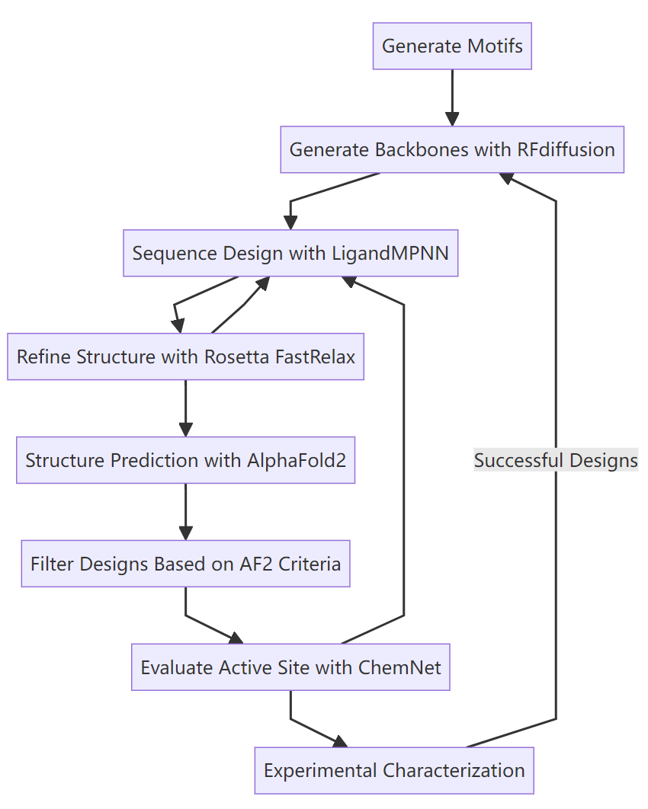
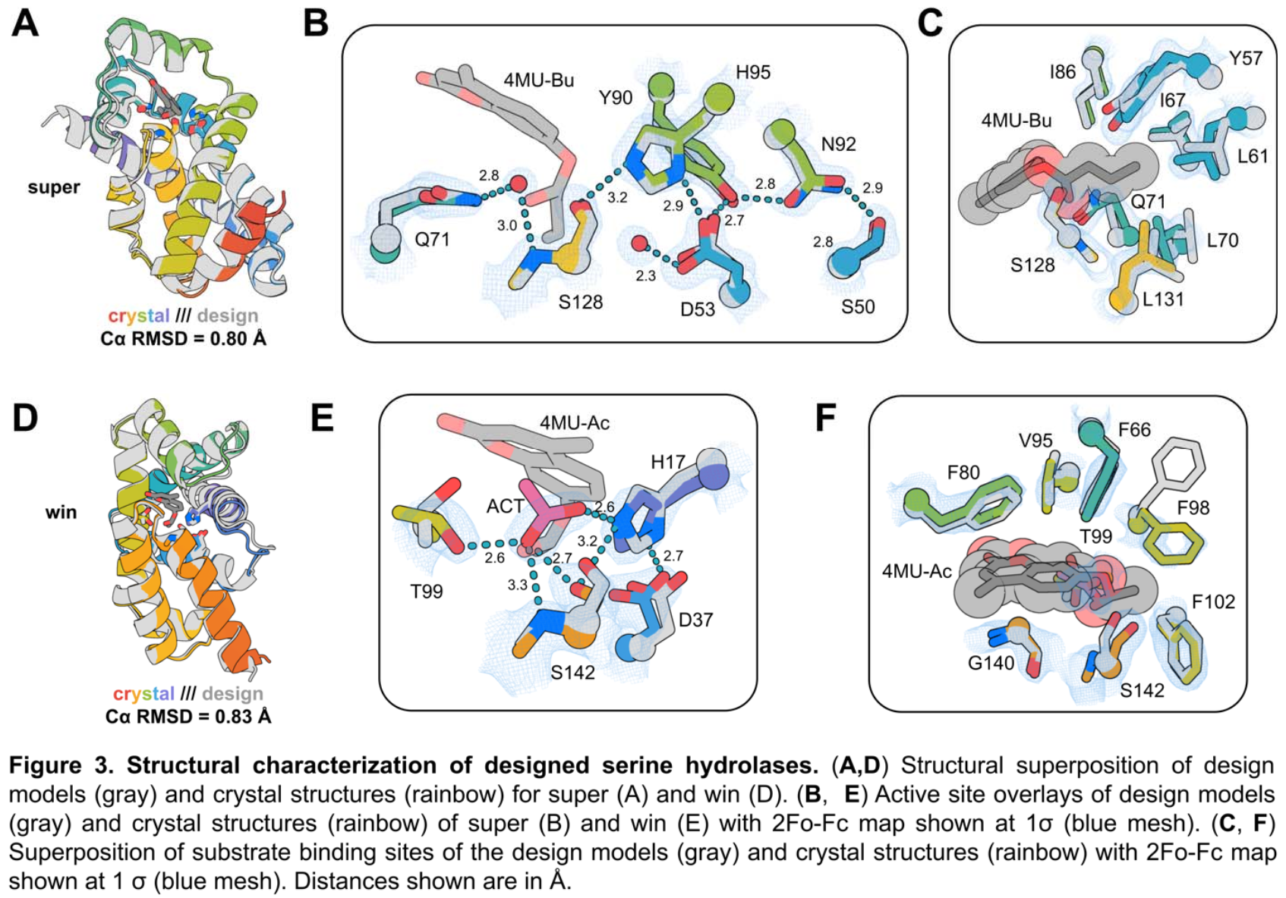
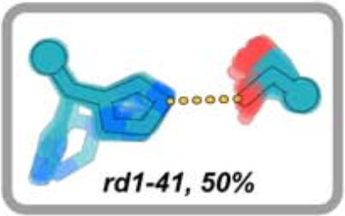
Overview of the computational design workflow
Methods
Taking the active site from 1scn
Determine Ser-substrate conformation with DFT
Sample other catalytic residues’ conformations that satisfies H bond geometry
Fixing three-residue segment
Biased toward polar amino acids for all residues with Cα within 8 Å of the active site
Fix catalytic residues; restrain H bonds
Compare with standard motifs
global Cα RMSD < 1.5 Å
pLDDT > 75
catalytic residue Cα RMSD < 1.0 Å
50 confs (active site) for each reaction state
Frequency of formation of key interactions
Notes:
B3LYP-D3(BJ)/6-31G(d) (1) apo, (2) substrate bound, (3) tetrahedral intermediate 1, (4) acylenzyme intermediate, and (5) tetrahedral intermediate 2

Slide 8
Design results
Results
Pretty low success rate
More restraint→higher success rate
The two successful designs ↓
Metric | Super | Win
kcat/Km (M⁻¹ s⁻¹) | 22 | 410
kcat (s⁻¹) | 0.00137 ± 0.00005 | 0.00117 ± 0.00003
Km (μM) | 64 ± 6 | 2.8 ± 0.3
Preferred Substrate | 4MU-Bu | 4MU-Ac
Round | 1 | 2 | 3
Residues fixed | His, Ser, Ox1 | His, Ser, Ox1 | All the five
Filter | AF2 | AF2+ChemNet | AF2+ChemNet
Experimentally tested | 129 | 192 | 111
Acylation | 2 | 10 | 20
turnover | 0 | 0 | 2

Slide 9
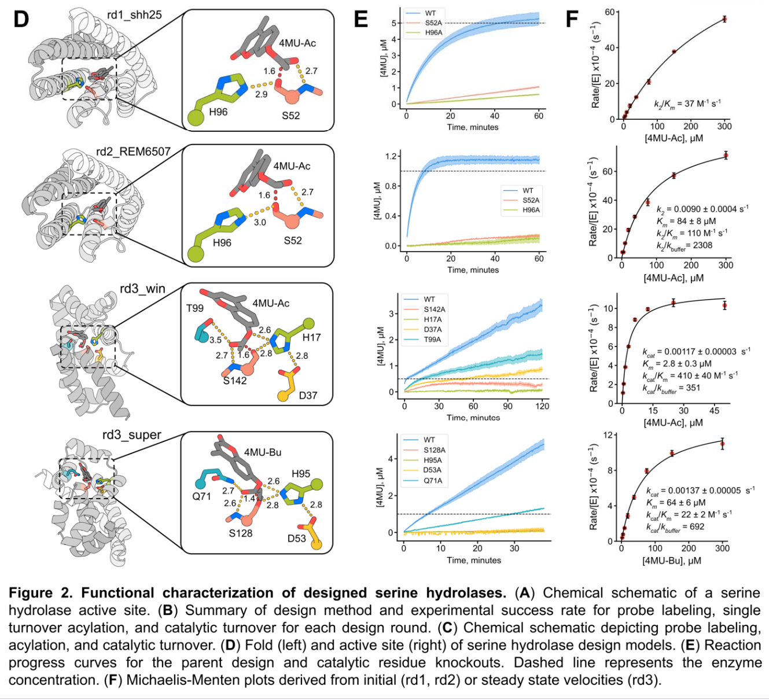
Design results
Results

Slide 10
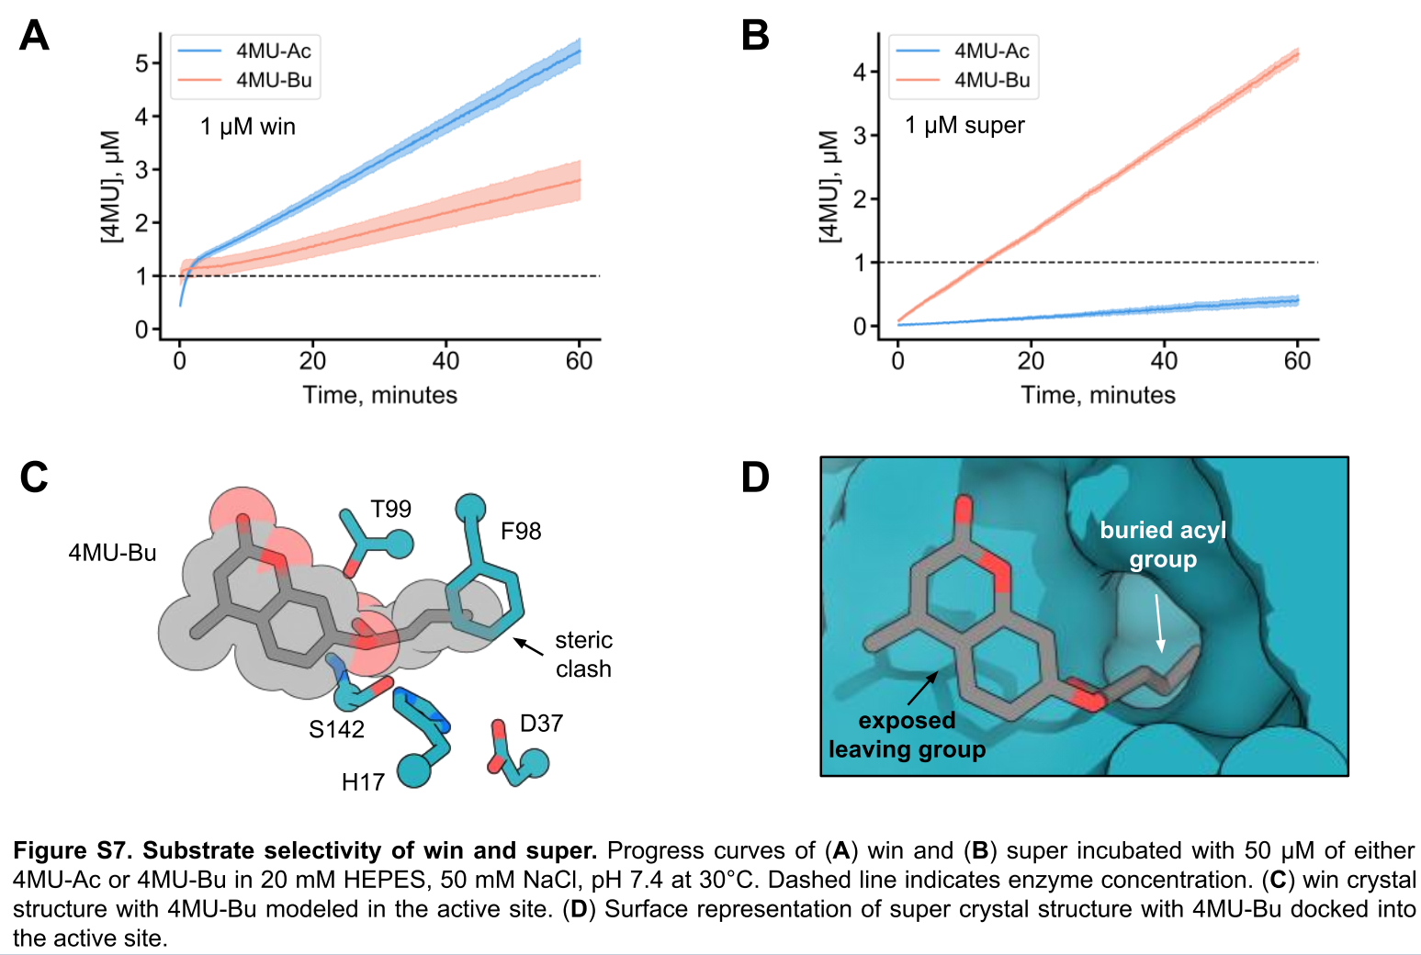
Compare the design with crystal structure (apo)
Results
Correspondence of side chains even without the substrate (good preorganization!)
Explains the substrate selectivity
Notes:
T99 is oxyanion

Slide 11
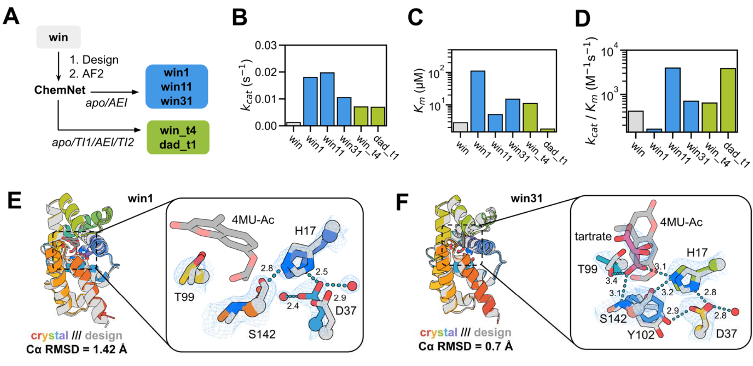
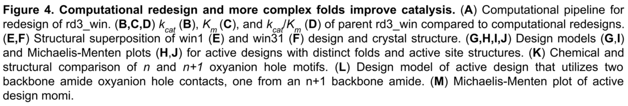
Redesign “win” sequence with more preorganization
Results
Metric | Two-state filtered | Four-state filtered
Success Rate (FP-probe) | 84% (38/45 designs) | 91% (10/11 designs)
Number with Higher kcat | 3 | 2

Slide 12
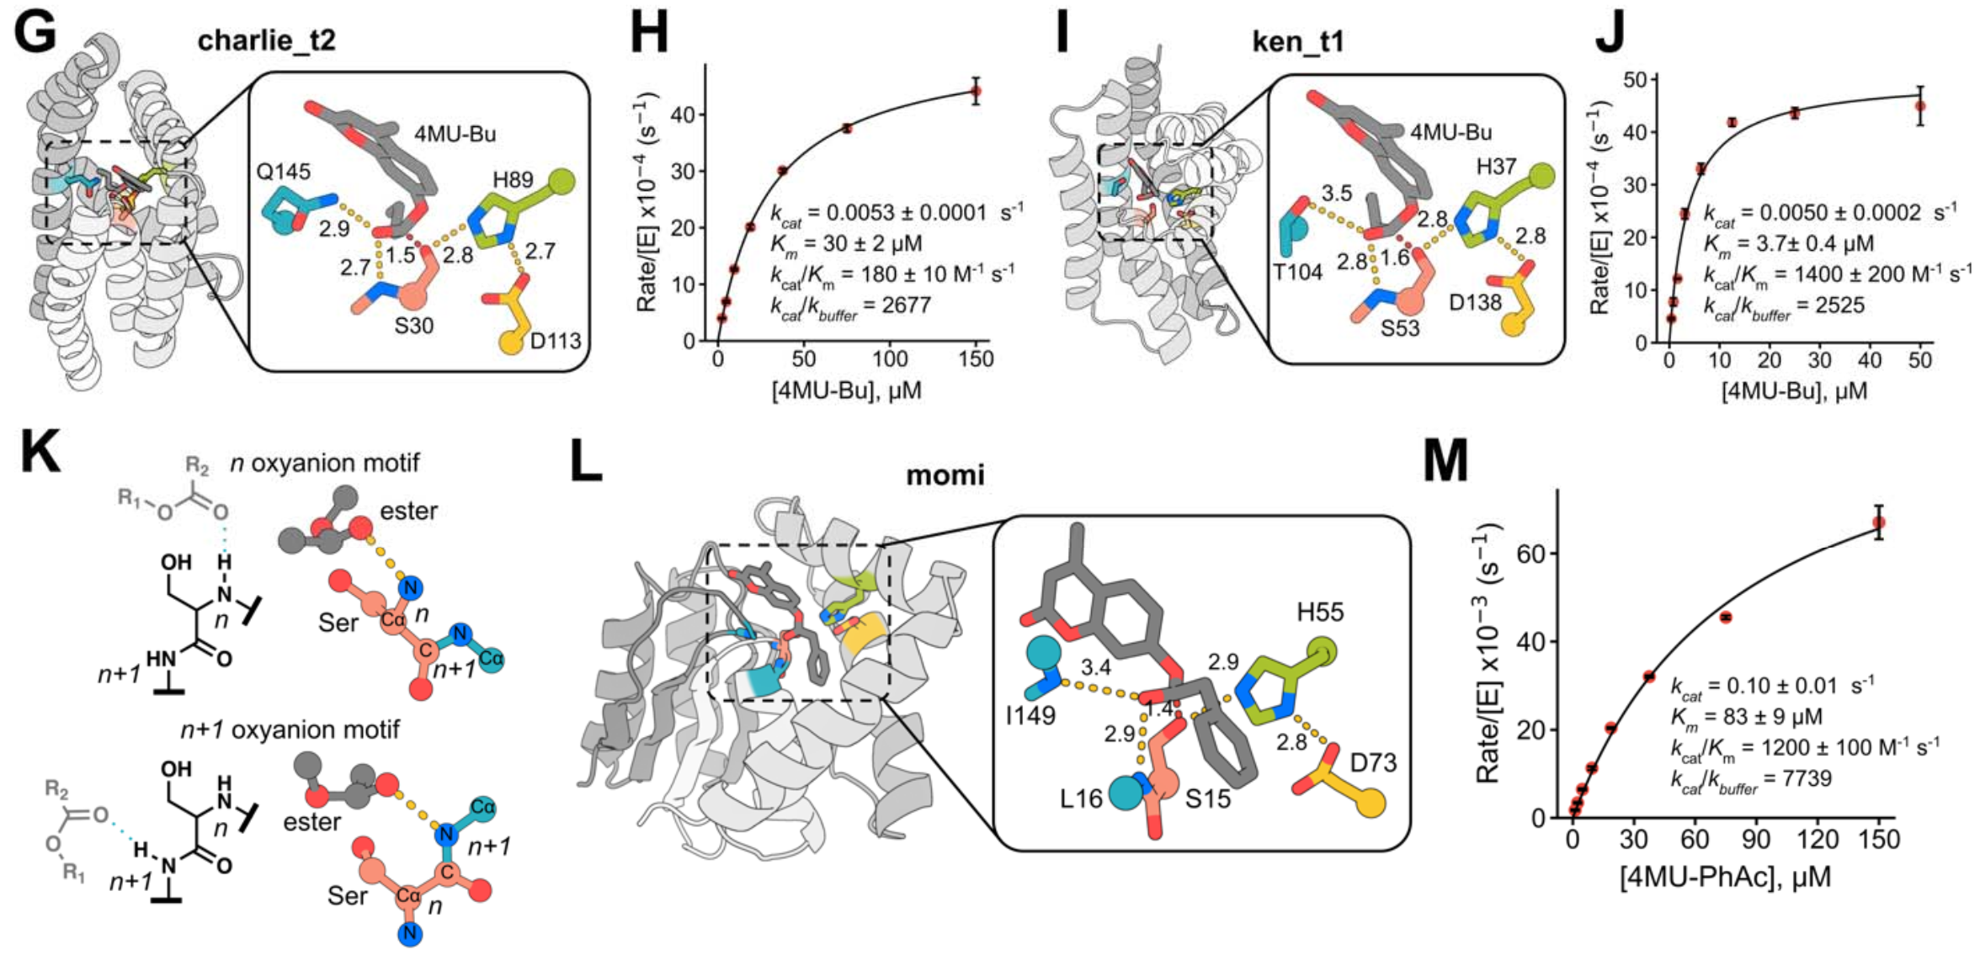
Filtering based on catalytic geometry in all four states
Results
stringent ChemNet filtering
G-J:
Starting from round 3 backbones that had not previously displayed esterase activity
Two of 20 designs tested displayed significant esterase activity
K: 4MU-phenylacetate
a different active site configuration in which the oxyanion hole consists of two backbone amide hydrogen bond donors
Notes:
66 designs

Slide 13
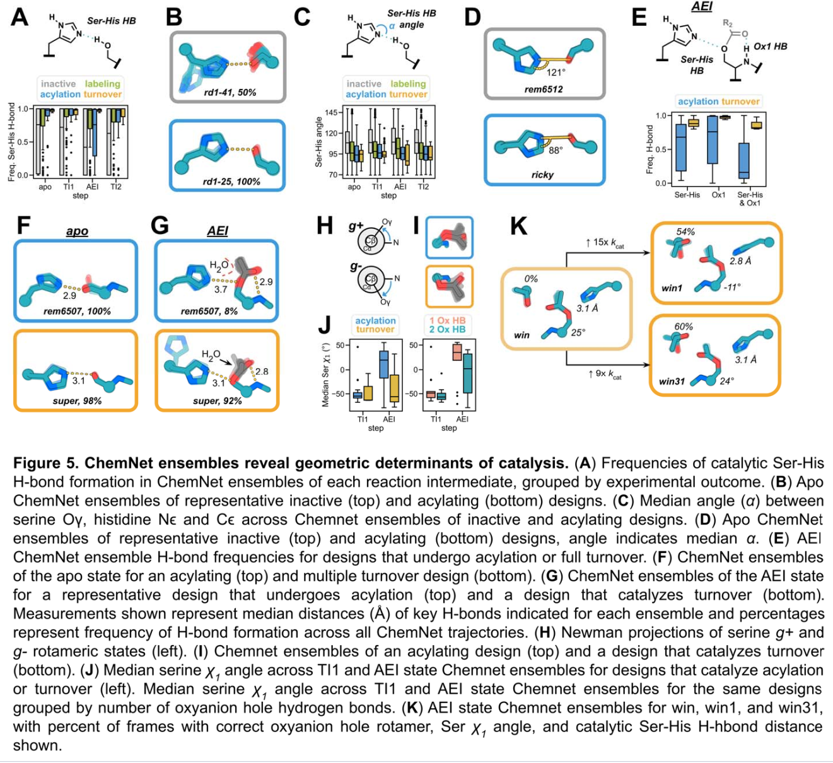
Structural determinants of catalysis
Results
Analyzing all experimentally tested designs
All designs capable of catalyzing turnover displayed highly preorganized Ser-His H-bonds across all four states
Good geometry (H bond, etc.) is a necessary but not sufficient conditions for catalytic activity

Slide 14
Take-home messages & thoughts
Summary
Results and Limitations
far higher than previously reported catalytic triad-based serine hydrolase designs
able to design enzymes for any scaffold
still orders of magnitude slower than native hydrolases (3.8 x 10³)
the oxyanion hole identities and geometries differ slightly from those in native structures (for some, mutation does not affect the activity)
Inspirations
motif scaffolding works better than traditional scaffold searching
still strictly following natural designs
the catalytic residues themselves might not be enough…
the more restraint added, the better success rate is
enzymes are intricate machines; more mechanism studies are required…
Notes:
Comments:
Still low successful rate…
Fixing the backbone
Simply learning from nature
More mechanism studies…

Slide 15
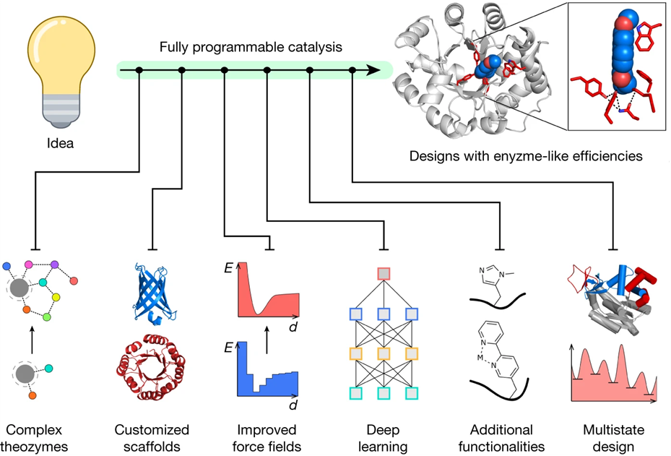
Thanks for listening!

