Slide 1
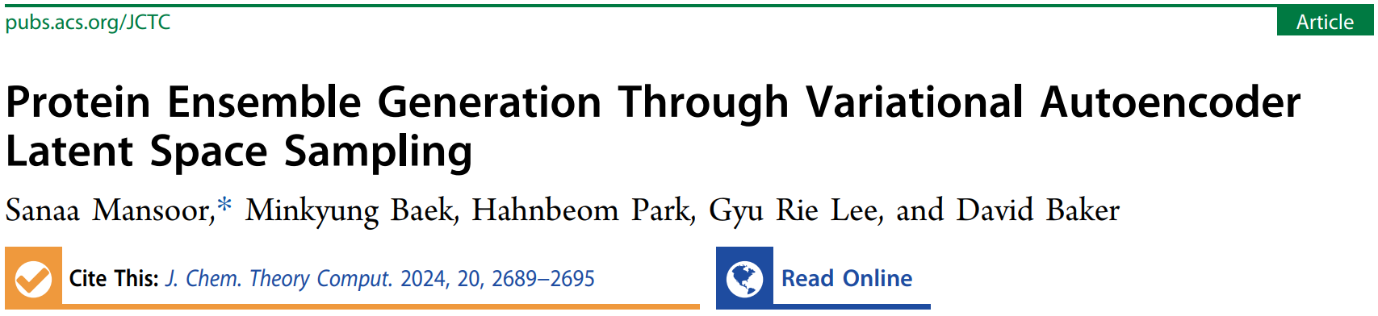
Reporter: 高旭帆
Date: 2024.5.22

Slide 2
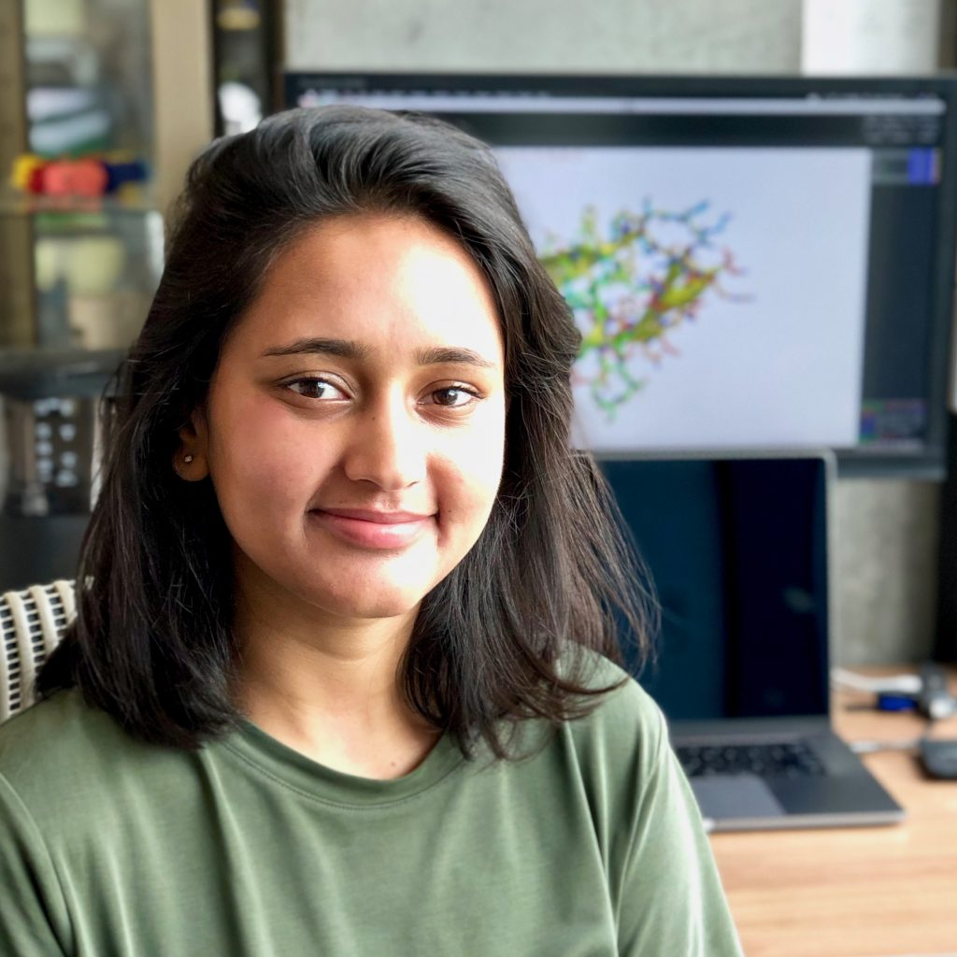

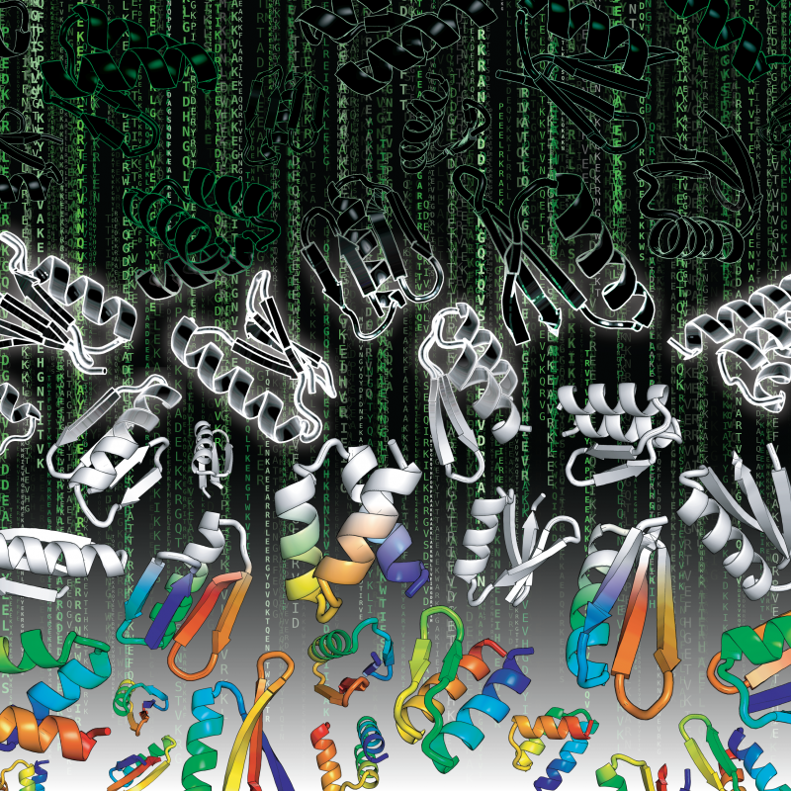
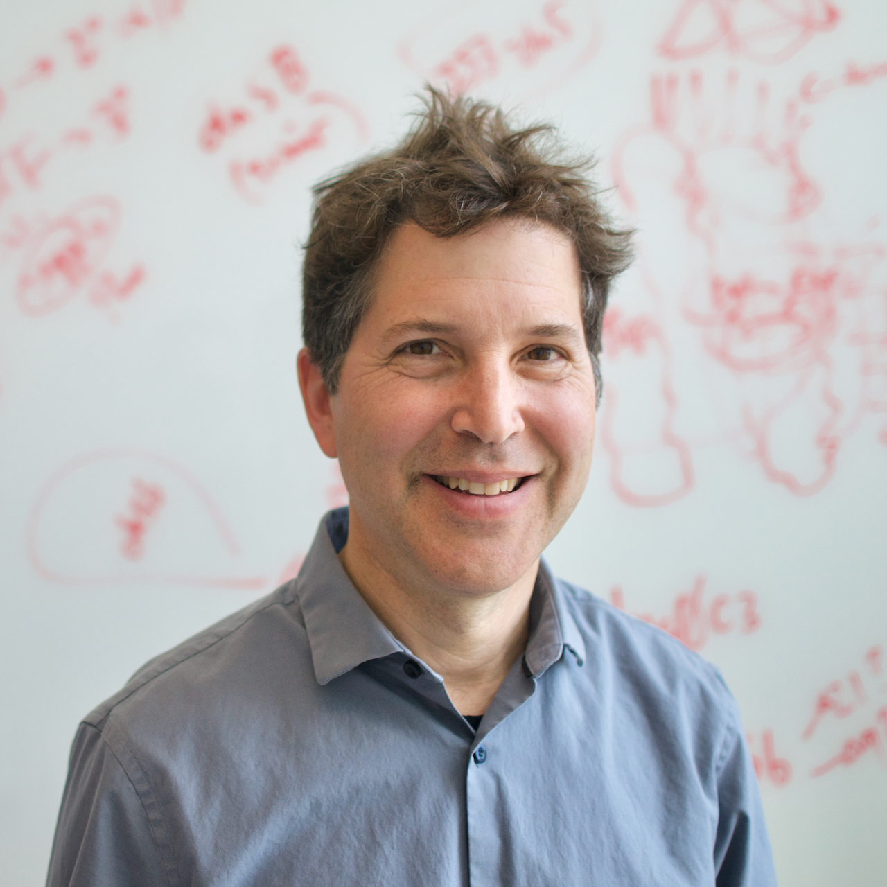
Authors
Intro
Sanaa Mansoor
Previous PhD in Baker Lab (now in X)
Research: use deep learning (specifically generative models) for protein structure refinement and design.
Minkyung Baek and Hahnbeom Park are previous postdocs
Gyu Rie Lee is a staff
David Baker, PhD
Director, Institute for Protein Design, School of Medicine, University of Washington
Investigator, Howard Hughes Medical Institute
Member of the National Academy of Sciences
2021 Breakthrough Prize in Life Sciences
The world’s 100 Most Influential People in health.
Notes:
https://scholar.google.com/citations?hl=en&user=AeVM8igAAAAJ&view_op=list_works&sortby=pubdate
https://www.linkedin.com/in/sanaa-mansoor/
https://www.bakerlab.org/

Slide 3
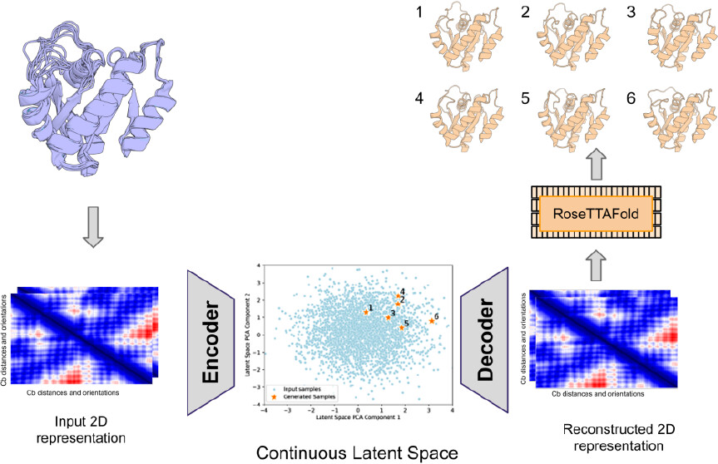
Highlights
Intro
Innovative Approach: Combines Soft-Introspective Variational Autoencoder (SI-VAE) with RoseTTAFold to generate high-quality protein conformations, addressing the challenge of protein structure diversity.
Data Sources: Uses K-Ras crystal structures and MD snapshots, encoded as 2D template features by RoseTTAFold.
High Accuracy: Achieves sub-1 Å RMSD for 13 out of 20 targets, outperforming MD simulations and AlphaFold2.
Latent Space Sampling: Employs gradient optimization in latent space to ensure generated structures are consistent and plausible.
Drug Discovery Potential: Improves identification of hidden binding pockets, enhancing accuracy and efficiency in drug design.
Fast and efficient Sampling!

Slide 4
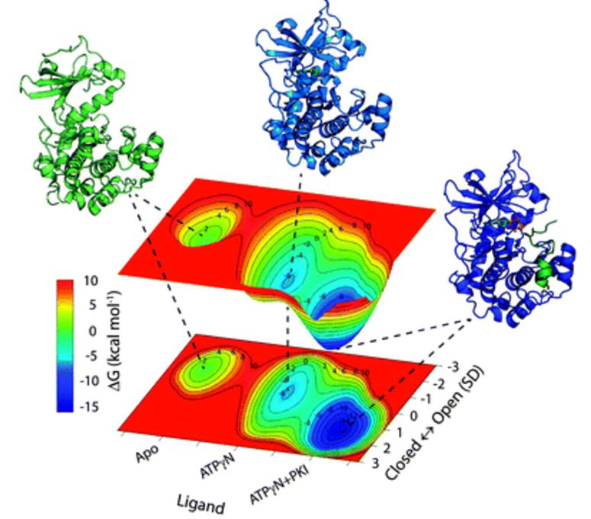
Protein ensemble generation is challenging
Background
Drugs often target the functional conformations of proteins, which may differ significantly from their native states
Traditional protein structure prediction methods, such as AlphaFold and RoseTTAFold, primarily generate a single structure rather than an ensemble of structures.
Molecular dynamics (MD) trajectories generate protein conformational ensembles by simulating the movements. However, MD may fail to identify hidden binding pockets in unbound structures and requires computationally expensive simulations.
Sampling in the latent space of a VAE provides a solution for generating conformational ensembles of specific protein sequences. This approach can overcome energy barriers to sample different conformational states.
Notes:
https://pubs.rsc.org/en/content/articlelanding/2014/cp/c4cp00110a

Slide 5
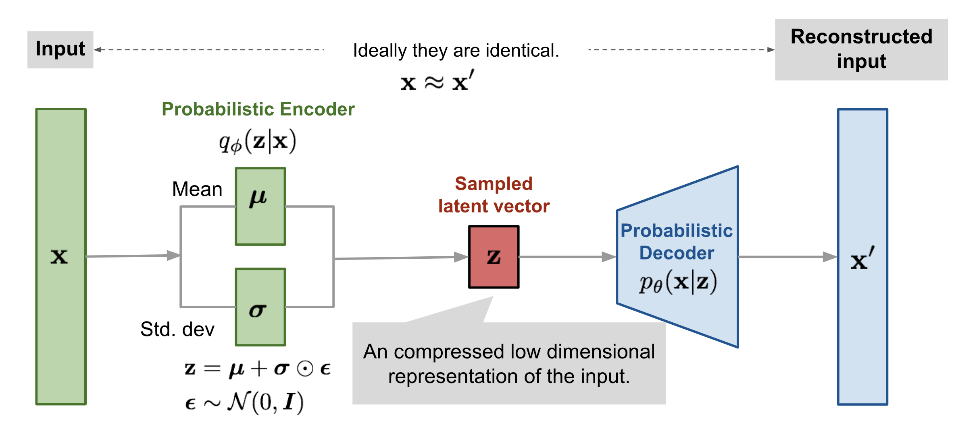
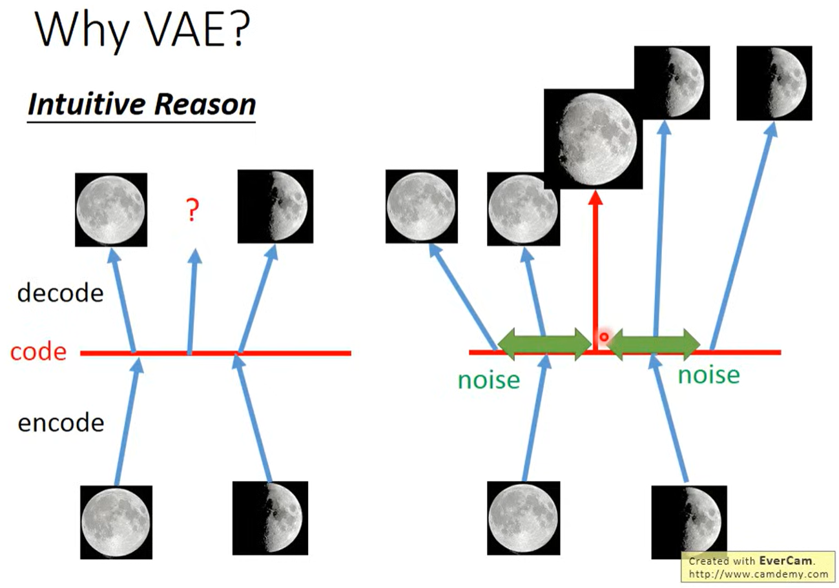
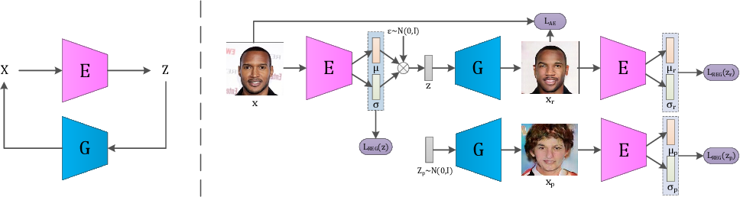
Soft-Introspective VAE
Background
IntroVAE: add a discriminator after the generator
Notes:
https://github.com/taldatech/soft-intro-vae-pytorch/blob/main/soft_intro_vae_tutorial/soft_intro_vae_image_code_tutorial.ipynb
https://www.youtube.com/watch?v=8zomhgKrsmQ
@inproceedings{Huang2018IntroVAEIV, title={IntroVAE: Introspective Variational Autoencoders for Photographic Image Synthesis}, author={Huaibo Huang and Zhihang Li and Ran He and Zhenan Sun and Tieniu Tan}, booktitle={Neural Information Processing Systems}, year={2018}, url={https://api.semanticscholar.org/CorpusID:49865829} }

Slide 6
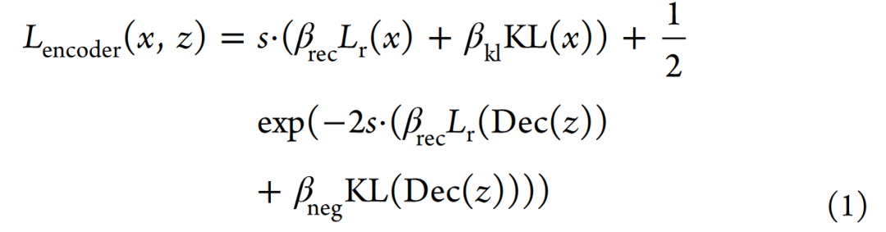
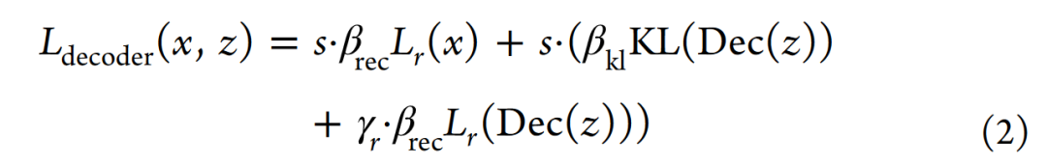
Data & Loss
Methods
Model system: K-Ras
Clinical significance
Many available structures
K-Ras Structures
20 K-Ras structures with ligands were chosen for study.
Each starting structure → 1000 MD snapshots (5*10 ns).
Data Conversion:
Structures were converted into 2D template features using RoseTTAFold.
Features captured 6D transformations within a 20 Å range, focusing on Cβ−Cβ distances.
Cartesian coordinates were extracted from N, Ca, C, and Cb atoms.
6D coordinates included pairwise distances and angles (omega, theta, phi).
L_{r}(x) = reconstruction loss
KL(x) = KL divergence
L_{r}(Dec(z)) = GAN-like loss
Notes:
selecting distinct K-Ras conformations deposited in the PDB that are at least an angstrom (calculated over C-alpha coordinates) away from each other as our ‘training set crystal structures.’

Slide 7
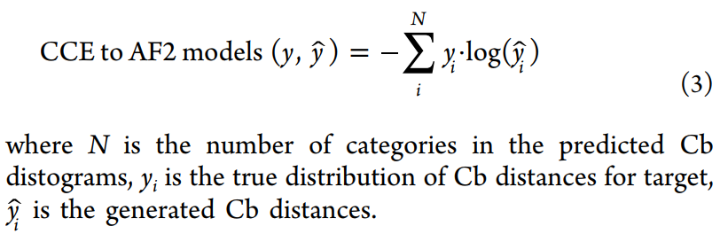
Training details
Methods
Soft-Introspective VAE (SI-VAE) was used, incorporating adversarial losses similar to GANs but trained introspectively.
General architecture included CNNs with 3 ResNet blocks, 64 convolutional kernels each, and BatchNorm with Leaky ReLU activation.
Optimization was done using Adam optimizer (β1=0.9, β2=0.999), learning rate 1×10⁻³, batch size 64.
Latent space sampling was performed using Gaussian distribution and gradient optimization.
Samples were decoded into template features, and distances were discretized using Radial Basis Function (RBF).
Optimization aimed to minimize categorical cross-entropy (CCE) between generated structures and AF2 predictions.
Final optimized latent vectors were decoded into template features and used with RoseTTAFold for 3D structure generation.
Train with MD snapshots
Sample from latent space with CCE restraint
Try to generate held-out crystal structures

Slide 8
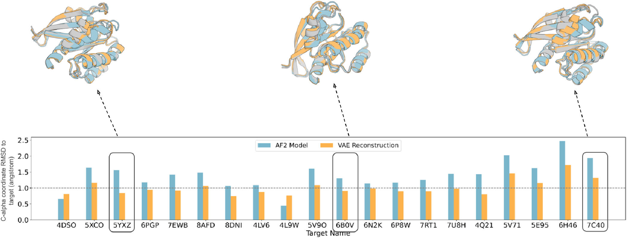
Figure 1. VAE structure reconstruction accuracy
Results
C-alpha coordinate RMSD (angstrom) of the closest AF2 predicted model and the reconstructed model from the VAE decoded template features generated using RoseTTAFold. Structural superimpositions for 3 targets are highlighted on the top with the target crystal in gray, the AF2 prediction in blue, and the VAE reconstruction in orange.
Notes:
为确保采样结构与序列大致一致且物理上合理，我们根据AF2预测的氨基酸序列距离分布来引导采样。从均值为0，方差为1的正态分布中生成样本，解码为相应的Cb距离图，计算与AF2预测的序列距离图的CCE，并通过对CCE值进行梯度下降进行潜在空间的局部优化，以限制从起点开始的总距离，防止收敛。解码和RF结构生成后，使用坐标RMSD评估样本，以目标晶体对整体结构和隐蔽口袋环境（定义为与配体结合口袋内5埃的残基）进行重构。
初始化的隐空间坐标设置为可训练的。然后，每个样本被解码成相应的模板特征，且通过径向基函数（Radial Basis Function，RBF）将Cβ距离离散化以确保反向传播。作者选择优化的得分指标是所有5个AF2预测的目标结构和生成的Cβ距离之间的最小分类交叉熵（categorical crossentropy，CCE）。Adam优化器修改隐空间样本以最小化这一得分指标。这个过程重复进行直到收敛。为了确保维持多样性，限制隐空间坐标只在其初始起点坐标的欧几里得距离d（=10）内探索。该探索技术的目标是搜索隐空间，以找到比初始随机生成坐标更好的解决方案。最终收敛的隐空间坐标被解码成各自的模板特征，并连同目标MSA一起传入RoseTTAFold进行结构建模。

Slide 9
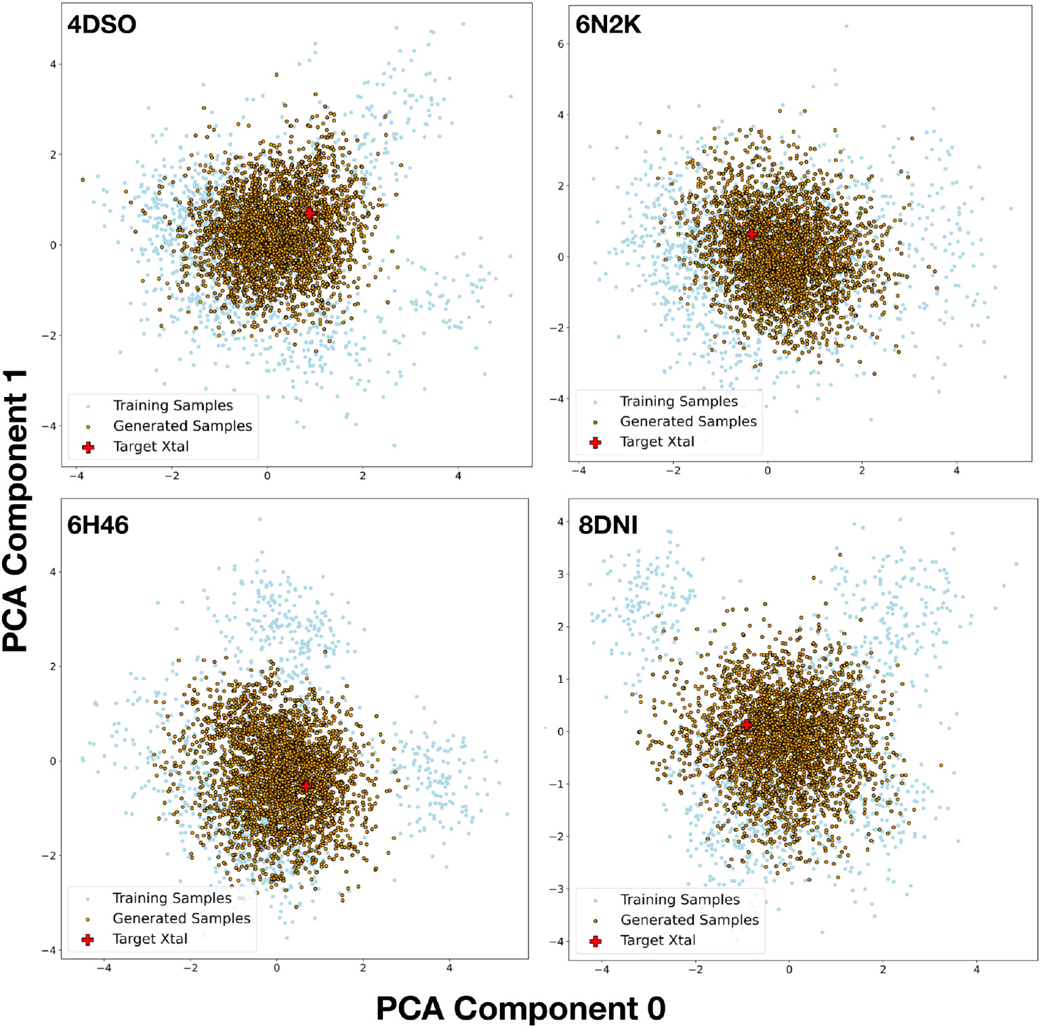
Figure 2. Latent space PCA analysis
Results
Each subplot displays a 2D PCA projection of the 256-dimensional latent space. The training and generated samples have similar distributions and surround the crystal structure.

Slide 10
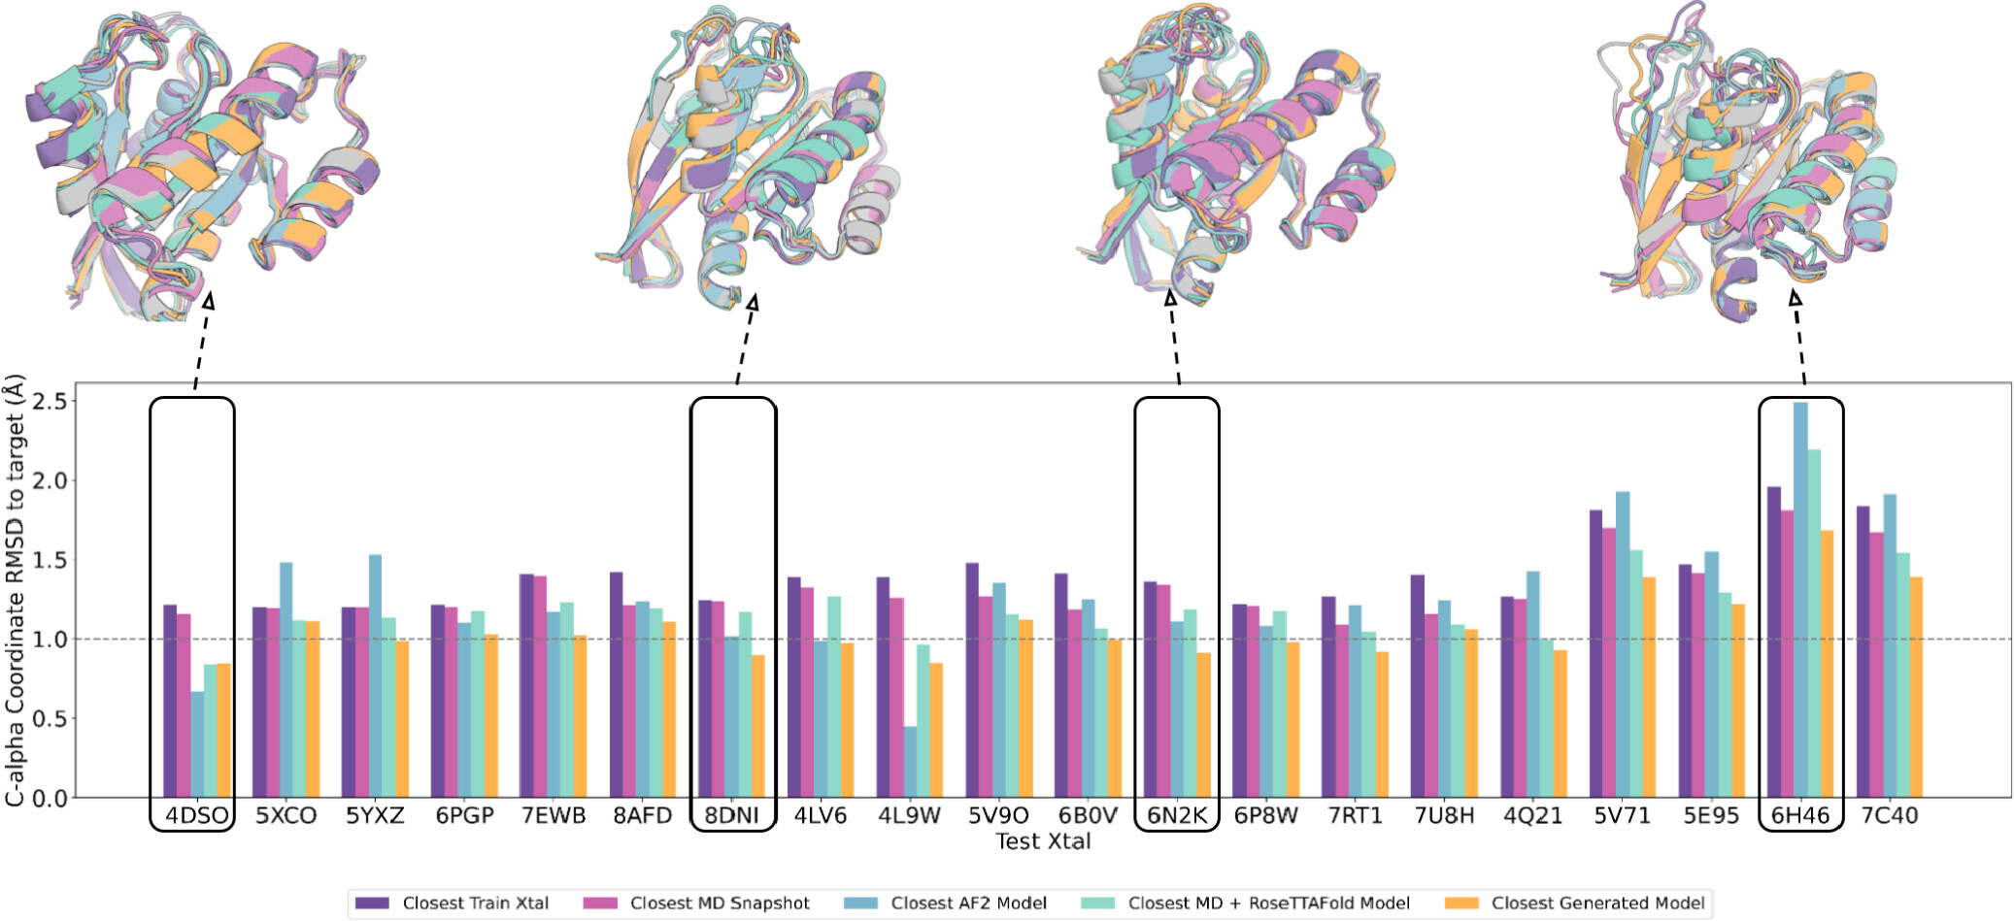
Figure 3. K-Ras overall structure reconstruction evaluation
Results
The VAE enables sampling closer to held-out K-Ras crystal structures than MD, MD template features passed into RoseTTAFold, or AlphaFold generated structures. For each test crystal structure (name below bars), a VAE model was trained using MD simulation data from all crystal structures with greater than 1 Å C-alpha RMSD and used to generate a structure ensemble. Bars indicate the coordinate error to the test crystal of the closest train crystal, the closest training sample, the closest AF2 model, the closest MD + RoseTTAFold sample, and the closest VAE generated sample.
Notes:
Closest这件事就表明，不能预测未知的

Slide 11
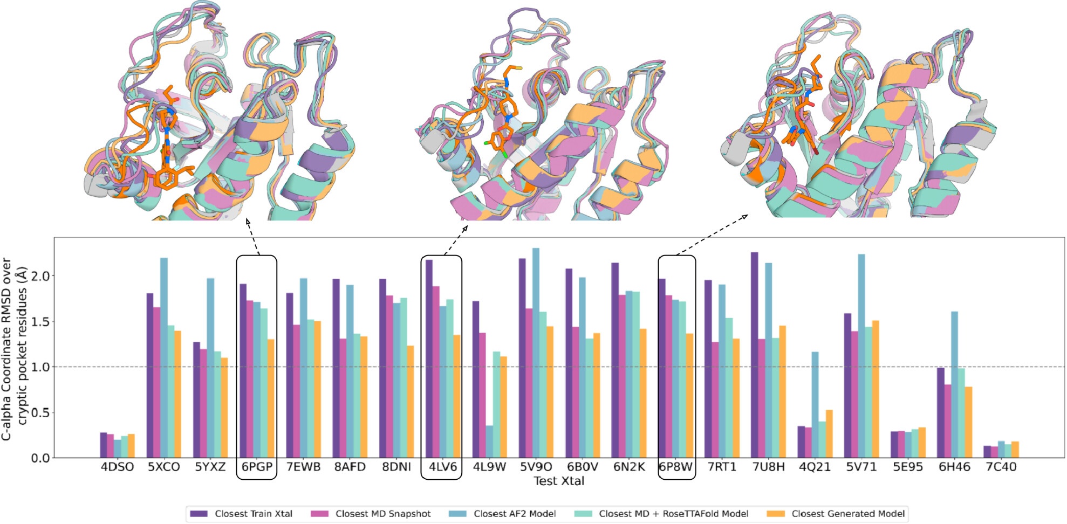
Figure 4. K-Ras cryptic pocket reconstruction evaluation
Results
As in Figure 3, but with the C-alpha coordinate error to the test crystal structure computed over only the binding site residues (defined as the residues within 5 Å in C-alpha coordinate space of the ligand binding pocket). The structural superimpositions (top) show the ligand inhibitor docked in the target crystal with the cryptic binding pocket and the ligand highlighted in orange on the target crystal structure.

Slide 12
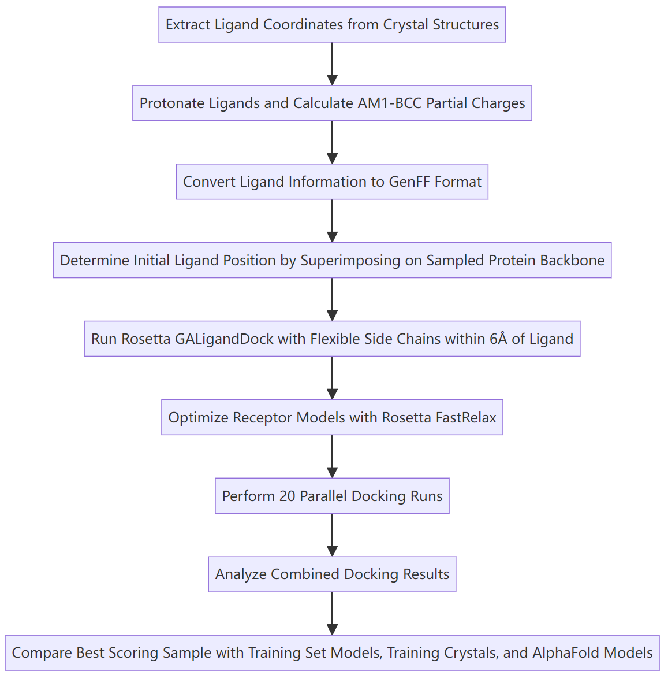
Docking Workflow
Methods
Notes:
Physics-based Rosetta GA-ligand docking method

Slide 13
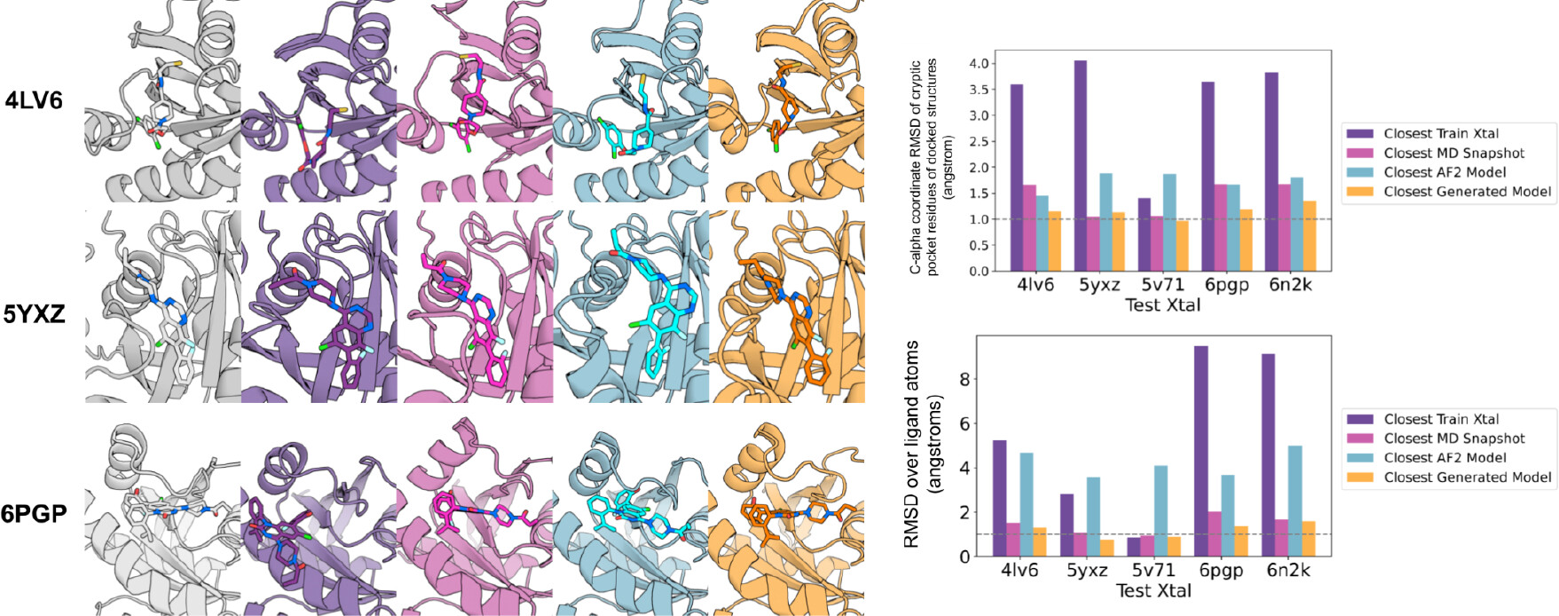
Figure 5. Small molecule docking into VAE generated ensembles
Results
Ligands from held-out crystal structures were docked into protein conformers using the GA-ligand dock. Left: the held-out crystal structure complex (column 1) and the closest docked complex (in terms of coordinate RMSD over the ligand atoms) among the training set crystal structures (column 2), the MD snapshots (column 3), the AlphaFold models (column 4), and the VAE ensembles (column 5). The closest C-alpha RMSDs of the cryptic pocket of docked structures and lowest RMSD over ligand atoms (ligand RMSD) are indicated on the bar charts on the right.

Slide 14
Summary & Thoughts
Summary
This study proposes a VAE-based method for generating protein conformational ensembles.
The approach has advantages in capturing hidden binding pockets and is more efficient and accurate than traditional MD simulations and single-state structure prediction methods.
Limitations
The differences between many of the different conformations are also ∼1 Å in Cα RMSD
The use of AF2 CCE to guide sampling could limit diversity
Future improvements can be made to the VAE architecture and training process to enhance the performance and accuracy of protein conformational ensemble generation.
My thoughts
Ensemble generation is a cutting-edge research topic
AI models can overcoming the energy barriers in MD sampling, and is less time-consuming
Lack of training data
Biomolecules are interacting; it’s hard to sample conformation selection.

Slide 15
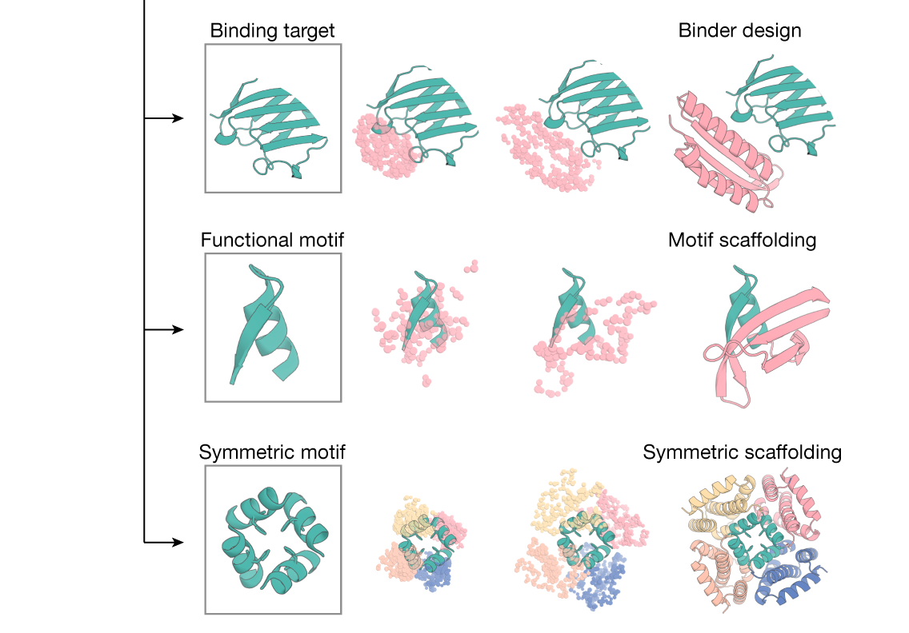
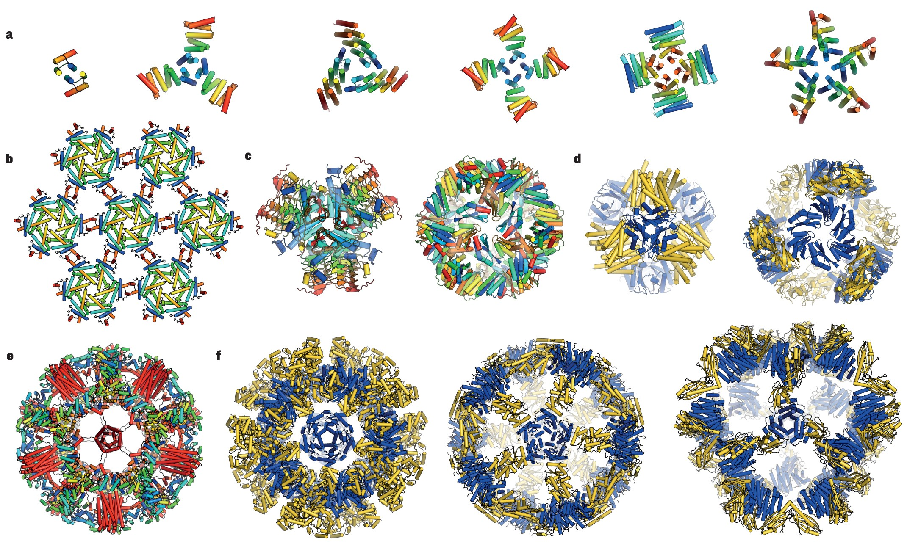
Thanks for listening!

