Slide 1
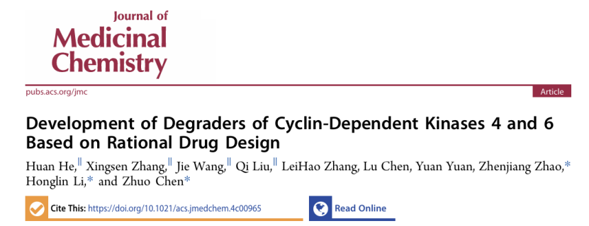
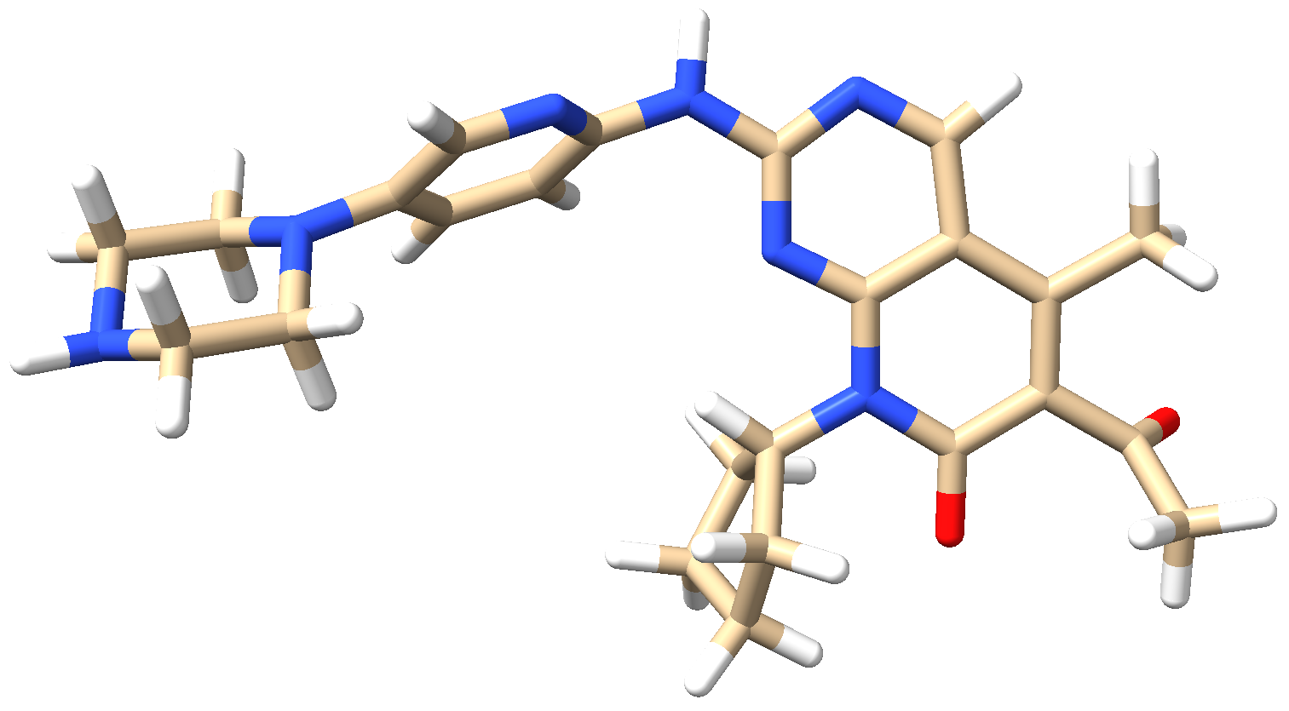
Reporter: 高旭帆
Date: 2024.7.10

Slide 2
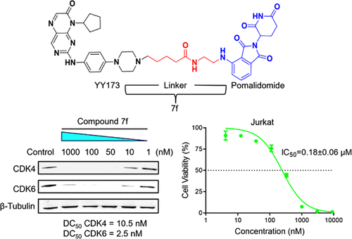

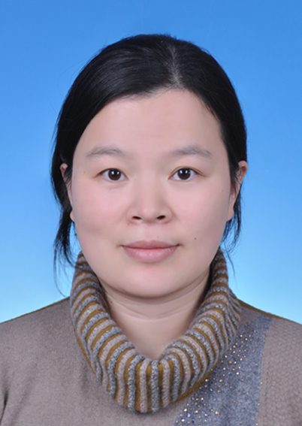
Authors & summary
Introduction
Honglin Li Ph.D, Professor
Research: drug design, computational biology and drug informatics, with a focus on basic research related to target identification and drug discovery, which are well validated in web lab
Zhuo Chen, PhD, Associate Professor
Research: anticancer drug development
Highlights:
Identified compound 7f that can selectively degrade CDK4/6 in vitro
Inhibitory proliferative activity and induced cell apoptosis and G1 phase cell cycle arrest
A simple rational design strategy
East China University of Science and Technology, School of Pharmacy
Shanghai Key Laboratory of New Drug Design
Notes:
https://lilab-ecust.cn/home/member/hlli.html
https://pharmacy.ecust.edu.cn/2869/list.htm
https://pharmacy.ecust.edu.cn/2018/0920/c9874a79649/page.htmhttps://pharmacy.ecust.edu.cn/2018/0920/c9874a79649/page.htm

Slide 3
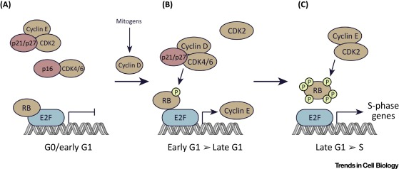
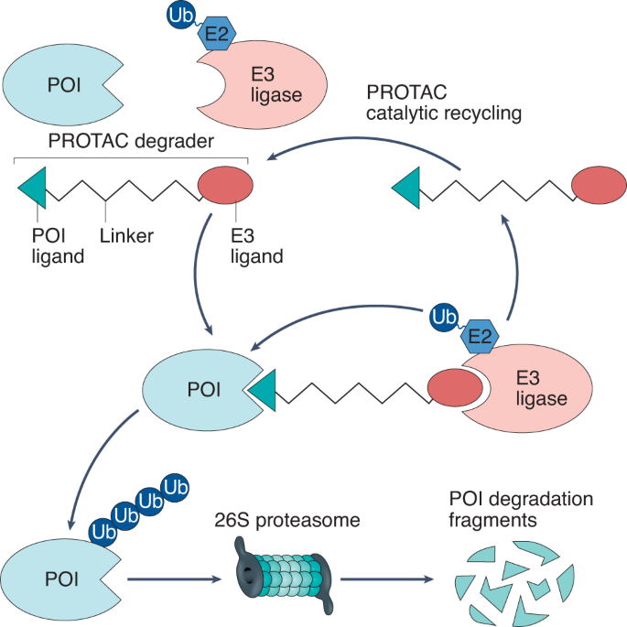
PROTAC is a promising strategy for CDK4/6 inhibition
Background
CDK4/6 inhibitors have shown promising clinical benefits in recurrent metastatic breast cancer
PROTACs may help to
Overcome acquired resistance
Improve target selectivity
3
Notes:
https://doi.org/10.1016/j.tcb.2018.07.002
低亲和力，突变/过表达/口袋依赖，选择性（还要结合E3），不可成药
HR+/HER2-

Slide 4
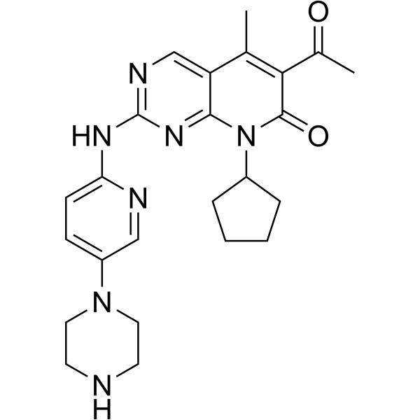
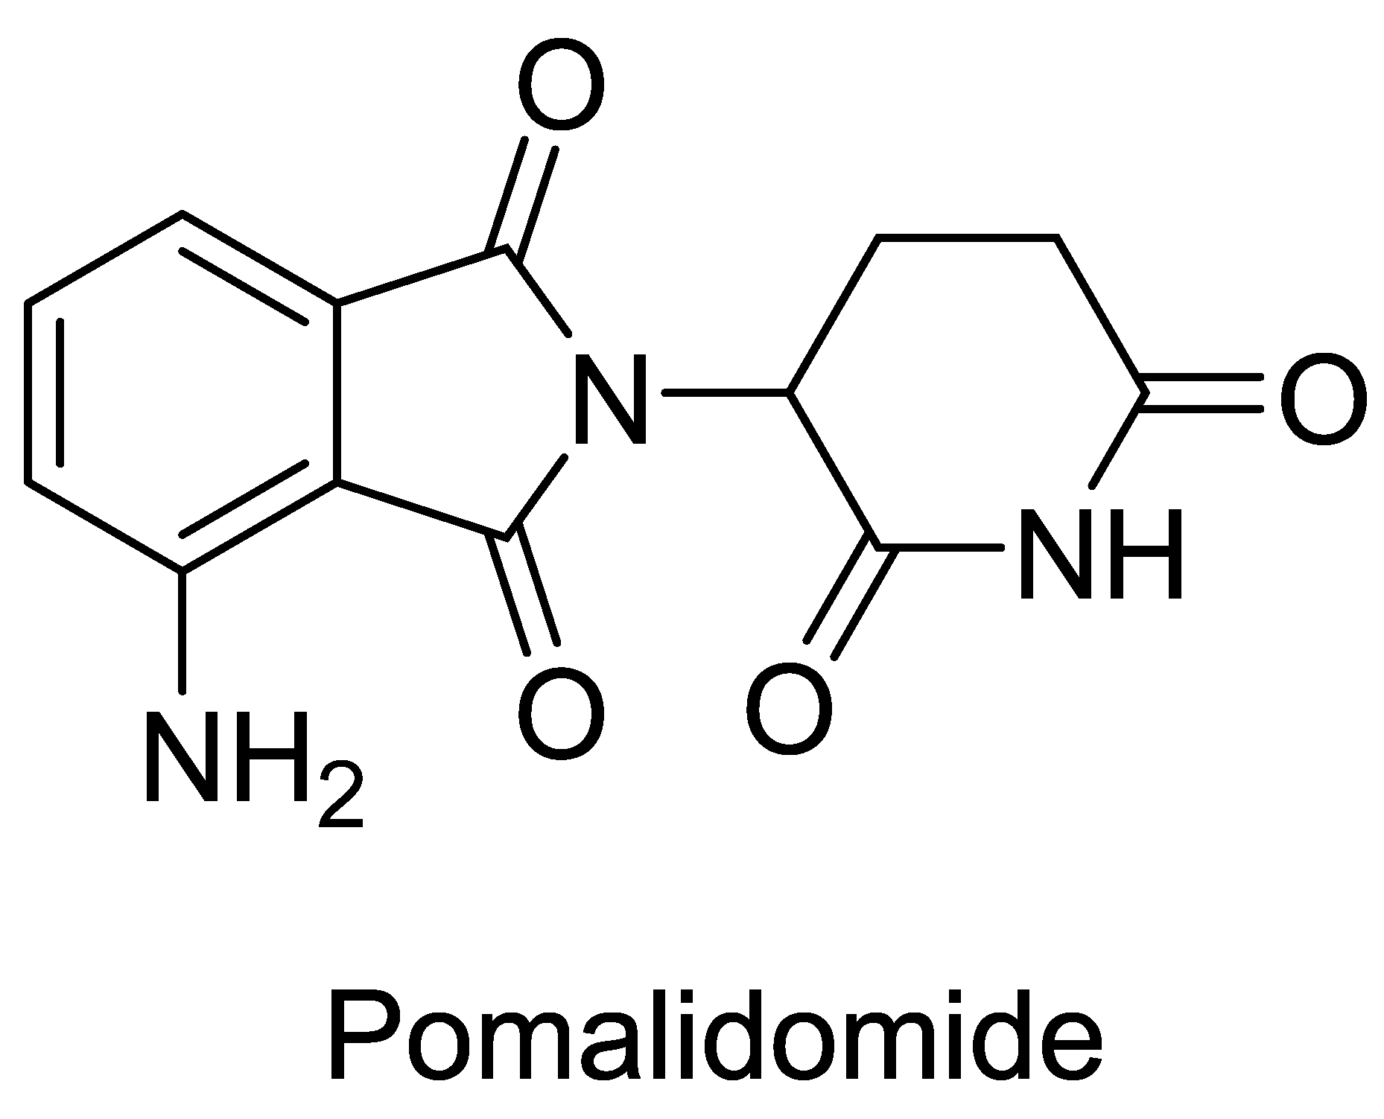
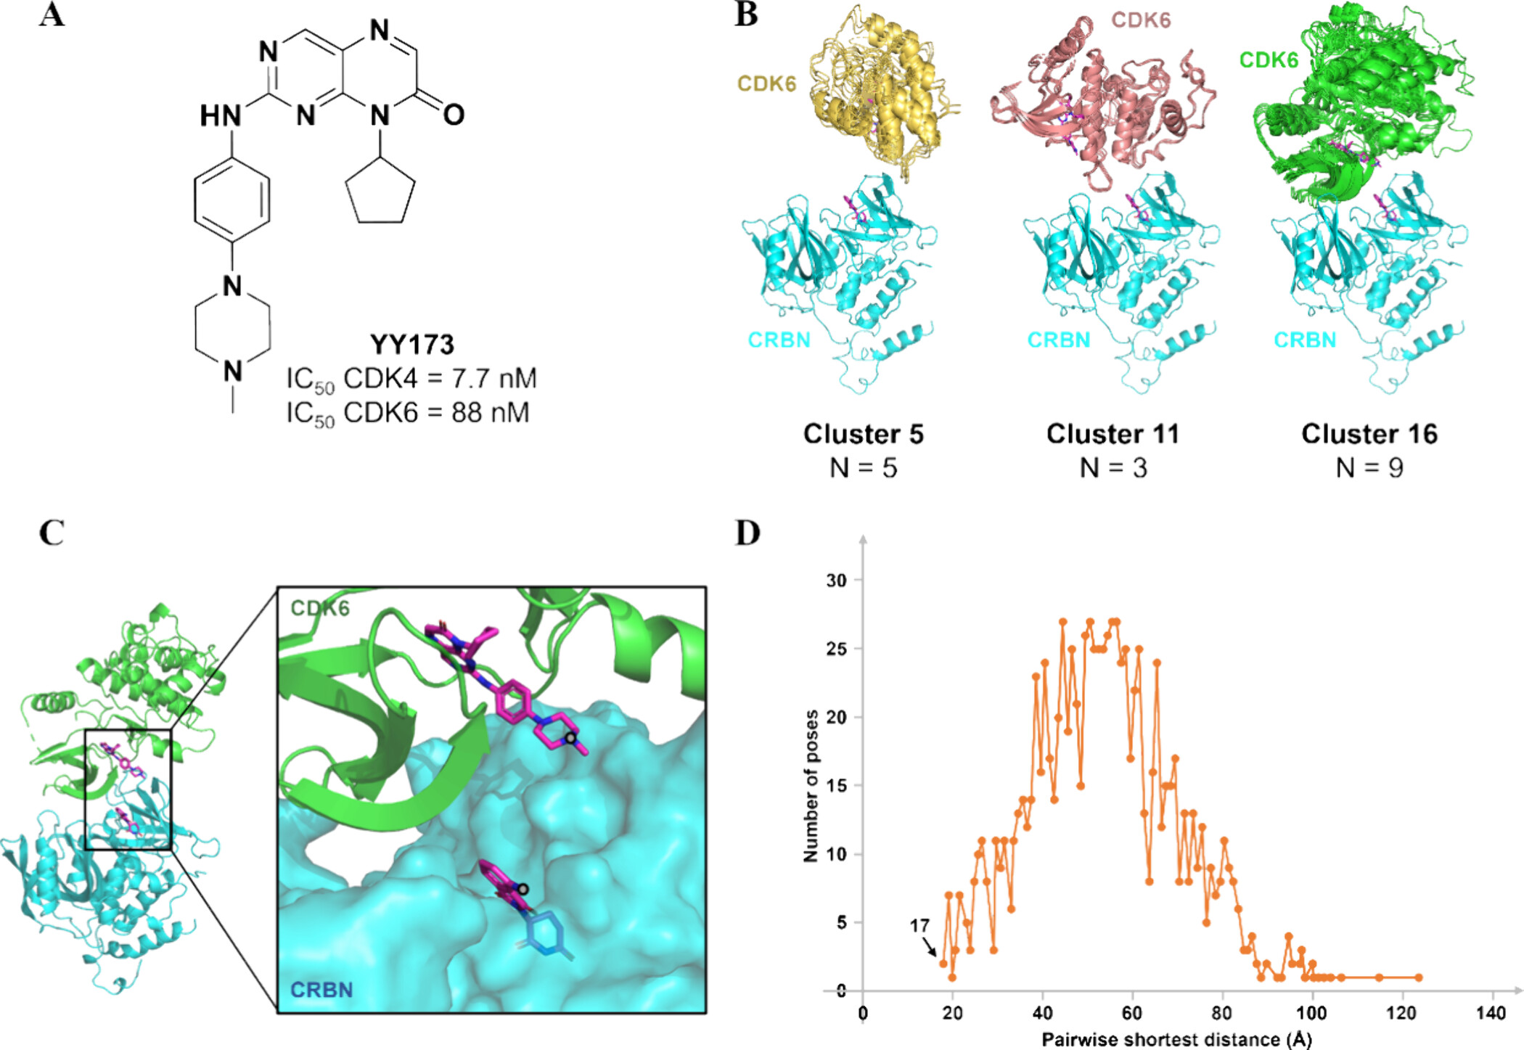
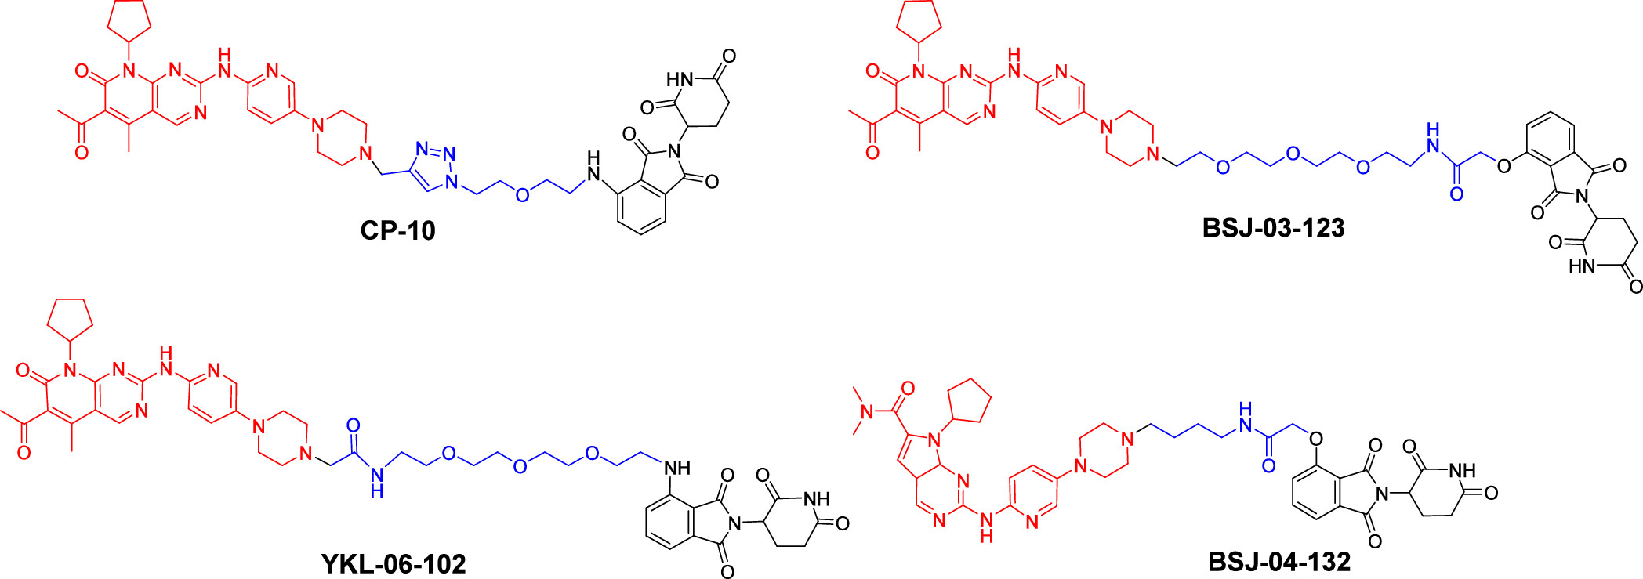
PROTACs targeting CDK4/6
Background
Identified YY173 through screening their in-house database
Palbociclib (帕布昔利布) is a FDA-approved CDK4/6 inhibitor
PDB ID: 5l2i
泊马度胺, targeting E3 ligase CRBN
PDB ID: 4ci3
None of these CDK4/6 PROTACs have entered in clinical trials
Figure 1. Structures of published CDK4/6-selective PROTACs
4
Notes:
https://www.uspharmacist.com/article/a-review-of-cdk4-6-inhibitors 帕布昔利布是首个被批准作为癌症疗法的CDK4 / 6抑制剂。 CRBN，核内外都有

Slide 5
Docking protocol
Methods
Using the Rosetta docking programs for
Docked YY173 to CDK6
Docked pomalidomide-bound CRBN to YY173-bound CDK6
Clustered the top 200 low-energy conformations
Figure 2B shows three representatives
Calculated pairwise shortest distances between selected solvent-exposed atoms of YY173 and pomalidomide for all poses.
17 to 18 Å, i.e. six to eight atoms
The shortest may provide the best selectivity
Figure 2

Slide 6
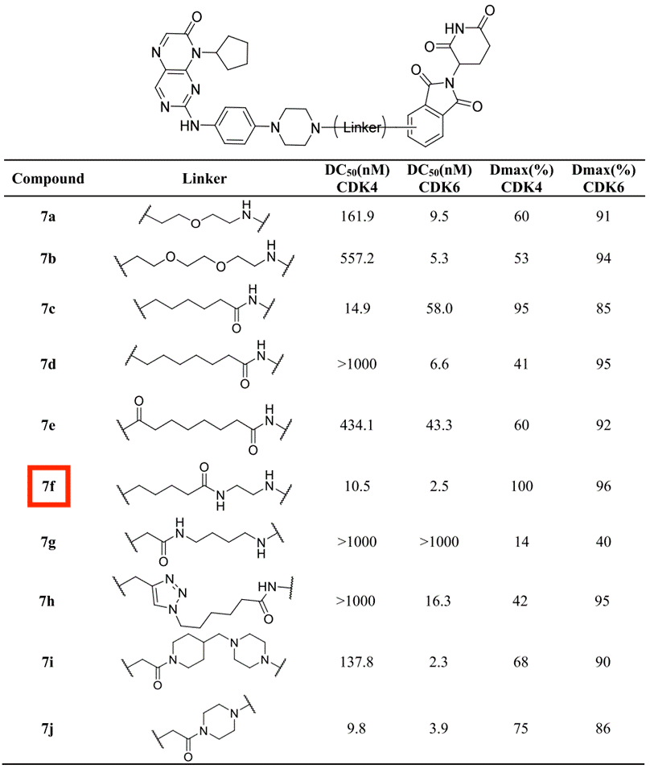
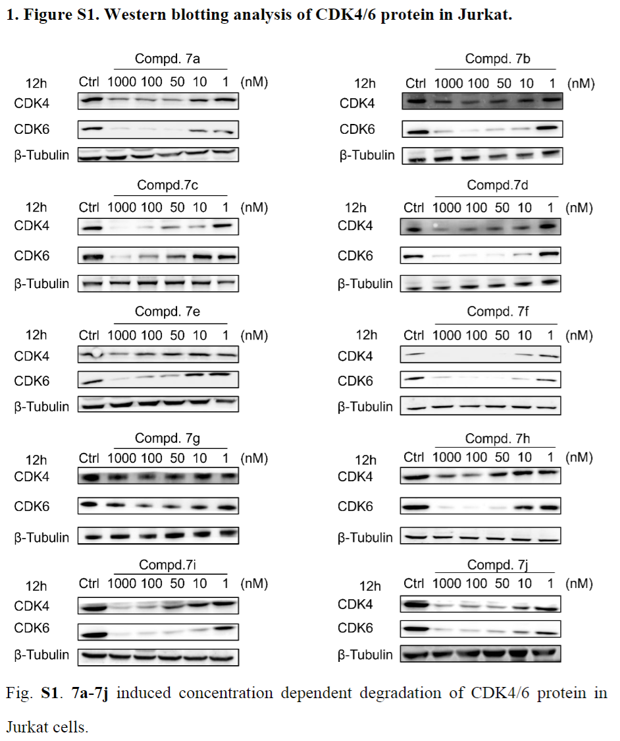
Rational design of linker
Results
Table 1
Jurkat cells are from acute T cell leukemia
Western blot assay in Jurkat cells
They picked 7f for further study
DC50: The half-maximal degradation concentration
Designed based on length
From literature

Slide 7
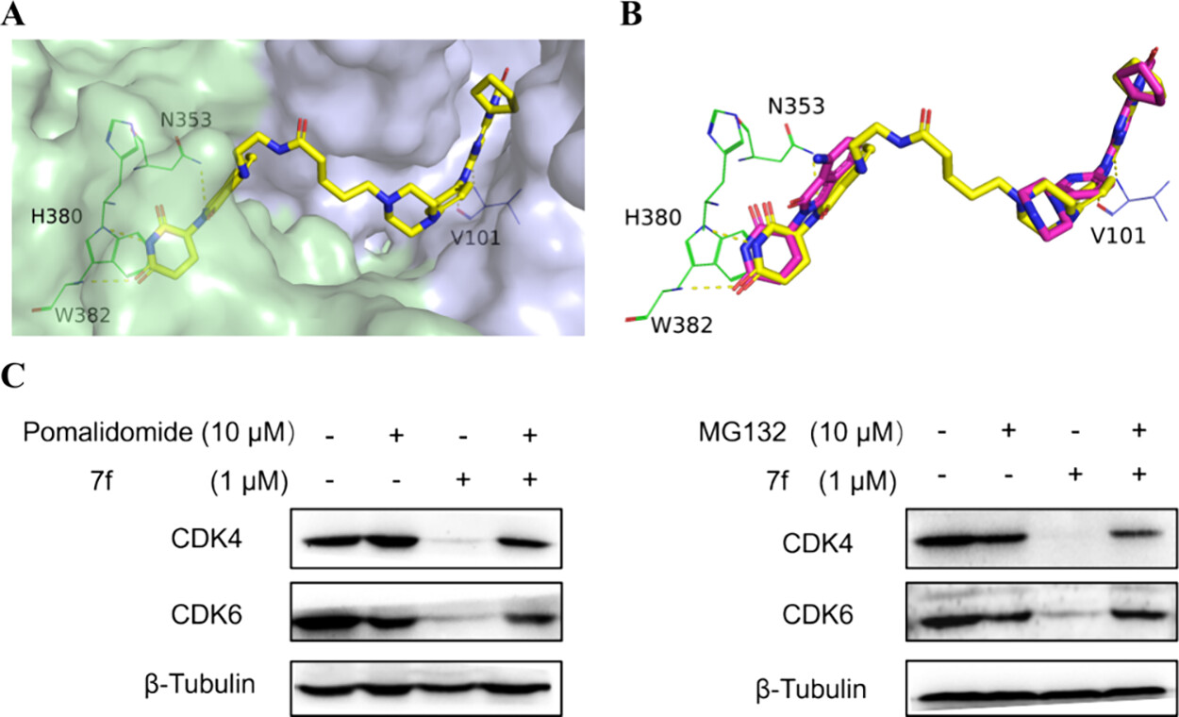
Determining the binding mode of 7f
Methods
Figure 3
generated 1000 conformations of small molecules using software Cyndi
superimposed these conformations onto YY173 and pomalidomide using the SHAFT program, selecting the optimal conformation of 7f.
optimized the structure of the ternary complex system using Maestro.
7f maintained the binding conformation of ligands and polar interactions with protein residues in the original crystal structure

Slide 8
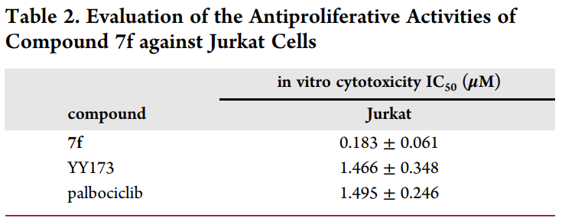
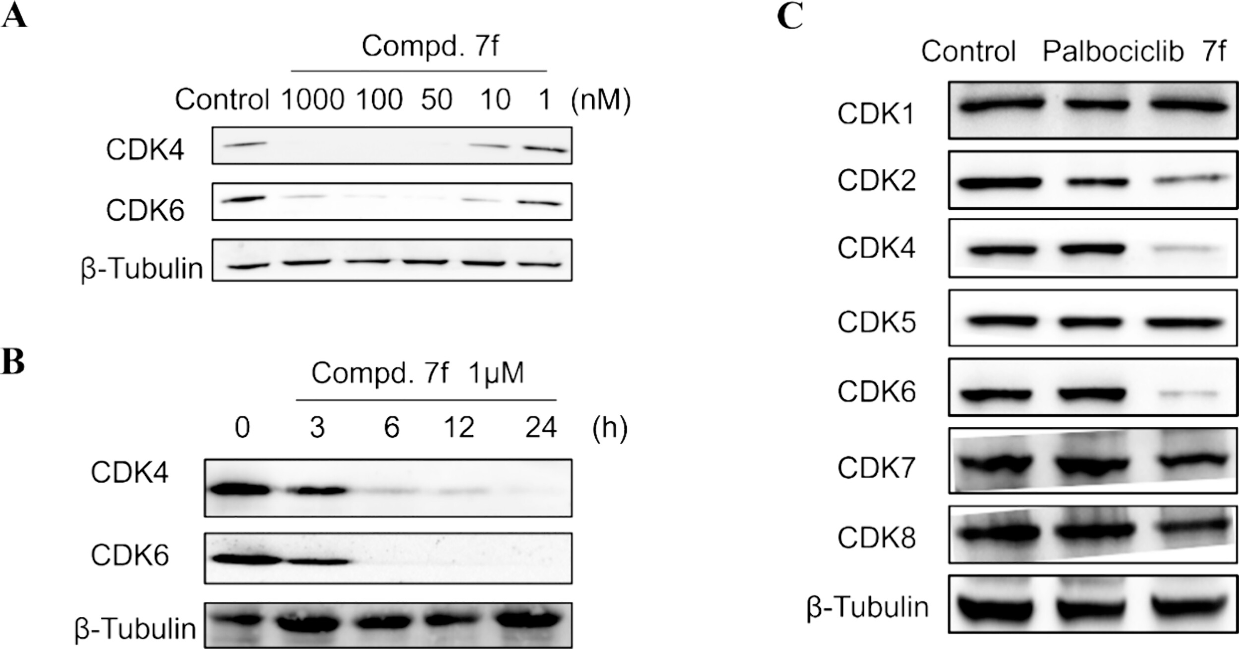
Evaluation of 7f in Jurkat Cells
Results
Figure 4
Figure 3C
an eightfold improvement over YY173
MG132: proteasome inhibitor
the degradation is proteasome-dependent
7f exhibited concentration-dependent and time-dependent degradation of CDK4/6
Compound 7f is a selective CDK4/6 degrader

Slide 9
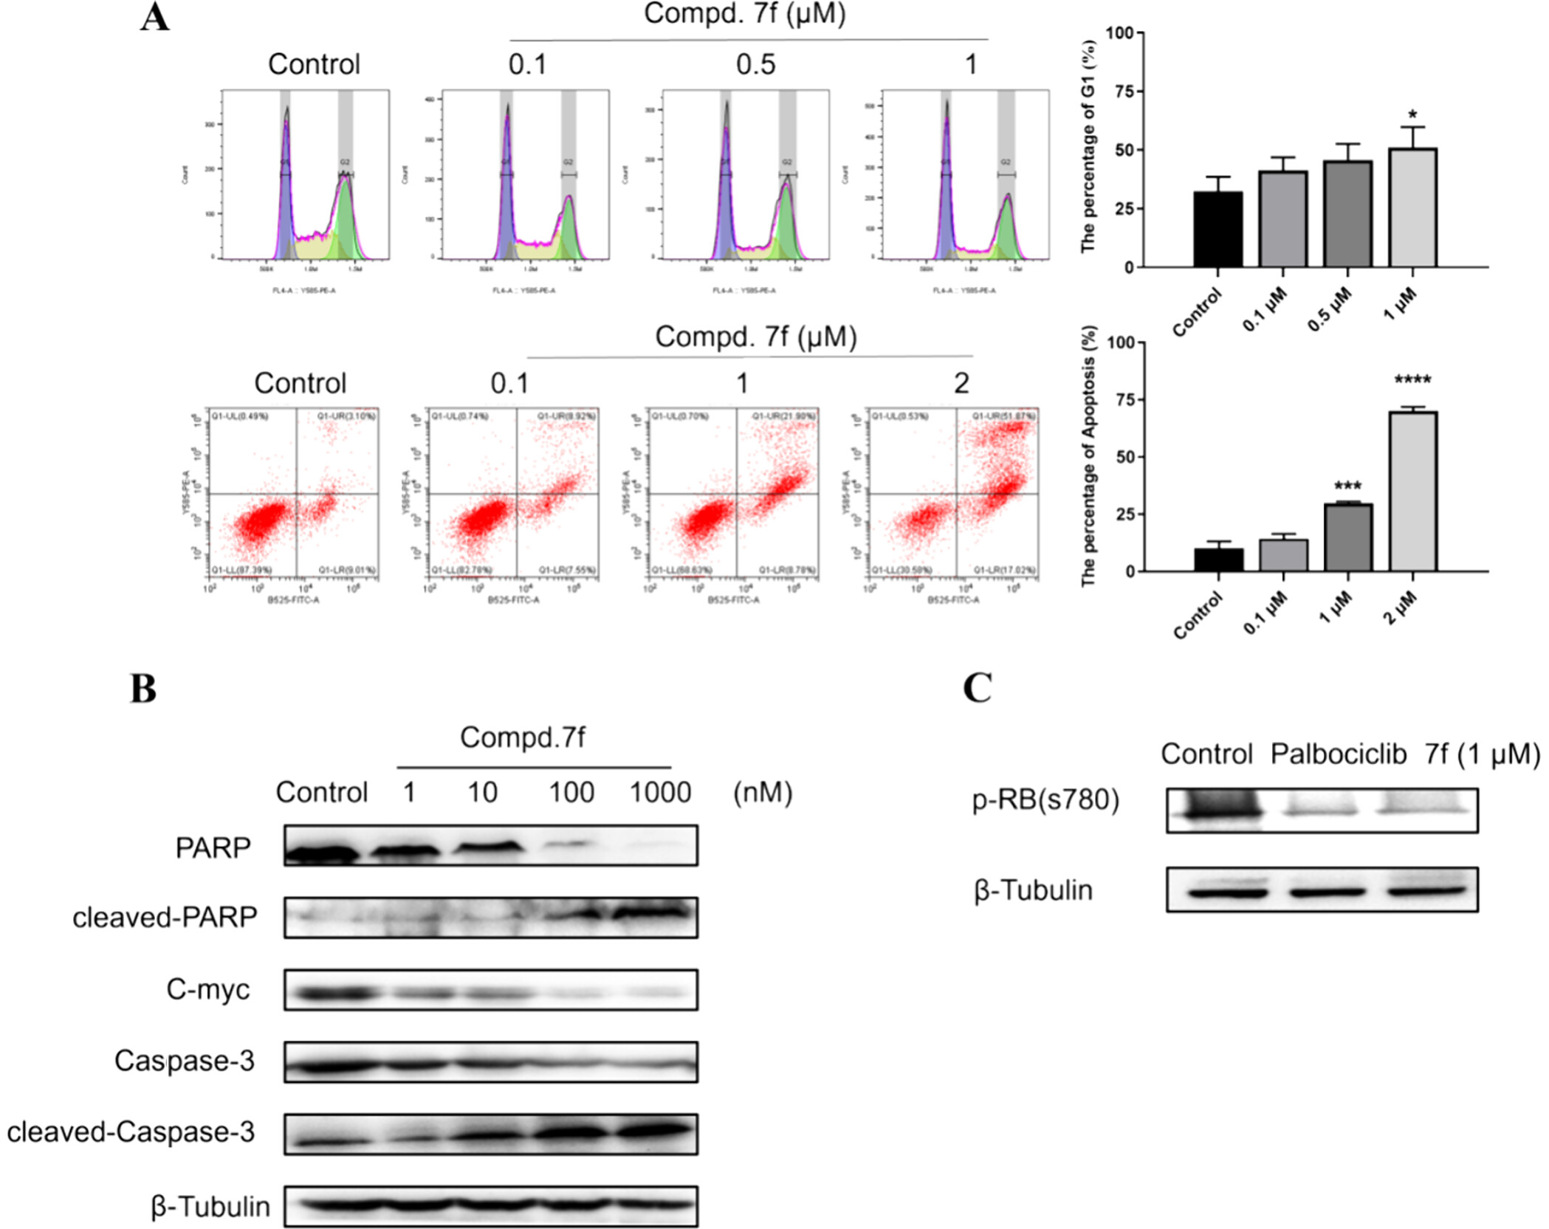
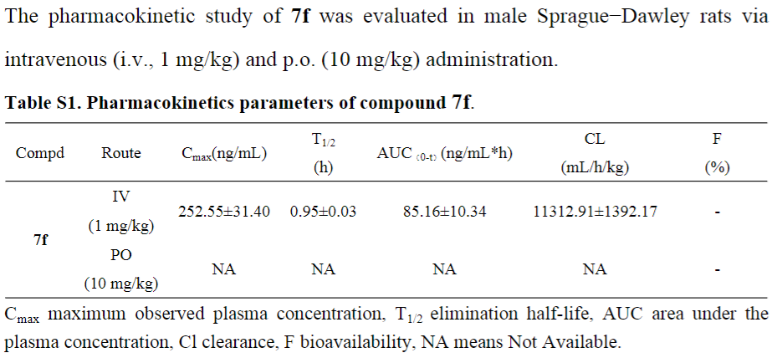
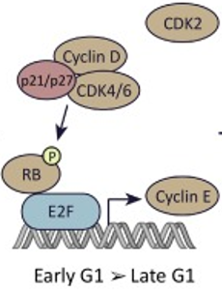
7f induces cell apoptosis by cleaving PARP and Caspase3
Results
Figure 5
7f induces cell apoptosis in a dose dependent manner
7f inhibits the phosphorylation of RB
7f lacks the potential to be developed as an oral drug
G1
G2
Y585-PE-A
B525-FITC-A
Notes:
PARP-1-mediated cell death initiates from the damage of chromosomal DNA and activation of a signal cascade that terminates with large scale DNA cleavage and pyknotic nuclei.
PARP had been cleaved by caspase-3
B525-FITC-A: Represents the fluorescence intensity of FITC (fluorescein isothiocyanate) detected at 525 nm. FITC is commonly used to label Annexin V, which binds to phosphatidylserine exposed on the outer leaflet of the cell membrane during early apoptosis.
Y585-PE-A: Represents the fluorescence intensity of PE (phycoerythrin) detected at 585 nm. PE is often used to label propidium iodide (PI), which stains the DNA of cells with compromised membranes, indicating late apoptosis or necrosis.

Slide 10
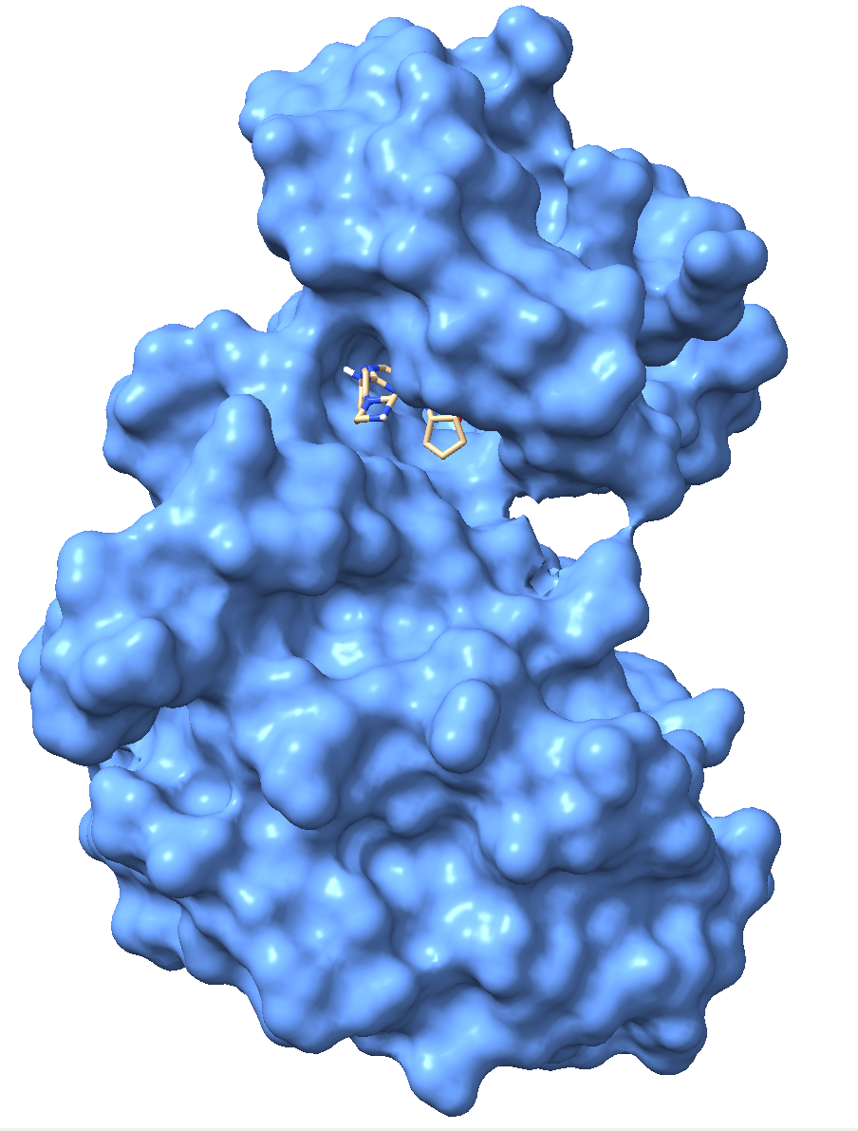
Thanks for listening!

