Slide 1


Computational Linguistics & Natural Language Processing
Lvxiaowei Xu
2024/12/25
PRON—VERB—a—lot

Slide 2
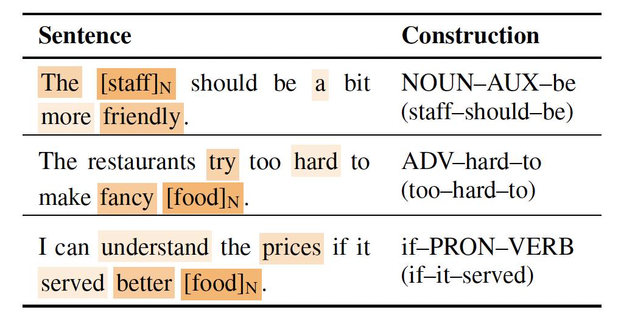
What is Construction Grammar (CxG) ?
DEFINITION
Constructions are stored pairings of form and function / meaning.
They cannot be strictly predictable by their components.
They vary in level of abstractness, including partially or fully filled components.
TYPES

Slide 3

Linguistics and NLP can complement each other
Battle: “Hinton vs. Chomsky”
How do language models assist in linguistic research?
How does linguistics influence natural language processing?
Can linguistics do what LLMs cannot?
1 ”Hinton接受尤利西斯奖章获奖感言“.当代语言学.2024.

Slide 4
How do language models assist in linguistic research?

Slide 5
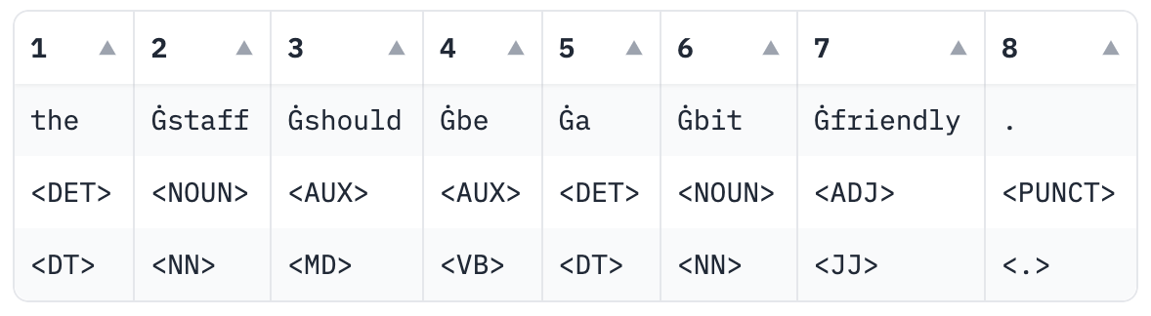

Construction Grammar Induction
How can we automatically acquire constructions from corpora?
Introducing a construction grammar induction framework (CxGLearner).
Step 1
Split & Encode the corpus
Step 2
Pre-train Association Strength Estimator
Background Corpus
NSLP
Inference / Estimate
Association Strength
*NSLP - Next Slot Prediction: selects different abstraction levels of the slots for modeling
1 "CoELM: Construction-Enhanced Language Modeling". ACL 2024.
2 Jonathan Dunn."Frequency vs. Association for Constraint Selection in Usage-Based Construction Grammar". CMCL 2019.

Slide 6
Construction Grammar Induction
How can we automatically acquire constructions from corpora?
Introducing a construction grammar induction framework (CxGLearner).
Step 3
Candidate Extraction & Candidate Pruning
1 "CoELM: Construction-Enhanced Language Modeling". ACL 2024.
2 Jonathan Dunn."Frequency vs. Association for Constraint Selection in Usage-Based Construction Grammar". CMCL 2019.

Slide 7
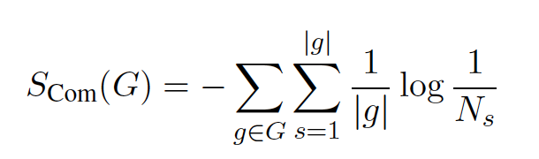
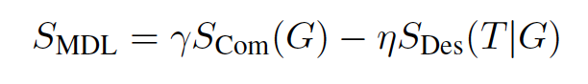
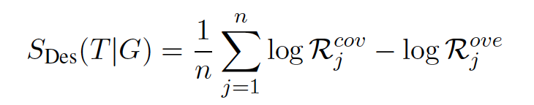
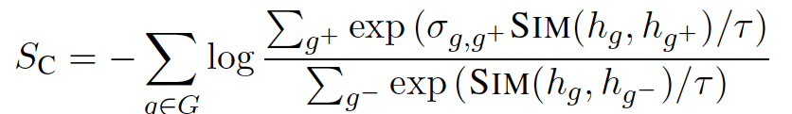
Construction Grammar Induction
How can we automatically acquire constructions from corpora?
Introducing a construction grammar induction framework (CxGLearner).
Step 4
Heuristic Learning of Constructions
Four psychological principles considered essential for the
organization of constructions in a language
1) Maximized Expressive Power
2) Maximized Economy
3) Maximized Motivation
4) No Synonymy
1 "CoELM: Construction-Enhanced Language Modeling". ACL 2024

Slide 8
How does linguistics influence natural language processing?

Slide 9
Focusing on language understanding
(Q1)
Which CxG approach is applicable for Natural Language Understanding?
FCG, ECG, SBCG, or usage-based approaches?
(Q2)
How can typical constructions be identified?
Do we need all the constructions? What constructions would be beneficial for NLU?
(Q3)
How can constructions be encoded?
How to incorporate constructional information into the language representation?
1 "Enhancing Language Representation with Constructional Information for Natural Language Understanding". ACL 2023

Slide 10

Focusing on language understanding
Step 1
Step 2
Step 3
Construction Extraction & Selection
Constructional Information Interaction
Fine-tune
1 "Enhancing Language Representation with Constructional Information for Natural Language Understanding". ACL 2023

Slide 11
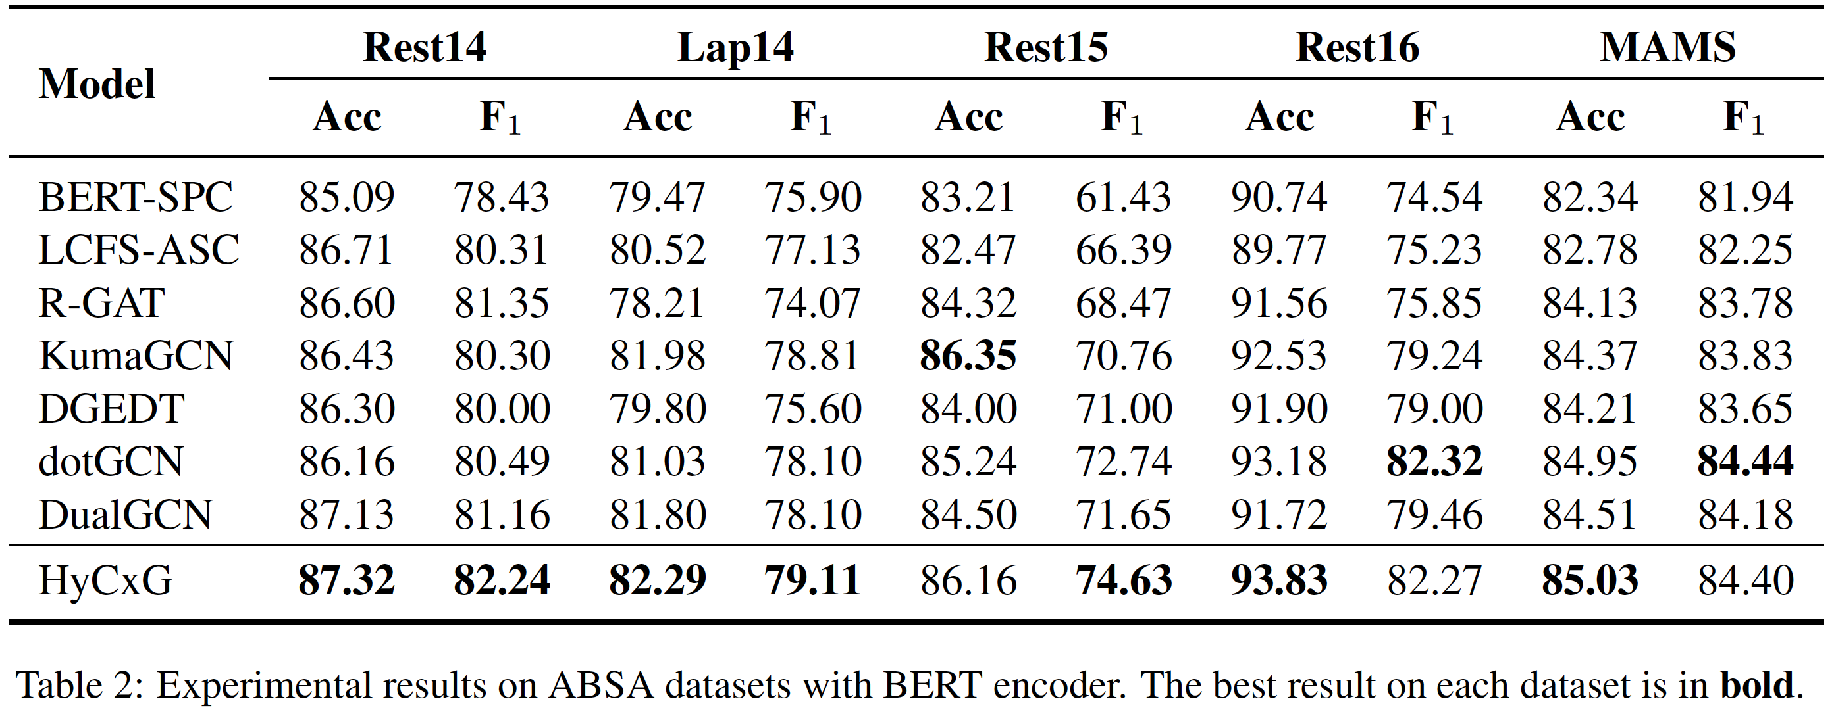
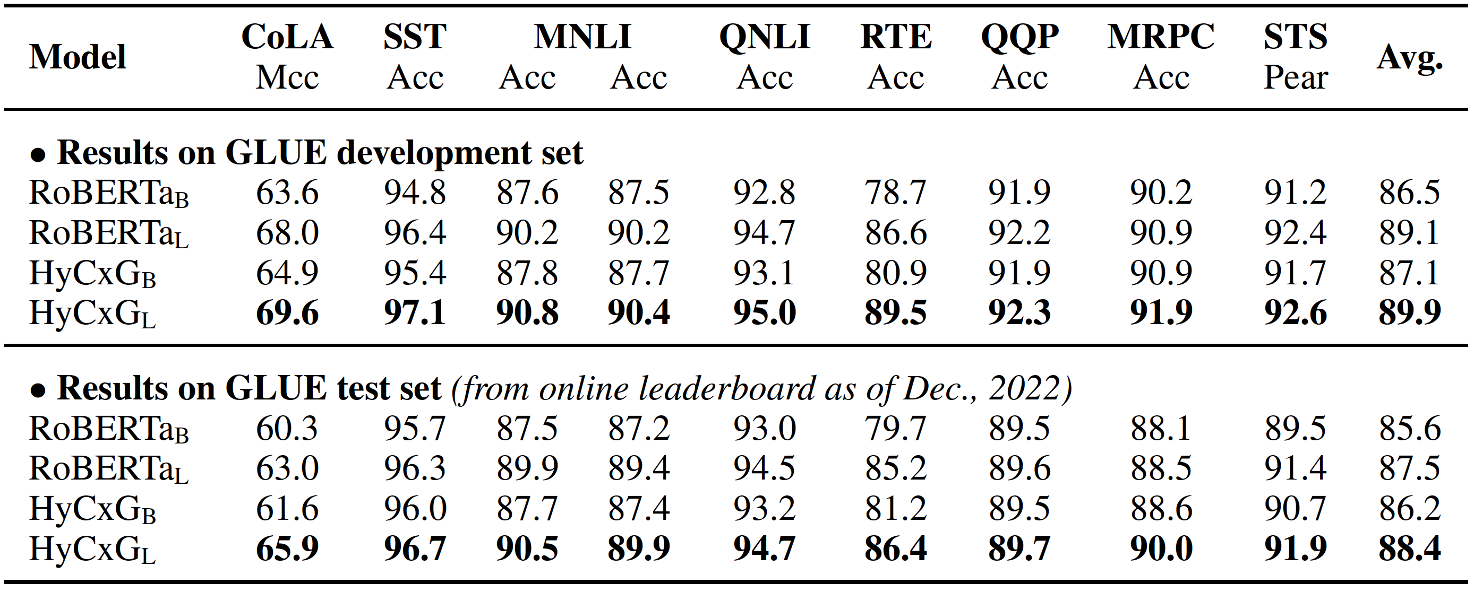
Focusing on language understanding
Experimental Results
GLUE benchmark
Tasks:
Linguistic Acceptability (CoLA)
NLI (MNLI, QNLI, RTE)
Sentiment Analysis (SST-2)
Paraphrase (MRPC, QQP)
Similarity (STS-B)
Aspect-based sentiment analysis
Datasets: Rest14/15 /16 & Lap 14 from SemEval & MAMS
1 "Enhancing Language Representation with Constructional Information for Natural Language Understanding". ACL 2023

Slide 12
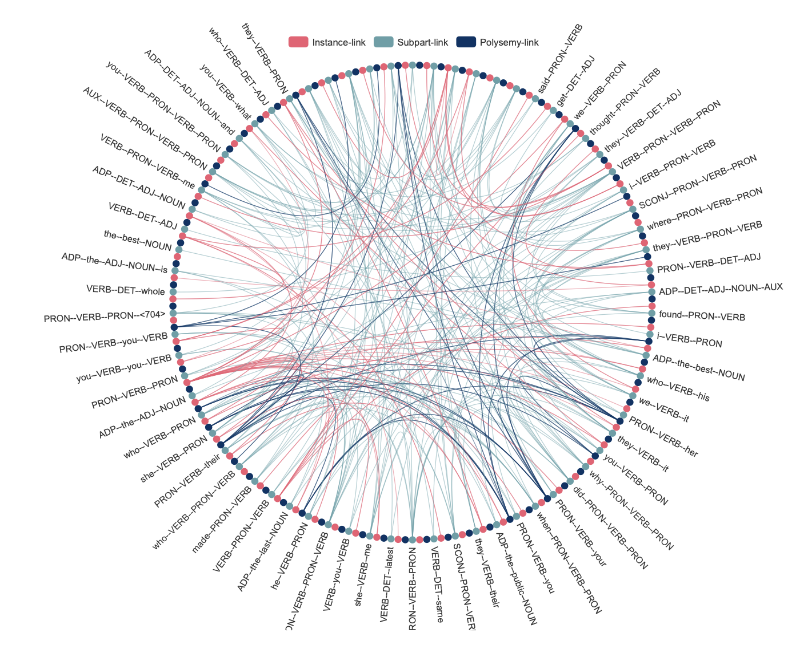
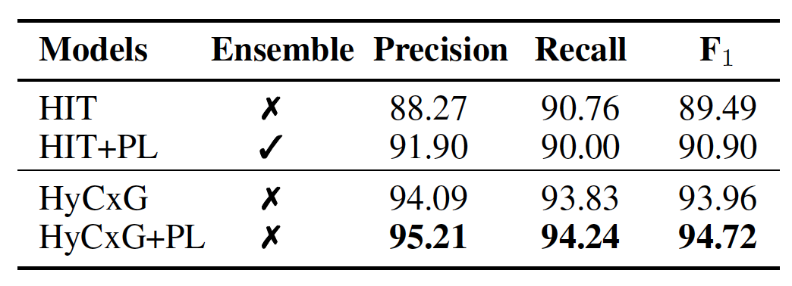
Focusing on language understanding
Pattern Recognition
Network of Constructions
Datasets: Counterfactual Detection SemEval 2020
*PL is stand for pseudo - labeling
Original Sentence: if I were asked to, I would be happy to talk to anyone.
“if–PRON–were–VERB” → “if I were asked”
“AUX–be–ADJ” → “would be happy”
Constructions:
1 "Enhancing Language Representation with Constructional Information for Natural Language Understanding". ACL 2023

Slide 13
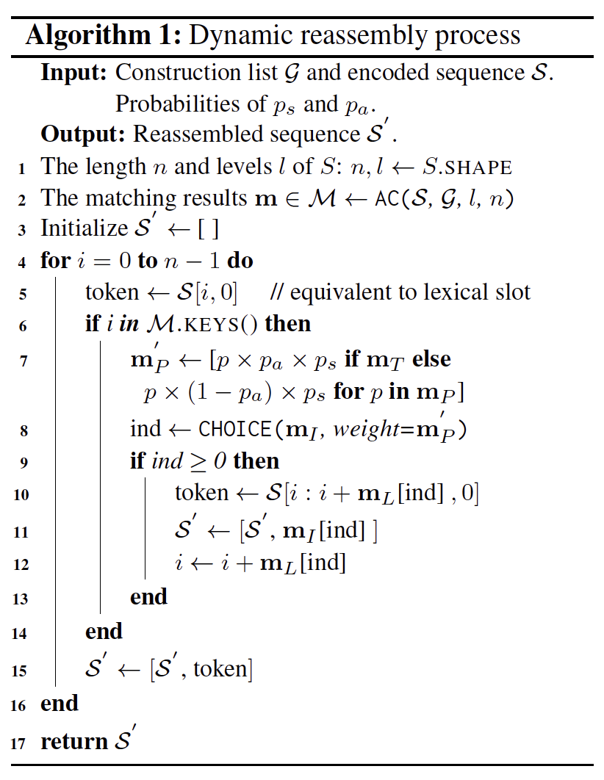
Focusing on language generation
How can we exploit constructions as inductive bias?
Proposing the Dynamic Sequence Reassembly (DSR) Strategy for pre-training.
Dynamic Sequence Reassembly Strategy
1 "CoELM: Construction-Enhanced Language Modeling". ACL 2024

Slide 14
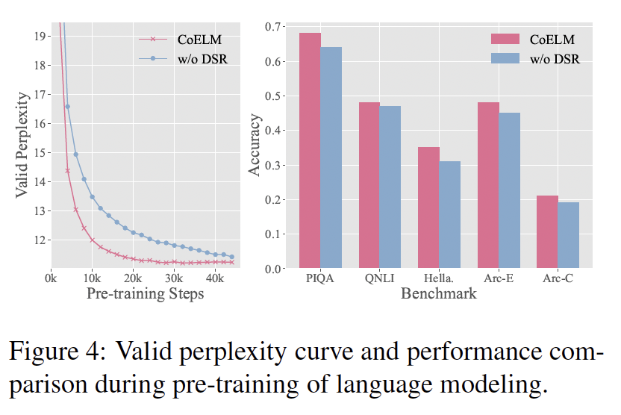
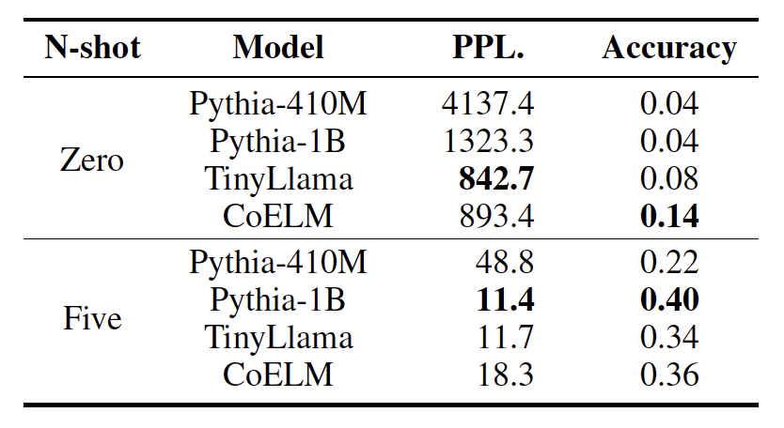
Focusing on language generation
Language Modeling Acceleration
Wug Test
To investigate whether the pre-trained language models
possess human-like linguistic knowledge.
During pretraining, the curves of loss and perplexity of language models first plummet in a power law, and then seemingly enter a near-linear decline.
Containing 50 irregular verbs that by one or two letters
e.g., wug → wugged
Predict the past tense of these nonce words.
1 "CoELM: Construction-Enhanced Language Modeling". ACL 2024
2 “Counting the bugs in ChatGPT’s wugs: A multilingual investi- gation into the morphological capabilities of a large language model.” EMNLP 2023.

Slide 15
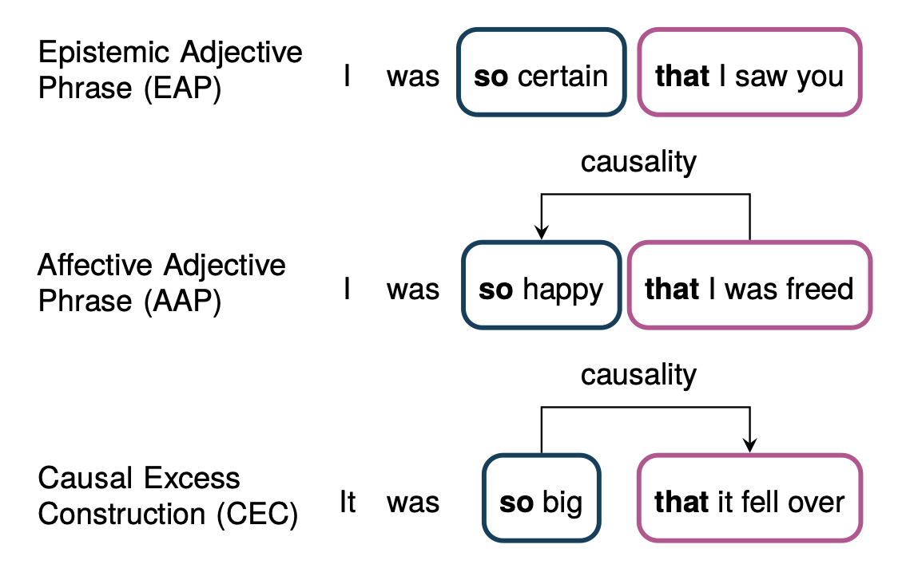
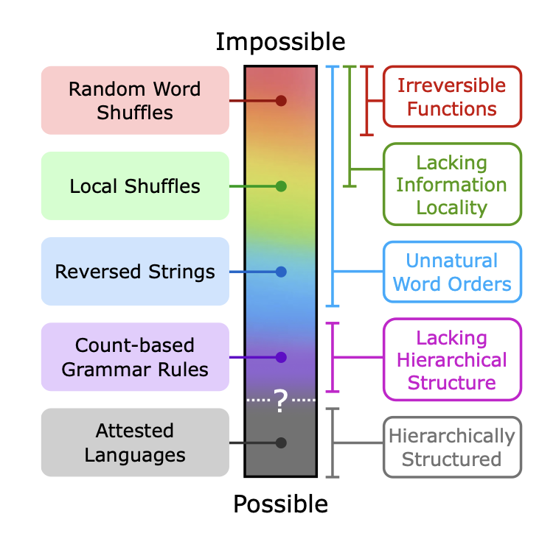
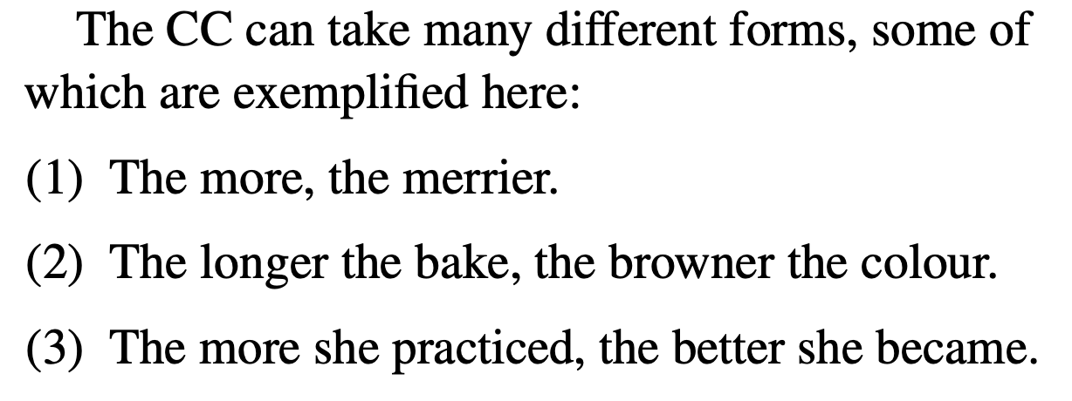
What are other linguists working on?
Probing & Evaluation
Psychology-related research
1 "Constructions Are So Difficult That Even Large Language Models Get Them Right for the Wrong Reasons". COLING 2024.
2 "Counting the bugs in ChatGPT’s wugs: A multilingual investigation into the morphological capabilities of a large language model. " EMNLP 2023.
3 "The better your Syntax, the better your Semantics? Probing Pretrained Language Models for the English Comparative Correlative”. EMNLP 2022.
4 "A Crosslingual Investigation of Conceptualization in 1335 Languages." ACL 2023.
5 “Mission: Impossible Language Models”. ACL 2024 (Best Paper)

Slide 16
Can linguistics do what LLMs cannot?

Slide 17
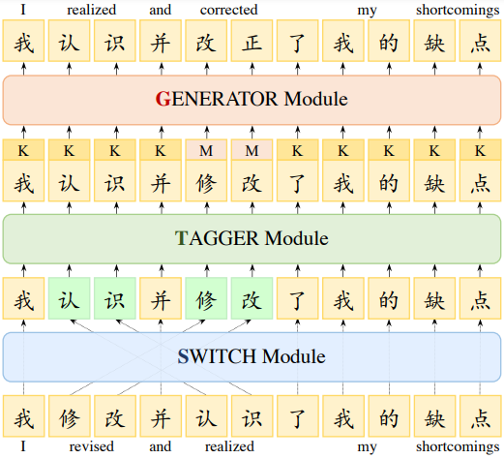
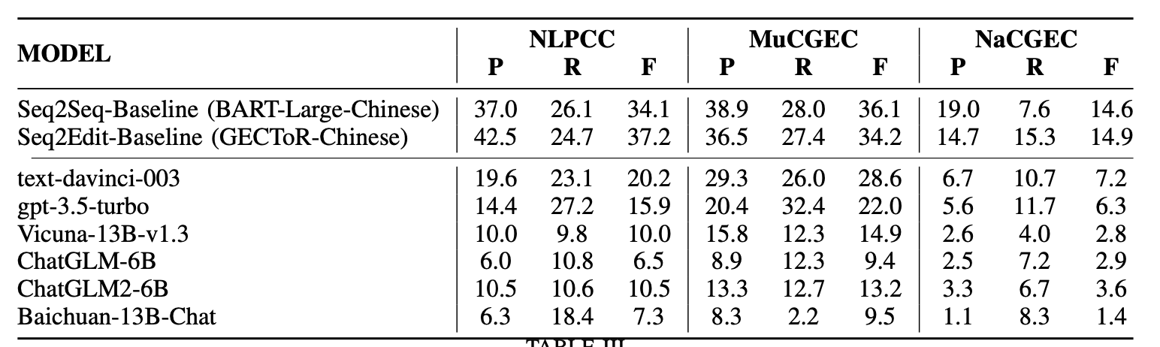
Application: Grammatical Error Correction
Erroneous Sentence: 毋庸置疑，原生态的东西有精华也有糟粕，必须具体分析，辩证对待，因此，王冰认为赵亮关于原生态艺术的那篇文章有错误的观点是值得商榷的。
Corrected Sentence: 毋庸置疑，原生态的东西有精华也有糟粕，必须具体分析，辩证对待，因此，王冰认为赵亮关于原生态艺术的那篇文章有些观点是错误的。
GPT-4 Output: The sentence has no grammatical errors.
1 FCGEC: Fine-Grained Corpus for Chinese Grammatical Error Correction.
2 On the (In)Effectiveness of Large Language Models for Chinese Text Correction.
Observation: LLMs face significant challenges in the CGEC

Slide 18
Application: Grammatical Error Correction
Motivation: Can constructions help models with grammatical correction?
The knowledge view of constructions - Constructions store knowledge of language use, and grammatical errors are manifestations of insufficient language knowledge.
Using constructions that store knowledge of language use can help guide grammatical error correction with language knowledge via exploiting CxG.
Hypothesis: Grammatical errors that occur within or at the boundaries of constructions hold the most value for error correction cues in language models.
Key Observation: Even with slight perturbations in the text structure, language models can still accurately predict the correct constructions.
1 Goldberg, Adele E. "Constructions: A new theoretical approach to language." Trends in cognitive sciences 7.5 (2003): 219-224.
2 Hoffmann, Thomas, and Graeme Trousdale. The Oxford handbook of construction grammar. Oxford University Press, 2013.
3 施春宏.构式三观：构式语法的基本理念[J].东北师大学报(哲学社会科学版),2021,(04):1-15.
4 Nuances are the key: Unlocking chatgpt to find failure-inducing tests with differential prompting." 2023 ASE. IEEE, 2023.

Slide 19
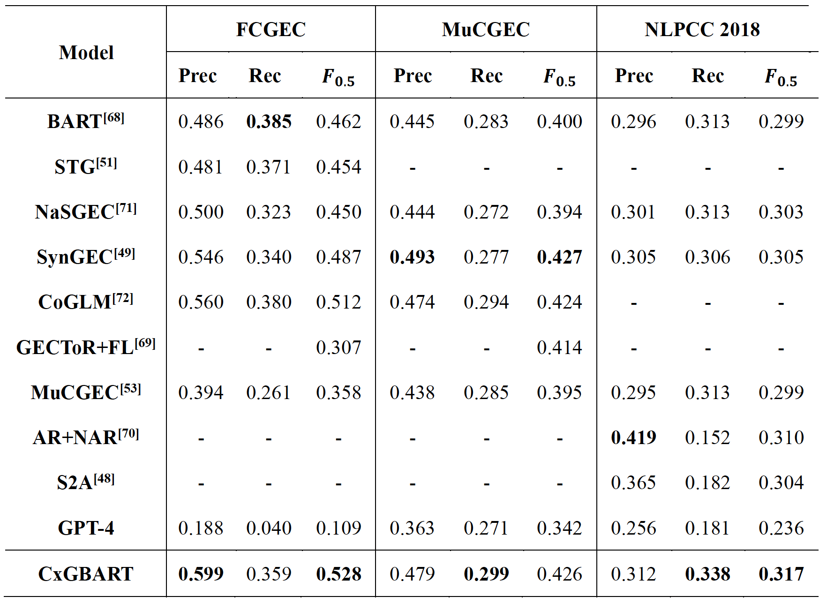
Application: Grammatical Error Correction
Experimental Results
Erroneous Sentence: 恰逢中国传统元宵佳节，在印度滞留将近50余载、年近八旬的王琪老人终于在这一天如愿返回祖国。从新德里到北京，再从北京到咸阳，路漫漫，情深深。
Predicted: 恰逢中国传统元宵佳节，在<ns>--<v>将--近--<m>--<m>、年近<t>--<uj>--<nr>--<n>终于在<r>--<m>如愿返回祖国。从新德里到北京，再从北--京--<v>咸阳，路漫漫，情深深。
Final Output: 恰逢中国传统元宵佳节，在印度滞留将近50载、年近八旬的王琪老人终于在这一天如愿返回祖国。从新德里到北京，再从北京到咸阳，路漫漫，情深深。
GPT-4: 恰逢中国传统元宵佳节，在印度滞留将近50年、年近八旬的王琪老人终于在这一天如愿返回祖国。从新德里到北京，再从北京到咸阳，路漫漫，情深深。

