Slide 1
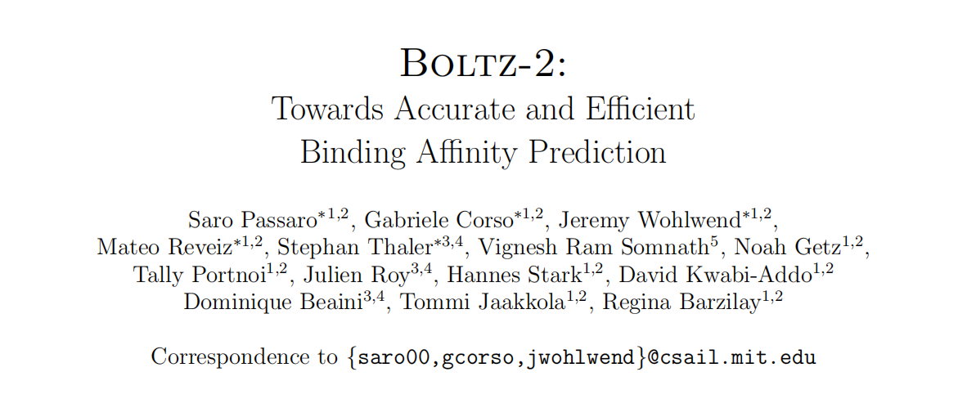
Reporter: 高旭帆
Date: 2025.6.9

Slide 2
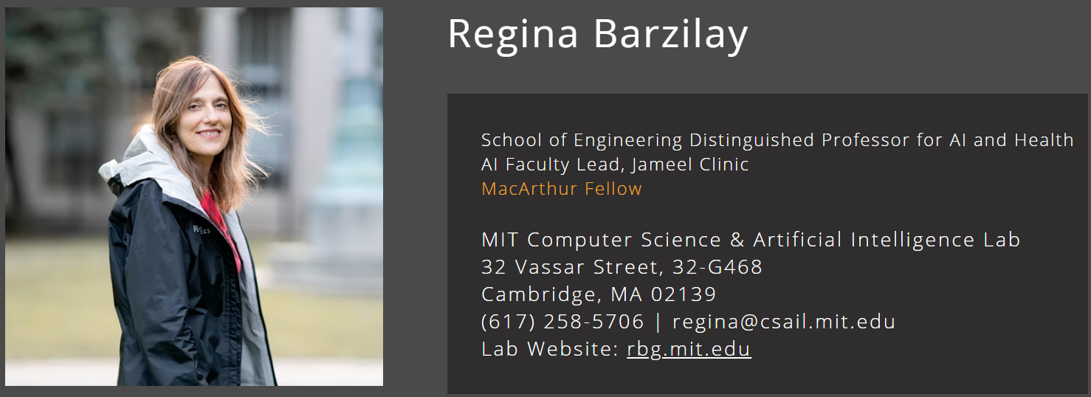
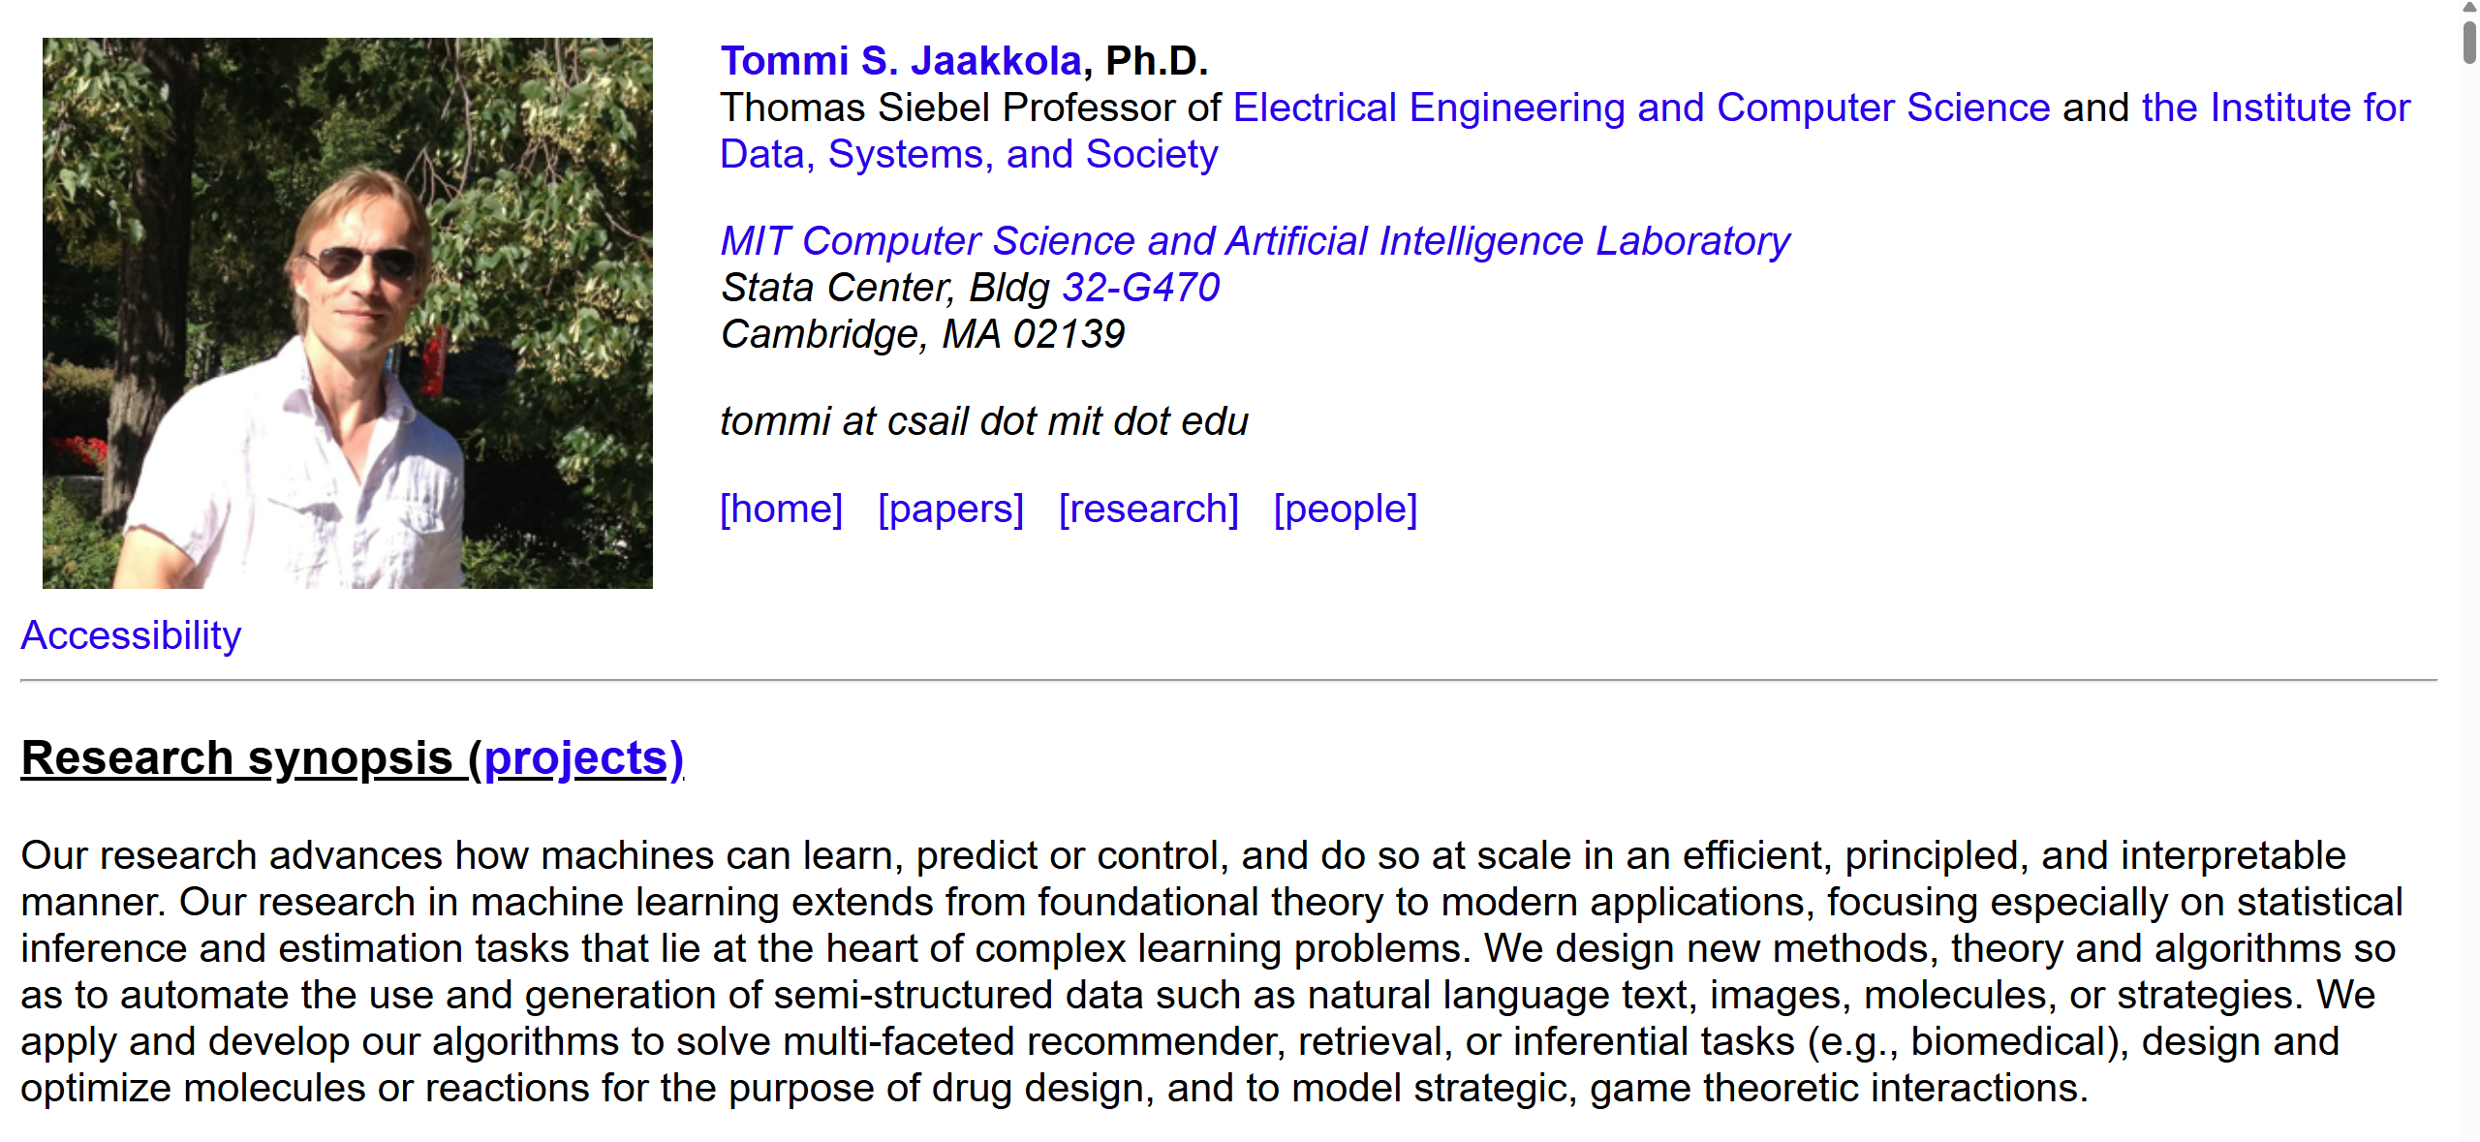

Authors
Introduction
https://people.csail.mit.edu/tommi/
https://www.regina.csail.mit.edu/

Slide 3
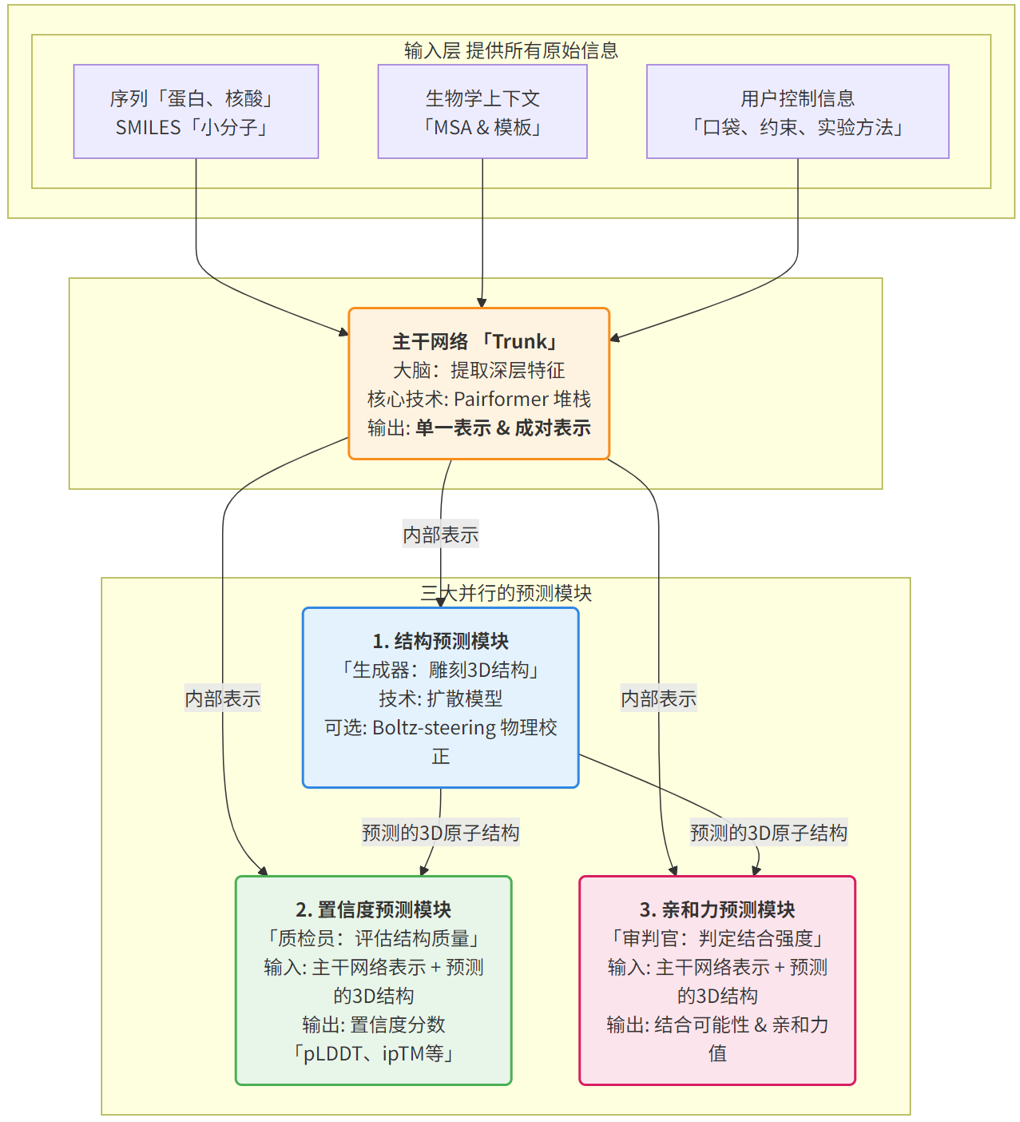
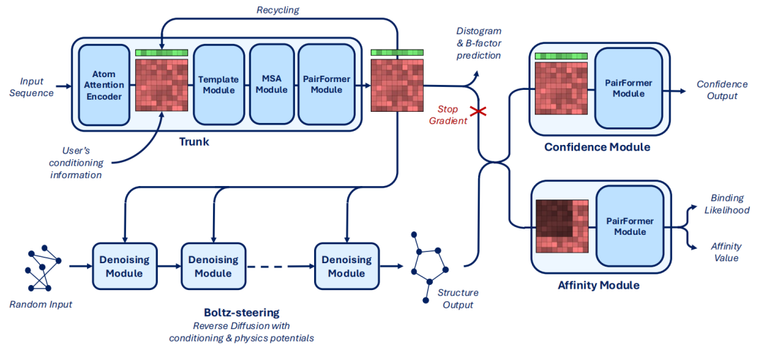
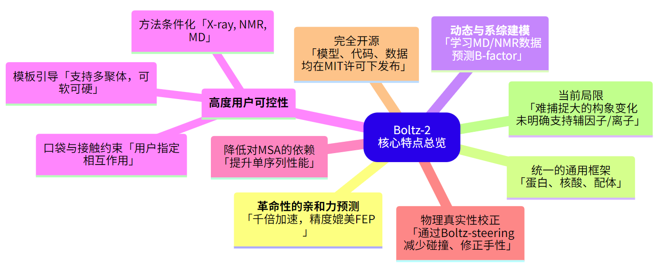
Overall Features
Overview
Comparable RMSF prediction accuracy with BioEmu, etc.

Slide 4
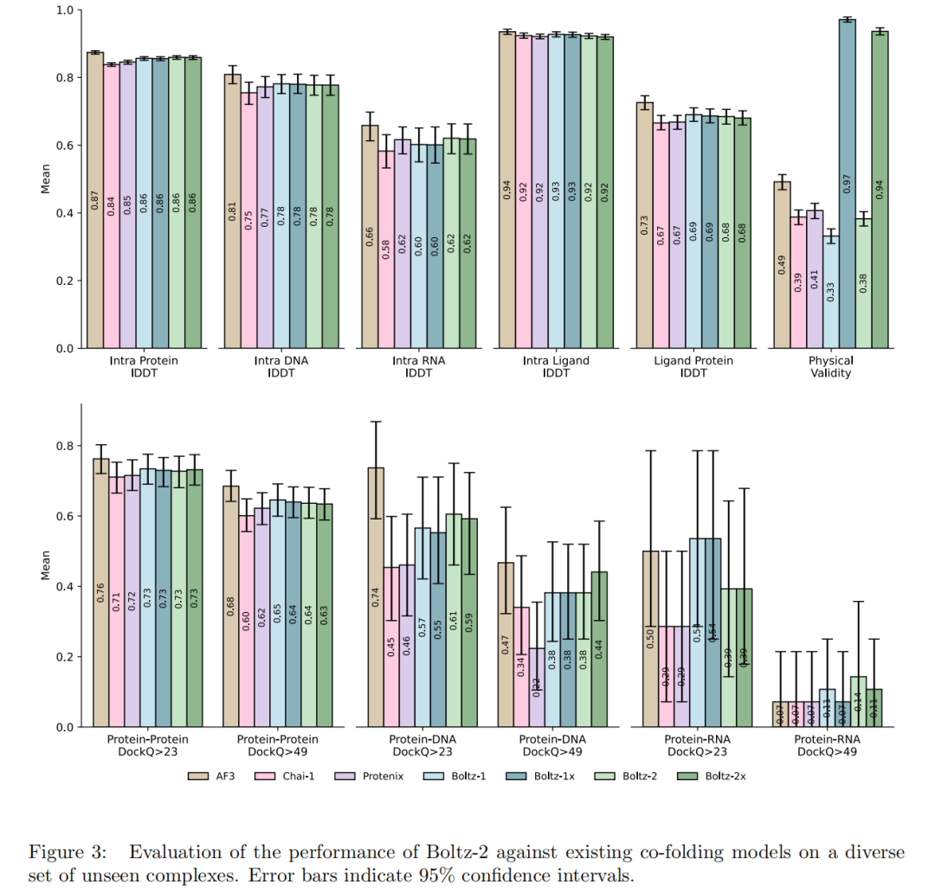
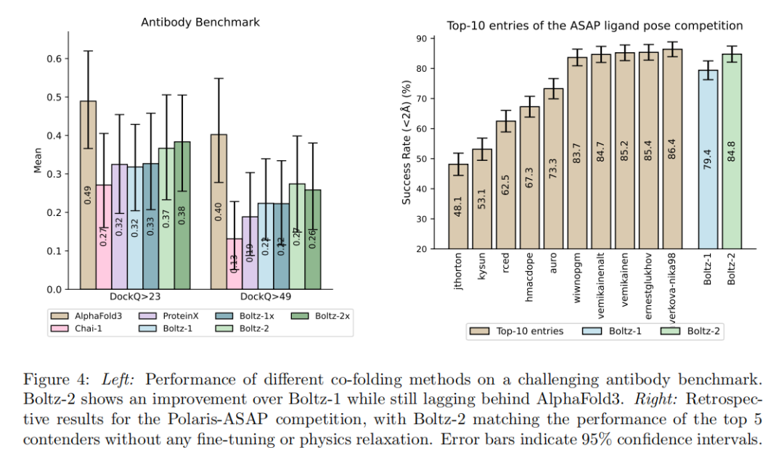
Key Results: Structural Prediction
Overview
Ag-Ab
CoV Mpro-ligands
Comparable structural prediction accuracy with AF3, etc.
Notes:
Boltz-2x 是在Boltz-2的基础上，额外集成了Boltz-steering的版本 。
Boltz-steering是一种在推理阶段（inference-time）应用的技术，它通过施加一组基于物理的势能（physics-based potentials）来修正和引导模型的结构生成过程 。

Slide 5
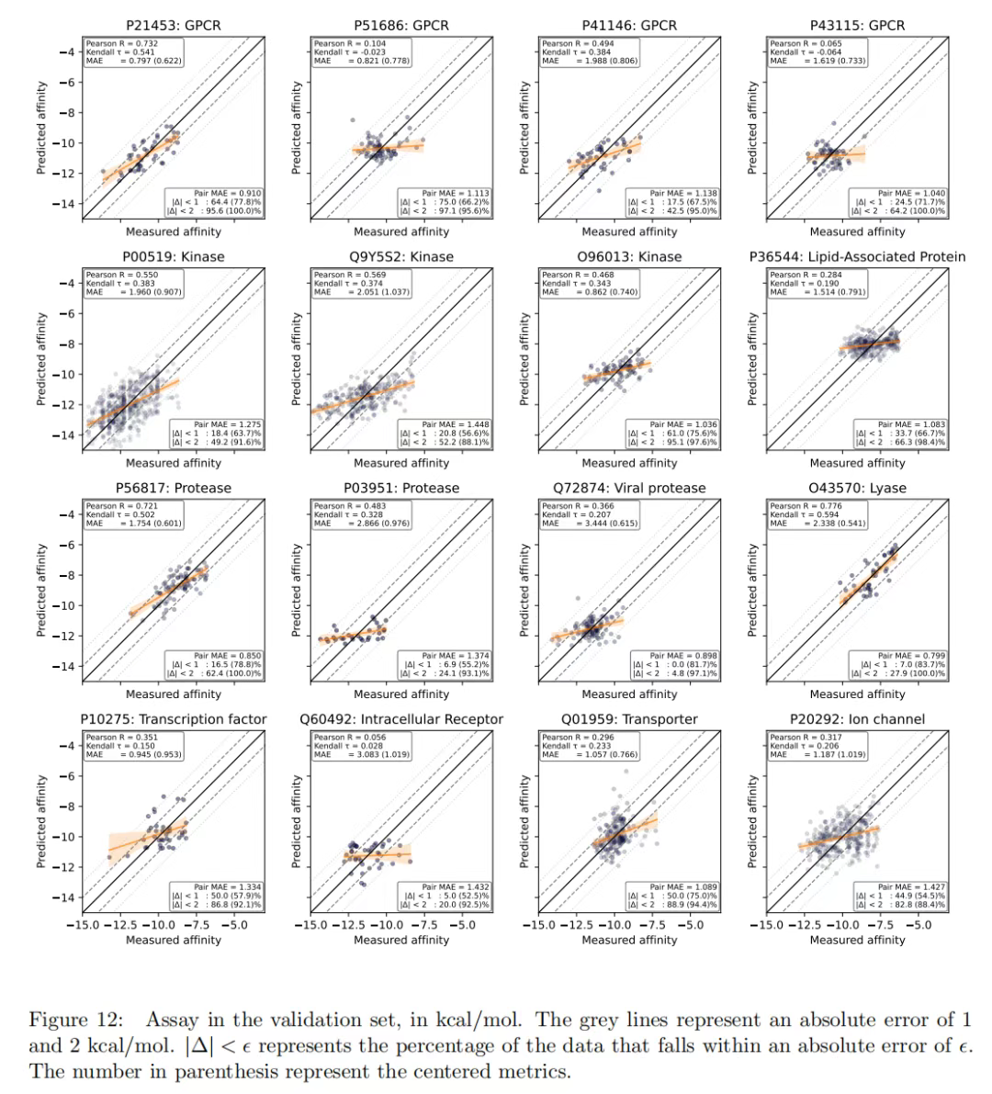
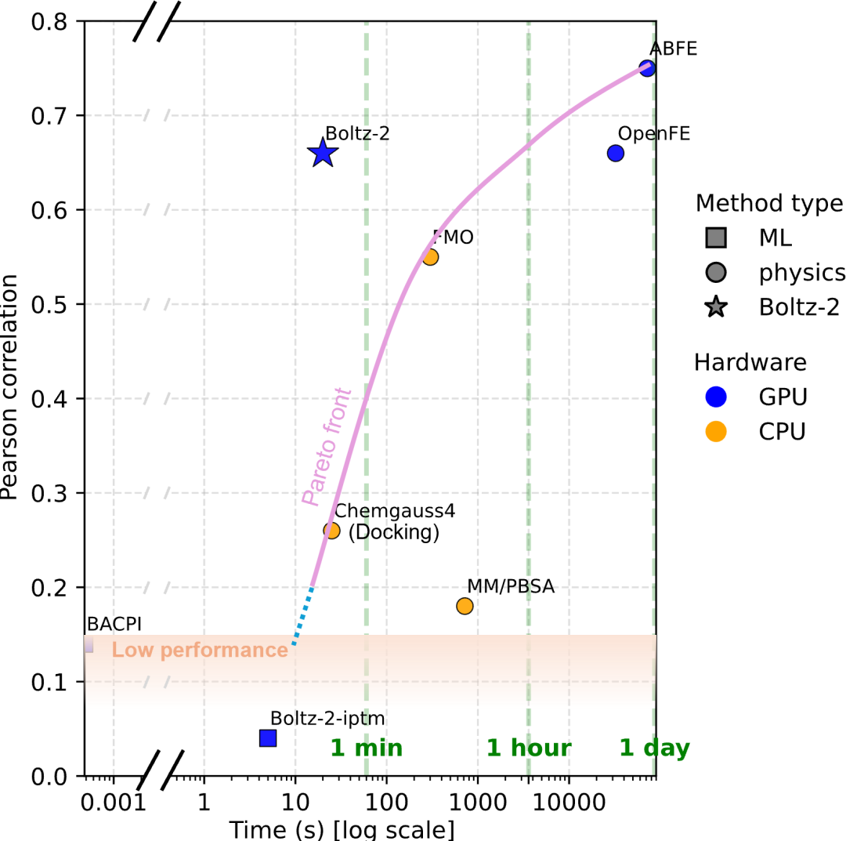
Key Results: Affinity Prediction
Overview
Claim: docking time, FEP accuracy
Claim: docking time, FEP accuracy

Slide 6
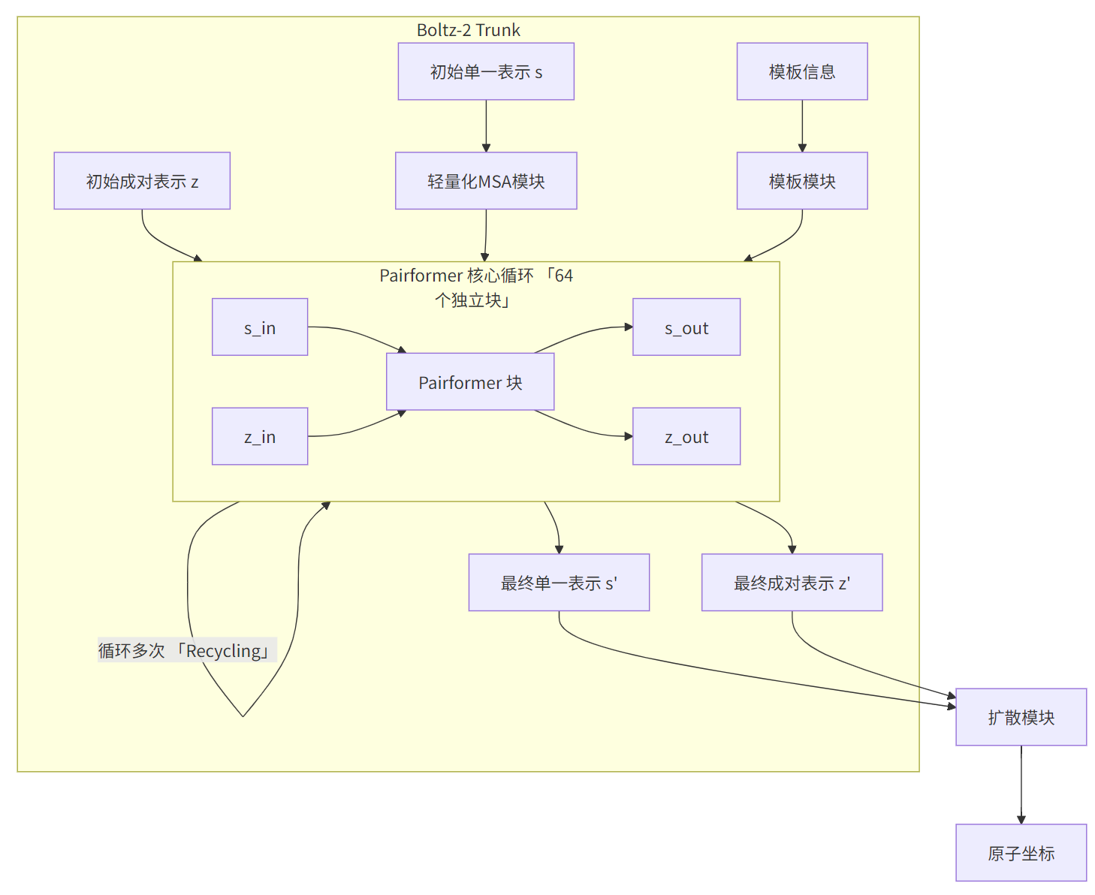
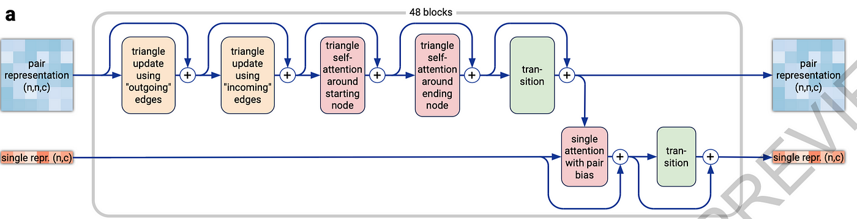
Methods: PairFormer Architecture
Structure
单一表示 (Single Representation)：一个二维张量，尺寸为 n×c_{s} ，其中 n 是系统中所有残基和原子（tokens）的总数， c_{s} 是编码每个token自身属性的特征通道数。
成对表示 (Pair Representation)：一个三维张量，尺寸为 n×n×c_{z} ，其中 c_{z} 是特征通道数。它编码了系统中每对token之间的空间和化学关系。
Original PairFormer (AF3)

Slide 7
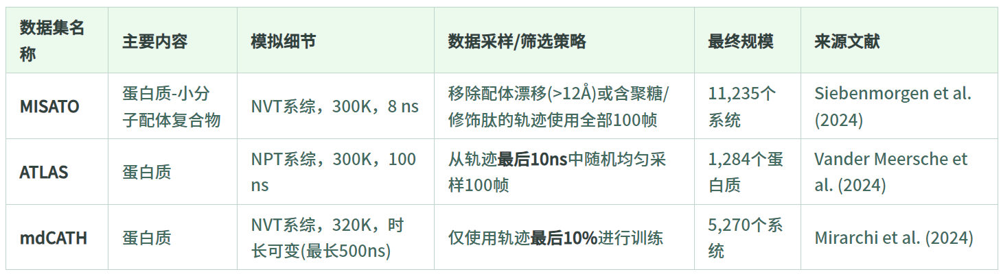
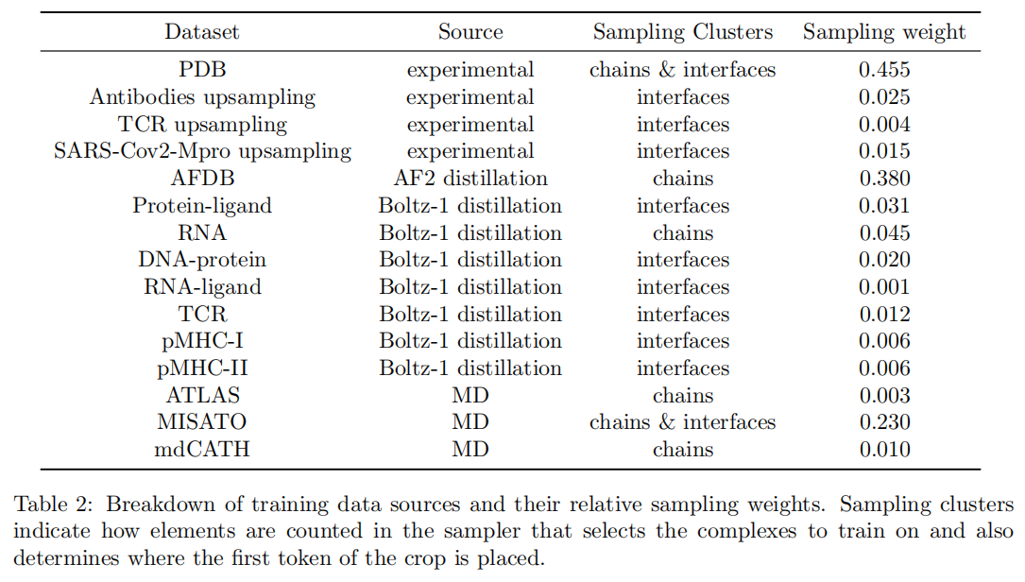
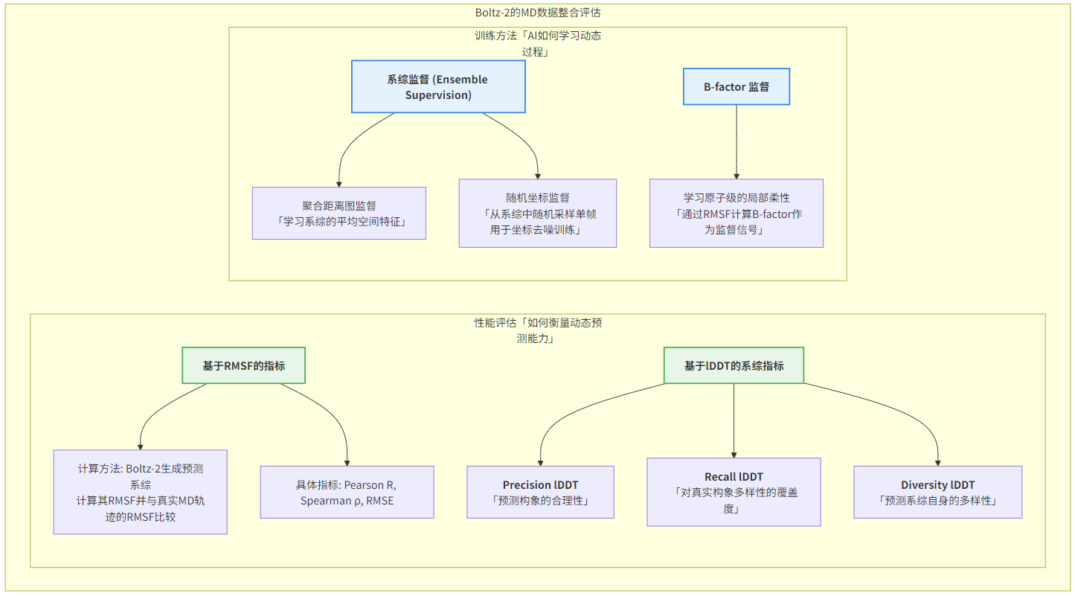
Methods: Dataset; Ensemble-related Methods
Structure

Slide 8
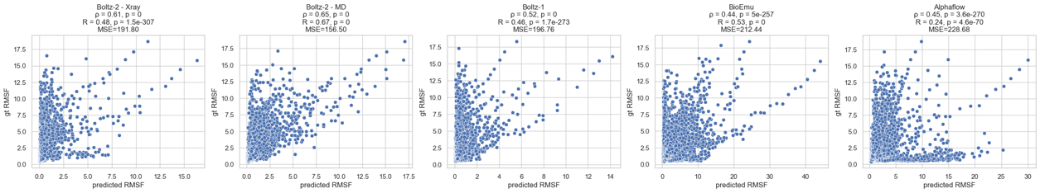
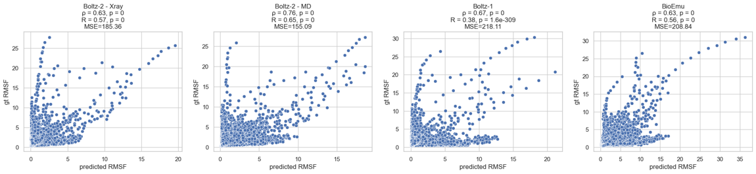
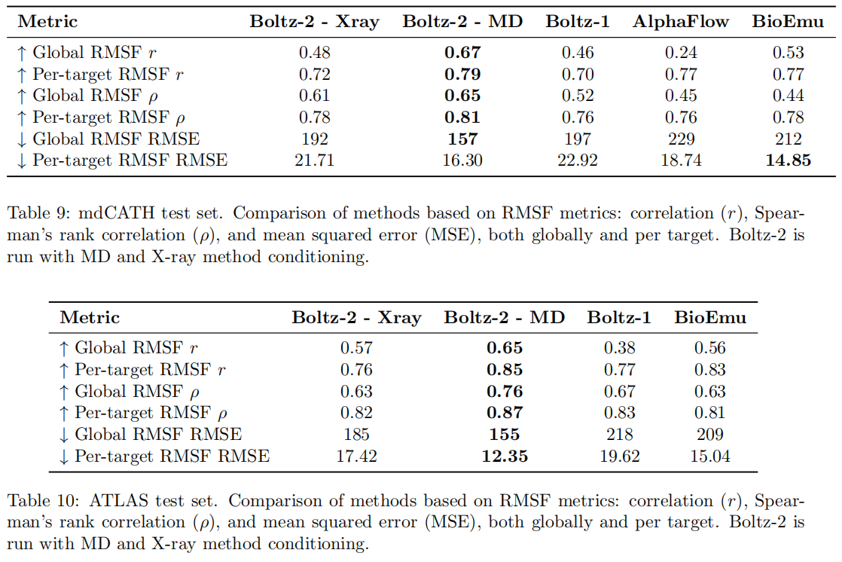
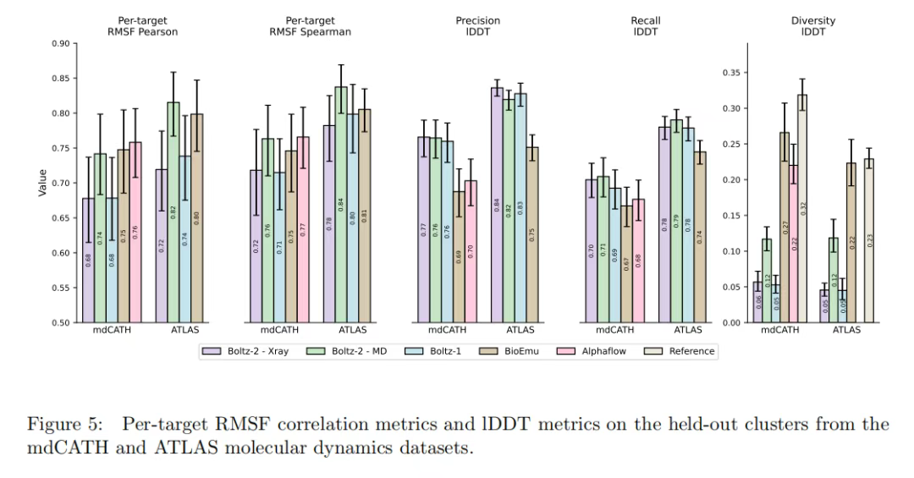
Results: RMSF and lDDT Metrics
Structure
RMSF unit: angstrom
mdCATH (top)
ALTAS (bottom)
Left 2: boltz-2

Slide 9
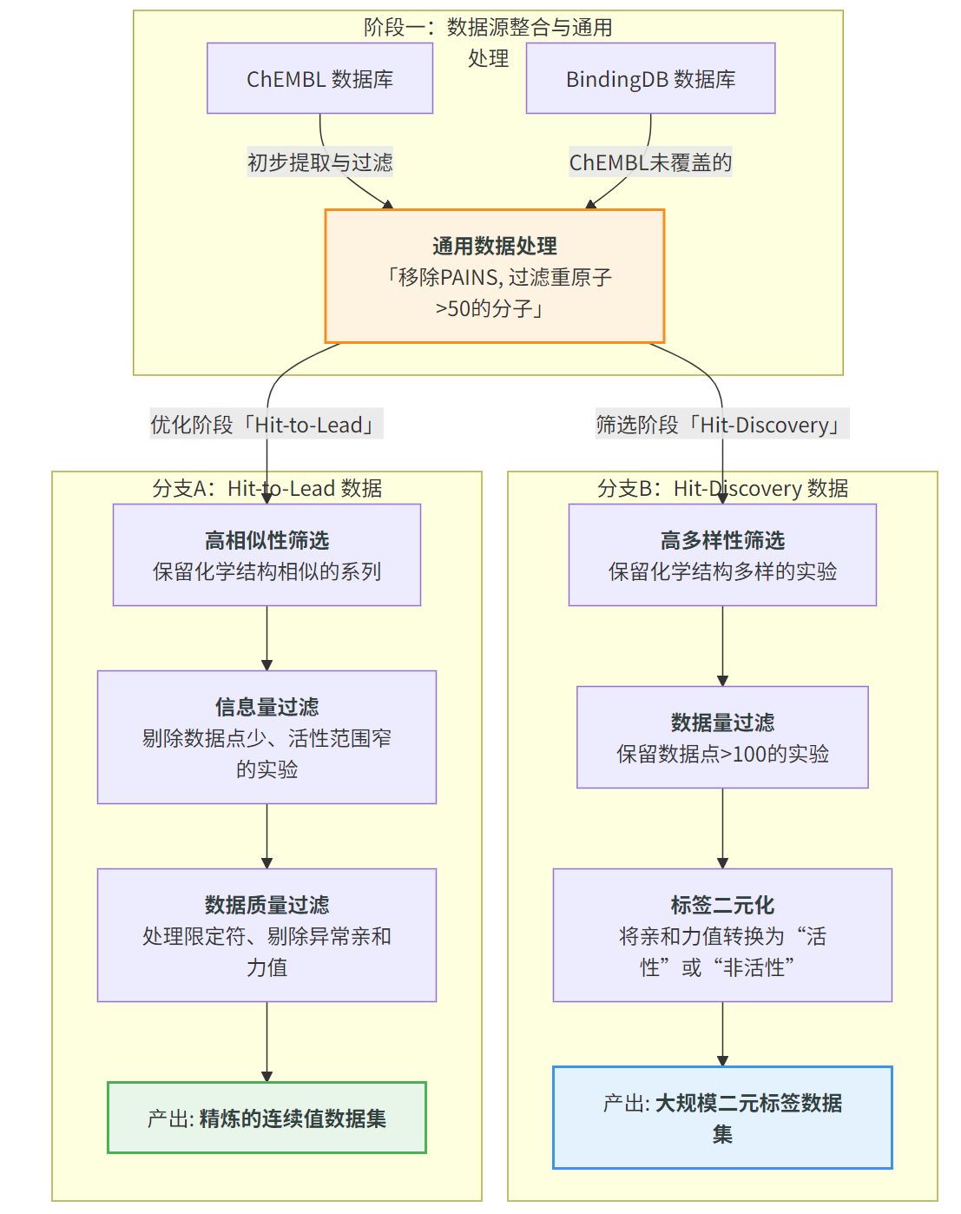
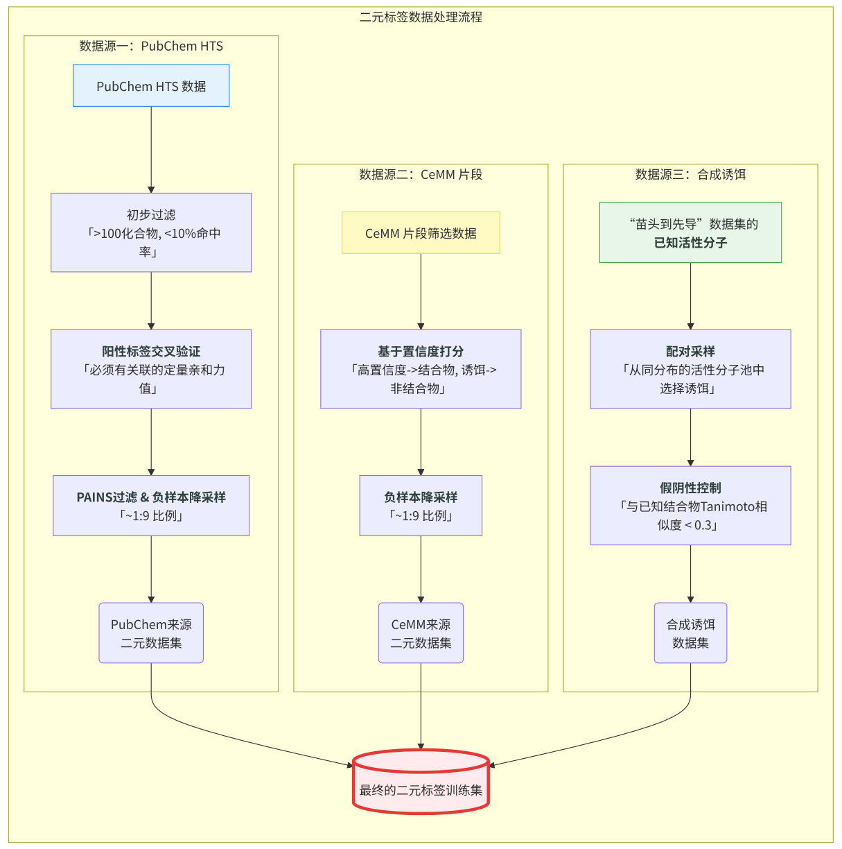
Methods: Dataset Curation
Affinity
Continuous (left)
Binary (right)

Slide 10
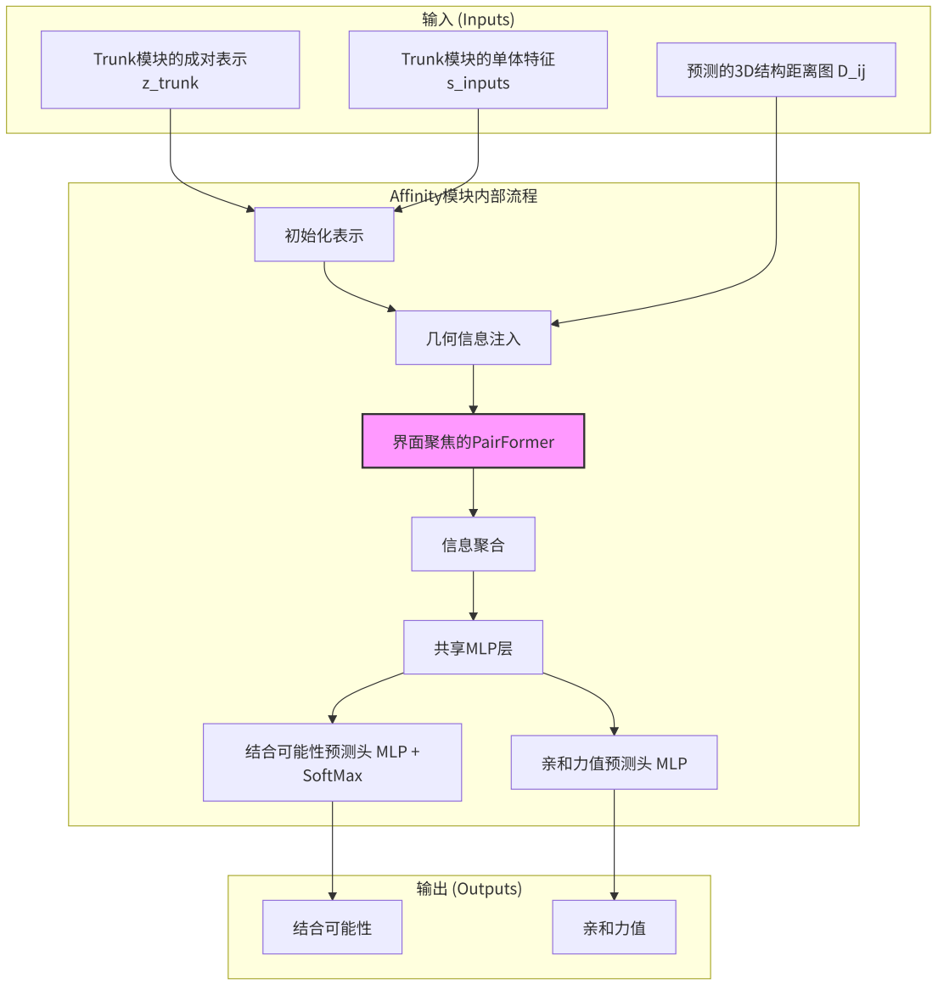
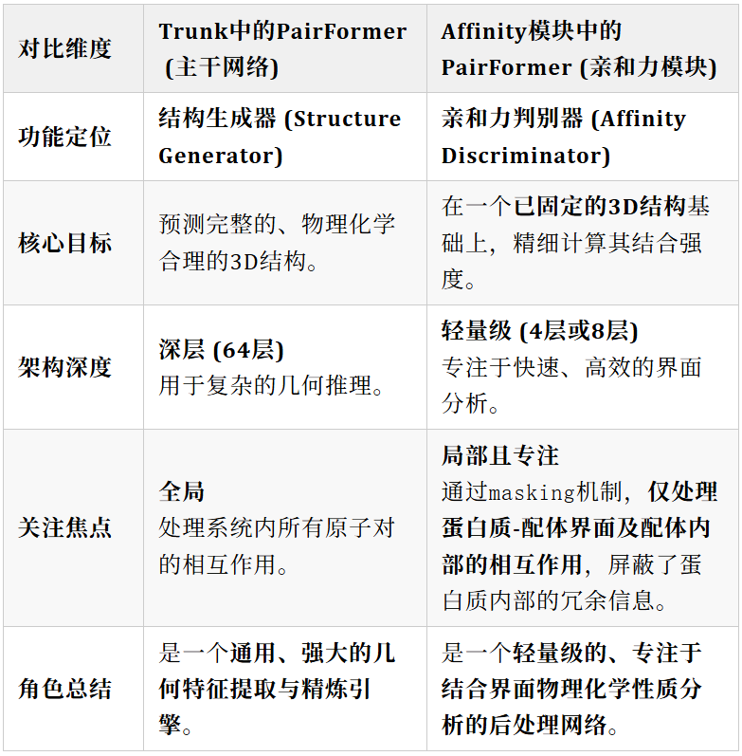
Methods: PairFormer in Affinity Module
Affinity

Slide 11
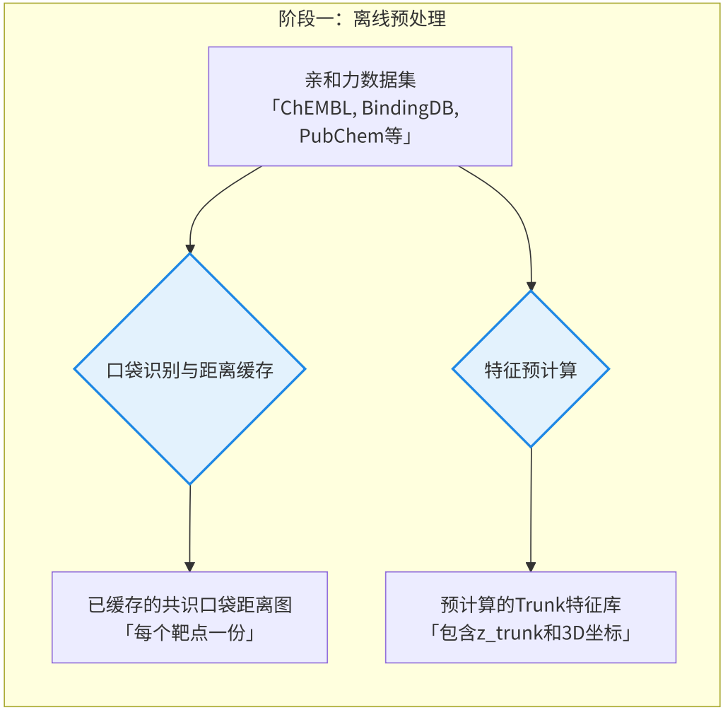
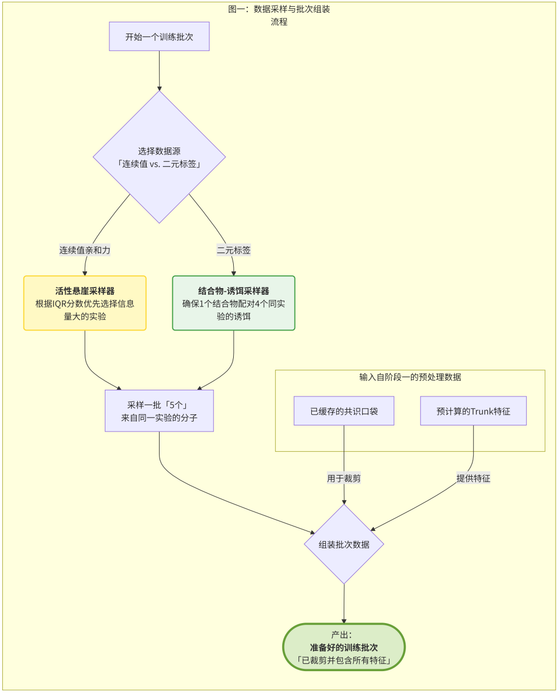
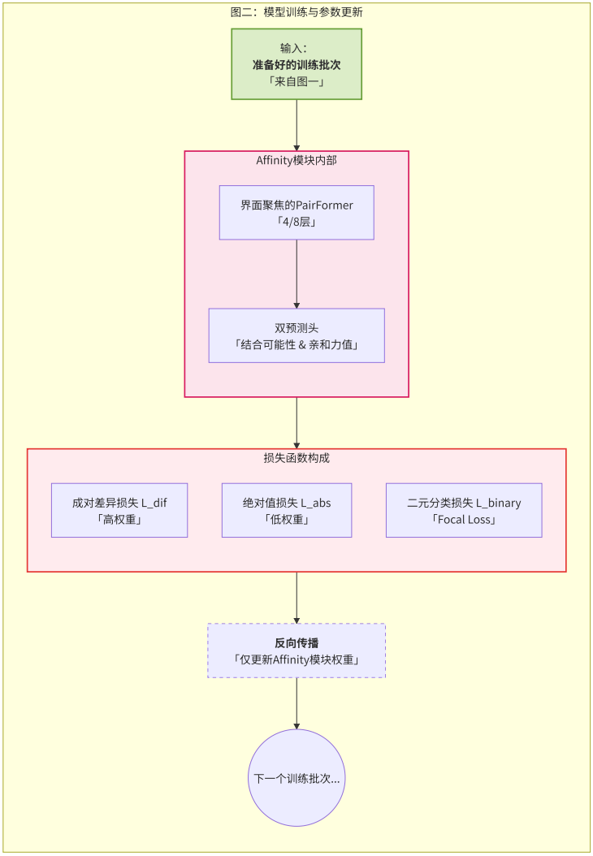
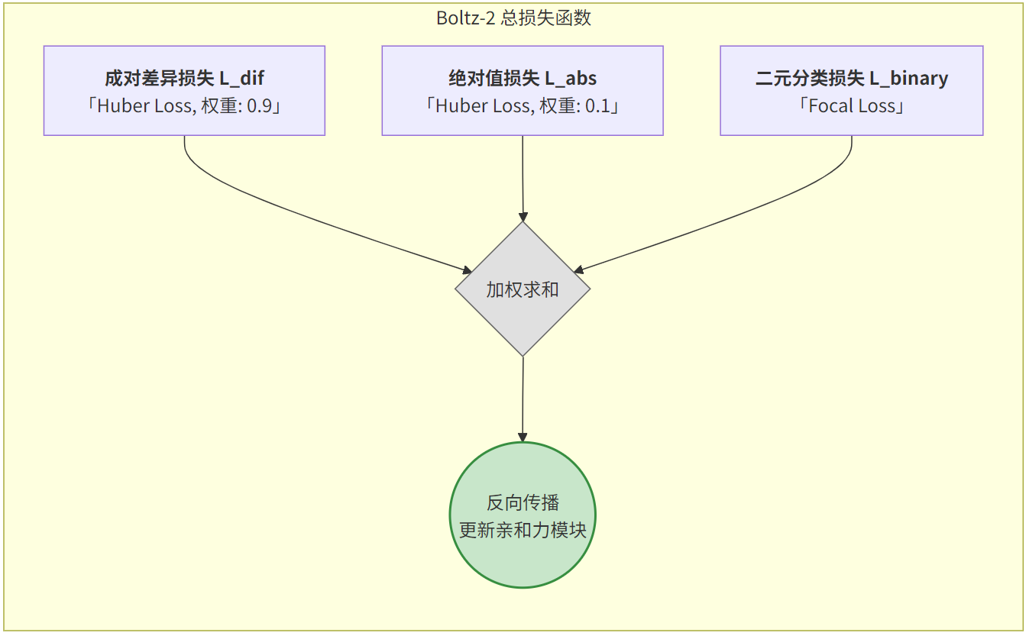
Methods: Affinity Model Training
Affinity
Pocket Identification and cropping

Slide 12
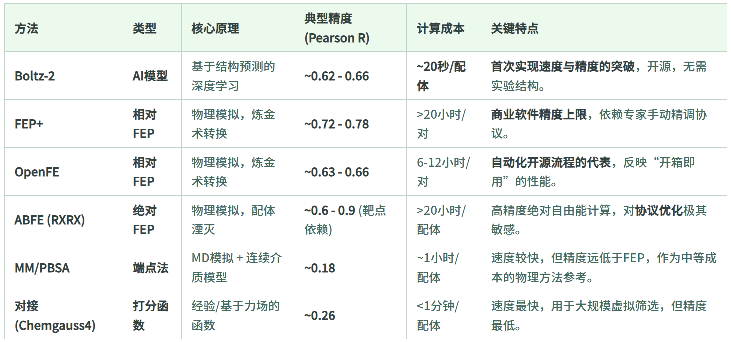
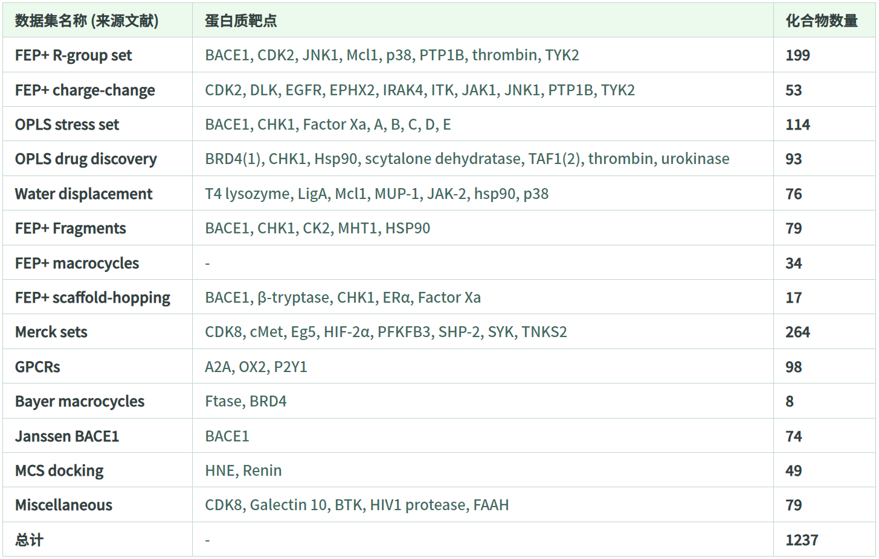
Methods: Affinity Benchmark Dataset
Affinity
Overview of benchmark
Details of FEP+ benchmark
FEP+ 基准集相关链接
论文原文: https://doi.org/10.1038/s42004-023-01019-9
GitHub仓库: https://github.com/schrodinger/public_binding_free_energy_benchmark
OpenFE 基准集相关链接
博客文章: https://blog.omsf.io/the-free-energy-of-everything-benchmarking-openfe/
GitHub仓库: https://github.com/OpenFreeEnergy/openfe-benchmarks
ABFE (RXRX协议) 基准集预印本原文: https://doi.org/10.26434/chemrxiv-2025-q08ld-v2

Slide 13
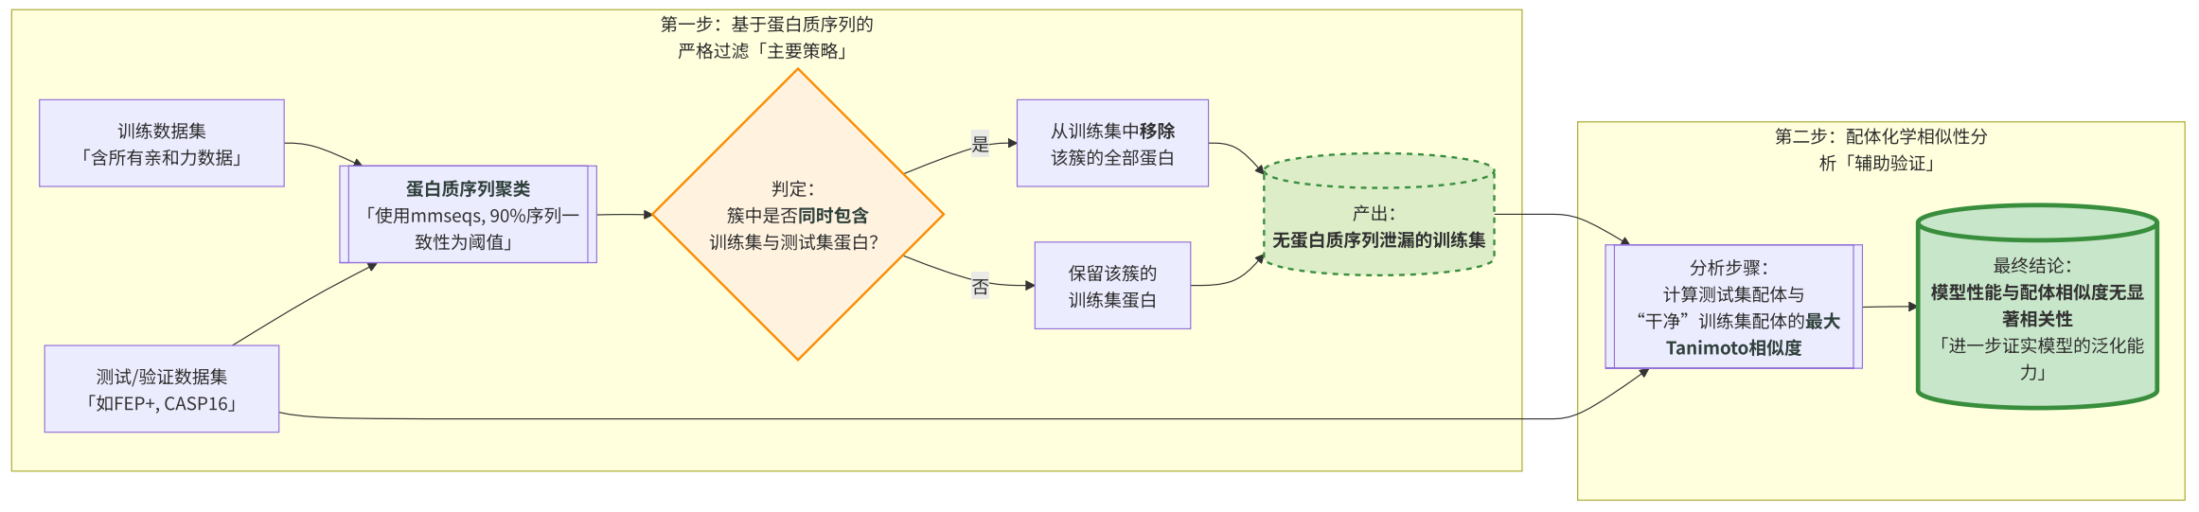
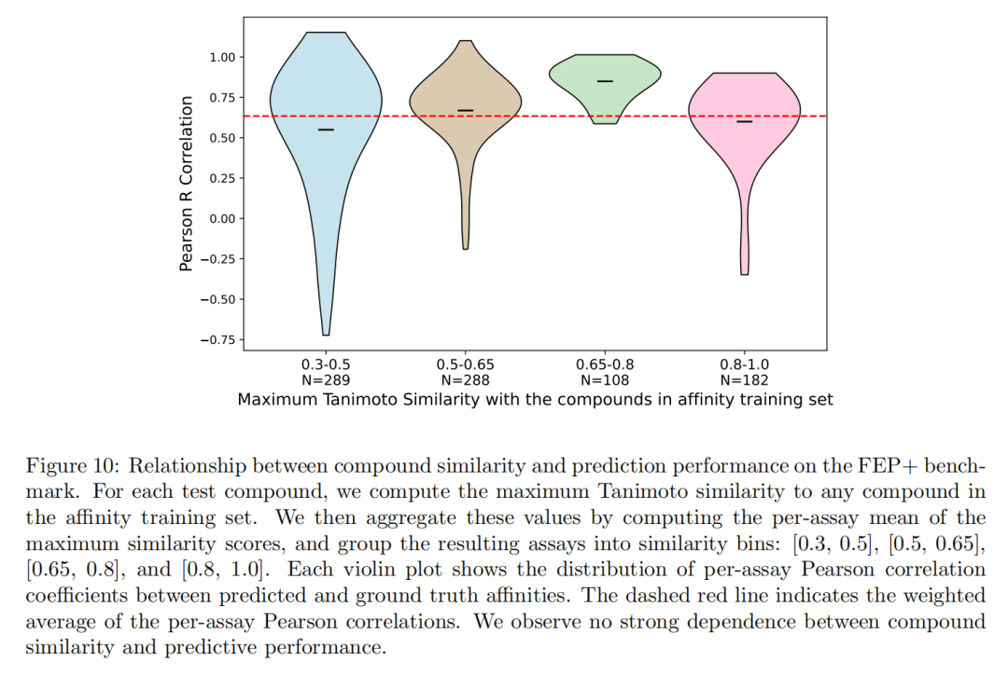
Results: Avoiding Data Leakage Problem
Affinity

Slide 14
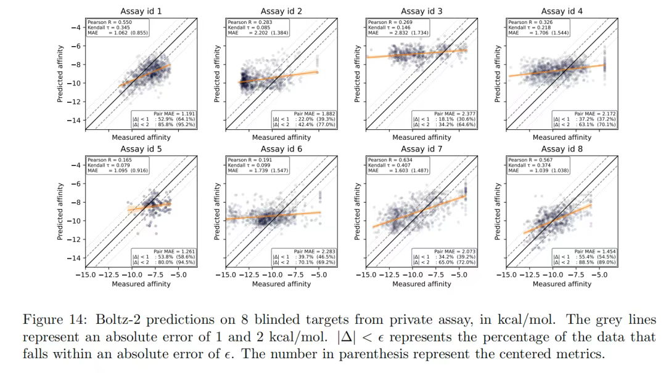
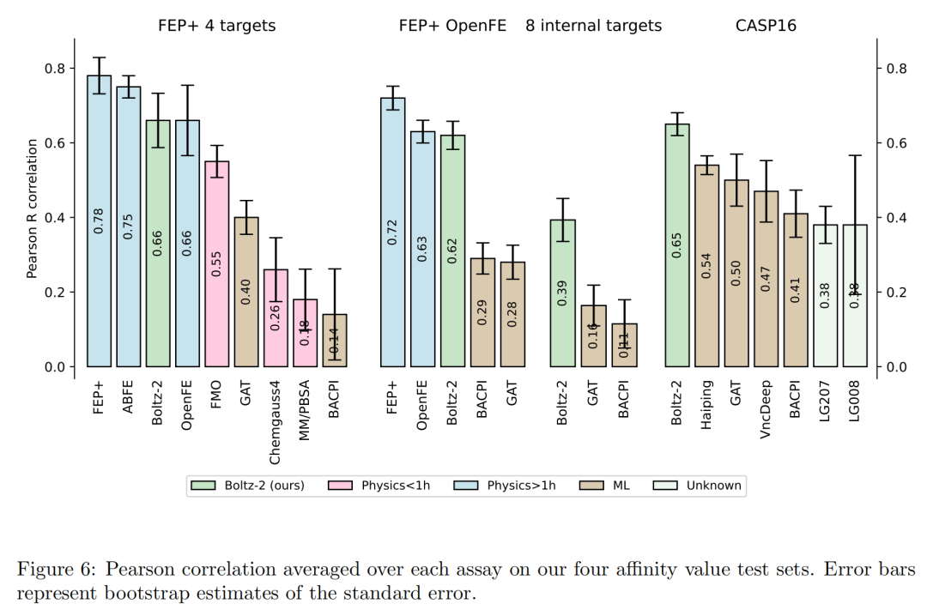
Results: Affinity Benchmark against FEP
Affinity

Slide 15
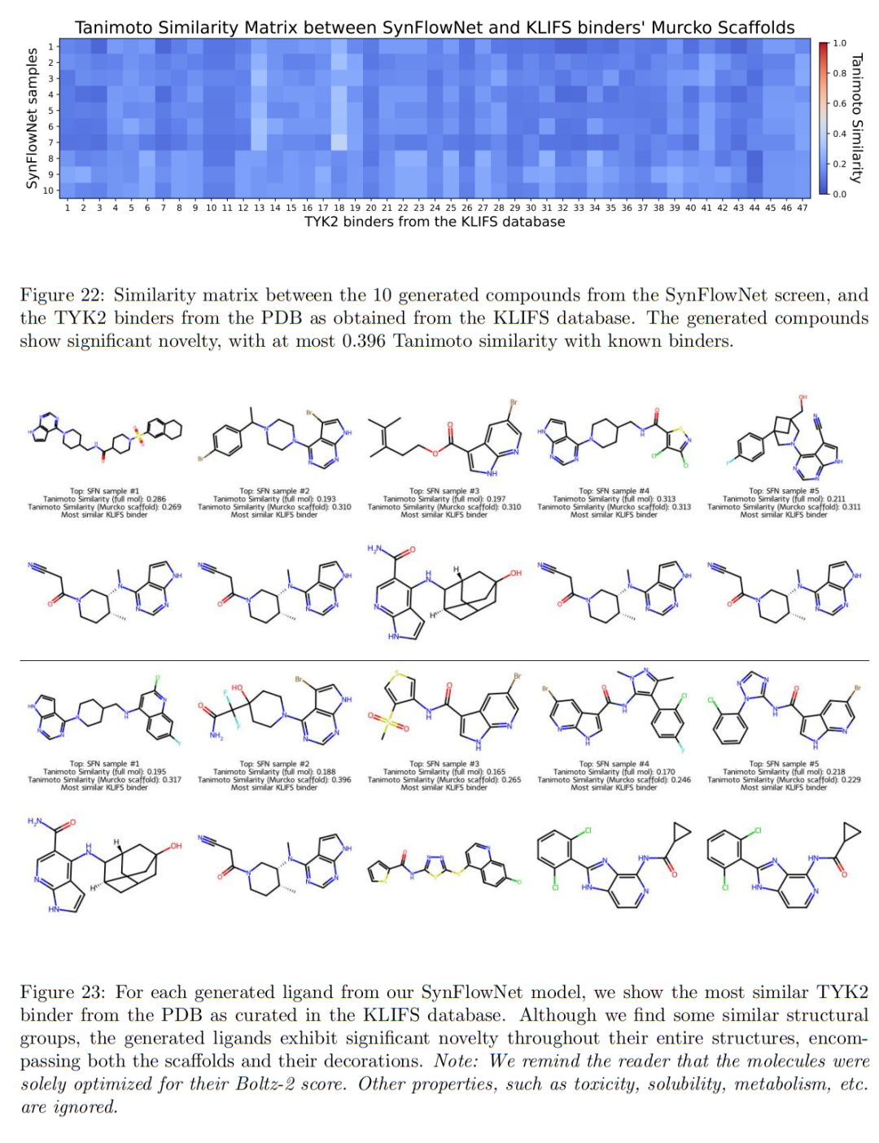
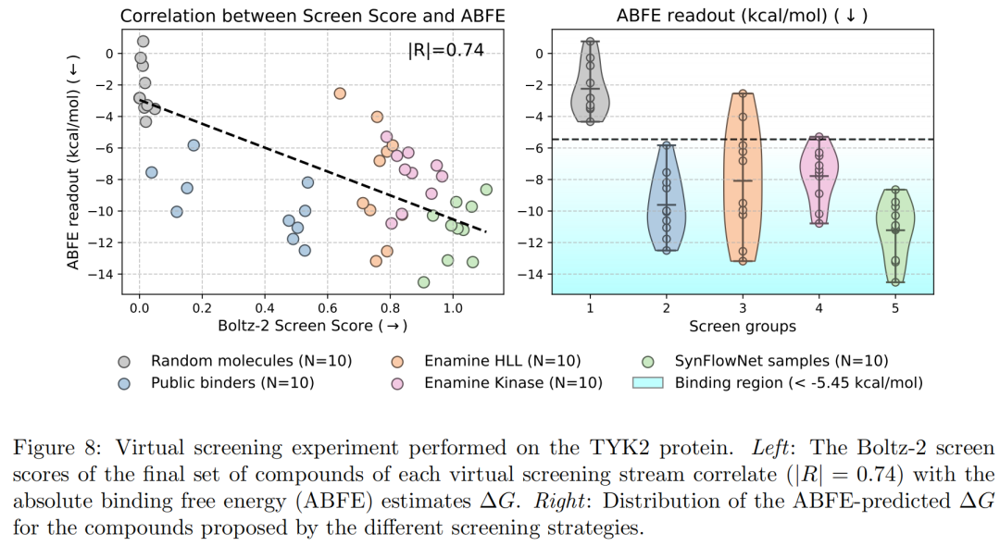
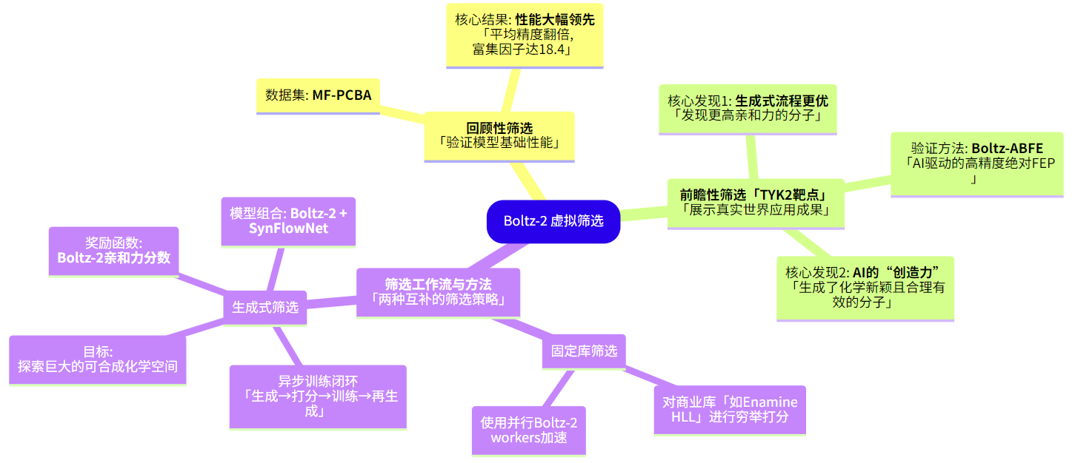
Results: virtual screening
Affinity

Slide 16
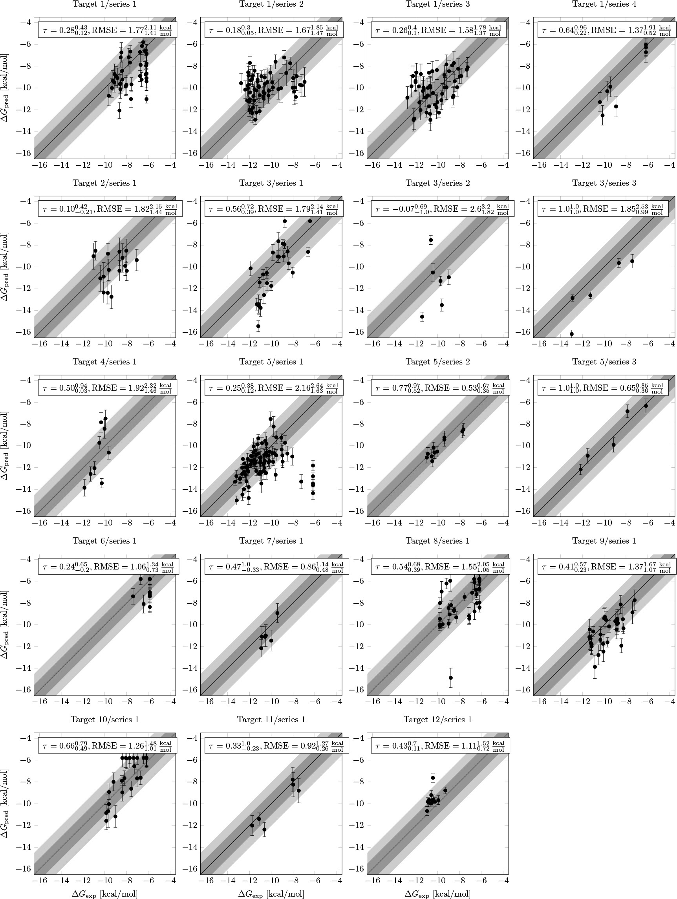
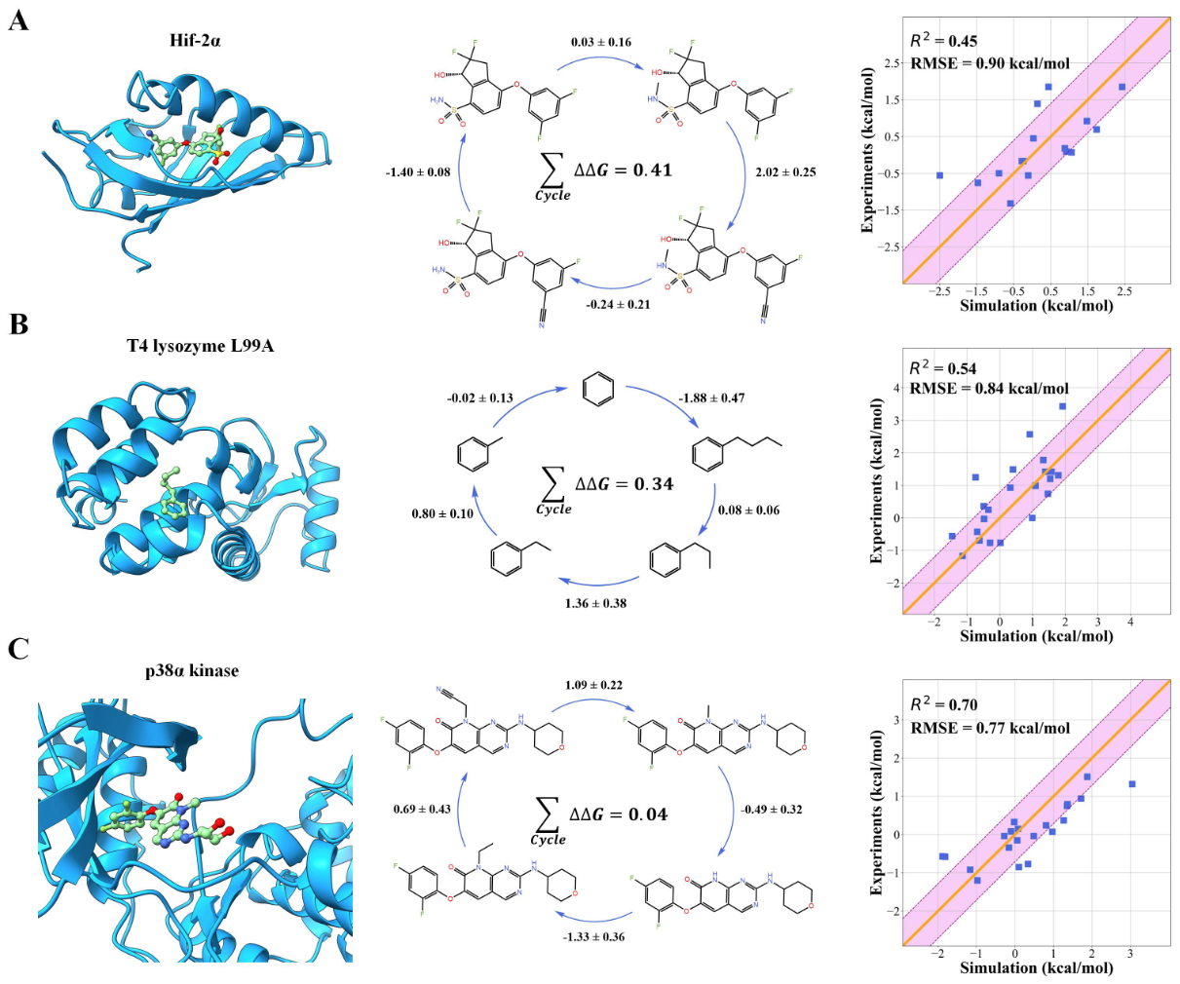
FEP+ benchmarking (2020)
Affinity
Mine (taking only good samples…)

Slide 17
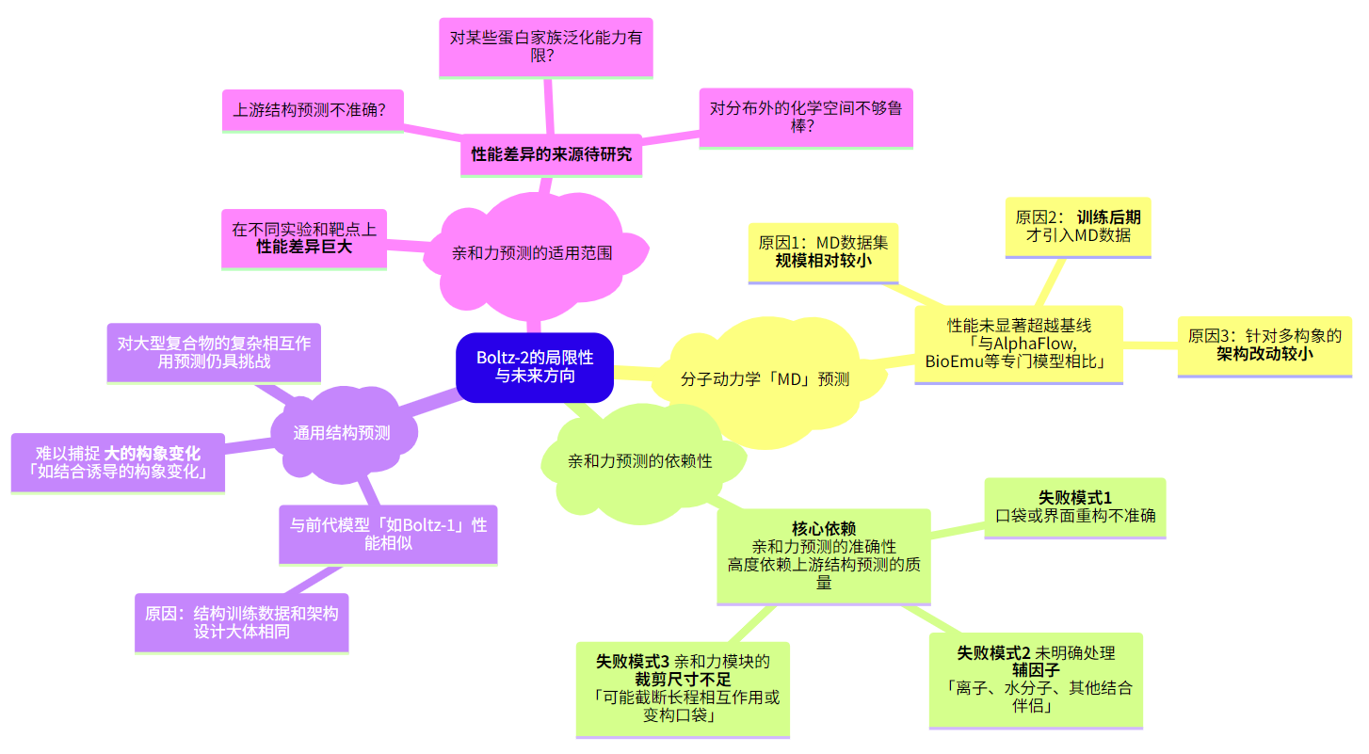
Limitations
Summary

Slide 18
Take-home messages & thoughts
Summary
Inspirations
Generalizability: another tool for faster virtual screening
We still need FEP for new systems! Combine FEP data with models…
We can create high-quality MD or FEP dataset for the community
Still limited by data

Slide 19
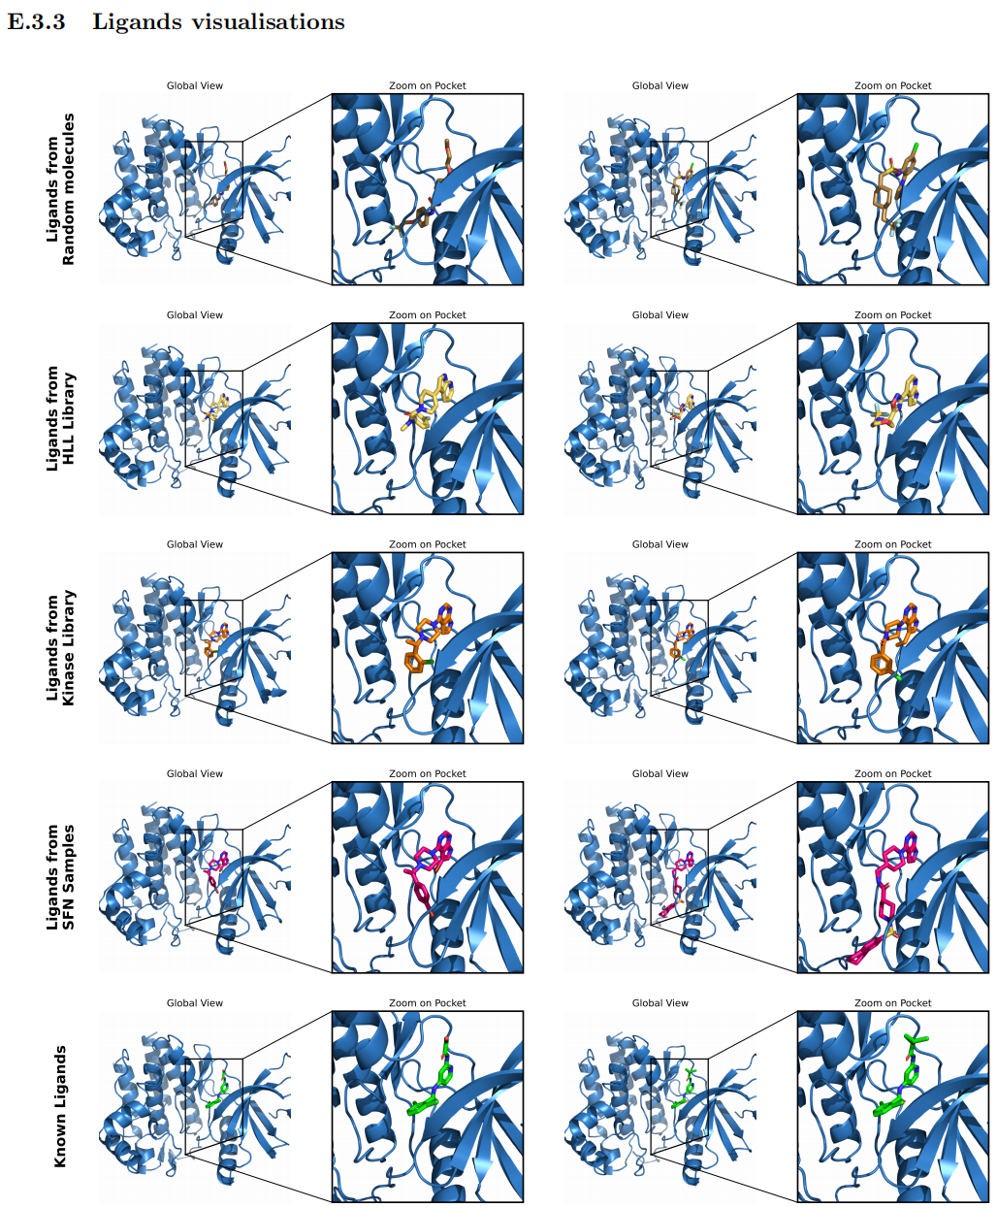
Thanks for listening!

Slide 20
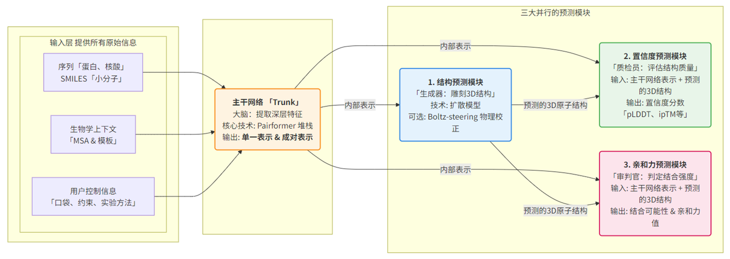
Theoretical basis of computational enzyme design
Background
Enzymes reduce activation energy by stabilizing the transition state (TS)
Nature 2022, 606, 7912, 49–58.
https://www.uv.es/biophys/sbe/6/PDFsite/SimulatingEnzymeCatalysis.pdf
20

