Slide 1

Percona XtraDB Cluster
刘小成@sohu

Slide 2

Agenda
Replication
Galera
Percona XtraDB Cluster
Refference

Slide 3
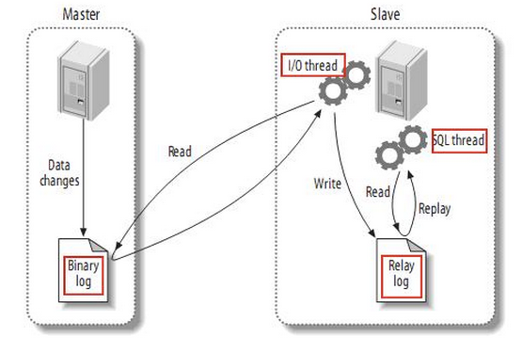
Replication

Slide 4
Replication-Async
begin
committing
commit
sqls
commit time
master
time
binlog
slave
time
apply events
delay

Slide 5
Replication-Semi
begin
committing
commit
sqls
commit time
master
time
Yes/no
binlog
slave
time
Receive
Apply events
delay

Slide 6
Replication-Certification
begin
committing
commit
sqls
Commit time
Node 1
time
writeset
Yes/no
Node 2
time
Certification
Apply events
Node 3
delay
time
Certification
Apply events

Slide 7
Certification
t0
ta->committing
t1
t2
ta->broadcast
Certification list
t3
t4
……
ta->certification
tm
ta
Notes:
1.数据库状态机
2.事务队列
时间充足就讲

Slide 8
Galera Cluster
Client
Transparent
Connection
MySQL
MySQL
MySQL
Multi Master
wsrep
wsrep
wsrep
Galera Replication
Synchronous
Replication

Slide 9
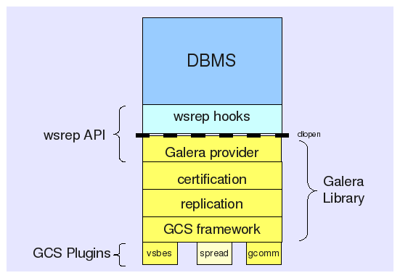
Galera

Slide 10
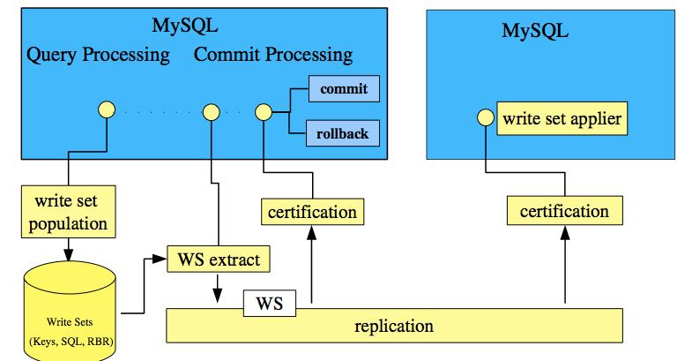
Galera Cluster

Slide 11


Galera Cluster for MySQL
High-Availability
Multi-Master replication
Parallel Replication
Automatic node provisioning
Notes:
以pxc为例讨论
Galera 特性

Slide 12
Percona XtraDB Cluster
UUID
01aea6cd-1496-11e3-92d9-ae81f48f9fe4
GTID
01aea6cd-1496-11e3-92d9-ae81f48f9fe4:seqno(64-bit signed integer)
PC:Primary Component
Notes:
名词解释

Slide 13
Percona XtraDB Cluster
Parallel Applying
Flow Control
Causal Reads
Split-Brain
Notes:
名词解释

Slide 14
WriteSet
WriteSet
key，sql，RBR
Gcache:
Memory
Disk: (128M default)
Ring buffer
On-demand

Slide 15
IST & SST
Joiner
group
SST request
donor
SST request
donor assigned
mysqld
mysqld
Perform sst
SST（mysqldump,xtrabackup,rsync）
SST complete
SST complete
joined
joined
catch-up
Synced
catch-up
Synced
Notes:
这个地方，容易误解，mysqld 最先启动，然后sst，然后innodb启动

Slide 16
DDL
TOI Total Order Isolation
RSU Rolling Schema Upgrade

Slide 17
Configuration
query_cache_size=0
binlog_format=ROW
default_storage_engine=innodb
innodb_autoinc_lock_mode=2
innodb_locks_unsafe_for_binlog=1
innodb_doublewrite=1

Slide 18
Configuration
wsrep_cluster_address=gcomm://10.10.58.168:4030,10.10.58.232:4030
wsrep_sst_receive_address=10.10.58.209:4020
wsrep_cluster_name=PXCS_10-10-57-2
wsrep_provider_options=“ist.recv_addr = tcp://10.10.58.209:4031;…”
wsrep_node_name=PXCN_10-10-58-209
wsrep_sst_method=xtrabackup
wsrep_sst_auth=user:pwd
…

Slide 19
Monitor
wsrep_cluster_status Primary
wsrep_cluster_size 3
wsrep_cluster_state_uuid e2c9a15e-5485-11e0-0800-6bbb637e7211
wsrep_local_state_comment Synced
wsrep_local_state 4
wsrep_ready ON
wsrep_local_state_uuid e2c9a15e-5485-11e0-0800-6bbb637e7211
wsrep_incoming_addresse 10.10.58.168:3306,10.10.58.209:3306,
10.10.58.232:3306

Slide 20
Monitor
wsrep_replicated 16109
wsrep_received 17831
wsrep_local_cert_failures 333
wsrep_local_bf_aborts 960
wsrep_local_send_queue_avg 0.145
wsrep_local_recv_queue_avg 3.348452
wsrep_flow_control_paused 0.184353
wsrep_cert_deps_distance 23.88889
wsrep_commit_window 0

Slide 21
Tips
Primary key
InnoDB tables
No MyISAM tables
No forien key
Commit exception
Small transaction
innodb_flush_log_at_trx_commit=2
wsrep_slave_threads=32（4*core）

Slide 22
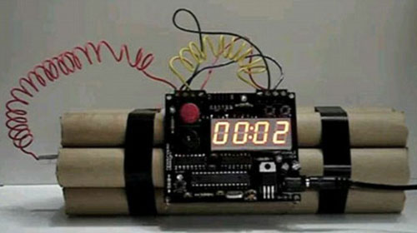
MyISAM
Update mysql.user set …/insert into host…
LOCK/UNLOCK TABLES
SET wsrep_on=0;
SET sql_log_bin=0;

Slide 23
Galera Cluster-Architecture
Client
proxy
Three or more
MySQL
MySQL
MySQL
wsrep
wsrep
wsrep
Galera Replication

Slide 24
Galera Cluster-Arbitrator
Client
proxy
MySQL
MySQL
Arbitrator
wsrep
wsrep
Galera Replication

Slide 25
数据库云平台
用户端
应用层
自助服务台/BI
调度/负载均衡
keepalived,lvs,haproxy,dbproxy
存储
MySQL
MongoDB
OracleDB
PXC集群
MySQL主备
mongdb
tokumx
tokudb

Slide 26
Refference
CAP：http://en.wikipedia.org/wiki/CAP_theorem
The database state machine and group communication issues
http://infoscience.epfl.ch/record/32566/files/EPFL_TH2090.pdf
Integrity Dangers in Certiﬁcation-Based Replication Protocols：
http://web.iti.upv.es/~fmunyoz/research/pdf/TR-ITI-ITE-0813.pdf
Comparison of Database Replication Techniques Based on Total Order Broadcast
Codership : www.codership.com
Percona: www.percona.com
Percona Xtradb Cluster的设计与实现
http://www.cnblogs.com/bamboos/p/3543309.html

Slide 27

Q&A

