Slide 1
What are the possible causes of vehicle collisions in Victoria in the last five years?
By Lucy Gu

Slide 2
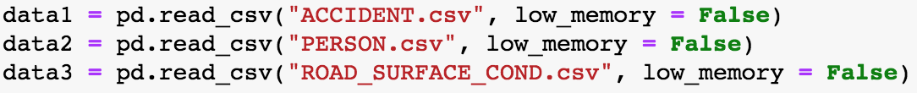
Dataset
3 datasets
Linked by accident number

Slide 3
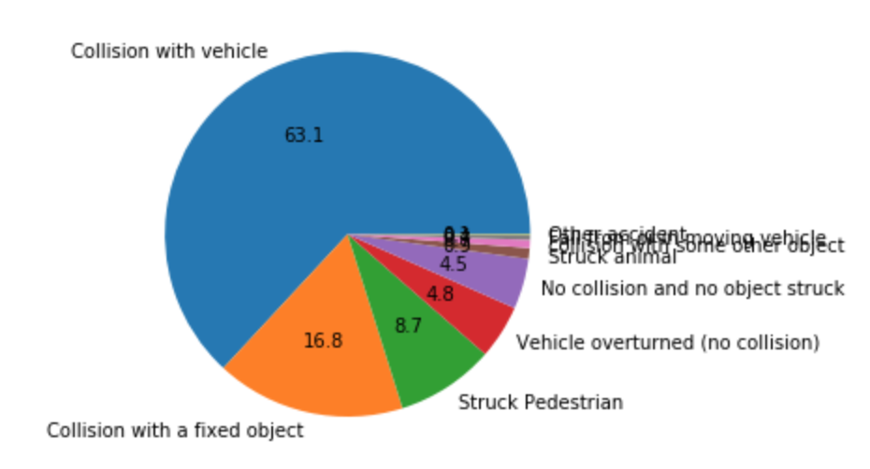
Data Wrangling
select the dataset from 2013 to 2017 (to_datetime & Timestamp)
Combine datasets (merging)
Drop missing values
Choose data for vehicle collisions only

Slide 4
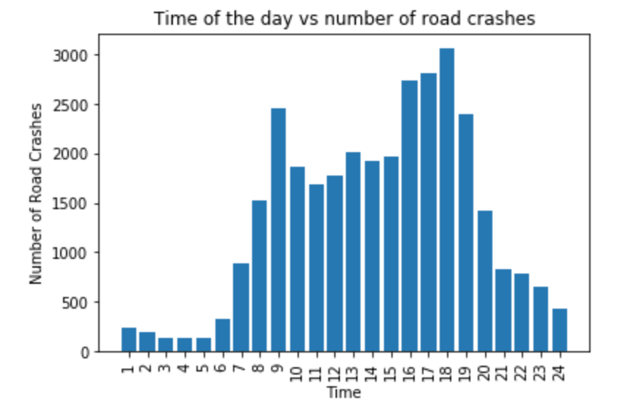
1st: Time of the day
Histogram: number of collisions vs different time of the day
Highest: 9am, 5pm, 6pm, 7pm
Morning and evening peak hours

Slide 5
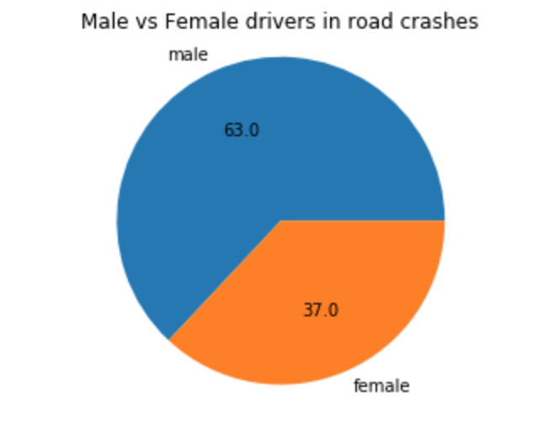
2nd: Gender of driver
Pie chart
Male: 63%
Female: 37%

Slide 6
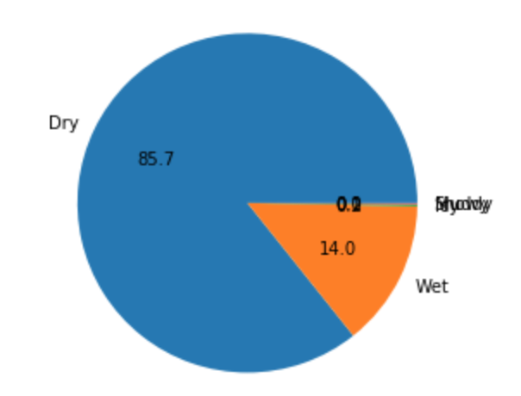
3rd: Road surface condition
Dry, wet, muddy, snowy, icy
Possibility of collision under wet road surface condition is much less than dry’s

Slide 7
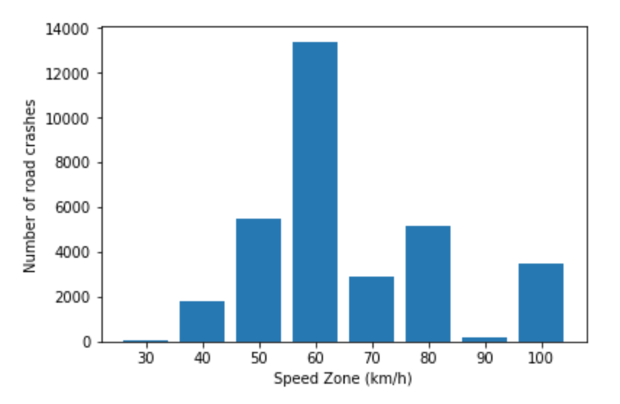
4th: Speed zone
Pie chart : 30, 40, 50, 60, 70, 80, 90, 100 (km/h)
Number of collisions happened in 60 km/h speed zone is extraordinary high & is more than double of second highest
Solution: reduce the speed limit in some 60km/h high collision area to 50km/h

