Slide 1
Oauth with custom login (Redirect) and Authorization Default Form
APIC
(DP)
Browser
identityExtraction
APIC Identity extraction – redirect
http://192.168.225.1:3080/login.html
Login
APIC original_URL + username & code
APIC Authentication URL + Authorization header (username & confirmation)
http://192.168.225.1:3080/authenticateRedirect
authenticateUser
200
APIC Authorization – Default Form
Authorization Default Form
Default Form
clientOAuthRedirectionURL
Allow access
OAuth Code
OK
OAuth Code

Slide 2
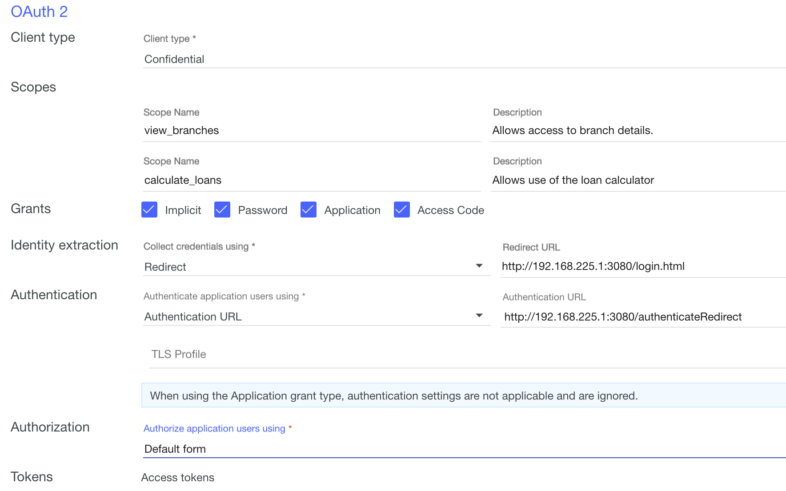
Oauth with custom login (Redirect) and Authorization Default Form

Slide 3
Oauth with custom login (Redirect) and Authorization Default Form
APIC
(DP)
Browser
identityExtraction
APIC Identity extraction – redirect
http://192.168.225.1:3080/login.html
Login
APIC original_URL + username & code
APIC Authentication URL + Authorization header (username & confirmation)
http://192.168.225.1:3080/authenticateRedirect
authenticateUser
200
OAuth Code
clientOAuthRedirectionURL
OK
OAuth Code

Slide 4
Oauth with custom login (Redirect) and Authenticated
APIC
(DP)
Browser
authenticateAuthorize
APIC Identity extraction – redirect
http://192.168.225.1:3080/login.html
Login
APIC original_URL + username & code
APIC Authentication URL + Authorization header (username & code)
http://192.168.225.1:3080/authenticateRedirect
authenticateRedirect
200
APIC Authorization – Authorized
http://192.168.225.1:3080/clientRedirect
App
OAuth Redirection URL

Slide 5
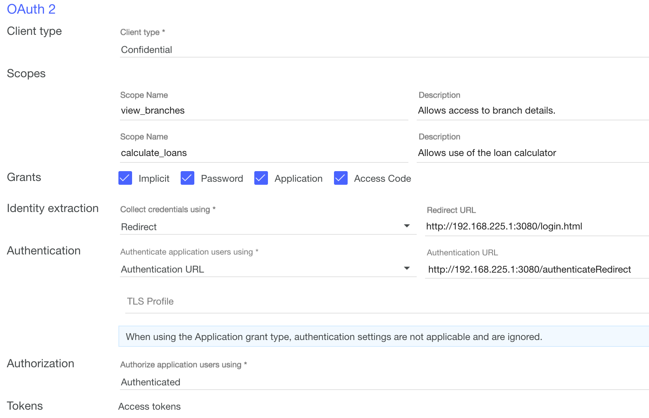
Oauth with custom login (Redirect) and Authenticated

