Slide 1
Beyond Bloom Filters:
Approximate Concurrent State Machines
Michael Mitzenmacher
Joint work with Flavio Bonomi, Rina Panigrahy, Sushil Singh, George Varghese

Slide 2
Goals of the Talk
Survey some of my recent work on Bloom filters and related hashing-based data structures.
  But lots of other people currently working in this area – an area of research in full bloom.
Highlight: new results from SIGCOMM, ESA, Allerton 2006.
For more technical details and experimental results, see papers at my home page.

Slide 3
Motivation: Router State Problem
Suppose each flow has a state to be tracked. Applications:
  Intrusion detection
  Quality of service
  Distinguishing P2P traffic
  Video congestion control
  Potentially, lots of others!
Want to track state for each flow.
  But compactly; routers have small space.
  Flow IDs can be ~100 bits. Can’t keep a big lookup table for hundreds of thousands or millions of flows!

Slide 4
Approximate Concurrent
State Machines
Model for ACSMs
  We have underlying state machine, states 1…X.
  Lots of concurrent flows.
  Want to track state per flow.
  Dynamic: Need to insert new flows and delete terminating flows.
  Can allow some errors.
  Space, hardware-level simplicity are key.

Slide 5
Problems to Be Dealt With
Keeping state values with small space, small probability of errors.
Handling deletions.
Graceful reaction to adverarial/erroneous behavior.
  Invalid transitions.
  Non-terminating flows.
    Could fill structure if not eventually removed.
  Useful to consider data structures in well-behaved systems and ill-behaved systems.

Slide 6
Results
Comparison of multiple ACSM proposals.
  Based on Bloom filters, d-left hashing, fingerprints.
  Surprisingly, d-left hashing much better!
Experimental evaluation.
  Validates theoretical evaluation.
  Demonstrates viability for real systems.
New construction for Bloom filters.
New d-left counting Bloom filter structure.
  Factor of 2 or better in terms of space.

Slide 7
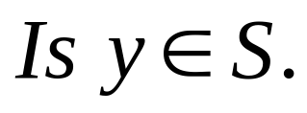
Review: Bloom Filters
Given a set S = {x₁,x₂,x₃,…x_{n}} on a universe U, want to answer queries of the form:
Bloom filter provides an answer in
  “Constant” time (time to hash).
  Small amount of space.
  But with some probability of being wrong.
Alternative to hashing with interesting tradeoffs.

Slide 8
Bloom Filters
Start with an m bit array, filled with 0s.
B
0
0
0
0
0
0
0
0
0
0
0
0
0
0
0
0
Hash each item x_{j} in S k times. If H_{i}(x_{j}) = a, set B[a] = 1.
B
0
1
0
0
1
0
1
0
0
1
1
1
0
1
1
0
To check if y is in S, check B at H_{i}(y). All k values must be 1.
B
0
1
0
0
1
0
1
0
0
1
1
1
0
1
1
0
Possible to have a false positive; all k values are 1, but y is not in S.
B
0
1
0
0
1
0
1
0
0
1
1
1
0
1
1
0
n items m = cn bits k hash functions

Slide 9
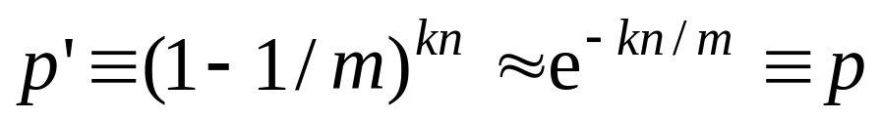
False Positive Probability
Pr(specific bit of filter is 0) is
If ρ is fraction of 0 bits in the filter then false positive probability is
Approximations valid as ρ is concentrated around E[ρ].
  Martingale argument suffices.
Find optimal at k = (ln 2)m/n by calculus.
  So optimal fpp is about (0.6185)^{m/n}
n items m = cn bits k hash functions

Slide 10
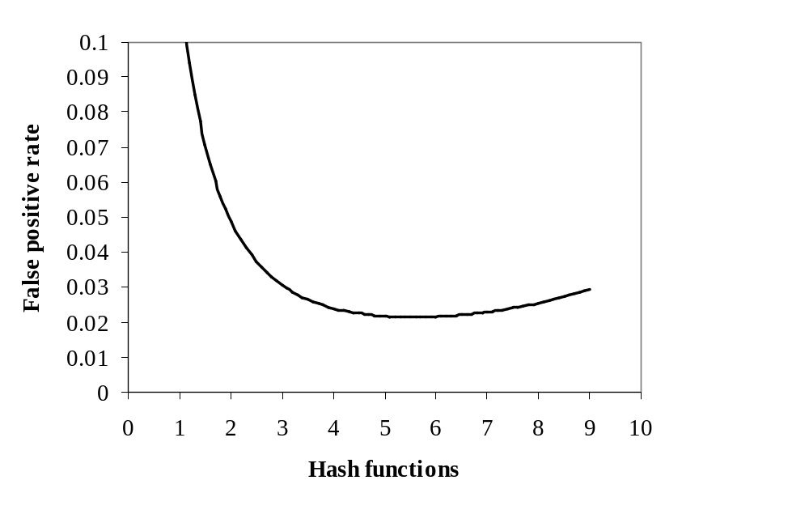
Example
m/n = 8
Opt k = 8 ln 2 = 5.45...
n items m = cn bits k hash functions

Slide 11
Handling Deletions
Bloom filters can handle insertions, but not deletions.
If deleting x_{i} means resetting 1s to 0s, then deleting x_{i} will “delete” x_{j}.
x_{i} x_{j}
B
0
1
0
0
1
0
1
0
0
1
1
1
0
1
1
0

Slide 12
Counting Bloom Filters
Start with an m bit array, filled with 0s.
B
0
0
0
0
0
0
0
0
0
0
0
0
0
0
0
0
Hash each item x_{j} in S k times. If H_{i}(x_{j}) = a, add 1 to B[a].
B
0
3
0
0
1
0
2
0
0
3
2
1
0
2
1
0
To delete x_{j} decrement the corresponding counters.
B
0
2
0
0
0
0
2
0
0
3
2
1
0
1
1
0
Can obtain a corresponding Bloom filter by reducing to 0/1.
B
0
1
0
0
0
0
1
0
0
1
1
1
0
1
1
0

Slide 13
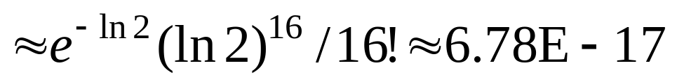
Counting Bloom Filters: Overflow
Must choose counters large enough to avoid overflow.
Poisson approximation suggests 4 bits/counter.
  Average load using k = (ln 2)m/n counters is ln 2.
  Probability a counter has load at least 16:
Failsafes possible.
We assume 4 bits/counter for comparisons.

Slide 14
ACSM Basics
Operations
  Insert new flow, state
  Modify flow state
  Delete a flow
  Lookup flow state
Errors
  False positive: return state for non-extant flow
  False negative: no state for an extant flow
  False return: return wrong state for an extant flow
  Don’t know: return don’t know
    Don’t know may be better than other types of errors for many applications, e.g., slow path vs. fast path.

Slide 15
ACSM via Counting Bloom Filters
Dynamically track a set of current (FlowID,FlowState) pairs using a CBF.
Consider first when system is well-behaved.
  Insertion easy.
  Lookups, deletions, modifications are easy when current state is given.
    If not, have to search over all possible states. Slow, and can lead to don’t knows for lookups, other errors for deletions.

Slide 16
Direct Bloom Filter (DBF) Example
0
0
1
0
2
3
0
0
2
1
0
1
1
2
0
0
(123456,3)
(123456,5)
0
0
0
0
1
3
0
0
3
1
1
1
1
2
0
0

Slide 17
Timing-Based Deletion
Motivation: Try to turn non-terminating flow problem into an advantage.
Add a 1-bit flag to each cell, and a timer.
  If a cell is not “touched” in a phase, 0 it out.
Non-terminating flows eventually zeroed.
Counters can be smaller or non-existent; since deletions occur via timing.
Timing-based deletion required for all of our schemes.

Slide 18
Timer Example
Timer bits
1
0
0
0
1
0
1
0
3
0
0
2
1
0
1
1
RESET
0
0
0
0
0
0
0
0
3
0
0
0
1
0
1
0

Slide 19
Stateful Bloom Filters
Each flow hashed to k cells, like a Bloom filter.
Each cell stores a state.
If two flows collide at a cell, cell takes on don’t know value.
On lookup, as long as one cell has a state value, and there are not contradicting state values, return state.
Deletions handled by timing mechanism (or counters in well-behaved systems).
Similar in spirit to [KM], Bloom filter summaries for multiple choice hash tables.

Slide 20
Stateful Bloom Filter (SBF) Example
1
4
3
4
3
3
0
0
2
1
0
1
4
?
0
2
(123456,3)
(123456,5)
1
4
5
4
5
3
0
0
2
1
0
1
4
?
0
2

Slide 21
What We Need : A New Design
These Bloom filter generalizations were not doing the job.
  Poor performance experimentally.
Maybe we need a new design for Bloom filters!
In real life, things went the other way; we designed a new ACSM structure, and found that it led to a new Bloom filter design.

Slide 22
Interlude : The Main Point
There are alternative ways to design Bloom filter style data structures that are more effective for some variations, applications.
The goal is to accomplish this while maintaining the simplicity of the Bloom filter design.
  For ease of programming.
  For ease of design in hardware.
  For ease of user understanding!

Slide 23

A New Approach to Bloom Filters
Folklore Bloom filter construction.
  Recall: Given a set S = {x₁,x₂,x₃,…x_{n}} on a universe U, want to answer membership queries.
  Method: Find an n-cell perfect hash function for S.
    Maps set of n elements to n cells in a 1-1 manner.
  Then keep bit fingerprint of item in each cell. Lookups have false positive < ε.
  Advantage: each bit/item reduces false positives by a factor of 1/2, vs ln 2 for a standard Bloom filter.
Negatives:
  Perfect hash functions non-trivial to find.
  Cannot handle on-line insertions.

Slide 24
Perfect Hashing Approach
Element 1
Element 2
Element 3
Element 4
Element 5
Fingerprint(4)
Fingerprint(5)
Fingerprint(2)
Fingerprint(1)
Fingerprint(3)

Slide 25
Near-Perfect Hash Functions
In [BM96], we note that d-left hashing can give near-perfect hash functions.

Slide 26
Review: d-left Hashing
Split hash table into d equal subtables.
To insert, choose a bucket uniformly for each subtable.
Place item in a cell in the least loaded bucket, breaking ties to the left.

Slide 27
Properties of d-left Hashing
Analyzable using both combinatorial methods and differential equations.
  Maximum load very small: O(log log n).
  Differential equations give very, very accurate performance estimates.
Maximum load is extremely close to average load for small values of d.

Slide 28
Example of d-left hashing
Consider 3-left performance.
Average load 6.4
Average load 4
Load 0 | 1.7e-08
Load 1 | 5.6e-07
Load 2 | 1.2e-05
Load 3 | 2.1e-04
Load 4 | 3.5e-03
Load 5 | 5.6e-02
Load 6 | 4.8e-01
Load 7 | 4.5e-01
Load 8 | 6.2e-03
Load 9 | 4.8e-15
Load 0 | 2.3e-05
Load 1 | 6.0e-04
Load 2 | 1.1e-02
Load 3 | 1.5e-01
Load 4 | 6.6e-01
Load 5 | 1.8e-01
Load 6 | 2.3e-05
Load 7 | 5.6e-31

Slide 29
Near-Perfect Hash Functions
In [BM96], we note that d-left hashing can give near-perfect hash functions.
  Useful even with deletions.
Main differences
  Multiple buckets must be checked, and multiple cells in a bucket must be checked.
  Not perfect in space usage.
    In practice, 75% space usage is very easy.
    In theory, can do even better.

Slide 30
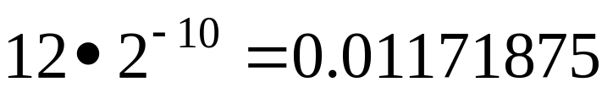
First Design : Just d-left Hashing
For a Bloom filter with n elements, use a 3-left hash table with average load 4, 60 bits per bucket divided into 6 fixed-size fingerprints of 10 bits.
  Overflow rare, can be ignored.
False positive rate of
  Vs. 0.000744 for a standard Bloom filter.
Problem: Too much empty, wasted space.
  Other parametrizations similarly impractical.
  Need to avoid wasting space.

Slide 31
Just Hashing : Picture
Empty
Empty
Bucket
0000111111
1010101000
0001110101
1011011100

Slide 32
Key: Dynamic Bit Reassignment
Use 64-bit buckets: 4 bit counter, 60 bits divided equally among actual fingerprints.
  Fingerprint size depends on bucket load.
False positive rate of 0.0008937
  Vs. 0.0004587 for a standard Bloom filter.
DBR: Within a factor of 2.
  And would be better for larger buckets.
  But 64 bits is a nice bucket size for hardware.
Can we remove the cost of the counter?

Slide 33
DBR : Picture
000110110101
111010100001
101010101000
101010110101
010101101011
Bucket
Count : 4

Slide 34
Semi-Sorting
Fingerprints in bucket can be in any order.
  Semi-sorting: keep sorted by first bit.
Use counter to track #fingerprints and #fingerprints starting with 0.
First bit can then be erased, implicitly given by counter info.
Can extend to first two bits (or more) but added complexity.

Slide 35
DBR + Semi-sorting : Picture
000110110101
111010100001
101010101000
101010110101
010101101011
Bucket
Count : 4,2

Slide 36
DBR + Semi-Sorting Results
Using 64-bit buckets, 4 bit counter.
  Semi-sorting on loads 4 and 5.
  Counter only handles up to load 6.
  False positive rate of 0.0004477
    Vs. 0.0004587 for a standard Bloom filter.
  This is the tradeoff point.
Using 128-bit buckets, 8 bit counter, 3-left hash table with average load 6.4.
  Semi-sorting all loads: fpr of 0.00004529
  2 bit semi-sorting for loads 6/7: fpr of 0.00002425
    Vs. 0.00006713 for a standard Bloom filter.

Slide 37
Additional Issues
Futher possible improvements
  Group buckets to form super-buckets that share bits.
  Conjecture: Most further improvements are not worth it in terms of implementation cost.
Moving items for better balance?
Underloaded case.
  New structure maintains good performance.

Slide 38
Improvements to Counting Bloom Filter
Similar ideas can be used to develop an improved Counting Bloom Filter structure.
  Same idea: use fingerprints and a d-left hash table.
Counting Bloom Filters waste lots of space.
  Lots of bits to record counts of 0.
Our structure beats standard CBFs easily, by factors of 2 or more in space.
  Even without dynamic bit reassignment.

Slide 39
End of Interlude :
Back to ACSMs
How do we use this new design for ACSMs?

Slide 40
Fingerprint Compressed Filter
Each flow hashed to d choices in the table, placed at the least loaded.
  Fingerprint and state stored.
Deletions handled by timing mechanism or explicitly.
False positives/negatives can still occur (especially in ill-behaved systems).
Lots of parameters: number of hash functions, cells per bucket, fingerprint size, etc.
  Useful for flexible design.

Slide 41
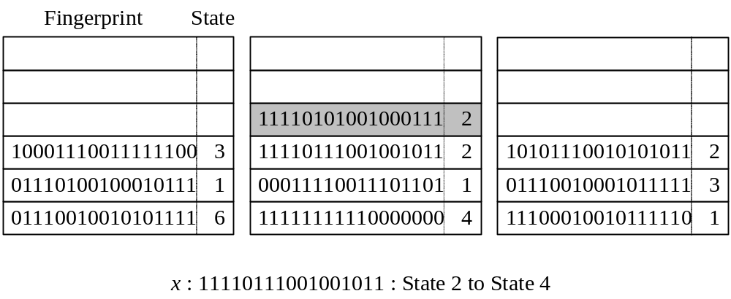
Fingerprint Compressed Filter (FCF) Example

Slide 42
Experiment Summary
FCF-based ACSM is the clear winner.
  Better performance than less space for the others in test situations.
ACSM performance seems reasonable:
  Sub 1% error rates with reasonable size.

Slide 43
Conclusions and Open Questions
Approximate concurrent state machines are very practical, potentially very useful.
  Natural progression from set membership to functions (Bloomier filter) to state machines. What is next?
Surprisingly, d-left hashing variants appear much stronger that standard Bloom filter constructions.
  Leads to new Bloom filter/counting Bloom filter constructions, well suited to hardware implementation.
Lots more to understand.
  Tradeoffs of different errors at the data structure level.
  Impact of different errors at the application level.
  On the fly dynamic optimization of data structure.
    Reduce fingerprint bits as load increases?

