Slide 1


Slide 2
Problem
Due to demographic shift in audience, farmer’s markets are facing a decrease in consumers
Farmer’s markets are not utilizing growing technology to combat this issue
Farmers of a local county are creating and utilizing market stands as a way of reaching the public and selling produce. It has become increasingly difficult to let customers know where and when they will be set up and be open for business.

Slide 3
Scope
Problem affects farmers markets throughout the nation
87.2% of consumers consider local farm food “very/somewhat important” (Tropp, “Why Local Food Matters”)
Accessibility an ongoing problem with lack of distribution and weak marketing infrastructure (Tropp, “Why Local Food Matters”)
Consumers have growing distrust of national chains to provide them with fresh, local produce (Tropp, “Why Local Food Matters”)

Slide 4
Scenario
Family unable to find fresh food at a national chain, has nowhere to turn to give their children fresh produce
Consumers want fresh, local produce, but are unsure where they are available

Slide 5
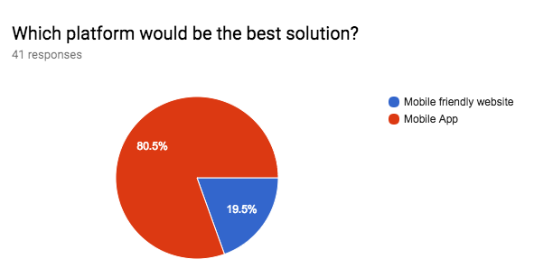
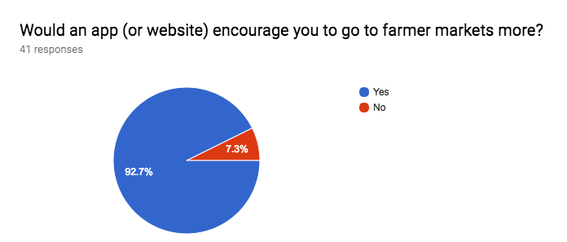
Primary Research
With the mobile app marketing strategies and information about the current state for farmers markets, having a mobile app will not only attract users, but continue to engage them as the demographic for farmer markets become more technological

Slide 6
Secondary Research
87.2% of consumers consider local farm food “very/somewhat important”(Tropp, “Why Local Food Matters”)
Harder for farmer markets to retain their customers (Carman, “For some growers, farmers markets just aren’t what they used to be”)
Making an app user friendly will help user engagement/retention, as well as promoting the app to peak users’ interests (Gauchet, “The Ultimate iPhone App Marketing Strategy Guide”)

Slide 7
Research Insights
Research conducted shows that solution of mobile app is viable
Topic research, market research, survey results
Consumers trust farmers markets the most to provide them fresh, local food (Tropp, “Why Local Food Matters”)
The need for local food has increased so much that consumers are willing to pay more for it (Tropp, “Why Local Food Matters”)
Survey results show mobile app is best platform for solution
Market research shows app marketing is low cost, and easy to engage users (Gauchet, “The Ultimate iPhone App Marketing Strategy Guide”)

Slide 8
Solution Introduction
New solution - no apps in App Store or Google Play Store
Target Audience - younger, more technological demographic
Minimum viable product is location and time of the market
Mobile app would streamline the user's experience by having the app downloaded on their phone
Shows the information of when the farmer’s market is open, as well as the location
A map will show the location of each particular stand
Users can see the fruits and vegetables that each stand offers

Slide 9
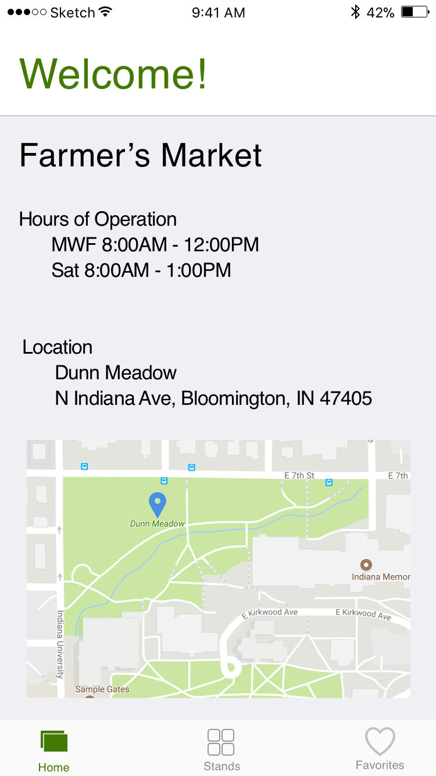
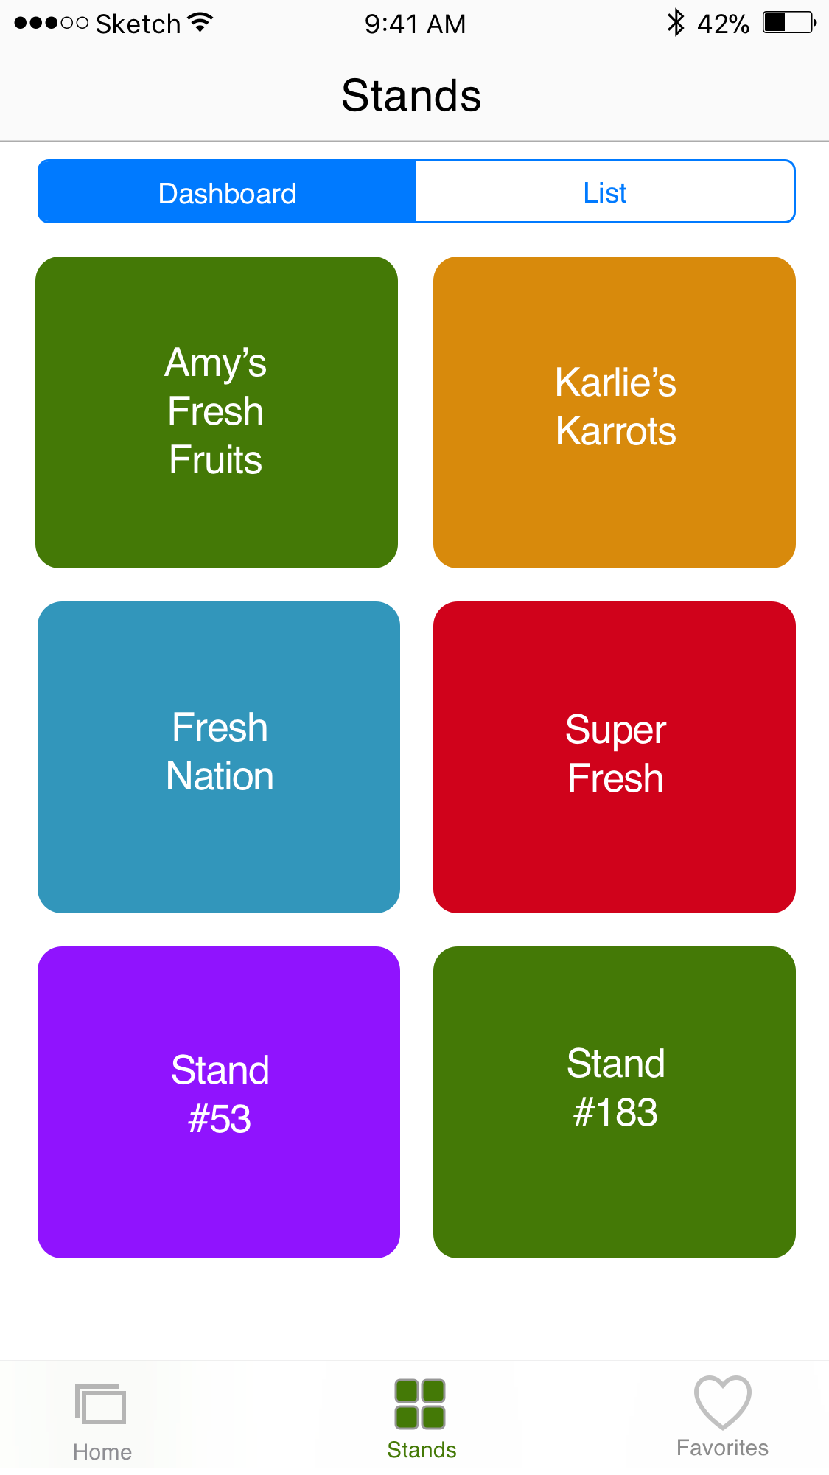
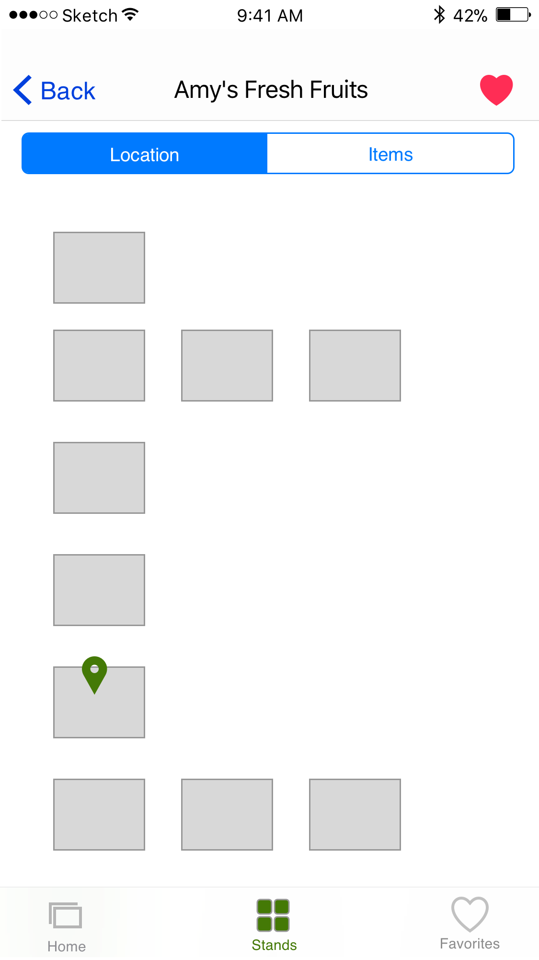
Solution Mockup
LINK

Slide 10
Solution Reception (Potential)
Based off of topic research, app market research, and user research survey- anticipating a positive reaction to the app
Demographic shift is leaning more towards a more technological audience
Farmers markets must adapt in order to continue to appeal to its consumers
A mobile app would satisfy the consumer need, and not only keep them interested in farmers market, but encourage them to regularly attend

