Slide 1
An End-to-end Encrypted Application
Xiangyu Gao
Rui Li

Slide 2
Introduction
End-to-end Encrypted Session System
Encrypted Session
Face Recognition Login
Sensitive Content Recognition
User Firewall
Notes:
We designed an end-to-end encrypted session system, which includes some functions, such as encrypted session, face recognition login, sensitive content recognition, user firewall function, etc., to comprehensively realize the privacy protection of users. The system prevents people from hacking into other people's sessions and stealing content. The system adopts a high-intensity face recognition function to ensure that user privacy is protected. And the session content is encrypted during transmission, so even if the content is stolen, the user's session message cannot be obtained intuitively.

Slide 3
Technical Attack
Potential Attack
2D Facial Recognition Attack
Hacking
Potential Attack
Mitigate the Attack
Notes:
Due to the concurrent and contactless nature of face recognition, people can take advantage of it. In other words, if someone has access to your high-definition photo, it's also possible that he's authenticated through facial recognition.
In addition, hackers may also steal user session information by breaking into the system and obtaining this information for other purposes.
--------------------------------------------
Our solution is to protect the privacy of users by designing systems, mainly by implementing face recognition and encrypted transmission. However - due to 2D recognition - this vulnerability cannot be completely avoided, we just reduce the likelihood of this happening.

Slide 4
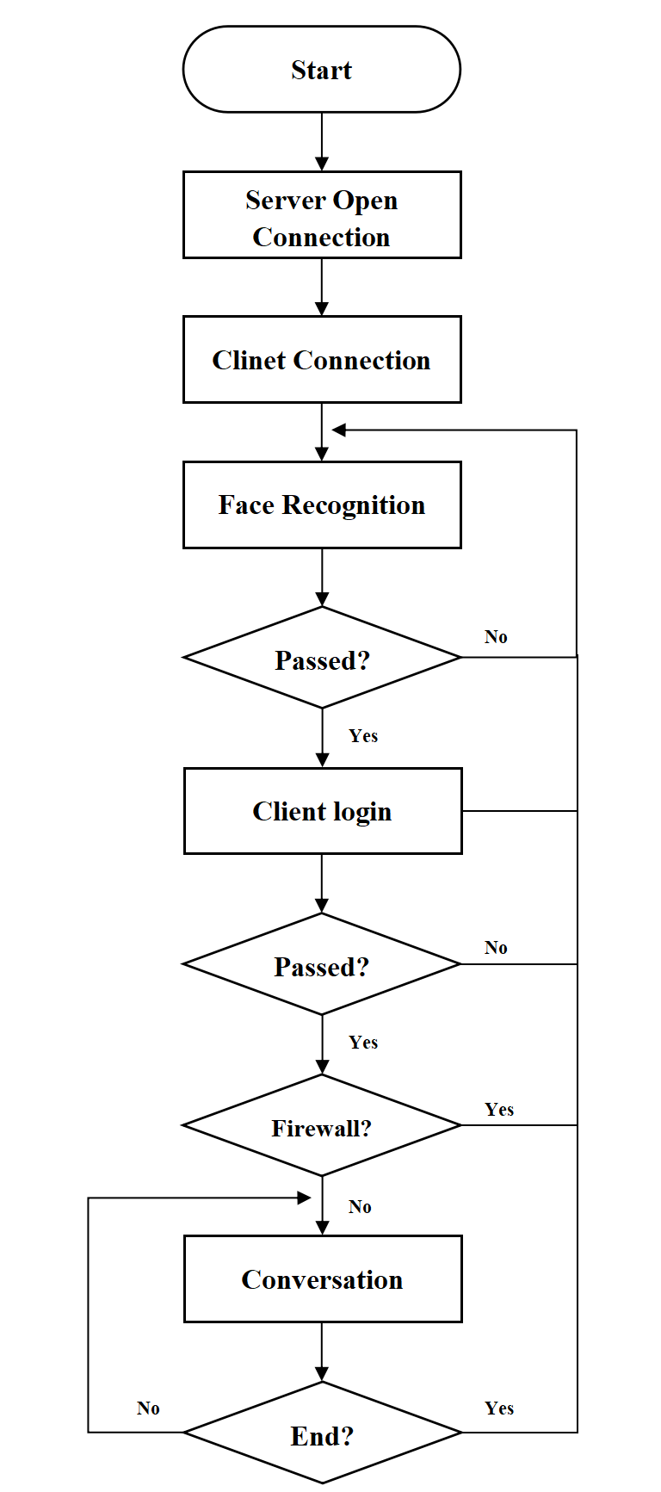
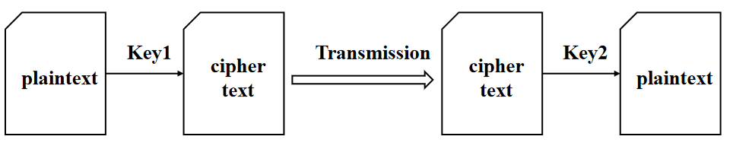
System Overview
Overall System Logic Design
Encryption Algorithm
Notes:
Our system is shown in Figure 1. Open the connection on the server side, keep it in standby. The client accesses and establishes a connection. Then perform face recognition authentication. After the client takes a picture, the picture is sent to the server in binary form for verification. Enter the user login name after the verification is passed.
If no firewall policy is triggered, the session is logged in and encryption and decryption are performed as information is transmitted within the session. If one of the servers or clients proposes to terminate the session, this will end the session, the client will close the connection, and the server side will remain on standby.
----------------------------------------------------------------
Here we are using asymmetric encryption.key1 and key2 are a pair of keys that are very different and hard to guess from one to the other. We can publicly transmit it to the left side Key1, and then the left side calculates the ciphertext and transmits it to the right side, and the right side decrypts it with Key2.

Slide 5
System Overview
Face Recognition
Face++ API
requests
Over 95% Similarity
Firewall
Restrict Unauthorized Users
Prevent Intruders
Record the Content and Activities
Sensitive Data Identification
Notes:
In the face recognition part, the requests library, OpenCV, and face++ document API are mainly used. By judging the similarity between the image captured by the camera and the sample image, it is determined whether it is the same person. First, call this function to open the camera and display the image. After receiving the photographing command, the picture is captured and converted into a grayscale image and stored. Then call the Face++ API to process the pre-uploaded sample image and the captured image, and obtain the face tokens of the two images. Compare the face tokens of two pictures and return the similarity of the two pictures. Finally, add a judgment statement and call the judgment function to judge the similarity of the two pictures. If the similarity is greater than 95%, it is considered to be the same person, and you can enter the system for the next step, that is, enter the user name and password to log in.
-----------------------------------------------
Firewalls isolate risk areas from safe areas and set a block list to restrict users who are on that list. In general, the firewall we designed has the following functions:
•Restrict unauthorized users from accessing the server, and filter out unsafe services and illegal users.
•Prevent intruders from approaching the defense facilities of the internal network, and detect and alarm network attacks.
•Record the content and activities of information passing through the firewall.
-------------------------------------------------------
During information transmission, if sensitive information appears in the information, the server detects the information and issues an alert.

Slide 6
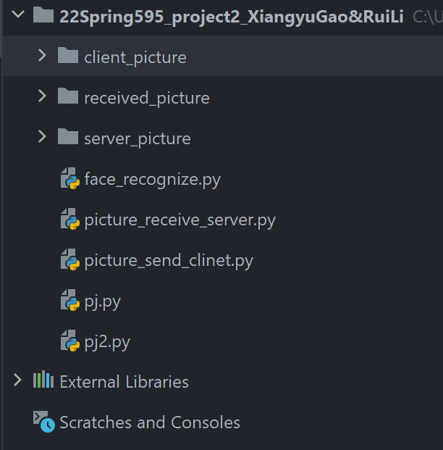
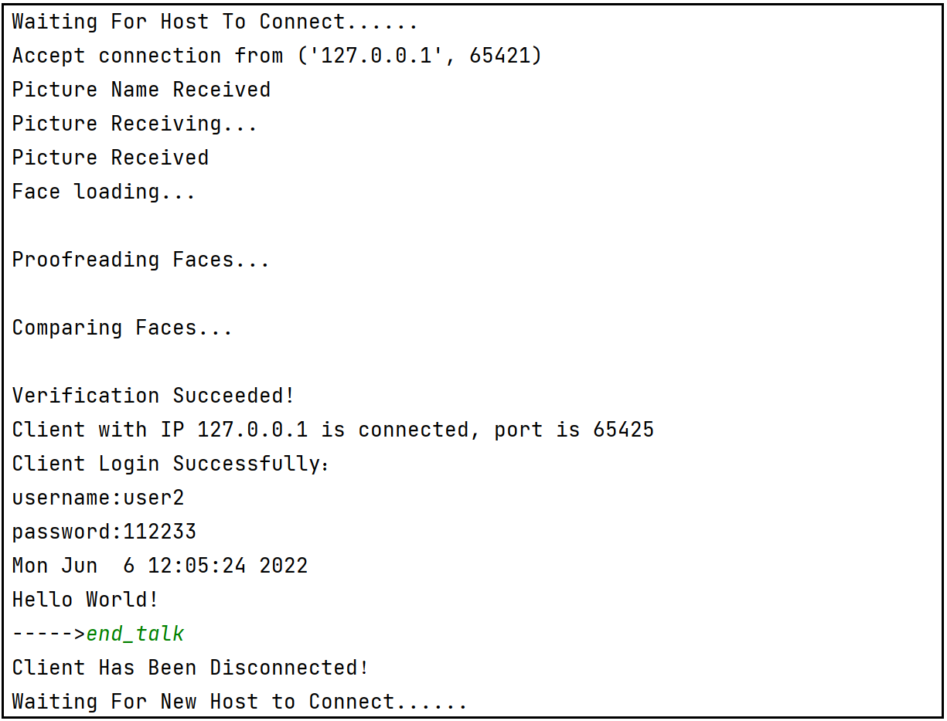
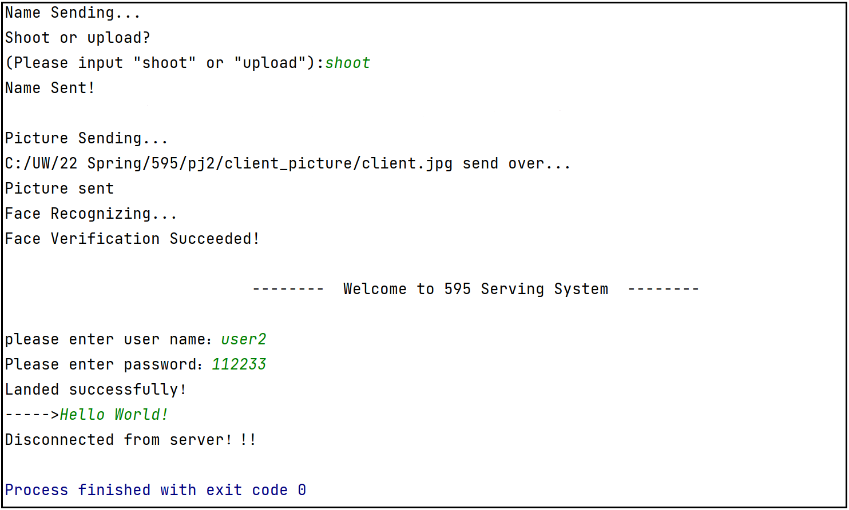
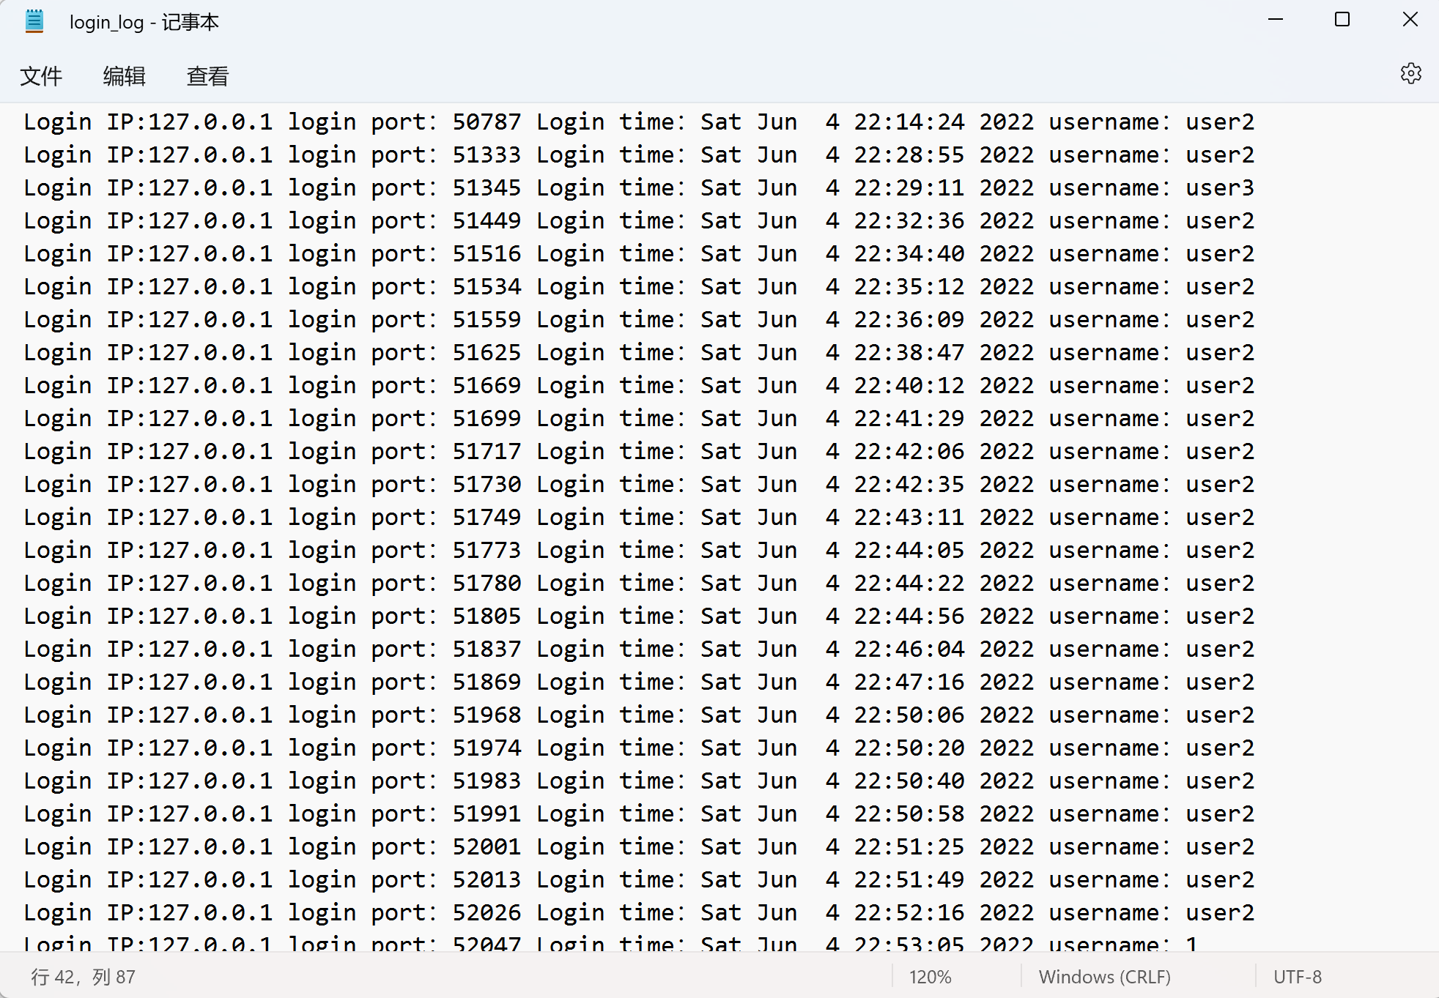
Work Description
Notes:
We wrote a python security project, including four py files,
and defined three classes and dozens of functions.
In total, more than 400 lines of code were written.
When thinking about system design,
we looked at more than a dozen papers and designed several drafts of running logic.
Although the process is continuous thinking and rewriting,
after unremitting efforts, we finally get a design that we think is relatively reasonable.
The figures on the right side are the progress of server and client.
------------------------------------------
We can output the login information to the txt log file.

Slide 7

Demonstration https://www.youtube.com/watch?v=zYbMCRfGSrc

Slide 8
Conclusion
Session System
Importance of Security
Improvement
Notes:
We implemented an end-to-end encrypted session system,
and implemented encryption algorithms,
face recognition authentication,
sensitive data capture,
and user firewall functions in the system.
In the process of project practice,
I also felt the importance of security and privacy.
Developers must not only prevent system errors but also prevent hacker intrusion,
which is a difficult problem. In the next step,
we will continue to try to attack the system we designed and improve the system.

