Slide 1
Read in input radar file
Read in input lidar file
Check next cell for ice
[Yes]
Trace iceberg footprint and append iceberg values
[No]
Check next unvisited cell for ice
Create figure of iceberg tow-ability
[Display values on GUI]
Print outputs to GUI
[Simple GUI]

Slide 2
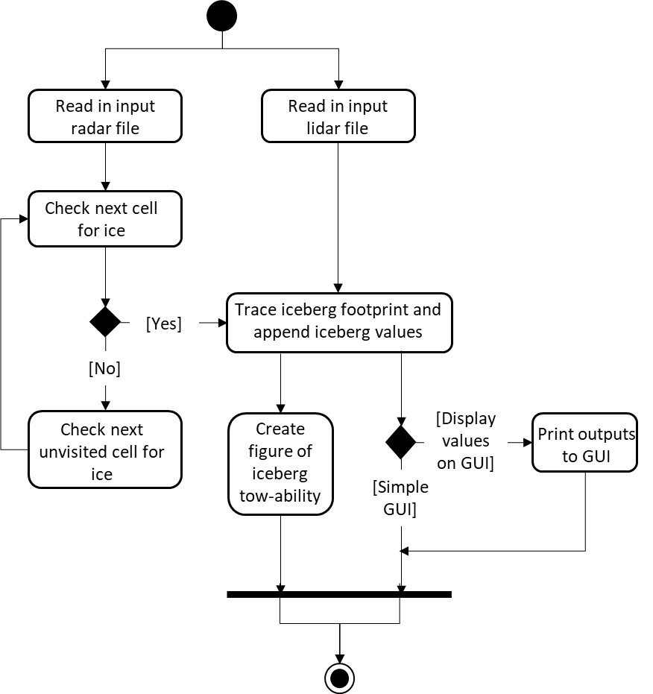

Slide 3
