Slide 1
Amazon Product Evaluation Dataset used: Toys and Games
Due Date: April 28
Joris Chomarat
Halil Arici
Gyaan Antia

Slide 2
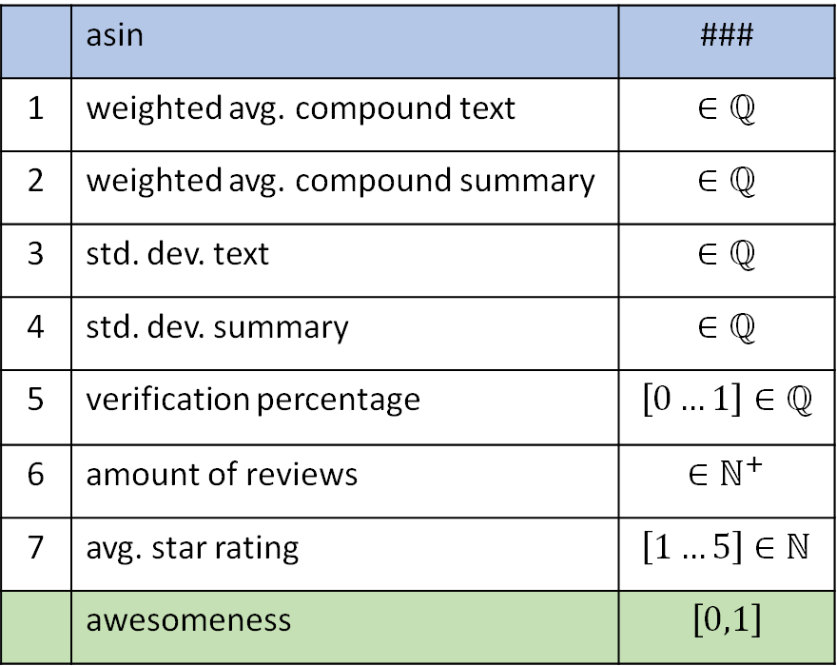
Feature preprocessing
 | asin | ###
1 | weighted avg. compound text | $$∈ℚ$$
2 | weighted avg. compound summary | $$∈ℚ$$
3 | std. dev. text | $$∈ℚ$$
4 | std. dev. summary | $$∈ℚ$$
5 | verification percentage | $$\left[0…1\right]∈ℚ$$
6 | amount of reviews | $$∈ℕ^{+}$$
7 | avg. star rating | $$\left[1…5\right]∈ℕ$$
 | awesomeness | $$\left[0,1\right]$$
1) 2) 3) 4) on next slide
5) Verification percentage
Self-explanatory. Percentage of verified reviews out of all reviews of one product.
6) Amount of reviews
Self-explanatory. Amount of reviews a product has.
7) Average star rating
Summary data in dataset contains star rating left by reviewer, if no summary was left. The average of all ratings from these reviews was taken. If no review of a product has a star rating, the lowest possible Amazon star rating of ”1” is assigned.

Slide 3
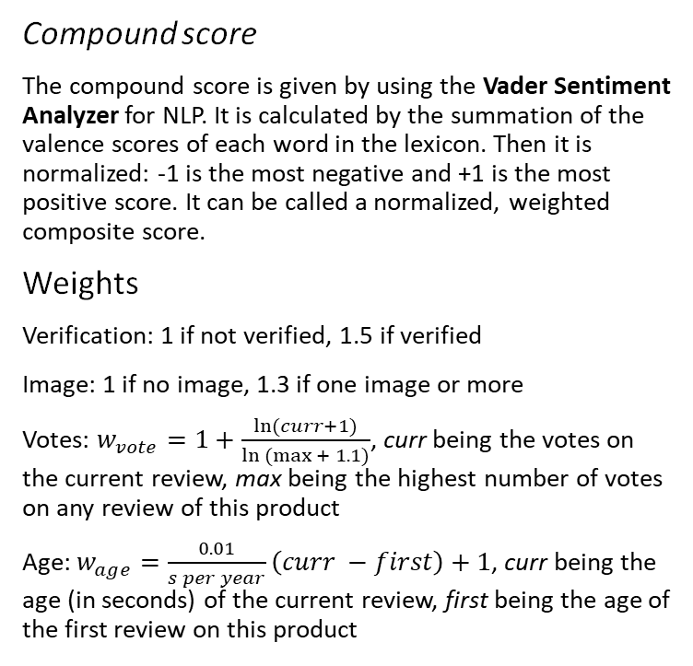
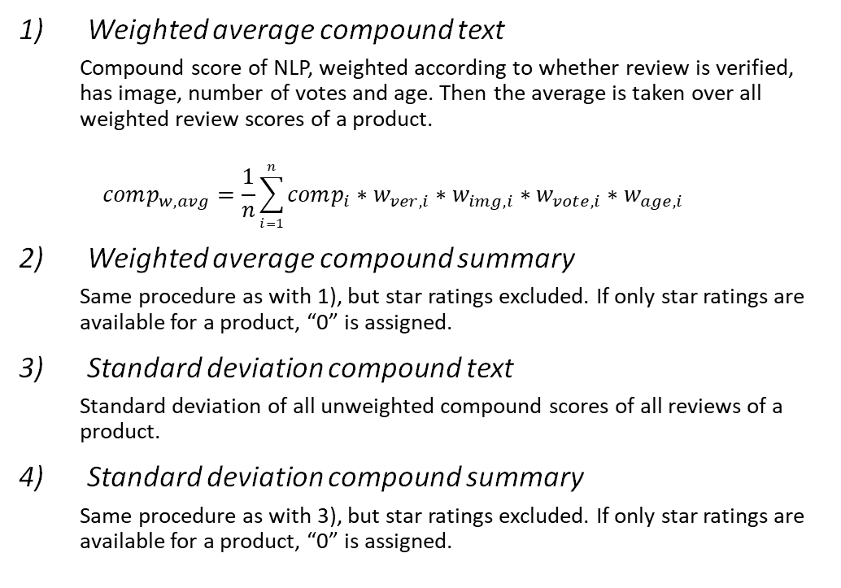
Feature preprocessing (continued)
Weighted average compound text
Compound score of NLP, weighted according to whether review is verified, has image, number of votes and age. Then the average is taken over all weighted review scores of a product.
$$comp_{w,avg}=\frac{1}{n}\sum_{i=1}^{n}{comp_{i}∗w_{ver,i}∗w_{img,i}∗w_{vote,i}∗w_{age,i}}$$
Weighted average compound summary
Same procedure as with 1), but star ratings excluded. If only star ratings are available for a product, “0” is assigned.
Standard deviation compound text
Standard deviation of all unweighted compound scores of all reviews of a product.
Standard deviation compound summary
Same procedure as with 3), but star ratings excluded. If only star ratings are available for a product, “0” is assigned.
Compound score
The compound score is given by using the Vader Sentiment Analyzer for NLP. It is calculated by the summation of the valence scores of each word in the lexicon. Then it is normalized: -1 is the most negative and +1 is the most positive score. It can be called a normalized, weighted composite score.
Weights
Verification: 1 if not verified, 1.5 if verified
Image: 1 if no image, 1.3 if one image or more
Votes: $w_{vote}=1+\frac{\ln{(curr+1)}}{\ln{(max{+ 1.1)}}}$, curr being the votes on the current review, max being the highest number of votes on any review of this product
Age: $w_{age}=\frac{0.01}{s per year}\left(curr −first\right)+1$, curr being the age (in seconds) of the current review, first being the age of the first review on this product

Slide 4
Algorithms
Model performance was evaluated using 10-fold cross validation for each model
Classifier hyper-parameters were optimized using a grid search algorithm maximizing the F1 score
Hyper-parameters not mentioned on next slides were kept at their default value
Where possible, the amount of CPU cores was increased to the maximum (for logistic regression and random forest classifier)
Parameters to optimize over were chosen based on our research which parameters should have the largest impact on performance
Classifiers evaluated:
Decision Tree (model_dt)
Naïve Bayes (model_nb)
Logistic Regression (model_lr)
Random Forest Classifier (model_rf)
Performance scores of algorithms may vary minimally (4th digit after decimal point) after each run

Slide 5
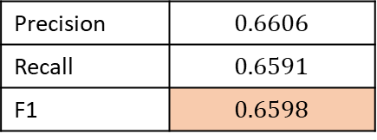

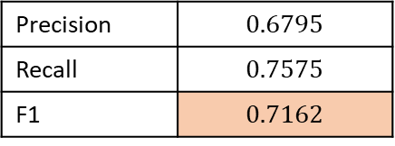
Results
Decision Tree
Naïve Bayes
Parameters used in grid search & optimum
Performance
only Gaussian NB was evaluated, because
Multinomial NB is for features > 0 only
Bernoulli is for features $∈[0, 1]$ only
Performance
Criterion | gini, entropy, log_loss | entropy
Splitter | best, random | best
Class weight | None, balanced | None
Precision | $$0.6795$$
Recall | $$0.7575$$
F1 | $$0.7162$$
Precision | $$0.6606$$
Recall | $$0.6591$$
F1 | $$0.6598$$

Slide 6
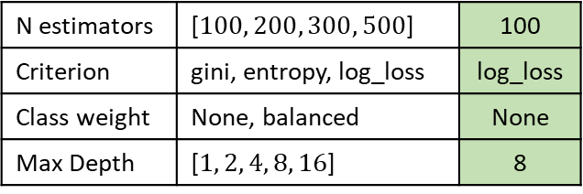
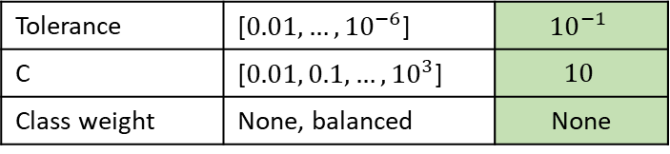
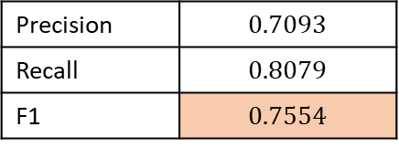

Results (continued)
Logistic Regression
Random Forest Classifier
Parameters used in grid search & optimum
Max. iterations were increased to 1000 so that every classifier converged before reaching the limit
Performance
Parameters used in grid search & optimum
Performance
Tolerance | [$0.01, …, {10}^{−6}$] | $${10}^{−1}$$
C | [$0.01, 0.1, …, {10}^{3}$] | $$10$$
Class weight | None, balanced | None
N estimators | [$100, 200, 300, 500$] | 100
Criterion | gini, entropy, log_loss | log_loss
Class weight | None, balanced | None
Max Depth | [$1, 2, 4, 8, 16$] | 8
Precision | $$0.6864$$
Recall | $$0.7966$$
F1 | $$0.7374$$
Precision | $$0.7093$$
Recall | $$0.8079$$
F1 | $$0.7554$$

Slide 7
Results (continued)
based on performance of the optimized classifiers tried out, predictions on test1 were done with model_rf

Slide 8
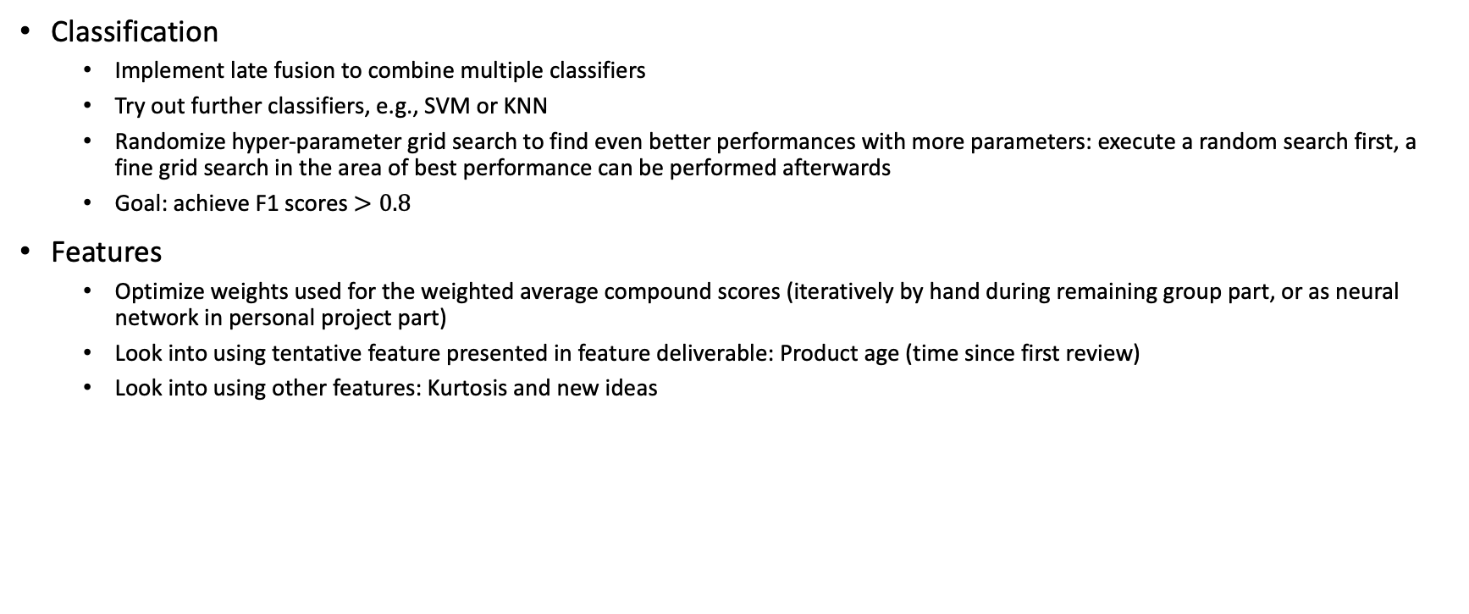
Next steps
Classification
Implement late fusion to combine multiple classifiers
Try out further classifiers, e.g., SVM or KNN
Randomize hyper-parameter grid search to find even better performances with more parameters: execute a random search first, a fine grid search in the area of best performance can be performed afterwards
Goal: achieve F1 scores $>0.8$
Features
Optimize weights used for the weighted average compound scores (iteratively by hand during remaining group part, or as neural network in personal project part)
Look into using tentative feature presented in feature deliverable: Product age (time since first review)
Look into using other features: Kurtosis and new ideas

