Slide 1
Collection and dissemination of media data
April 2014
Gagarine Yaikhom

Slide 2
Requirements
Download and storage of media data
Processing of media data
Dissemination of media data

Slide 3
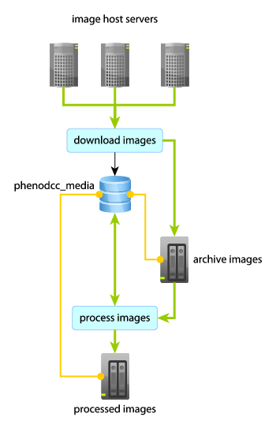
Features
Original media data must be archived
  DCC and CDA must be fault tolerant
  Centres might delete original files
Reduce storage requirement
  Prevent replication of identical data
  Use efficient compression techniques
  Choose efficient file formats

Slide 4
Features
Future proofing
  Fully automated (part of crawler run)
  Ability to support new media types
  Low maintenance

Slide 5
Features
Optimise user experience
  Fast download (less processing per request)
  Efficient download (only download visible)
  Responsive and interactive

Slide 6
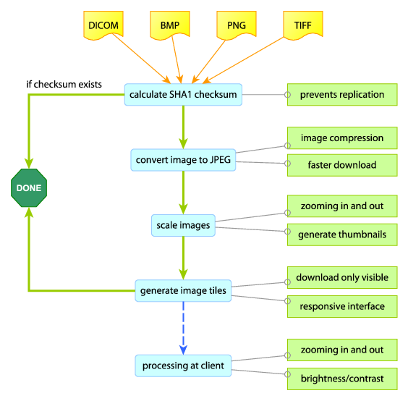

Slide 7
Live deployment
Image storage
  Sufficiently large drive (production ready)
  Download and processing takes time (prevent repetition)
Image server
  Static file server (Apache or Nginx)
  Separate from current servers (if possible)
  Accessible under mousephenotype.org domain

