Slide 1
Team No. : 1769 Team Name : KILL A BYTE
Institute Name : Shyama Prasad Mukherji College, Delhi University Team Leader : Gyana Karn Team Members : Gungun, Priya, Sakshi

Slide 2
OUR PROBLEM STATEMENT
Healthcare is the basic need of the hour for each and every individual but People in Rural areas generally have less access to healthcare than their urban counterparts. Fewer medical practitioners, mental health programs, and healthcare facilities in these areas often mean less preventative care and longer response times in emergencies.
SANJEEVANI
SANJEEVANI
India is more prone to such adversities, so it is important to require a feasible, open solution, involving less monetary investment in remote areas. Our software “SANJEEVANI” will provide immediate consultations to the ones in need without much hassle.
It’s a virtual system where anyone would be able to contact the doctors and their assistants in emergency cases from anywhere at any time.
Actors involved: A system administrator, Assistant, Doctors, and End users or Patients.
The project objective is to lay out the fulfillment of health amenities in no time with minimal infrastructure cost and rapid cure to the problem

Slide 3
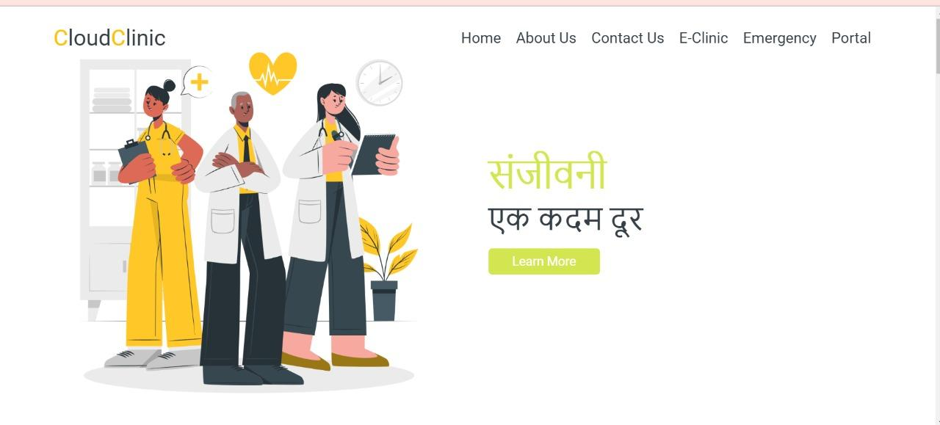
OUR IDEA: “SANJEEVANI” will provide immediate consultations to the ones in need without much hassle.
The way cloud kitchens operate, similarly, our model represents some of its features to work in with healthcare systems.
OUR SOLUTION:
SANJEEVNI IN WHICH- 1) A system administrator will be responsible for providing quick assistance.The doctors will provide medical prescriptions. They will prescript according to their availability. If they are not able to check up physically, an e-help or digital help will be assisted the end users through them.
2)End users or patient will provide their details and register themselves on the portal, this will help in maintaining their details. Assistance will be provided on the needs they enter.
->Portal: login through portal
•About us: It has information about our software.
•Contact us: Here are the details for contacting us.
Technology used:
Prototype
• handled by HTML, CSS, PHP, and MYSQL.

Slide 4
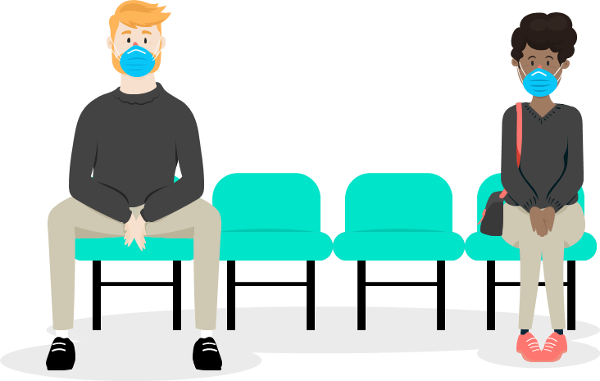

LOGIN
Description of our cases / adaptability
CLINIC PORTAL
MEDICAL
PRESCIPTION
MEDICAL ADVICE
PATIENT
DOCTOR
MEDICAL
HELP
SOLVING
QUERIES
ASSISTANT
QUICK
ASSISTANCE
USER
ACCOUNT
MANAGEMENT

Slide 5
WHAT WE SPECIALIZE IN?
01
02
03
EMERGENCY
E-help
BOOTH FACULTY
SANJEEVNI PROVIDES EMERGENCY HELP
It’s the closest planet to the Sun
Every region will provide booth faculty

