Slide 1
Wi-Fi HaLow (IEEE 802.11ah)
Topic ID: T24
Rohit Kumar (cs23b2053)
Gyan Chandra (cs23i1053)
Aluri Venkat Vaibhav (cs23i1040)
CS5005 (IIoT and Cloud Computing)
Research Paper/ IIoT and Cloud Computing Topic Presentation

Slide 2
Contents
Introduction & The Connectivity Gap
Global Sub-1 GHz Channelization
IEEE 802.11ah NGI Protocol Stack
Key MAC Features (RAW & TIM)
Achieving Massive Scalability
Technology Comparison
Implementation (NS-3 Simulation)
Energy Efficiency (TWT)
IIoT Applications
Conclusion

Slide 3
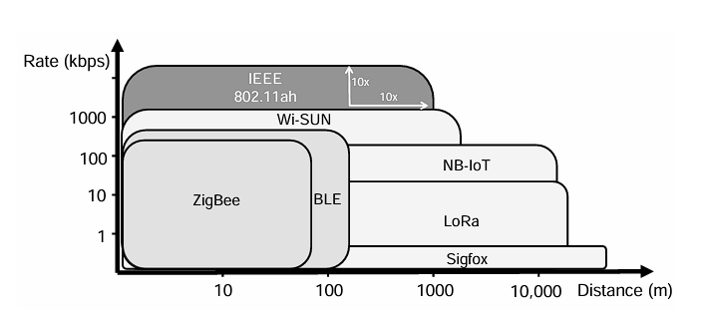
Introduction
Operates in sub-1 GHz bands, enabling extended 1 km transmission range.
Supports massive device density (up to 8,192 devices per Access Point).
Provides adaptive data rates ranging from 150 Kbps up to 78 Mbps.
Integrates natively with IP networks (IPv6), eliminating the need for proprietary gateways.

Slide 4
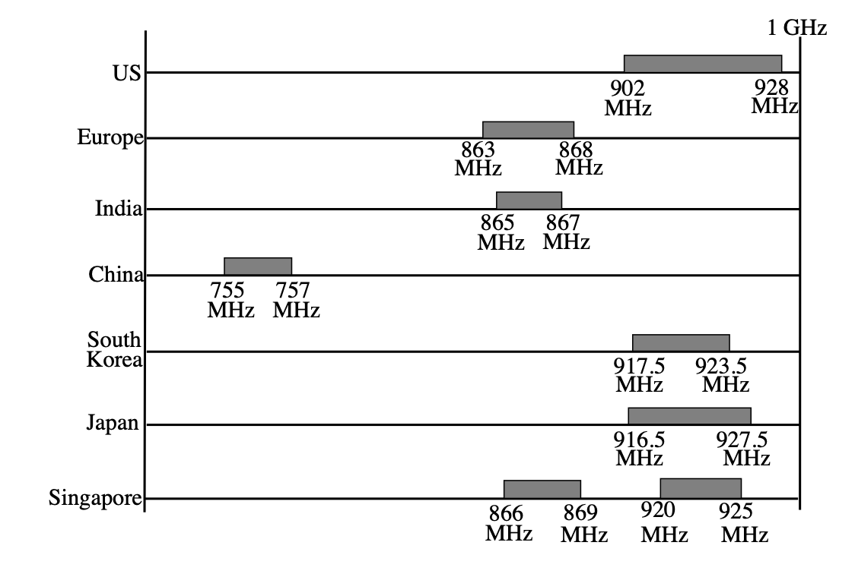
Global Spectrum
Operates in unlicensed sub-1 GHz bands, avoiding expensive cellular spectrum costs.
US Band (902–928 MHz): Offers the widest allocation, supporting up to 16 MHz channels.
India & Europe: Support narrower 1 MHz and 2 MHz channels for dense deployments.
Sub-1 GHz operation guarantees superior penetration through concrete walls and vegetation.

Slide 5
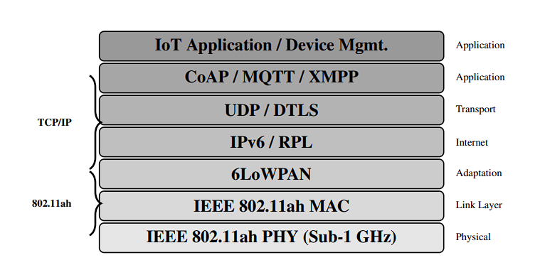
Protocol Stack
Acts as the robust sub-1 GHz Physical and Link layer for Next-Gen IoT (NGI).
Utilizes the 6LoWPAN adaptation layer to efficiently bridge the MAC to IPv6/RPL.
Natively supports lightweight internet transport protocols like UDP and DTLS.
Seamlessly integrates with cloud-level application messaging (CoAP, MQTT, XMPP).

Slide 6
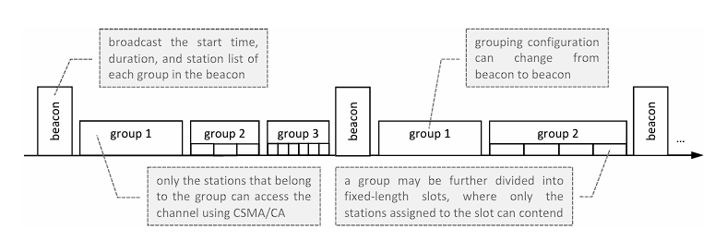
Key Technical Features
Restricted Access Window (RAW): Groups stations into specific time slots to drastically reduce data collisions.
TIM Segmentation: Allows stations to wake up only for specific group beacons, maximizing sleep time.
Target Wake Time (TWT): AP and stations negotiate sleep schedules, enabling multi-year battery life
Hierarchical AID: Efficiently manages and organizes up to 8,191 IoT endpoints..

Slide 7
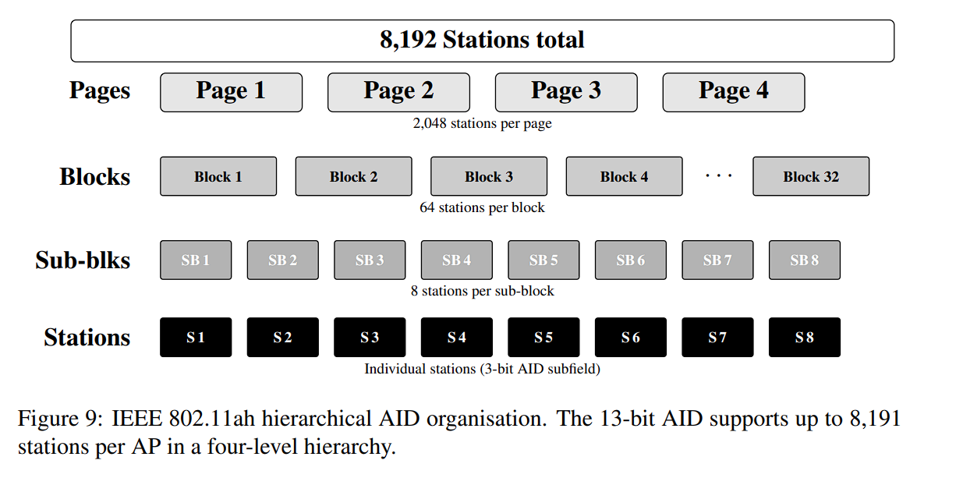
Achieving Massive Scalability
Expands the legacy Association ID (AID) space from 11 bits to 13 bits.
Organizes AIDs hierarchically: Pages → Blocks → Sub-blocks → Stations.
This structured approach drastically reduces protocol overhead during traffic indication.
Enables a single Access Point (AP) to efficiently manage up to 8,192 IoT devices.

Slide 8
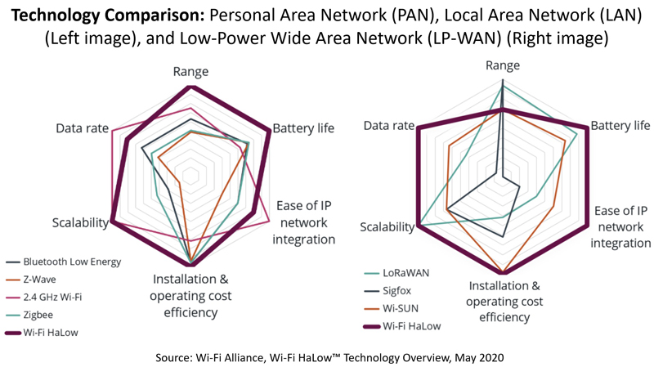
Technology Comparison
Outperforms LoRa and SigFox in data rates while matching their LP-WAN range.
Exceeds BLE and ZigBee range by 10× with superior wall and obstacle penetration.
High throughput natively supports fast, encrypted Over-The-Air (OTA) firmware updates.
Mandates WPA3 enterprise-grade security for industrial applications.

Slide 9
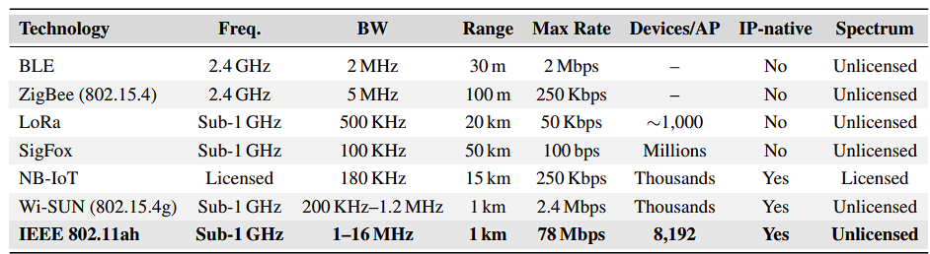
Technology Comparison

Slide 10
Implementation
Simulated a dense smart agriculture scenario (500m radius, up to 500 stations).
Standard CSMA/CA throughput collapses by >90% at 500 stations due to severe collisions.
TAROA-optimised RAW maintains stable throughput (175 Kbps) and low latency (<225 ms).
RAW improves the Packet Received Ratio (PRR) from 12% to 94% at peak density.

Slide 11
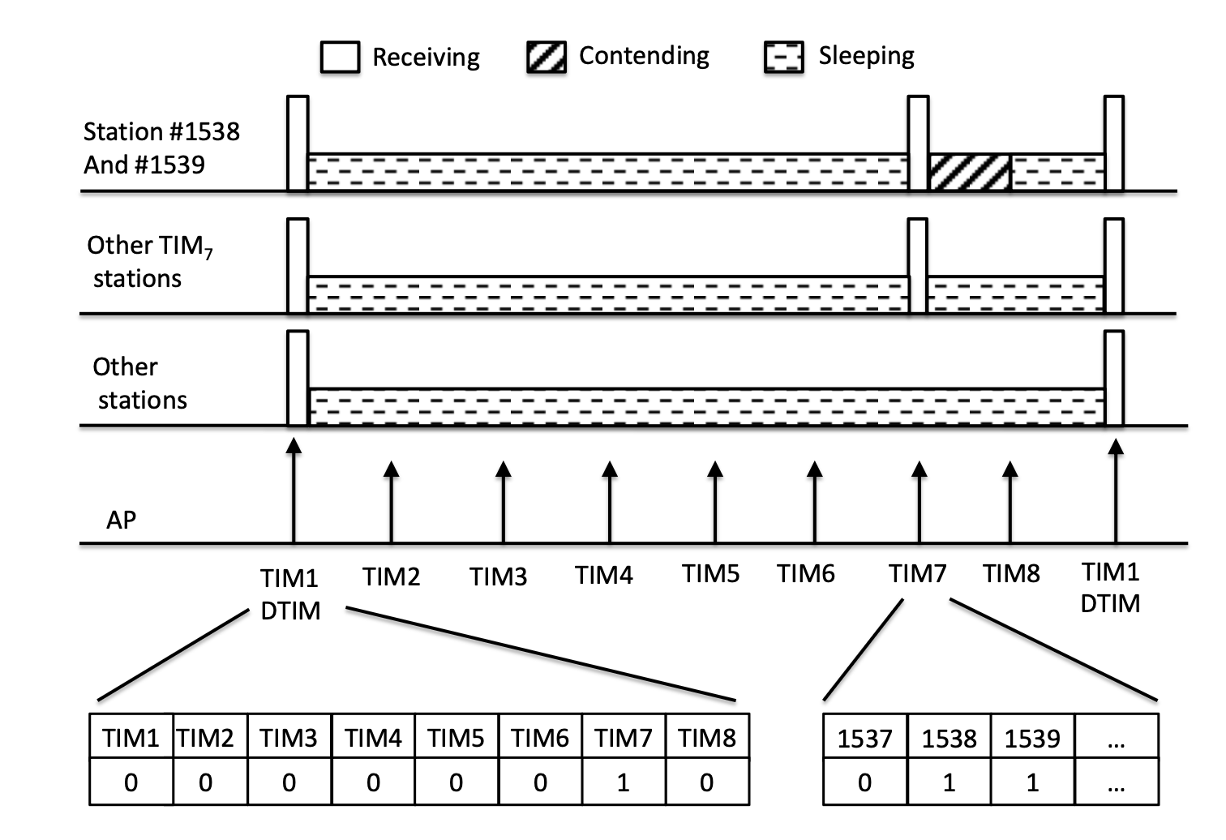
Energy Efficiency: Target Wake Time (TWT)
TWT allows the Access Point (AP) and stations to negotiate specific sleep schedules.
Devices remain in a deep sleep state between pre-agreed TWT Service Periods (SPs)
Eliminates the need for devices to wake up for every beacon frame.
Crucial for remote sensors (e.g., agriculture, metering) to achieve multi-year battery lifespans.

Slide 12
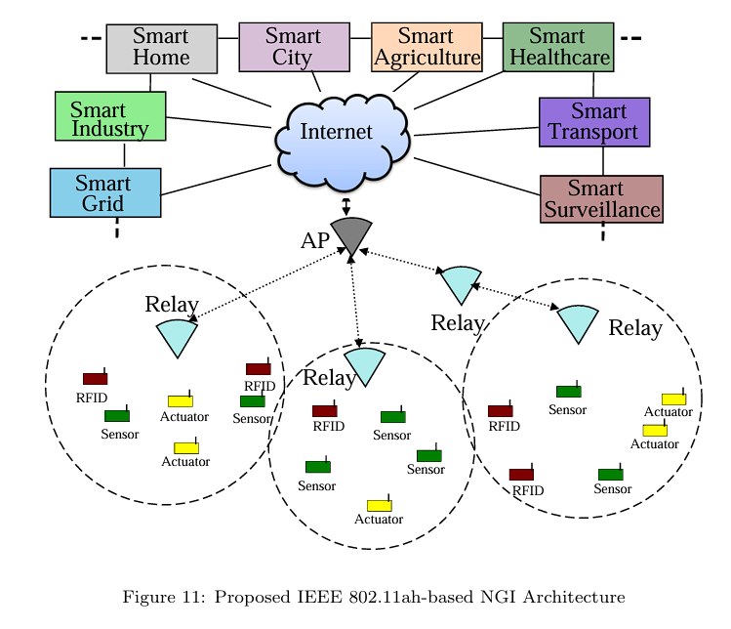
IIoT Applications of Wi-Fi HaLow
Smart Agriculture: 1-2 km coverage; TWT ensures soil sensors run for years on coin-cell batteries..
Industrial Automation: Sub-1 GHz easily penetrates factory walls; guarantees sub-100 ms latency.
Smart Grid / Metering: Cost-effective, bi-directional communication without licensed spectrum fees.
Smart Healthcare: WPA3 compliance ensures strict HIPAA-level data security for remote tracking.

Slide 13
Conclusion
Wi-Fi HaLow perfectly balances range, data speed, and energy efficiency for IIoT.
The RAW mechanism is fundamentally essential for dense network scalability.
Native IP support and robust security significantly lower integration complexity and CAPEX.
Poised to become the standard backbone for next-generation smart environments.

Slide 14
References
[1] Wi-Fi Alliance, "Wi-Fi CERTIFIED HaLow: Wi-Fi for IoT applications," White Paper, Nov 2021.
[2] L. Tian et al., "Wi-Fi HaLow for the Internet of Things: An up-to-date survey," Journal of Network and Computer Applications, 2021.
[3] M. Alam et al., "Analysing the suitability of IEEE 802.11ah for Next Generation IoT," Ad Hoc Networks, 2024.
[4] V. Banos-Gonz ˜ alez, M. S. Afaqui, E. Lopez-Aguilera, and E. Garcia-Villegas, “IEEE ´ 802.11ah: A technology to face the IoT challenge,” Sensors, vol. 16, no. 11, p. 1960, 2016.
[5] E. Khorov, A. Lyakhov, A. Krotov, and A. Guschin, “A survey on IEEE 802.11ah: An enabling networking technology for smart cities,” Computer Communications, vol. 58, pp. 53–69, 2015.

