Slide 1

ASSAM DOWN TOWN UNIVERSITY
Shankar Madhab Path, Gandhinagar, Panikhaiti, Guwahati, Assam – 781026
Effects of Display Polarity and Text Colour on Visual Fatigue,
Ocular Behaviour and Task Performance,
Under Controlled Ambient Illumination
Synopsis presentation for partial fulfilment of the requirements for the award of the degree of
DOCTOR OF PHILOSOPHY (Ph.D.) IN OPTOMETRY
Faculty of Allied and Healthcare Sciences · Programme of Optometry
Submitted by
Mr. Gyandeep Nath
Research Scholar, Programme of Optometry
Under the guidance of
Dr. Susmita Saha
Associate Dean, Faculty of Allied and Healthcare Sciences
Notes:
This synopsis proposes a within-subject experiment on how two freely changeable display settings — polarity and text colour — affect visual fatigue during prolonged tablet reading.

Slide 2
Overview
1.
Introduction
Background, definitions, burden of disease and the biophysiological basis
2.
Review of Literature
Display polarity; text colour and the contrast confound; ambient illumination; the research gaps
3.
Aim and Objectives
The aim, the four objectives, and the hypotheses attached to them
4.
Methods and Methodology
Study design and display conditions; participants and eligibility; procedure, outcome measures and analysis
5.
Expected Outcome
What the results are expected to establish, and the significance of the work
6.
References
Sources cited in this presentation
2
Notes:
Six parts, following the prescribed synopsis structure.

Slide 3
1. Introduction — Background and Burden
The medium has changed
Reading has moved from print to screens. Tablets are now a routine medium for study, work and leisure reading, often for hours at a time.
A printed page reflects whatever light falls on it and is fixed once printed. A screen emits its own light, and almost every property of what it displays can be altered in software at no cost.
These choices are made constantly — by interface designers, and by users every time a theme is switched — yet the evidence on their combined effect during prolonged reading remains limited.
Terms used throughout
Display polarity — which of the two elements is lighter. Positive polarity is dark text on a light background, the arrangement of a printed book; negative polarity is light text on a dark background, popularly "dark mode".
Text colour (chromaticity) — the hue of the letters themselves, which need not be black or white.
Luminance contrast — the difference in brightness between the letters and their background, and the property that decides whether text is easy to resolve. It is not the same as colour difference: two colours may look very different and still be hard to read against one another.
The clinical burden
Prolonged screen reading produces a recognised symptom cluster — dry or gritty eyes, blurred vision, delayed refocusing, headache and neck or shoulder ache — grouped as digital eye strain, or computer vision syndrome.
Pooled prevalence across 103 cross-sectional studies (66,577 participants) is 69.0% (95% CI 62.3–75.3), rising to 76.1% among university students (Ccami-Bernal et al., 2024).
Across 45 randomised controlled trials (4,497 participants), no therapy examined — blue-blocking lenses included — reached high-certainty evidence (Singh et al., 2022).
The displayed stimulus is upstream of the visual load, costs nothing to change and can be deployed universally — and is the least investigated of the available levers.
3
Notes:
Two numbers frame the problem: roughly seven in ten screen users are affected, and nothing currently offered to them is proven to work.

Slide 4
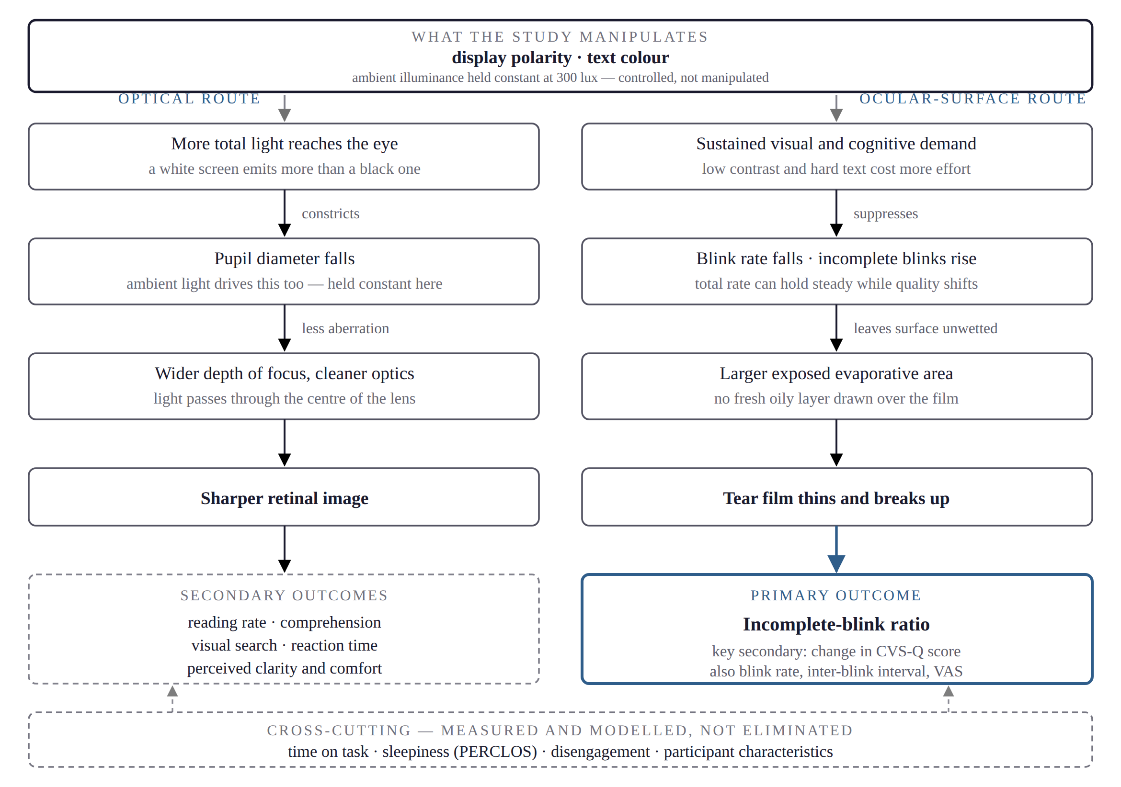
1. Introduction — Biophysiological Basis
The symptoms arise by two routes, and separating them is what makes them measurable (Sheppard & Wolffsohn, 2018).
Accommodative and vergence route. Sustained near focusing — a change in the shape of the lens together with inward rotation of both eyes — produces blur, difficulty refocusing, transient myopia after close work, and headache. It responds measurably to display parameters (Jiménez et al., 2020; Redondo et al., 2025), but is not measured in this study and is reviewed as mechanistic context.
Ocular-surface route. A blink spreads fresh tear fluid across the surface and draws an oily secretion from the lid margins over it, which slows evaporation. Screen work lowers blink frequency and raises the proportion of blinks in which the lids approach one another but do not meet — incomplete blinks. These leave part of the surface unwetted, so the tear film thins and breaks up sooner, and the surface enters the recognised inflammatory cycle of dry eye disease (Fjaervoll et al., 2022; Kamøy et al., 2022).
Mechanistic review attributes display-associated dry eye principally to impaired blinking, rather than to parasympathetic or blue-light contributions (Fjaervoll et al., 2022).
It is therefore the completeness of blinking, and not its frequency, that this study treats as its primary outcome.
Figure 1. The two pathways from display configuration to measured outcome.
4
Notes:
Both routes run at once from the same settings. The left route produces the performance measures; the right route produces the primary outcome.

Slide 5
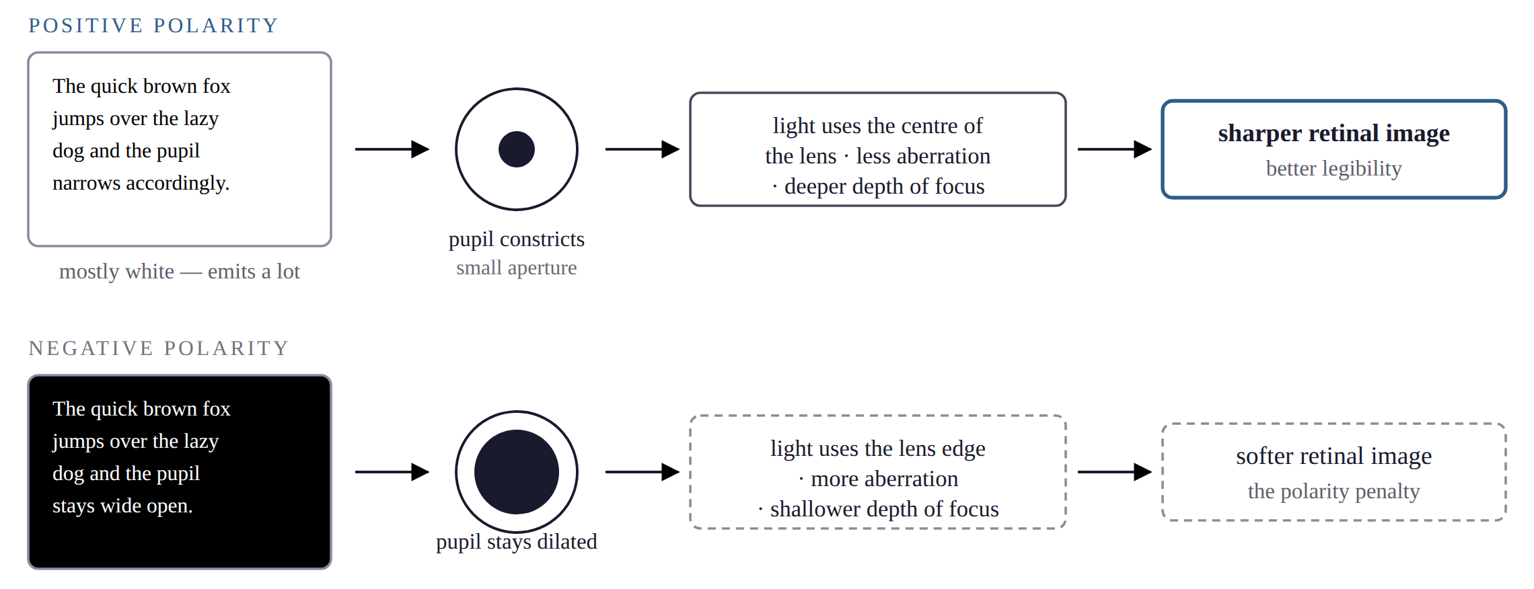
2. Review of Literature — Display Polarity
The positive polarity advantage. Reading is better for dark text on a light field than for light text on a dark one. This is the most consistently replicated finding in the field.
The accepted mechanism is pupillary, not aesthetic. A positive-polarity screen is mostly white and so emits more light; more light constricts the pupil; a smaller pupil admits light through the optically cleaner centre of the lens and widens the depth of focus; the retinal image is consequently sharper (Buchner & Baumgartner, 2007; Piepenbrock et al., 2014a, 2014b). Buchner et al. (2009) report that the advantage disappears when overall display luminance is equalised, so what is estimated is polarity together with its attendant luminance.
What the corpus does not show. The paradigms are brief and threshold-limited and the stimuli almost entirely achromatic; none measures blinking, validated symptoms or fatigue accumulated over an hour. An advantage in legibility does not license an inference about visual fatigue.
Sengsoon and Intaruk (2025), the most direct tablet test located, randomised thirty users between light and dark mode and found no difference in subjective visual fatigue, while critical flicker frequency and dry-eye symptoms did differ.
Figure 2. The pupil-mediated account of the positive polarity advantage.
5
Notes:
Nothing in this chain mentions colour. Ambient light drives pupil size the same way, which is why room light must be held constant rather than left to vary.

Slide 6
2. Review of Literature — Text Colour, Contrast and Ambient Illumination
Text colour and the contrast confound
Ambient illumination
The literature manipulating text chromaticity is small, and no located study has crossed colour with polarity while measuring fatigue.
Jiménez et al. (2020) tested fourteen text–background colour combinations over 2-minute passages. Colour modulated accommodative and pupillary dynamics and low-contrast pairs were rated less legible, but no symptom outcome was recorded.
Fan et al. (2024) tested colour under negative polarity only, reporting red worst and yellow best. That is precisely the ordering luminance contrast alone predicts for those hues on a black background, and a single-polarity design cannot exclude that explanation.
Any manipulation of text colour also manipulates luminance contrast, because chromatic pigments differ intrinsically in relative luminance; chromatic contrast cannot substitute for luminance contrast (Buchner & Baumgartner, 2007).
Hue and luminance contrast have therefore not been separated in the studies located.
Illumination modulates the legibility cost of negative polarity (Dobres et al., 2017) and the fatigue cost of coloured text under it (Fan et al., 2024), consistent with a pupil-mediated account in which room light and display polarity trade against one another.
The evidence is not uniform, and that disagreement determined the present design: the proofreading advantage was independent of ambient lighting (Buchner & Baumgartner, 2007) whereas threshold legibility showed a clear interaction (Dobres et al., 2017). The performance-side effect of polarity appears not to depend on room light; the effects that do are concentrated in the ocular and tear-film measures.
Lin, M., et al. (2025) is the most directly relevant work on that second point: reading in a dark room from a bright screen produced the greatest tear-film destabilisation and the largest blink changes, with incomplete blinking rising over time in every condition.
Ambient illuminance is accordingly held constant here at a single measured level rather than manipulated. What that forfeits is stated plainly: Sethi and Ziat (2023) located the cognitive cost of negative polarity in younger adults specifically under dim conditions, and this design cannot speak to it.
Why illumination is controlled here rather than manipulated
The ocular outcomes of this study are derived from the tablet’s own front camera rather than from dedicated instrumentation. In a darkened room the display is the dominant source of light falling on the reader’s face, and the two polarities differ greatly in how much light they emit: computed from the locked condition table, a positive-polarity screen casts roughly thirty times the illuminance of a negative-polarity one at the reading distance used.
Against a 10 lux room that leaves the face lit about 2.3 times more brightly in positive than in negative polarity; against a 300 lux room the ratio falls to about 1.05. Camera exposure, and with it the achieved frame rate on which blink classification depends, would therefore have varied systematically with the primary independent variable.
Undersampling biases the measured minimum eyelid aperture upward, inflating the incomplete-blink ratio in the direction the hypothesis predicts — and an artefact of that shape is indistinguishable from the effect it imitates. A narrower question answered with a trustworthy instrument was therefore preferred.
6
Notes:
The disagreement between Buchner & Baumgartner and Dobres is real, and is presented as such rather than resolved by selective citation. The bottom block is the measurement argument, which is the question a committee is most likely to press on.

Slide 7
2. Review of Literature — Research Gaps
The positive polarity advantage is established for brief, achromatic legibility tasks, but is untested for prolonged reading with fatigue accumulation and ocular-surface outcomes.
The interaction between polarity and text colour on visual fatigue appears unestimated: the only located text-colour fatigue study held polarity constant (Fan et al., 2024), and hue has not been separated from luminance contrast in the studies located.
No located study reports contrast metrics alongside measured display photometry, and the prevailing accessibility standard is polarity-blind (World Wide Web Consortium, 2023).
Few studies co-register a validated symptom instrument with objective markers in the same condition, leaving the subjective–objective discrepancy unresolved (Sheppard & Wolffsohn, 2018).
The incomplete-blink ratio does not appear to have been tested as an outcome of a display manipulation, despite its specificity — and no automated implementation located has been validated against manual annotation, so the measure does not scale.
Table 3.2 — The proposed design against the published studies from which its measures are drawn.
Study | Year | N | Conditions per participant | Total condition-runs | Ocular measure | Display parameter manipulated
Hirota et al. | 2013 | 11 | 1 | 11 | Blink composition, tear break-up | None
Jackson et al. | 2016 | 12 | 2 | 24 | PERCLOS | None
Jiménez et al. | 2020 | 20 | 14 | 280 | Accommodation, pupil | Text–background colour
Portello et al. | 2013 | 21 | 2 | 42 | Blink rate, completeness | None
Cardona et al. | 2011 | 25 | 3 | 75 | Blink rate, amplitude | Task dynamism
Lin, M., et al. | 2025 | 30 | 4 | 120 | Blink patterns, tear film | Ambient light × screen brightness
Argilés et al. | 2015 | 50 | 6 | 300 | Blink rate, completeness | Reading medium
Proposed study | — | 130 | 10 | 1,300 | Incomplete-blink ratio, blink rate, IBI, PERCLOS | Polarity × colour, illumination controlled
Precision on the primary outcome follows the number of condition-runs, not the number of participants.
7
Notes:
The table is the sample-size justification: 130 participants give 1,300 condition-runs, more than four times the largest comparable study.

Slide 8
3. Aim and Objectives
Aim
To determine the effects and interaction of display polarity and text colour on visual fatigue, ocular behaviour and visual task performance during prolonged tablet-based reading under controlled ambient illumination, and, as a secondary methodological objective, to evaluate the validity and feasibility of camera-based blink assessment as an objective measure of ocular response.
Primary objectives
1.
To investigate the individual and interactive effects of display polarity and text colour on subjective visual fatigue, ocular behaviour, cognitive workload and task performance during prolonged tablet reading, with ambient illumination held constant at a single controlled level.
2.
To model the contribution of luminance contrast and to distinguish it from residual, hue-specific effects, by computing standards-based contrast metrics for every condition and entering contrast explicitly alongside colour.
3.
To determine the combination of polarity and text colour that minimises visual fatigue and maximises task performance at that illumination level, and to examine how participant characteristics moderate these effects.
Methodological objective
4.
To establish the feasibility and criterion validity of tablet-based camera metrology for this purpose, including the agreement of automated blink classification against manual annotation, and the correspondence between subjective and objective indices.
8
Notes:
Objective 2 is what makes the design unusual: it is what allows a statement about whether colour matters, or only contrast.

Slide 9
3. Aim and Objectives — Hypotheses
Null hypothesis (H₀). Display polarity and text colour, individually or in combination, have no significant effect on visual fatigue, ocular behaviour or visual task performance during prolonged tablet reading at a controlled ambient illumination of 300 lux.
Alternative hypothesis (H₁). At least one of these factors, individually or in combination, significantly affects these outcomes.
Hypotheses linked to the objectives
H₁ₐ (Objective 1, main effects).
Positive polarity and higher luminance contrast are each associated with a lower incomplete-blink ratio, lower subjective visual fatigue and better task performance.
H₁ᵦ (Objective 1, interaction).
The effect of text colour depends on polarity. The further prediction that negative polarity costs more under dim illumination (Dobres et al., 2017) is not tested here, illumination being held constant; it is retained as a stated limitation.
H₁ᵪ (Objective 2, contrast mediation).
Colour-related variance is largely accounted for by luminance contrast. Because the computed contrast ordering reverses between the two polarities, contrast mediation predicts a matching reversal of the colour ordering, whereas a residual hue-specific effect predicts a consistent ordering — with red the a priori candidate exception (Fan et al., 2024).
H₁ᵨ (Objective 3, moderation).
Habitual display-mode preference, habitual screen exposure, typical ambient-lighting environment and digital literacy moderate the magnitude of these effects.
9
Notes:
H1c is the testable core: the two rival results look completely different when plotted, so the study cannot return an ambiguous answer on that question.

Slide 10
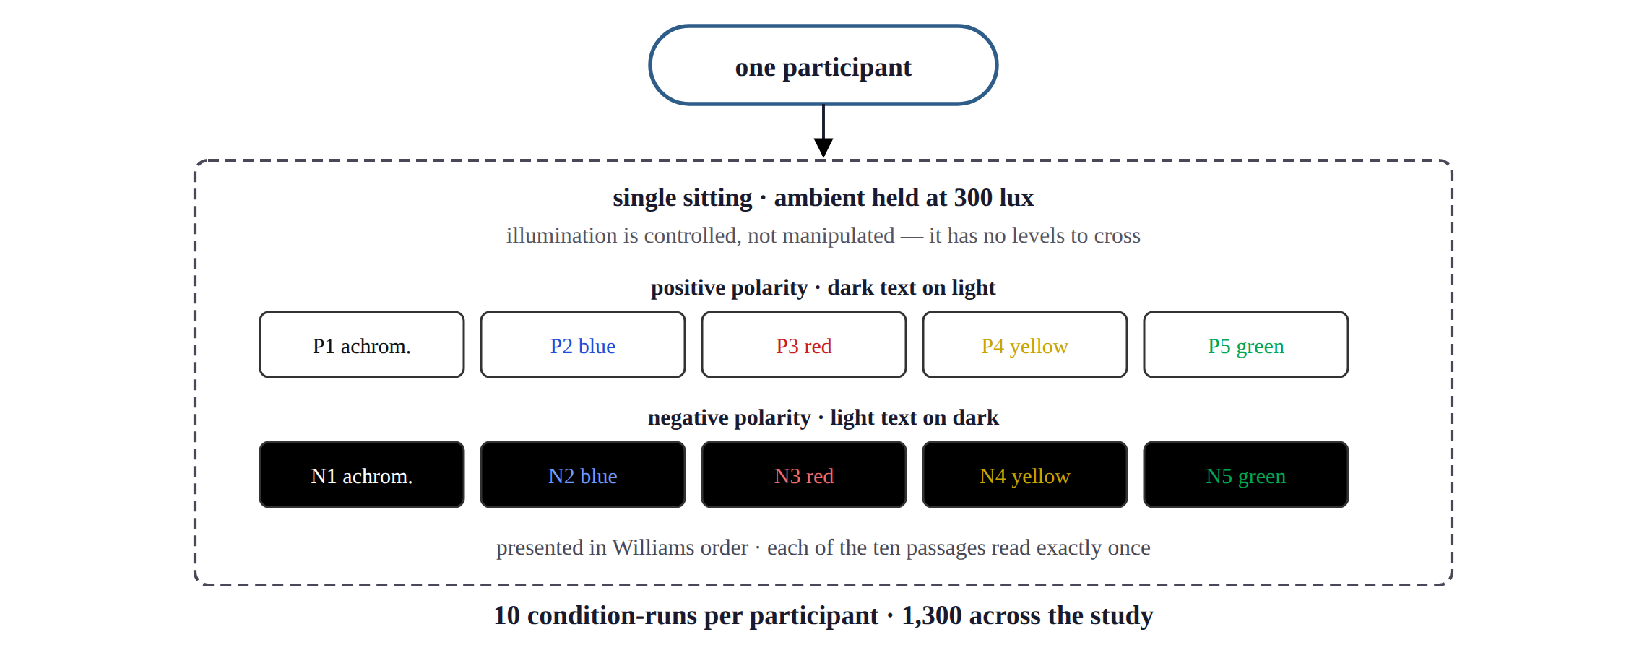
4. Methods and Methodology — Study Design and Display Conditions
Design. A repeated-measures (within-subject) factorial design. Display polarity (positive, negative) is crossed with text colour (achromatic, blue, red, yellow, green), giving ten display conditions, each presented once in a single sitting. Each participant contributes ten condition-runs and serves as their own control; 130 analysed participants give 1,300 condition-runs.
Display conditions. One tablet at a fixed white luminance, characterised photometrically before collection. Hex values are locked and WCAG contrast is computed from them, entering the analysis as a covariate. Because contrast on a white field falls as the text’s relative luminance rises while contrast on a black field rises with it, the rank order of the chromatic conditions is exactly inverted between the two polarities; the achromatic pair is contrast-matched at 21.00 : 1 in both, giving the one comparison in which a polarity effect cannot be attributed to contrast.
Ambient illumination. Held constant at 300 lux (accepted 250–350), verified at the eye position and the display plane with a calibrated meter and logged three times per sitting. It is a controlled variable with a manipulation check, not a factor, and the level is high enough that room light rather than the display dominates the illuminance on the reader’s face — necessary because the ocular measures are camera-derived.
Counterbalancing. A balanced Williams-type Latin square over the ten conditions: each condition occupies each serial position equally often, and precedes and follows every other equally often. Participants are assigned to rows by enrolment number, with complete balance in blocks of ten. Ten reading passages cover the ten runs, each read exactly once, so no practice effect requires adjustment.
Figure 3. The ten display conditions one participant sees within a single sitting.
10
Notes:
Every participant sees all ten conditions, so each person is their own control, and order follows a Williams square so each condition sits in each serial position equally often.

Slide 11
4. Methods and Methodology — Participants and Eligibility
Table 3.1 — Eligibility criteria.
Setting and sampling
Inclusion | Exclusion
Age 18 to 35 years | Refractive error beyond ±3.00 D
Distance visual acuity 6/6 or better, with or without correction | Manifest binocular vision disorder
Habitual screen use of at least four hours daily | Colour-vision deficiency on screening
No known ocular, systemic or neurological illness | History of photosensitivity or migraine
Able to give written informed consent | Medication affecting vision, accommodation or tear film
Able to attend one sitting of approximately 100 minutes | Diagnosed learning or psychiatric disorder
— | Contact-lens wear on test days; ocular surgery within six months
A controlled laboratory room at Assam down town University, in which ambient illuminance can be held constant and daylight is excluded.
Purposive sampling of university students and staff meeting the criteria opposite.
145 enrolled, 130 analysed. The target is a multiple of ten, as the Williams counterbalancing requires, and was set by simulation rather than by a formula assuming independent observations.
130 participants contribute 1,300 condition-runs. Precision on the primary outcome follows the number of condition-runs, not the number of participants.
One sitting per participant. Simulation over 2,000 synthetic participants gives a median of 98 minutes and a 95th percentile of 119 — also the total contact time, there being one visit.
A pilot of ten precedes the main study. Failing a 120-minute median, one withdrawal in ten, or 0.90 face presence in a tenth of runs, the conditions are split across two sittings of five, with the Williams row continuing rather than restarting.
Ethical considerations
Institutional Ethics Committee approval obtained before recruitment; conducted in accordance with the Declaration of Helsinki.
Written informed consent, with photography and video capture consented separately and refusable without affecting participation.
No video leaves the tablet unless separately consented; data are pseudonymised, and a participant may withdraw at any point.
11
Notes:
Eligibility is reproduced from Table 3.1 of the synopsis without alteration.

Slide 12
4. Methods and Methodology — Procedure, Outcome Measures and Analysis
The sequence within one condition-run, repeated ten times in Williams order
Adaptation on
neutral grey
60 s (120 s when
polarity switches)
Reading task
the exposure that
produces the
primary outcome
Comprehension,
3 questions ·
display rating ·
visual-fatigue VAS
Visual search
tap every
occurrence of a
target word
Go/no-go
reaction time
32 trials on the
active background
A self-paced rest follows every second condition and no performance feedback is given. The sitting closes with the CVS-Q repeated and the NASA Task Load Index administered once.
Outcome measures
Blink classification and analysis
Primary. Incomplete-blink ratio, derived from the tablet’s front camera by facial-landmark tracking.
Key secondary. Change in CVS-Q score from baseline (Seguí et al., 2015).
Secondary. Blink rate and inter-blink interval; a five-item visual-fatigue VAS with display comfort and clarity ratings per condition; NASA-TLX once per sitting (Hart & Staveland, 1988).
Performance. Reading rate, comprehension accuracy, visual-search accuracy and efficiency, and reaction-time mean, variability, lapse rate, d′ and criterion.
Covariates. Serial position, measured illuminance and display luminance, computed contrast, PERCLOS, achieved sampling rate, and refractive and binocular status.
Confirmatory inference is confined to the primary outcome.
Eye-aspect ratio (Soukupová & Čech, 2016), expressed relative to the open-eye baseline set at calibration.
Eye-aspect ratio at its minimum | Classification
Never falls below 0.75 × baseline | No blink registered
Reaches 0.60 × baseline or lower | Complete blink
Between 0.60 and 0.75 × baseline | Incomplete blink
Incomplete-blink ratio = incomplete blinks ÷ all detected blinks, per condition. Counting blinks alone would miss this: a lid that descends but never meets is still one blink.
Validation. Twenty participants contribute two 3-minute segments each for masked frame-by-frame annotation. Criteria: Cohen’s κ ≥ 0.60, and Bland–Altman bias within ±5 percentage points.
Analysis. A binomial mixed-effects model of the incomplete-blink counts, with fixed effects for polarity, text colour, their interaction and serial position, and a random intercept for participant. Counts are modelled rather than the ratio, because a proportion from five blinks and one from sixty are not equally informative.
12
Notes:
The classification thresholds and the validation criteria are the methodological contribution: no located study has validated a camera-based incomplete-blink measure against manual annotation.

Slide 13
5. Expected Outcome and Significance
Expected outcomes
Quantified effects, with confidence intervals, of display polarity and text colour on subjective visual fatigue, ocular behaviour, cognitive workload and task performance at a controlled ambient illuminance — and, to the best of the available evidence, among the first estimates of the polarity-by-colour interaction on fatigue outcomes.
A determination of whether the positive polarity advantage extends from brief legibility tasks to prolonged reading and ocular-surface outcomes.
A separation of contrast from hue. Because the contrast ordering of the colours reverses across polarity, a crossover interaction would support contrast mediation, while a preserved ordering would indicate residual hue-specific effects — with red the a priori candidate exception.
Identification of the configurations that minimise and maximise fatigue, and an indication of whether a polarity-blind contrast criterion adequately predicts measured readability.
An account of subjective–objective correspondence, and a camera-based blink measure whose agreement with manual annotation is reported rather than assumed.
Significance
Display configuration is a preventive measure that costs nothing to change and can be deployed at population scale, for a condition affecting roughly seven in ten screen users.
For interface and product design, an empirically grounded specification of text presentation and dark-mode implementation for reading applications, e-readers, e-learning platforms and operating-system themes.
For accessibility standards, evidence on whether and how polarity must enter a contrast criterion that at present ignores it.
For optometric practice, actionable device-configuration advice in an area where practitioners are documented to lack quality evidence.
Methodologically, a scalable instrument that would relieve the manual-annotation bottleneck which has confined this literature to samples of eleven to fifty participants.
13
Notes:
The practical point is that, unlike every therapy trialled so far, this intervention is free.

Slide 14
6. References (1 of 2)
Argilés, M., Cardona, G., Pérez-Cabré, E., & Rodríguez, M. (2015). Blink rate and incomplete blinks in six different controlled hard-copy and electronic reading conditions. Investigative Ophthalmology & Visual Science, 56(11), 6679–6685.
Buchner, A., & Baumgartner, N. (2007). Text–background polarity affects performance irrespective of ambient illumination and colour contrast. Ergonomics, 50(7), 1036–1063.
Buchner, A., Mayr, S., & Brandt, M. (2009). The advantage of positive text–background polarity is due to high display luminance. Ergonomics, 52(7), 882–886.
Cardona, G., García, C., Serés, C., Vilaseca, M., & Gispets, J. (2011). Blink rate, blink amplitude, and tear film integrity during dynamic visual display terminal tasks. Current Eye Research, 36(3), 190–197.
Ccami-Bernal, F., Soriano-Moreno, D. R., Romero-Robles, M. A., Barriga-Chambi, F., Tuco, K. G., Castro-Diaz, S. D., Nuñez-Lupaca, J. N., Pacheco-Mendoza, J., Galvez-Olortegui, T., & Benites-Zapata, V. A. (2024). Prevalence of computer vision syndrome: A systematic review and meta-analysis. Journal of Optometry, 17(1), 100482.
Dobres, J., Chahine, N., & Reimer, B. (2017). Effects of ambient illumination, contrast polarity, and letter size on text legibility under glance-like reading. Applied Ergonomics, 60, 68–73.
Fan, Q., Xie, J., Dong, Z., & Wang, Y. (2024). The effect of ambient illumination and text color on visual fatigue under negative polarity. Sensors, 24(11), 3516.
Fjaervoll, K., Fjaervoll, H., Magno, M., Nøland, S. T., Dartt, D. A., Vehof, J., & Utheim, T. P. (2022). Review on the possible pathophysiological mechanisms underlying visual display terminal-associated dry eye disease. Acta Ophthalmologica, 100(8), 861–877.
Hart, S. G., & Staveland, L. E. (1988). Development of NASA-TLX (Task Load Index): Results of empirical and theoretical research. In P. A. Hancock & N. Meshkati (Eds.), Human mental workload (pp. 139–183). North-Holland.
Hirota, M., Uozato, H., Kawamorita, T., Shibata, Y., & Yamamoto, S. (2013). Effect of incomplete blinking on tear film stability. Optometry and Vision Science, 90(7), 650–657.
Jackson, M. L., Raj, S., Croft, R. J., Hayley, A. C., Downey, L. A., Kennedy, G. A., & Howard, M. E. (2016). Slow eyelid closure as a measure of driver drowsiness and its relationship to performance. Traffic Injury Prevention, 17(3), 251–257.
Jiménez, R., Redondo, B., Molina, R., Martínez-Domingo, M. Á., Hernández-Andrés, J., & Vera, J. (2020). Short-term effects of text-background color combinations on the dynamics of the accommodative response. Vision Research, 166, 33–42.
Kamøy, B., Magno, M., Nøland, S. T., Moe, M. C., Petrovski, G., Vehof, J., & Utheim, T. P. (2022). Video display terminal use and dry eye: Preventive measures and future perspectives. Acta Ophthalmologica, 100(7), 723–739.
14

Slide 15
6. References (2 of 2)
Lin, M., Zheng, X., He, C., Li, M., Lu, F., & Hu, L. (2025). Effects of ambient illuminance and mobile phone screen brightness on tear film stability, visual fatigue, and blink patterns during reading. Contact Lens and Anterior Eye, 49(1), 102515.
Piepenbrock, C., Mayr, S., & Buchner, A. (2014a). Positive display polarity is particularly advantageous for small character sizes: Implications for display design. Human Factors, 56(5), 942–951.
Piepenbrock, C., Mayr, S., & Buchner, A. (2014b). Smaller pupil size and better proofreading performance with positive than with negative polarity displays. Ergonomics, 57(11), 1670–1677.
Portello, J. K., Rosenfield, M., & Chu, C. A. (2013). Blink rate, incomplete blinks and computer vision syndrome. Optometry and Vision Science, 90(5), 482–487.
Redondo, B., Jiménez, R., Vera, J., & Rosenfield, M. (2025). The impact of break schedules on digital eye strain symptoms and ocular accommodation during prolonged near work. Experimental Eye Research, 258, 110463.
Seguí, M. del M., Cabrero-García, J., Crespo, A., Verdú, J., & Ronda, E. (2015). A reliable and valid questionnaire was developed to measure computer vision syndrome at the workplace. Journal of Clinical Epidemiology, 68(6), 662–673.
Sengsoon, P., & Intaruk, R. (2025). Immediate effects of light mode and dark mode features on visual fatigue in tablet users. International Journal of Environmental Research and Public Health, 22(4), 609.
Sethi, T., & Ziat, M. (2023). Dark mode vogue: Do light-on-dark displays have measurable benefits to users? Ergonomics, 66(12), 1814–1828.
Sheppard, A. L., & Wolffsohn, J. S. (2018). Digital eye strain: Prevalence, measurement and amelioration. BMJ Open Ophthalmology, 3(1), e000146.
Singh, S., McGuinness, M. B., Anderson, A. J., & Downie, L. E. (2022). Interventions for the management of computer vision syndrome: A systematic review and meta-analysis. Ophthalmology, 129(10), 1192–1215.
Soukupová, T., & Čech, J. (2016). Real-time eye blink detection using facial landmarks [Paper presentation]. 21st Computer Vision Winter Workshop, Rimske Toplice, Slovenia.
World Wide Web Consortium. (2023, October 5). Web content accessibility guidelines (WCAG) 2.2. https://www.w3.org/TR/WCAG22/
22 of the 25 references above are confirmed field by field against their PubMed records. The remaining three are not indexed in PubMed; their metadata is corroborated by secondary sources but was not verified at the issuing authority, which this environment could not reach. The verification record accompanies the synopsis and states which is which.
15

Slide 16
Thank you
Questions and suggestions are welcome
Gyandeep Nath · Programme of Optometry · Faculty of Allied and Healthcare Sciences
Assam down town University, Guwahati

