Slide 1


Design and Simulation of PID Controllers for Motor Speed Control
Predefined Hardware Project By
TEAM WIRED WIZARDS
Md Faizan (20212027)
Gyanesh Chandra Das (20212057)
Vaibhav Verma (20212020)
Mahipal Tarar (20212014)
Ayush Verma (20212080)

Slide 2
EXECUTIVE SUMMARY
Motor Speed Control System Design : System Modelling and Simulation :
Proper selection and integration of DC motor and control mechanism .
Selection and justification of sensors and actuators .
Clarity and completeness of the system design .
Accurate modelling of the motor speed control system and PID controller in MATLAB/Simulink .
Thorough analysis of transient response, steady-state error, and stability.
Response to Disturbances :
PID Controller Design :
Introduction of disturbances into the system simulation
Evaluation of PID controller response to disturbances.
Assessment of system robustness and ability to maintain desired speed .
Clear explanation of PID controllers and their role.
Detailed explanation of the structure and functioning of each PID component .
Step-by-step guide for tuning PID parameters (Kp, Ki, Kd) .
Application of tuning methods for optimal system performance.
Applications :
PID Controller applications.

Slide 3
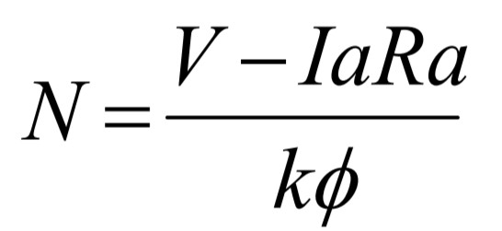
DC MOTOR SPEED CONTROL
The DC motors have been popular in the industry control area for a long time, because they have many good characteristics, for example: high start torque characteristic, high response performance, easier to be linear control…etc.
The speed of a DC motor is given be the relationship
This Equation show that the speed is dependent on the supply voltage V, the armature circuit resistance Ra, and field flux Ф, which is produced by the field current. We can control the speed of DC motor using PID controller .For Observing this in MATLAB ,we need to find mathematical modelling of DC motor.

Slide 4
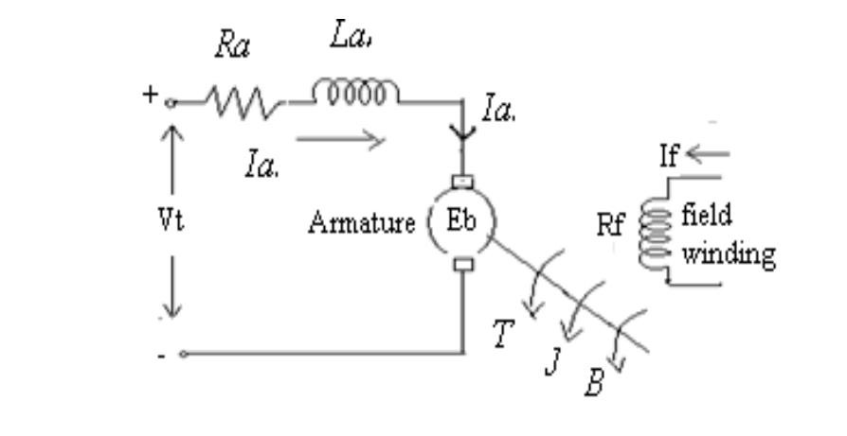
MATHEMATICAL MODEL OF DC MOTOR
The electric circuit of the armature and the free body diagram of the rotor are shown in the following fig:
La=Armature self inductance caused by armature flux,
Ia= Armature current,
If= field current,
Ra=Armature Resistance,
Eb=Back EMF in armature,
V =Applied voltage,
T=Torque developed by the motor,
θ = Angular displacement of the motor shaft,
Ј =Equivalent moment of inertia of motor shaft & load referred to the motor,
B= Equivalent Coefficient of friction of motor shaft & load referred to the motor.

Slide 5
The DC motors are generally used in the linear range of the magnetization curve. Therefore,
air gap flux Ф is proportional of the field current i.e.
Φ = Kf.If.........................(1)
The torque T developed by motor is proportional to the armature current and air gap flux T = KIa..............................(2)
The motor back emf being proportional to speed is given as
Eb= Kbw.............................(3)
Applying KVL in the armature circuit
Va = IaRa + L .dIa/dt + Eb...................(4)
And the dynamic equation with moment of inertia & coefficient of friction will be T= J.dw/dt + Bw + TL …...........................(5)
Where TL= load torque

Slide 6
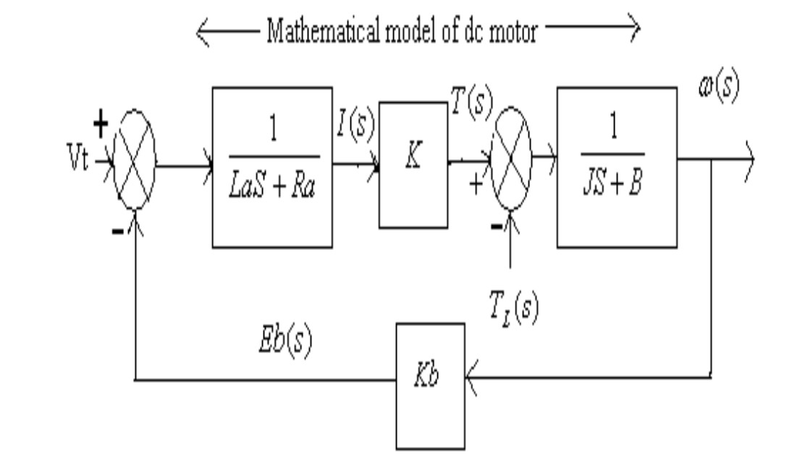
Taking the laplace transform of equation 2,3,4,5 T(s) = KIa(s)…..........(6)
Eb(s) = Kb.W(s)…...........(7)
Va(s)-Eb(s) = Ia(s) (Ra + sLa)…............(8)
T(s)-TL(s)=(Js+B) W(s)…....................(9)

Slide 7
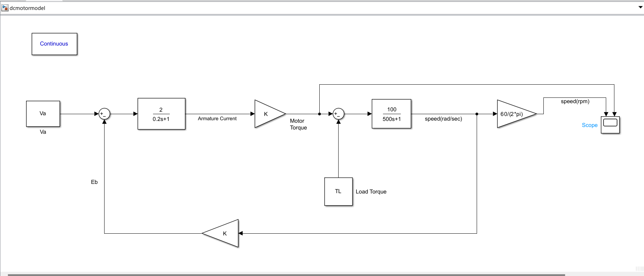
MATLAB MODELLING OF DC MOTOR

Slide 8
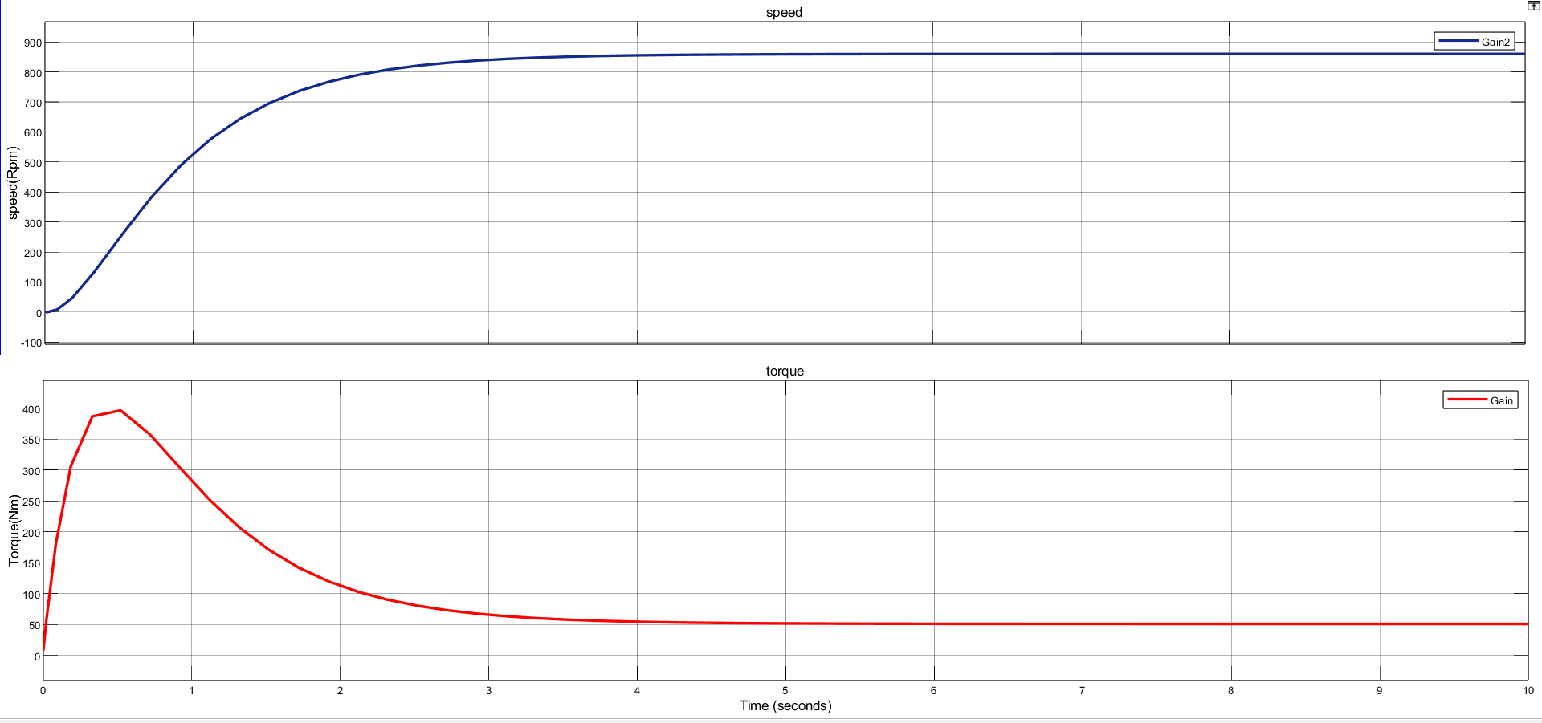
Dc motor characteristics

Slide 9
PID CONTROLLER
A proportional-integral-derivative (PID) controller is a control mechanism that is widely used in various industrial applications. The controller's purpose is to regulate a system's output by adjusting its input, taking in to account the system's error, rate of change, and accumulated error. The PID controller has become the standard for process control applications in various industries, including manufacturing, chemical, automotive, and aerospace.
A PID controller is a feedback control system that continuously measures the system's output and compares it to the desired output. The difference between the two is known as the error signal. The controller uses the error signal to adjust the system's input to bring the output closer to the desired output.
The controller's input is adjusted by adding or subtracting a correction factor, which is determined by three terms:
1. Proportional term (P): This term is proportional to the error signal and represents the immediate response of the controller. The proportional term is multiplied by a gain factor, which determines the controller's sensitivity to the error signal.

Slide 10
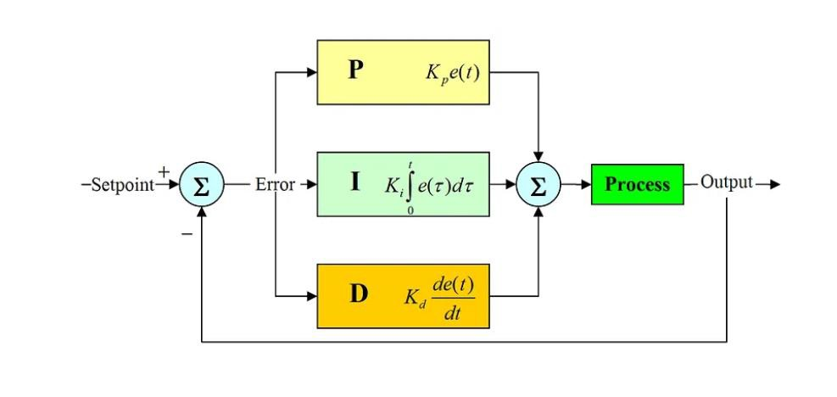
2. Integral term (I): This term is proportional to the accumulated error over time and represents the steady-state response of the controller. The integral term is multiplied by a gain factor, which determines the controller's responsiveness to the accumulated error.
3 . Derivative term (D): This term is proportional to the rate of change of the error signal and represents the controller's transient response. The derivative term is multiplied by a gain factor, which determines the controller's sensitivity to the rate of change of the error signal.

Slide 11
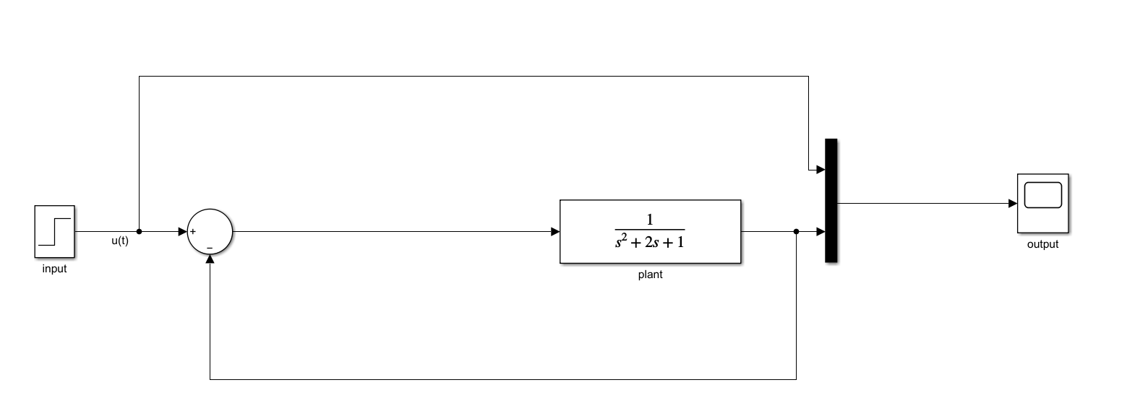
Plant without any controller

Slide 12
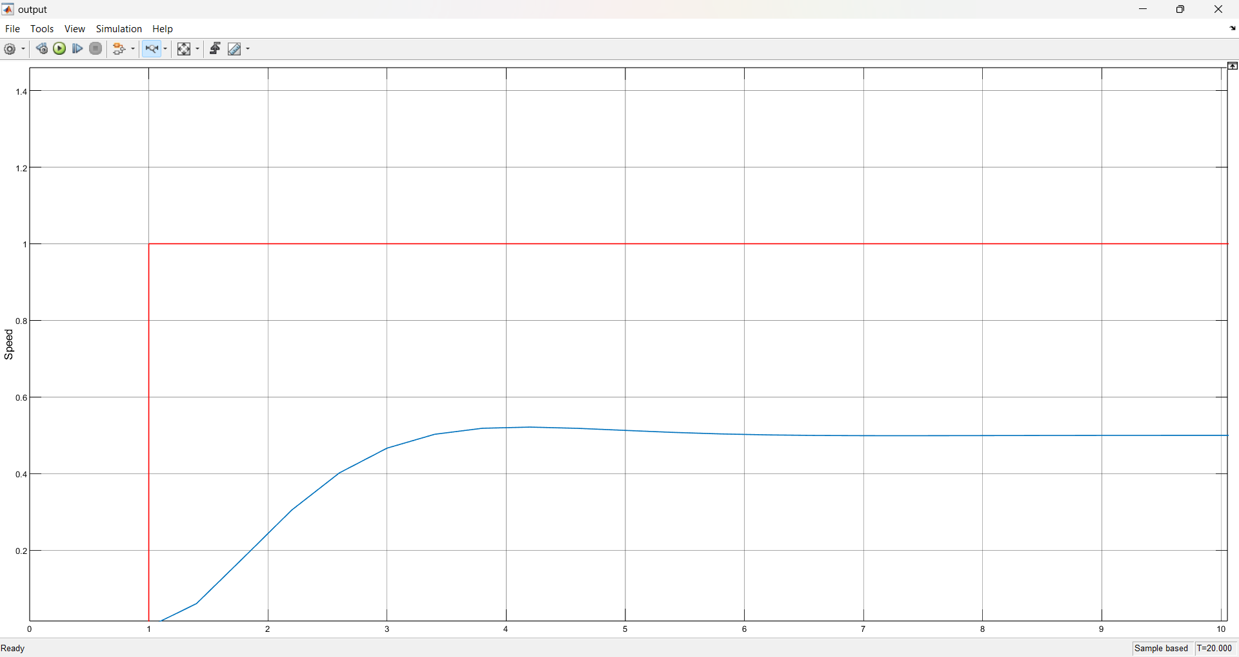
Y-axes represents speed in rpm (for all the following graphs)
X –axes represents time in sec (for all the following graphs)
: Reference speed
: actual response

Slide 13
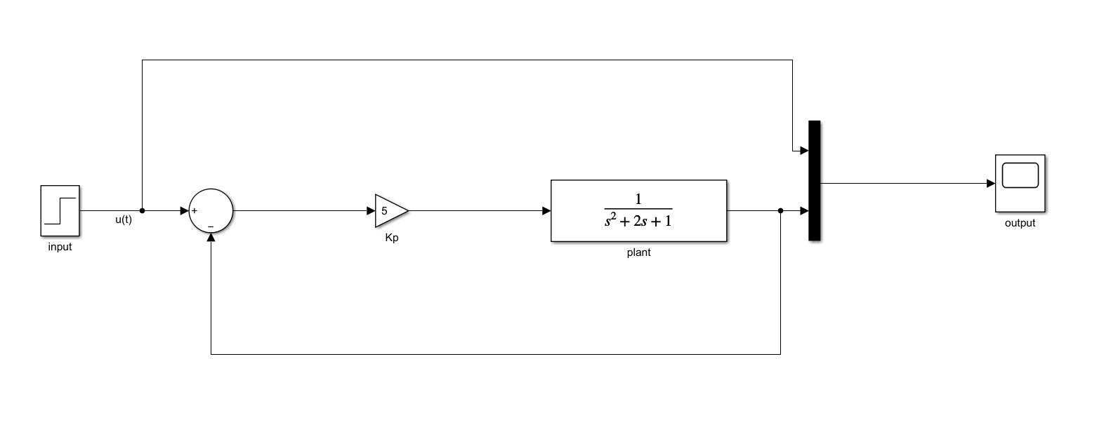
We can clearly see there is large error between reference and actual response. To reduce this response, PID controller is used. First, Proportional controller is provided to the plant to reduce the error.
Plant with proportional controller

Slide 14
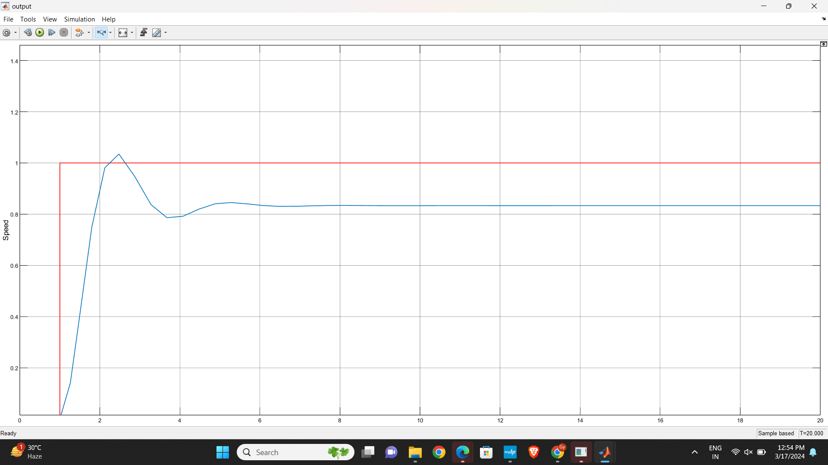
Proportional Controlled response of plant

Slide 15
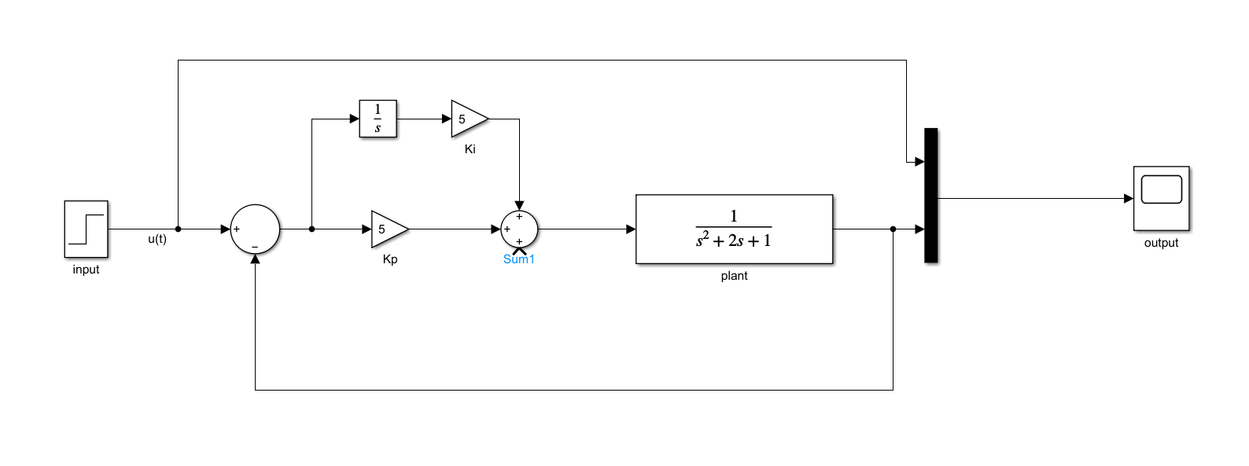
Plant with proportional and integral controller

Slide 16
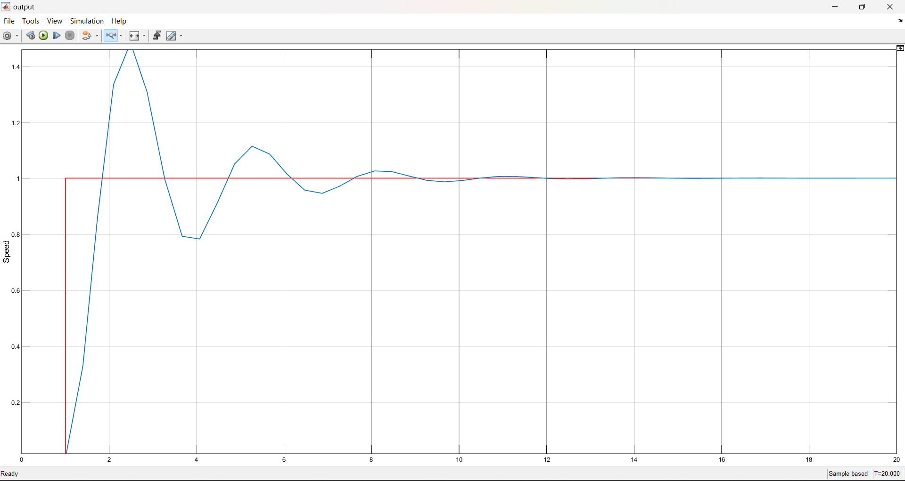
PI controlled response of plant

Slide 17
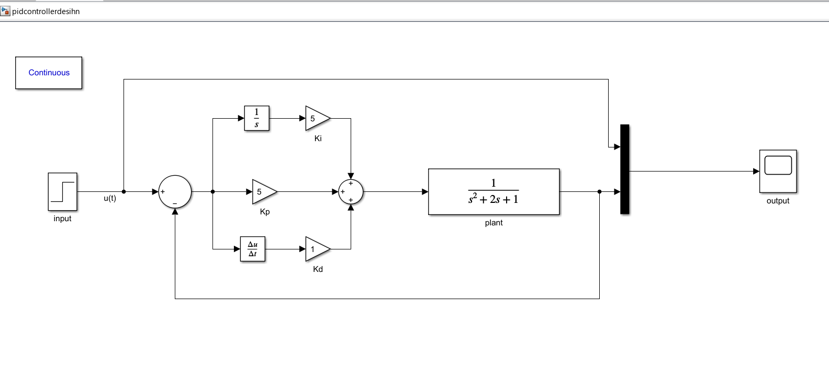
Plant with Proportional, Integral and Derivative controller

Slide 18
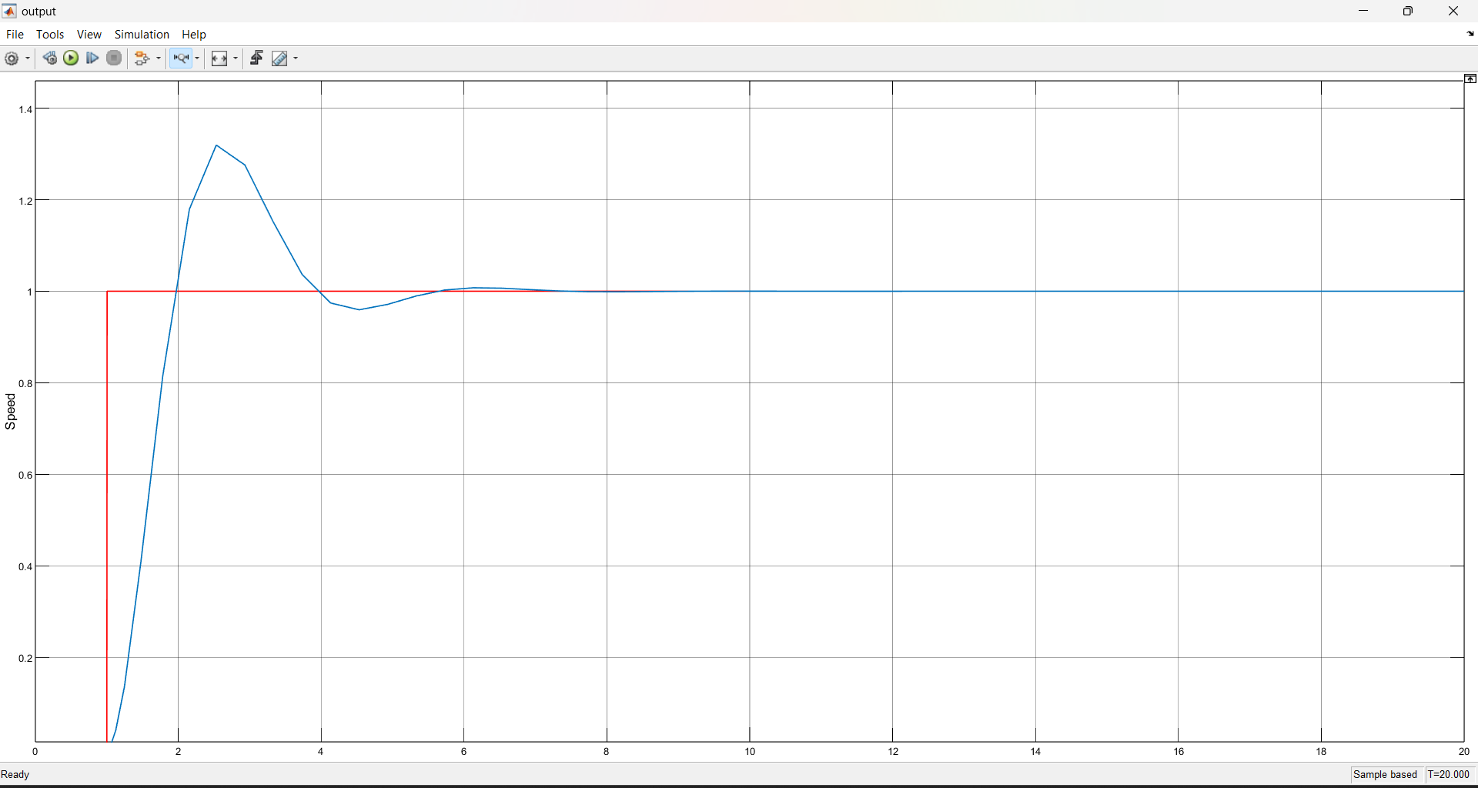
PID controlled response of Plant

Slide 19
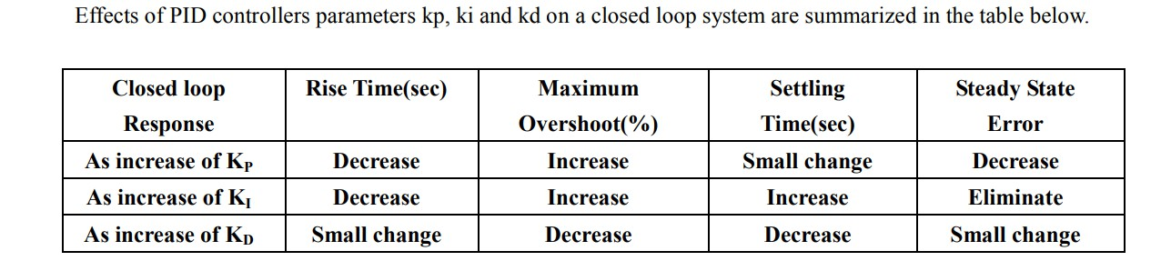
Summary of PID Controller
A proportional controller Kp will have the effect of reducing the rise time and reduce but never eliminate the steady state error.
An integral controller Ki will have the effect of eliminate the steady state error but it may make the transient response worse by increasing overshoot ,which further increases settling time.
A derivative controller Kd will have the effect of increasing the stability of the system and reducing the overshoot and improve the transient response.

Slide 20
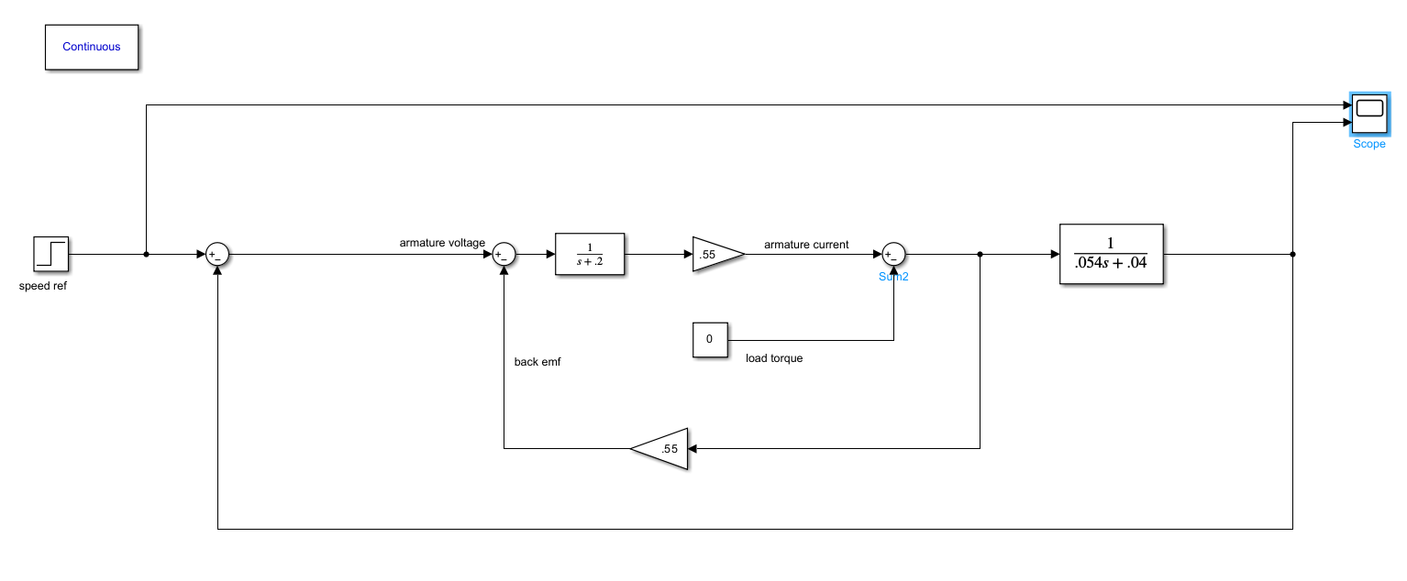
DC MOTOR SPEED CONTROL BY PID CONTROLLER
Simulink model of armature control dc motor

Slide 21
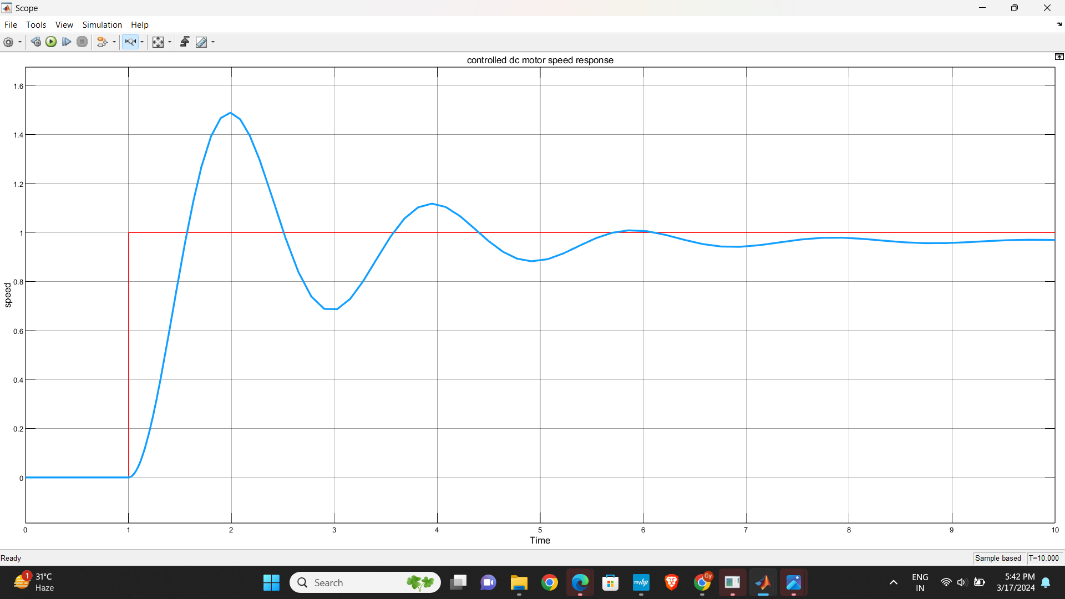
Uncontrolled DC motor speed response
: Reference speed
: Actual speed

Slide 22
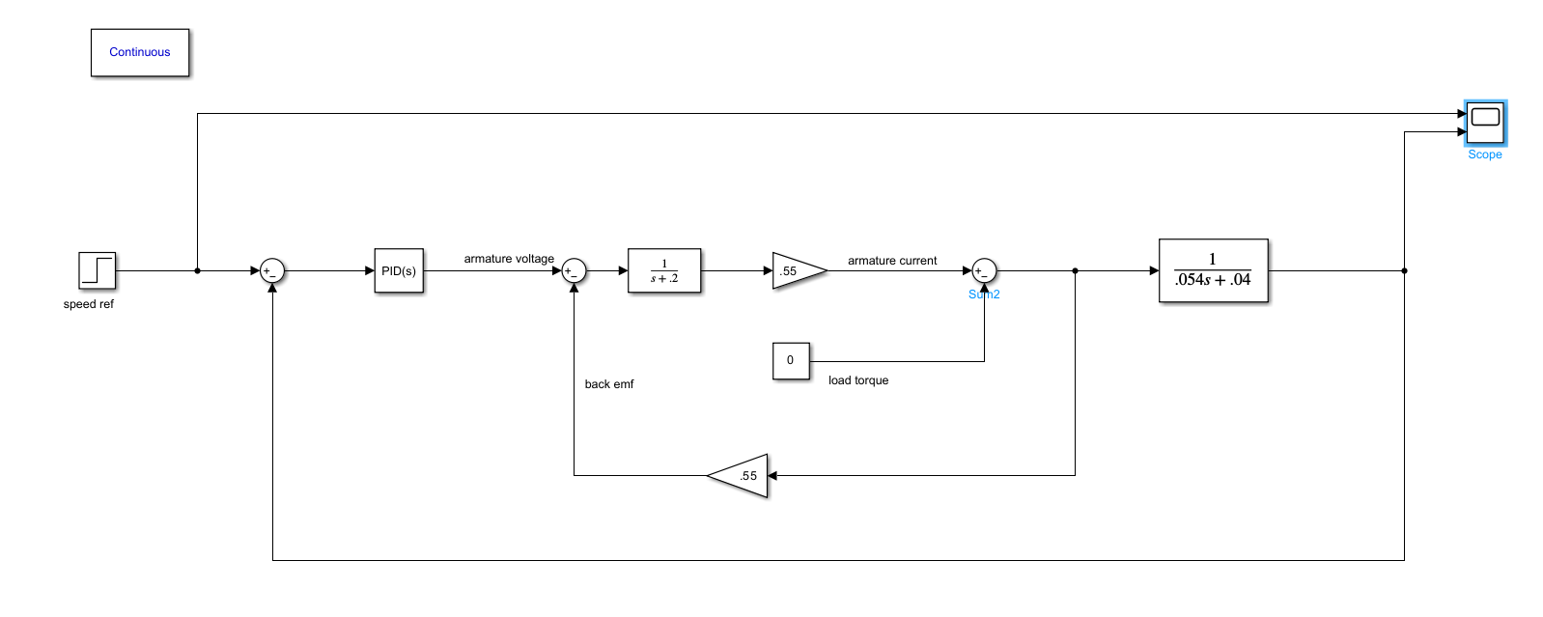
Block diagram of armature controlled DC motor with PID controller

Slide 23
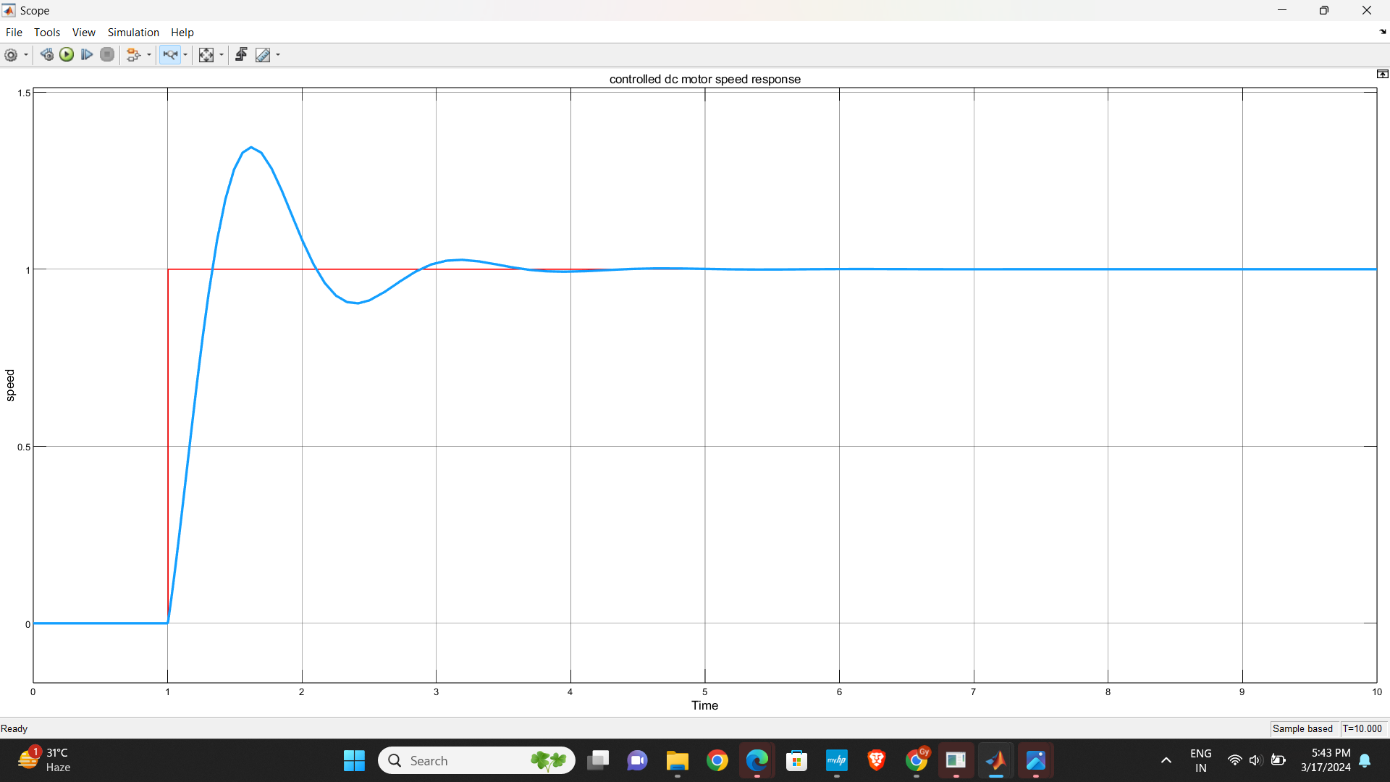
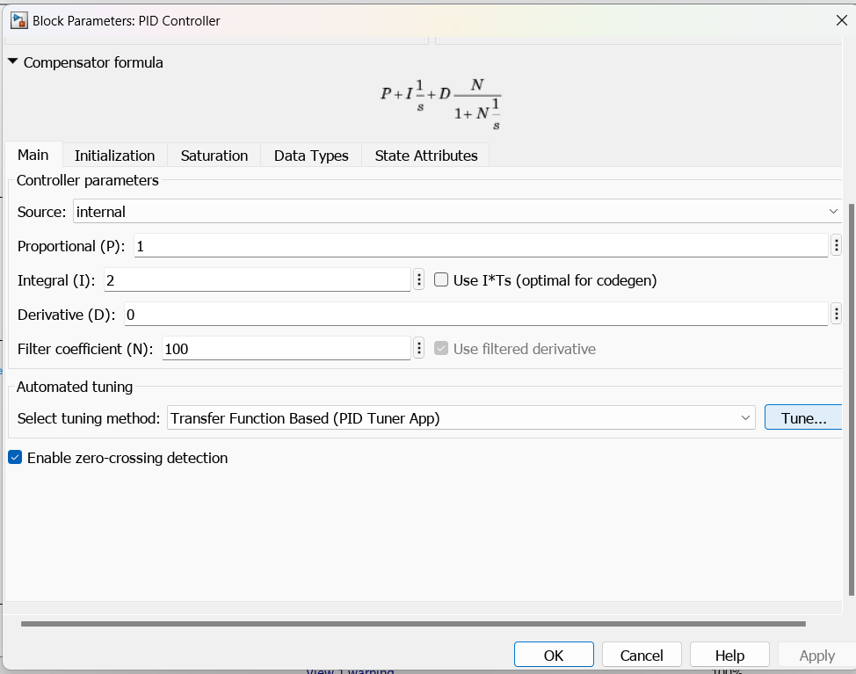
Controlled DC motor speed control.

Slide 24
The task of tuning is find the value of Ki, kp, and kd . If they are not
properly tuned, then the system can become unstable.
In power system, we commonly use the PID controller to bring
the frequency, voltage , and the other pararmeters to their original value.
PID TUNING
However, tuningof PID controller is very difficult most of the times, hit and trial method is used which is extremely time consuming.
MATLAB software in it's latest versions has provided the PID tuner . In this PID tuner, you just have to put the response of any model from simulink and it will automatically provide the tuned responsewithin fraction of seconds.

Slide 25
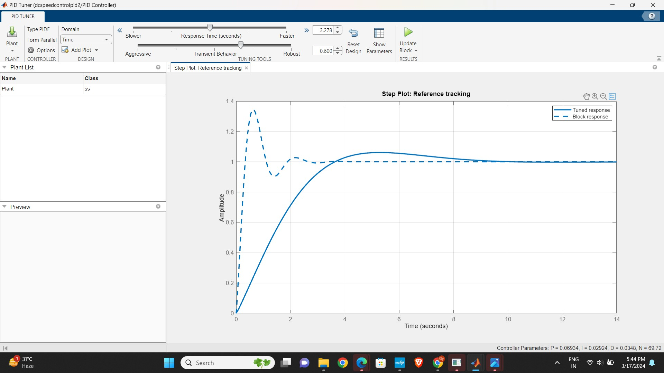

Slide 26

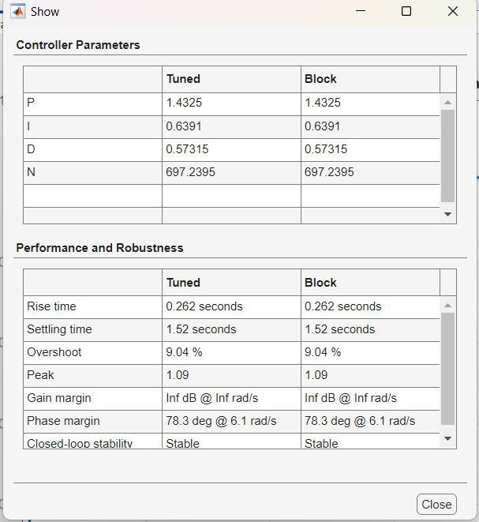

Slide 27
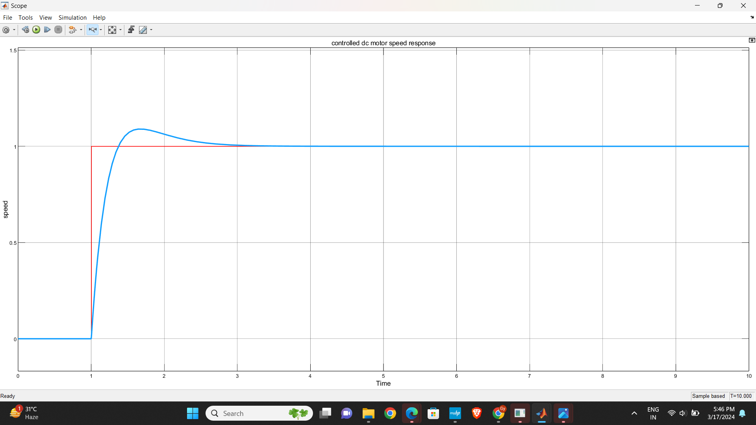
Response after PID tuning

Slide 28
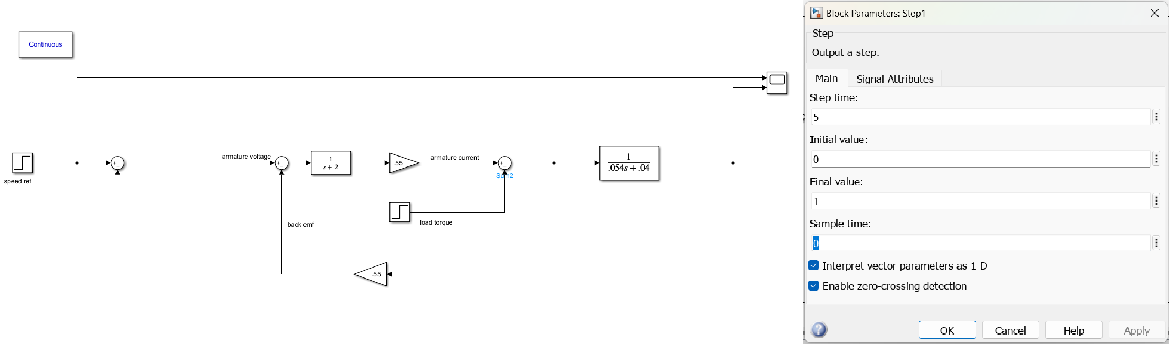
Response to Disturbances
First, we will see the response when load disturbance is provided to an uncontrolled system.

Slide 29
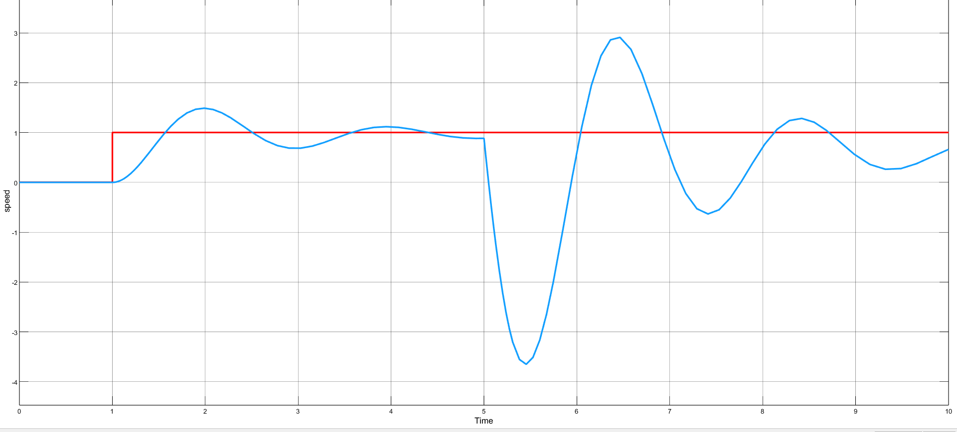
Uncontrolled speed response of DC motor under load disturbance.

Slide 30
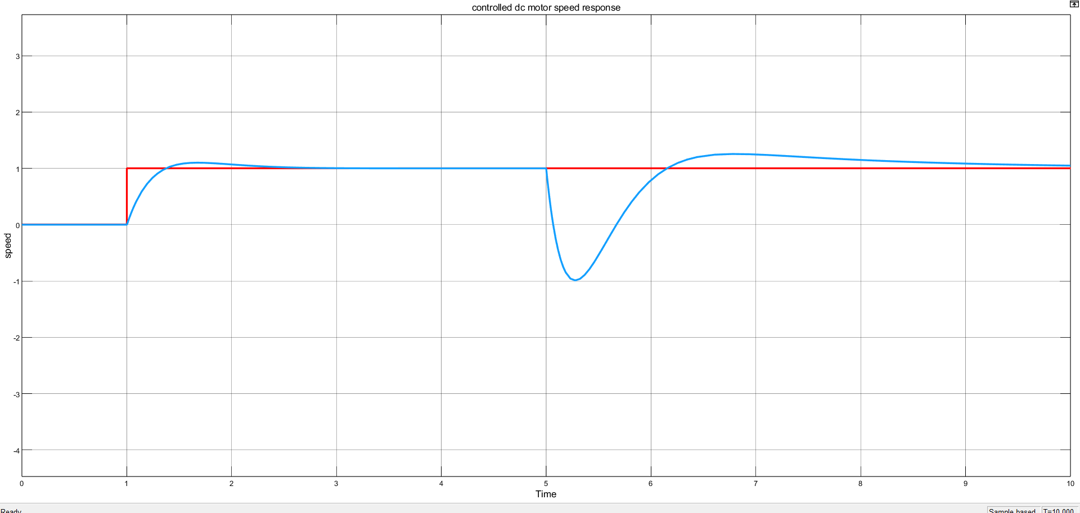
Tuned PID controlled speed response of DC motor under load disturbance

Slide 31
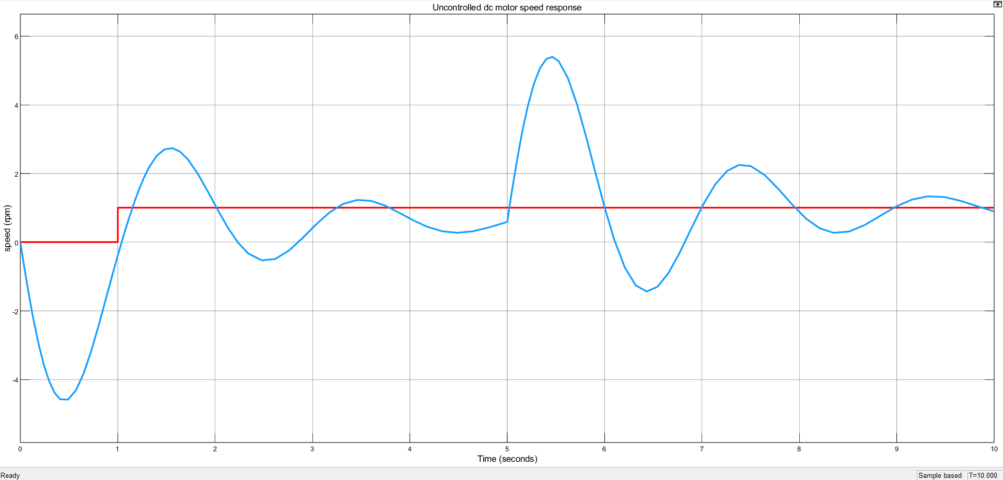
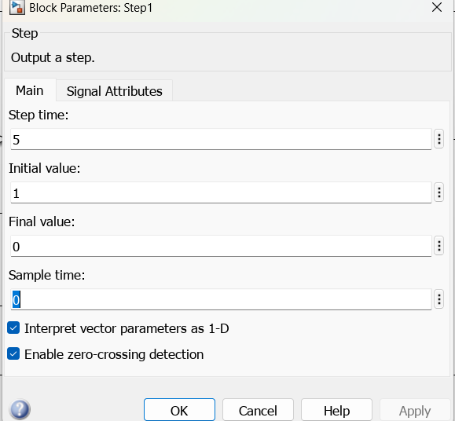
Uncontrolled DC motor speed response with Unloading condition

Slide 32
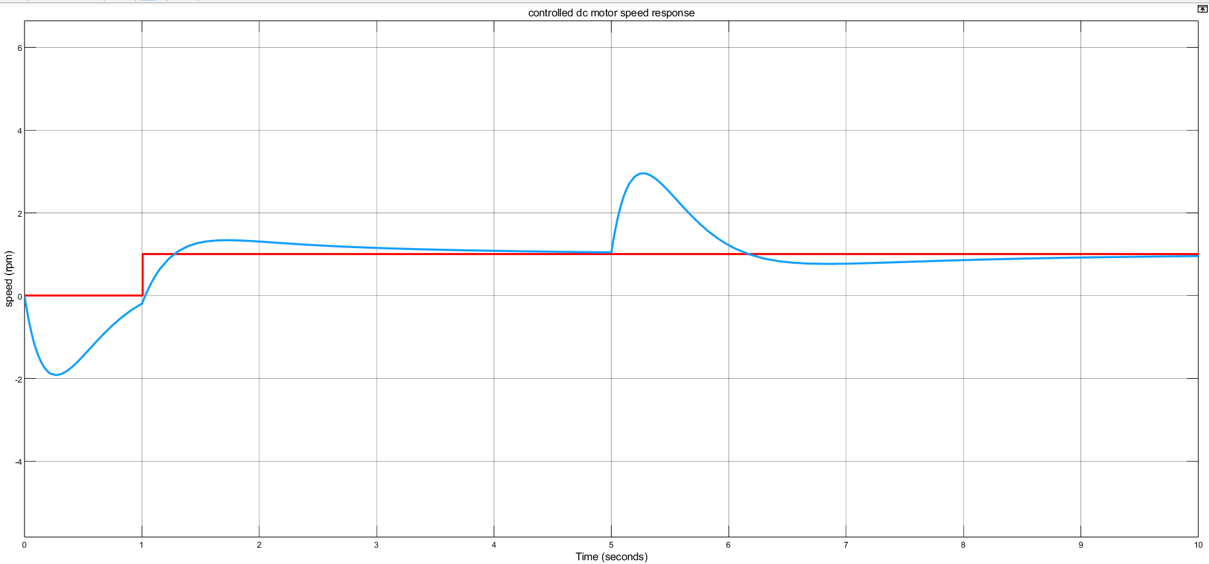
Tuned PID controlled DC motor speed response with Unloading condition.

Slide 33


Applications of PID Controller :
Temperature Control: PID controllers are widely used for temperature control in various industrial applications, such as chemical
processing, food processing, and HVAC systems. The controller measures the system's temperature and adjusts the input to maintain the desired temperature.
Motion Control: PID controllers are used for motion control applications, such as robotic systems, CNC machines, and motor control. The controller measures the system's position, velocity, or acceleration and adjusts the input to maintain the desired motion profile.
Process Control: PID controllers are widely used for process control applications, such as chemical processing, power generation, and manufacturing. The controller measures the process variables, such as flow rate, pressure, or level, and adjusts the input to maintain the desired process cond
Power Control: PID controllers are used for power control applications, such as voltage regulation, power factor correction, and motor control. The controller measures the system's power output and adjusts the input to maintain the desired power level.

Slide 34
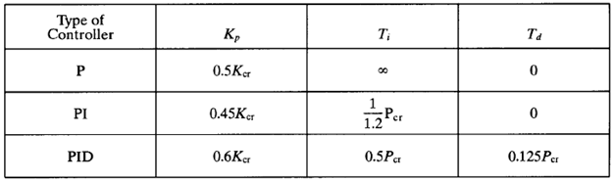
PID TUNING METHODS :
Zieglar-Nichols Method :
Find the value of Kp for which response is oscillating.
Then Kcr = Kp (Critical gain)
Find the time period of oscillations ie T.
The PID parameters are given by :
Kp = 0.6Kcr
Ki = Kp/0.5T
Kd = 0.125*T*Kp

Slide 35
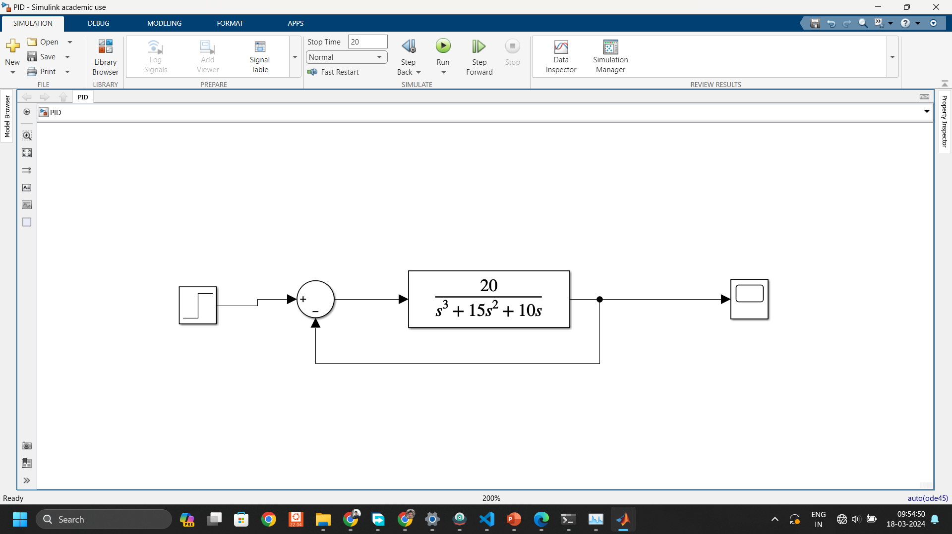
MOTOR WITHOUT GAIN OR PID

Slide 36
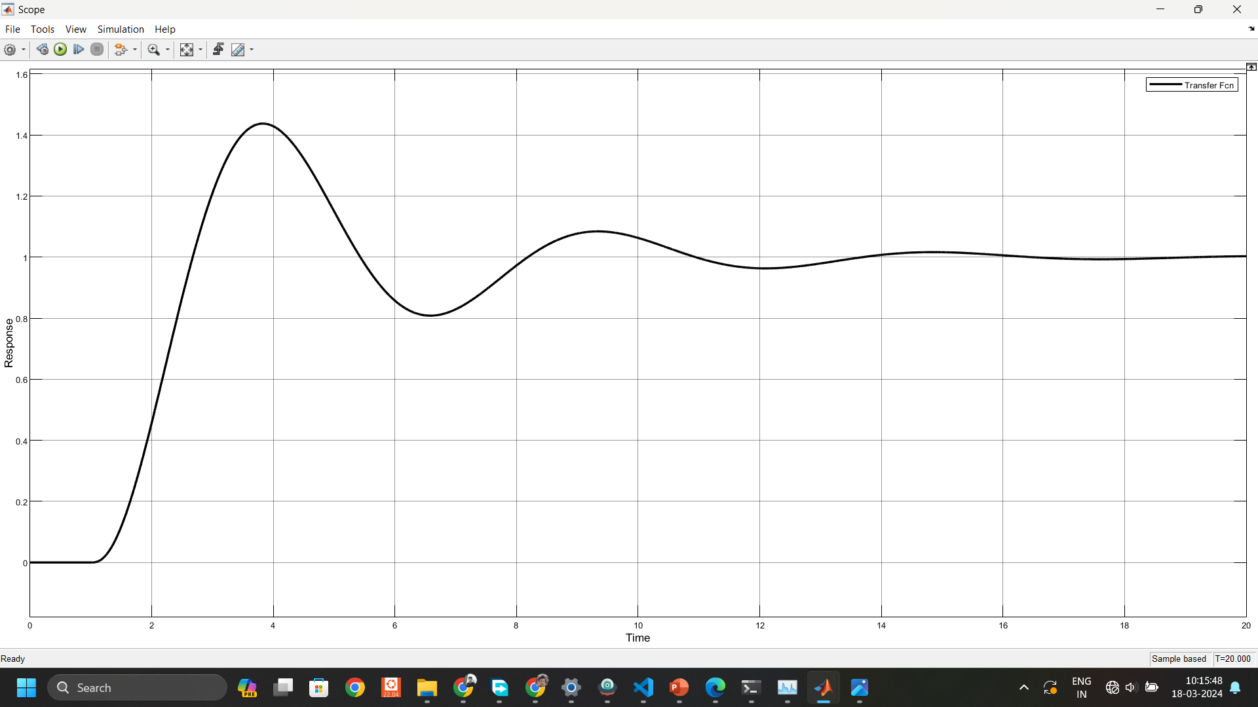
RESPONSE WITHOUT GAIN OR PID

Slide 37
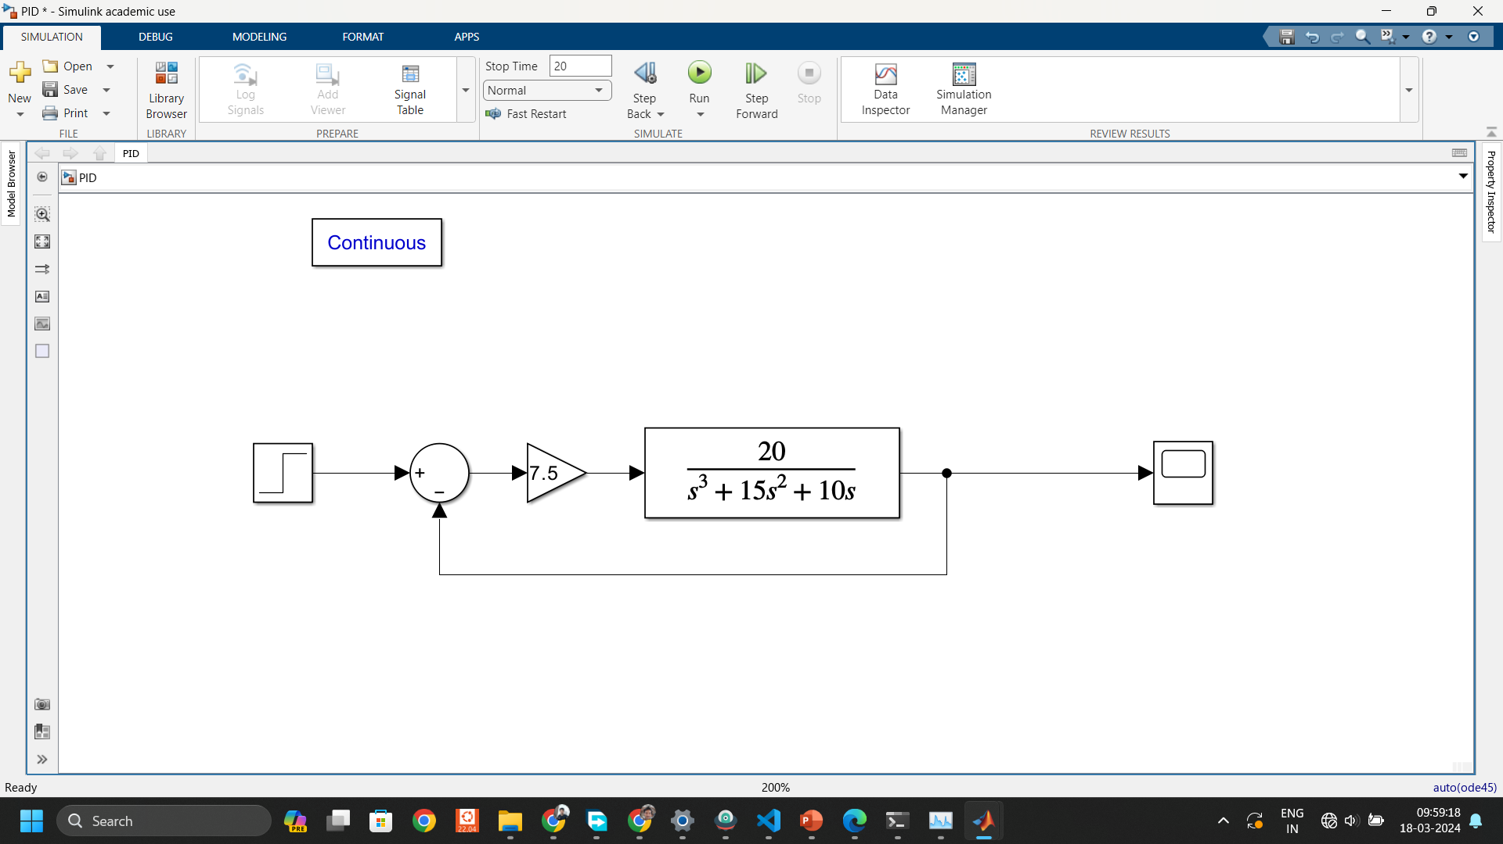
MOTOR WITH GAIN (Kp = Kcr)

Slide 38
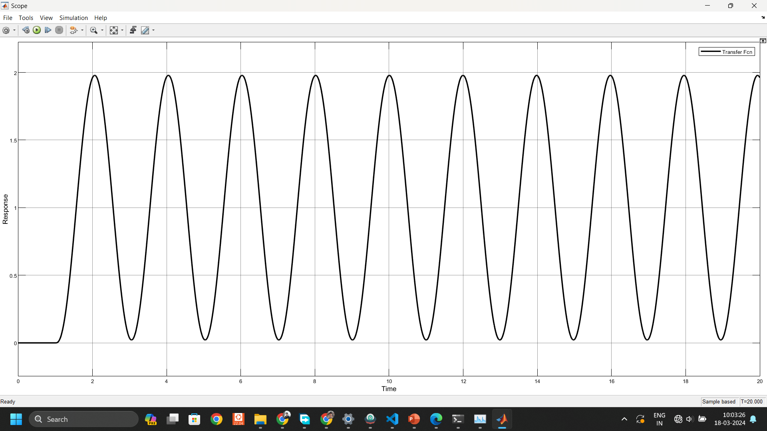
RESPONSE WITH GAIN= Kcr

Slide 39
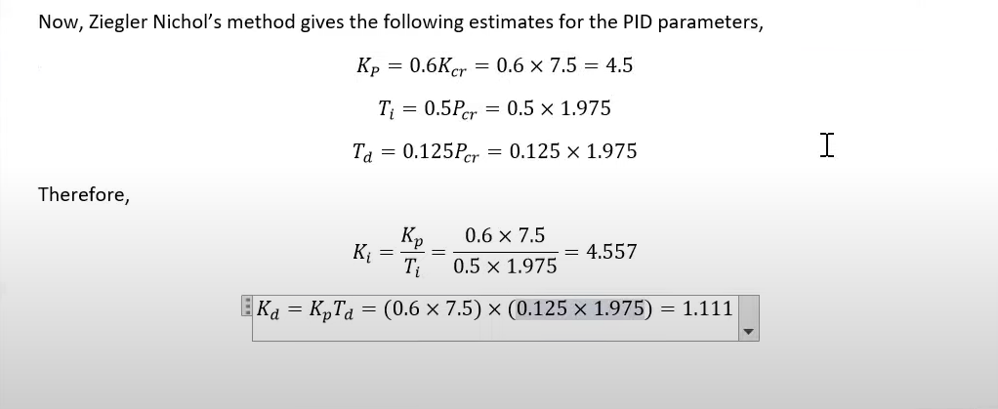
PARAMETERS CALCULATION
From the graph the time period T = 1.975

Slide 40
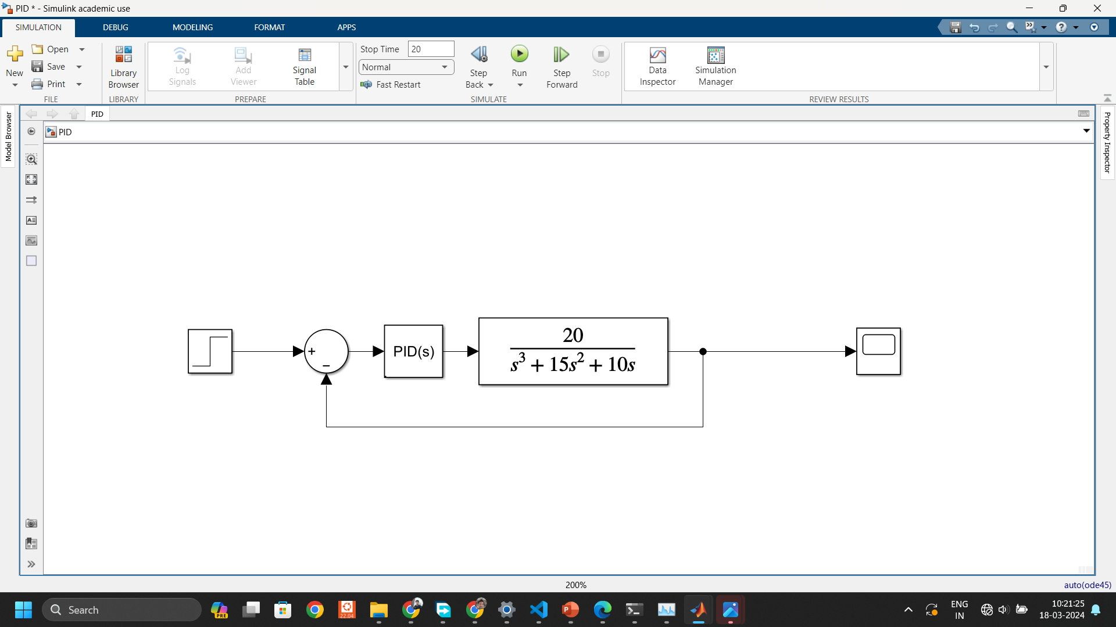
MOTOR WITH PID CONTROLLER

Slide 41
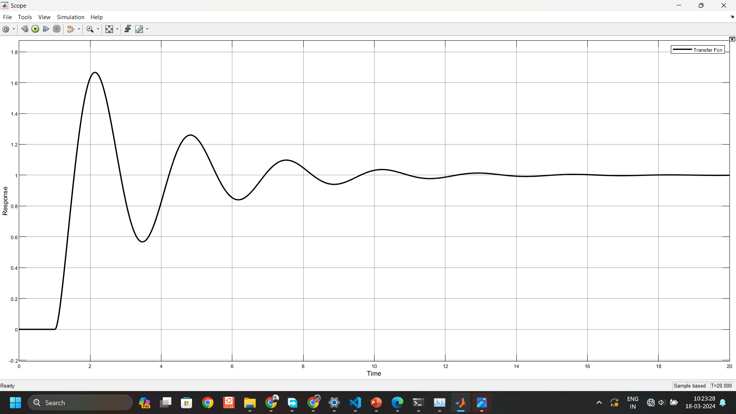
RESPONSE WITH TUNED PID

Slide 42

CONCLUSION
The Ziegler-Nichols Method is one of the best known tuning methods, that is based an open loop step-response function of time.
The Ziegler Nicholas method gives 10% to 60% overshoot and can be used when dealing with non-complex dynamic systems.
Based on the applications of the DC motor, the controller should be chosen and appropriately tuned using this method.

Slide 43




THANK YOU

