Slide 1
Tomato Leaf Disease Detection
PGDS AIML CAPSTONE · OCTOBER 2026
A model that checks tomato leaf photos for 9 diseases, with a Streamlit app to try it
Problem: checking leaves by eye is slow and needs an expert, who isn't always around. Farmers need a quick first check.
Gyanesh Apte
Individual project
Notes:
Introduce the project. The problem: farmers and farm advisors need a fast first check of tomato leaf diseases. Checking by eye is slow and needs an expert. Goal: a model that takes a leaf photo, names the most likely disease, shows how confident it is, and explains the result in plain words. It is a first check, not a diagnosis.

Slide 2
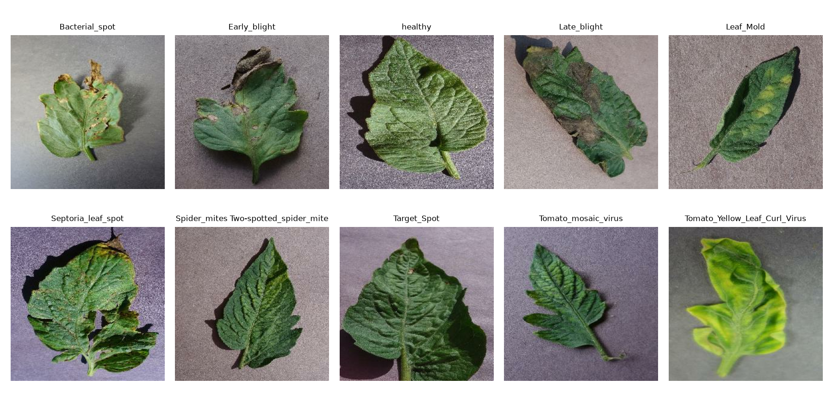

Dataset: PlantVillage, tomato leaves
54,303
18,159
images, 38 classes, 14 crops
tomato images, 10 classes
Split | Images | Share
Train | 14,522 | 80%
Validation | 1,812 | 10%
Test | 1,825 | 10%
Total | 18,159 | 100%
One image per class. All lab photos: one leaf, plain background
Loaded with tfds.load('plant_village'), kept the 10 tomato classes, split each class 80/10/10 (seed 42).
2 · Source: TensorFlow Datasets, plant_village v1.0.2
Notes:
Data comes from TensorFlow Datasets, as the brief asks. The full PlantVillage set has 54,303 images in 38 classes across 14 crops. I kept only tomato: 10 classes, 9 diseases plus healthy, 18,159 images. Tomato only means the model has to learn disease features, not just tell crops apart. I split each class 80/10/10 separately with seed 42, so every split has the same disease mix: 14,522 train, 1,812 validation, 1,825 test, which adds back to 18,159. I did not use the train[:80%] slice syntax because it cuts by position before the tomato filter, so the splits would not be balanced by class.

Slide 3
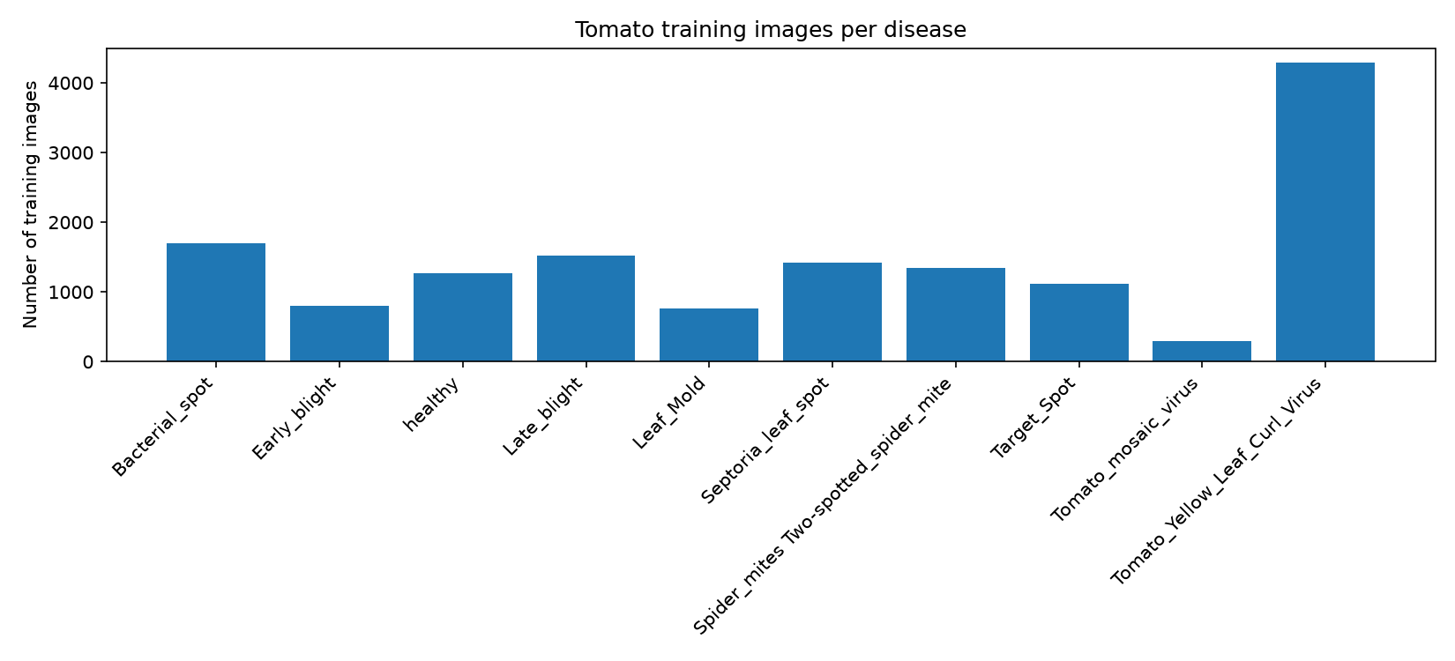
EDA and preprocessing
Classes are unbalanced (14x)
Accuracy can look good while small classes do badly, so I also check macro-F1 and per-class recall.
Data checks
All images are 256x256, colour. Found 14 duplicate pairs (same label). 4 ended up in both train and val, none in test.
Train images per class. Yellow leaf curl has 4,285, mosaic virus only 298
Preprocessing
Resized to 224x224, pixels scaled the way each model needs. Only train images get flipped, rotated, zoomed and contrast-changed.
3 · Notebooks 00 and 01
Notes:
Biggest class has 4,285 training images, smallest has 298, about 14 times fewer. That is why I do not rely on accuracy alone. Data checks: every image is 256 by 256 with 3 colour channels, pixels 0 to 255. A pixel-level hash check found 14 exact duplicate pairs in the source data, all with the same label. 4 pairs fall across train and validation, none in test, so the test set is clean. I kept them because the effect on validation is about 0.2 percent. Preprocessing: resize to 224 for the pretrained models, normalise per model, and augment only the training images so the model sees leaves at different angles and positions.

Slide 4
Models I trained
Baseline CNN
MobileNetV2
ResNet50
Trained from scratch
ImageNet weights, 8.7 MB
ImageNet weights, 90 MB
23.9M
1.85M
20.5K
trainable parameters
trainable when fine-tuned (12.8K when frozen)
trainable parameters
2 conv layers, Flatten, Dense
No augmentation on purpose
Used as the starting point
Only the last layer trained
Needs its own pixel prep
Not fine-tuned
Stage 1: base frozen
Then unfroze layers 100 to 153
BatchNorm kept frozen
Both transfer models end the same way: average pooling, dropout 0.2, then 10 outputs. Everything uses 224x224 images, batch 32, Adam and seed 42.
4 · Notebooks 02 and 03
Notes:
The baseline is a small CNN trained from scratch. Most of its 23.9 million parameters sit in the dense layer after Flatten. It has no augmentation on purpose, so it is a clean reference point. MobileNetV2 and ResNet50 start from ImageNet weights. With the base frozen, only the new last layer trains: 12.8 thousand parameters for MobileNetV2, 20.5 thousand for ResNet50. For MobileNetV2 I then fine-tuned layers 100 to 153, which makes 1.85 million parameters trainable, at a learning rate of 0.00001. BatchNorm stays frozen, because unfreezing it broke training. ResNet50 was not fine-tuned: fine-tuned MobileNetV2 was already better on validation and 10 times smaller, and fine-tuning is optional in the brief.

Slide 5
What I tried and what I kept
What I tried | Val result | So I
Baseline at LR 0.001 | Loss exploded, over 300 | used LR 0.0001
No fixed seed, two runs | 72% on one, 82% on the other | fixed seed 42
Added EarlyStopping, ReduceLROnPlateau | 88.5% went up to 90.2% | used them everywhere
BatchNorm unfrozen in fine-tuning | Train accuracy dropped to 75% | froze BatchNorm
Augmentation, MobileNetV2 fine-tuned | Same 96.5%, less overfitting | kept it
Augmentation, ResNet50 frozen | Dropped from 98.0% to 95.5% | kept it, noted the drop
Batch 32, Adam and 224x224 stayed the same throughout. One catch: the runs with and without augmentation also differ in callbacks, so the gaps aren't from augmentation alone. All 11 runs are in notebook 03.
5 · Experiment log, notebook 03
Notes:
Each row is a decision I made from the validation set. The default learning rate made the baseline loss explode, so I used 0.0001. Two runs without a seed gave 72 and 82 percent, so I fixed the seed at 42 to make results repeatable. Early stopping and learning-rate reduction lifted the baseline from 88.5 to 90.2 percent and are used for every model. My first fine-tuning run without frozen BatchNorm broke: training accuracy fell to 75 percent, so BatchNorm stays frozen. Augmentation: for fine-tuned MobileNetV2 accuracy stayed at 96.5 percent and overfitting went down. For frozen ResNet50 it dropped from 98 to 95.5 percent on lab-style validation images. I kept augmentation because real photos vary more than lab photos. Honest caveat: those runs also differ in callbacks, so it is not a clean one-change comparison.

Slide 6
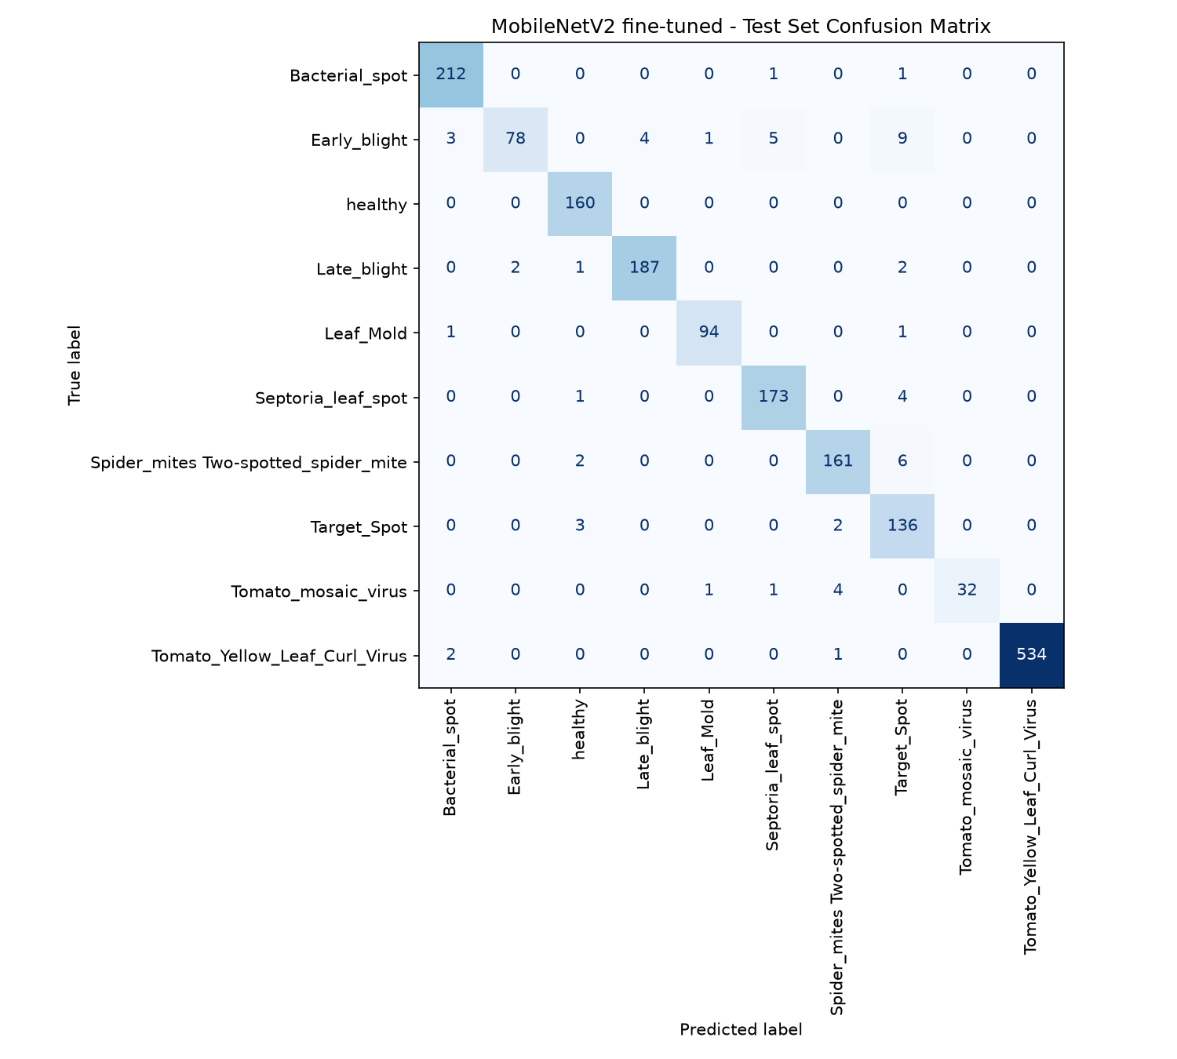
Test results and where it goes wrong
Model | Accuracy | Macro-F1 | Top-3 | ms/image
Baseline CNN | 90.2% | 0.867 | 98.5% | 23.8
MobileNetV2 frozen | 91.5% | 0.882 | 99.0% | 36.9
MobileNetV2 fine-tuned | 96.8% | 0.952 | 99.7% | 36.6
ResNet50 frozen | 96.7% | 0.958 | 99.7% | 36.2
Where MobileNetV2 fine-tuned gets it wrong
Early blight: only 78 of 100 found, 9 of the misses called Target spot
Called 7 of 1,665 sick leaves healthy (ResNet50 did this 13 times)
Test and val scores are within about 1 point for every model
6 · Test set: 1,825 images, not used for training or for picking models · Notebook 04
Notes:
The test set was used only here, never to choose a model. Fine-tuned MobileNetV2 and frozen ResNet50 are basically tied: 96.8 vs 96.7 percent accuracy, which is about 3 images. ResNet50 has slightly higher macro-F1, so it does a bit better on small classes. Top-3 accuracy is 99.7 percent, so the right answer is almost always in the top 3, which is why the app shows three. The weakest class is Early blight, 78 of 100 found, mostly confused with Target spot because both show brown ringed spots. The most dangerous mistake is calling a sick leaf healthy: MobileNetV2 does that 7 times out of 1,665 diseased leaves, ResNet50 13 times. That plus its size, 8.7 MB vs 90 MB, is why the app uses MobileNetV2. Latency is about the same for both, so size is the reason, not speed.

Slide 7

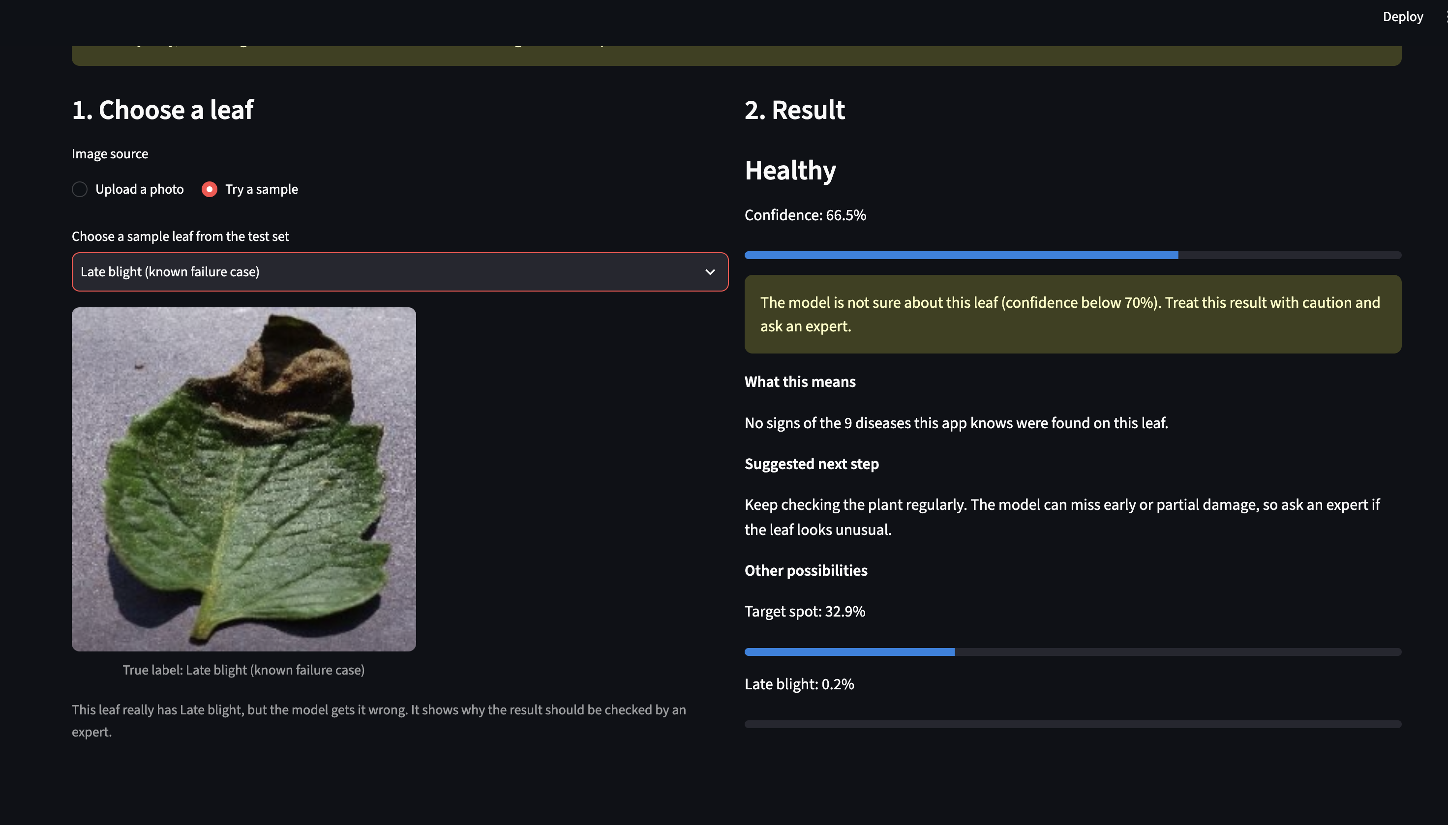
The app and how it predicts
Upload a photo or pick a sample
Resize to 224x224
MobileNetV2, 8.7 MB
10 class probabilities
Top 3, confidence and what to do
Warning if under 70% sure
Picked on the val set: under 70% the model was right only 61.9% of the time (84 images), above it 98.2%.
Live demo
3 samples it gets right, then one it gets wrong: a Late blight leaf it calls Healthy at 66.5%. The warning shows up.
7 · app/app.py · Warning level chosen in notebook 05
Notes:
Switch to the live app here. Walk through the flow: a user uploads a leaf photo or picks a test sample, the image is resized to 224 by 224, MobileNetV2 gives a probability for each of the 10 classes, and the app shows the top class, its confidence, the next two possibilities, and a plain-language explanation with a suggested next step. If confidence is below 70 percent it shows a warning. I picked 70 percent on the validation set, not test: below it the model is right only 61.9 percent of the time, above it 98.2 percent. Demo order: three correct samples, then the Late blight leaf the model calls Healthy at 66.5 percent. The warning appears, which shows why the app always says to confirm with an expert.

Slide 8
Limits and what's next
What it can't do
How it should be used
What I'd do next
Only seen lab photos. Not properly tested on field photos, and can be confidently wrong there
Tomato only. Any photo still gets one of the 10 labels
Weakest on Early blight, and called 7 sick leaves healthy
A first check, not a diagnosis
Shows how sure it is, warns under 70%, lists its limits
Always tells the user to check with an expert
Test on real field photos
Train on field photos, stronger augmentation
Fine-tune ResNet50
A phone app using TensorFlow Lite
Code and notebooks: github.com/gyanesh5522apte-web/plant-disease-detection
8 · Thank you
Notes:
The biggest limitation: every training and test image is a lab photo of one leaf on a plain background. Field photos with soil, other leaves and shadows were not formally evaluated, and the model can be wrong on them even with high confidence. The 70 percent warning was set on lab-style validation images, so it cannot catch those. It only knows tomato, so any other image is still forced into one of the 10 classes. Responsible use: the app is advisory only, it shows its confidence and limits, and always points to an expert, as the brief requires. Next steps: test and train on field photos, stronger augmentation, fine-tune ResNet50, and a TensorFlow Lite version of MobileNetV2 for an offline phone app, which is part of why I chose a small model.

