Slide 1
Applied Data Science Capstone
Gyan Prakash Singh

Slide 2
bACKGROUND
Using data to solve is a business problem is one of the things which makes data science useful.
Deciding the location of a new business venture is one of the crucial decisions which can have critical consequences for the future of a business.
However, the factors which affect the suitability of a location for a new business venture vary and as businesses have unique requirements to ensure success.

Slide 3
PROBLEM
Core problem is use of data science tools to find 3 candidate locations for setting up a fine dining restaurant in delhi.
Factors which may lead to higher footfall such as number of high quality fine dining restaurants in the locality, other landmarks bazaars, museums, art galleries, shopping centers, parking lots etc.
These factors need to be identified and explored to make a suitable model which may solve this problem.

Slide 4
Data sources
censusindia.gov.in
Foursquare
Google Maps

Slide 5
REsources
IBM Cloud: Watson Studio
Github
Overleaf

Slide 6
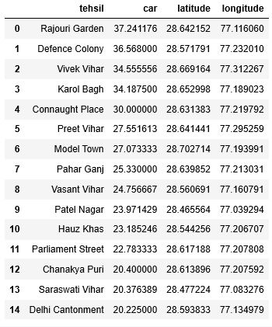
Data analysis

Slide 7
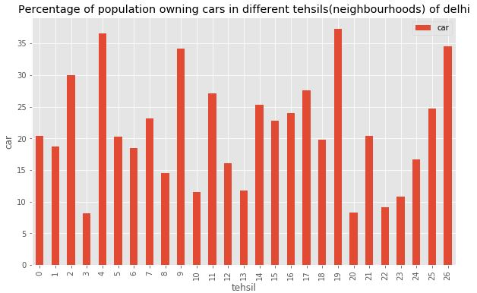
Data analysis

Slide 8
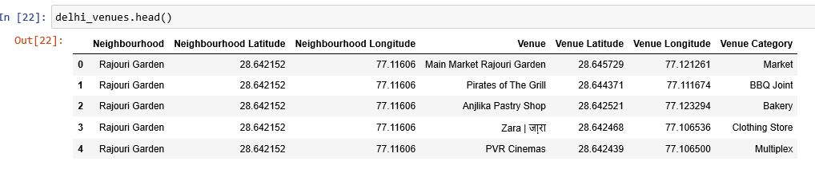
DATA ANALYSIS

Slide 9
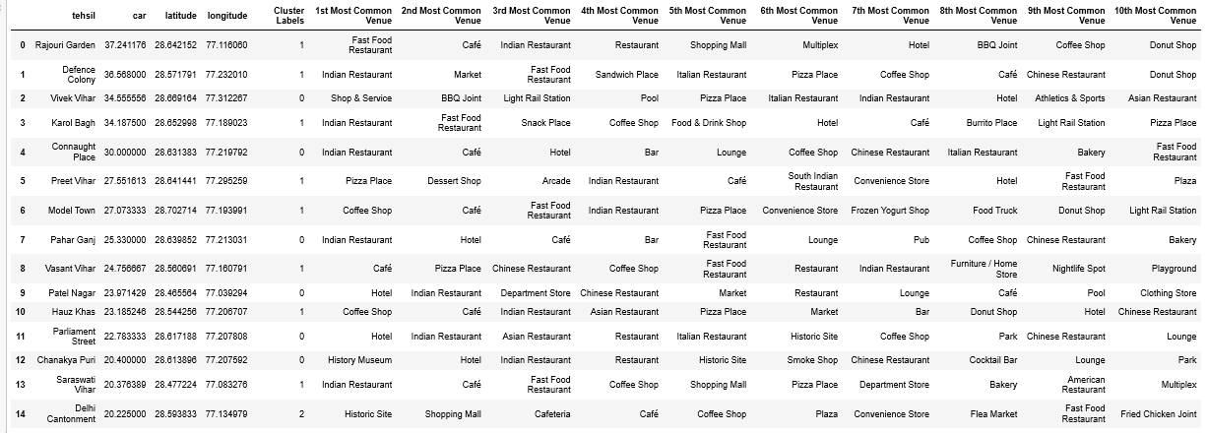
DATA ANALYSIS

Slide 10
RESULT/CONCLUSION
Three neighbourhoods in Delhi for establishing a fine dining restaurant
Connaught Place
Pahar Ganj
Defence Colony

