Slide 1
Employee Onboarding Application Technical Requirements and Implementation Steps
By Gyan Prakash

Slide 2
01
Project Overview
Table of Contents
02
Technical Stack Overview
03
Frontend Development with React.js
04
Database Design and Implementation
05
Backend Development with Express.js
06
Launch the Server.
07
Project summary

Slide 3
1
Project Overview
The Employee Onboarding Application is a comprehensive software solution designed to streamline the process of managing employee data within an organization. This project aims to provide a user-friendly interface for administrators to perform essential tasks related to employee management, such as authentication, employee search, and Employee Details
Technologies Used
Node.js: A JavaScript runtime environment that allows you to run JavaScript on the server side.
React.js: A JavaScript library for building user interfaces
Database: employees.txt (JSON format)
Backend Node.js with Express: A web application framework for Node.js, simplifying the process of building APIs and web applications.
Axios : Libraries used for making HTTP requests from the frontend to the backend API
CORS (Cross-Origin Resource Sharing): A mechanism that allows resources on a web page to be requested from another domain outside the domain from which the first resource was served

Slide 4
2
Technical Stack Overview
Details about the frontend technology: React.js. Explanation of the backend framework: Express.js Database selection: Txt file Chosen IDE for development: Visual Studio. Integration of the chosen technologies and their benefits.

Slide 5
3
Frontend Development with React.js
Setting up the development environment with React.js.
Using command npx create-react-app project name. Creating components for the user interface. Connecting frontend with backend services with the help of Axios.(Axios simplifies the process of sending asynchronous HTTP requests and handling responses by providing a simple and intuitive API.) Fetching and displaying data from the database. Implementing search functionality to display employee data.
Create login page : Use the React code provided earlier to create a simple login page.
A simple login page where users can log in with their ID and password.
Allows user authentication using ID and password.
Displays error messages for invalid login attempts.

Slide 6
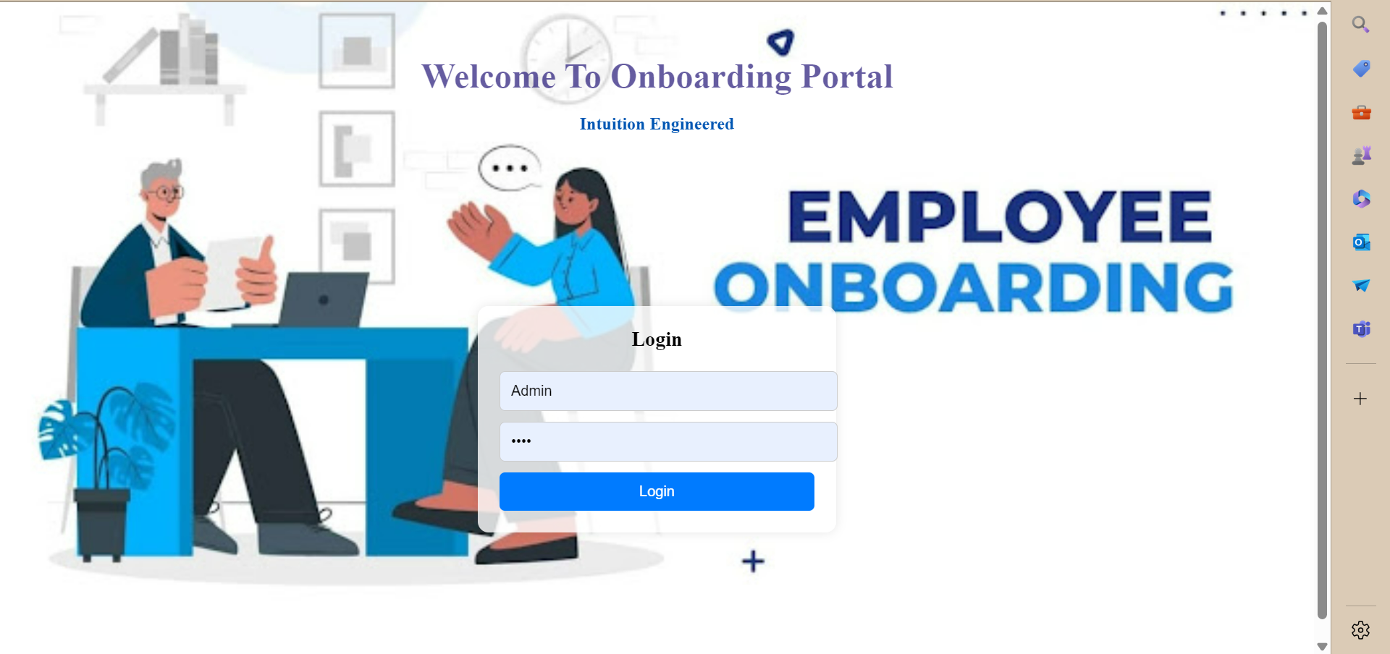

Slide 7
4
Employee search by year : The purpose of this is analyze the trends and outcomes of employee searches conducted year.
Total Searches: The number of employee searches conducted each year.
Success Rate: The percentage of searches that successfully resulted in a hire.
Time to Fill: The average number of days taken to fill a position.
Employee search by Id : we get employee all details when we put employee id and press search button.(Name, ID, Address, salary, Date of joining).
.

Slide 8
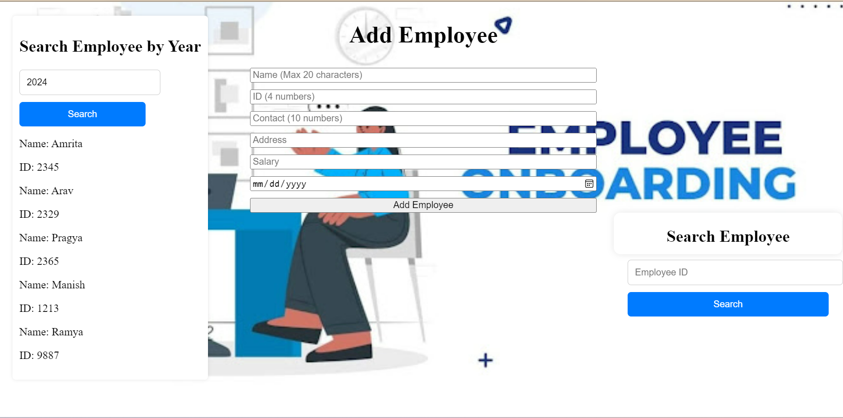

Slide 9
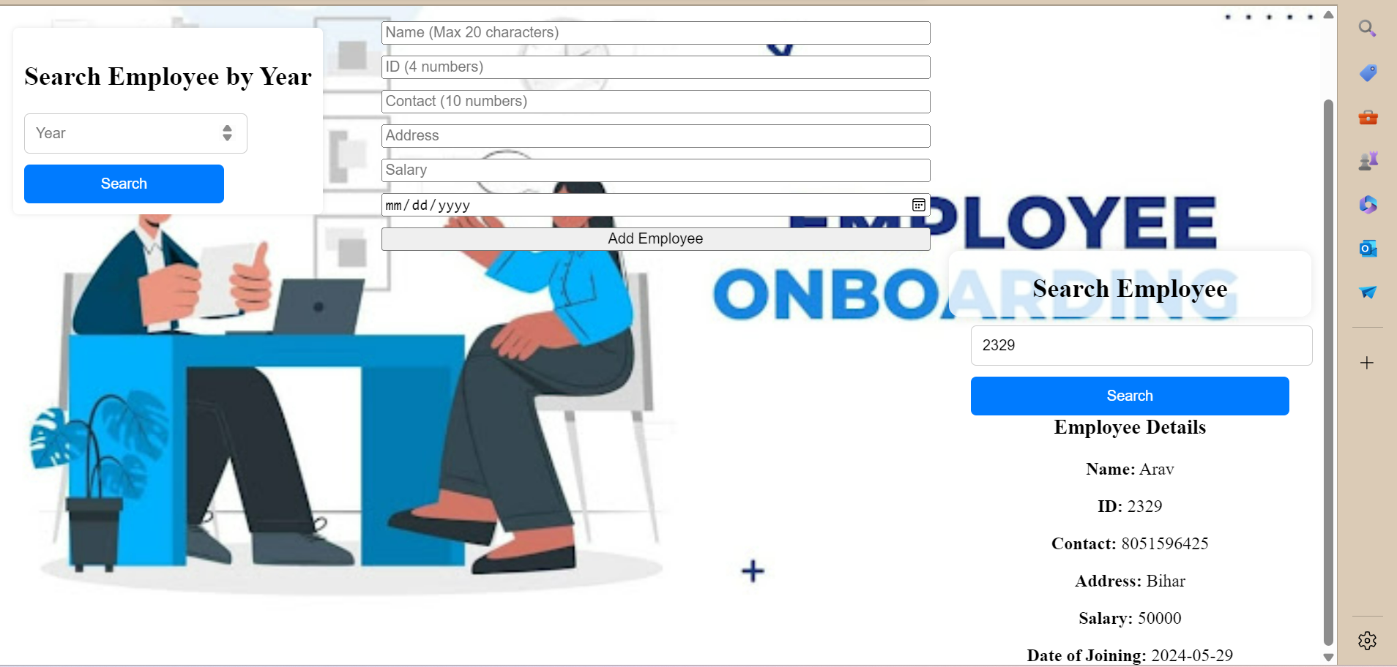

Slide 10
5
Add Employee details
In this page we insert employee of data , Data reflected in employee.txt files.
The add employee component allows users to input details of a new employee and add them to the database.
It contains input fields for the employee's name, ID, address, contact, and salary.
Users can submit the form by clicking the add button.
Error handling is implemented to display messages for any validation errors or server-side errors encountered during the addition of a new employee.
Employee details :
Employee Name
Employee Id
Employee Address
Employee contact
Employee salary
Employee d.o.j

Slide 11
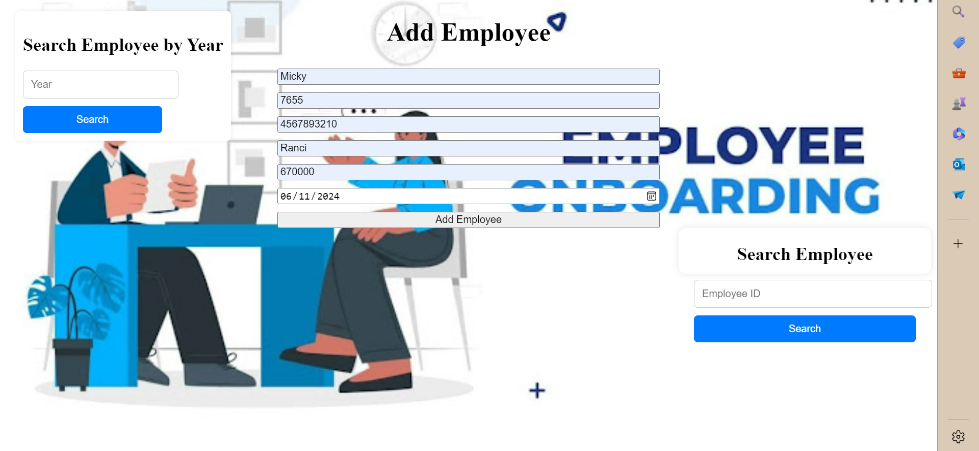

Slide 12
6
Employee Database (Employee.txt)
Overview: employees.txt serves as the database for employee records in the application.
Structure: Each line represents an employee record in JSON format
Fields: Includes name, ID, address, contact, and salary.
Accessing Data: Application reads/writes to employee.txt For Employee info
Advantages: Simple, portable, and flexible.
Considerations: Scalability and data integrity are key factors
The employees.txt file stores employee records in a text-based format, using JSON structure for each entry. It provides simplicity, flexibility, and portability for managing employee data. While efficient for small to medium-sized datasets, considerations for data integrity and scalability should be noted. Overall, employees.txt serves as a reliable solution for storing and accessing employee information within the Employee Management Application
Benefits:
Simplicity: The straightforward structure of employees.txt simplifies the process of storing and retrieving employee information, minimizing complexity and facilitating ease of use.
Flexibility: As a text-based file, employees.txt offers flexibility in terms of data manipulation and integration with other systems or applications.
Ease of Maintenance: Maintenance tasks such as data backup, restoration, and version control are simplified due to the file's inherent simplicity and accessibility.

Slide 13
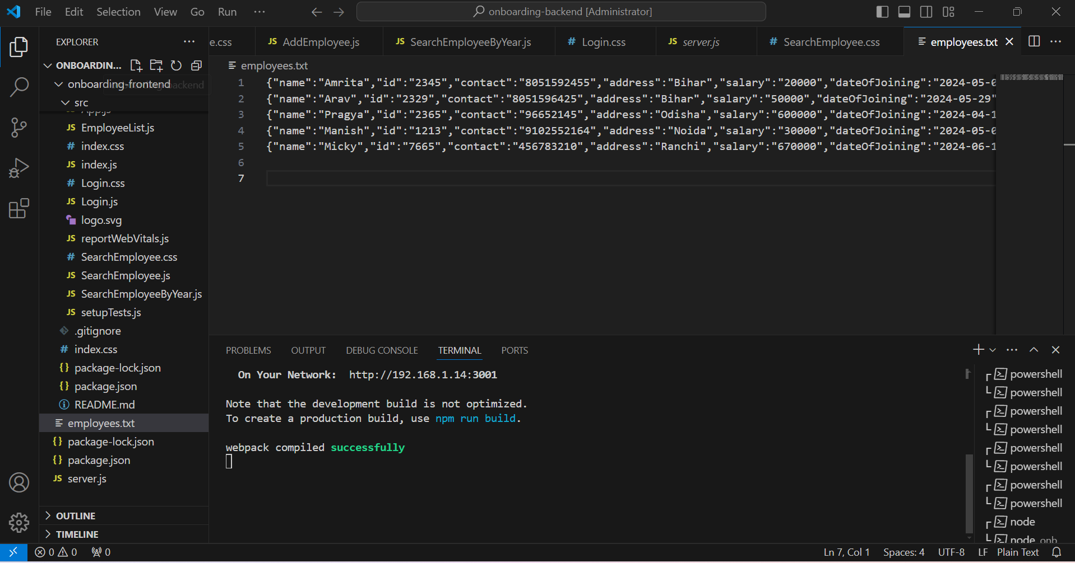

Slide 14
7
Backend Development with Express.js
Setting up the Express.js in Visual Studio.
Creating RESTful APIs for frontend-backend communication.
Handling database operations with TXT File.
Implementing business logic for data submission and retrieval.
Ensuring secure and efficient data transactions.
When we will give command Node server.js backend server will be start.

Slide 15
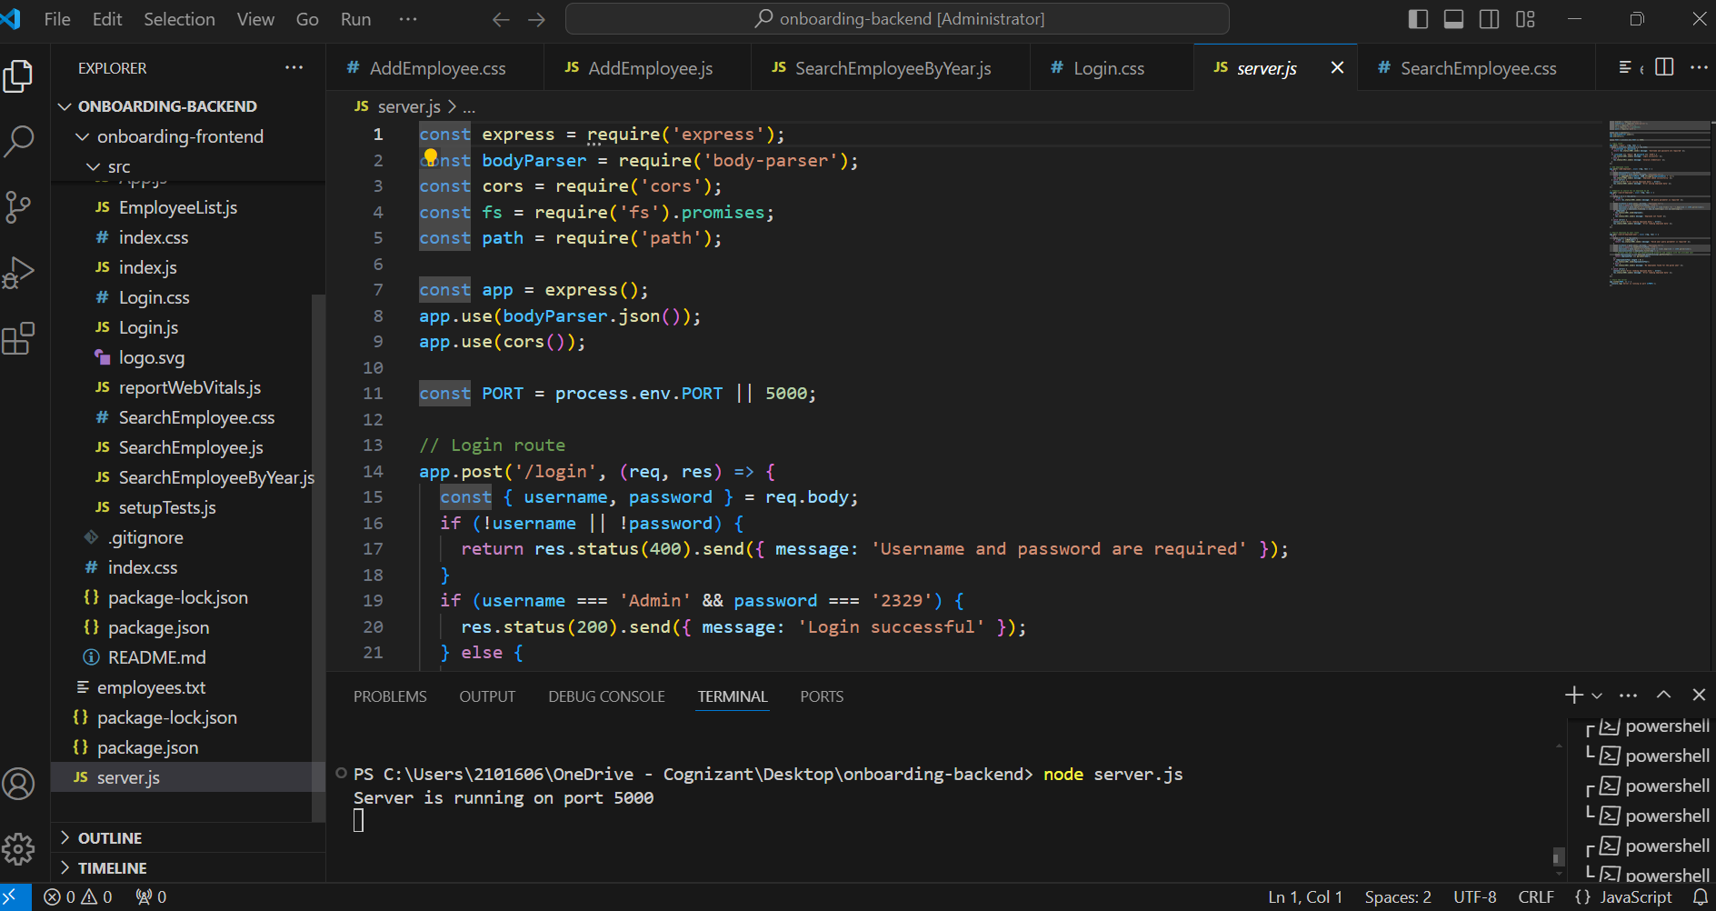

Slide 16
8
Backend Structure
Overview Of Backend Structure
Server.js: The main entry point of the backend application. It sets up the Express server and defines routes and middleware.
Endpoints: Express routes defined for handling various client requests. These endpoints handle tasks such as user authentication, employee search, and adding new employees.
Middleware: Middleware functions used to process incoming requests before they reach the route handlers. This includes functions for parsing request bodies, handling CORS, and error handling.
Database Interaction (employees.txt): The backend interacts with a simple text file (employees.txt) acting as a database. It reads employee data from this file and performs CRUD (Create, Read, Update, Delete) operations as required.
Express Routes: Sample code snippets showcasing the implementation of routes for different functionalities, such as login, employee search, and adding new employees.
Middleware Functions: Code snippets demonstrating the use of middleware functions, including error handling middleware to catch and process errors.
Database Interaction Code: Code snippets illustrating how the backend reads from and writes to the Employee.txt file, including Functions For Searching Employees And Adding New Entries

Slide 17
r.
9
.
Launch the server
Run Your Backend:
Execute node server.js to start the backend server It will run on Default Address, typically http://localhost:5000
Run Your Frontend:
Run npm start to start the development server for your React application
After starting the development server, our React application should automatically open in your default web browser http://localhost:3000 (or the port specified) in Our browser

Slide 18
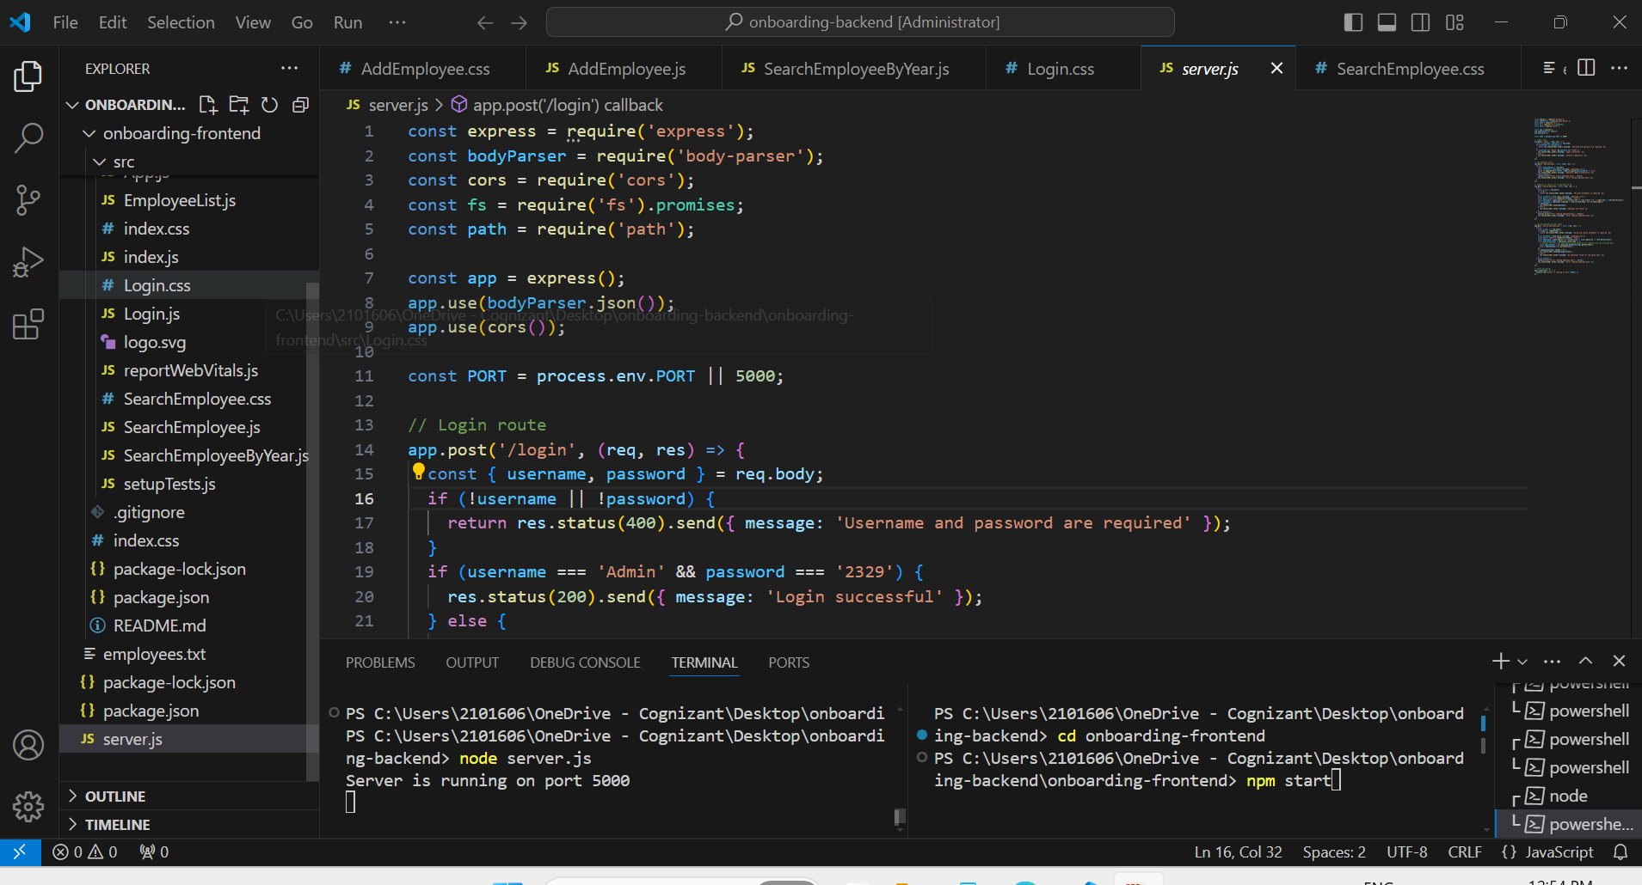

Slide 19
10
Project Summary and Next Steps
Recap of the project objectives and achievements.
Summary of the technical stack and its advantages.
Key learnings and challenges faced during implementation.
Future roadmap and planned enhancements.
Final thoughts and open floor for questions and discussions
Thank You

