Slide 1


SMART INDIA HACKATHON 2025
TITLE PAGE
Problem Statement ID –
SIH25164
Problem Statement Title –
Development of a tool for the identification and assessment of cryptographic assets and their post-quantum migration readiness
Theme –
Cybersecurity
PS Category –
Software
Team ID –
<TEAM ID>
Team Name (Registered on portal) –
Team Nexus
CBOM Compass — an X-ray for your organisation’s encryption.
Find every lock in the building, work out which ones a quantum computer can pick and which ones the regulator bans first — then hand back a prioritised locksmith’s list.
8
sources scanned
191
assets, demo scan
262
tests green

Slide 2
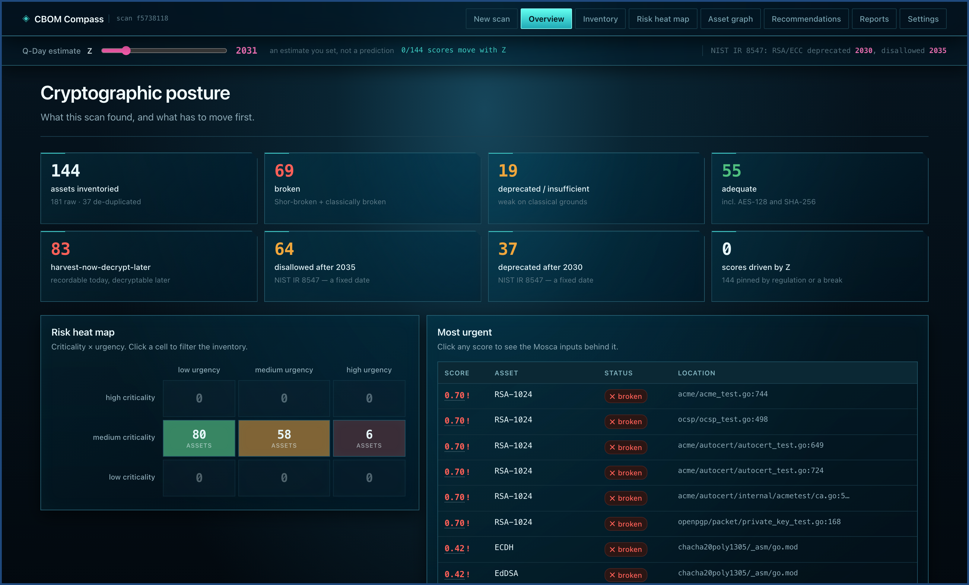
IDEA TITLE
Team Nexus
CBOM COMPASS — an X-ray for your organisation’s encryption
SIH25164 · Cybersecurity · working prototype
Proposed Solution (Describe your Idea/Solution/Prototype)
THE PROBLEM, IN ONE PICTURE — “harvest now, decrypt later”
1 · TODAY
2 · TODAY
3 · ~2031
Your data is locked with today’s encryption.
An attacker copies the locked file. They cannot open it — yet.
A quantum computer opens it. Everything recorded since today is exposed.
HOW WE DECIDE WHAT MOVES FIRST — Mosca’s inequality, drawn
WHAT THE TOOL ACTUALLY DOES
X · data must stay secret · 10 yrs
Y · migrate · 5
1 SEE
2 JUDGE
3 RANK
4 FIX
every place
encryption hides
broken, weak,
or genuinely fine
what breaks
you first
the exact NIST
replacement
Q-Day 2031
2026
2031
2036
2041
X + Y = 15 yrs > Z = 5 yrs → already overdue
One command, or one drag-and-drop. Nothing scanned ever leaves the machine.
Detailed explanation of the proposed solution
How it addresses the problem
Innovation and uniqueness of the solution
Eight sources — code, config, dependencies, binaries, containers, TLS, SSH, cloud & HSM — merged into one de-duplicated inventory.
You cannot migrate what you cannot see. “We think we use RSA somewhere” becomes 191 named assets, each with an exact location.
Mosca made continuous, not yes/no. We refuse to cry wolf — AES-256 stays green. Every finding is re-proved from disk.
Notes:
Open with the threat, not the tool. Attackers are recording encrypted traffic today so they can decrypt it once a quantum computer exists — 'harvest now, decrypt later'. Anything that must stay secret for longer than the time left until then is already exposed. But no organisation can migrate cryptography it cannot see. CBOM Compass scans the six places encryption hides, merges everything into one de-duplicated inventory, and scores each asset on two clocks: physics and regulation. The screenshot on the right is a real scan of github.com/golang/crypto — 144 assets, 69 broken, 83 exposed to harvest-now-decrypt-later. If asked what is genuinely new: the priority score is continuous rather than a yes/no, we deliberately refuse to overstate Grover, and every finding can be re-verified from disk.

Slide 3
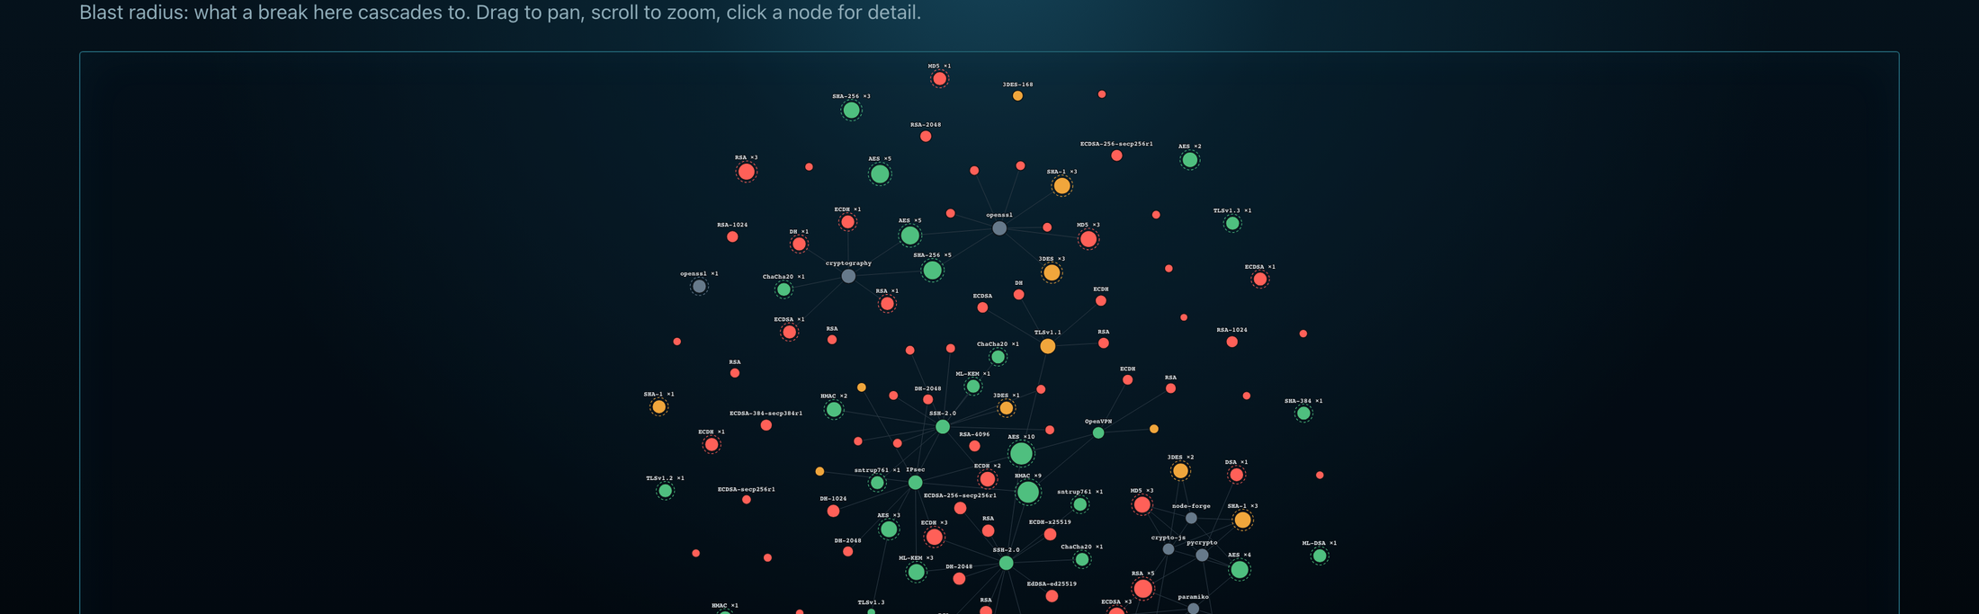
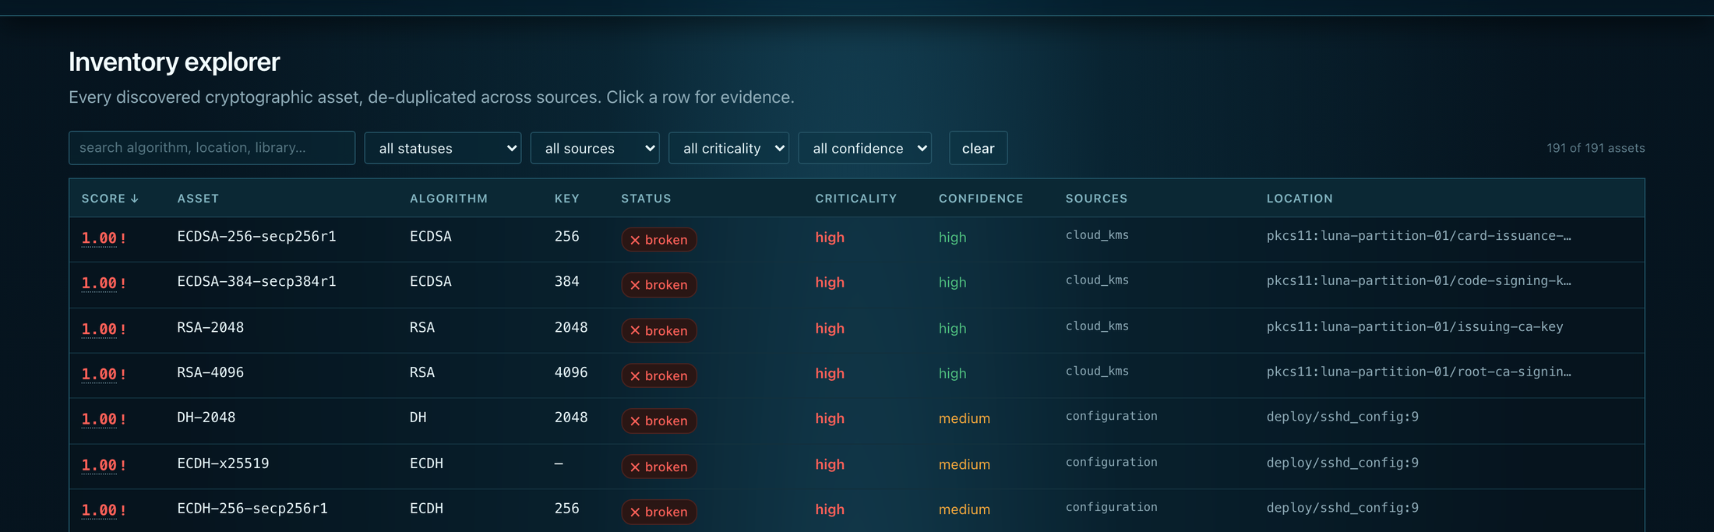
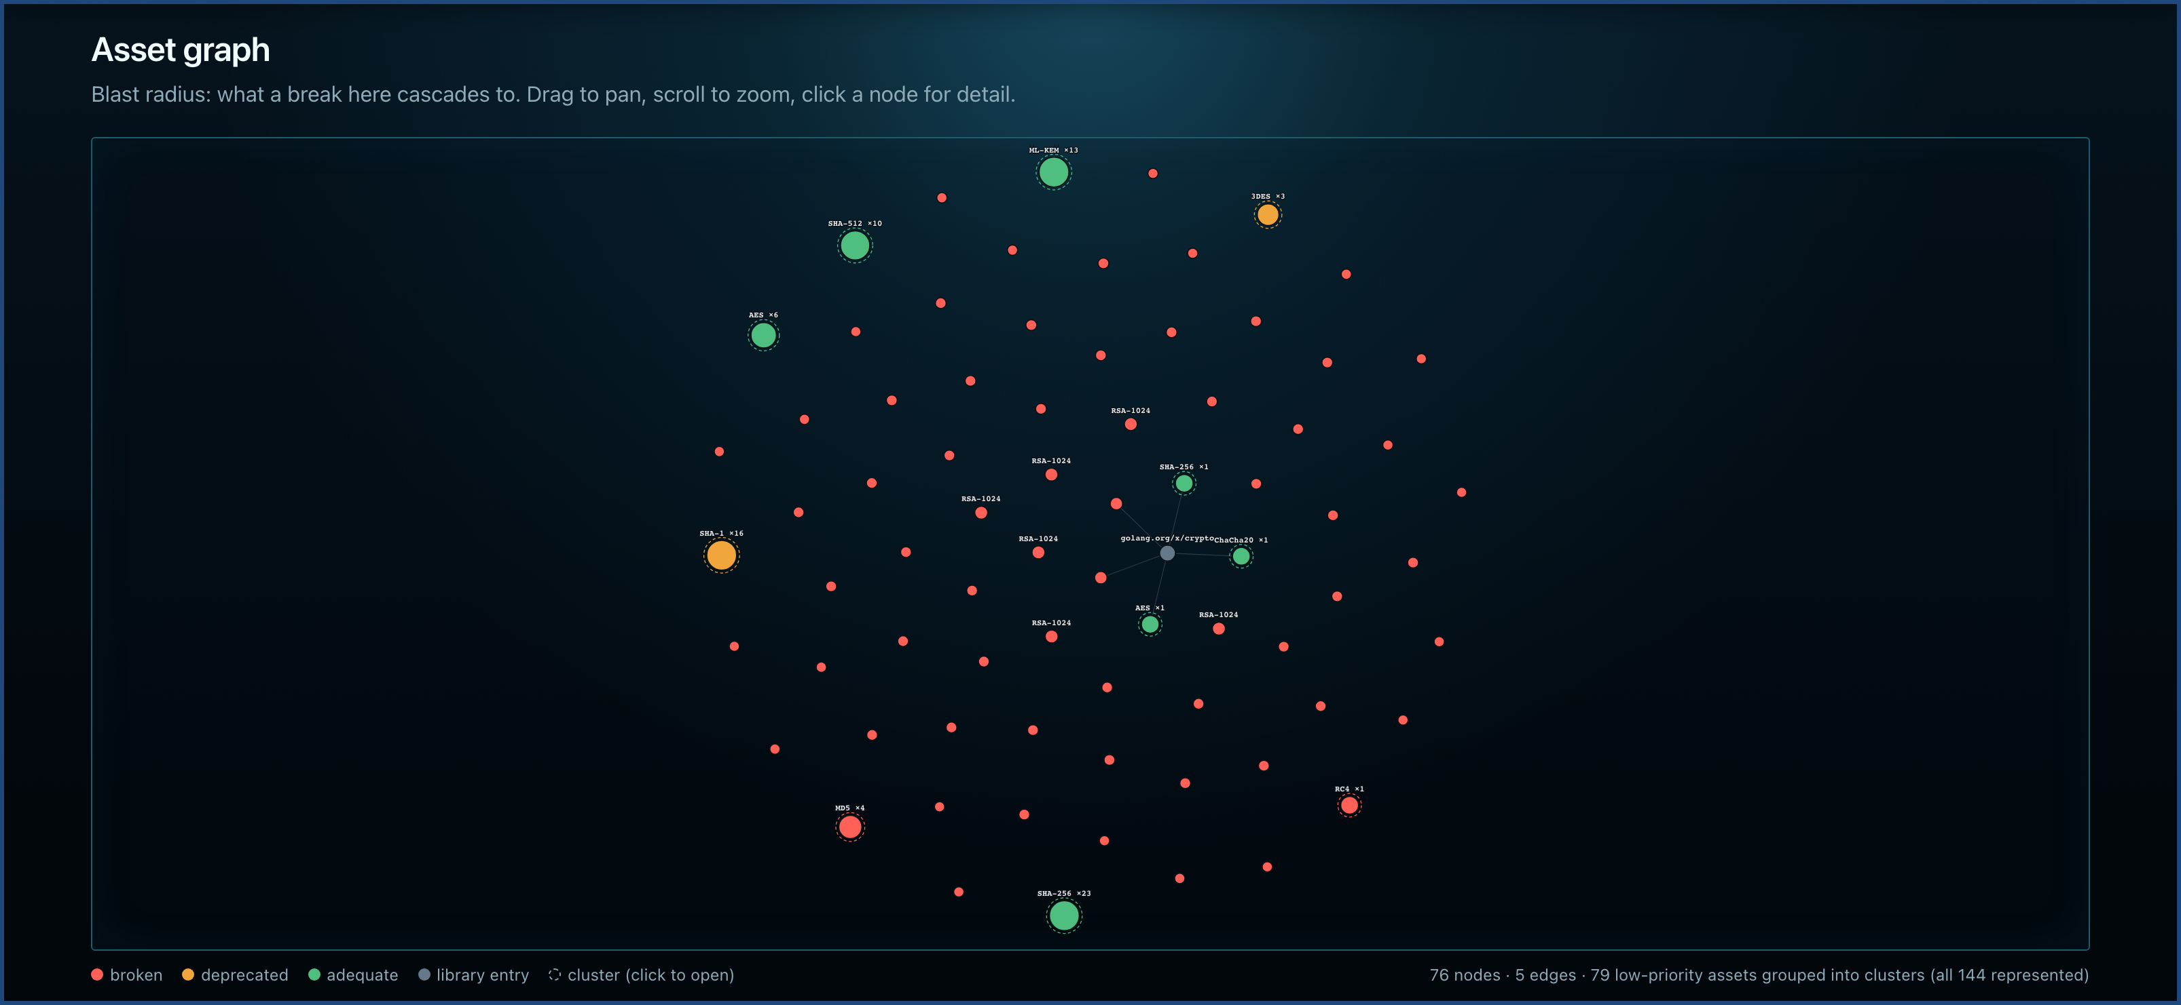
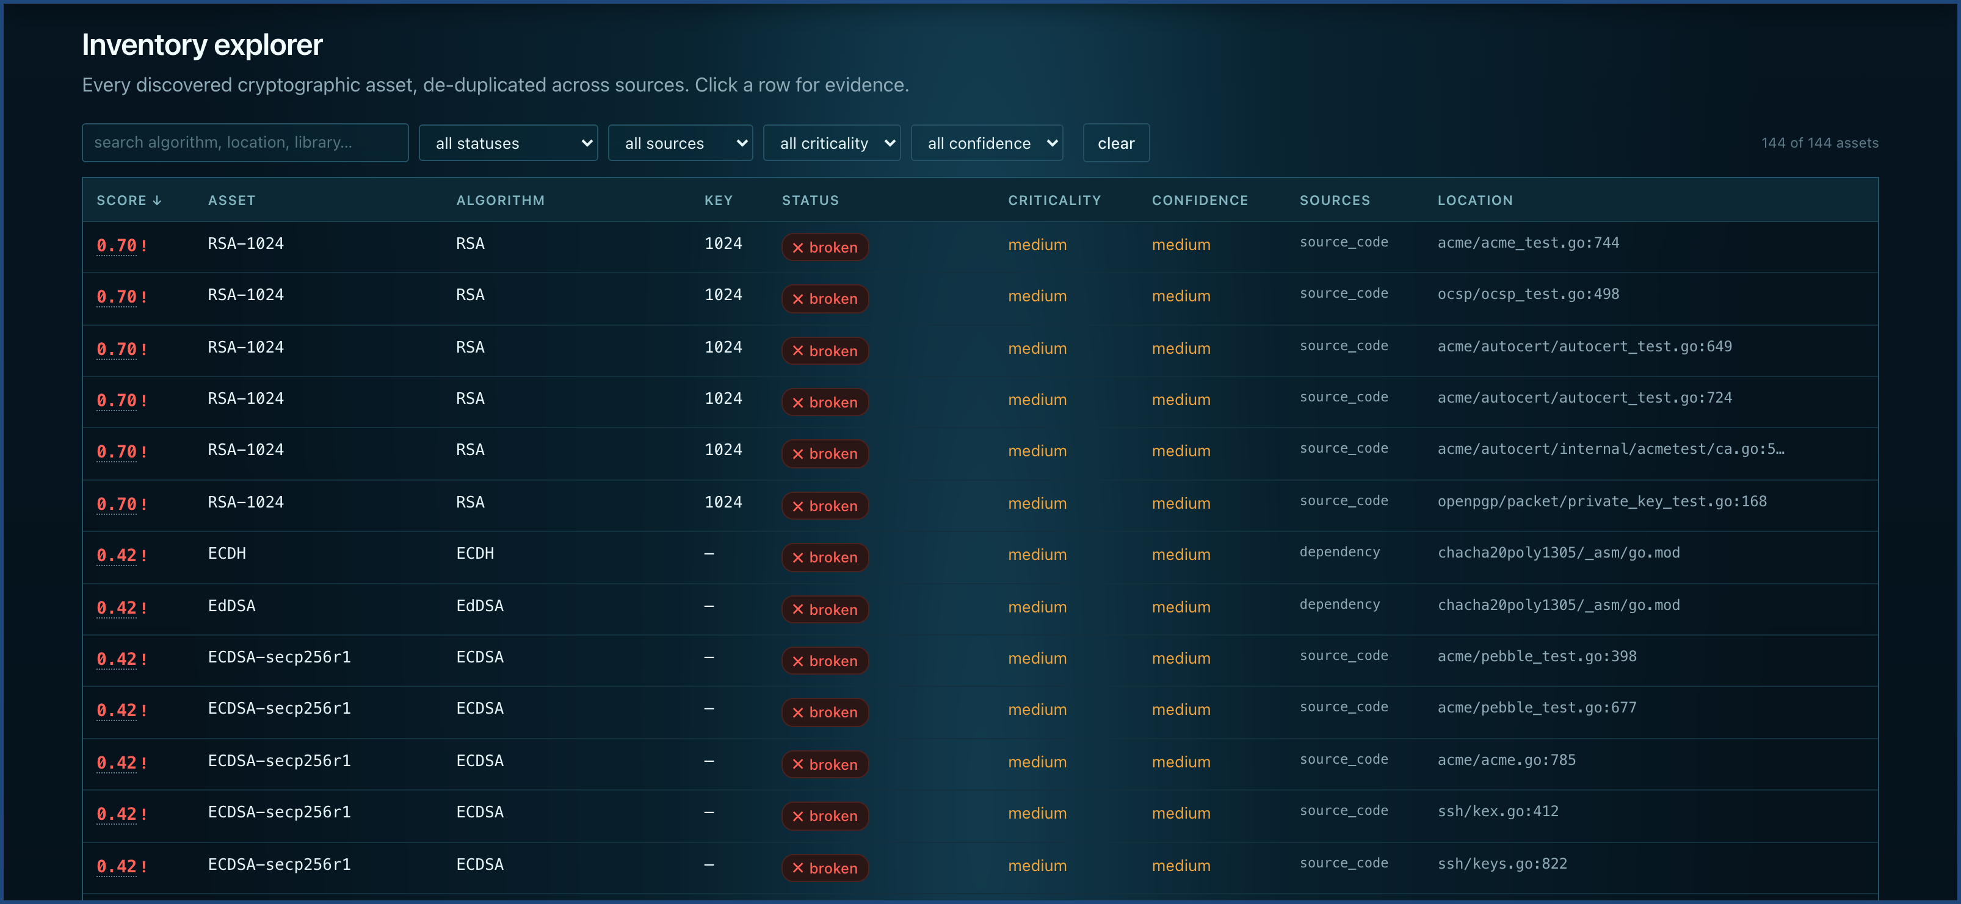
TECHNICAL APPROACH
Team Nexus
Technologies to be used (e.g. programming languages, frameworks, hardware)
CODE
Python AST
+ 6 languages
CONFIG
SSH · IPsec
nginx · VPN
DEPS
manifests +
library KB
BINARIES
ELF · PE
Mach-O
CONTAINERS
layers +
baked-in keys
TLS
live
handshake
SSH
live offered
algorithms
CLOUD & HSM
AWS · Azure · GCP
PKCS#11
Core
Python 3.11 · FastAPI · Uvicorn · SQLite documents → Postgres + JSONB by connection string
Output & QA
CycloneDX 1.7 / ECMA-424 2nd Ed. · ReportLab board PDF · zero-build HTML dashboard · pytest ×262 · Playwright UI tests
Hardware: none. Runs offline on a laptop — no GPU, no cluster, no agent, no external service; a full 191-asset scan takes about a second.
Methodology and process for implementation (Flow Charts/Images/ working prototype)
1 INGEST
2 SCAN
3 MERGE
4 ASSESS
5 RANK
6 DELIVER
zip upload or repo URL — traversal, zip-bomb, symlink and SSRF gated at the edge
›
eight scanners run independently; one failure degrades that source, never the run
›
cross-source identity merge — 209 raw findings become 191 real assets
›
Shor-broken / classically broken / deprecated, plus NIST IR 8547 and CNSA 2.0
›
risk = vulnerability × timing × HNDL, weighted by business criticality
›
dashboard, CycloneDX 1.7 CBOM, board PDF, drift diff between two scans
Asset graph — blast radius. 125 nodes, 117 low-priority assets clustered so all 191 stay represented, never truncated.
Inventory explorer — every asset traceable to its source, its confidence band and an exact file:line for evidence.
Notes:
Two things to land here. First, there is no exotic dependency — Python, FastAPI, SQLite, and it runs offline on a laptop. Second, the pipeline is six honest stages. Emphasise stage 3: 181 raw findings collapse to 144 real assets, because the same OpenSSL seen by three scanners is one asset, while two RSA-2048 call sites in different services stay separate. Both screenshots are the live prototype, not mockups. If a judge probes scale, point at the graph: the long tail is clustered, never truncated — all 144 assets stay represented.

Slide 4
FEASIBILITY AND VIABILITY
Team Nexus
Analysis of the feasibility of the idea
262
tests green, incl. browser UI tests
100% / 97.5%
precision / recall, 91-usage corpus
7
languages, Python through Rust
8
source types, code to PKCS#11
0
hard dependencies, runs offline
1.7
CycloneDX / ECMA-424, validated
Feasible because it is already built and measured. Every number above comes from pytest, the accuracy evaluator and a live scan on this machine — none of it is an estimate.
Potential challenges and risks
Strategies for overcoming these challenges
Static analysis cannot see runtime-chosen algorithms
Confidence banding + independent ground truth
Algorithm names read from the environment, or resolved through getattr, are invisible to any scanner.
→
Every finding carries a confidence level, and our 2 known misses are published in the corpus as misses, not hidden.
Q-Day (Z) is genuinely unknowable
Score the certain clock alongside the uncertain one
Hardcode a date and every score inherits one team’s guess — easy for a sceptical auditor to dismiss.
→
Z is a visible dial, never a constant, and the fixed NIST IR 8547 date is scored beside it.
Business context cannot be read out of code
Human inputs, declared as human inputs
No parser knows that a given AES call protects 25-year defence records. Guessing silently produces confident, wrong numbers.
→
Lifetime and criticality come from a reviewed crypto-policy.yaml; anything defaulted is stored and badged “assumed”.
The tool’s own output is a weapon
A security model for the scanner itself
A ranked list of an organisation’s weakest cryptography is an attacker’s shopping list, pre-sorted.
→
Read-only connectors (never Decrypt, never Sign) · allowlisted probing, refused not warned · role-gated settings · audit-logged exports.
Notes:
This slide answers 'is it real?' before it answers 'is it hard?'. Every number in the top strip is reproducible on the machine in front of you: pytest for 140, cbom-compass eval for the accuracy figures. Then be honest about the limits — that honesty is the argument. We cannot see runtime-chosen algorithms, so we publish those five misses instead of hiding them. Q-Day is unknowable, so we score the NIST deadline beside it and the tool still works for a sceptic who thinks Q-Day is 2050. And the tool's own output is dangerous, so the connectors are read-only and the private keys we find are stored as fingerprints only.

Slide 5
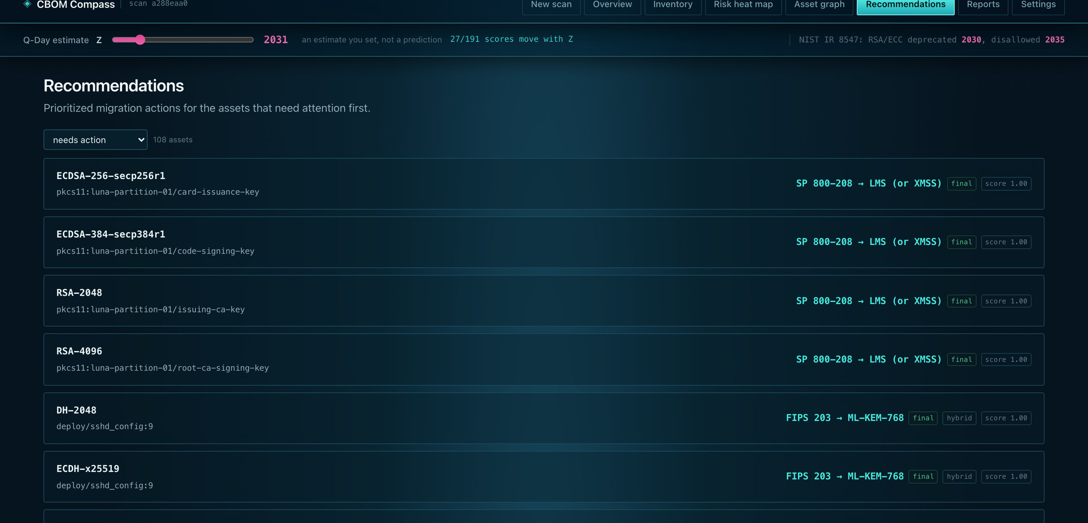
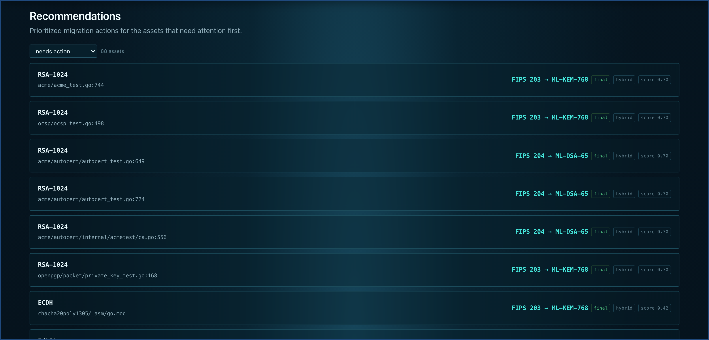
IMPACT AND BENEFITS
Team Nexus
Potential impact on the target audience
CISO / risk officer
A ranked, defensible board report instead of a spreadsheet guess — and owns the Z dial that drives it.
Security / crypto engineer
Algorithm, key size, library version and an exact file:line per finding, each with a confidence band.
DevOps / platform team
One command or one drag-and-drop. No agent, no cluster, no code leaving the building.
Compliance / audit lead
A standards-conformant CycloneDX 1.7 CBOM is regulatory evidence. A screenshot is not.
India, at national scale
Recommendations — every broken asset gets a named NIST replacement, ranked by risk, latency and rotation cost.
RBI, SEBI, UIDAI, defence and telecom all hold data whose confidentiality must outlast 2035 — and none of them can migrate what they have never inventoried.
In plain English: it does not just say “this lock is weak”. It says replace this exact lock, with this exact model, before this date.
Benefits of the solution (social, economic, environmental, etc.)
SOCIAL
ECONOMIC
STRATEGIC
ENVIRONMENTAL
Citizen data recorded today — Aadhaar-linked, health, financial — stays private after Q-Day.
Budget goes to the assets that matter instead of a blanket rewrite. Weeks of consultancy become one command.
Open and self-hosted. No Indian organisation hands a map of its weak points to a foreign SaaS vendor.
Static analysis on a laptop. No GPU, no always-on agent, no cluster.
Notes:
Move from the tool to the consequence. For a CISO this replaces a spreadsheet guess with a defensible ranked report; for an auditor a CycloneDX CBOM is evidence in a way a screenshot never is. The national point is the one worth landing: RBI, SEBI, UIDAI, defence and telecom all hold data that must stay confidential well past 2035, and inventory is the first step of any PQC transition — the step almost nobody has done. On benefits, the strategic one usually gets the most attention: this is self-hosted, so no Indian organisation has to send a map of its cryptographic weak points to a foreign SaaS vendor.

Slide 6
RESEARCH AND REFERENCES
Team Nexus
Details / Links of the reference and research work
Standards we implement
Formats and prior art
Method and theory
NIST IR 8547 (ipd)
CycloneDX 1.7, ratified ECMA-424 2nd Ed. (Dec 2025)
M. Mosca — will we be ready?
RSA and ECC deprecated after 2030, disallowed after 2035 — the second, certain clock we score alongside Q-Day.
cyclonedx.org/capabilities/cbom · our CBOM output format, validated on every single scan.
The X + Y > Z inequality is the backbone of our priority score.
FIPS 203 / 204 / 205 / 206 (ipd)
CycloneDX Cryptography Registry
P. Shor (1994)
ML-KEM, ML-DSA, SLH-DSA, FN-DSA — the replacements we name per asset. FIPS 206 carries a maturity badge, never a default.
Algorithm-name normalisation, so our output is directly comparable with other vendors’ CBOMs instead of using private names.
Why RSA, DSA, DH, ECDSA and ECDH break outright rather than merely weaken: there is no key-size fix, the mathematics is gone.
NIST SP 800-208 · NSA CNSA 2.0
IBM CBOM · github.com/IBM/CBOM
L. Grover (1996) · Brassard–Høyer–Tapp
LMS / XMSS for firmware signing; CNSA is the source of our AES-256 and SHA-384 flags, raised as policy, never as a break.
The closest prior art to this problem statement, and the baseline we measured our own output shape against.
And why they matter far less than the headlines claim. This reading is why we classify AES-128 and SHA-256 as adequate.
Our own research — not just citations
corpus/ — a labelled ground truth we built
Measured, not asserted · cbom-compass eval
Proof the findings are real · cbom-compass verify
91 cryptographic usages hand-labelled from source across 7 languages, plus 7 negative controls that discuss cryptography while performing none. Building it surfaced 7 real bugs in our own scanner.
Algorithm level 100% precision / 97.5% recall; strict — key size, mode and curve — 98.9% / 96.7%. Zero findings on the negative controls, and a regression fails CI instead of shipping quietly.
Re-opens each artefact on disk and re-checks the claim by a deliberately different technique, quoting the line. The tests plant fabricated findings and assert every one is rejected.
Research that changed the design. Our PRD v1.0 targeted CycloneDX 1.6; reading the ECMA-424 2nd Edition ratification moved us to 1.7, where nistQuantumSecurityLevel is a native field rather than a vendor extension. A scan of real third-party code (paramiko) scored an already-migrated ML-KEM key exchange at 0.60 — that single finding rewrote the priority formula from a flat max() across peer axes to vulnerability × timing.
Full specification and design record: docs/cbom-compass-prd.md · scanner accuracy notes: corpus/README.md · architecture, security model and stated limits: README.md
Notes:
Do not read the citations aloud. Say that the standards column is what we implement, not what we admire — NIST IR 8547 is the deadline we score, FIPS 203/204/205 are the replacements we name. Spend the time on the bottom strip instead: we built a 50-usage labelled corpus with four negative controls, and building it found seven real bugs in our own scanner. That is the difference between claiming accuracy and measuring it. Finish on 'research that changed the design' — each of those three items is a case where reading the source material or running against real code made us rewrite something.

