Slide 1


SMART INDIA HACKATHON 2025
TITLE PAGE
Problem Statement ID – SIH25164
Problem Statement Title – Development of a tool for the identification and assessment of cryptographic assets and their post-quantum migration readiness
Theme – Cybersecurity
PS Category – Software
Team ID – <TEAM ID>
Team Name (Registered on portal) – Team Nexus
CBOM Compass — find every lock in the building, work out which ones a quantum computer can pick and which ones the regulator bans first, and hand back a prioritised locksmith's list.

Slide 2
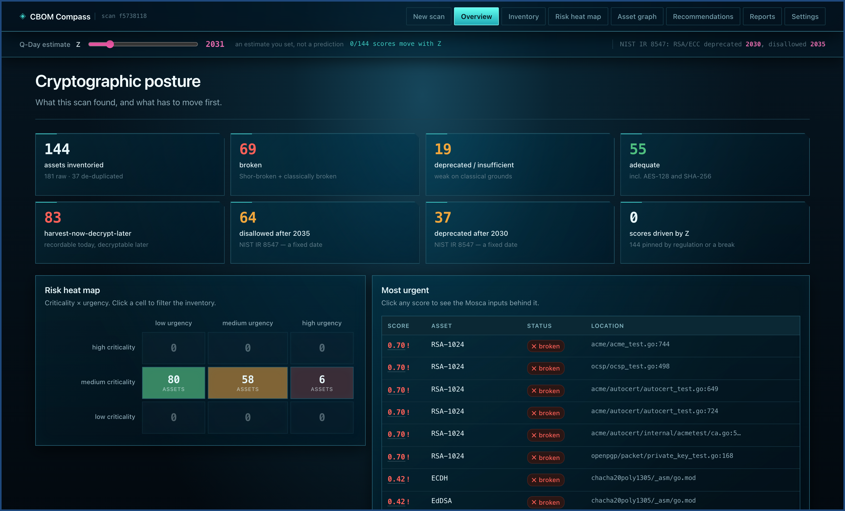
IDEA TITLE
Team Nexus
CBOM COMPASS — an X-ray for your organisation's encryption
SIH25164 · Cybersecurity · working prototype
Proposed Solution (Describe your Idea/Solution/Prototype)
Detailed explanation of the proposed solution
• Scans the six places encryption hides — source code, dependencies, compiled binaries, container images, live TLS endpoints and cloud / HSM key stores.
• Merges them into one de-duplicated inventory: algorithm, key size, confidence and the exact file:line.
• Scores every asset on two clocks — physics (Q-Day) and regulation (NIST IR 8547) — then names the exact NIST replacement.
How it addresses the problem
• You cannot migrate what you cannot see. "We think we use RSA somewhere" becomes 144 named assets with locations.
• Delivers all four asks of the problem statement in a single run: Discover → Assess → Classify → Recommend.
• Ranks by business urgency, so a five-person team knows which 6 of 144 to fix this quarter.
Innovation and uniqueness of the solution
• Mosca's inequality made computable — a continuous score, not a yes/no. The same RSA-2048 scores 1.00 on 25-year data and 0.36 on session data.
• We refuse to cry wolf — AES-128 and SHA-256 stay adequate, so the "act now" list stays short and credible.
• verify re-reads every finding from disk by a different technique and quotes the line — proof, not a claim.
Live dashboard — a real scan of github.com/golang/crypto: 144 assets, 69 broken, 83 harvest-now-decrypt-later.
In plain English: today's locks are picked by tomorrow's quantum computers — and attackers are already stealing the locked boxes to open later. We find every lock you own and say which to change first.
Notes:
Open with the threat, not the tool. Attackers are recording encrypted traffic today so they can decrypt it once a quantum computer exists — 'harvest now, decrypt later'. Anything that must stay secret for longer than the time left until then is already exposed. But no organisation can migrate cryptography it cannot see. CBOM Compass scans the six places encryption hides, merges everything into one de-duplicated inventory, and scores each asset on two clocks: physics and regulation. The screenshot on the right is a real scan of github.com/golang/crypto — 144 assets, 69 broken, 83 exposed to harvest-now-decrypt-later. If asked what is genuinely new: the priority score is continuous rather than a yes/no, we deliberately refuse to overstate Grover, and every finding can be re-verified from disk.

Slide 3
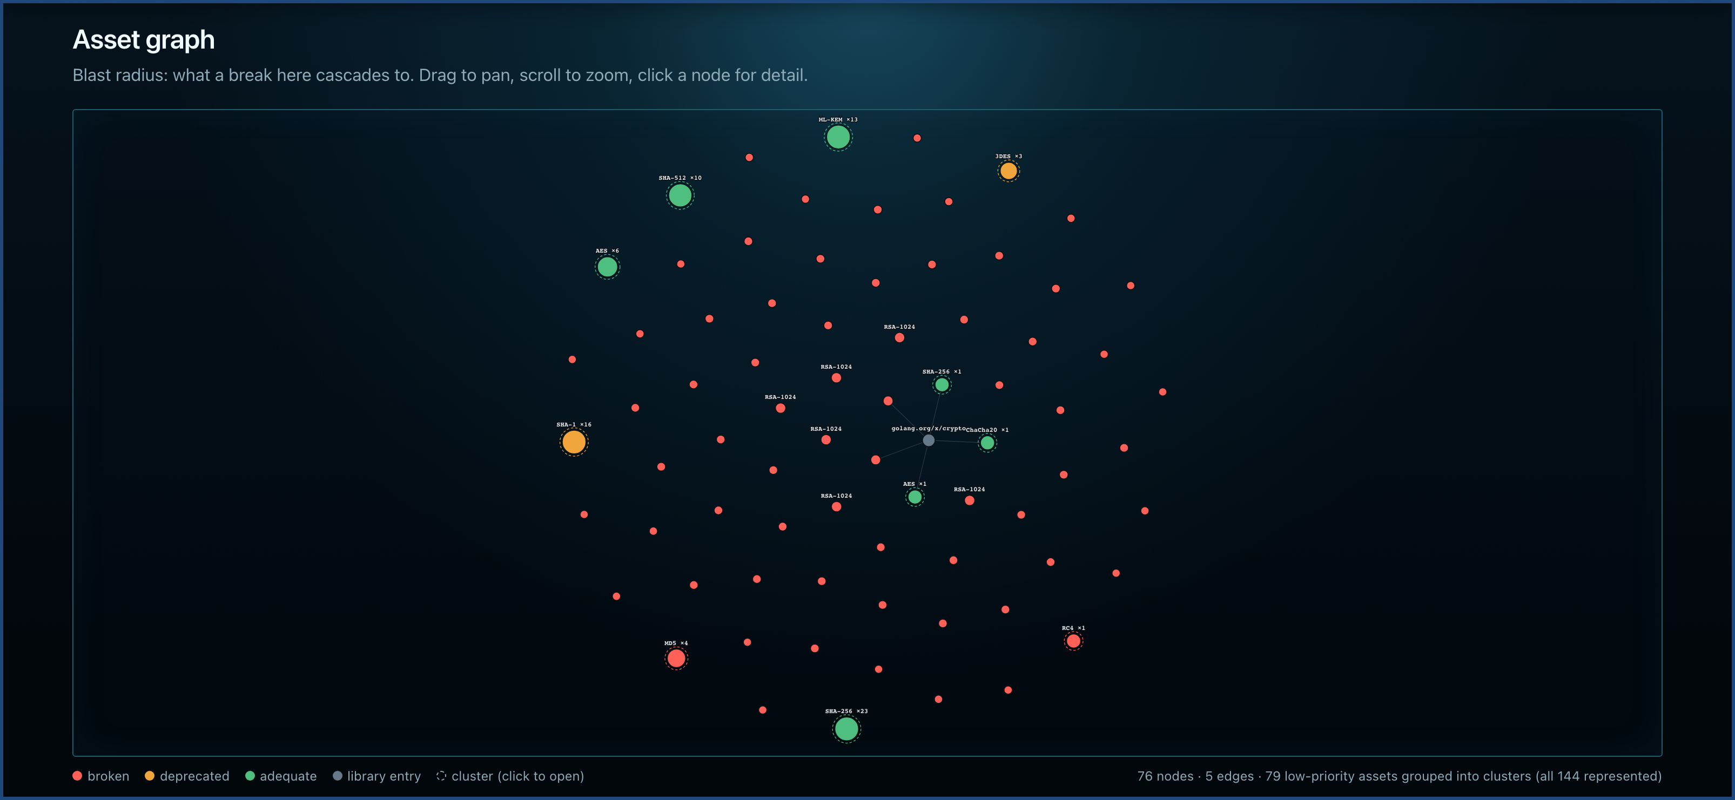
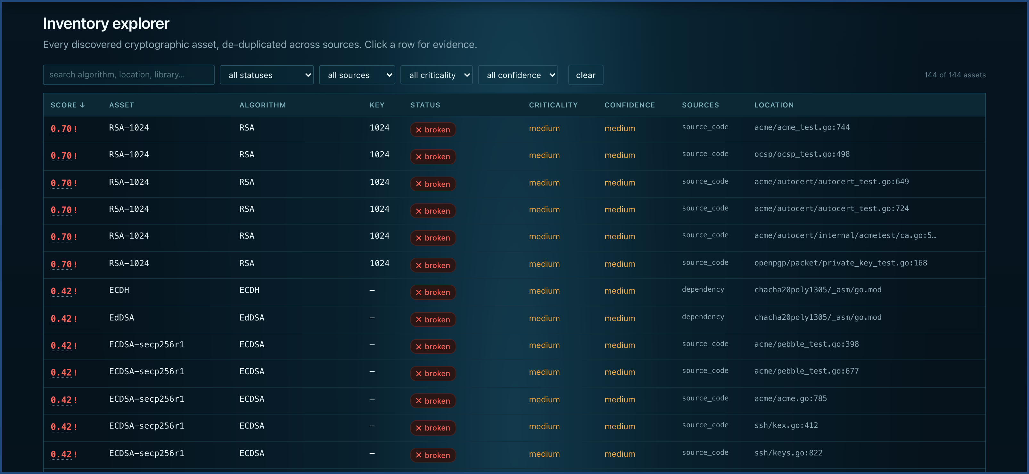
TECHNICAL APPROACH
Team Nexus
Technologies to be used (e.g. programming languages, frameworks, hardware)
Language
& API
Python 3.11 · FastAPI · Uvicorn · Pydantic v2 · SQLite (JSON documents) → Postgres + JSONB by connection string
Detection
engines
Python ast (resolves literal key sizes, curves, modes) · pattern rules for Java / JS / Go · LIEF import-table + symbol parsing for ELF / PE / Mach-O · Syft + layer walk · TLS handshake probe · boto3 (AWS KMS, read-only)
Output
& QA
CycloneDX 1.7 / ECMA-424 2nd Ed. + Cryptography Registry · ReportLab board PDF · zero-build HTML / JS / Canvas dashboard · pytest ×140 · Playwright headless-Chromium UI tests
Hardware: none. Runs offline on a laptop — no GPU, no cluster, no agent, no external service; nothing scanned ever leaves the machine.
Methodology and process for implementation (Flow Charts/Images/ working prototype)
1 INGEST
2 SCAN
3 INVENTORY
4 ASSESS
5 CLASSIFY
6 DELIVER
zip upload or public repo URL — path-traversal, zip-bomb, symlink and SSRF gated at the edge
›
six scanners run independently; one failure degrades that source, never aborts the run
›
cross-source identity merge and de-duplication — 181 raw findings → 144 real assets
›
Shor-broken / classically broken / deprecated, plus the NIST IR 8547 and CNSA 2.0 deadlines
›
risk = vulnerability × timing × HNDL, weighted by business criticality
›
dashboard, CycloneDX 1.7 CBOM, board PDF, drift diff between two scans
Asset graph — blast radius. 76 nodes, 79 low-priority assets clustered so all 144 stay represented, never truncated.
Inventory explorer — every asset traceable to its source, its confidence band and an exact file:line for evidence.
Notes:
Two things to land here. First, there is no exotic dependency — Python, FastAPI, SQLite, and it runs offline on a laptop. Second, the pipeline is six honest stages. Emphasise stage 3: 181 raw findings collapse to 144 real assets, because the same OpenSSL seen by three scanners is one asset, while two RSA-2048 call sites in different services stay separate. Both screenshots are the live prototype, not mockups. If a judge probes scale, point at the graph: the long tail is clustered, never truncated — all 144 assets stay represented.

Slide 4
FEASIBILITY AND VIABILITY
Team Nexus
Analysis of the feasibility of the idea
140
100% / 95%
4
6
0
1.7
tests green, including headless-browser UI tests
precision / recall, hand-labelled 50-usage corpus
languages covered — Python, Java, JS, Go
real scans of unmodified upstream repositories
hard external dependencies — runs fully offline
CycloneDX / ECMA-424 2nd Ed. output, validated
Feasible because it is already built and measured. Every number above comes from pytest, cbom-compass eval and a live scan on this machine — none of it is an estimate.
Potential challenges and risks
Strategies for overcoming these challenges
Static analysis cannot see runtime-chosen algorithms
Confidence banding + independent ground truth
Algorithm names read from the environment or getattr(hashlib, …) are invisible to any scanner. Pretending otherwise is how tools lose trust.
→
Every finding carries a confidence level; the 5 known misses are published in the corpus as misses, not hidden. Live TLS handshakes and binary symbol tables give ground truth where source cannot.
Q-Day (Z) is genuinely unknowable
Score the certain clock alongside the uncertain one
Hardcode a date and every score in the system inherits one team's guess — an easy thing for a sceptical auditor to dismiss.
→
Z is a visible dial, never a constant, and the NIST IR 8547 deadline (RSA/ECC disallowed 2035) is scored beside it — so the output stands up even for someone who thinks Q-Day is 2050.
Business context cannot be read out of code
Human inputs, declared as human inputs
No parser knows that a given AES call protects 25-year defence records. Guessing silently produces confident, wrong numbers.
→
Data lifetime and criticality come from a checked-in crypto-policy.yaml; anything defaulted is stored x_source: assumed and badged in the UI and the export. "We assumed 7 years — click to change" is defensible; a bare number is not.
The tool's own output is a weapon
A security model for the scanner itself
A ranked list of an organisation's weakest cryptography is an attacker's pre-sorted shopping list — and the tool ingests KMS and HSM credentials to build it.
→
Read-only least-privilege connectors (never Decrypt, never Sign) · allowlist-gated probing, refused not warned · Z and weights are role-gated · every export audit-logged · discovered private keys recorded as fingerprint only.
Notes:
This slide answers 'is it real?' before it answers 'is it hard?'. Every number in the top strip is reproducible on the machine in front of you: pytest for 140, cbom-compass eval for the accuracy figures. Then be honest about the limits — that honesty is the argument. We cannot see runtime-chosen algorithms, so we publish those five misses instead of hiding them. Q-Day is unknowable, so we score the NIST deadline beside it and the tool still works for a sceptic who thinks Q-Day is 2050. And the tool's own output is dangerous, so the connectors are read-only and the private keys we find are stored as fingerprints only.

Slide 5
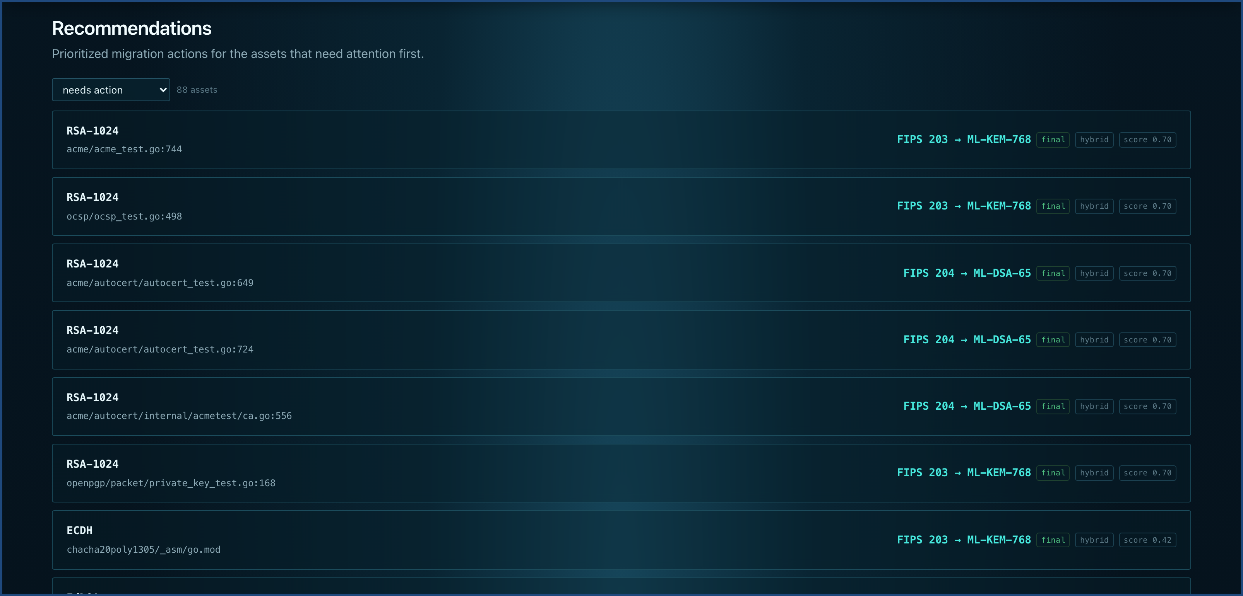
IMPACT AND BENEFITS
Team Nexus
Potential impact on the target audience
CISO / risk officer
Replaces a spreadsheet guess with a ranked, defensible board report — and owns the Z dial and the criticality weights that drive it.
Security / crypto engineer
Algorithm, key size, library version and file:line per finding, with a confidence band attached to each one.
DevOps / platform team
One command or one drag-and-drop. No agent, no cluster, no code leaving the building.
Compliance / audit lead
A standards-conformant CycloneDX 1.7 CBOM is regulatory evidence. A screenshot is not.
India, at national scale
Recommendations — every broken asset gets a named NIST replacement, ranked, with hybrid and standards-maturity flags.
RBI, SEBI, UIDAI, defence and telecom all hold data with confidentiality requirements beyond 2035. Inventory is the step every PQC transition has to start from — and the step nobody has done.
In plain English: it does not just say "this lock is weak". It says replace this exact lock, with this exact model, before this date — and puts the six that matter most at the top of the list.
Benefits of the solution (social, economic, environmental, etc.)
SOCIAL
ECONOMIC
STRATEGIC
ENVIRONMENTAL
Citizen data recorded today — Aadhaar-linked, health, financial — stays private after Q-Day. Harvest-now-decrypt-later can only be defeated before it arrives.
Budget goes to the six assets that matter instead of a blanket rewrite. Discovery that costs a consultant weeks costs one command.
Open and self-hosted. No Indian organisation has to hand a map of its cryptographic weak points to a foreign SaaS vendor.
Static analysis on a laptop. No GPU, no always-on agent, no cluster — a full 144-asset scan finishes in about a second.
Notes:
Move from the tool to the consequence. For a CISO this replaces a spreadsheet guess with a defensible ranked report; for an auditor a CycloneDX CBOM is evidence in a way a screenshot never is. The national point is the one worth landing: RBI, SEBI, UIDAI, defence and telecom all hold data that must stay confidential well past 2035, and inventory is the first step of any PQC transition — the step almost nobody has done. On benefits, the strategic one usually gets the most attention: this is self-hosted, so no Indian organisation has to send a map of its cryptographic weak points to a foreign SaaS vendor.

Slide 6
RESEARCH AND REFERENCES
Team Nexus
Details / Links of the reference and research work
Standards we implement
Formats and prior art
Method and theory
NIST IR 8547 (ipd) — Transition to Post-Quantum Cryptography Standards. RSA and ECC deprecated after 2030, disallowed after 2035. This is the second, certain clock we score alongside Q-Day.
nvlpubs.nist.gov/nistpubs/ir/2024/NIST.IR.8547.ipd.pdf
NIST FIPS 203 ML-KEM · FIPS 204 ML-DSA · FIPS 205 SLH-DSA · FIPS 206 (ipd) FN-DSA — the replacement algorithms we name per asset. FIPS 206 is not final, so it carries a maturity badge and is never a default.
NIST SP 800-208 — stateful hash-based signatures (LMS / XMSS) for firmware and code signing.
NSA CNSA 2.0 suite and timeline — the source of our AES-256 / SHA-384 policy flags, which we raise as policy, never as a quantum break.
CycloneDX — CBOM capability
cyclonedx.org/capabilities/cbom/
CycloneDX v1.7 (Oct 2025), ratified as ECMA-424 2nd Edition (Dec 2025).
ecma-international.org/publications-and-standards/standards/ecma-424/
CycloneDX Cryptography Registry — algorithm-name normalisation, so our output is directly comparable with other vendors' CBOMs instead of using private names.
IBM CBOM reference implementation — the closest prior art to this problem statement, and the baseline we measured our own output shape against.
github.com/IBM/CBOM
M. Mosca — Cybersecurity in an era with quantum computers: will we be ready? The X + Y > Z inequality is the backbone of our priority score.
P. Shor (1994) — efficient factoring and discrete log. This is why RSA, DSA, DH, ECDSA and ECDH break outright rather than merely weaken: there is no key-size fix, the mathematics is gone.
L. Grover (1996) and Brassard–Høyer–Tapp — and why they matter far less than the headlines claim. Grover needs ~2⁶⁴ sequential operations and parallelises poorly; BHT's cube-root speedup does not beat the classical birthday bound once quantum memory is costed. This reading is why we classify AES-128 and SHA-256 as adequate.
Our own research — not just citations
corpus/ — a labelled ground truth we built
Measured, not asserted · cbom-compass eval
Proof the findings are real · cbom-compass verify
50 cryptographic usages hand-labelled from source across Python, Java, JS and Go, plus 4 negative controls that discuss cryptography in prose and identifiers while performing none. Building it surfaced 7 real bugs in our own scanner — Triple-DES reported as single DES, every pycryptodome cipher mode silently dropped.
Algorithm level 100% precision / 95% recall; strict — key size, mode and curve — 97.9% / 94%. Zero findings on the negative controls. Every remaining miss is a documented dynamic-resolution case, and test_evaluate.py asserts no miss appears anywhere else, so a regression fails CI instead of shipping quietly.
Re-opens each artefact on disk and re-checks the claim by a deliberately different technique, quoting the line so a sceptic can repeat it by hand. test_verify.py plants fabricated findings and asserts every one is rejected — a verifier that confirms everything proves nothing.
Research that changed the design. Our own PRD v1.0 targeted CycloneDX 1.6; reading the ECMA-424 2nd Edition ratification moved us to 1.7, where nistQuantumSecurityLevel is a native schema field rather than a vendor extension. A scan of real third-party code (paramiko) scored an already-migrated ML-KEM key exchange at 0.60 — that single finding rewrote the priority formula from a flat max() across peer axes to vulnerability × timing. And running verify against real code exposed findings anchored to commented-out declarations in jjwt; filtering comments removed 14 false positives.
Full specification and design record: docs/cbom-compass-prd.md (PRD v1.2) · scanner accuracy notes: corpus/README.md · architecture, security model and stated limits: repository README.md
Notes:
Do not read the citations aloud. Say that the standards column is what we implement, not what we admire — NIST IR 8547 is the deadline we score, FIPS 203/204/205 are the replacements we name. Spend the time on the bottom strip instead: we built a 50-usage labelled corpus with four negative controls, and building it found seven real bugs in our own scanner. That is the difference between claiming accuracy and measuring it. Finish on 'research that changed the design' — each of those three items is a case where reading the source material or running against real code made us rewrite something.

