Slide 1


VILLAGE DEVELOPMENT PLAN
Bamori Kalan: Current Rural Challenges and a Roadmap to Holistic Village Development
(An overview of infrastructure, community, and development opportunities)
Presented By: _____
Date: _____

Slide 2

Contents
Introduction
Village Profile
Current Infrastructure
Socio-Economic Overview
SWOT Analysis
Needs & Gaps
Visions & Goals
Sector-Wise Development Plan
Implementation Strategy
Monitoring & Evaluation
Budget Overview
Risk & Management
Conclusion

Slide 3


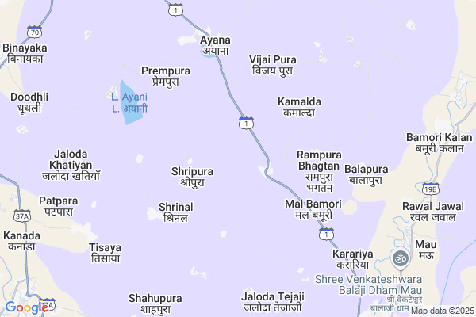
About Village
Bamori Kalan is a rural village situated in the Mangrol Block of Baran District, Rajasthan

Slide 4
Agriculture
Livelihood/Skill Development
Digital Connectivity
Education
Objective
Infrastructure
Water & Sanitation
Animal Husbandry
Renewable Energy

Slide 5
Public Works Department(PWD)
Gram Panchayat
Health Department
Education Department
Stakeholders
Electricity Board
Animal Husbandry Department
Agriculture Department
Drinking Water Department

Slide 6
VILLAGE PROFILE
Total: 6000
Men’s: 3547
Women’s: 2453
POPULATION
AREA
About 16.61 sq. km
Literacy Rate:
Overall ~63%
Male Literacy: ~75%
Female Literacy: ~50%
Main Occupations:
Agriculture, animal husbandry, and seasonal labor migration

Slide 7

CURRENT INFRASTRUCTUIRE
Roads & Transportation
Major access via NH27 and NH52
Internal roads largely unpaved (kaccha), challenging during monsoons
Electricity
Connected to the state electricity grid
Power cuts still frequent
Limited household use of solar panels despite district solar project presence
Water
Wells and hand pumps
Issues: Seasonal water scarcity and quality concerns
Healthcare Facilities
A primary health center exists but lacks staff and equipment
People travel to towns for specialized care
Education
One government senior secondary school and a few primary schools and one secondary School and one private school

Slide 8
SOCIO-ECONOMIC OVERVIEW
AGRICULTURE & Livelihoods
Major dependence on rain-fed agriculture and animal husbandry.
Seasonal labor migration to cities for supplementary income.
Seasonal labor migration to cities for supplementary income.
Education status
Primary and secondary schools are present.
Literacy improving but female literacy still lags behind.
High dropout rate in higher education levels.
Helath Indicators
Limited access to healthcare facilities.
Malnutrition and maternal health remain concerns.
Need for awareness and preventive care services.
SHGs or Cooperatives
Presence of a few active Self-Help Groups led by women.
Lack of access to financial literacy and microcredit opportunities.
Employment/Unemployment Rate
Majority engaged in informal employment.
Scarcity of local job opportunities.
Youth unemployment high; migration prevalent.

Slide 9
SWOT Analysis
Strenghts
Strong community ties and cultural heritage
Fertile land for agriculture
Presence of basic infrastructure like schools and health center
Active participation of SHGs and Panchayat
Weaknesses
Poor road connectivity and transport facilities
Inconsistent electricity and water supply
Low female literacy and high dropout rates
Limited access to quality healthcare
Opportunities
Scope for solar energy expansion
Government schemes for rural development
Potential to develop skill centers and cooperatives
Access to markets for dairy and agriculture products
Threats
Migration of youth due to unemployment
Climate variability affecting agriculture
Health risks due to inadequate facilities
Social disparities and gender gap

Slide 10
Needs & Gaps
Sector | Gaps Identified | Development Needs
Roads & Transport | Limited public transport; possible poor road quality | All-weather roads; improved public transport to towns and markets
Water Supply | Seasonal scarcity; dependence on handpumps during summer | Reliable piped water system; rainwater harvesting; tank and well maintenance
Electricity | Potential voltage issues or occasional cuts (needs verification) | Uninterrupted power supply; solar lighting systems
Education | No higher secondary school or local college | Establish higher secondary school; ensure transport to nearby colleges
Healthcare | No local Primary Health Centre (PHC) | Set up of a PHC or Health Sub-Centre; regular health camps
Agriculture | Traditional methods; market access and storage limitations | Modern farming training; cold storage; direct market linkage; input subsidies
Employment | High dependence on agriculture; lack of job diversification | Rural enterprise promotion; SHGs; local and migration-linked job support
Sanitation | Unclear status of toilets and waste management | Ensure 100% toilet coverage; implement solid & liquid waste management systems
Skill Development | No dedicated centre for vocational or technical training | Establish a Skill Development Centre under PMKVY or state schemes; promote youth training programs

Slide 11
Visions & Goals
VISION
To transform Bamori Kalan into a self-sustaining, inclusive, and digitally empowered rural community through integrated development.
GOALS
Ensure 100% access to clean drinking water and electricity (including solar integration)
Pave all internal roads and ensure safe transportation access
Achieve full school attendance and reduce dropout rates to near-zero
Provide accessible primary and preventive healthcare
Create at least one operational skill training center
Enable digital literacy and basic internet access for every household
Increase employment and local enterprise opportunities, especially for youth and women
Promote organized dairy and agriculture through cooperatives and government schemes

Slide 12

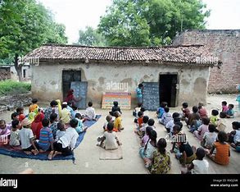
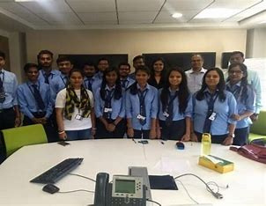
Sector-Wise Development Plan
.EDUCATION
Strategy
Infrastructure & Digital Access
Scholarship & Outreach Programs
Plan

Slide 13

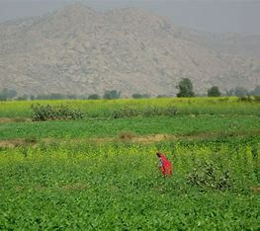
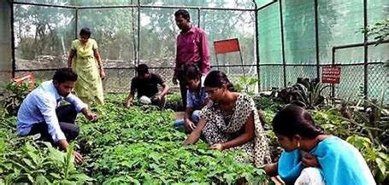
.Agriculture
Strategy
Modernization of Farming Practices and Technology Adoption
Formation of Agricultural Cooperatives and Market Linkages
Plan

Slide 14

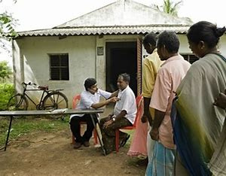
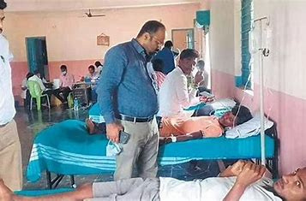
.Health
Strategy
Healthcare Facility Strengthening
Health Awareness Programs & Community Outreach
Plan

Slide 15

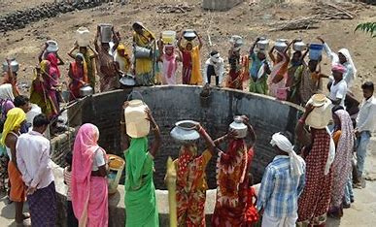
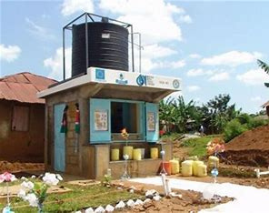
.Water
Strategy
Solar-Powered Water Supply & Filtration Systems
Installation of Rainwater Harvesting Systems
Plan

Slide 16

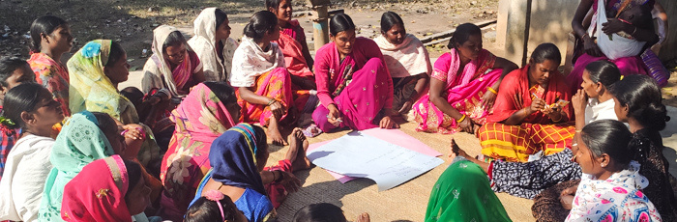
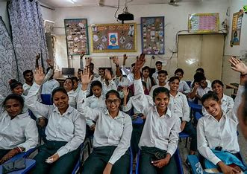
.Livelihood/Skill Development
Strategy
Establishment of Skill Development Centers
Support for Entrepreneurship and Self-Employment
Plan

Slide 17
About Organization
Manhit Exim Pvt. Ltd. (MEPL), established in 2018 by Director Mr. Vikas Nagar, is a nationally recognized organization dedicated to delivering multi-disciplinary learning and skill development solutions. With operations across 15–18 states, MEPL partners with government ministries and agencies such as NSDC, UPSDM, RSLDC, ASDM, and NULM to implement skill training programs. As an authorized training partner of the National Skill Development Corporation (NSDC), MEPL specializes in equipping youth with employable skills and supporting job placement. The organization’s experienced team of certified trainers and IT professionals makes it a strong candidate to drive sustainable development in villages like Bamori Kalan by setting up training centres and promoting livelihood enhancement.

Slide 18
OUR Major Areas/Focus OF Work
Strong Vision for Sustainable Development
Proven Experience in Skill Development
Rural Education Campaigns
Employment & Career Focused
Emphasis on Cultural Engagement
Support for Education through Scholarships
Environmental Commitment
Health Awareness Programs

Slide 19
Implementation Strategy
Phase | Duration | Focus Area
Phase I | 0–3 months | Baseline survey, partnerships with local authorities, identify beneficiaries
Phase II | 3–9 months | Start skill training, initiate educational support, set up health camps
Phase III | 9–18 months | Strengthen infrastructure, expand placement support, solar energy installation
Phase IV | 18+ months | Continuous monitoring, performance assessment, new initiative rollout

Slide 20
Monitoring & Evaluation
Development Area | Key Indicators (KPIs) | Monitoring Frequency | Responsible Entity | Evaluation Method
Skill Development & Employment | - No. of youth trained - % job placement rate - No. of new enterprises started | Monthly | MEPL Training Team Govt. Skill Schemes Cell | Trainee tracking reports, employer feedback
Education Improvement | - School attendance rate - Dropout rate (esp. girls) - Students receiving scholarships | Quarterly | School Admin MEPL Education Volunteers | School records, field surveys, focus group discussions
Healthcare & Awareness | - No. of health camps - % of population screened - Health issue reduction rate | Quarterly | PHC Staff MEPL Health Volunteers | Camp reports, health department data
Water & Sanitation | - No. of functional water sources - % households with toilets - Water quality levels | Bi-annually | Jal Jeevan Mission Team Local Panchayat | Physical verification, lab water tests
Electricity & Solar | - No. of households with solar panels - Reduction in power outages - No. of solar streetlights | Quarterly | Energy Dept. MEPL Infrastructure Team | Energy usage logs, field audits
Livelihood & Dairy | - Milk production volume - No. of dairy SHGs formed - Cooperative revenue growth | Monthly | Animal Husbandry Dept. SHG Coordinators | Dairy collection reports, cooperative accounts
Community Engagement | - No. of cultural events - Community participation rate - Formation of youth/women groups | Quarterly | Community Leaders MEPL Program Team | Event records, group meeting logs
Digital & Internet Access | - No. of internet-connected households - No. of people trained in digital literacy | Bi-annually | Digital India Cell MEPL Tech Team | ISP data, digital literacy assessments

Slide 21
Budget Overview
Sector | Estimated Cost (INR) | Fund Mobilization Plan | Funding Gap (If Any)
1. Infrastructure |  | PMGSY (roads), Jal Jeevan Mission (water), Saubhagya Scheme (electricity), CSR funds
2. Education |  | RTE Funds, Sarva Shiksha Abhiyan, Scholarships (NSP), NGO contributions
3. Healthcare |  | NHM (National Health Mission), CSR from pharma/health firms, NGO support
4. Skill Development |  | NSDC, UPSDM, RSLDC schemes, company-led CSR (MEPL, Manhit Exim Pvt. Ltd)
5. Agriculture/Dairy |  | NABARD, Agri Start-up Funds, Dairy Co-op Assistance Scheme

Slide 22
Risk & Management
Potential Challenges (Risks) | Mitigation Strategies
1. Low community participation or resistance to change | - Conduct regular awareness sessions - Involve local leaders and SHGs in planning
2. Inconsistent government support or delays in fund allocation | - Diversify funding sources (NGOs, CSR) - Establish MoUs with relevant departments
3. Skill mismatch with job market requirements | - Conduct industry needs assessment - Regularly update training modules accordingly
4. Migration of youth before completing programs | - Provide local job linkages and incentives to stay - Promote entrepreneurship
5. Infrastructure implementation delays (roads, solar, water) | - Establish clear timelines and regular contractor reviews - Community monitoring
6. Poor health service adoption due to social stigma or lack of awareness | - Health education campaigns - Engage community health workers and women volunteers
7. Gender disparity in education and employment | - Special programs and incentives for girls/women - Gender-sensitive planning
8. Internet and digital divide | - Provide shared digital access points - Conduct digital literacy workshops
9. Sustainability of solar systems and water infrastructure | - Train local maintenance teams - Set up village-level operation and maintenance fund
10. Environmental challenges (drought, water shortage) | - Promote rainwater harvesting - Use drought-resilient crops and techniques

Slide 23
Conclusion & Way Forward
The success of our development plan for Bamori Kalan hinges on a comprehensive, seven-pillar approach: establishing a fully equipped Training Centre, implementing critical Infrastructure Upgrades, ensuring reliable Water & Sanitation, providing rich Educational Resources, maintaining rigorous Health & Safety standards, setting up efficient Office & Administration, and driving ongoing Community Engagement. By addressing each of these core areas in concert, we will create an enabling environment that empowers local youth, strengthens village infrastructure, and fosters sustainable, community-led growth.
Call for Collaboration:
Government Departments
NGOs & Development Organizations
Private Sector & CSR Units
Local Community Leaders & Panchayat
Youth & Women

Slide 24
Thank You

