Slide 1
CSCI B609: “Foundations of Data Science”
Lecture 8/9: Faster Power Method
and Applications of SVD
Slides at http://grigory.us/data-science-class.html
Grigory Yaroslavtsev
http://grigory.us

Slide 2

Faster Power Method
PM drawback: $A^{T}A$ is dense even for sparse $A$
Pick random Gaussian $x$ and compute $B^{k}x$
$x=\sum_{i=1}^{d}{c_{i}v_{i}}$(augment $v_{i}$’s to o.n.b. if $r<d$)
$B^{k}x≈\left(σ_{1}^{2k}v_{1}^{}v_{1}^{T}\right)\left(\sum_{i=1}^{d}{c_{i}v_{i}}\right)= σ_{1}^{2k}c_{1}v_{1}$
$$B^{k}x=\left(A^{T}A\right)\left(A^{T}A\right)…(A^{T}A)x$$
Theorem: If $x$ is unit $ℝ^{d}$-vector, $\left|x^{T}v_{1}\right|≥δ$:
$V$ = subspace spanned by $v_{i}^{′}s$for $σ_{j}≥\left(1−ε\right)σ_{1}$
$w=$ unit vector after $k=\frac{1}{2ε}\ln\left(\frac{1}{εδ}\right)$ iterations of PM
$⇒$ $w$has a component at most $ε$ orthogonal to $V$

Slide 3
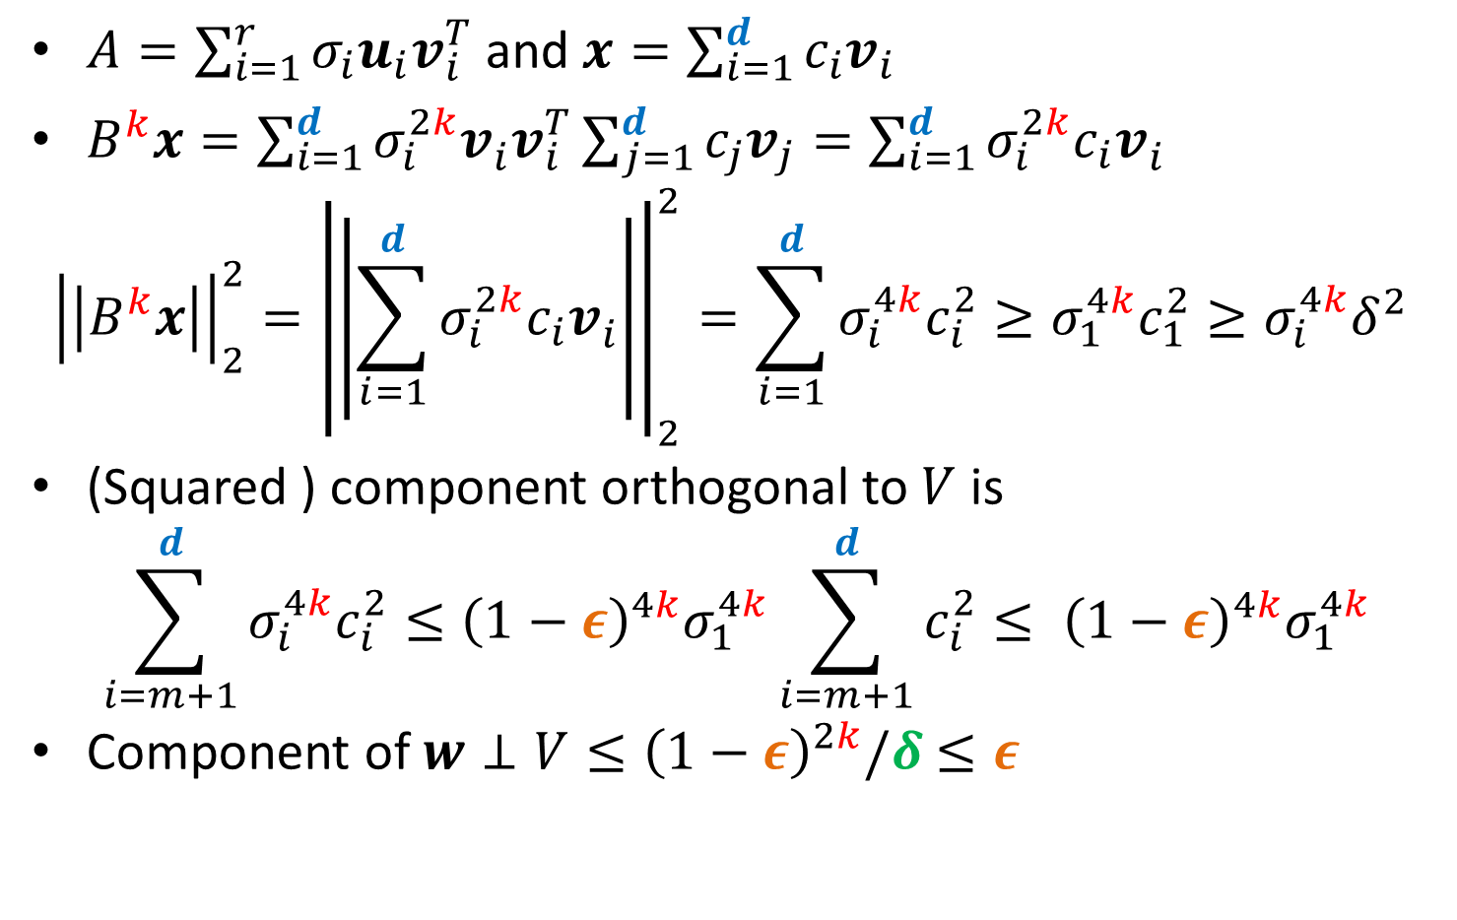
Faster Power Method: Analysis
$A=\sum_{i=1}^{r}{σ_{i}u_{i}v_{i}^{T}}$ and $x=\sum_{i=1}^{d}{c_{i}v_{i}}$
$B^{k}x=\sum_{i=1}^{d}{σ_{i}^{2k}v_{i}^{}v_{i}^{T}}\sum_{j=1}^{d}{c_{j}v_{j}}=\sum_{i=1}^{d}{σ_{i}^{2k}c_{i}v_{i}^{}}$
$${\left|\left|B^{k}x\right|\right|}_{2}^{2}={\left|\left|\sum_{i=1}^{d}{σ_{i}^{2k}c_{i}v_{i}^{}}\right|\right|}_{2}^{2}=\sum_{i=1}^{d}{σ_{i}^{4k}c_{i}^{2}}≥σ_{1}^{4k}c_{1}^{2}≥σ_{i}^{4k}δ^{2}$$
(Squared ) component orthogonal to $V$ is
$$\sum_{i=m+1}^{d}{σ_{i}^{4k}c_{i}^{2}}≤{\left(1−ε\right)}_{}^{4k}σ_{1}^{4k}\sum_{i=m+1}^{d}{c_{i}^{2}}≤ {\left(1−ε\right)}_{}^{4k}σ_{1}^{4k}$$
Component of $w⊥V≤{\left(1−ε\right)}_{}^{2k}/δ$ $≤ε$

Slide 4
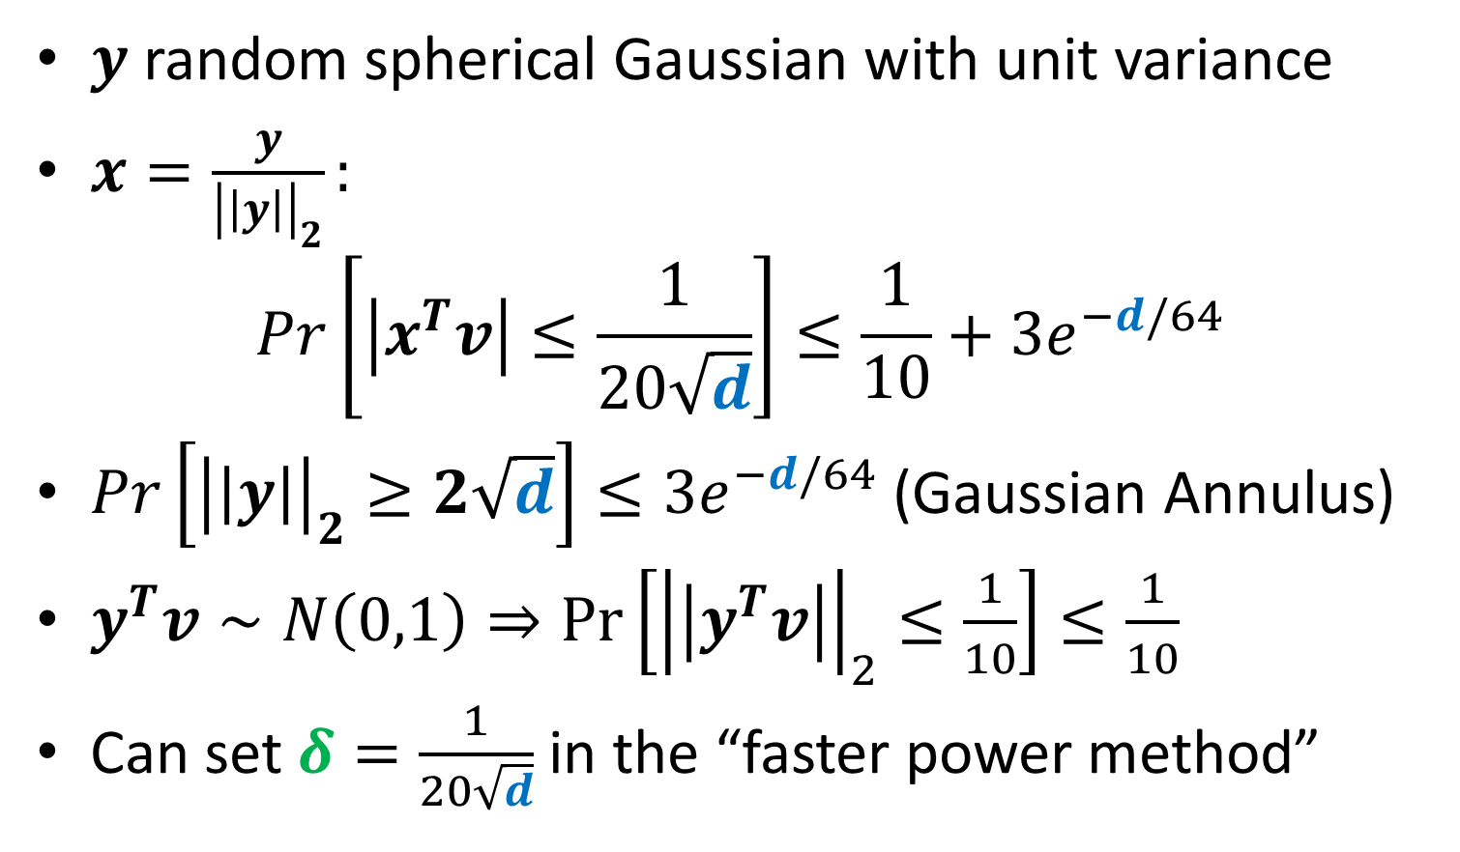

Choice of $x$
$y$ random spherical Gaussian with unit variance
$x=\frac{y}{{\left|\left|y\right|\right|}_{2}}:$
$$Pr\left[\left|x^{T}v\right|≤\frac{1}{20\sqrt{d}}\right]≤\frac{1}{10}+3e^{−d/64}$$
$Pr\left[{\left|\left|y\right|\right|}_{2}≥2\sqrt{d}\right]≤3e^{−d/64}$ (Gaussian Annulus)
$y^{T}v∼N\left(0,1\right)⇒\operatorname{Pr}\left[{\left|\left|y^{T}v\right|\right|}_{2}≤\frac{1}{10}\right]≤\frac{1}{10}$
Can set $δ=\frac{1}{20\sqrt{d}}$ in the “faster power method”

Slide 5
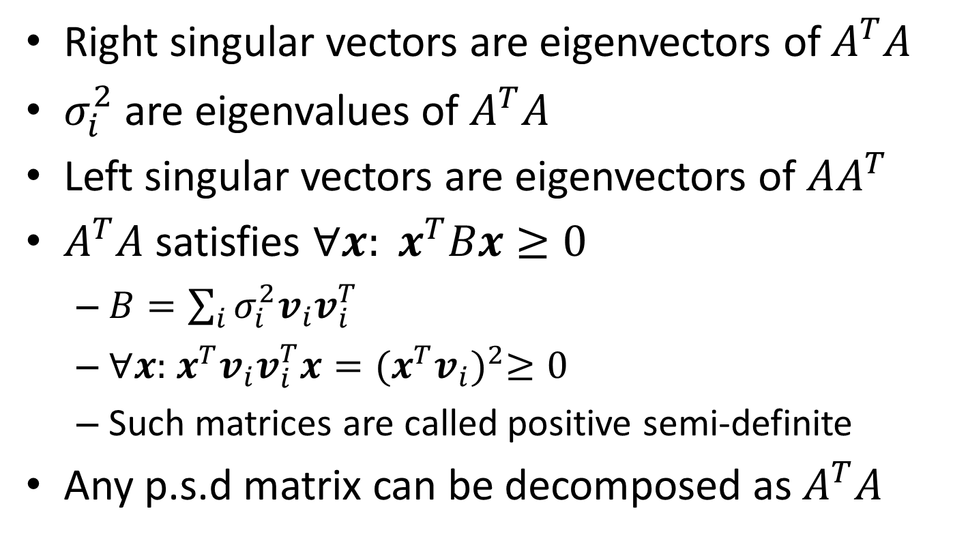
Singular Vectors and Eigenvectors
Right singular vectors are eigenvectors of $A^{T}A$
$σ_{i}^{2}$ are eigenvalues of $A^{T}A$
Left singular vectors are eigenvectors of $AA^{T}$
$A^{T}A$ satisfies ${∀x: x}^{T}Bx≥0$
$B=\sum_{i}{σ_{i}^{2}v_{i}v_{i}^{T}}$
$∀x:$ $x^{T}v_{i}v_{i}^{T}x{={(x}^{T}v_{i})}^{2}≥0$
Such matrices are called positive semi-definite
Any p.s.d matrix can be decomposed as $A^{T}A$

Slide 6
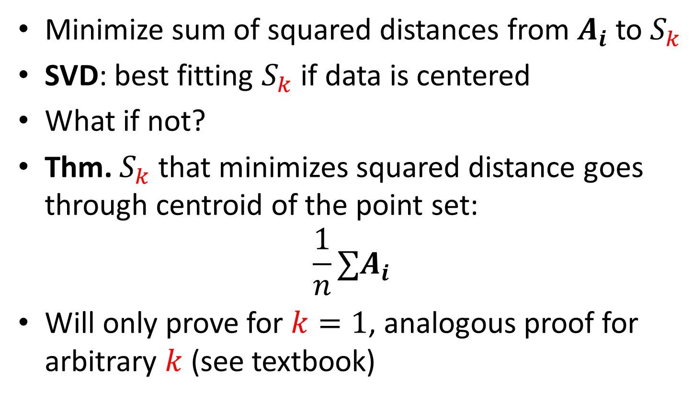
Application of SVD: Centering Data
Minimize sum of squared distances from $A_{i}$ to $S_{k}$
SVD: best fitting $S_{k}$ if data is centered
What if not?
Thm. $S_{k}$ that minimizes squared distance goes through centroid of the point set:
$$\frac{1}{n}∑A_{i}$$
Will only prove for $k=1$, analogous proof for arbitrary $k$ (see textbook)

Slide 7
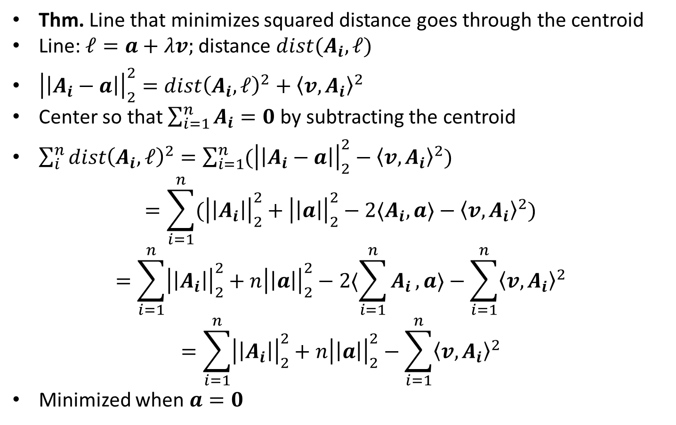
Application of SVD: Centering Data
Thm. Line that minimizes squared distance goes through the centroid
Line: $ℓ=a+λv;$ distance $dist(A_{i},ℓ)$
${\left|\left|A_{i}−a\right|\right|}_{2}^{2}=dist{\left(A_{i},ℓ\right)}^{2}+{〈v,A_{i}〉}^{2}$
Center so that $\sum_{i=1}^{n}{A_{i}}=0$ by subtracting the centroid
$\sum_{i}^{n}{dist{\left(A_{i},ℓ\right)}^{2}}=\sum_{i=1}^{n}{({\left|\left|A_{i}−a\right|\right|}_{2}^{2}−{〈v,A_{i}〉}^{2})}$
$$=\sum_{i=1}^{n}{({\left|\left|A_{i}\right|\right|}_{2}^{2}+{\left|\left|a\right|\right|}_{2}^{2}−2〈A_{i},a〉−{〈v,A_{i}〉}^{2})}$$
$$=\sum_{i=1}^{n}{{\left|\left|A_{i}\right|\right|}_{2}^{2}+{n\left|\left|a\right|\right|}_{2}^{2}−2〈\sum_{i=1}^{n}{A_{i}},a〉−\sum_{i=1}^{n}{{〈v,A_{i}〉}^{2}}}$$
$$=\sum_{i=1}^{n}{{\left|\left|A_{i}\right|\right|}_{2}^{2}+{n\left|\left|a\right|\right|}_{2}^{2}−\sum_{i=1}^{n}{{〈v,A_{i}〉}^{2}}}$$
Minimized when $a=0$

Slide 8
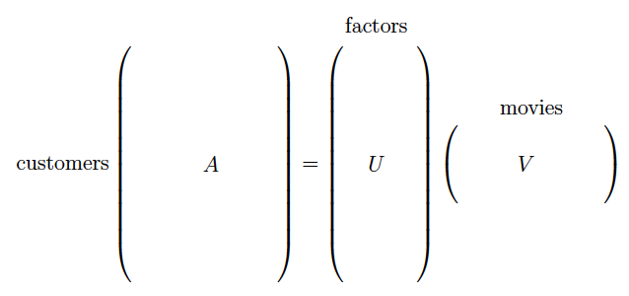
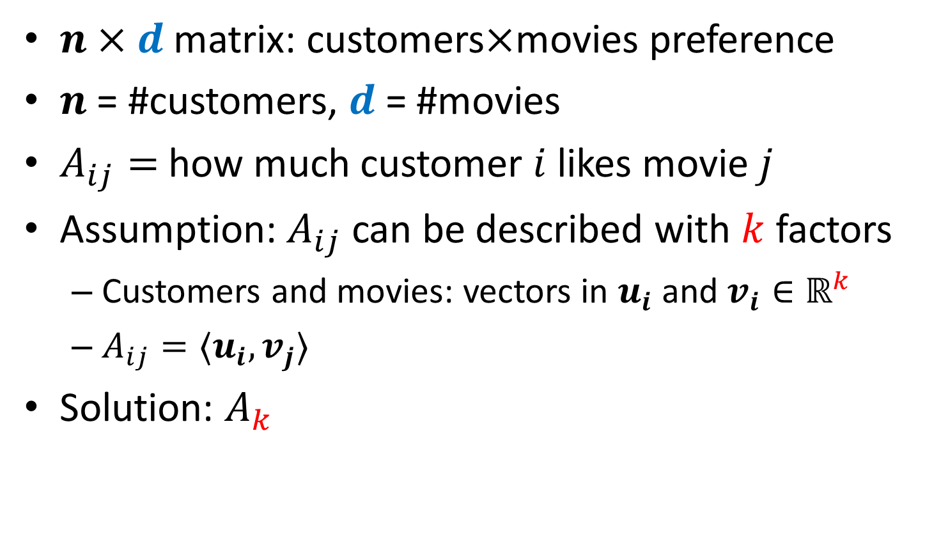
Principal Component Analysis
$n×d$ matrix: customers$×$movies preference
$n$ = #customers, $d$ = #movies
$A_{ij}=$ how much customer $i$ likes movie $j$
Assumption: $A_{ij}$ can be described with $k$ factors
Customers and movies: vectors in $u_{i}$ and $v_{i}∈ℝ^{k}$
$A_{ij}=〈u_{i},v_{j}〉$
Solution: $A_{k}$

Slide 9
Class Project
Survey of 3-5 research papers
Closely related to the topics of the class
Algorithms for high-dimensional data
Fast algorithms for numerical linear algebra
Algorithms for machine learning and/or clustering
Algorithms for streaming and massive data
Office hours if you need suggestions
Individual (not a group) project
1-page Proposal Due: October 31, 2016 at 23:59 EST
Final Deadline: December 09, 2016 at 23:59 EST
Submission by e-mail to Lisul Islam (IU id: islammdl)
Submission Email Title: Project + Space + “Your Name”
Submission format: PDF from LaTeX

Slide 10
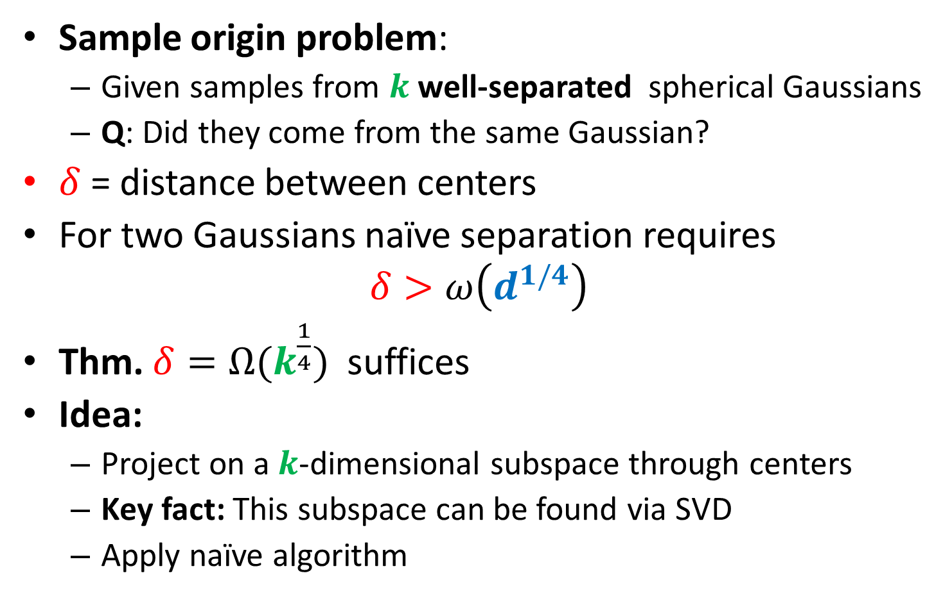

Separating mixture of $k$ Gaussians
Sample origin problem:
Given samples from $k$well-separated spherical Gaussians
Q: Did they come from the same Gaussian?
$δ$ = distance between centers
For two Gaussians naïve separation requires
$$δ>ω\left(d^{1/4}\right)$$
Thm. ${δ=Ω(k}^{\frac{1}{4}})$ suffices
Idea:
Project on a $k$-dimensional subspace through centers
Key fact: This subspace can be found via SVD
Apply naïve algorithm

Slide 11
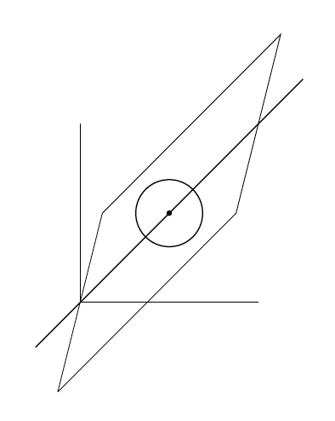

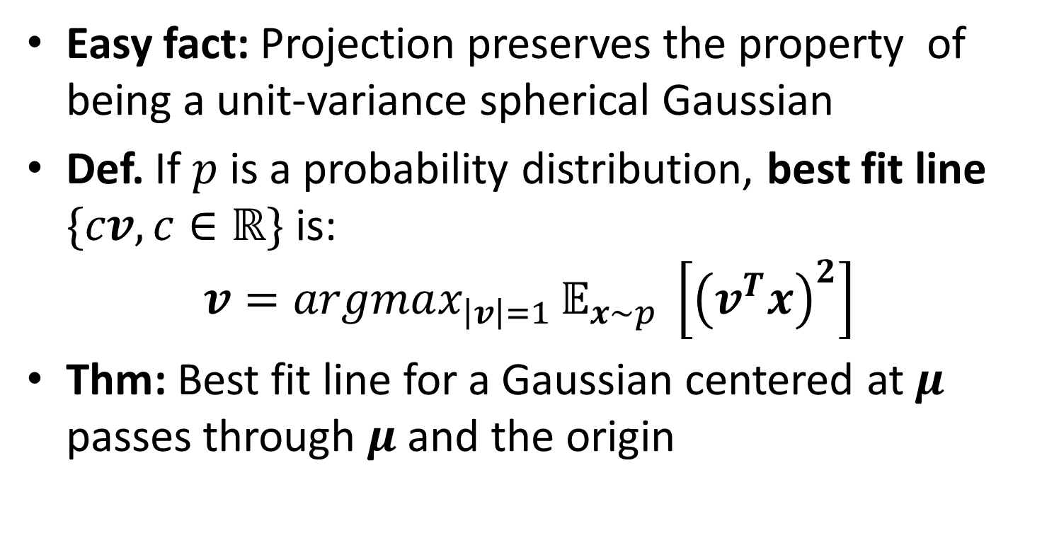
Separating mixture of $k$ Gaussians
Easy fact: Projection preserves the property of being a unit-variance spherical Gaussian
Def. If $p$ is a probability distribution, best fit line $\{cv, c∈ℝ\}$ is:
$$v=argmax_{\left|v\right|=1 }𝔼_{x∼p} \left[{\left(v^{T}x\right)}^{2}\right]$$
Thm: Best fit line for a Gaussian centered at $μ$ passes through $μ$ and the origin

Slide 12
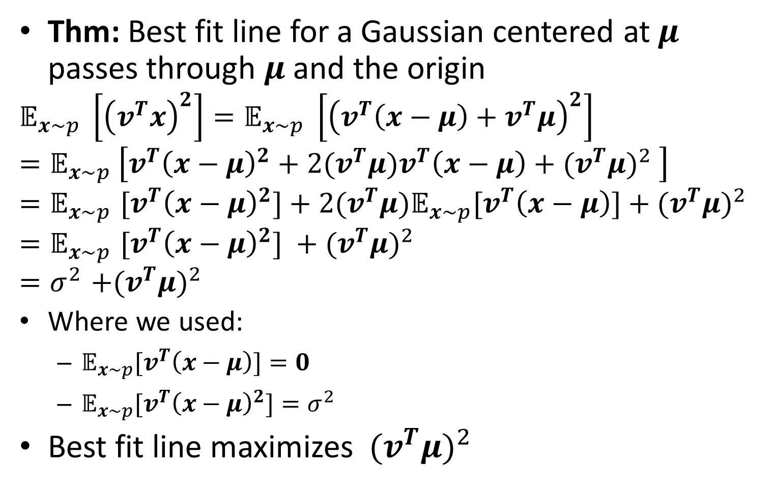
Best fit line for a Gaussian
Thm: Best fit line for a Gaussian centered at $μ$ passes through $μ$ and the origin
$$𝔼_{x∼p} \left[{\left(v^{T}x\right)}^{2}\right]=𝔼_{x∼p} \left[{\left(v^{T}\left(x−μ\right)+v^{T}μ\right)}^{2}\right]$$
$$=𝔼_{x∼p} \left[v^{T}{\left(x−μ\right)}^{2}+2{(v}^{T}μ)v^{T}\left(x−μ\right)+{{(v}^{T}μ)}^{2} \right]$$
$${=𝔼}_{x∼p}{[v}^{T}{\left(x−μ\right)}^{2}]+2{(v}^{T}μ){𝔼_{x∼p}[v}^{T}\left(x−μ\right)]+{{(v}^{T}μ)}^{2}$$
$${=𝔼}_{x∼p}{[v}^{T}{\left(x−μ\right)}^{2}] +{{(v}^{T}μ)}^{2}$$
$${=σ}^{2}+{{(v}^{T}μ)}^{2}$$
Where we used:
${𝔼_{x∼p}[v}^{T}\left(x−μ\right)]=0$
$𝔼_{x∼p}{[v}^{T}{\left(x−μ\right)}^{2}]=σ^{2}$
Best fit line maximizes ${{ (v}^{T}μ)}^{2}$

Slide 13
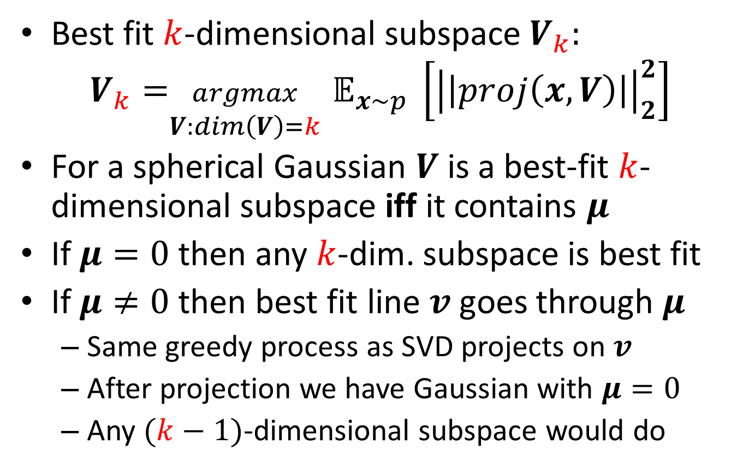
Best fit subspace for one Gaussian
Best fit $k$-dimensional subspace $V_{k}:$
$${V_{k}=}_{\begin{aligned}argmax \\ V:dim\left(V\right)=k\end{aligned}}𝔼_{x∼p} \left[{\left|\left|proj\left(x,V\right)\right|\right|}_{2}^{2}\right]$$
For a spherical Gaussian $V$ is a best-fit $k$-dimensional subspace iff it contains $μ$
If $μ=0$ then any $k$-dim. subspace is best fit
If $μ≠0$ then best fit line $v$goes through $μ$
Same greedy process as SVD projects on $v$
After projection we have Gaussian with $μ=0$
Any $(k−1)$-dimensional subspace would do

Slide 14
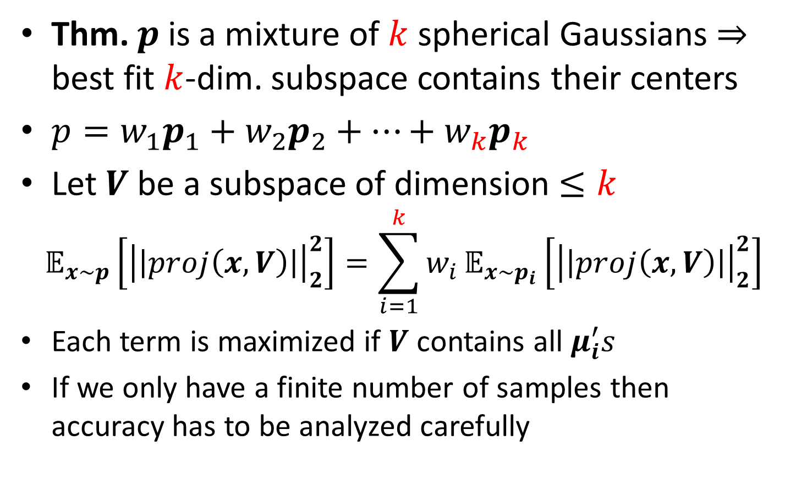

Best fit subspace for $k$ Gaussians
Thm. $p$ is a mixture of $k$ spherical Gaussians $⇒$ best fit $k$-dim. subspace contains their centers
$p=w_{1}p_{1}+w_{2}p_{2}+…+w_{k}p_{k}$
Let $V$ be a subspace of dimension $≤k$
$$𝔼_{x∼p}\left[{\left|\left|proj\left(x,V\right)\right|\right|}_{2}^{2}\right]=\sum_{i=1}^{k}{w_{i}}𝔼_{x∼p_{i}}\left[{\left|\left|proj\left(x,V\right)\right|\right|}_{2}^{2}\right]$$
Each term is maximized if $V$ contains all $μ_{i}^{′}s$
If we only have a finite number of samples then accuracy has to be analyzed carefully

Slide 15
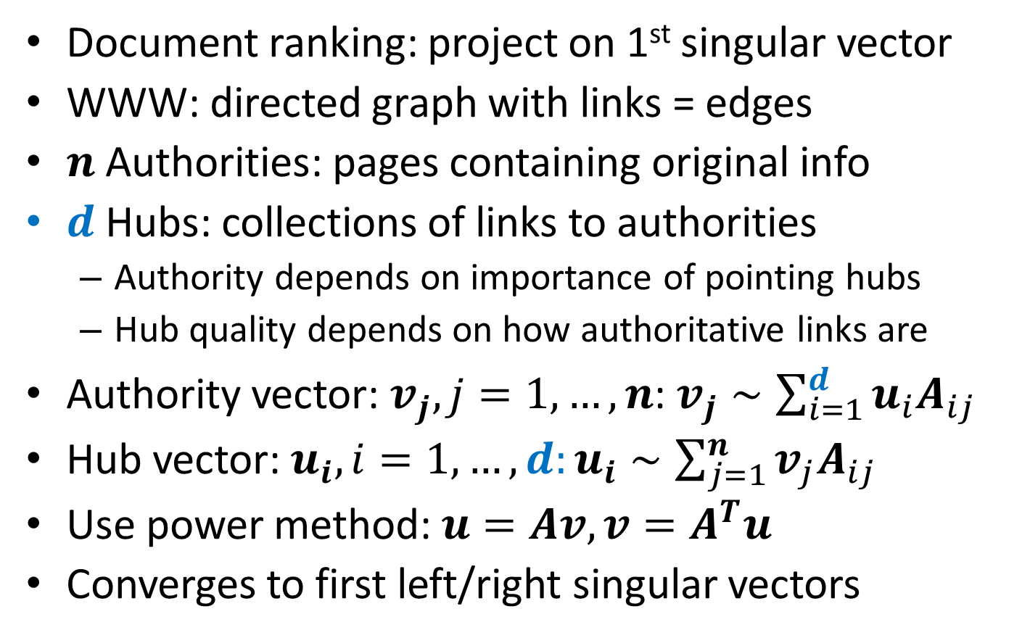
HITS Algorithm for Hubs and Authorities
Document ranking: project on 1st singular vector
WWW: directed graph with links = edges
$n$Authorities: pages containing original info
$d$ Hubs: collections of links to authorities
Authority depends on importance of pointing hubs
Hub quality depends on how authoritative links are
Authority vector: $v_{j},j=1,…,n$: $v_{j}∼\sum_{i=1}^{d}{u_{i}A_{ij}}$
Hub vector: $u_{i}, i=1,…,d:u_{i}∼\sum_{j=1}^{n}{v_{j}A_{ij}}$
Use power method: $u=Av, v=A^{T}u$
Converges to first left/right singular vectors

Slide 16
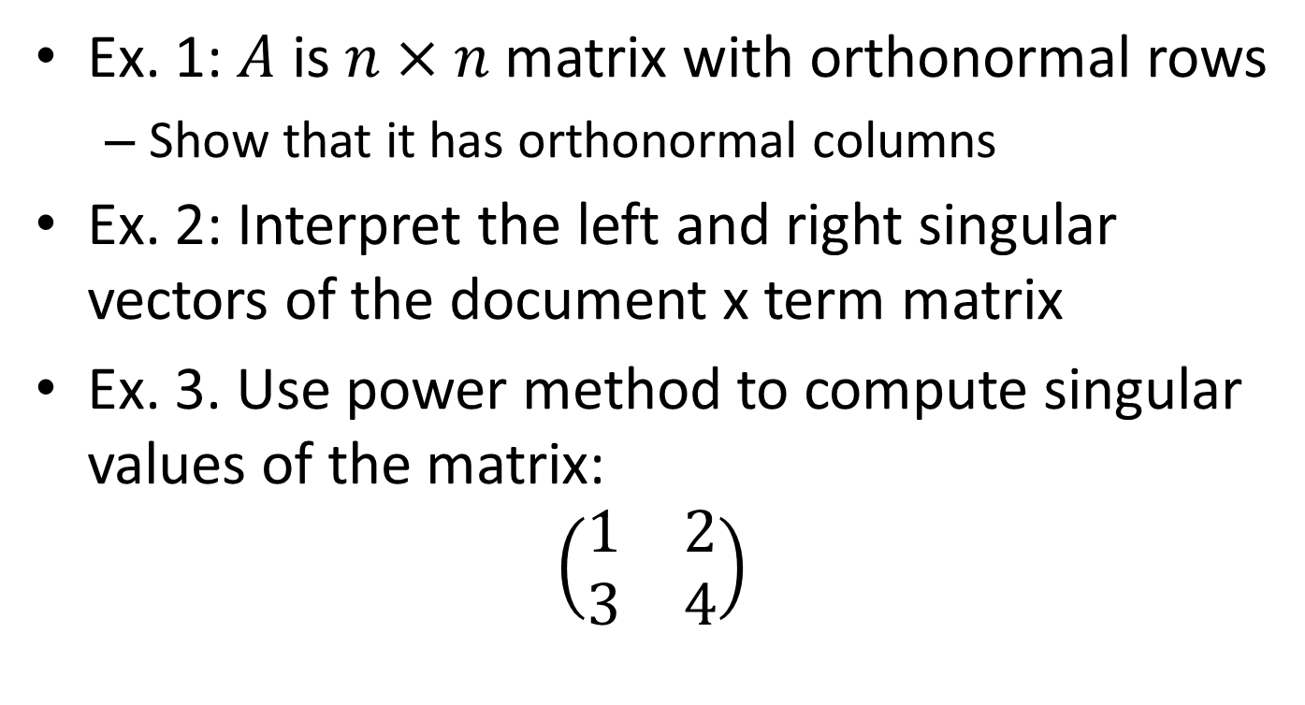
Exercises
Ex. 1: $A$ is $n×n$ matrix with orthonormal rows
Show that it has orthonormal columns
Ex. 2: Interpret the left and right singular vectors of the document x term matrix
Ex. 3. Use power method to compute singular values of the matrix:
$$\left(\begin{matrix}1 & 2 \\ 3 & 4\end{matrix}\right)$$

