Slide 1
CSCI B609: “Foundations of Data Science”
Lecture 17/18: Graph Sketching
Slides at http://grigory.us/data-science-class.html
Grigory Yaroslavtsev
http://grigory.us

Slide 2
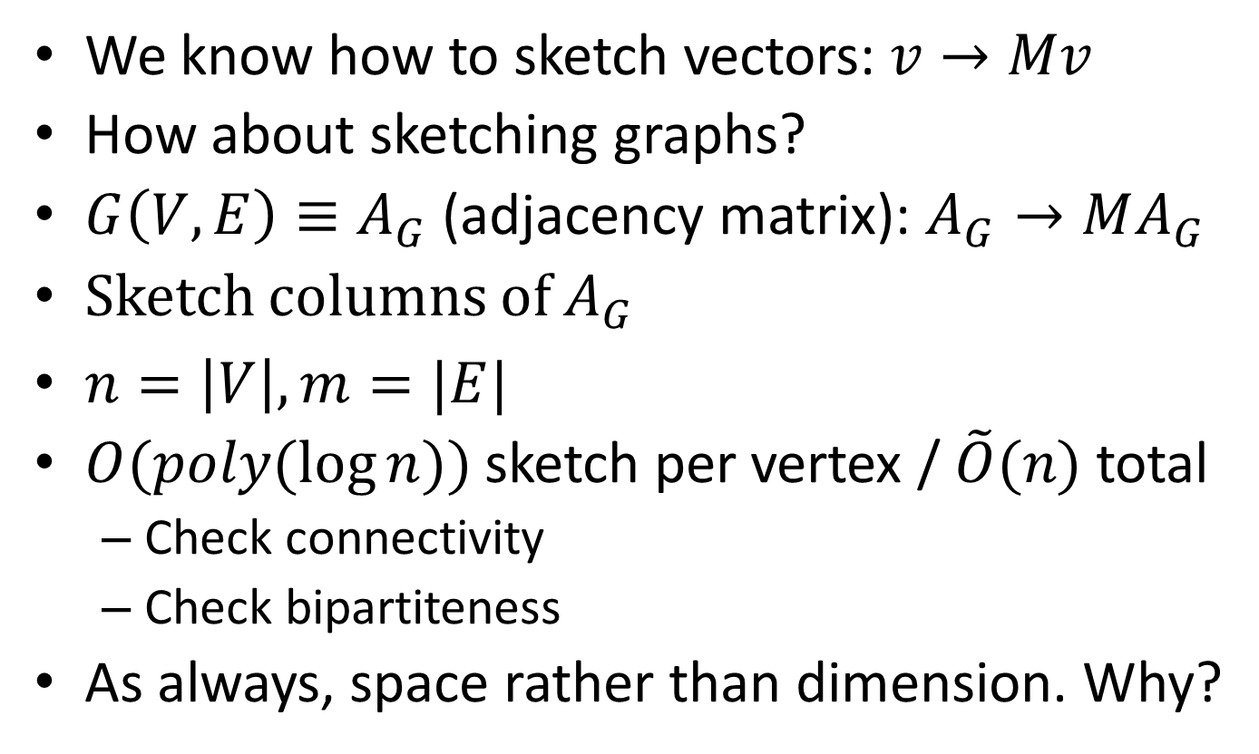
Sketching Graphs?
We know how to sketch vectors:$v→Mv$
How about sketching graphs?
$G\left(V,E\right)≡A_{G}$ (adjacency matrix): $A_{G}→MA_{G}$
Sketch columns of $A_{G}$
$n=\left|V\right|, m=|E|$
$O(poly(\log{n}))$ sketch per vertex / $\tilde{O}(n)$ total
Check connectivity
Check bipartiteness
As always, space rather than dimension. Why?

Slide 3
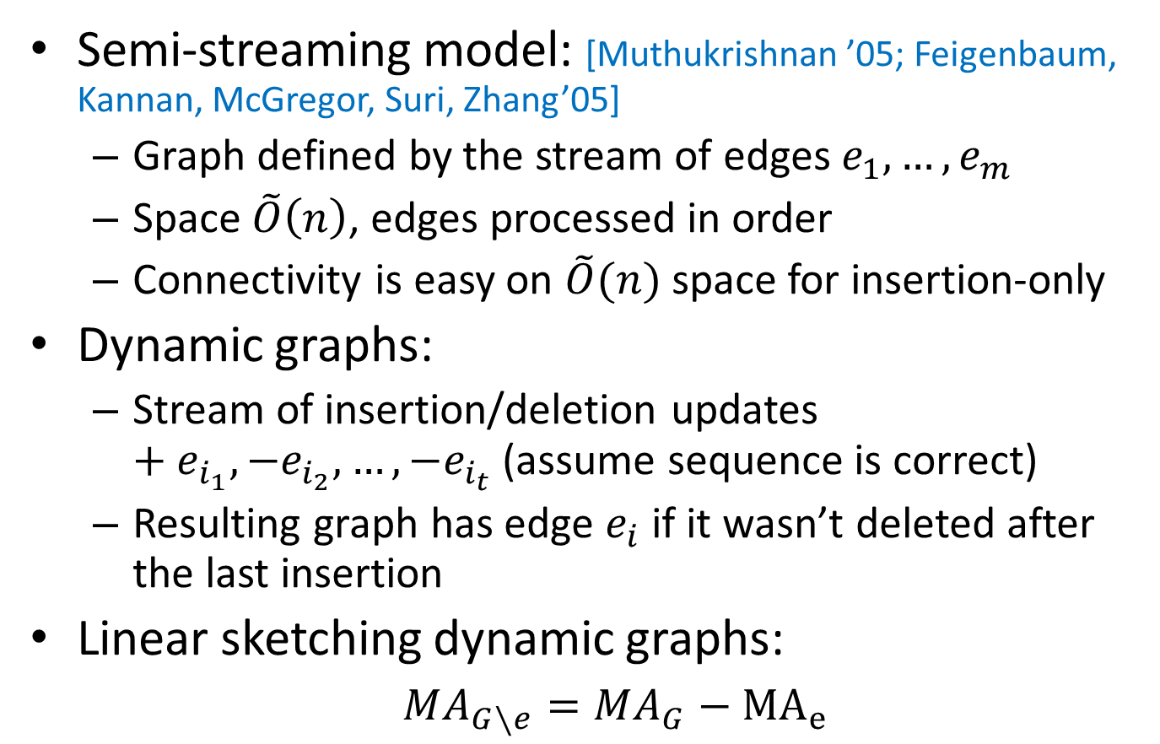
Graph Streams
Semi-streaming model: [Muthukrishnan ’05; Feigenbaum, Kannan, McGregor, Suri, Zhang’05]
Graph defined by the stream of edges $e_{1},…, e_{m}$
Space $\tilde{O}\left(n\right)$, edges processed in order
Connectivity is easy on $\tilde{O}(n)$ space for insertion-only
Dynamic graphs:
Stream of insertion/deletion updates $+e_{i_{1}}, −e_{i_{2}}, …, −e_{i_{t}}$ (assume sequence is correct)
Resulting graph has edge $e_{i}$ if it wasn’t deleted after the last insertion
Linear sketching dynamic graphs:
$MA_{G∖e}=MA_{G}−{MA}_{e}$

Slide 4
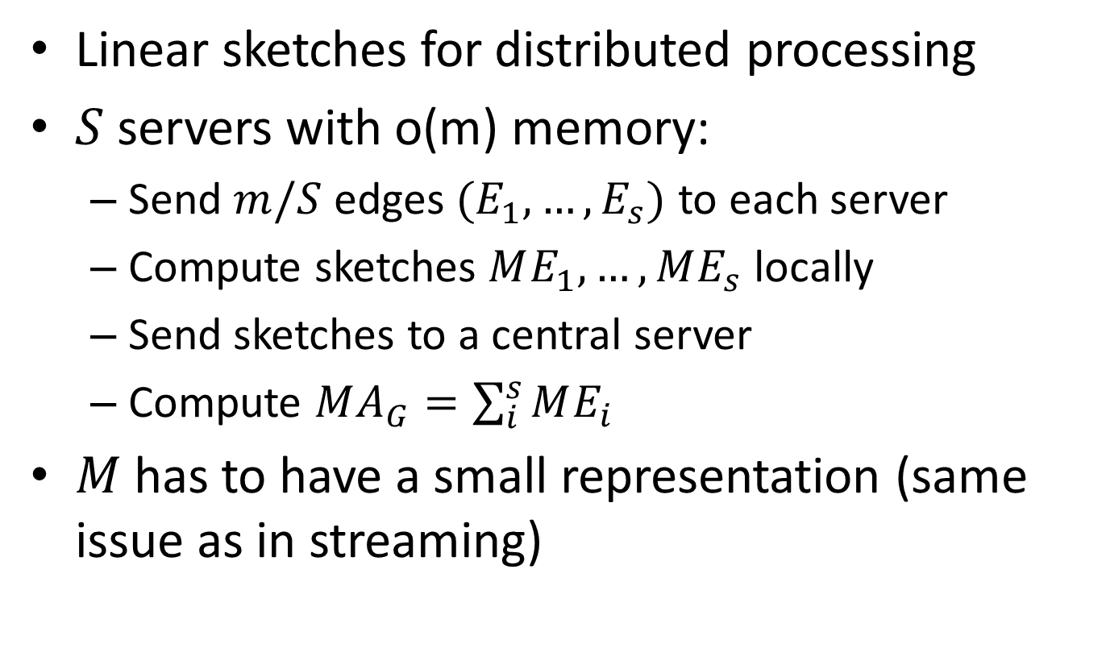
Distributed Computing
Linear sketches for distributed processing
$S$ servers with o(m) memory:
Send $m/S$ edges $(E_{1},…, E_{s})$ to each server
Compute sketches $ME_{1},…, ME_{s}$ locally
Send sketches to a central server
Compute $MA_{G}=\sum_{i}^{s}{ME_{i}}$
$M$ has to have a small representation (same issue as in streaming)

Slide 5

Connectivity
Thm. Connectivity is sketchable in $\tilde{O}(n)$ space
Framework:
Take existing connectivity algorithm (Boruvka)
Sketch $A_{G}→MA_{G}$
Run Boruvka on $MA_{G}$
Important that the sketch is homomorphic w.r.t the algorithm

Slide 6

Part 1: Parallel Connectivity (Boruvka)
Repeat until no edges left:
For each vertex, select any incident edge
Contract selected edges
Lemma: process converges in $O(\log{n})$ steps

Slide 7
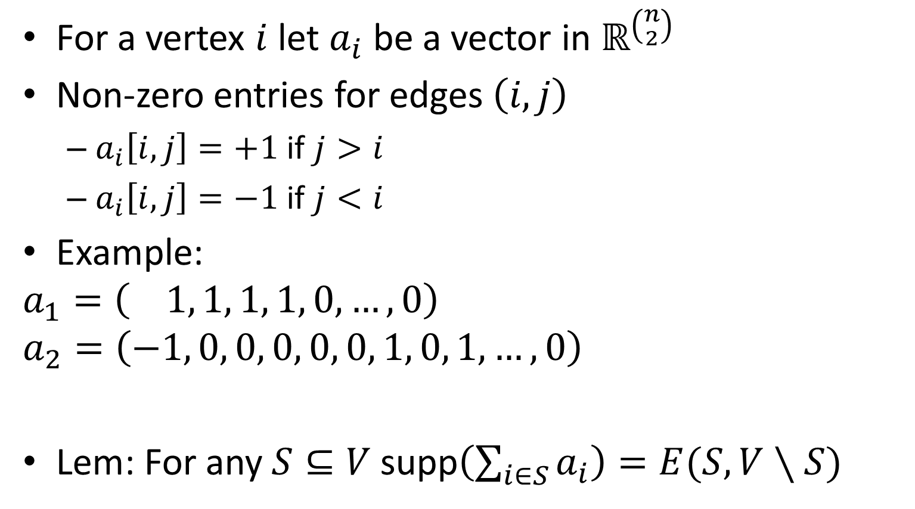
Part 2: Graph Representation
For a vertex $i$ let $a_{i}$ be a vector in $ℝ^{\left({n \atop 2}\right)}$
Non-zero entries for edges $\left(i,j\right)$
$a_{i}\left[i,j\right]=+1$ if $j>i$
$a_{i}\left[i,j\right]=−1$ if $j<i$
Example:
$$a_{1}=\left( 1, 1, 1, 1, 0, …,0\right)$$
$$a_{2}=\left(−1, 0, 0, 0, 0, 0, 1, 0, 1, …, 0\right)$$
Lem: For any $S⊆V$ supp$\left(\sum_{i∈S}{a_{i}}\right)=E(S,V∖S)$
7
3
2
6
1
4
5
$$\left\{1,2\right\},\left\{1,3\right\},\left\{1,4\right\},\left\{1,5\right\},\left\{1,6\right\},\left\{1,7\right\},\left\{2,3\right\},\left\{2.4\right\}.\left\{2,5\right\}, …$$

Slide 8
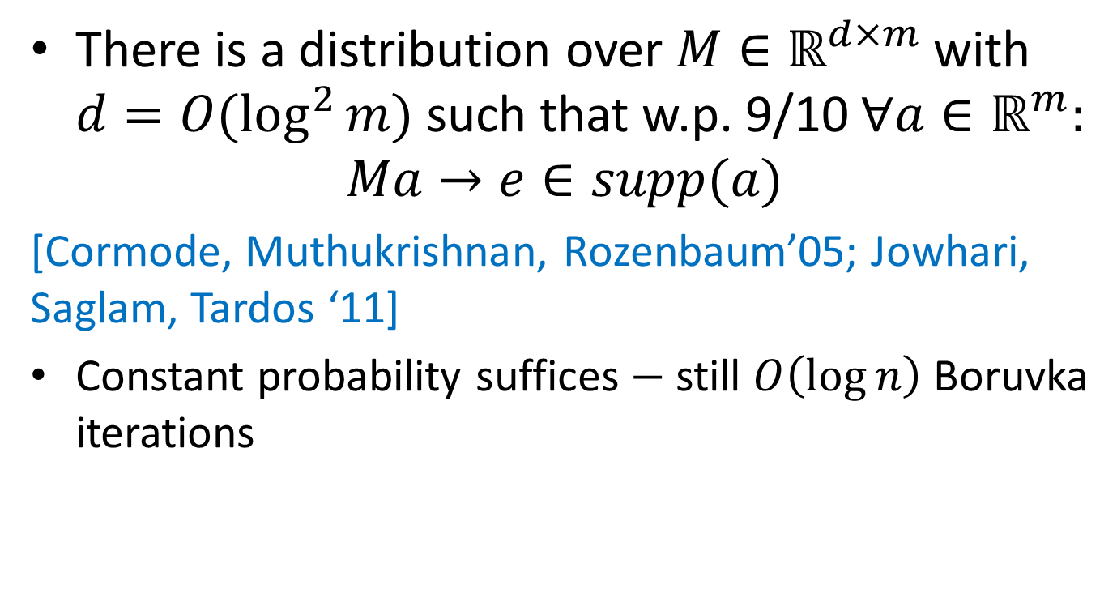

Part 3: $L_{0}$-Sampling
There is a distribution over $M∈ℝ^{d×m}$ with $d=O(\log^{2}{m})$ such that w.p. 9/10 $∀a∈ℝ^{m}:$
$$Ma→e∈supp(a)$$
[Cormode, Muthukrishnan, Rozenbaum’05; Jowhari, Saglam, Tardos ‘11]
Constant probability suffices $−$ still $O\left(\log{n}\right)$ Boruvka iterations

Slide 9
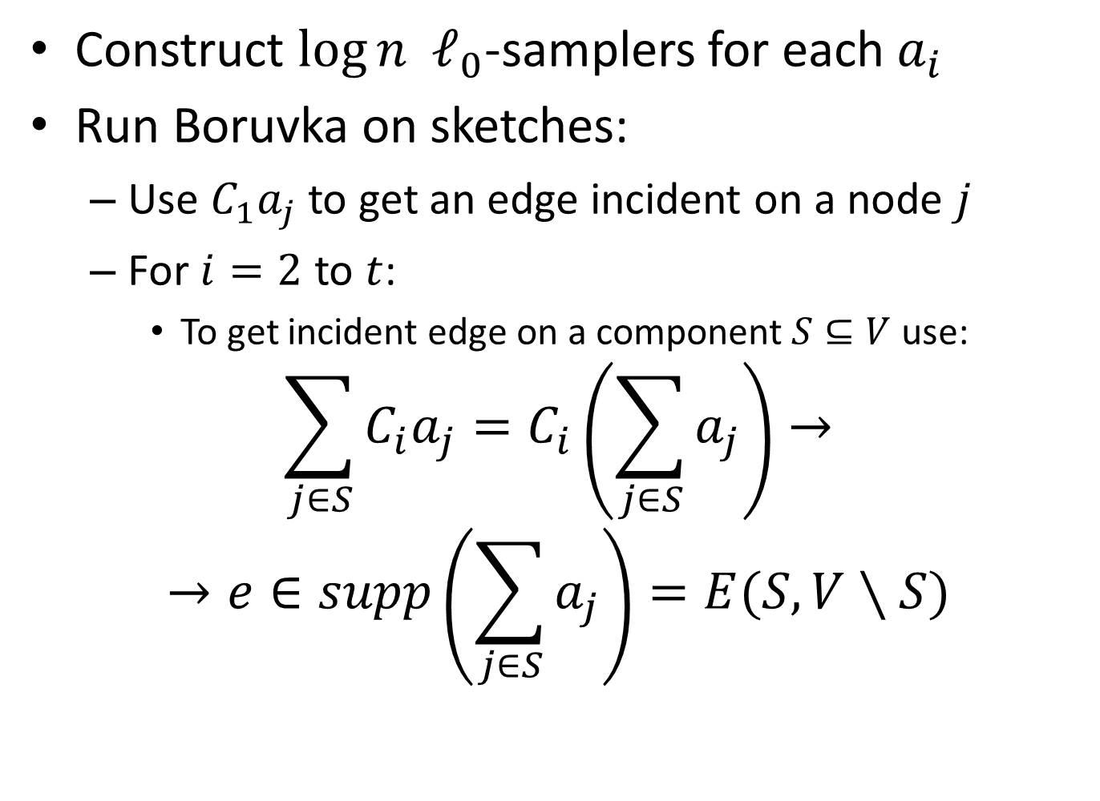
Final Algorithm
Construct $\log{n}$ $ℓ_{0}$-samplers for each $a_{i}$
Run Boruvka on sketches:
Use $C_{1}a_{j}$ to get an edge incident on a node $j$
For $i=2$ to $t$:
To get incident edge on a component $S⊆V$ use:
$$\sum_{j∈S}{C_{i}a_{j}=C_{i}\left(\sum_{j∈S}{a_{j}}\right)→}$$
$$→e∈supp\left(\sum_{j∈S}{a_{j}}\right)=E(S,V∖S)$$

Slide 10
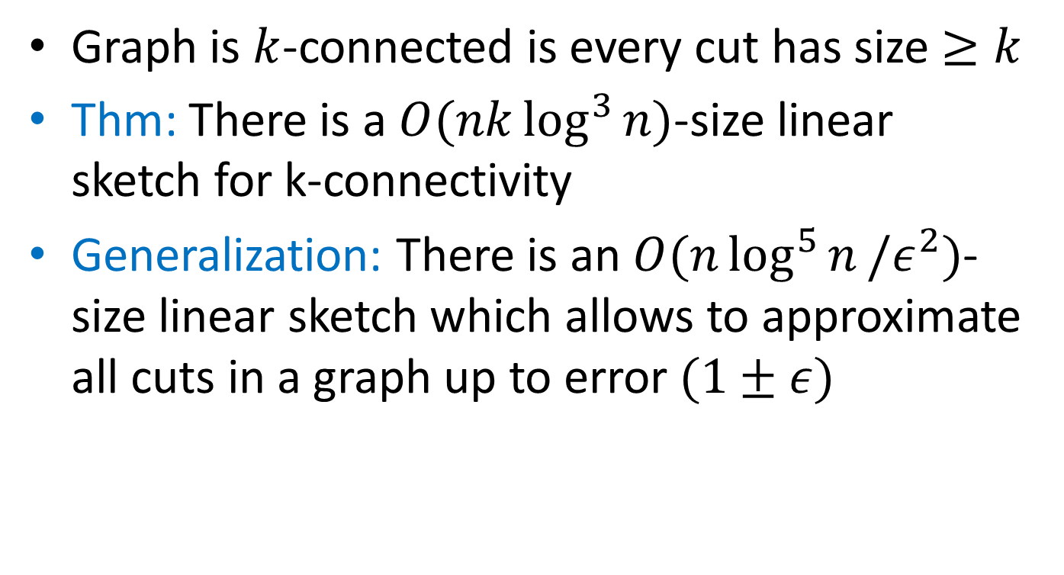
K-Connectivity
Graph is $k$-connected is every cut has size $≥k$
Thm: There is a $O(nk\log^{3}{n})$-size linear sketch for k-connectivity
Generalization: There is an $O(n\log^{5}{n}/ε^{2})$-size linear sketch which allows to approximate all cuts in a graph up to error $(1±ε)$

Slide 11
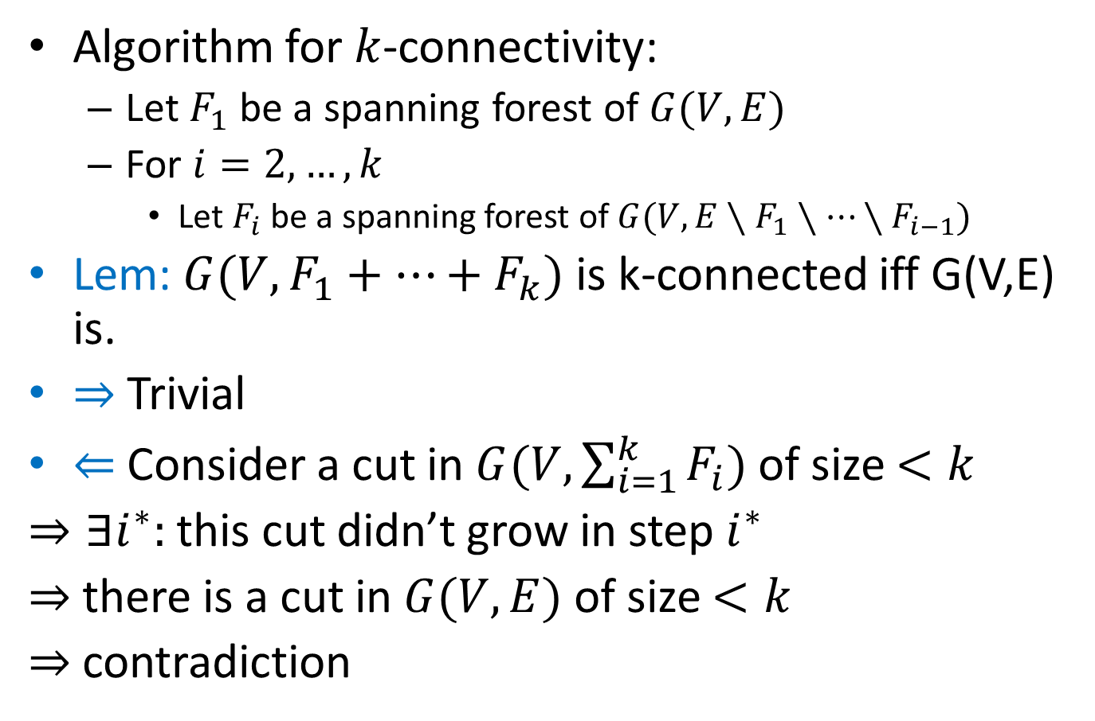
K-connectivity Algorithm
Algorithm for $k$-connectivity:
Let $F_{1}$ be a spanning forest of $G(V,E)$
For $i=2, …, k$
Let $F_{i}$ be a spanning forest of $G(V, E∖F_{1}∖…∖F_{i−1})$
Lem: $G(V,F_{1}+…+F_{k})$ is k-connected iff G(V,E) is.
$⇒$ Trivial
$⇐$ Consider a cut in $G(V,\sum_{i=1}^{k}{F_{i}})$ of size $<k$
$⇒∃i^{∗}:$ this cut didn’t grow in step $i^{∗}$
$⇒$ there is a cut in $G(V,E)$ of size $<k$
$⇒$contradiction

Slide 12
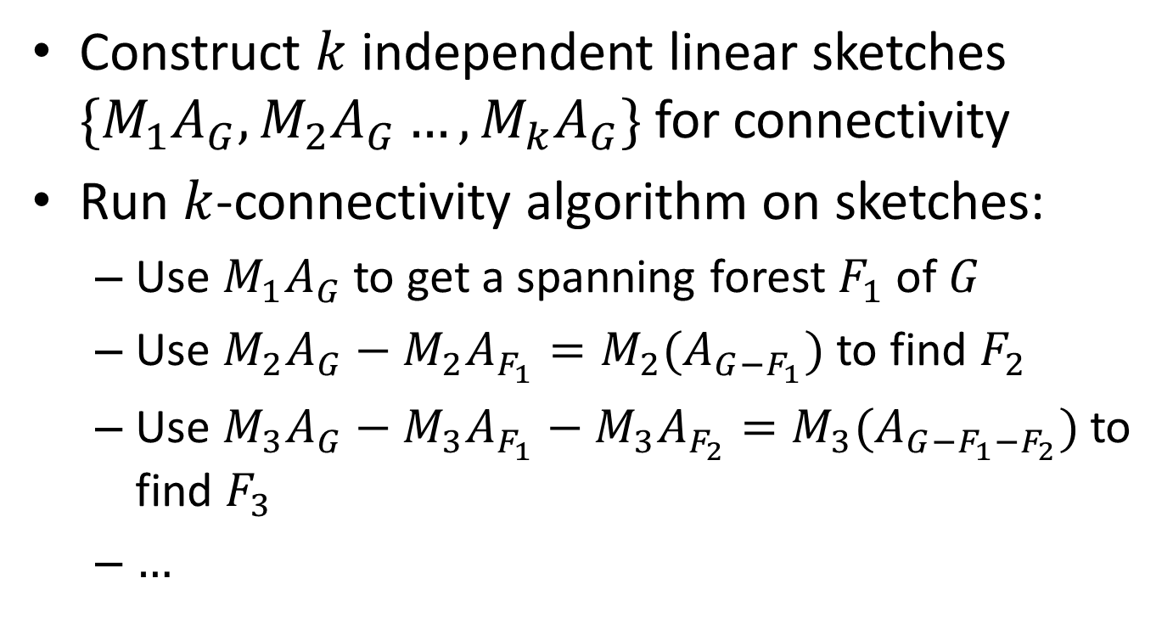
K-connectivity Algorithm
Construct $k$ independent linear sketches $\{M_{1}A_{G},M_{2}A_{G}…, M_{k}A_{G}\}$ for connectivity
Run $k$-connectivity algorithm on sketches:
Use $M_{1}A_{G}$ to get a spanning forest $F_{1}$ of $G$
Use $M_{2}A_{G}−M_{2}A_{F_{1}}=M_{2}(A_{G−F_{1}})$ to find $F_{2}$
Use $M_{3}A_{G}−M_{3}A_{F_{1}}−M_{3}A_{F_{2}}=M_{3}(A_{G−F_{1}−F_{2}})$ to find $F_{3}$
$…$

Slide 13



Bipartiteness
Reduction: Given $G$ define $G′$ where vertices $v→(v_{1},v_{2})$; edges $\left(u,v\right)→(u_{1},v_{2})$ & $(u_{2},v_{1})$
Lem: # connected components doubles iff the graph is bipartite.
Thm: $O(n\log^{3}{n})$-size linear sketch for k-connectivity (sketch $G′$ (implicitly).)
$$→$$
$$→$$

Slide 14
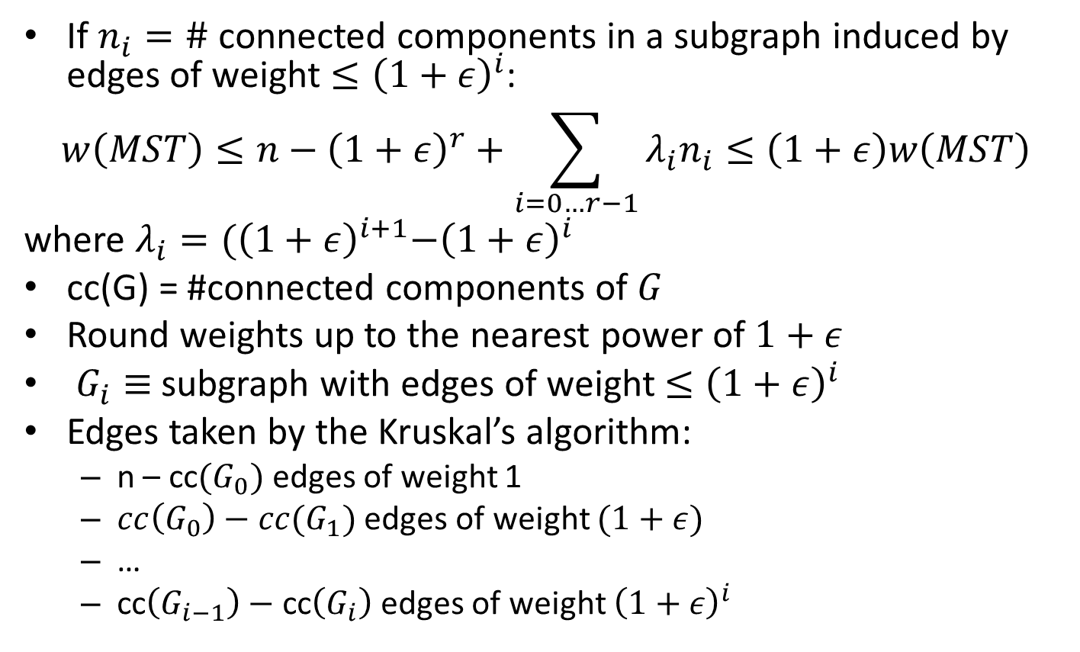
Minimum Spanning Tree
If $n_{i}=\#$ connected components in a subgraph induced by edges of weight $≤{\left(1+ε\right)}^{i}$:
$$w\left(MST\right)≤n−{\left(1+ε\right)}^{r}+\sum_{i=0…r−1}{λ_{i}n_{i}≤\left(1+ε\right)w\left(MST\right)}$$
where $λ_{i}={(\left(1+ε\right)}^{i+1}−{\left(1+ε\right)}^{i}$
cc(G) = #connected components of $G$
Round weights up to the nearest power of $1+ε$
$G_{i}≡$ subgraph with edges of weight $≤{\left(1+ε\right)}^{i}$
Edges taken by the Kruskal’s algorithm:
n – cc$(G_{0})$ edges of weight 1
$cc\left(G_{0}\right)−cc(G_{1})$ edges of weight $(1+ε)$
…
cc$\left(G_{i−1}\right)−$ cc$\left(G_{i}\right)$ edges of weight ${\left(1+ε\right)}^{i}$

Slide 15
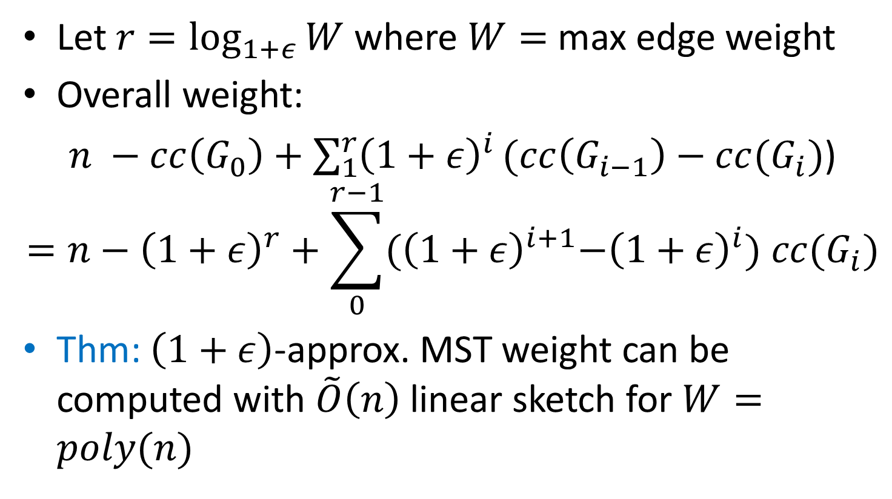
Minimum Spanning Tree
Let $r=\log_{1+ε}{W}$ where $W=$ max edge weight
Overall weight:
$n −cc\left(G_{0}\right)+\sum_{1}^{r}{{\left(1+ε\right)}^{i}}(cc\left(G_{i−1}\right)−cc(G_{i})$)
$$=n−{\left(1+ε\right)}^{r}+\sum_{0}^{r−1}{{(\left(1+ε\right)}^{i+1}−{\left(1+ε\right)}^{i}) cc(G_{i})}$$
Thm: $\left(1+ε\right)$-approx. MST weight can be computed with $\tilde{O}\left(n\right)$ linear sketch for $W=poly(n)$

Slide 16
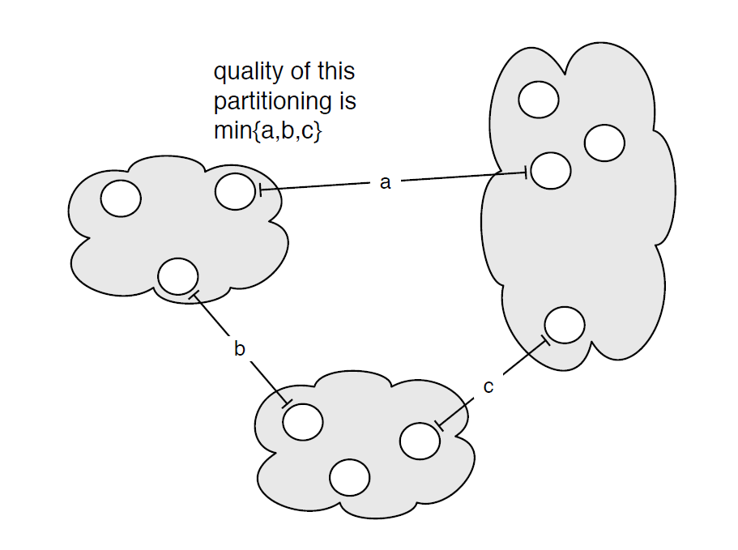

MST: Single Linkage Clustering
[Zahn’71] Clustering via MST (Single-linkage):
k clusters: remove $k−1$ longest edges from MST
Maximizes minimum intercluster distance
[Kleinberg, Tardos]
Notes:
“”

Slide 17
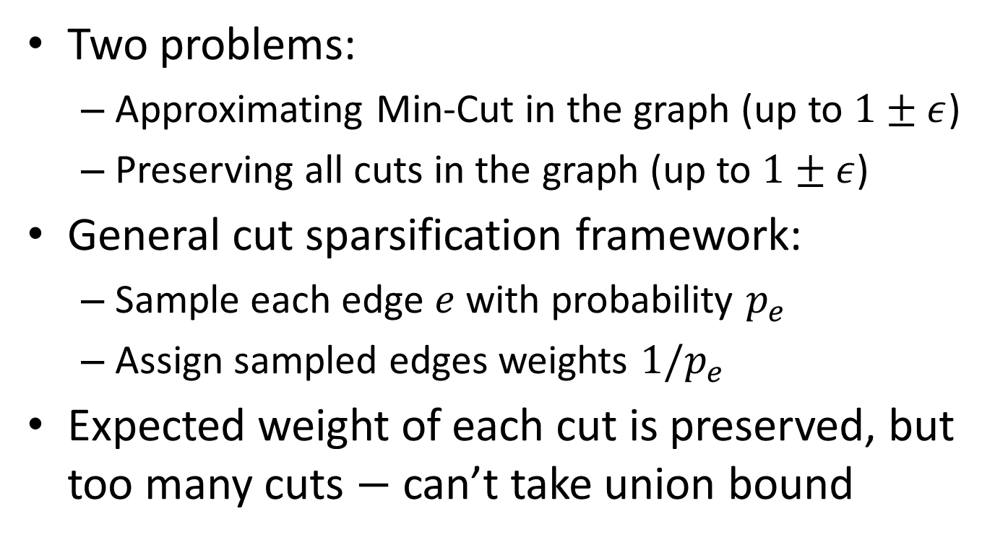
Cut Sparsification
Two problems:
Approximating Min-Cut in the graph (up to $1±ε$)
Preserving all cuts in the graph (up to $1±ε$)
General cut sparsification framework:
Sample each edge $e$ with probability $p_{e}$
Assign sampled edges weights $1/p_{e}$
Expected weight of each cut is preserved, but too many cuts $−$ can’t take union bound

Slide 18
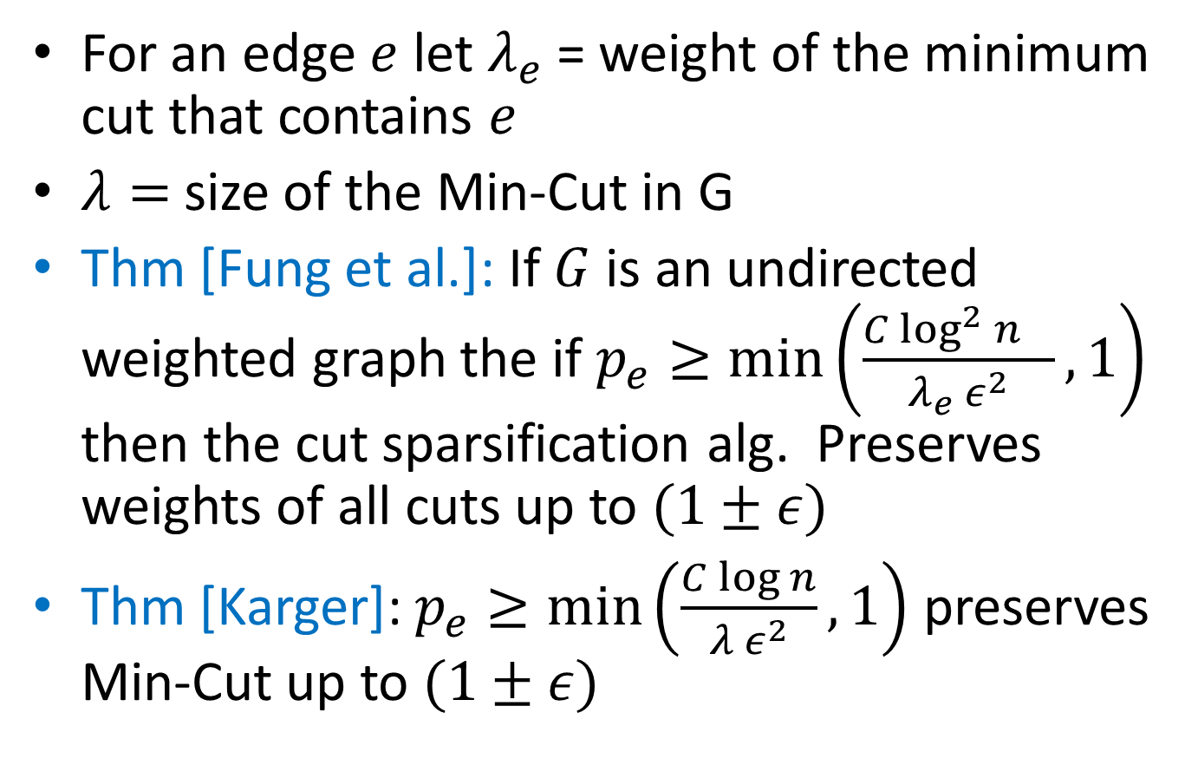
Cut Sparsification
For an edge $e$ let $λ_{e}$ = weight of the minimum cut that contains $e$
$λ=$ size of the Min-Cut in G
Thm [Fung et al.]: If $G$ is an undirected weighted graph the if $p_{e}≥\min\left(\frac{C{\log^{2}{n}}^{}}{{λ_{e} ε}^{2}},1\right)$ then the cut sparsification alg. Preserves weights of all cuts up to $(1±ε)$
Thm [Karger]: $p_{e}≥\min\left(\frac{C\log{n}}{{λ ε}^{2}},1\right)$ preserves Min-Cut up to $(1±ε)$

Slide 19
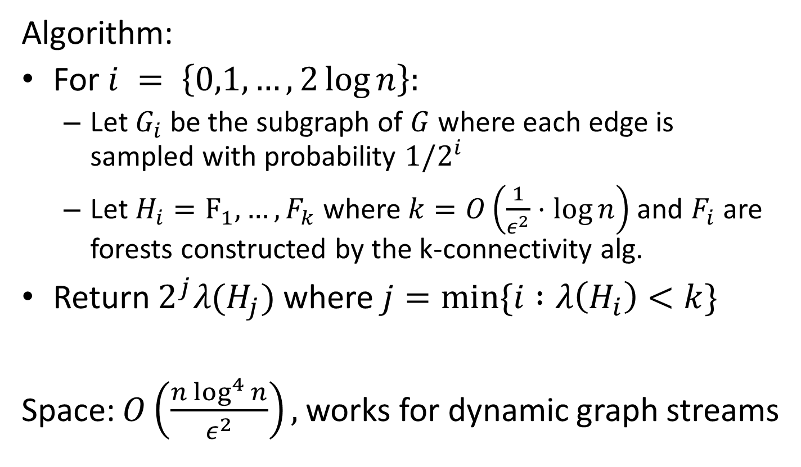
Minimum Cut
Algorithm:
For $i = \left\{0,1,…, 2\log{n}\right\}:$
Let $G_{i}$ be the subgraph of $G$ where each edge is sampled with probability $1/2^{i}$
Let $H_{i}=F_{1},…, F_{k}$ where $k=O\left(\frac{1}{ε^{2}}⋅\log{n}\right)$ and $F_{i}$ are forests constructed by the k-connectivity alg.
Return $2^{j}λ(H_{j})$ where $j=min⁡\{i :λ\left(H_{i}\right)<k\}$
Space: $O\left(\frac{n\log^{4}{n}}{ε^{2}}\right),$works for dynamic graph streams

Slide 20
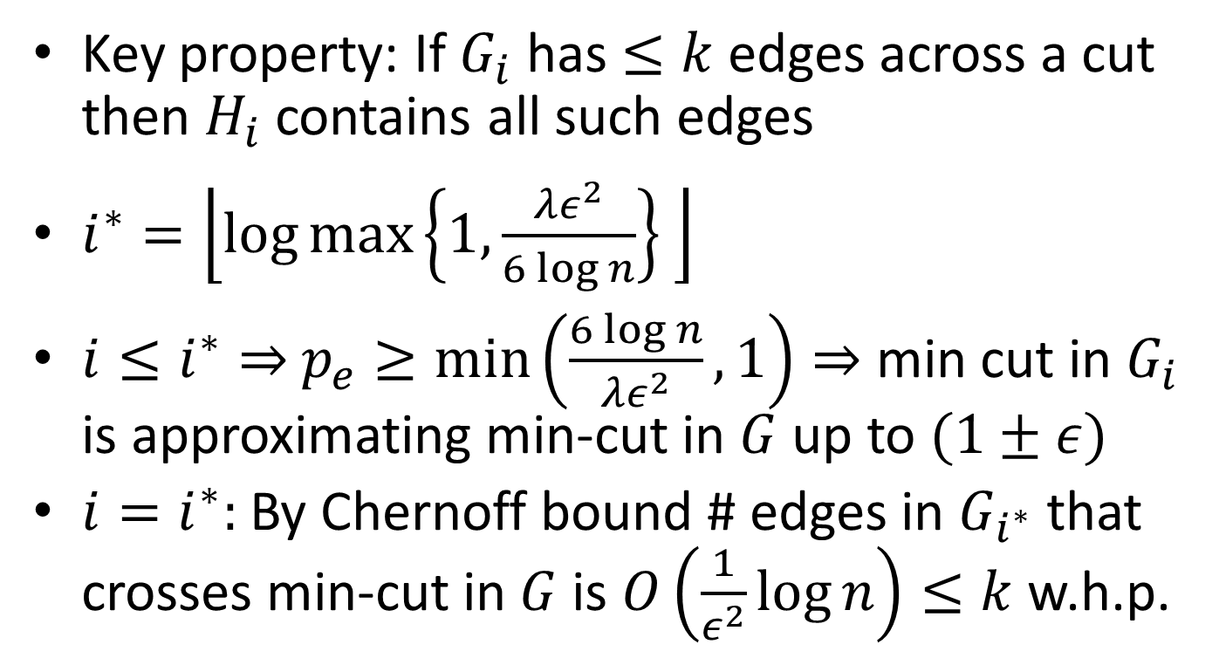
Minimum Cut: Analysis
Key property: If $G_{i}$ has $≤k$ edges across a cut then $H_{i}$ contains all such edges
$i^{∗}=\left\lfloor \log{\max\left\{1,\frac{λε^{2}}{6\log{n}}\right\}} \right\rfloor$
$i≤i^{∗}⇒$ $p_{e}≥\min\left(\frac{6\log{n}}{λε^{2}},1\right)⇒$ min cut in $G_{i}$ is approximating min-cut in $G$ up to $(1±ε)$
$i=i^{∗}:$ By Chernoff bound # edges in $G_{i^{∗}}$ that crosses min-cut in $G$ is $O\left(\frac{1}{ε^{2}}\log{n}\right)≤k$ w.h.p.

Slide 21
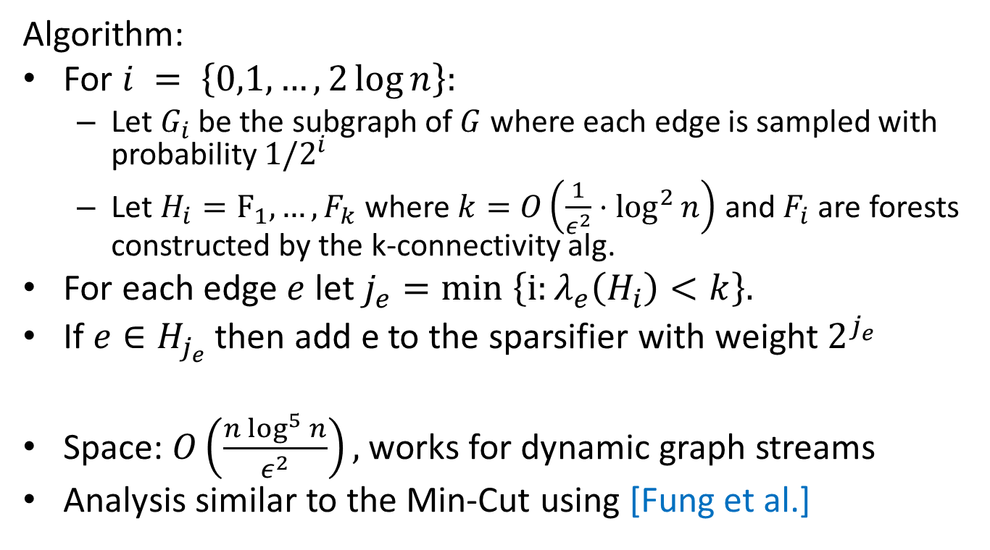
Cut Sparsification
Algorithm:
For $i = \left\{0,1,…, 2\log{n}\right\}:$
Let $G_{i}$ be the subgraph of $G$ where each edge is sampled with probability $1/2^{i}$
Let $H_{i}=F_{1},…, F_{k}$ where $k=O\left(\frac{1}{ε^{2}}⋅\log^{2}{n}\right)$ and $F_{i}$ are forests constructed by the k-connectivity alg.
For each edge $e$ let $j_{e}=min \left\{i:λ_{e}\left(H_{i}\right)<k\right\}.$
If $e∈H_{j_{e}}$ then add e to the sparsifier with weight $2_{}^{j_{e}}$
Space: $O\left(\frac{n\log^{5}{n}}{ε^{2}}\right),$works for dynamic graph streams
Analysis similar to the Min-Cut using [Fung et al.]

