Slide 1

CIS 700: “algorithms for Big Data”
Lecture 5: Dimension Reduction
Slides at http://grigory.us/big-data-class.html
Grigory Yaroslavtsev
http://grigory.us

Slide 2
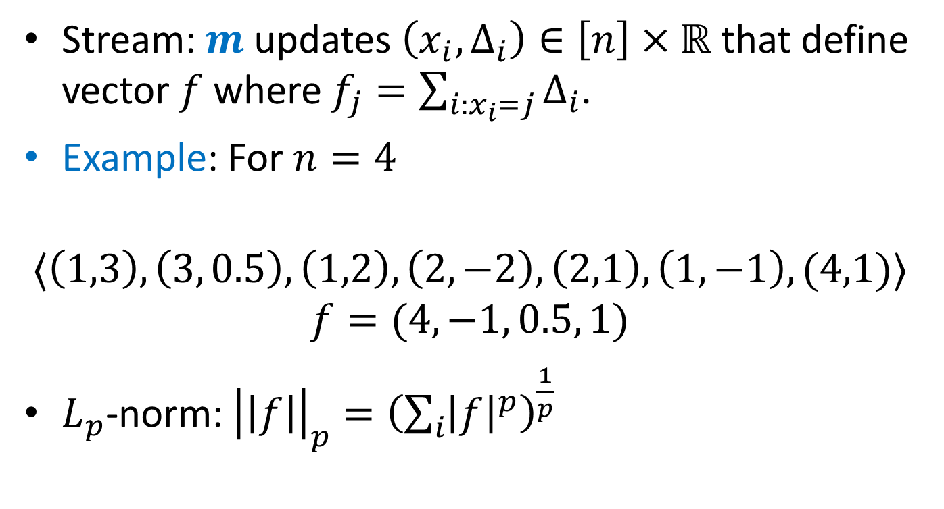

$L_{p}$-norm Estimation
Stream: $m$ updates $\left(x_{i}, Δ_{i}\right)∈\left[n\right]×ℝ$ that define vector $f$ where $f_{j}=\sum_{i:x_{i}=j}{Δ_{i}}$.
Example: For $n=4$
$$〈\left(1,3\right), \left(3, 0.5\right), \left(1,2\right), \left(2,−2\right),\left(2,1\right), \left(1,−1\right), (4,1)〉$$
$$f=(4, −1, 0.5, 1)$$
$L_{p}$-norm: ${\left|\left|f\right|\right|}_{p}={\left(\sum_{i}{{\left|f\right|}^{p}}\right)}^{\frac{1}{p}}$

Slide 3
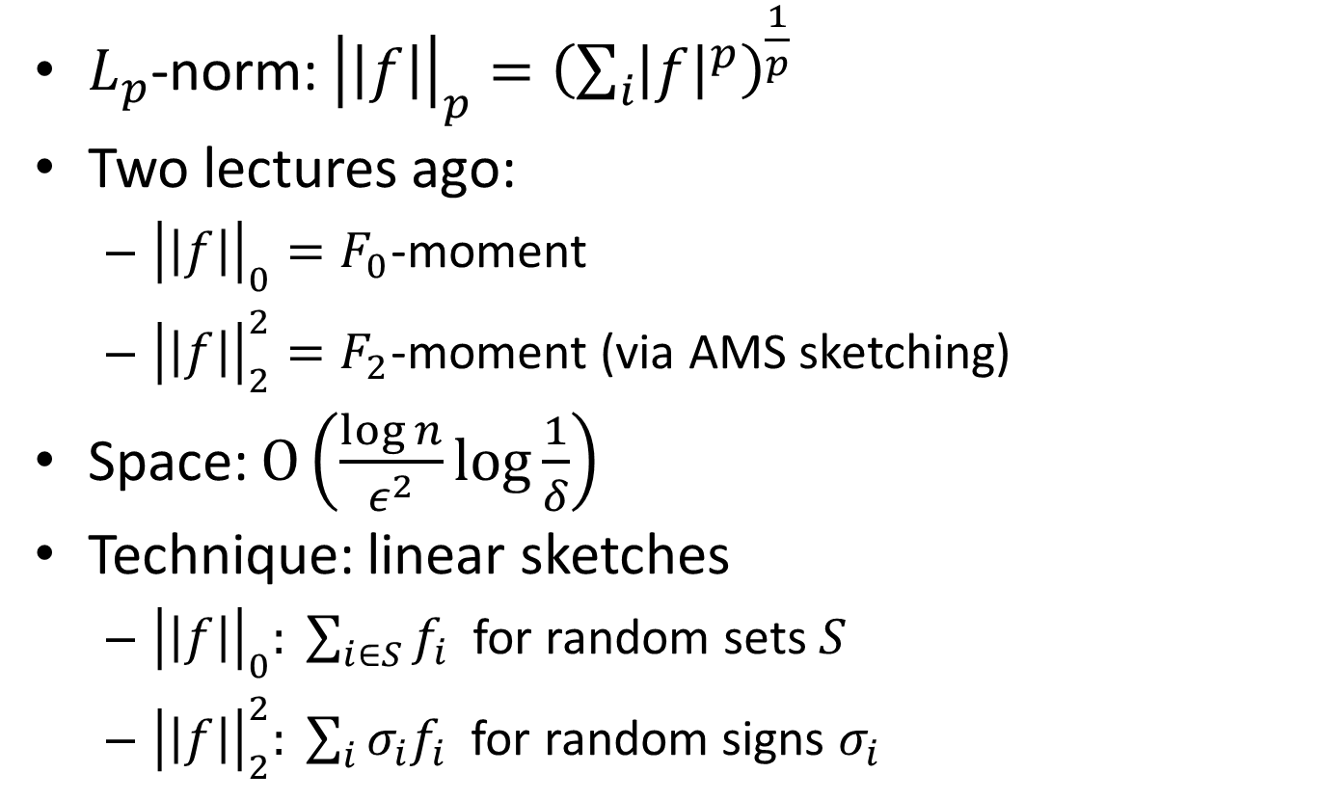
$L_{p}$-norm Estimation
$L_{p}$-norm: ${\left|\left|f\right|\right|}_{p}={\left(\sum_{i}{{\left|f\right|}^{p}}\right)}^{\frac{1}{p}}$
Two lectures ago:
${\left|\left|f\right|\right|}_{0}=F_{0}$-moment
${\left|\left|f\right|\right|}_{2}^{2}=F_{2}$-moment (via AMS sketching)
Space: $O\left(\frac{\log{n}}{ε^{2}}\log{\frac{1}{δ}}\right)$
Technique: linear sketches
${\left|\left|f\right|\right|}_{0}: \sum_{i∈S}{f_{i}}$ for random sets $S$
${\left|\left|f\right|\right|}_{2}^{2}: \sum_{i}{σ_{i}f_{i}}$ for random signs $σ_{i}$

Slide 4
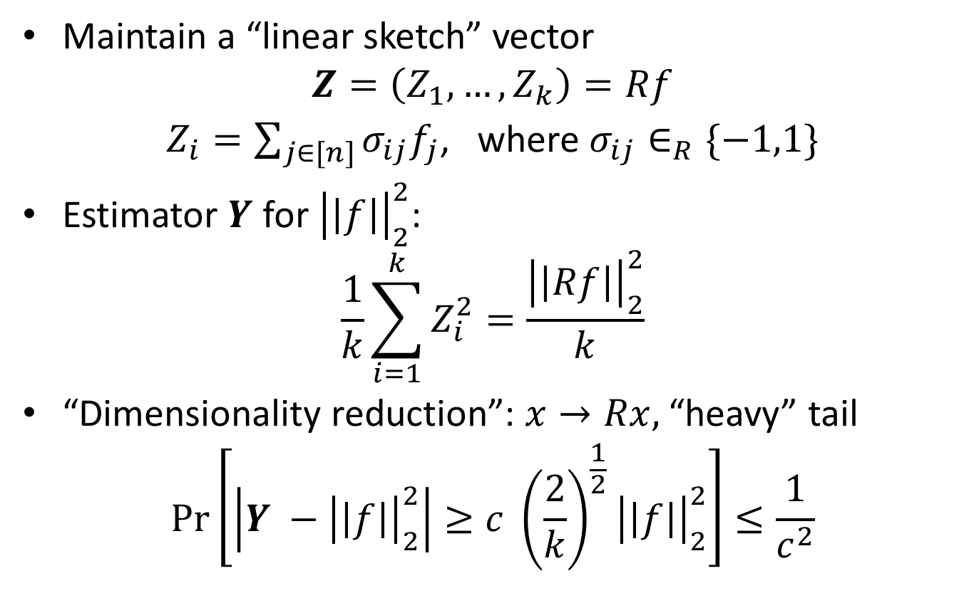
AMS as dimensionality reduction
Maintain a “linear sketch” vector
$$Z=\left(Z_{1}, …, Z_{k}\right)=Rf$$
$Z_{i}=\sum_{j∈[n]}{σ_{ij}f_{j}}$, where $σ_{ij}∈_{R}\{−1,1\}$
Estimator $Y$ for ${\left|\left|f\right|\right|}_{2}^{2}$:
$$\frac{1}{k}\sum_{i=1}^{k}{Z_{i}^{2}}=\frac{{\left|\left|Rf\right|\right|}_{2}^{2}}{k}$$
“Dimensionality reduction”: $x→Rx,$ “heavy” tail
$$\operatorname{Pr}\left[\left|Y −{\left|\left|f\right|\right|}_{2}^{2}\right|≥c {\left(\frac{2}{k}\right)}^{\frac{1}{2}}{\left|\left|f\right|\right|}_{2}^{2}\right]≤\frac{1}{c^{2}}$$

Slide 5
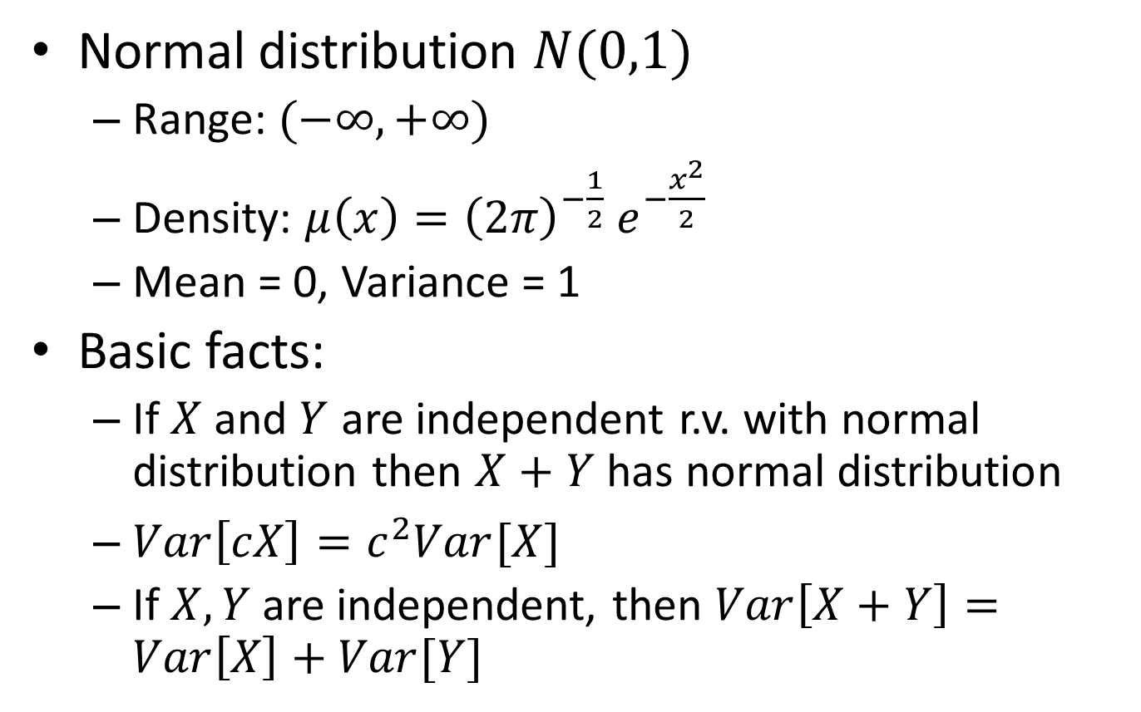
Normal Distribution
Normal distribution $N(0,1)$
Range: $(−∞, +∞)$
Density: $μ\left(x\right)={{\left(2π\right)}^{−\frac{1}{2}} e}^{−\frac{x^{2}}{2}}$
Mean = 0, Variance = 1
Basic facts:
If $X$ and $Y$ are independent r.v. with normal distribution then $X+Y$ has normal distribution
$Var\left[cX\right]=c^{2}Var[X]$
If $X, Y$ are independent, then $Var\left[X+Y\right]=Var\left[X\right]+Var[Y]$

Slide 6
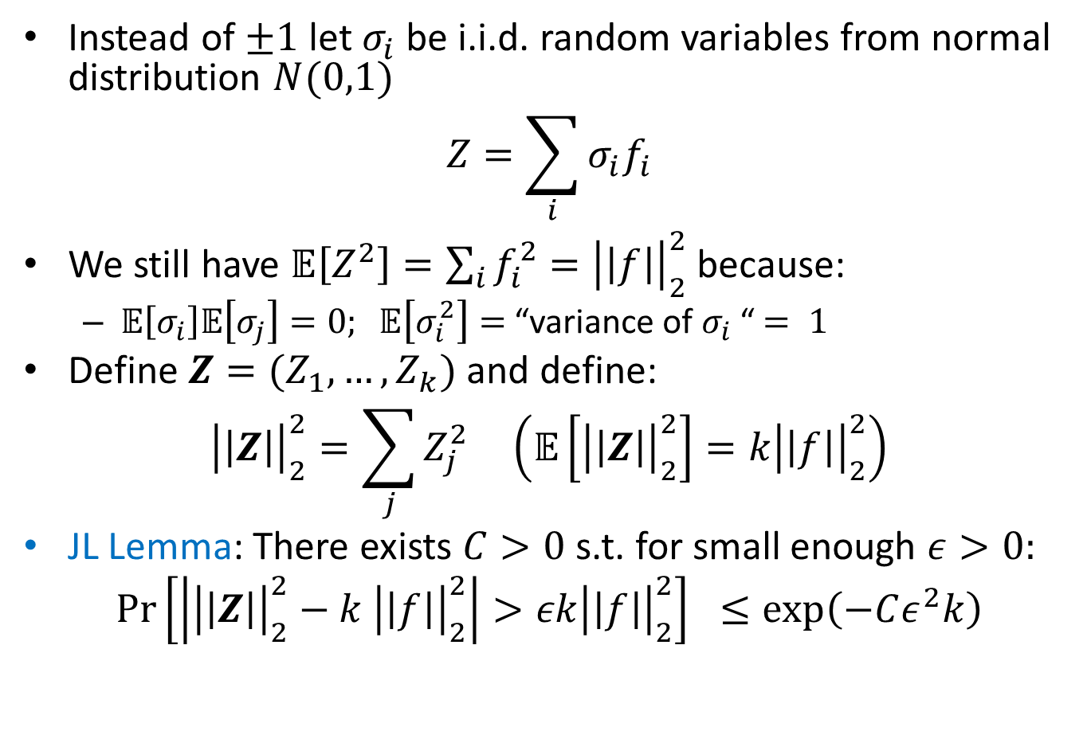
Johnson-Lindenstrauss Transform
Instead of $±1$ let $σ_{i}$ be i.i.d. random variables from normal distribution $N(0,1)$
$$Z=\sum_{i}{σ_{i}f_{i}}$$
We still have $𝔼\left[Z^{2}\right]=\sum_{i}{f_{i}^{2}}={\left|\left|f\right|\right|}_{2}^{2}$ because:
$𝔼\left[σ_{i}\right]𝔼\left[σ_{j}\right]=0; 𝔼\left[σ_{i}^{2}\right]=$ “variance of $σ_{i}$ “$= 1$
Define $Z=(Z_{1}, …, Z_{k})$ and define:
$${\left|\left|Z\right|\right|}_{2}^{2}=\sum_{j}{Z_{j}^{2}} \left(𝔼\left[{\left|\left|Z\right|\right|}_{2}^{2}\right]=k{\left|\left|f\right|\right|}_{2}^{2}\right)$$
JL Lemma: There exists $C>0$s.t. for small enough $ε>0:$
$$\operatorname{Pr}\left[\left|{\left|\left|Z\right|\right|}_{2}^{2}−k {\left|\left|f\right|\right|}_{2}^{2}\right|>εk{\left|\left|f\right|\right|}_{2}^{2}\right] ≤\exp\left(−Cε^{2}k\right)$$

Slide 7
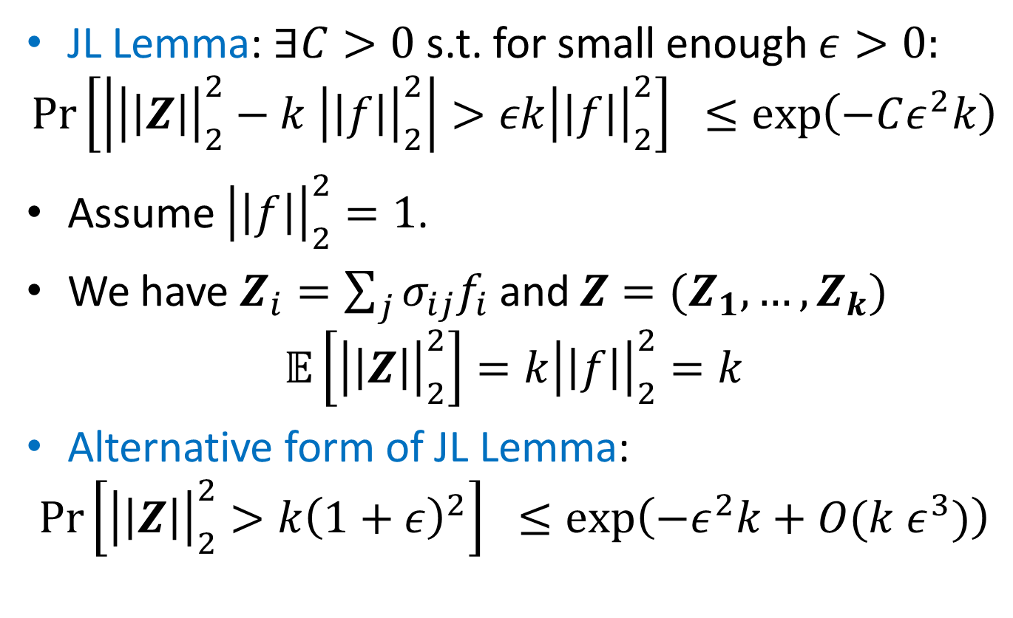
Proof of JL Lemma
JL Lemma: $∃C>0$s.t. for small enough $ε>0:$
$$\operatorname{Pr}\left[\left|{\left|\left|Z\right|\right|}_{2}^{2}−k {\left|\left|f\right|\right|}_{2}^{2}\right|>εk{\left|\left|f\right|\right|}_{2}^{2}\right] ≤\exp\left(−Cε^{2}k\right)$$
Assume ${\left|\left|f\right|\right|}_{2}^{2}=1$.
We have $Z_{i}=\sum_{j}{σ_{ij}f_{i}}$ and $Z=(Z_{1}, …,Z_{k})$
$$𝔼\left[{\left|\left|Z\right|\right|}_{2}^{2}\right]=k{\left|\left|f\right|\right|}_{2}^{2}=k$$
Alternative form of JL Lemma:
$$\operatorname{Pr}\left[{\left|\left|Z\right|\right|}_{2}^{2}>k{\left(1+ε\right)}^{2}\right] ≤\exp\left(−ε^{2}k+O(k ε^{3})\right)$$

Slide 8
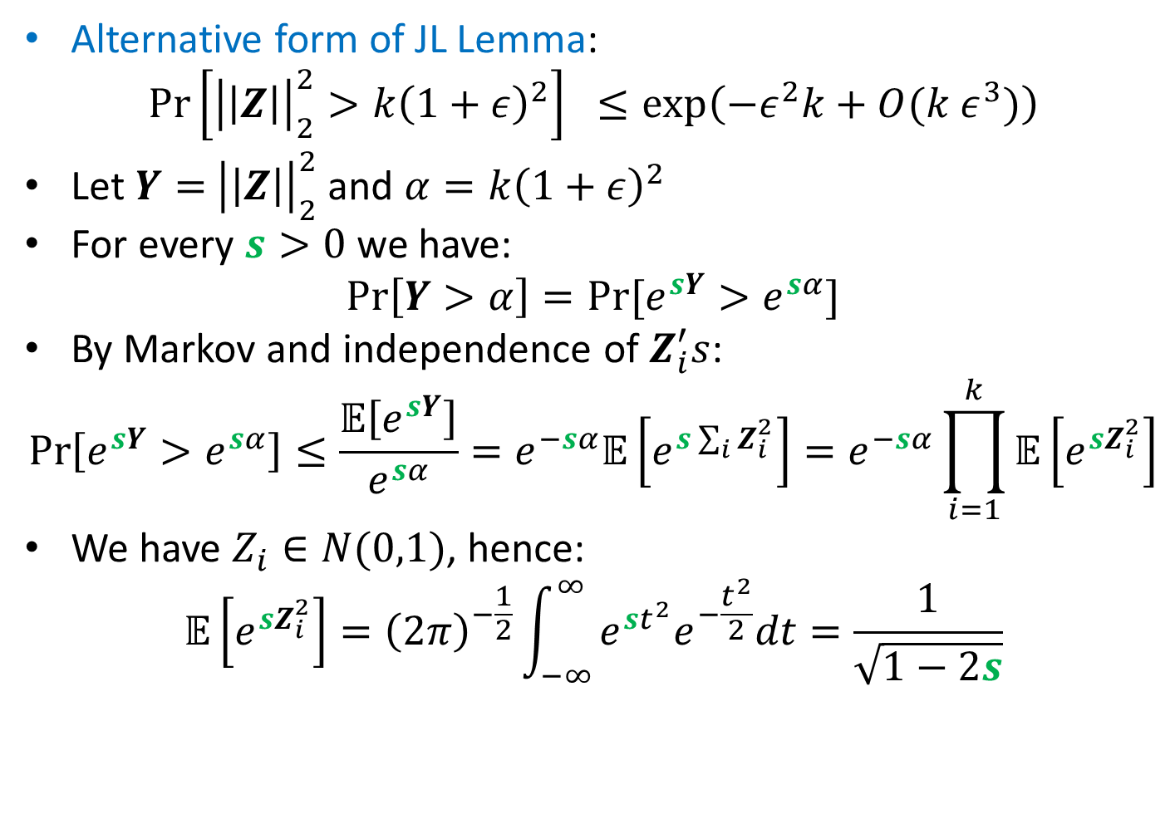
Proof of JL Lemma
Alternative form of JL Lemma:
$$\operatorname{Pr}\left[{\left|\left|Z\right|\right|}_{2}^{2}>k{\left(1+ε\right)}^{2}\right] ≤\exp\left(−ε^{2}k+O(k ε^{3})\right)$$
Let $Y=$ ${\left|\left|Z\right|\right|}_{2}^{2}$ and $α=k{\left(1+ε\right)}^{2}$
For every $s>0$ we have:
$$\operatorname{Pr}\left[Y>α\right]=Pr⁡[e^{sY}>e^{sα}]$$
By Markov and independence of $Z_{i}^{′}s$:
$$\operatorname{Pr}\left[e^{sY}>e^{sα}\right]≤\frac{𝔼\left[e^{sY}\right]}{e^{sα}}=e^{−sα}𝔼\left[e^{s\sum_{i}{Z_{i}^{2}}}\right]=e^{−sα}\prod_{i=1}^{k}{𝔼\left[e^{sZ_{i}^{2}}\right]}$$
We have $Z_{i}∈N(0,1)$, hence:
$$𝔼\left[e^{sZ_{i}^{2}}\right]={\left(2π\right)}^{−\frac{1}{2}}\int_{−∞}^{∞}{e^{st^{2}}e^{−\frac{t^{2}}{2}}dt}=\frac{1}{\sqrt{1−2s}}$$

Slide 9
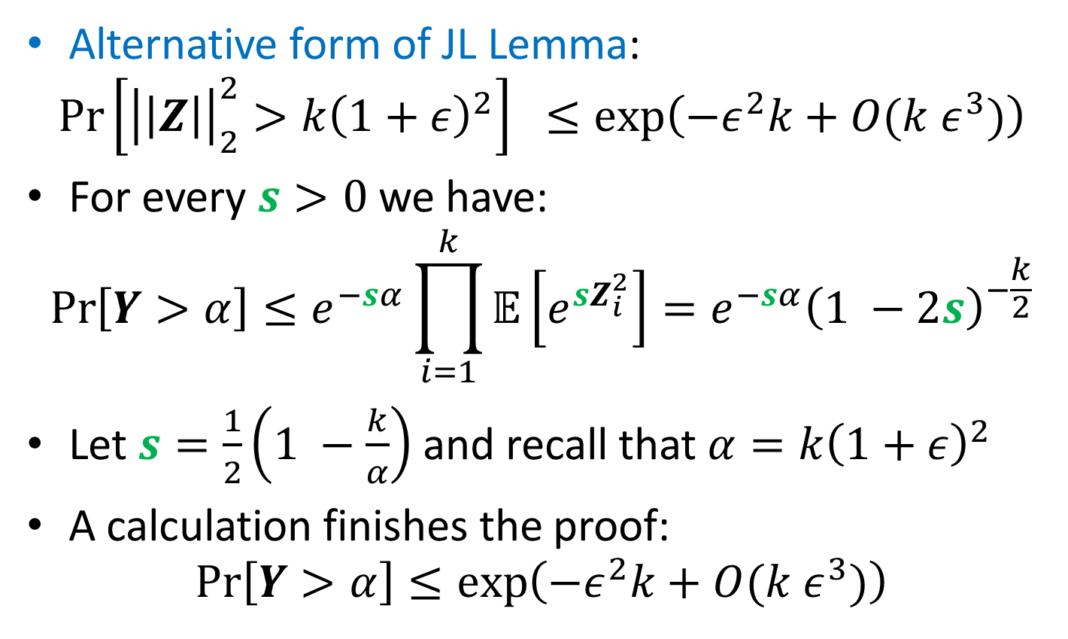
Proof of JL Lemma
Alternative form of JL Lemma:
$$\operatorname{Pr}\left[{\left|\left|Z\right|\right|}_{2}^{2}>k{\left(1+ε\right)}^{2}\right] ≤\exp\left(−ε^{2}k+O(k ε^{3})\right)$$
For every $s>0$ we have:
$$\operatorname{Pr}\left[Y>α\right]≤e^{−sα}\prod_{i=1}^{k}{𝔼\left[e^{sZ_{i}^{2}}\right]}=e^{−sα}{\left(1 −2s\right)}^{−\frac{k}{2}}$$
Let $s=\frac{1}{2}\left(1 −\frac{k}{α}\right)$ and recall that $α=k{\left(1+ε\right)}^{2}$
A calculation finishes the proof:
$$\operatorname{Pr}\left[Y>α\right]≤\exp\left(−ε^{2}k+O(k ε^{3})\right)$$

Slide 10
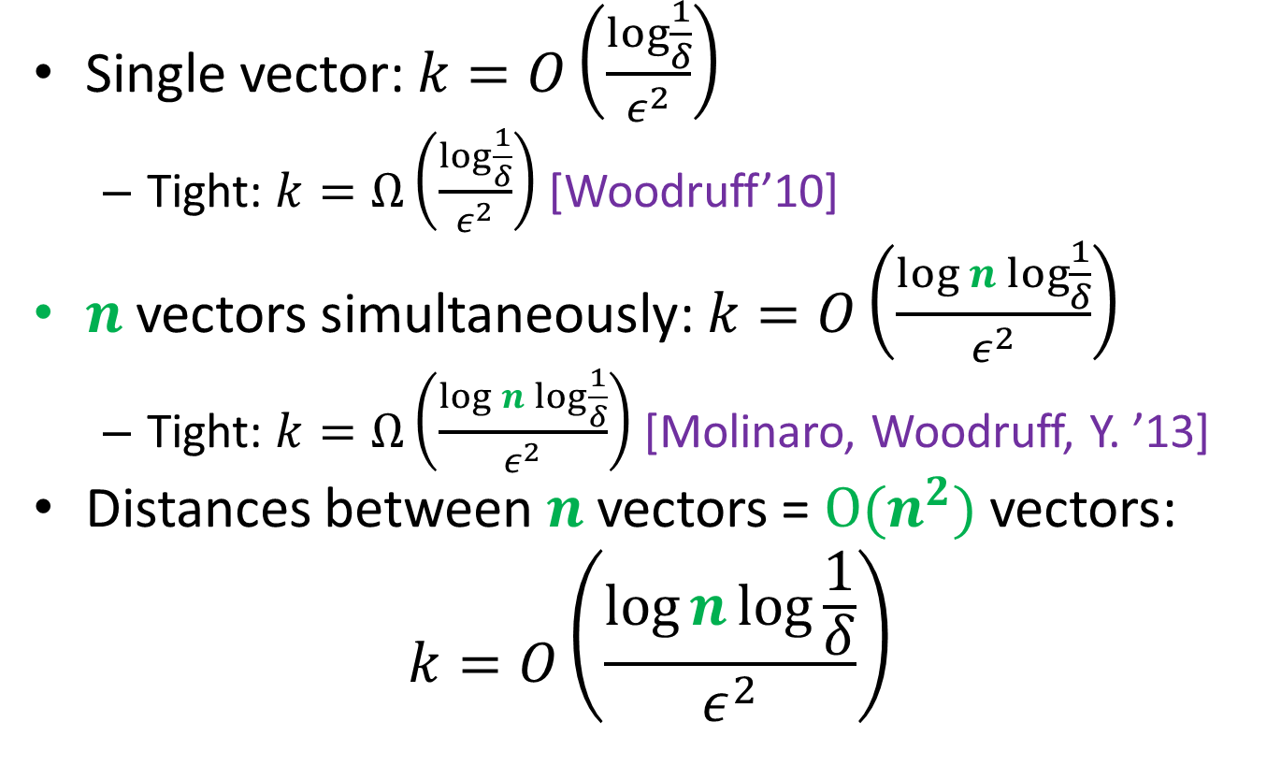
Johnson-Lindenstrauss Transform
Single vector: $k=O\left(\frac{\log{\frac{1}{δ}}}{ε^{2}}\right)$
Tight: $k=Ω\left(\frac{\log{\frac{1}{δ}}}{ε^{2}}\right)$ [Woodruff’10]
$n$ vectors simultaneously: $k=O\left(\frac{\log{n}\log{\frac{1}{δ}}}{ε^{2}}\right)$
Tight: $k=Ω\left(\frac{\log{n}\log{\frac{1}{δ}}}{ε^{2}}\right)$ [Molinaro, Woodruff, Y. ’13]
Distances between $n$ vectors = $O(n^{2})$ vectors:
$$k=O\left(\frac{\log{n}\log{\frac{1}{δ}}}{ε^{2}}\right)$$

Slide 11
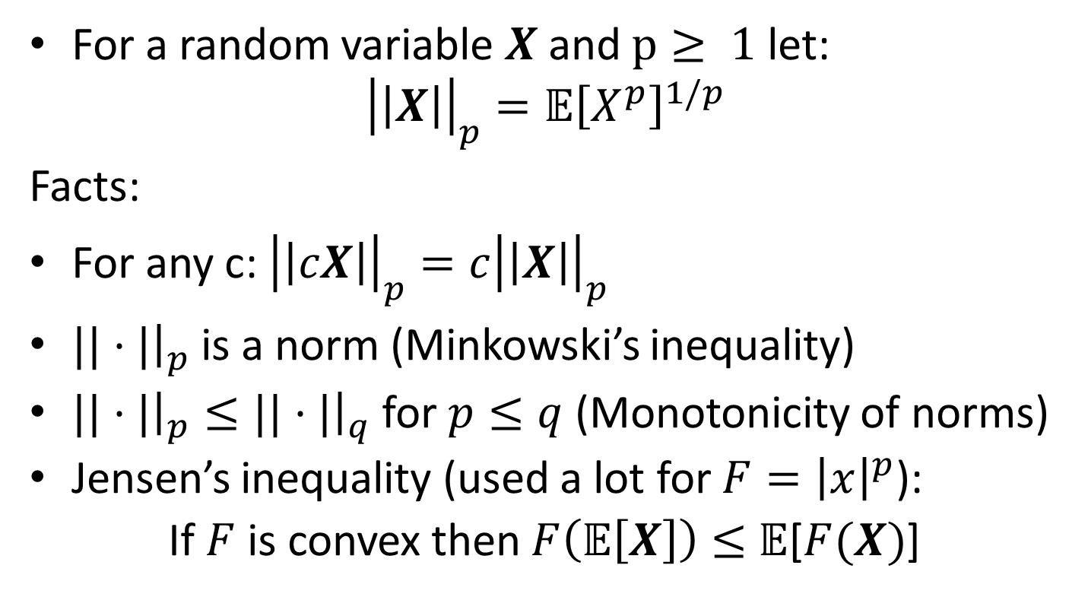
Random Variables and Norms
For a random variable $X$ and $p≥ 1$ let:
$${\left|\left|X\right|\right|}_{p}={𝔼\left[X^{p}\right]}^{1/p}$$
Facts:
For any c: ${\left|\left|cX\right|\right|}_{p}=c{\left|\left|X\right|\right|}_{p}$
$||⋅|{\left.​\right|}_{p}$ is a norm (Minkowski’s inequality)
$||⋅|{\left.​\right|}_{p}≤||⋅|{\left.​\right|}_{q}$ for $p≤q$(Monotonicity of norms)
Jensen’s inequality (used a lot for $F={\left|x\right|}^{p}$):
If $F$ is convex then $F\left(𝔼\left[X\right]\right)≤$ $𝔼$[$F(X)$]

Slide 12
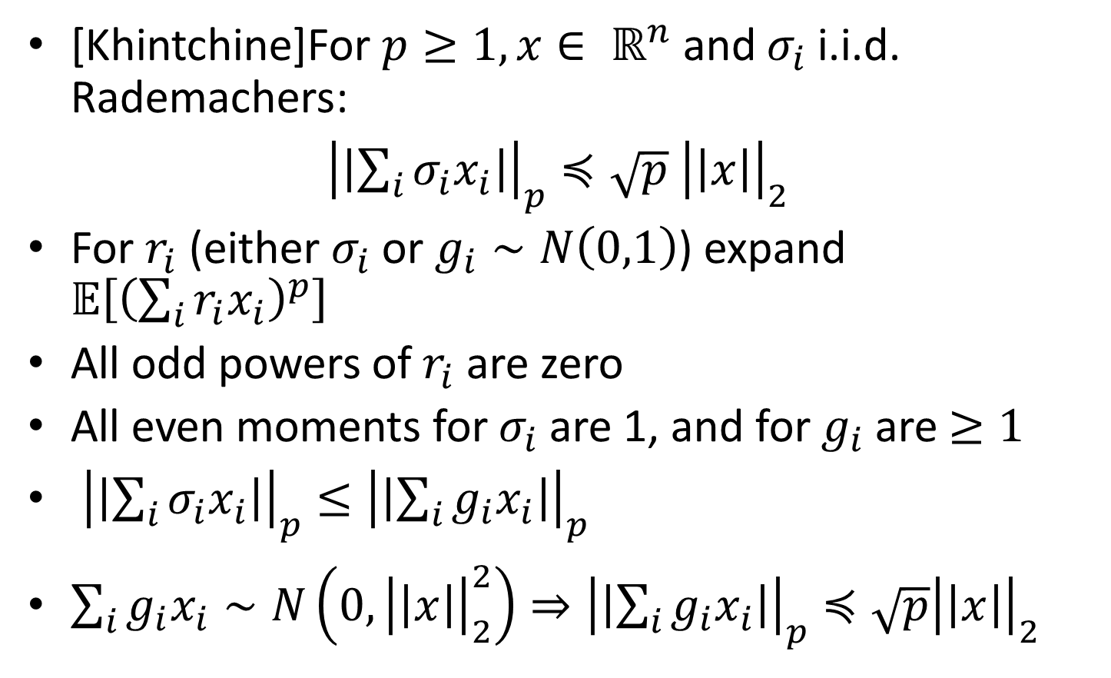
Khintchine Inequality
[Khintchine]For $p≥1, x∈ ℝ^{n}$ and $σ_{i}$ i.i.d. Rademachers:
${\left|\left|\sum_{i}{σ_{i}x_{i}}\right|\right|}_{p}≼\sqrt{p} {\left|\left|x\right|\right|}_{2}$
For $r_{i}$ (either $σ_{i}$ or $g_{i}∼N\left(0,1\right)$) expand $𝔼\left[{\left(\sum_{i}{r_{i}x_{i}}\right)}^{p}\right]$
All odd powers of $r_{i}$ are zero
All even moments for $σ_{i}$ are 1, and for $g_{i}$ are $≥1$
${\left|\left|\sum_{i}{σ_{i}x_{i}}\right|\right|}_{p}≤{\left|\left|\sum_{i}{g_{i}x_{i}}\right|\right|}_{p}$
$\sum_{i}{g_{i}x_{i}}∼N\left(0,{\left|\left|x\right|\right|}_{2}^{2}\right)⇒{\left|\left|\sum_{i}{g_{i}x_{i}}\right|\right|}_{p}≼\sqrt{p}{\left|\left|x\right|\right|}_{2}$

Slide 13
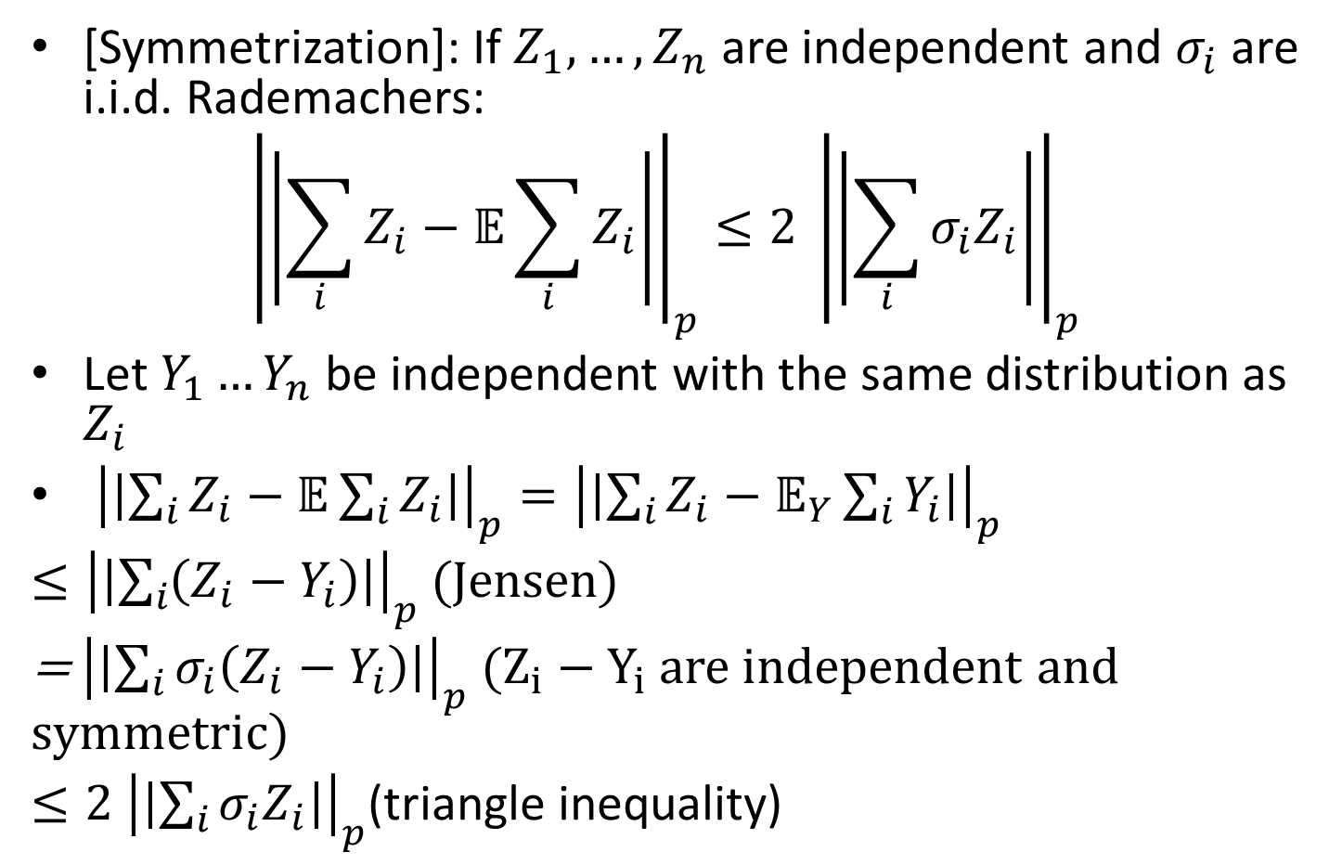
Symmetrization
[Symmetrization]: If $Z_{1}, …,Z_{n}$ are independent and $σ_{i}$ are i.i.d. Rademachers:
$${\left|\left|\sum_{i}{Z_{i}}−𝔼\sum_{i}{Z_{i}}\right|\right|}_{p}≤2 {\left|\left|\sum_{i}{σ_{i}Z_{i}}\right|\right|}_{p}$$
Let $Y_{1}…Y_{n}$ be independent with the same distribution as $Z_{i}$
${\left|\left|\sum_{i}{Z_{i}}−𝔼\sum_{i}{Z_{i}}\right|\right|}_{p}={\left|\left|\sum_{i}{Z_{i}}−𝔼_{Y}\sum_{i}{Y_{i}}\right|\right|}_{p}$
$≤{\left|\left|\sum_{i}{\left(Z_{i}−Y_{i}\right)}\right|\right|}_{p}$ (Jensen)
= ${\left|\left|\sum_{i}{σ_{i}\left(Z_{i}−Y_{i}\right)}\right|\right|}_{p}$ ($Z_{i}−Y_{i}$ are independent and symmetric)
$≤2 {\left|\left|\sum_{i}{σ_{i}Z_{i}}\right|\right|}_{p}$(triangle inequality)

Slide 14
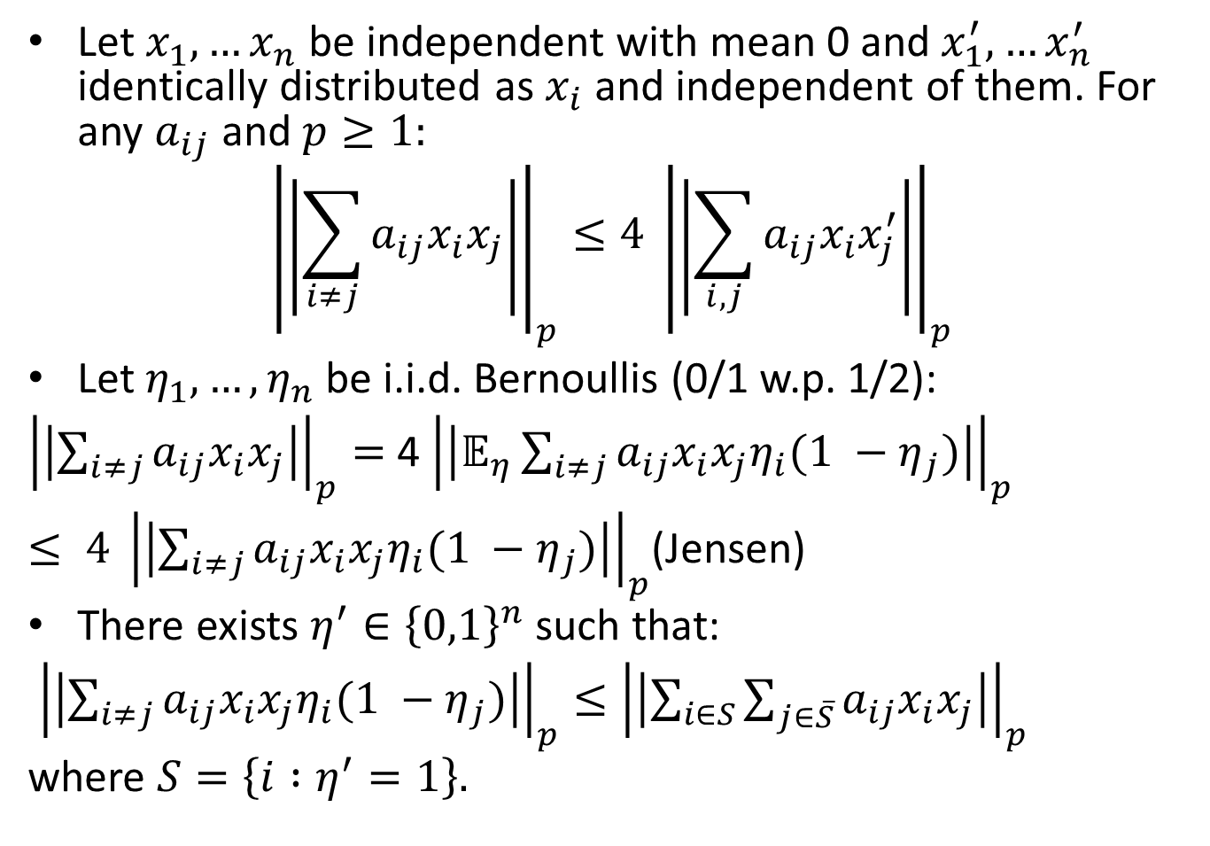
Decoupling
Let $x_{1},…x_{n}$ be independent with mean 0 and $x_{1}^{′},…x_{n}^{′}$ identically distributed as $x_{i}$ and independent of them. For any $a_{ij}$ and $p≥1:$
$${\left|\left|\sum_{i≠j}{a_{ij}x_{i}x_{j}}\right|\right|}_{p}≤4 {\left|\left|\sum_{i,j}{a_{ij}x_{i}x_{j}^{′}}\right|\right|}_{p}$$
Let $η_{1},…, η_{n}$be i.i.d. Bernoullis (0/1 w.p. 1/2):
${\left|\left|\sum_{i≠j}{a_{ij}x_{i}x_{j}}\right|\right|}_{p}=$ 4 ${\left|\left|𝔼_{η}\sum_{i≠j}{a_{ij}x_{i}x_{j}η_{i}(1 −η_{j})}\right|\right|}_{p}$
$≤ {4 \left|\left|\sum_{i≠j}{a_{ij}x_{i}x_{j}η_{i}(1 −η_{j})}\right|\right|}_{p}$(Jensen)
There exists $η^{′}∈{\left\{0,1\right\}}^{n}$ such that:
${\left|\left|\sum_{i≠j}{a_{ij}x_{i}x_{j}η_{i}(1 −η_{j})}\right|\right|}_{p}≤{\left|\left|\sum_{i∈S}{\sum_{j∈\overline{S}}{a_{ij}x_{i}x_{j}}}\right|\right|}_{p}$
where $S=\left\{i :η^{′}=1\right\}.$

Slide 15
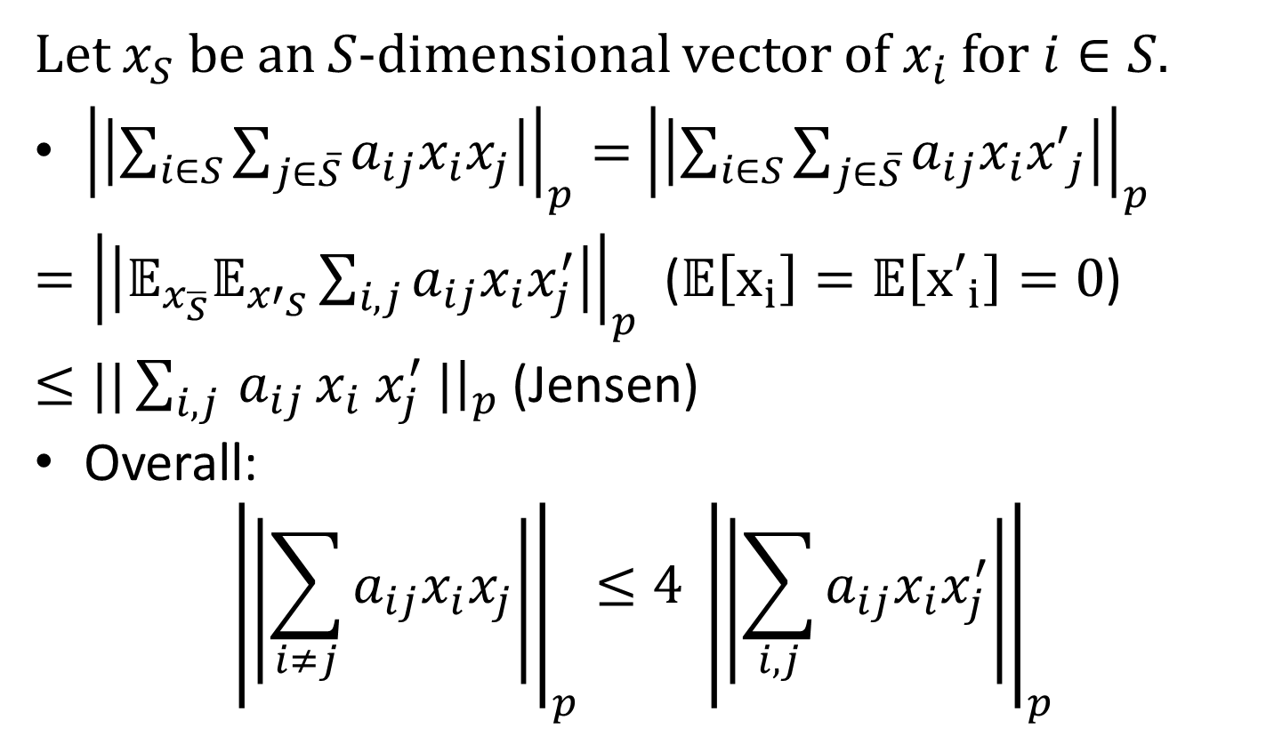
Decoupling (continued)
Let $x_{S}$ be an $S$-dimensional vector of $x_{i}$ for $i∈S.$
${\left|\left|\sum_{i∈S}{\sum_{j∈\overline{S}}{a_{ij}x_{i}x_{j}}}\right|\right|}_{p}=$ ${\left|\left|\sum_{i∈S}{\sum_{j∈\overline{S}}{a_{ij}x_{i}{x′}_{j}}}\right|\right|}_{p}$
$={\left|\left|𝔼_{x_{\overline{S}}}𝔼_{{x′}_{S}}\sum_{i,j}{a_{ij}x_{i}x_{j}^{′}}\right|\right|}_{p}$ ($𝔼\left[x_{i}\right]=𝔼\left[{x′}_{i}\right]=0$)
$≤||\sum_{i,j }{a_{ij}}x_{i} x_{j}^{′} |{\left.​\right|}_{p}$ (Jensen)
Overall:
$${\left|\left|\sum_{i≠j}{a_{ij}x_{i}x_{j}}\right|\right|}_{p}≤4 {\left|\left|\sum_{i,j}{a_{ij}x_{i}x_{j}^{′}}\right|\right|}_{p}$$

Slide 16
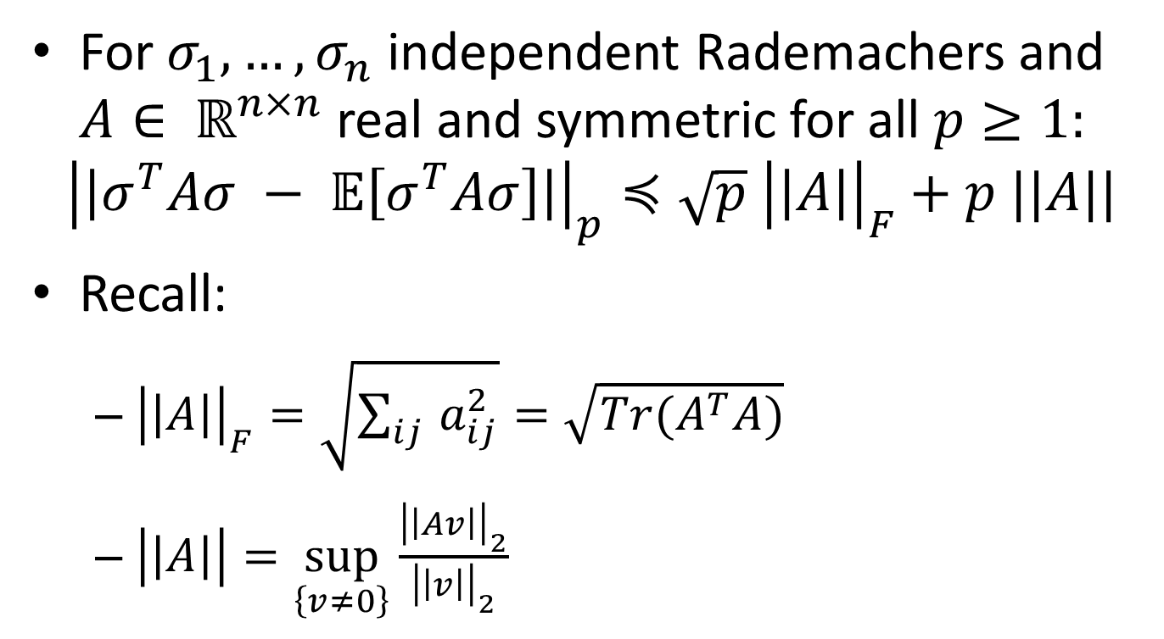
Hanson-Wright Inequality
For $σ_{1}, …, σ_{n}$ independent Rademachers and $A∈ ℝ^{n×n}$ real and symmetric for all $p≥1:$
$${\left|\left|σ^{T}Aσ − 𝔼\left[σ^{T}Aσ\right]\right|\right|}_{p}≼\sqrt{p} {\left|\left|A\right|\right|}_{F}+p ||A||$$
Recall:
${\left|\left|A\right|\right|}_{F}=\sqrt{\sum_{ij }{a_{ij}^{2}}}=\sqrt{Tr(A^{T}A)}$
$\left|\left|A\right|\right|=\sup_{\left\{v≠0\right\}}{\frac{{\left|\left|Av\right|\right|}_{2}}{{\left|\left|v\right|\right|}_{2}}}$

Slide 17
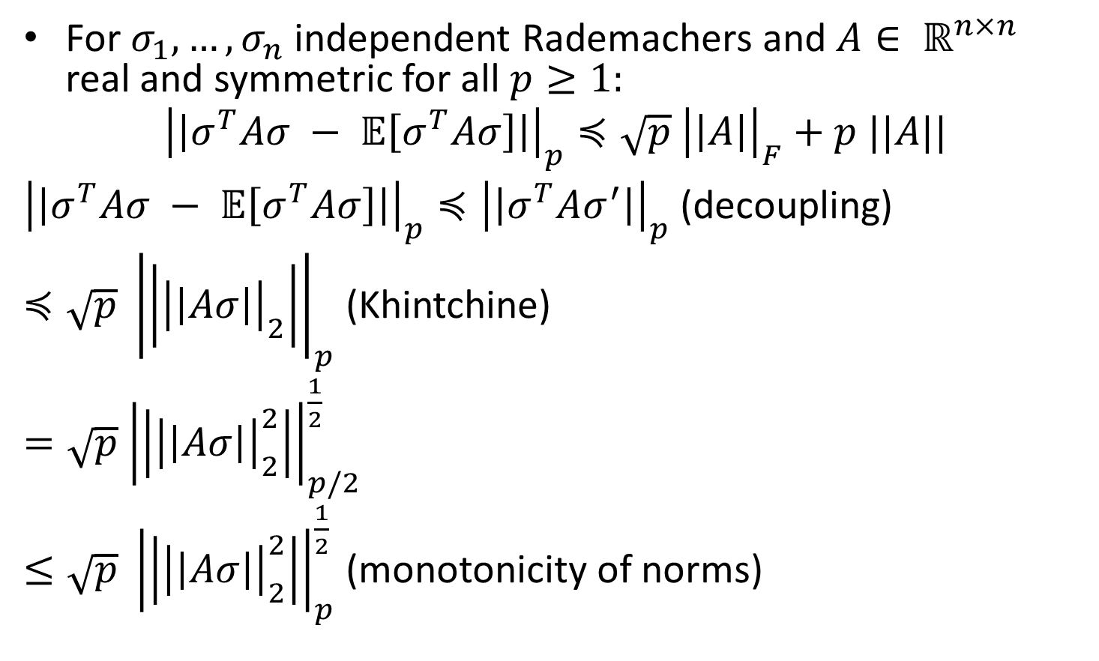
Hanson-Wright Inequality
For $σ_{1}, …, σ_{n}$ independent Rademachers and $A∈ ℝ^{n×n}$ real and symmetric for all $p≥1:$
$${\left|\left|σ^{T}Aσ − 𝔼\left[σ^{T}Aσ\right]\right|\right|}_{p}≼\sqrt{p} {\left|\left|A\right|\right|}_{F}+p ||A||$$
${\left|\left|σ^{T}Aσ − 𝔼\left[σ^{T}Aσ\right]\right|\right|}_{p}≼{\left|\left|σ^{T}Aσ^{′}\right|\right|}_{p}$ (decoupling)
$≼\sqrt{p} {\left|\left|{\left|\left|Aσ\right|\right|}_{2}\right|\right|}_{p}$ (Khintchine)
$=\sqrt{p}$ ${\left|\left|{\left|\left|Aσ\right|\right|}_{2}^{2}\right|\right|}_{p/2}^{\frac{1}{2}}$
$≤\sqrt{p} {\left|\left|{\left|\left|Aσ\right|\right|}_{2}^{2}\right|\right|}_{p}^{\frac{1}{2}}$ (monotonicity of norms)

Slide 18
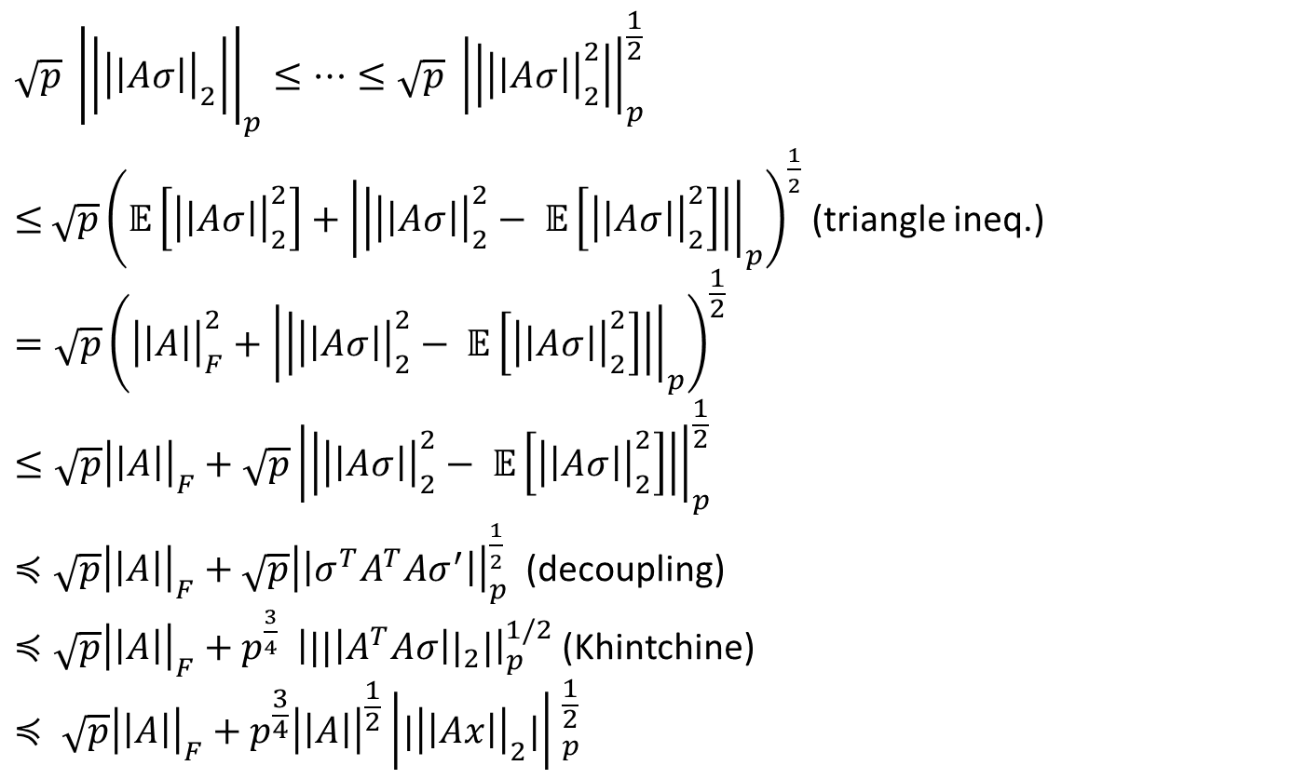
Hanson-Wright (continued)
$$\sqrt{p} {\left|\left|{\left|\left|Aσ\right|\right|}_{2}\right|\right|}_{p}≤…≤\sqrt{p} {\left|\left|{\left|\left|Aσ\right|\right|}_{2}^{2}\right|\right|}_{p}^{\frac{1}{2}}$$
$≤$ $\sqrt{p}{\left(𝔼\left[{\left|\left|Aσ\right|\right|}_{2}^{2}\right]+{\left|\left|{\left|\left|Aσ\right|\right|}_{2}^{2}− 𝔼\left[{\left|\left|Aσ\right|\right|}_{2}^{2}\right]\right|\right|}_{p}\right)}^{\frac{1}{2}}$ (triangle ineq.)
$$=\sqrt{p}{\left({\left|\left|A\right|\right|}_{F}^{2}+{\left|\left|{\left|\left|Aσ\right|\right|}_{2}^{2}− 𝔼\left[{\left|\left|Aσ\right|\right|}_{2}^{2}\right]\right|\right|}_{p}\right)}^{\frac{1}{2}}$$
$$≤\sqrt{p}{\left|\left|A\right|\right|}_{F}^{}+{\sqrt{p}\left|\left|{\left|\left|Aσ\right|\right|}_{2}^{2}− 𝔼\left[{\left|\left|Aσ\right|\right|}_{2}^{2}\right]\right|\right|}_{p}^{\frac{1}{2}}$$
$≼\sqrt{p}{\left|\left|A\right|\right|}_{F}^{}+\sqrt{p}{\left|\left|σ^{T}A^{T}Aσ^{′}\right|\right|}_{p}^{\frac{1}{2}}$ (decoupling)
$≼\sqrt{p}{\left|\left|A\right|\right|}_{F}^{}+p^{\frac{3}{4}} {\left|{||\left|A^{T}Aσ\right||}_{2}|\right|}_{p}^{1/2}$ (Khintchine)
$$≼ \sqrt{p}{\left|\left|A\right|\right|}_{F}^{}+p^{\frac{3}{4}}{\left|\left|A\right|\right|}^{\frac{1}{2}}{\left|{|\left|\left|Ax\right|\right|}_{2}|\right| }_{p}^{\frac{1}{2}}$$

Slide 19
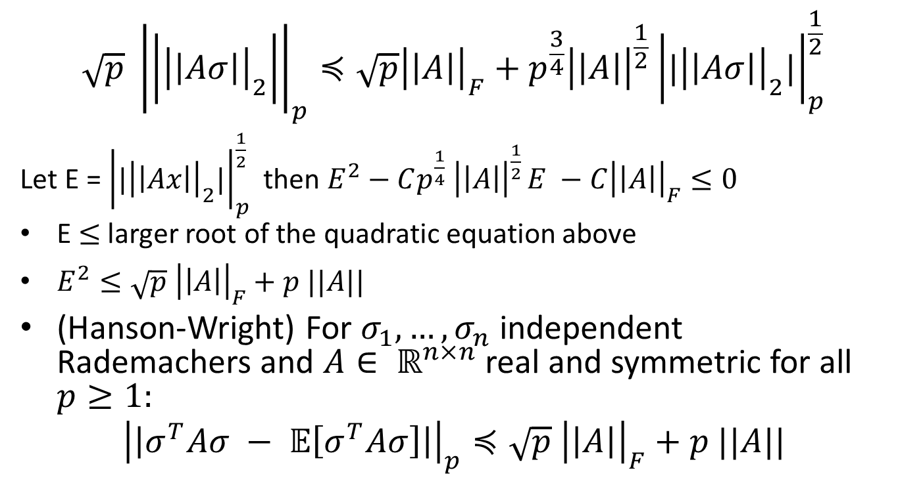
Hanson-Wright (continued)
$$\sqrt{p} {\left|\left|{\left|\left|Aσ\right|\right|}_{2}\right|\right|}_{p}≼\sqrt{p}{\left|\left|A\right|\right|}_{F}^{}+p^{\frac{3}{4}}{\left|\left|A\right|\right|}^{\frac{1}{2}}{\left|{|\left|\left|Aσ\right|\right|}_{2}|\right|}_{p}^{\frac{1}{2}}$$
Let E = ${\left|{|\left|\left|Ax\right|\right|}_{2}|\right|}_{p}^{\frac{1}{2}}$ then $E^{2}−Cp^{\frac{1}{4}} {\left|\left|A\right|\right|}^{\frac{1}{2} }E −C{\left|\left|A\right|\right|}_{F}≤0$
E $≤$ larger root of the quadratic equation above
$E^{2}≤\sqrt{p} {\left|\left|A\right|\right|}_{F}+p ||A||$
(Hanson-Wright) For $σ_{1}, …, σ_{n}$ independent Rademachers and $A∈ ℝ^{n×n}$ real and symmetric for all $p≥1:$
$${\left|\left|σ^{T}Aσ − 𝔼\left[σ^{T}Aσ\right]\right|\right|}_{p}≼\sqrt{p} {\left|\left|A\right|\right|}_{F}+p ||A||$$

