Slide 1






Lower Bounds for Testing Properties of Functions on Hypergrids
Grigory Yaroslavtsev
http://grigory.us
$$⇒$$
$$⇒$$
Joint with:
Eric Blais (MIT)
Sofya Raskhodnikova (PSU)

Slide 2






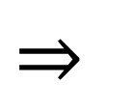



Property Testing [Goldreich, Goldwasser, Ron, Rubinfeld, Sudan]
Randomized algorithm
Property tester
YES
YES
$$⇒$$
Accept with probability $≥\frac{2}{3}$
$$⇒$$
Accept with probability $≥\frac{2}{3}$
$ε$-close
$$⇒$$
Don’t care
No
No
$$⇒$$
Reject with probability $≥\frac{2}{3}$
$$⇒$$
Reject with probability $≥\frac{2}{3}$
$ε$-close : $≤ε$fraction can be changed to become YES

Slide 3
Ultra-fast Approximate Decision Making

Slide 4
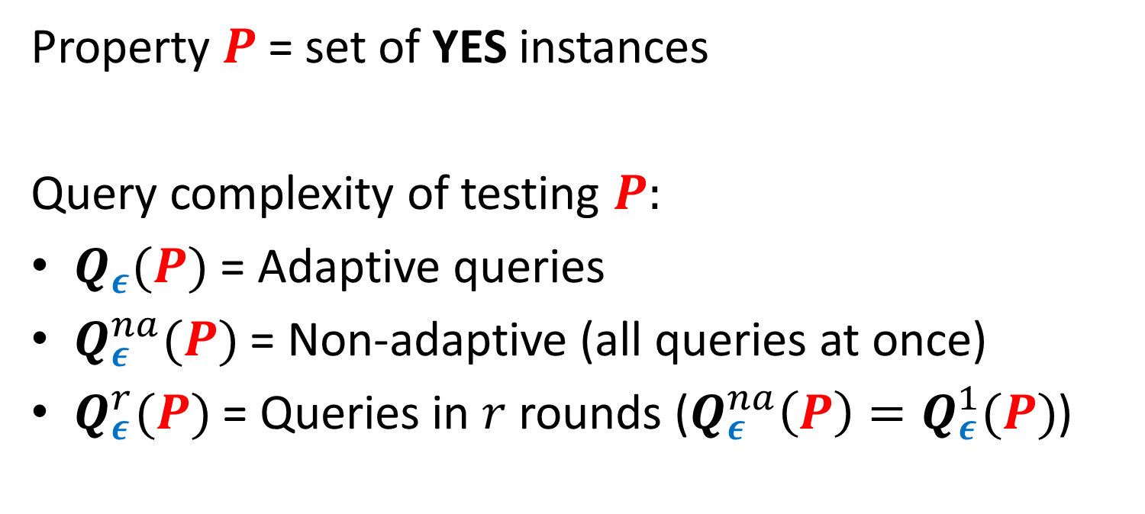
Property Testing [Goldreich, Goldwasser, Ron, Rubinfeld, Sudan]
Property $P$= set of YES instances
Query complexity of testing $P:$
$Q_{ε}(P)$ = Adaptive queries
$Q_{ε}^{na}(P)$ = Non-adaptive (all queries at once)
$Q_{ε}^{r}(P)$ = Queries in $r$ rounds ($Q_{ε}^{na}\left(P\right)=Q_{ε}^{1}(P)$)

Slide 5

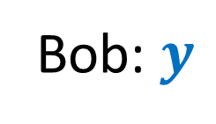

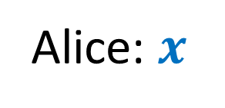



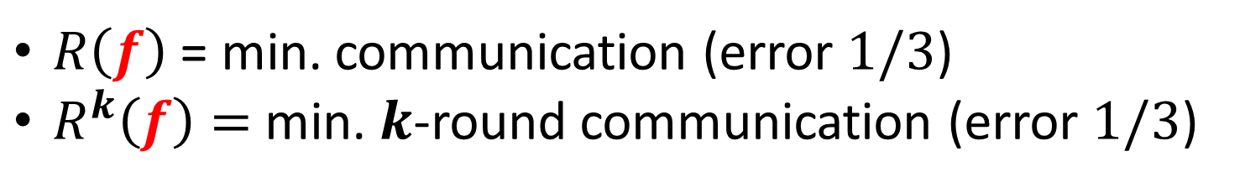
Communication Complexity [Yao’79]
Shared randomness
$M_{1}(x)$
$M_{2}(M_{1}, y)$
$$f(x,y)=?$$
$M_{3}(M_{2}, x)$
…
Alice: $x$
Bob: $y$
$$f(x,y)$$
$R\left(f\right)$ = min. communication (error $1/3$)
$R^{k}\left(f\right)=$ min. $k$-round communication (error $1/3$)

Slide 6

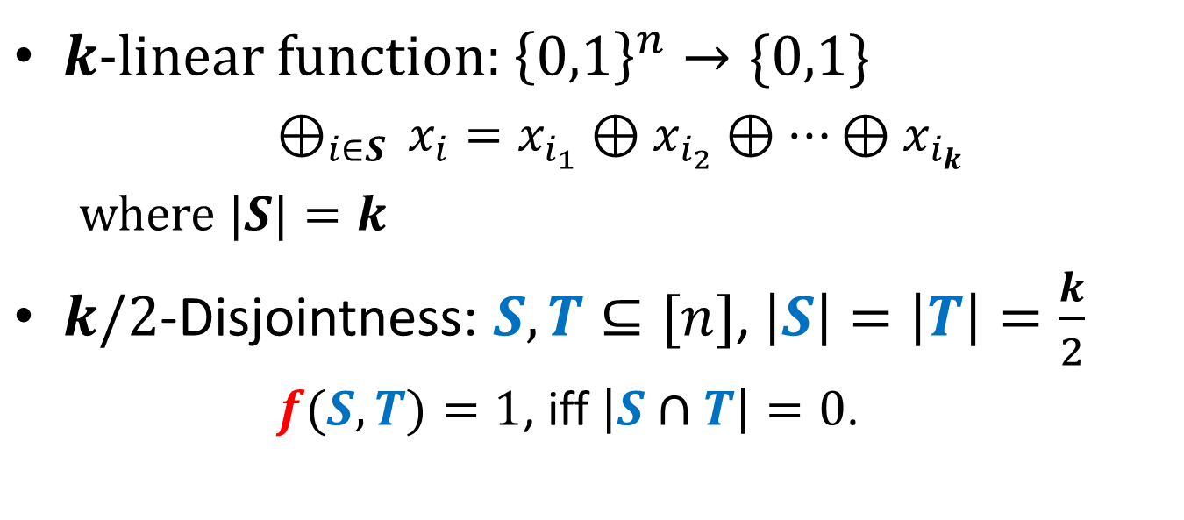
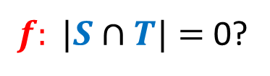
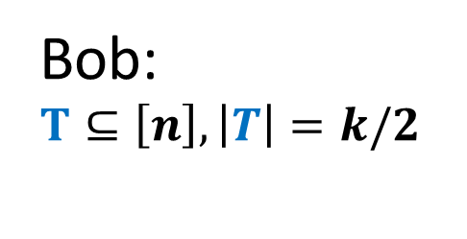
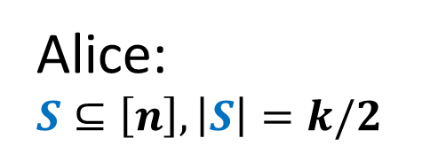
$k$/2-disjointness $⇒k$-linearity [Blais, Brody,Matulef’11]
$k$-linear function: ${\left\{0,1\right\}}^{n}→\{0,1\}$
$⊕_{i∈S }x_{i}=x_{i_{1}}⊕x_{i_{2}}⊕…⊕x_{i_{k}}$
where $|S|=k$
$k/2$-Disjointness: $S,T⊆[n]$, $\left|S\right|=\left|T\right|=\frac{k}{2}$
$f(S,T)=1$, iff $\left|S∩T\right|=0$.
$f: |S∩T|=$ 0?
Alice: $S⊆\left[n\right], \left|S\right|=k/2$
Bob:
$$T⊆\left[n\right], \left|T\right|=k/2$$

Slide 7

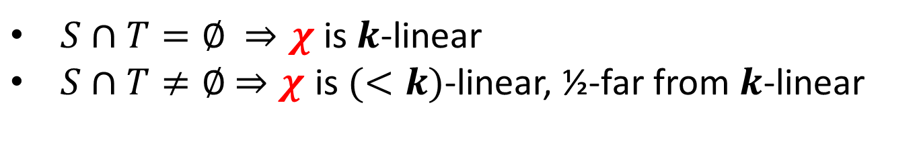





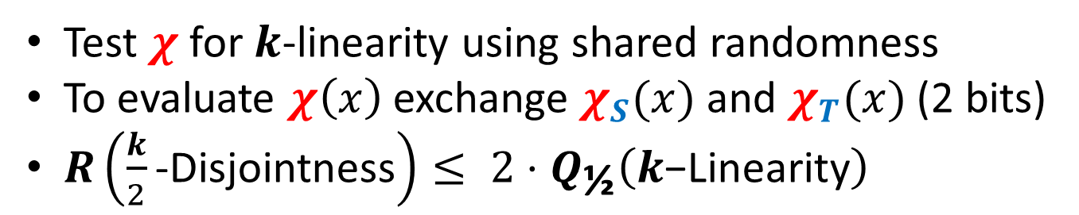
$k$/2-disjointness $⇒k$-linearity [Blais, Brody,Matulef’11]
$${χ= χ}_{S}⊕χ_{T}$$
$$S⊆\left[n\right], \left|S\right|=k/2$$
$$T⊆\left[n\right], \left|T\right|=k/2$$
$$χ_{S}=⊕_{i∈S }x_{i}$$
$$χ_{T}=⊕_{i∈T }x_{i}$$
$S∩T=∅$ $⇒χ$ is $k$-linear
$S∩T≠∅$ $⇒χ$ is $(<k)$-linear, ½-far from $k$-linear
Test $χ$ for $k$-linearity using shared randomness
To evaluate $χ\left(x\right)$ exchange $χ_{S}(x)$ and $χ_{T}(x)$ (2 bits)
$R\left(\frac{k}{2}\text{−}\text{Disjointness}\right)≤ 2⋅Q_{\text{½}}\left(k\text{−}\text{Linearity}\right)$

Slide 8

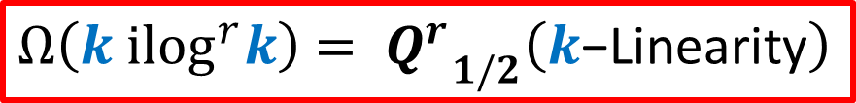

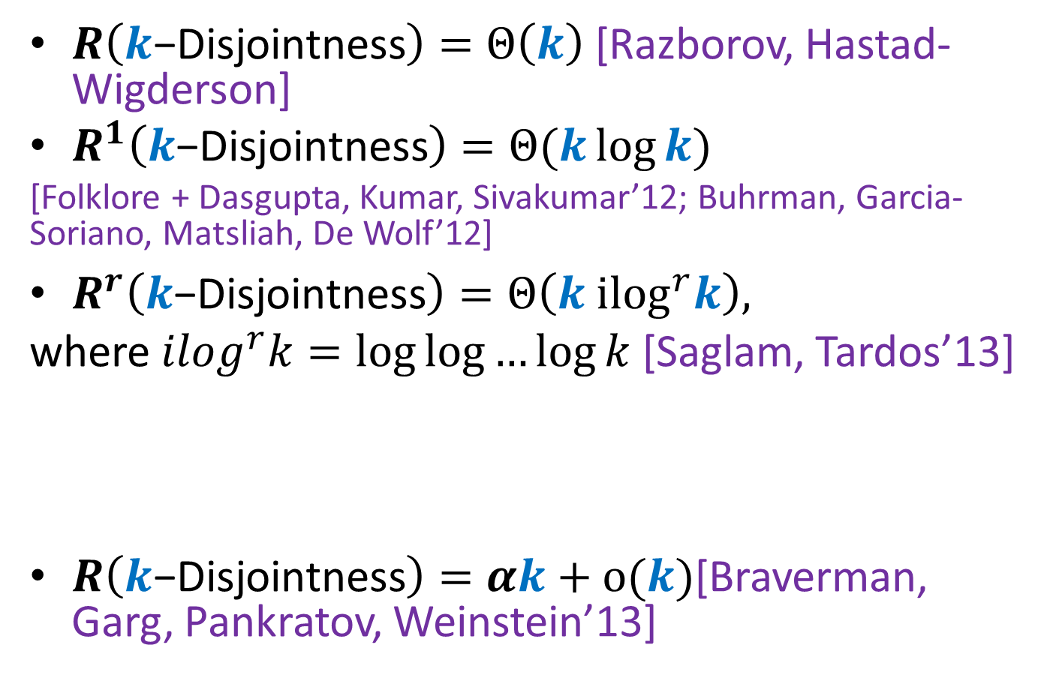
$k$-Disjointness
$R\left(k\text{−}\text{Disjointness}\right)=Θ\left(k\right)$[Razborov, Hastad-Wigderson]
$R^{1}\left(k\text{−}\text{Disjointness}\right)=Θ(k\log{k})$
[Folklore + Dasgupta, Kumar, Sivakumar’12; Buhrman, Garcia-Soriano, Matsliah, De Wolf’12]
$R^{r}\left(k\text{−}\text{Disjointness}\right)=Θ\left(k {ilog}^{r}k\right),$
where $ilog^{r}k=\log{\log{…{\log{k}}}}$ [Saglam, Tardos’13]
$R\left(k\text{−}\text{Disjointness}\right)=αk+o(k)$[Braverman, Garg, Pankratov, Weinstein’13]
{
$r$ times
$Ω\left(k {ilog}^{r}k\right)$ $= {Q^{r}}_{1/2}^{}\left(k\text{−}\text{Linearity}\right)$
Notes:
State k-linearity as an open problem

Slide 9
Property testing lower bounds via CC
Monotonicity, Juntas, Low Fourier degree, Small Decision Trees [Blais, Brody, Matulef’11]
Small-width OBDD properties [Brody, Matulef, Wu’11]
Lipschitz property [Jha, Raskhodnikova’11]
Codes [Goldreich’13, Gur, Rothblum’13]
Number of relevant variables [Ron, Tsur’13]
(Almost) all: Boolean functions over Boolean hypercube

Slide 10
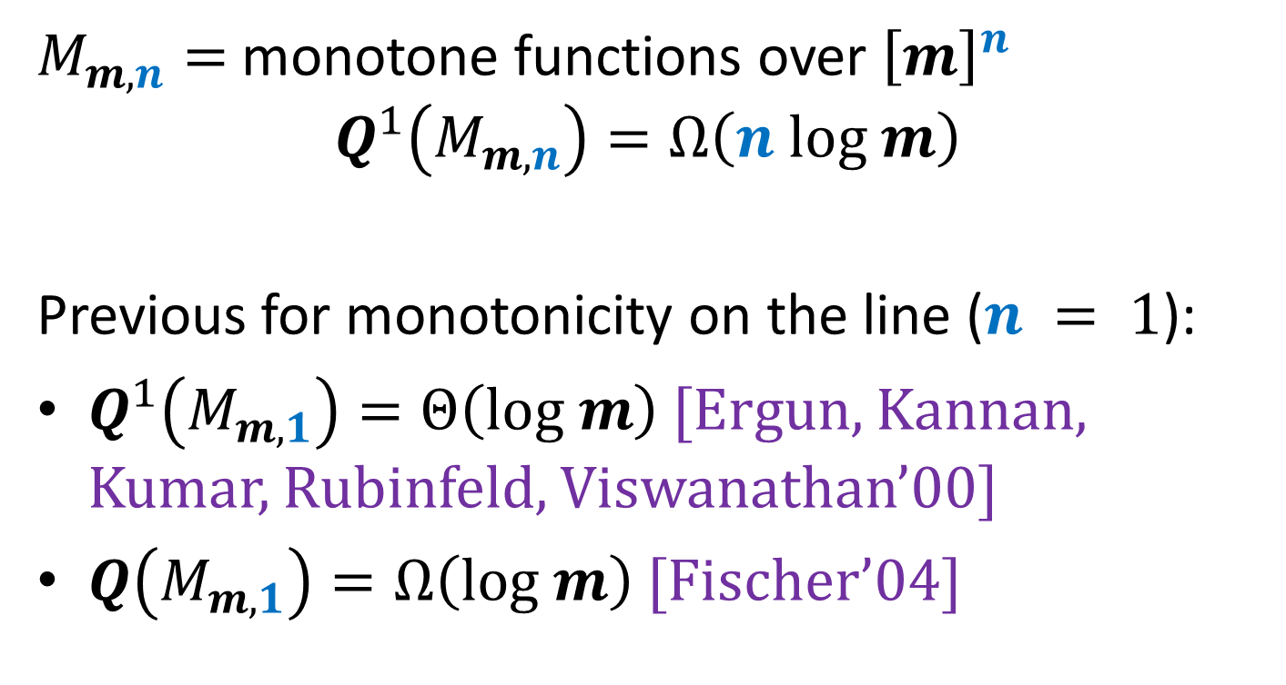

Functions ${\left[m\right]}^{n}→ℝ$ [Blais, Raskhodnikova, Y.]
$M_{m,n}=$ monotone functions over ${\left[m\right]}^{n}$
$$Q^{1}\left(M_{m,n}\right)=Ω\left(n log m\right)$$
Previous for monotonicity on the line ($n = 1$):
$Q^{1}\left(M_{m,1}\right)=Θ\left(log m\right)$ [Ergun, Kannan, Kumar, Rubinfeld, Viswanathan’00]
$Q\left(M_{m,1}\right)=Ω\left(log m\right)$ [Fischer’04]

Slide 11
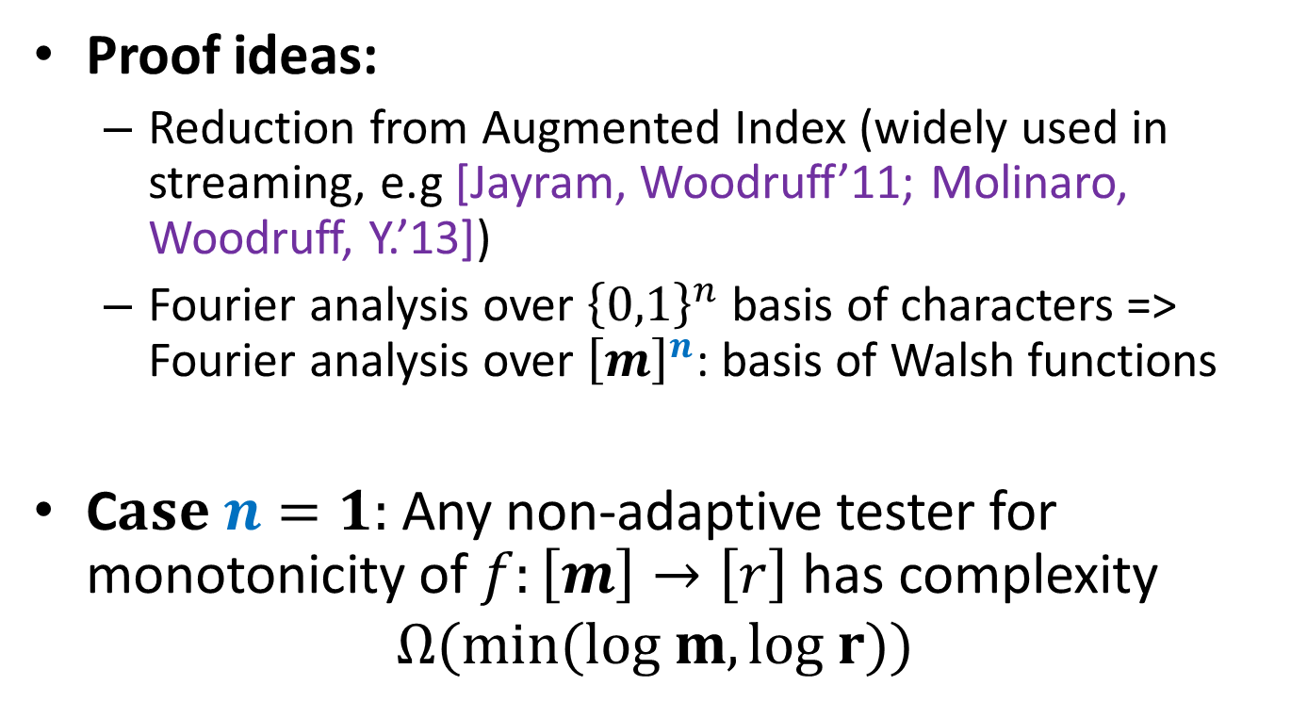
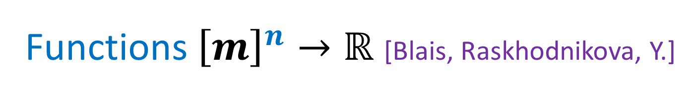
Functions ${\left[m\right]}^{n}→ℝ$ [Blais, Raskhodnikova, Y.]
Proof ideas:
Reduction from Augmented Index (widely used in streaming, e.g [Jayram, Woodruff’11; Molinaro, Woodruff, Y.’13])
Fourier analysis over ${\left\{0,1\right\}}^{n}$ basis of characters => Fourier analysis over ${\left[m\right]}^{n}$: basis of Walsh functions
C$ase n=1:$ Any non-adaptive tester for monotonicity of $f:\left[m\right]→\left[r\right]$ has complexity
$$Ω(min(log m, log r))$$

Slide 12

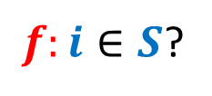


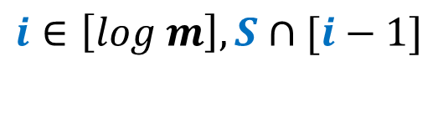

Functions $[m]→ℝ$ [Blais, Raskhodnikova, Y.]
Augmented Index: S; ($i, S∩[i−1]$)
$R^{1}\left[\text{Augmented} \text{Index}\right]=Ω(|S|)$ [Miltersen, Nisan, Safra, Wigderson, 98]
$f:i∈S$?
$M_{1}(S)$
$$S⊆\left[log m\right]$$
$$i∈\left[log m\right], S∩[i−1]$$

Slide 13



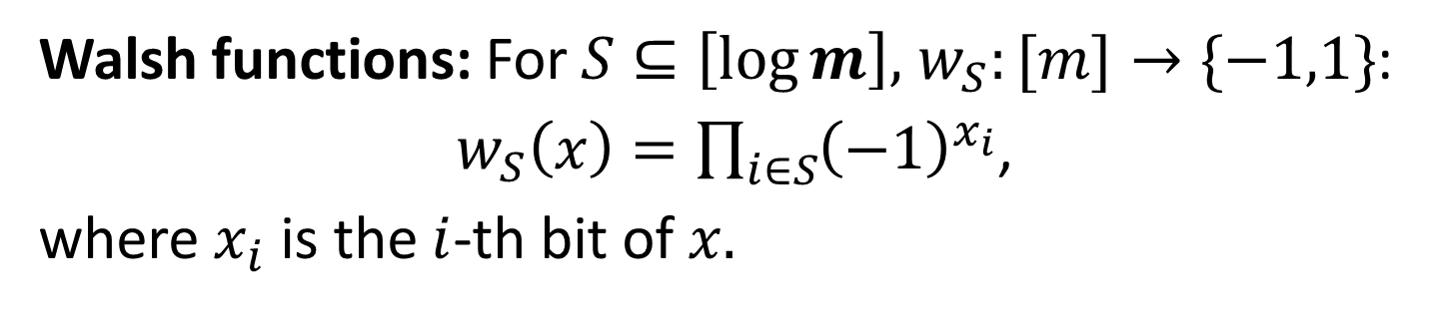




Functions $[m]→ℝ$ [Blais, Raskhodnikova, Y.]
Walsh functions: For $S⊆\left[\log{m}\right],$ $w_{S}:[m]→\{−1,1\}$:
$w_{S}\left(x\right)=\prod_{i∈S}{{\left(−1\right)}^{x_{i}}}$,
where $x_{i}$ is the $i$-th bit of $x.$
$$w_{\left\{1\right\}}=$$
$$x$$
$$w_{\left\{2\right\}}=$$
…
$$x$$
$$w_{\left\{4\right\}}=$$
$$x$$

Slide 14



Functions $[m]→ℝ$ [Blais, Raskhodnikova, Y.]
Step functions. For $i∈\left[\log{m}\right]: step_{i}$: $\left[m\right]→\left[\frac{m}{2^{i}} \right]:$
$$step_{i}\left(x\right)=⌈x/2^{i}⌉$$
$$step_{2}=$$
$$x$$

Slide 15

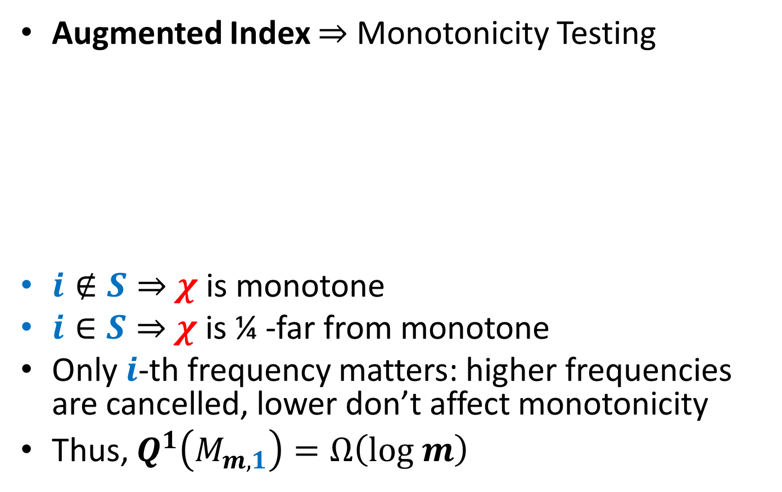
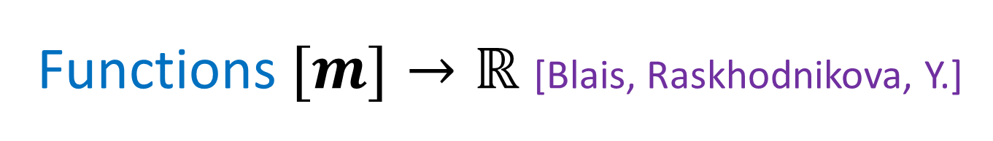

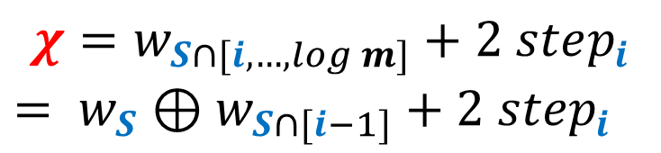
Functions $[m]→ℝ$ [Blais, Raskhodnikova, Y.]
Augmented Index $⇒$ Monotonicity Testing
$i∉S⇒$ $χ$ is monotone
$i∈S⇒$ $χ$ is ¼ -far from monotone
Only $i$-th frequency matters: higher frequencies are cancelled, lower don’t affect monotonicity
Thus, $Q^{1}\left(M_{m,1}\right)=Ω\left(log m\right)$
$$χ=w_{S∩[i, …,log m]}+2 step_{i}$$
$= w_{S}⊕w_{S∩[i−1]}+2 step_{i}$
$$S⊆\left[log m\right]$$
$$i∈\left[log m\right], S∩[i−1]$$

Slide 16

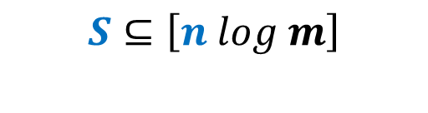
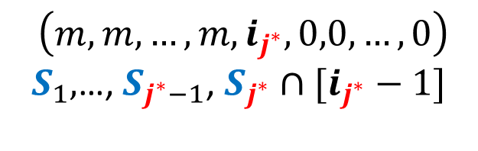


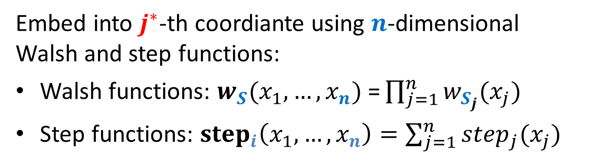

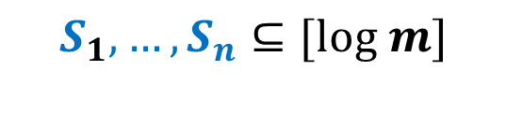
Functions ${\left[m\right]}^{n}→ℝ$ [Blais, Raskhodnikova, Y.]
$$S⊆\left[n log m\right]$$
$$i∈\left[n log m\right], S∩\left[i−1\right]$$
$$⇒$$
$$⇒$$
$$S_{1},…, S_{n}⊆[log m]$$
$\left(m, m, …,m, i_{j^{∗}},0,0,…,0\right)$
$S_{1},$…, $S_{j^{∗}−1}$, $S_{j^{∗}}∩[i_{j^{∗}}−1]$
Embed into $j^{∗}$-th coordiante using $n$-dimensional Walsh and step functions:
Walsh functions: $w_{S}(x_{1},…,x_{n})\text{ =}\prod_{j=1}^{n}{w_{S_{j}}(x_{j})}$
Step functions: ${step}_{i}\left(x_{1},…,x_{n}\right)=\sum_{j=1}^{n}{step_{j}(x_{j})}$

Slide 17

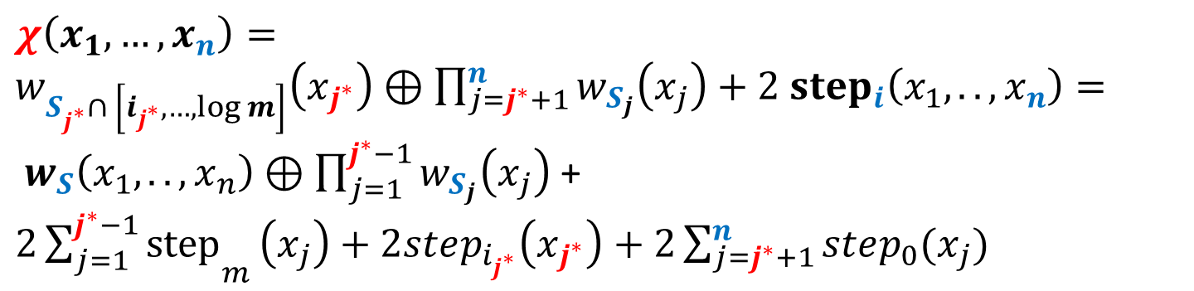
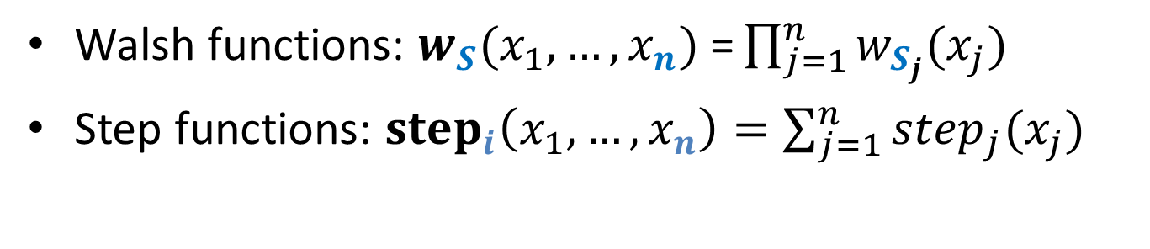
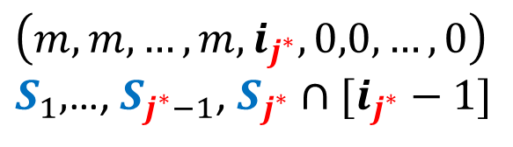
Functions ${\left[m\right]}^{n}→ℝ$ [Blais, Raskhodnikova, Y.]
$$S_{1},…, S_{n}⊆[log m]$$
$$\left(m, m, …,m, i_{j^{∗}},0,0,…,0\right)$$
$S_{1},$…, $S_{j^{∗}−1}$, $S_{j^{∗}}∩[i_{j^{∗}}−1]$
$$χ\left(x_{1}, …, x_{n}\right)=$$
$w_{S_{j^{∗}}^{}∩ \left[i_{j^{∗}},…,\log{m}\right]}\left(x_{j^{∗}}\right)⊕\prod_{j=j^{∗}+1}^{n}{w_{S_{j}}\left(x_{j}\right)}+2 {step}_{i}\left(x_{1},.., x_{n}\right)= w_{S}\left(x_{1},..,x_{n}\right)⊕\prod_{j=1}^{j^{∗}−1}{w_{S_{j}}\left(x_{j}\right)}$ + ${2\sum_{j=1}^{j^{∗}−1}{step}}_{m}\left(x_{j}\right)+2step_{i_{j^{∗}}}\left(x_{j^{∗}}\right)+2\sum_{j=j^{∗}+1}^{n}{step_{0}(x_{j})}$
Walsh functions: $w_{S}(x_{1},…,x_{n})\text{ =}\prod_{j=1}^{n}{w_{S_{j}}(x_{j})}$
Step functions: ${step}_{i}\left(x_{1},…,x_{n}\right)=\sum_{j=1}^{n}{step_{j}(x_{j})}$

Slide 18
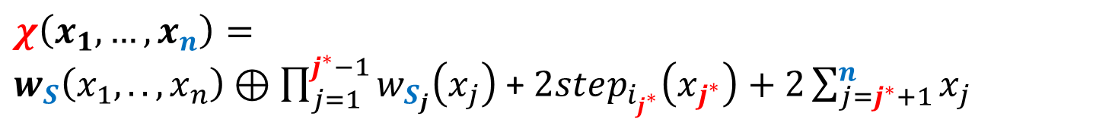
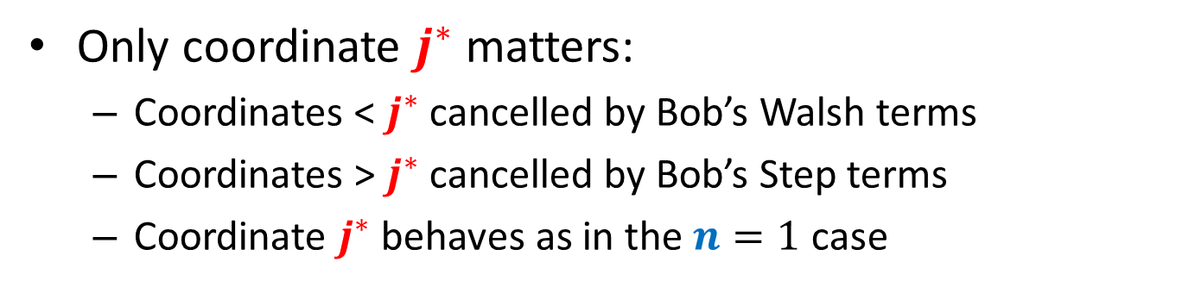
Functions ${\left[m\right]}^{n}→ℝ$ [Blais, Raskhodnikova, Y.]
$$S_{1},…, S_{n}⊆[log m]$$
$$\left(m, m, …,m, i_{j^{∗}},0,0,…,0\right)$$
$S_{1},$…, $S_{j^{∗}−1}$, $S_{j^{∗}}∩[i_{j^{∗}}−1]$
$$χ\left(x_{1}, …, x_{n}\right)=$$
$w_{S}\left(x_{1},..,x_{n}\right)⊕\prod_{j=1}^{j^{∗}−1}{w_{S_{j}}\left(x_{j}\right)}$ + $2step_{i_{j^{∗}}}\left(x_{j^{∗}}\right)+2\sum_{j=j^{∗}+1}^{n}{x_{j}}$
Only coordinate $j^{∗}$ matters:
Coordinates < $j^{∗}$ cancelled by Bob’s Walsh terms
Coordinates > $j^{∗}$ cancelled by Bob’s Step terms
Coordinate $j^{∗}$ behaves as in the $n=1$ case

Slide 19
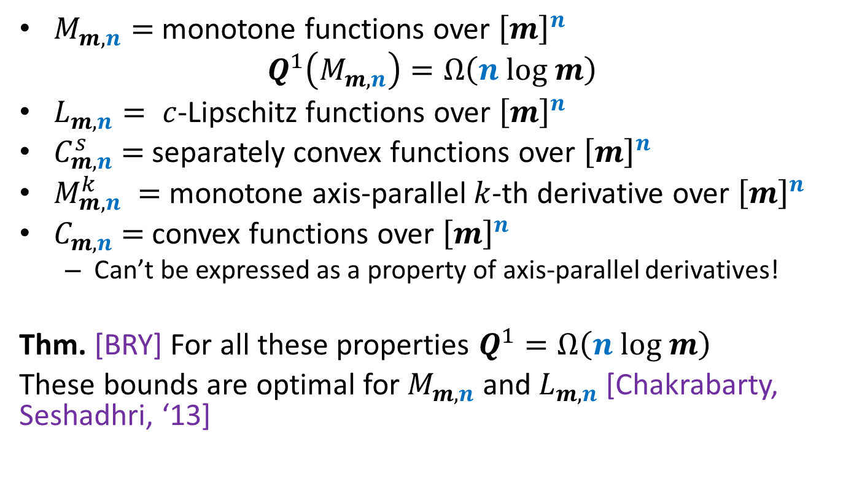
Functions ${\left[m\right]}^{n}→ℝ$ [Blais, Raskhodnikova, Y.]
$M_{m,n}=$ monotone functions over ${\left[m\right]}^{n}$
$$Q^{1}\left(M_{m,n}\right)=Ω\left(n log m\right)$$
$L_{m,n}= c$-Lipschitz functions over ${\left[m\right]}^{n}$
$C_{m,n}^{s}$ $=$separately convex functions over ${\left[m\right]}^{n}$
$M_{m,n}^{k} =$ monotone axis-parallel $k$-th derivative over ${\left[m\right]}^{n}$
$C_{m,n}^{}$ $=$convex functions over ${\left[m\right]}^{n}$
Can’t be expressed as a property of axis-parallel derivatives!
Thm. [BRY] For all these properties $Q^{1}=Ω\left(n log m\right)$
These bounds are optimal for $M_{m,n}$ and $L_{m,n}$ [Chakrabarty, Seshadhri, ‘13]

Slide 20
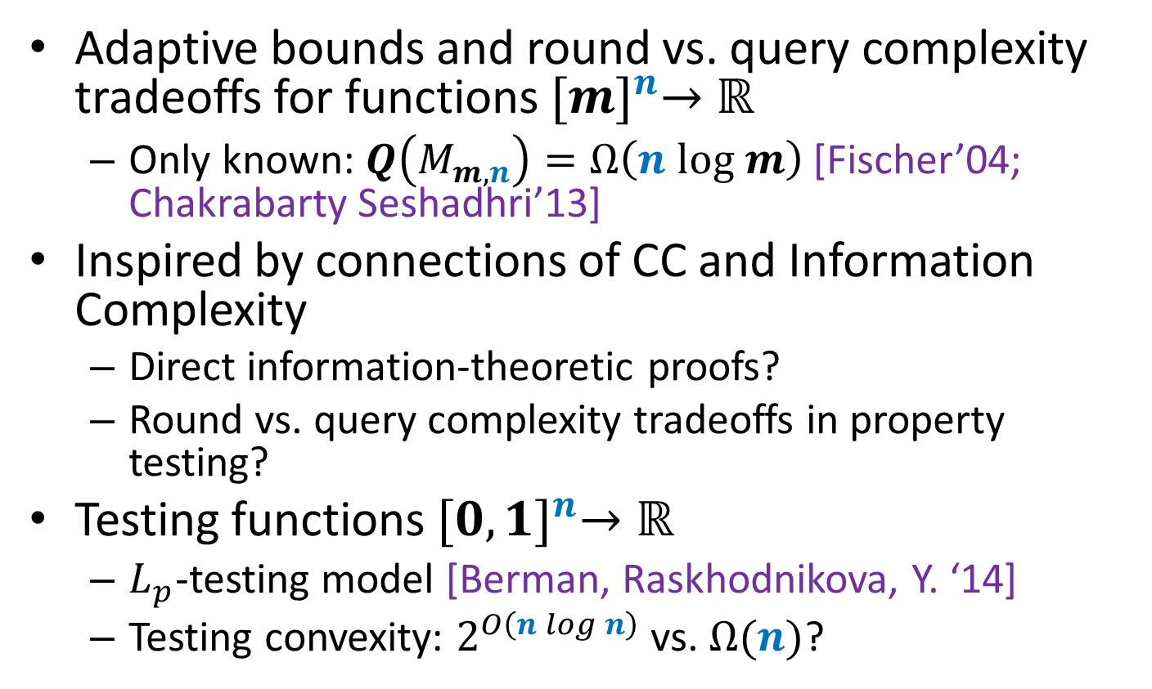
Open Problems
Adaptive bounds and round vs. query complexity tradeoffs for functions ${[m]}^{n}→ℝ$
Only known: $Q\left(M_{m,n}\right)=Ω\left(n log m\right)$ [Fischer’04; Chakrabarty Seshadhri’13]
Inspired by connections of CC and Information Complexity
Direct information-theoretic proofs?
Round vs. query complexity tradeoffs in property testing?
Testing functions ${[0,1]}^{n}→ℝ$
$L_{p}$-testing model [Berman, Raskhodnikova, Y. ‘14]
Testing convexity: $2^{O\left(n log n\right)}$ vs. $Ω(n)$?

