Slide 1
CSCI B609: “Foundations of Data Science”
Lecture 11/12: VC-Dimension and
VC-Theorem
Slides at http://grigory.us/data-science-class.html
Grigory Yaroslavtsev
http://grigory.us

Slide 2
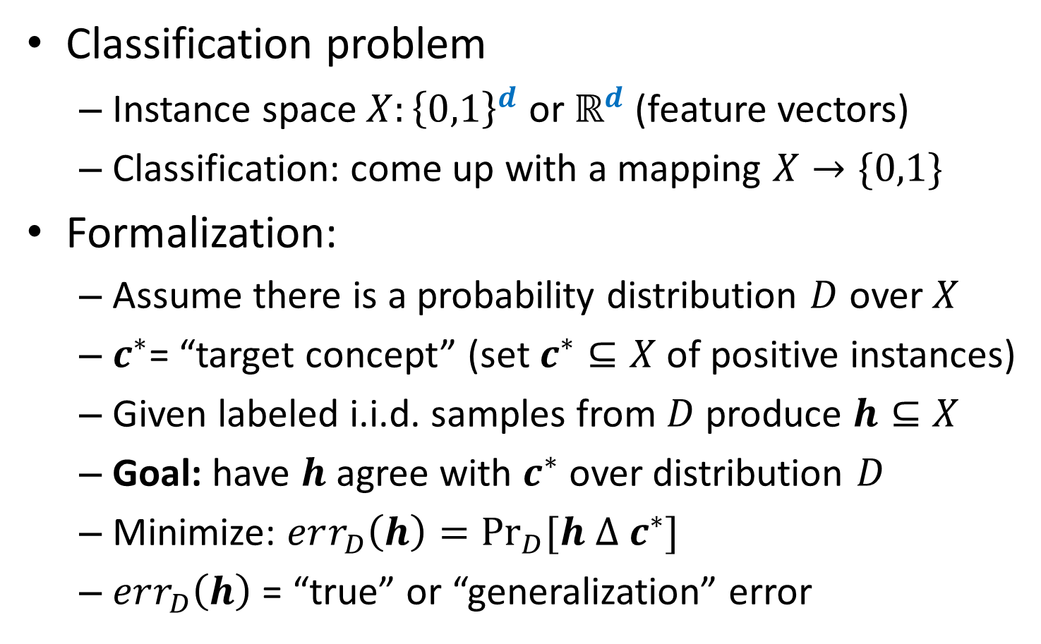
Intro to ML
Classification problem
Instance space $X:{\left\{0,1\right\}}^{d}$ or $ℝ^{d}$ (feature vectors)
Classification: come up with a mapping $X→\{0,1\}$
Formalization:
Assume there is a probability distribution $D$ over $X$
$c^{∗}$= “target concept” (set $c^{∗}⊆X$ of positive instances)
Given labeled i.i.d. samples from $D$ produce $h⊆X$
Goal: have $h$ agree with $c^{∗}$ over distribution $D$
Minimize: $err_{D}\left(h\right)=\underset{D}{Pr}{[h Δ c^{∗}]}$
$err_{D}\left(h\right)$ = “true” or “generalization” error

Slide 3
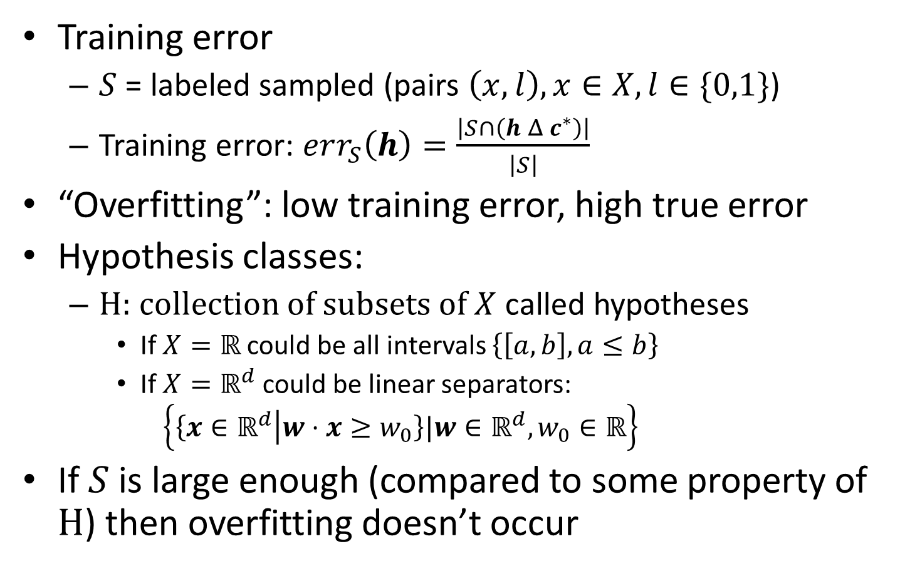
Intro to ML
Training error
$S$ = labeled sampled (pairs $\left(x,l\right), x∈X, l∈\{0,1\}$)
Training error: $err_{S}\left(h\right)=\frac{\left|S∩\left(h Δ c^{∗}\right)\right|}{\left|S\right|}$
“Overfitting”: low training error, high true error
Hypothesis classes:
H: collection of subsets of $X$ called hypotheses
If $X=ℝ$ could be all intervals $\left\{\left[a,b\right],a≤b\right\}$
If $X=ℝ^{d}$ could be linear separators:
$$\left\{\left\{x∈ℝ^{d} | w⋅x≥w_{0}\right\}|w∈ℝ^{d},w_{0}∈ℝ\right\}$$
If $S$ is large enough (compared to some property of H) then overfitting doesn’t occur

Slide 4

Overfitting and Uniform Convergence
PAC learning (agnostic): For $ε,δ>0$ if
$$\left|S\right|≥1/2ε^{2}(\ln\left|H\right|+\ln{2/δ})$$
then with probability $1−δ$:
$∀h∈H:$ $\left|err_{S}\left(h\right)−err_{D}\left(h\right)\right|≤ε$
Size of the class of hypotheses can be very large
Can also be infinite, how to give a bound then?
We will see ways around this today

Slide 5
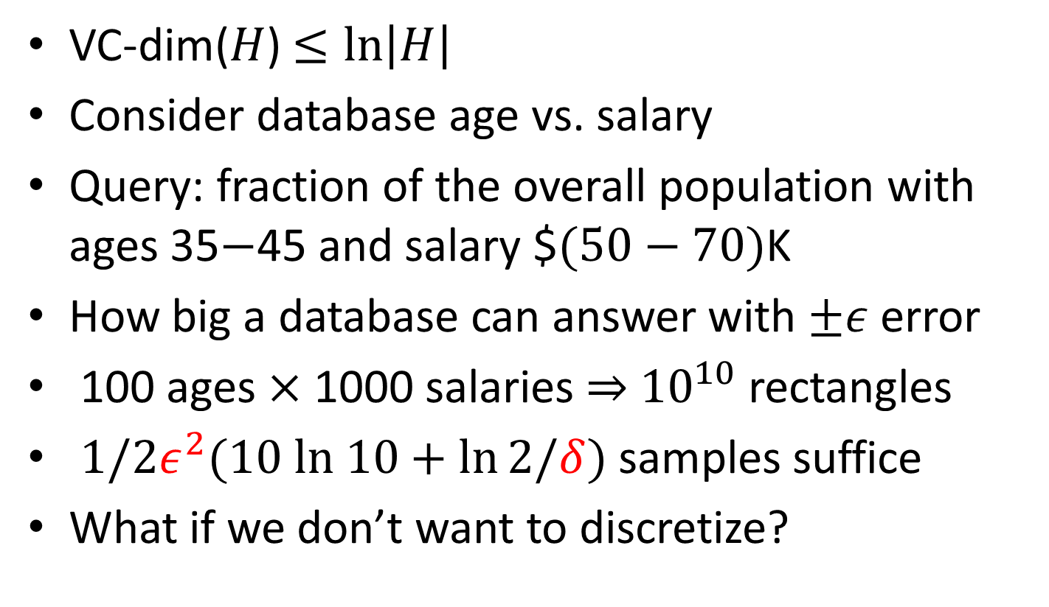
VC-dimension
VC-dim($H$) $≤\ln\left|H\right|$
Consider database age vs. salary
Query: fraction of the overall population with ages 35$−$45 and salary $$(50−70)$K
How big a database can answer with $±ε$ error
100 ages $×$ 1000 salaries $⇒$ ${10}^{10}$ rectangles
$1/2ε^{2}(10 ln 10+\ln{2/δ})$ samples suffice
What if we don’t want to discretize?

Slide 6
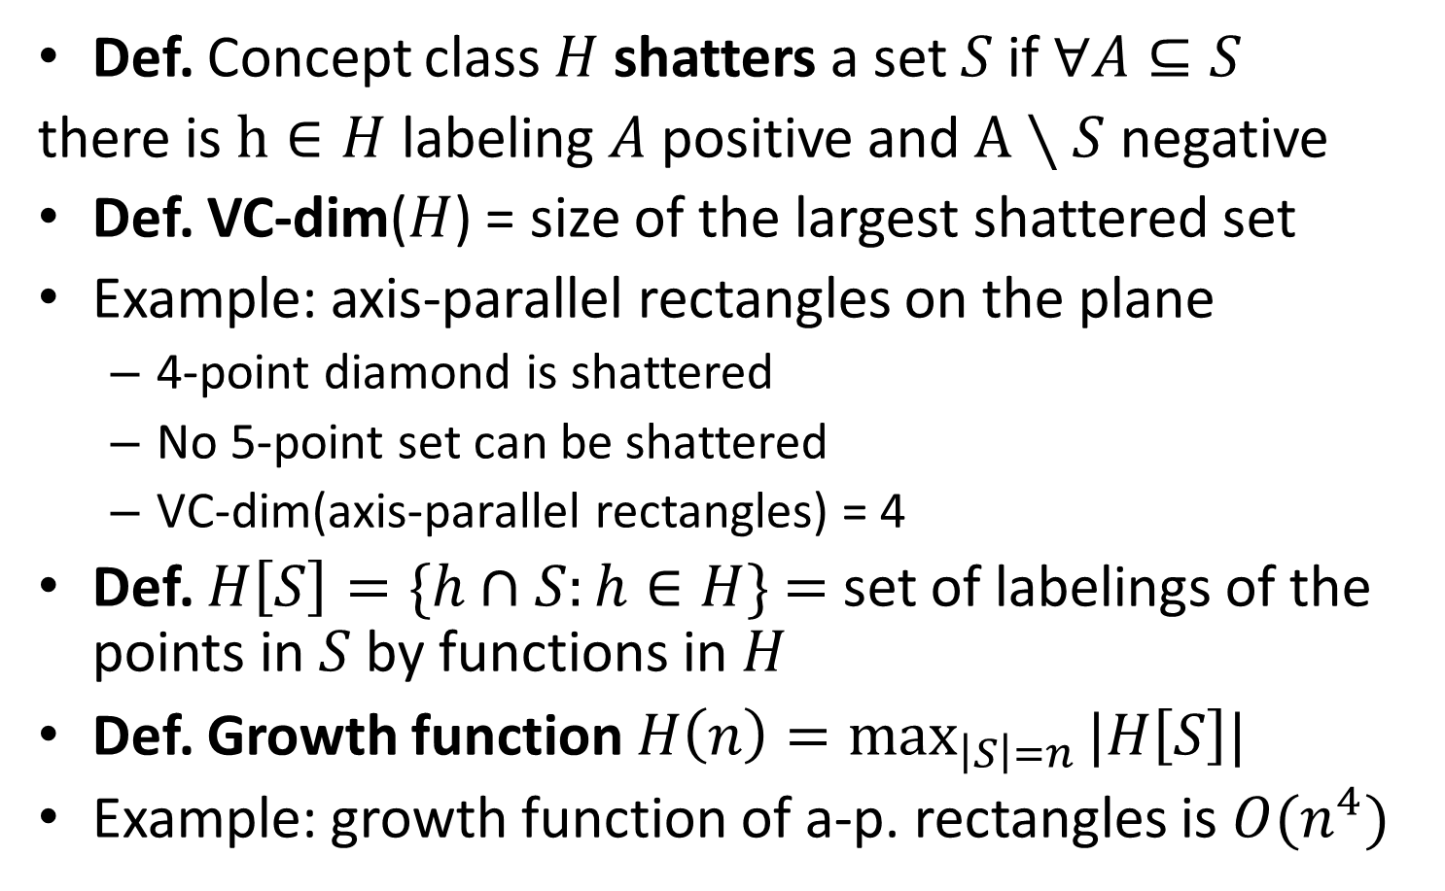
VC-dimension
Def. Concept class $H$ shatters a set $S$ if $∀A⊆S$
there is $h∈H$ labeling $A$ positive and $A∖S$ negative
Def. VC-dim($H$) = size of the largest shattered set
Example: axis-parallel rectangles on the plane
4-point diamond is shattered
No 5-point set can be shattered
VC-dim(axis-parallel rectangles) = 4
Def. $H\left[S\right]=\{h∩S:h∈H\}$ $=$ set of labelings of the points in $S$ by functions in $H$
Def. Growth function $H\left(n\right)=\max_{\left|S\right|=n}{|H\left[S\right]|}$
Example: growth function of a-p. rectangles is $O(n^{4})$

Slide 7

Growth function & uniform convergence
PAC learning via growth function: For $ε,δ>0$ if
$$\left|S\right|=n≥8/ε^{2}(\ln\left|2H(2n)\right|+\ln{1/δ})$$
then with probability $1−δ$:
$∀h∈H:$ $\left|err_{S}\left(h\right)−err_{D}\left(h\right)\right|≤ε$
Thm (Sauer’s lemma). If VC-dim($H$)$=d$ then:
$$H\left(n\right)≤\sum_{i=0}^{d}{\left({n \atop i}\right)≤{\left(\frac{en}{d}\right)}^{d}}$$
For half-planes, $\text{VC}\text{-}\text{dim}=3, H\left(n\right)=O(n^{2})$

Slide 8
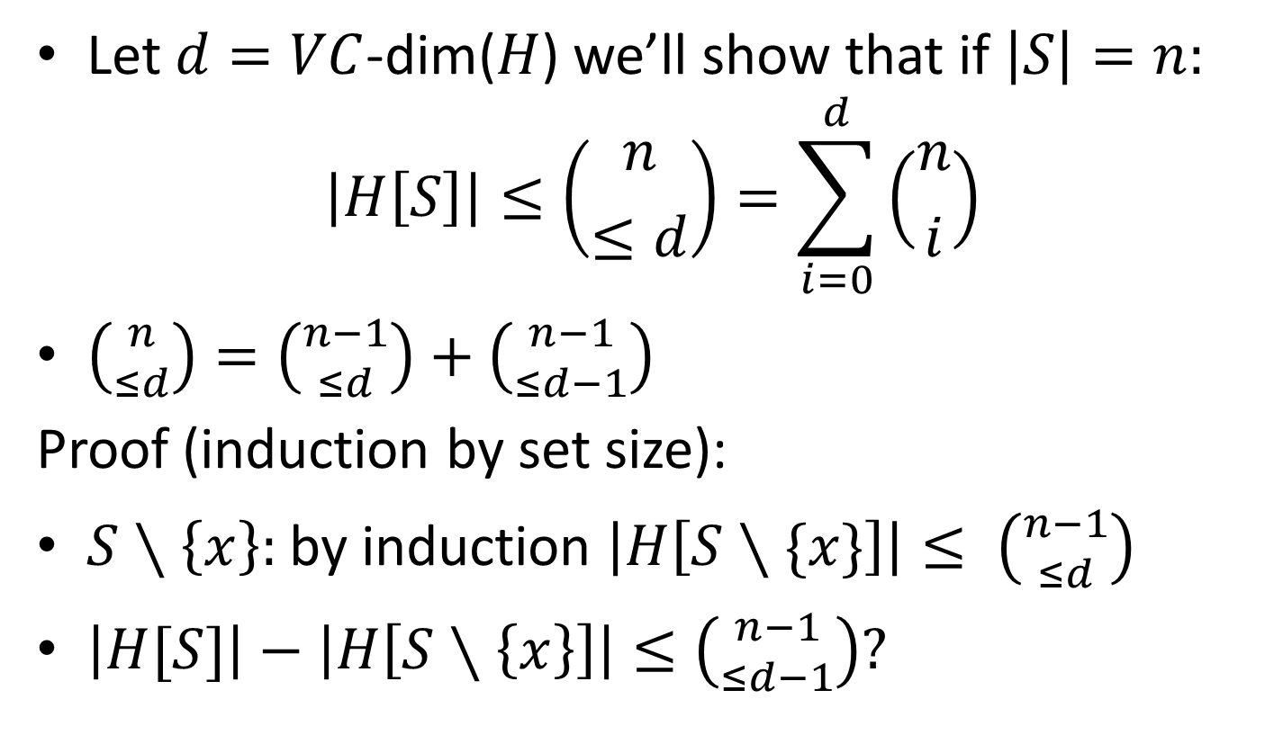
Sauer’s Lemma Proof
Let $d=VC$-dim($H$) we’ll show that if $\left|S\right|=n:$
$$\left|H\left[S\right]\right|≤\left({n \atop ≤d}\right)=\sum_{i=0}^{d}{\left({n \atop i}\right)}$$
$\left({n \atop ≤d}\right)=\left({n−1 \atop ≤d}\right)+\left({n−1 \atop ≤d−1}\right)$
Proof (induction by set size):
$S∖\left\{x\right\}:$ by induction $\left|H\left[S∖\{x\}\right]\right|≤ \left({n−1 \atop ≤d}\right)$
$\left|H[S]\right|−\left|H\left[S∖\left\{x\right\}\right]\right|≤\left({n−1 \atop ≤d−1}\right)?$

Slide 9
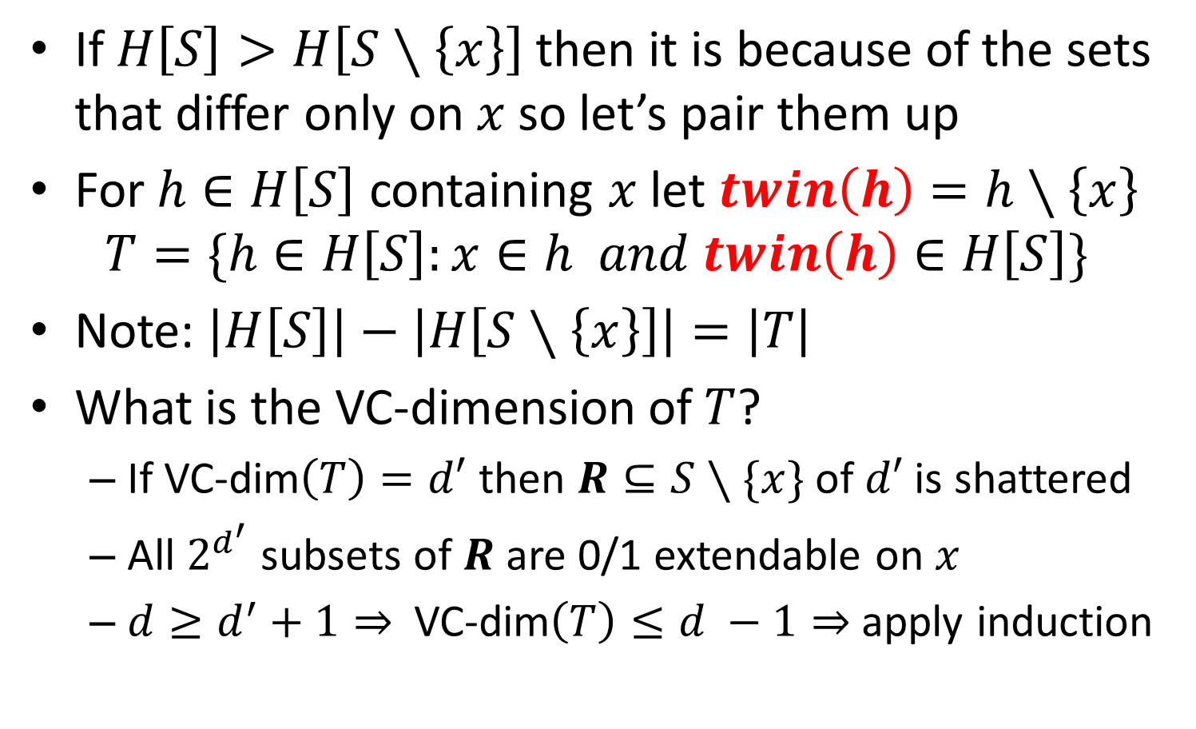
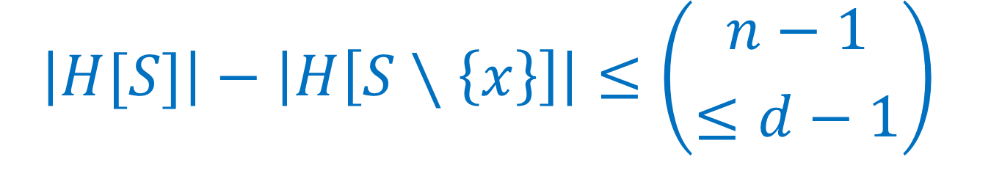
$$\left|H[S]\right|−\left|H\left[S∖\left\{x\right\}\right]\right|≤\left({n−1 \atop ≤d−1}\right)$$
If $H\left[S\right]>H\left[S∖\left\{x\right\}\right]$ then it is because of the sets that differ only on $x$ so let’s pair them up
For $h∈H\left[S\right]$ containing $x$ let $twin\left(h\right)=h∖\left\{x\right\}$
$$T=\{h∈H\left[S\right]:x∈h and twin\left(h\right)∈H\left[S\right]\}$$
Note: $\left|H\left[S\right]\right|−\left|H\left[S∖\left\{x\right\}\right]\right|=\left|T\right|$
What is the VC-dimension of $T$?
If VC-dim$\left(T\right)=d′$ then $R⊆S∖\{x\}$ of $d′$ is shattered
All $2^{d^{′}}$ subsets of $R$ are 0/1 extendable on $x$
$d≥d^{′}+1⇒$VC-dim$\left(T\right)≤d −1⇒$apply induction

Slide 10
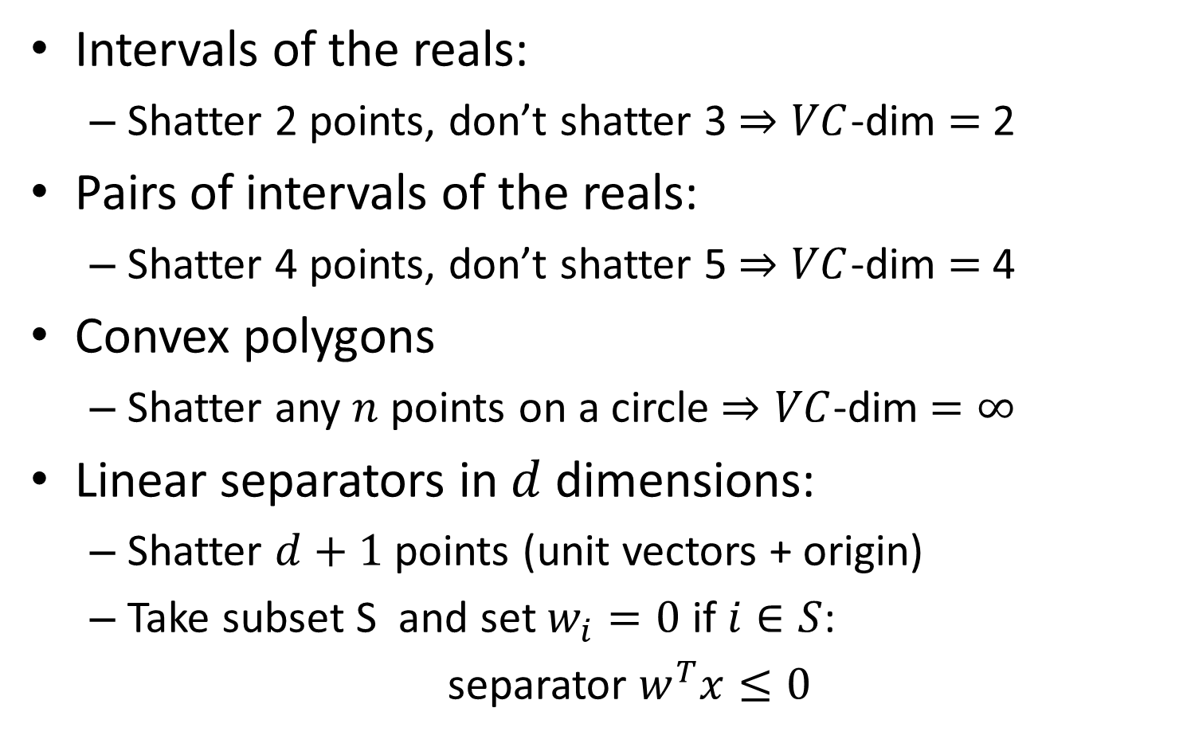
Examples
Intervals of the reals:
Shatter 2 points, don’t shatter 3 $⇒VC$-dim $=$ 2
Pairs of intervals of the reals:
Shatter 4 points, don’t shatter 5 $⇒VC$-dim $=$ 4
Convex polygons
Shatter any $n$ points on a circle $⇒VC$-dim $=∞$
Linear separators in $d$ dimensions:
Shatter $d+1$ points (unit vectors + origin)
Take subset S and set $w_{i}=0$ if $i∈S$:
separator $w^{T}x≤0$

Slide 11
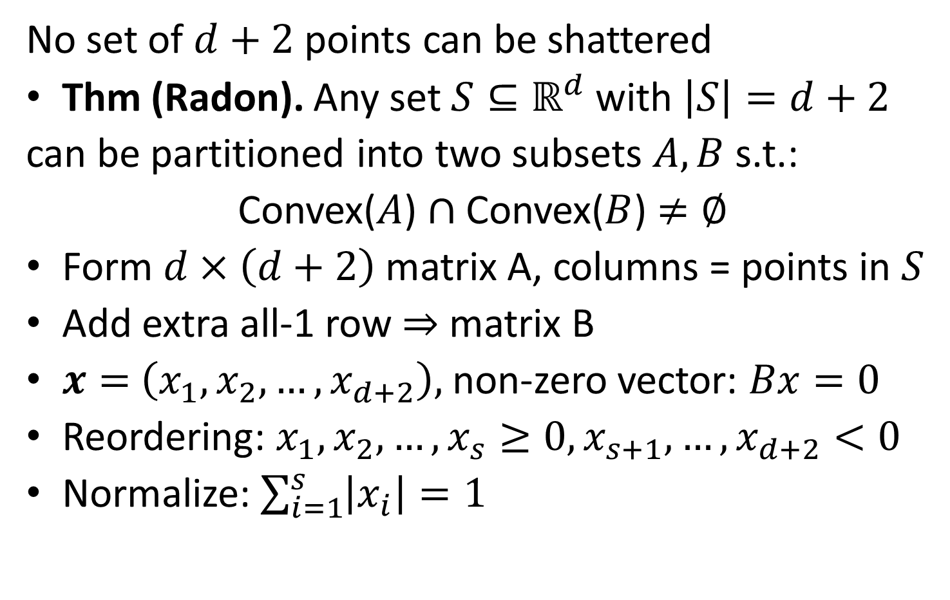
VC-dimension of linear separators
No set of $d+2$ points can be shattered
Thm (Radon). Any set $S⊆ℝ^{d}$ with $\left|S\right|=d+2$
can be partitioned into two subsets $A,B$ s.t.:
Convex($A$) $∩$ Convex($B$) $≠∅$
Form $d×\left(d+2\right)$ matrix A, columns = points in $S$
Add extra all-1 row $⇒$ matrix B
$x=$ $\left(x_{1},x_{2},…, x_{d+2}\right),$ non-zero vector: $Bx=0$
Reordering: $x_{1},x_{2},…,x_{s}≥0, x_{s+1}, …,x_{d+2}<0$
Normalize: $\sum_{i=1}^{s}{\left|x_{i}\right|=1}$

Slide 12
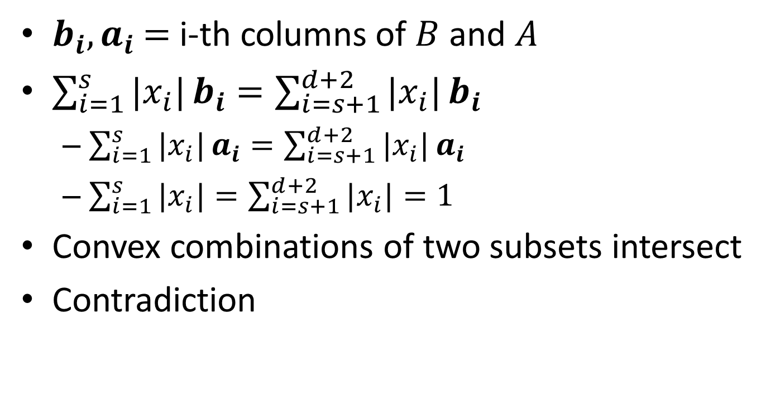
Radon’s Theorem (cont.)
$b_{i}, a_{i}$ $=$ i-th columns of $B$ and $A$
$\sum_{i=1}^{s}{|x_{i}|}b_{i}=\sum_{i=s+1}^{d+2}{|x_{i}|}b_{i}$
$\sum_{i=1}^{s}{|x_{i}|}a_{i}=\sum_{i=s+1}^{d+2}{|x_{i}|}a_{i}$
$\sum_{i=1}^{s}{|x_{i}|}=\sum_{i=s+1}^{d+2}{|x_{i}|}=1$
Convex combinations of two subsets intersect
Contradiction

Slide 13

Growth function & uniform convergence
PAC learning via growth function: For $ε,δ>0$ if
$$\left|S\right|=n≥8/ε^{2}(\ln\left|2H(2n)\right|+\ln{1/δ})$$
then with probability $1−δ$:
$∀h∈H:$ $\left|err_{S}\left(h\right)−err_{D}\left(h\right)\right|≤ε$
Assume event A:
$$∃h∈H: \left|err_{S}\left(h\right)−err_{D}\left(h\right)\right|>ε$$
Draw $S′$ of size $n$, event B:
$$∃h∈H: \left|err_{S}\left(h\right)−err_{D}\left(h\right)\right|>ε$$
$\left|err_{S^{′}}\left(h\right)−err_{D}\left(h\right)\right|<ε/2$

Slide 14
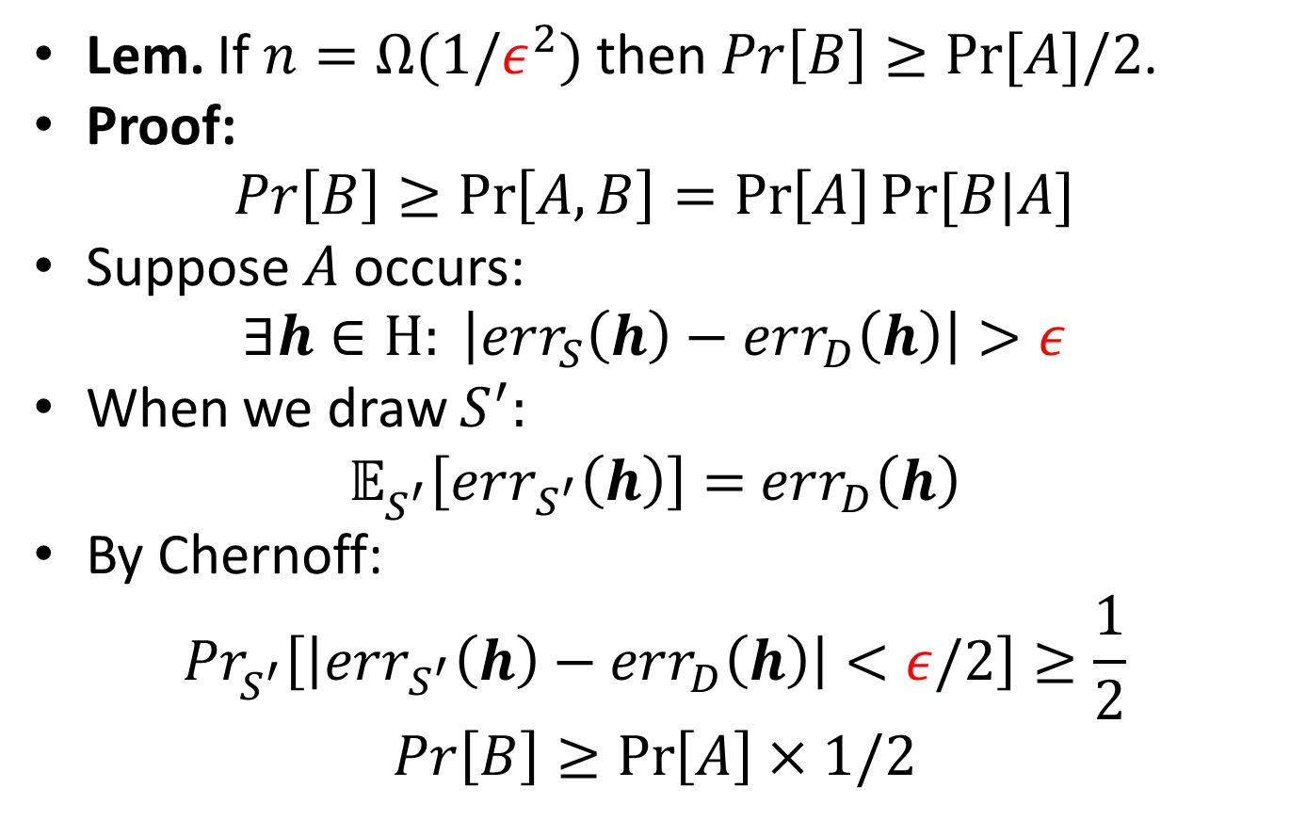

$$Pr\left[B\right]≥Pr⁡[A]/2$$
Lem. If $n=Ω(1/ε^{2})$ then $Pr\left[B\right]≥Pr⁡[A]/2$.
Proof:
$$Pr\left[B\right]≥\operatorname{Pr}\left[A,B\right]=\operatorname{Pr}\left[A\right]Pr⁡[B|A]$$
Suppose $A$ occurs:
$$∃h∈H: \left|err_{S}\left(h\right)−err_{D}\left(h\right)\right|>ε$$
When we draw $S^{′}:$
$𝔼_{S^{′}}^{}\left[err_{S^{′}}\left(h\right)\right]=$ $err_{D}\left(h\right)$
By Chernoff:
$${Pr}_{S^{′}}^{}\left[\left|err_{S^{′}}\left(h\right)−err_{D}\left(h\right)\right|<ε/2\right]≥\frac{1}{2}$$
$$Pr\left[B\right]≥\operatorname{Pr}\left[A\right]×1/2$$

Slide 15
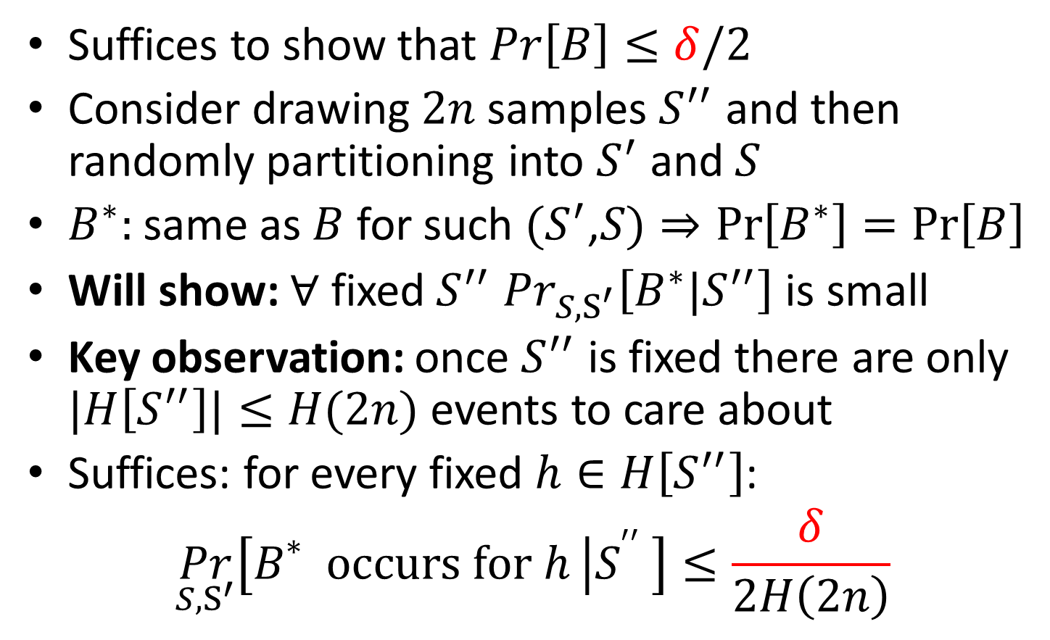
VC-theorem Proof
Suffices to show that $Pr\left[B\right]≤δ/2$
Consider drawing $2n$ samples $S^{′′}$ and then randomly partitioning into $S^{′}$ and $S$
$B^{∗}:$ same as $B$ for such ${(S}^{′}$,$S)⇒\operatorname{Pr}\left[B^{∗}\right]=\operatorname{Pr}\left[B\right]$
Will show: $∀$fixed$S^{′′}$ $\underset{S,S^{′}}{Pr}\left[B^{∗}|S^{′′}\right]$ is small
Key observation: once $S^{′′}$ is fixed there are only $|H\left[S^{′′}\right]|≤H(2n)$ events to care about
Suffices: for every fixed $h∈H\left[S^{′′}\right]$:
$$\underset{S,S^{′}}{Pr}\left[B^{∗} occurs for h | S^{′′} \right]≤\frac{δ}{2H\left(2n\right)}$$

Slide 16
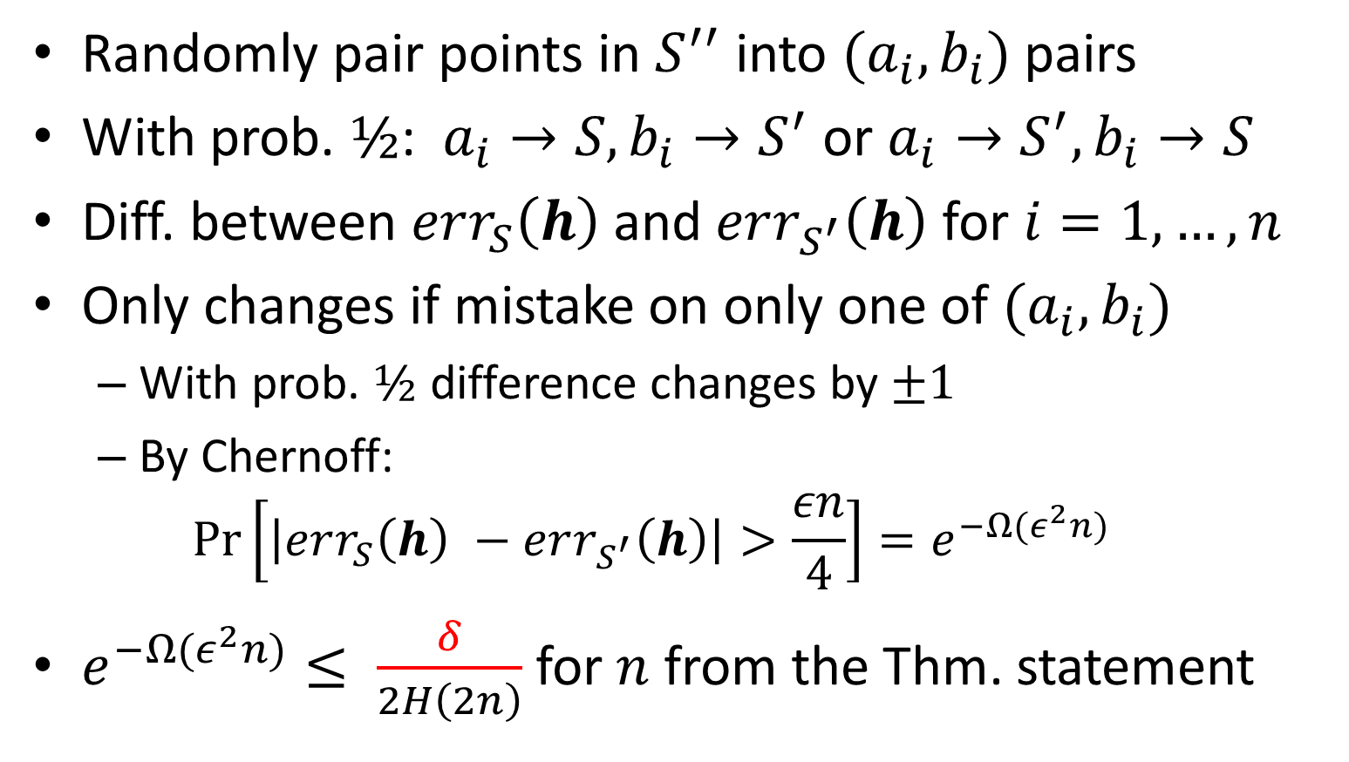
VC-theorem Proof (cont.)
Randomly pair points in $S^{′′}$ into $(a_{i}, b_{i})$ pairs
With prob. $½$: $a_{i}→S, b_{i}→S^{′}$ or $a_{i}→S^{′}, b_{i}→S$
Diff. between $err_{S}\left(h\right)$ and $err_{S^{′}}\left(h\right)$ for $i=1,…,n$
Only changes if mistake on only one of $(a_{i}, b_{i})$
With prob. $½$ difference changes by $±1$
By Chernoff:
$$Pr\left[\left|err_{S}\left(h\right) −err_{S^{′}}\left(h\right)\right|>\frac{εn}{4}\right]=e^{−Ω(ε^{2}n)}$$
$e^{−Ω(ε^{2}n)}≤ \frac{δ}{2H\left(2n\right)}$ for $n$ from the Thm. statement

