Slide 1
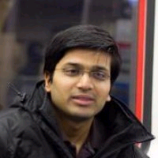
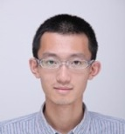



Communication Lower Bounds for Statistical Estimation Problems via a Distributed Data Processing Inequality
Mark Braverman Ankit Garg Tengyu Ma
Huy Nguyen David Woodruff
DIMACS Workshop on Big Data through the Lens of Sublinear Algorithms
Aug 28, 2015

Slide 2



Distributed mean estimation
Big Data! Distributed Storage
and Processing
Statistical estimation:
Unknown parameter $θ$.
Inputs to machines: i.i.d. data points $∼D_{θ}$.
Output estimator $\hat{θ}$.
Objectives:
Low communication $C=\left|Π\right|$.
Small loss
$R≔𝔼\left[{\left\|\hat{θ}−θ\right\|}^{2}\right]$.
small data
small data
Blackboard
$$\hat{θ}$$

Slide 3
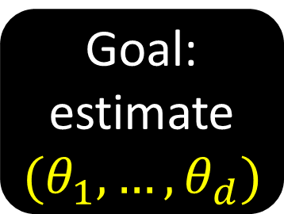

Distributed sparse Gaussian mean estimation
Goal: estimate$(θ_{1},…,θ_{d})$
Ambient dimension $d$.
Sparsity parameter $k$: ${\left\|θ\right\|}_{0}≤k$.
Number of machines $m$.
Each machine holds $n$ samples.
Standard deviation $σ$.
Thus each sample is a vector
$$X_{j}^{(t)}∼\left(𝒩\left(θ_{1},σ^{2}\right),…,𝒩\left(θ_{d},σ^{2}\right)\right)∈ℝ^{d}$$

Slide 4
Goal: estimate$(θ_{1},…,θ_{d})$
Higher value makes estimation:
Ambient dimension $d$.
Sparsity parameter $k$: ${\left\|θ\right\|}_{0}≤k$.
Number of machines $m$.
Each machine holds $n$ samples.
Standard deviation $σ$.
Thus each sample is a vector
$$X_{j}^{(t)}∼\left(𝒩\left(θ_{1},σ^{2}\right),…,𝒩\left(θ_{d},σ^{2}\right)\right)∈ℝ^{d}$$
harder
harder
easier*
easier
harder

Slide 5
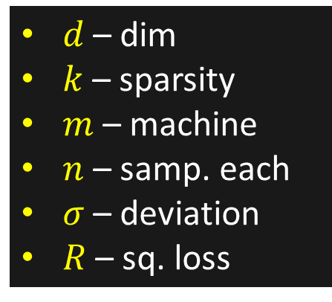
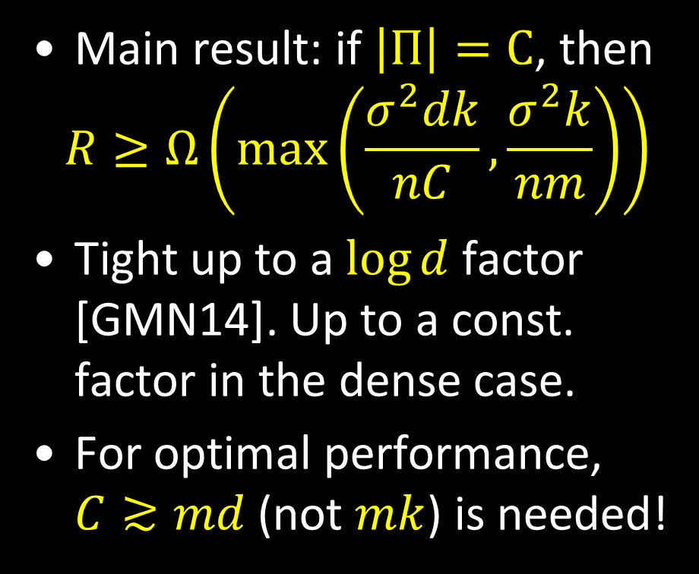
Distributed sparse Gaussian mean estimation
Statistical limit
Main result: if $\left|Π\right|=C$, then
$$R≥Ω\left(\max\left(\frac{σ^{2}dk}{nC},\frac{σ^{2}k}{nm}\right)\right)$$
Tight up to a $\log{d}$ factor [GMN14]. Up to a const. factor in the dense case.
For optimal performance, $C≳md$ (not $mk$) is needed!
$d$ – dim
$k$ – sparsity
$m$ – machine
$n$ – samp. each
$σ$ – deviation
$R$ – sq. loss

Slide 6
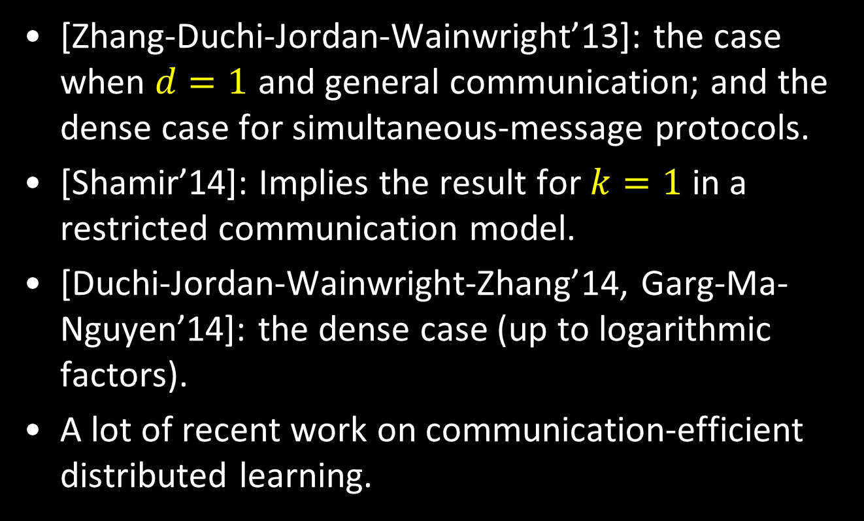
Prior work (partial list)
[Zhang-Duchi-Jordan-Wainwright’13]: the case when $d=1$ and general communication; and the dense case for simultaneous-message protocols.
[Shamir’14]: Implies the result for $k=1$ in a restricted communication model.
[Duchi-Jordan-Wainwright-Zhang’14, Garg-Ma-Nguyen’14]: the dense case (up to logarithmic factors).
A lot of recent work on communication-efficient distributed learning.

Slide 7

Reduction from Gaussian mean detection
$R≥Ω\left(\max\left(\frac{σ^{2}dk}{nC},\frac{σ^{2}k}{nm}\right)\right)$
Gaussian mean detection
A one-dimensional problem.
Goal: distinguish between $μ_{0}=𝒩\left(0,σ^{2}\right)$ and $μ_{1}=𝒩\left(δ,σ^{2}\right)$.
Each player gets $n$ samples.

Slide 8
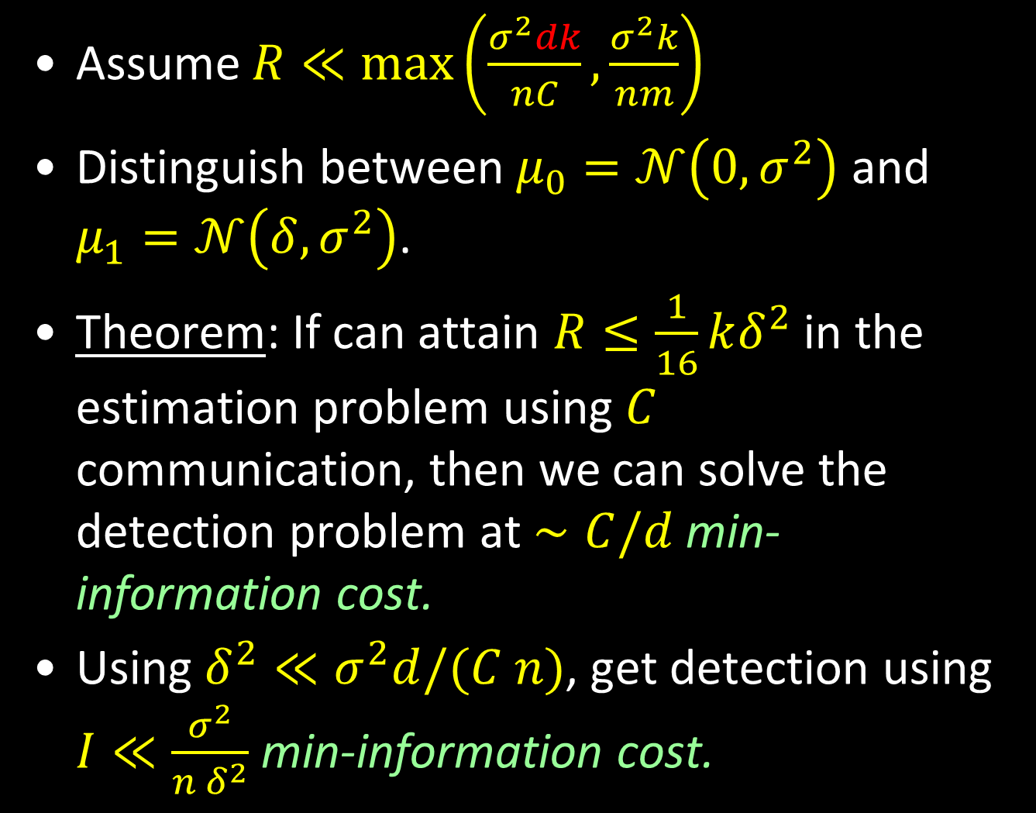
Assume $R≪\max\left(\frac{σ^{2}dk}{nC},\frac{σ^{2}k}{nm}\right)$
Distinguish between $μ_{0}=𝒩\left(0,σ^{2}\right)$ and $μ_{1}=𝒩\left(δ,σ^{2}\right)$.
Theorem: If can attain $R≤\frac{1}{16}kδ^{2}$ in the estimation problem using $C$ communication, then we can solve the detection problem at $∼C/d$ min-information cost.
Using $δ^{2}≪σ^{2}d/(C n)$, get detection using $I≪\frac{σ^{2}}{n δ^{2}}$ min-information cost.

Slide 9

The detection problem
Distinguish between $μ_{0}=𝒩\left(0,1\right)$ and $μ_{1}=𝒩\left(δ,1\right)$.
Each player gets $n$ samples.
Want this to be impossible using $I≪\frac{1}{n δ^{2}}$ min-information cost.

Slide 10
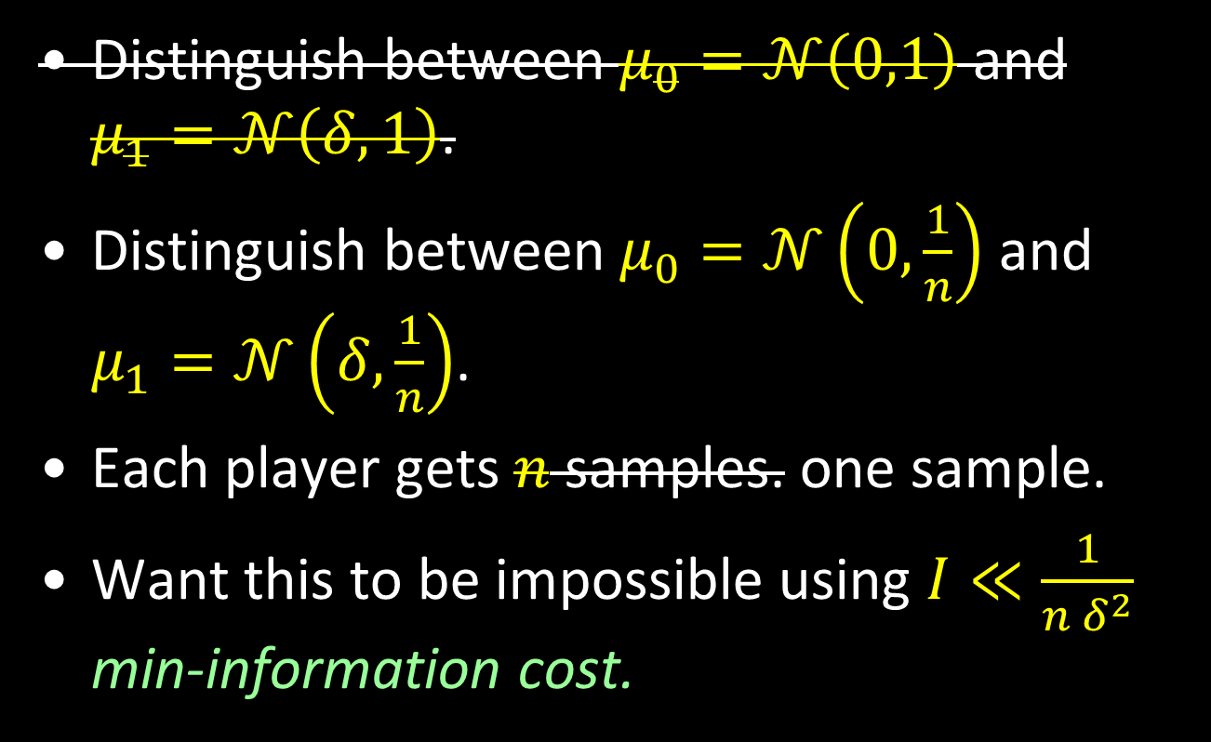
The detection problem
Distinguish between $μ_{0}=𝒩\left(0,1\right)$ and $μ_{1}=𝒩\left(δ,1\right)$.
Distinguish between $μ_{0}=𝒩\left(0,\frac{1}{n}\right)$ and $μ_{1}=𝒩\left(δ,\frac{1}{n}\right)$.
Each player gets $n$ samples. one sample.
Want this to be impossible using $I≪\frac{1}{n δ^{2}}$ min-information cost.

Slide 11
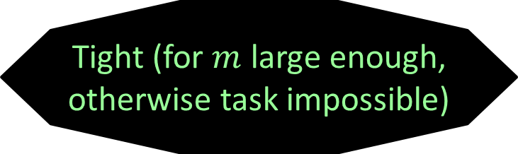

The detection problem
By scaling everything by $\sqrt{n}$ (and replacing $δ$ with $δ\sqrt{n}$).
Distinguish between $μ_{0}=𝒩\left(0,1\right)$ and $μ_{1}=𝒩\left(δ,1\right)$.
Each player gets one sample.
Want this to be impossible using $I≪\frac{1}{δ^{2}}$ min-information cost.
Tight (for $m$ large enough, otherwise task impossible)

Slide 12
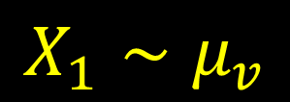



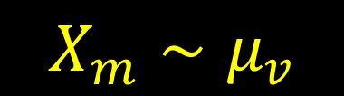
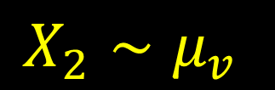
Information cost
$$μ_{v}=𝒩\left(δV,1\right)$$
$$V$$
$X_{1}∼μ_{v}$
$$X_{2}∼μ_{v}$$
$X_{m}∼μ_{v}$
Blackboard $Π$
$$IC\left(π\right):=I(Π;X_{1}X_{2}…X_{m})$$

Slide 13

Min-Information cost
$$μ_{V}=𝒩\left(δV,1\right)$$
$$V$$
$X_{1}∼μ_{v}$
$$X_{2}∼μ_{v}$$
$X_{m}∼μ_{v}$
Blackboard $Π$
$$minIC\left(π\right)≔\min_{v∈\{0,1\}}{I(Π;X_{1}X_{2}…X_{m}|V=v) }$$

Slide 14

Min-Information cost
$$minIC\left(π\right)≔\min_{v∈\{0,1\}}{I(Π;X_{1}X_{2}…X_{m}|V=v) }$$
We will want this quantity to be $Ω\left(\frac{1}{δ^{2}}\right)$.
Warning: it is not the same thing as $I(Π;X_{1}X_{2}…X_{m}|V\text{)=} 𝔼_{v∼V}$ $I(Π;X_{1}X_{2}…X_{m}|V=v)$
because one case can be much smaller than the other.
In our case, the need to use $minIC$ instead of $IC$ happens because of the sparsity.

Slide 15

Strong data processing inequality
$$μ_{v}=𝒩\left(δV,1\right)$$
$$V$$
$X_{1}∼μ_{v}$
$$X_{2}∼μ_{v}$$
$X_{m}∼μ_{v}$
Blackboard $Π$
Fact: $\left|Π\right|≥I\left(Π;X_{1}X_{2}…X_{m}\right)=\sum_{i}{I(Π;X_{i}|X_{<i})}$

Slide 16

Strong data processing inequality
$μ_{v}=𝒩\left(δV,1\right)$; suppose $V∼B_{1/2}$.
For each $i$, $V−X_{i}−Π$ is a Markov chain.
Intuition: “$X_{i}$ contains little information about $V$; no way to learn this information except by learning a lot about $X_{i}$”.
Data processing: $I\left(V;Π\right)≤I\left(X_{i};Π\right)$.
Strong Data Processing: $I\left(V;Π\right)≤β⋅I\left(X_{i};Π\right)$ for some $β=β(μ_{0},μ_{1})<1$.

Slide 17
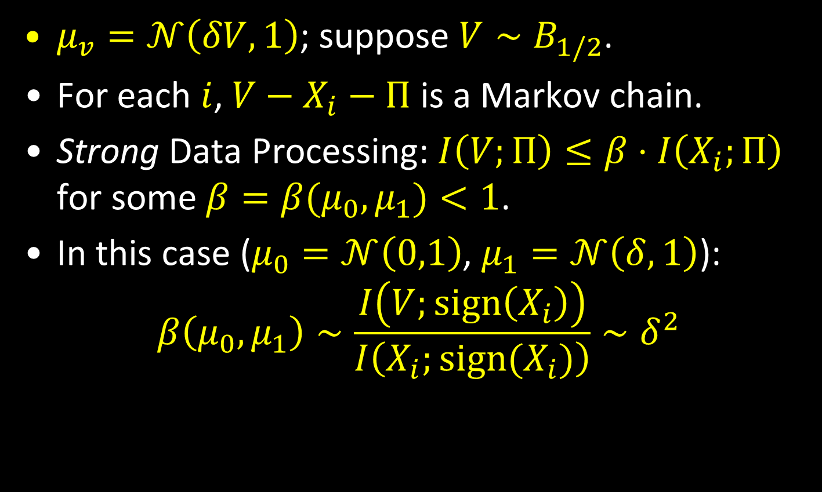
Strong data processing inequality
$μ_{v}=𝒩\left(δV,1\right)$; suppose $V∼B_{1/2}$.
For each $i$, $V−X_{i}−Π$ is a Markov chain.
Strong Data Processing: $I\left(V;Π\right)≤β⋅I\left(X_{i};Π\right)$ for some $β=β(μ_{0},μ_{1})<1$.
In this case ($μ_{0}=𝒩\left(0,1\right)$, $μ_{1}=𝒩\left(δ,1\right)$):
$$β\left(μ_{0},μ_{1}\right)∼\frac{I\left(V;\text{sign}\left(X_{i}\right)\right)}{I\left(X_{i};{\text{sign}(X}_{i})\right)}∼δ^{2}$$

Slide 18
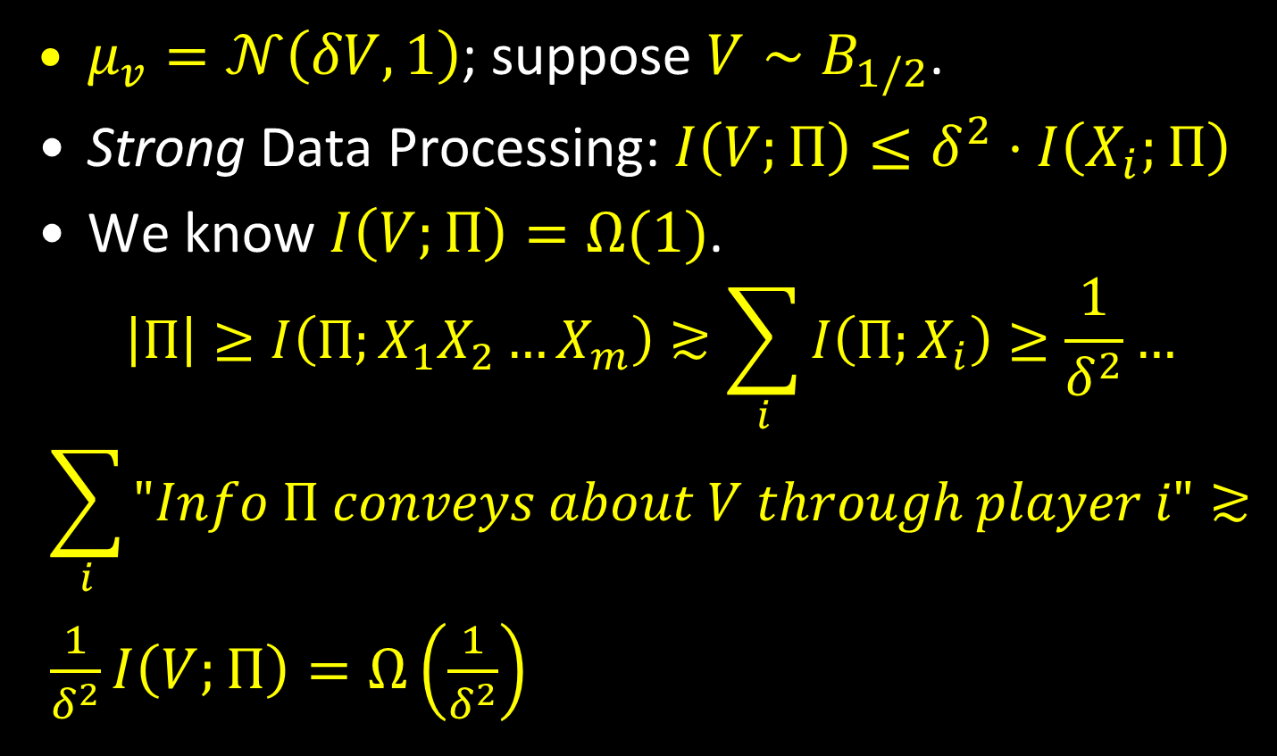
“Proof”
$μ_{v}=𝒩\left(δV,1\right)$; suppose $V∼B_{1/2}$.
Strong Data Processing: $I\left(V;Π\right)≤δ^{2}⋅I\left(X_{i};Π\right)$
We know $I\left(V;Π\right)=Ω(1)$.
$$\left|Π\right|≥I\left(Π;X_{1}X_{2}…X_{m}\right)≳\sum_{i}{I\left(Π;X_{i}\right)}≥\frac{1}{δ^{2}}…$$
$$\sum_{i}{"Info Π conveys about V through player i"}≳$$
$\frac{1}{δ^{2}}I\left(V;Π\right)=Ω\left(\frac{1}{δ^{2}}\right)$
Q.E.D!

Slide 19

Issues with the proof
The right high level idea.
Two main issues:
Not clear how to deal with additivity over coordinates.
Dealing with $minIC$ instead of $IC$.

Slide 20

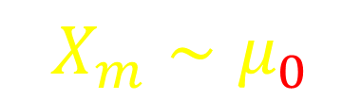
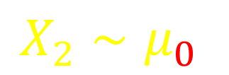
If the picture were this…
$$μ_{v}=𝒩\left(δV,1\right)$$
$$V$$
$X_{1}∼μ_{v}$
$$X_{2}∼μ_{0}$$
$X_{m}∼μ_{0}$
Blackboard $Π$
Then indeed $I\left(Π;V\right)≤δ^{2}⋅I\left(Π;X_{1}\right).$

Slide 21
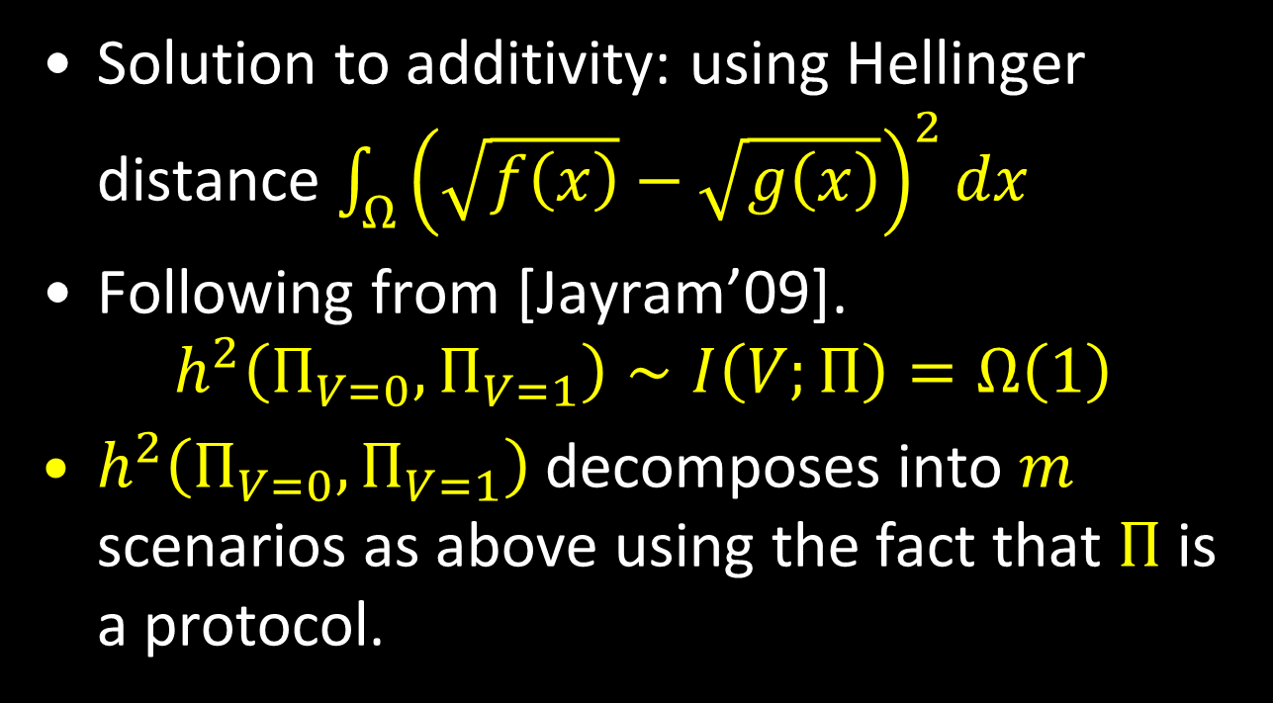
Hellinger distance
Solution to additivity: using Hellinger distance $\int_{Ω}{{\left(\sqrt{f\left(x\right)}−\sqrt{g\left(x\right)}\right)}^{2}dx}$
Following from [Jayram’09].
$$h^{2}\left(Π_{V=0},Π_{V=1}\right)∼I\left(V;Π\right)=Ω\left(1\right)$$
$h^{2}\left(Π_{V=0},Π_{V=1}\right)$ decomposes into $m$ scenarios as above using the fact that $Π$ is a protocol.

Slide 22

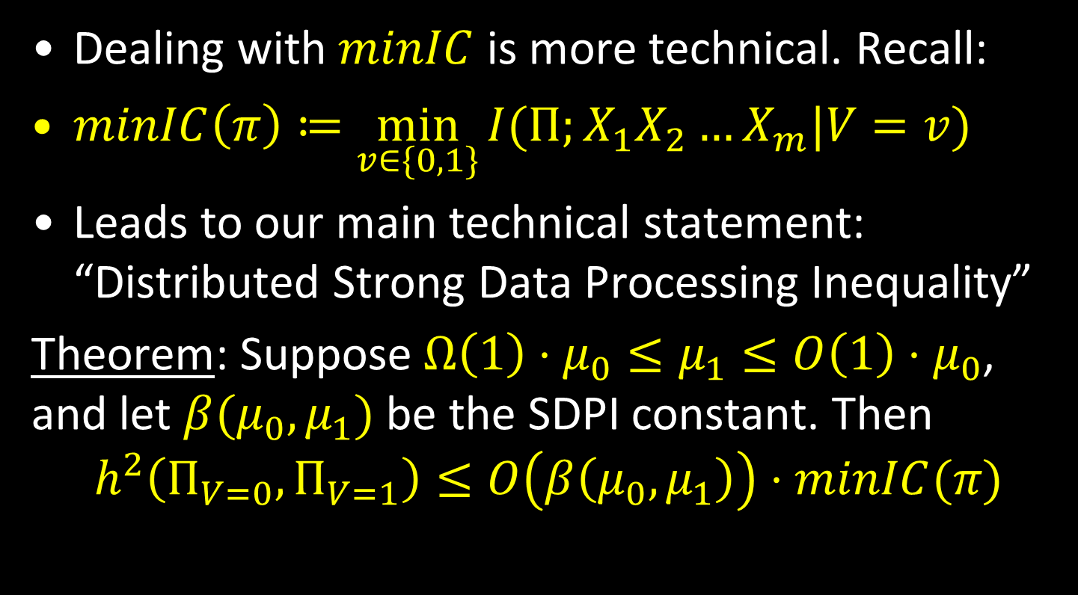
$$minIC$$
Dealing with $minIC$ is more technical. Recall:
$minIC\left(π\right)≔\min_{v∈\{0,1\}}{I(Π;X_{1}X_{2}…X_{m}|V=v) }$
Leads to our main technical statement: “Distributed Strong Data Processing Inequality”
Theorem: Suppose $Ω\left(1\right)⋅μ_{0}≤μ_{1}≤O\left(1\right)⋅μ_{0}$, and let $β(μ_{0},μ_{1})$ be the SDPI constant. Then
$$h^{2}\left(Π_{V=0},Π_{V=1}\right)≤O\left(β\left(μ_{0},μ_{1}\right)\right)⋅minIC(π)$$

Slide 23
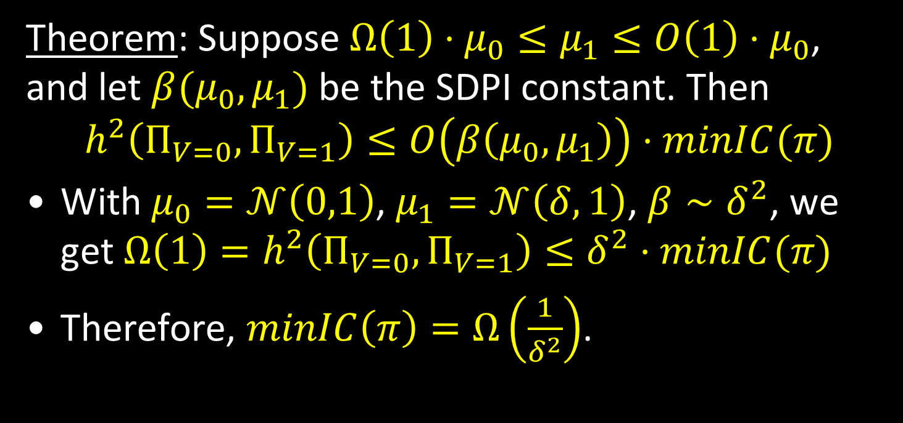
Putting it together
Theorem: Suppose $Ω\left(1\right)⋅μ_{0}≤μ_{1}≤O\left(1\right)⋅μ_{0}$, and let $β(μ_{0},μ_{1})$ be the SDPI constant. Then
$$h^{2}\left(Π_{V=0},Π_{V=1}\right)≤O\left(β\left(μ_{0},μ_{1}\right)\right)⋅minIC(π)$$
With $μ_{0}=𝒩\left(0,1\right)$, $μ_{1}=𝒩\left(δ,1\right)$, $β∼δ^{2}$, we get $Ω\left(1\right)=h^{2}\left(Π_{V=0},Π_{V=1}\right)≤δ^{2}⋅minIC(π)$
Therefore, $minIC\left(π\right)=Ω\left(\frac{1}{δ^{2}}\right)$.

Slide 24
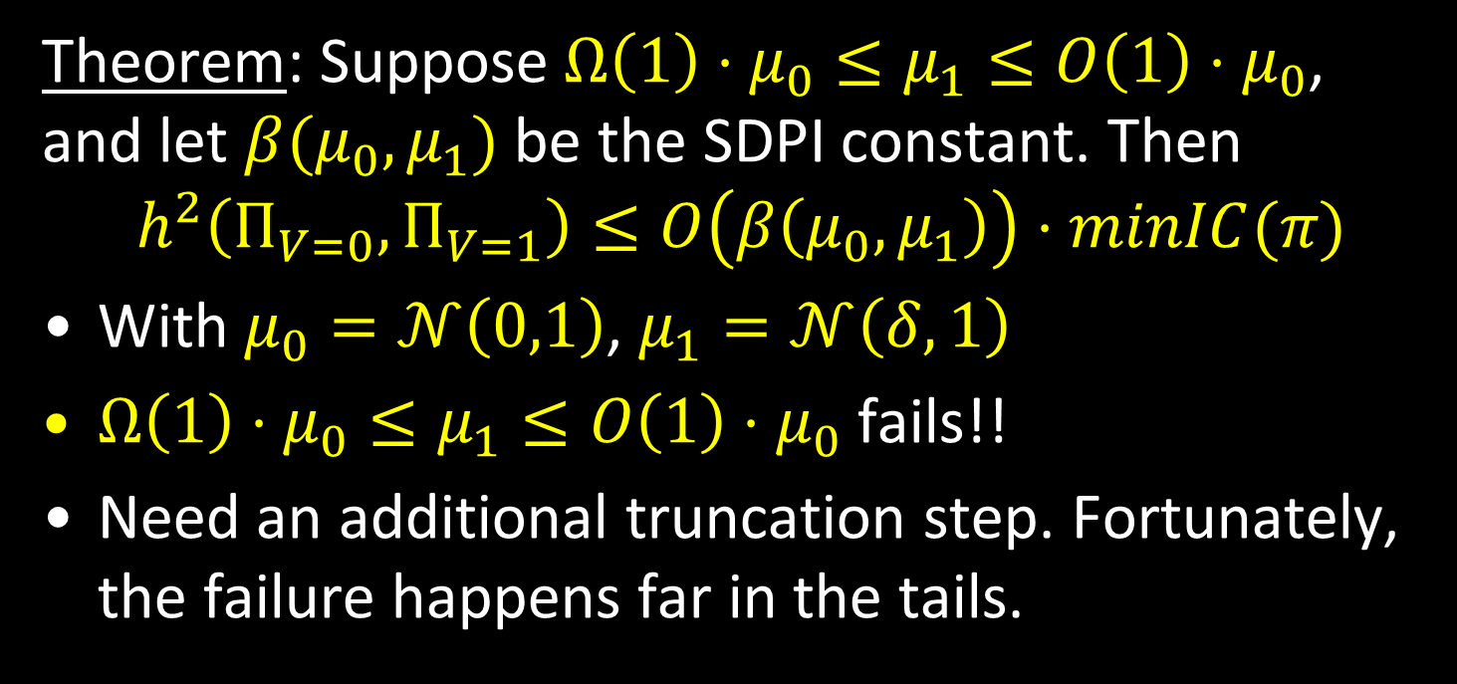
Putting it together
Essential!
Theorem: Suppose $Ω\left(1\right)⋅μ_{0}≤μ_{1}≤O\left(1\right)⋅μ_{0}$, and let $β(μ_{0},μ_{1})$ be the SDPI constant. Then
$$h^{2}\left(Π_{V=0},Π_{V=1}\right)≤O\left(β\left(μ_{0},μ_{1}\right)\right)⋅minIC(π)$$
With $μ_{0}=𝒩\left(0,1\right)$, $μ_{1}=𝒩\left(δ,1\right)$
$Ω\left(1\right)⋅μ_{0}≤μ_{1}≤O\left(1\right)⋅μ_{0}$ fails!!
Need an additional truncation step. Fortunately, the failure happens far in the tails.

Slide 25
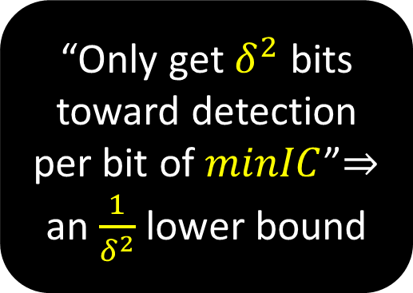
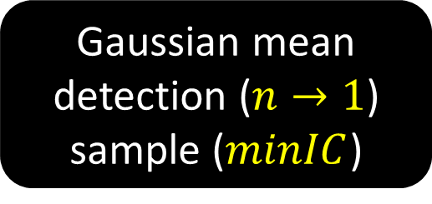
Summary
Hellinger distance
“Only get $δ^{2}$ bits toward detection per bit of $minIC$”$⇒$ an $\frac{1}{δ^{2}}$ lower bound
Distributed sparse linear regression
Strong data processing
Reduction [ZDJW’13]
A direct sum argument
Sparse Gaussian mean estimation
Gaussian mean detection ($n→1$) sample ($minIC$)

Slide 26
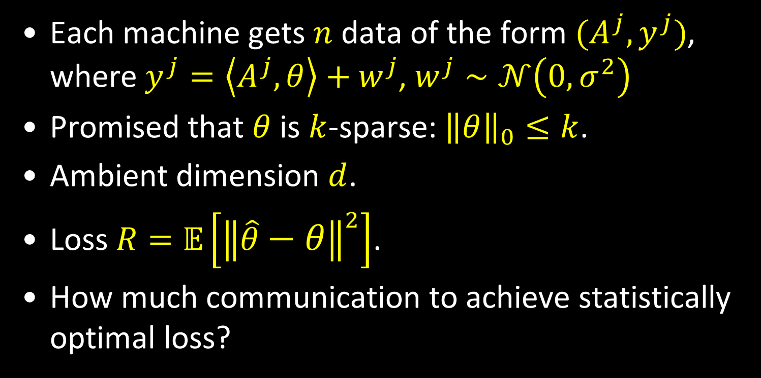
Distributed sparse linear regression
Each machine gets $n$ data of the form ${(A}^{j},y^{j})$, where $y^{j}=\left\langle A^{j},θ\right\rangle +w^{j}$, $w^{j}∼𝒩\left(0,σ^{2}\right)$
Promised that $θ$ is $k$-sparse: ${\left\|θ\right\|}_{0}≤k$.
Ambient dimension $d$.
Loss $R=𝔼\left[{\left\|\hat{θ}−θ\right\|}^{2}\right]$.
How much communication to achieve statistically optimal loss?

Slide 27

Distributed sparse linear regression
Promised that $θ$ is $k$-sparse: ${\left\|θ\right\|}_{0}≤k$.
Ambient dimension $d$. Loss $R=𝔼\left[{\left\|\hat{θ}−θ\right\|}^{2}\right]$.
How much communication to achieve statistically optimal loss?
We get: $C=Ω\left(m⋅min⁡(n,d)\right)$ (small $k$ doesn’t help).
[Lee-Sun-Liu-Taylor’15]: under some conditions $C=O\left(m⋅d\right)$ suffice.

Slide 28

A new upper bound (time permitting)
For the one-dimensional distributed Gaussian estimation (generalizes to $d$ dimensions trivially).
For optimal statistical performance, $Ω\left(m\right)$ is the lower bound.
We give a simple simultaneous-message upper bound of $O(m)$.
Previously: multi-round $O(m)$ [GMN’14] or simultaneous $O(m\log{n})$ [folklore].

Slide 29
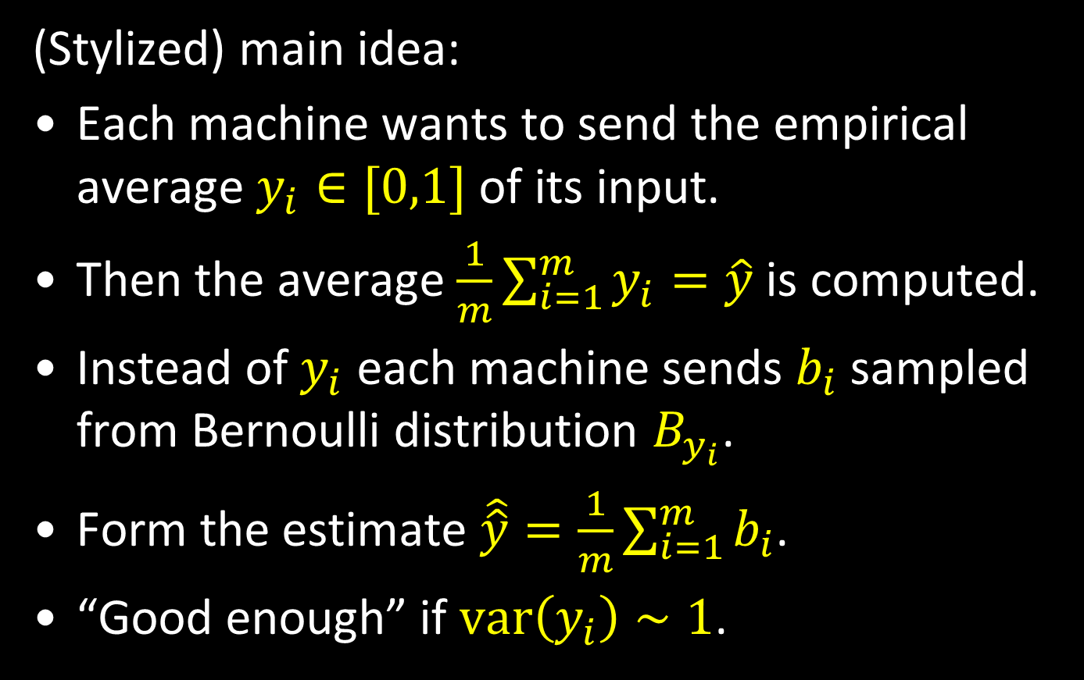
A new upper bound (time permitting)
(Stylized) main idea:
Each machine wants to send the empirical average $y_{i}∈[0,1]$ of its input.
Then the average $\frac{1}{m}\sum_{i=1}^{m}{y_{i}}=\hat{y}$ is computed.
Instead of $y_{i}$ each machine sends $b_{i}$ sampled from Bernoulli distribution $B_{y_{i}}$.
Form the estimate $\hat{\hat{y}}=\frac{1}{m}\sum_{i=1}^{m}{b_{i}}$.
“Good enough” if $\text{var}\left(y_{i}\right)∼1$.

Slide 30
Open problems
Closing the gap for the sparse linear regression problem.
Other statistical questions in the distributed framework. More general theorems?
Can Strong Data Processing be applied to the two-party Gap Hamming Distance problem?

Slide 31

http://csnexus.info/
Organizers
Mark Braverman (Princeton University)
Bobak Nazer (Boston University)
Anup Rao (University of Washington)
Aslan Tchamkerten, General Chair (Telecom Paristech)

Slide 32
http://csnexus.info/
Primary themes
Distributed Computation and Communication
Fundamental Inequalities and Lower Bounds
Inference Problems
Secrecy and Privacy

Slide 33

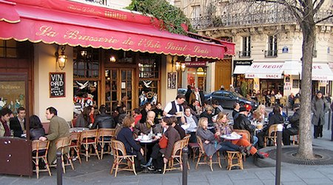
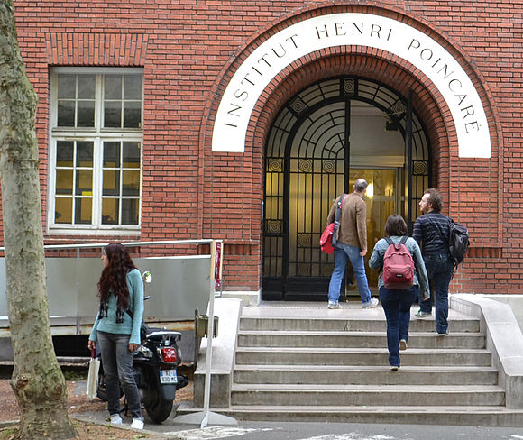


Institut Henri Poincaré
http://csnexus.info/

Slide 34
Thank You!

