Slide 1
Distributed Machine Learning
Maria-Florina Balcan
Carnegie Mellon University

Slide 2

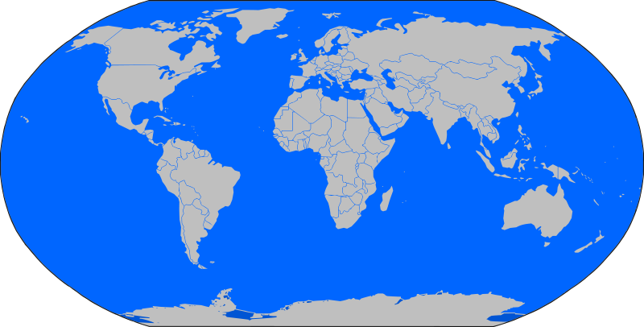
Distributed Machine Learning
Modern applications: massive amounts of data distributed across multiple locations.

Slide 3
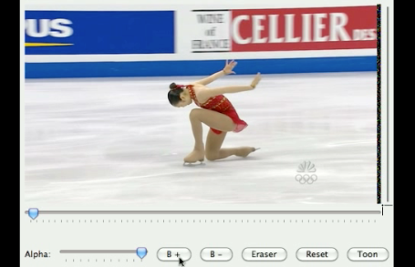
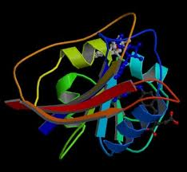
Distributed Machine Learning
Modern applications: massive amounts of data distributed across multiple locations.
E.g.,
video data
scientific data
Key new resource communication.

Slide 4
This talk: models and algorithms for reasoning about communication complexity issues.
Supervised Learning
[Balcan-Blum-Fine-Mansour, COLT 2012] Runner UP Best Paper
[TseChen-Balcan-Chau’15]
Clustering, Unsupervised Learning
[Balcan-Ehrlich-Liang, NIPS 2013]
[Balcan-Kanchanapally-Liang-Woodruff, NIPS 2014]

Slide 5
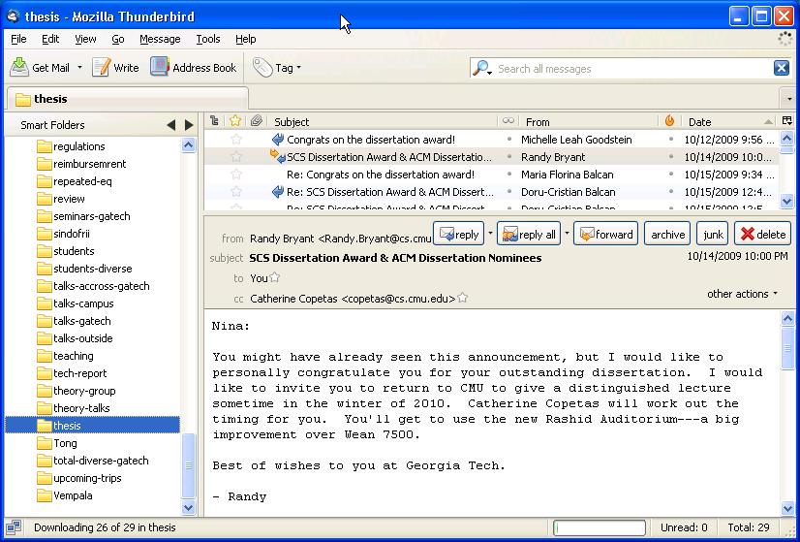
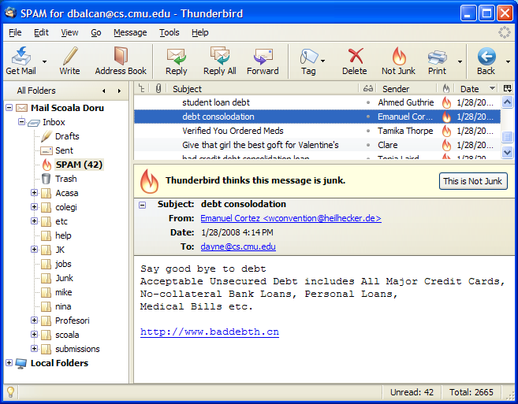


Supervised Learning
E.g., which emails are spam and which are important.
Not spam
spam
E.g., classify objects as chairs vs non chairs.
Not chair
chair
Notes:
Take a sample S of data, labeled according to whether they were/weren't spam.

Slide 6
Statistical / PAC learning model
Data Source
Distribution D on X
Expert / Oracle
Learning Algorithm
(x₁,…,x_{m})
Labeled Examples
(x₁,c*(x₁)),…, (x_{m},c*(x_{m}))
Alg.outputs
c* : X ! {0,1}
h : X ! {0,1}
-
+
+
-
+
-
-
+
-

Slide 7
Statistical / PAC learning model
Data Source
Distribution D on X
Expert / Oracle
Learning Algorithm
(x₁,…,x_{k})
Labeled Examples
(x₁,c*(x₁)),…, (x_{k},c*(x_{m}))
Alg.outputs
-
+
C* : X ! {0,1}
h : X ! {0,1}
-
+
-
-
+
+
-
Algo sees (x₁,c*(x₁)),…, (x_{k},c*(x_{m})), x_{i} i.i.d. from D
Do optimization over S, find hypothesis h 2 C.
Goal: h has small error over D.
err(h)=Pr_{x 2 D}(h(x) ≠ c*(x))
c* in C, realizable case; else agnostic

Slide 8

Two Main Aspects in Classic Machine Learning
Algorithm Design. How to optimize?
Automatically generate rules that do well on observed data.
E.g., Boosting, SVM, etc.
Generalization Guarantees, Sample Complexity
Confidence for rule effectiveness on future data.
$O\left(\frac{1}{ϵ}\left(VCdim\left(C\right)\log\left(\frac{1}{ϵ}\right)+\log\left(\frac{1}{δ}\right)\right)\right)$

Slide 9
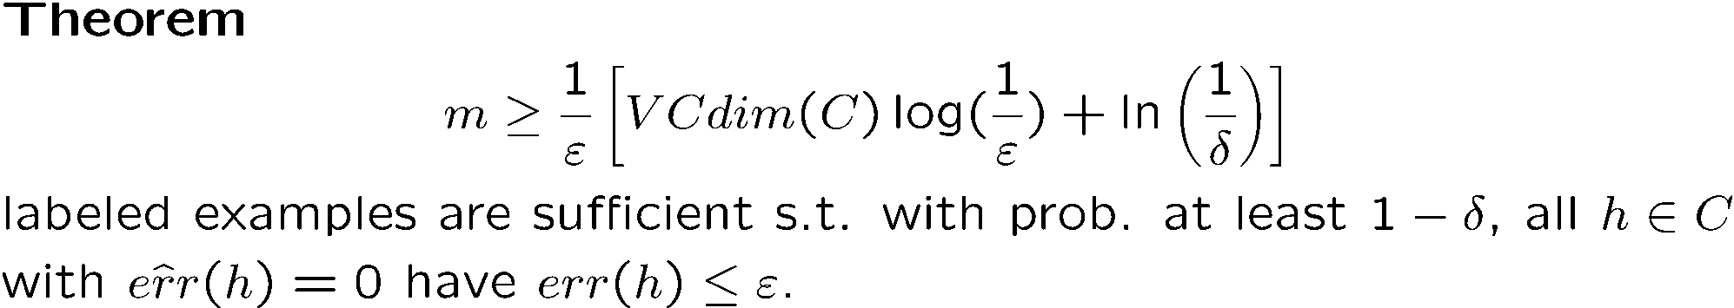
Sample Complexity Results
Confidence Bounds, Generalization Guarantees
Confidence for rule effectiveness on future data.
Agnostic – replace ε with ε².

Slide 10

Distributed Learning
Many ML problems today involve massive amounts of data distributed across multiple locations.
Often would like low error hypothesis wrt the overall distrib.

Slide 11
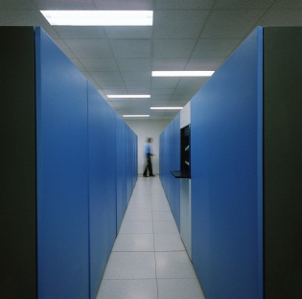

Distributed Learning
Data distributed across multiple locations.
E.g., medical data
Notes:
Put hospital Data

Slide 12
Distributed Learning
Data distributed across multiple locations.
E.g., scientific data

Slide 13

Distributed Learning
Data distributed across multiple locations.
Each has a piece of the overall data pie.
To learn over the combined D, must communicate.
Important question: how much communication?
Plus, privacy & incentives.

Slide 14


Distributed PAC learning
[Balcan-Blum-Fine-Mansour,COLT 2012]
X – instance space. s players.
Player i can sample from D_{i}, samples labeled by c*.
Goal: find h that approximates c* w.r.t. D=1/s ($D_{1}$ + … + $D_{s}$)
Fix C of VCdim d. Assume s << d.
[realizable: c* $∈$ C, agnostic:c*$∉C$ ]
Goal: learn good h over D, as little communication as possible
Total communication (bits, examples, hypotheses)
Rounds of communication.
Efficient algos for problems when centralized algos exist.
Notes:
Algos efficient for problems where the std (centralized) algos are efficient.

Slide 15

Interesting special case to think about
s=2. One has the positives and one has the negatives.
How much communication, e.g., for linear separators?
Player 1 Player 2
+
+
+
+
+
+
+
+
+
+
+
+
+
+
+
-
+
-
-
-
-
-
-
-
-
-
-
-
-
-
-
-

Slide 16
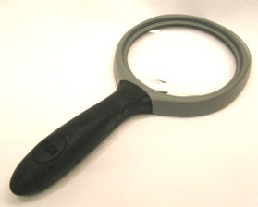
Overview of Our Results
Introduce and analyze Distributed PAC learning.
Generic bounds on communication.
Broadly applicable communication efficient distributed boosting.
Tight results for interesting cases (conjunctions, parity fns, decision lists, linear separators over “nice” distrib).
Analysis of privacy guarantees achievable.

Slide 17
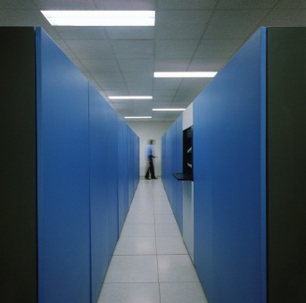
Some simple communication baselines.
Baseline #1
d/² log(1/²) examples, 1 round of communication
Each player sends d/(²s) log(1/²) examples to player 1.
Player 1 finds consistent h 2 C, whp error · ² wrt D
D₁ D₂ … D_{s}
Notes:
Make an arrow

Slide 18
Some simple communication baselines.
Baseline #2 (based on Mistake Bound algos):
M rounds, M examples & hyp, M is mistake-bound of C.
In each round player 1 broadcasts its current hypothesis.
If any player has a counterexample, it sends it to player 1. If not, done. Otherwise, repeat.
D₁ D₂ … D_{s}

Slide 19
Some simple communication baselines.
Baseline #2 (based on Mistake Bound algos):
M rounds, M examples, M is mistake-bound of C.
All players maintain same state of an algo A with MB M.
If any player has an example on which A is incorrect, it announces it to the group.
D₁ D₂ … D_{s}

Slide 20
Improving the Dependence on 1/²
Baselines provide linear dependence in d and 1/², or M and no dependence on 1/².
Can get better O(d log 1/²) examples of communication!
D₁ D₂ … D_{s}
Notes:
Add a slide with Adaboost!

Slide 21
Recap of Adaboost
Boosting: algorithmic technique for turning a weak learning algorithm into a strong (PAC) learning one.
Notes:
Add a slide with Adaboost!

Slide 22
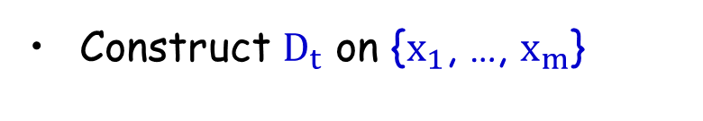
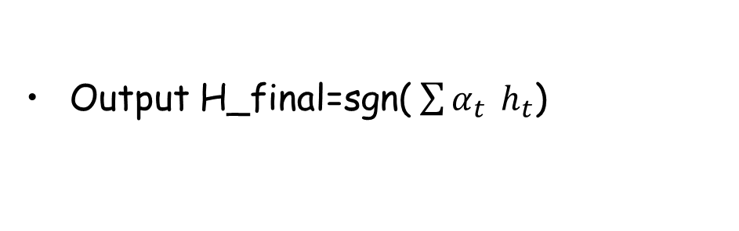

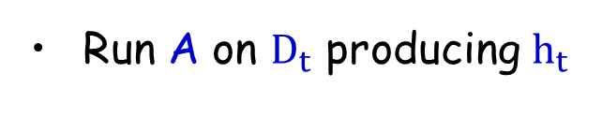
Recap of Adaboost
Boosting: turns a weak algo into a strong (PAC) learner.
Input: S={($x_{1},y_{1}$), …,($x_{m},y_{m}$)}; weak learner A
+
+
Weak learning algorithm A.
+
+
+
$$h_{t}$$
For t=1,2, … ,T
+
+
+
-
Construct $D_{t}$ on {$x_{1}$, …, $x_{m}$}
-
-
-
-
-
Run A on $D_{t}$ producing $h_{t}$
-
-
Output H_final=sgn($\sum{α_{t}} h_{t}$)
Notes:
Add a slide with Adaboost!

Slide 23

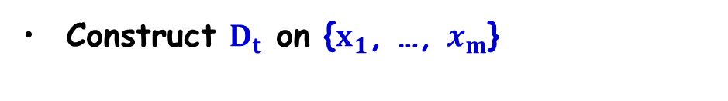
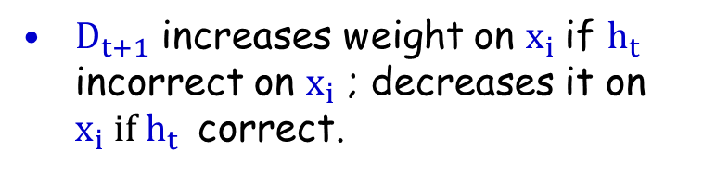

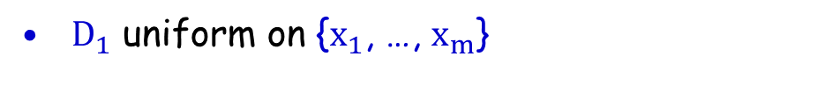

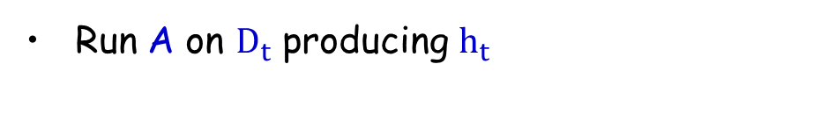
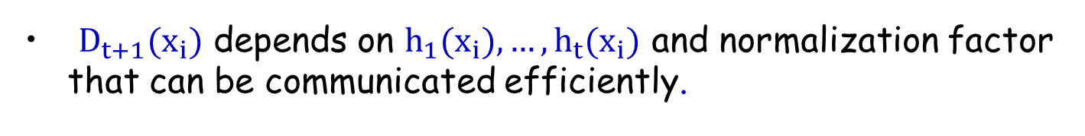
Recap of Adaboost
+
+
Weak learning algorithm A.
$$h_{t−1}$$
+
+
For t=1,2, … ,T
+
+
+
Construct $D_{t}$ on {$x_{1}$, …, $x_{m}$}
+
-
Run A on $D_{t}$ producing $h_{t}$
-
-
-
-
-
$D_{1}$ uniform on {$x_{1}$, …, $x_{m}$}
-
-
$D_{t+1}\left(i\right)=\frac{D_{t}\left(i\right)}{Z_{t}} e^{\left\{−α_{t}\right\} }$ if$y_{i}=h_{t}\left(x_{i}\right)$
$D_{t+1}$ increases weight on $x_{i}$if $h_{t}$ incorrect on $x_{i}$ ; decreases it on $x_{i} if h_{t}$ correct.
$D_{t+1}\left(i\right)=\frac{D_{t}\left(i\right)}{Z_{t}} e^{\left\{α_{t}\right\} }$ if$y_{i}≠h_{t}\left(x_{i}\right)$
Key points:
${D_{t+1}(x}_{i})$ depends on ${h_{1}(x}_{i}), …, {h_{t}(x}_{i})$ and normalization factor that can be communicated efficiently.
To achieve weak learning it suffices to use O(d) examples.
Notes:
Add a slide with Adaboost!

Slide 24
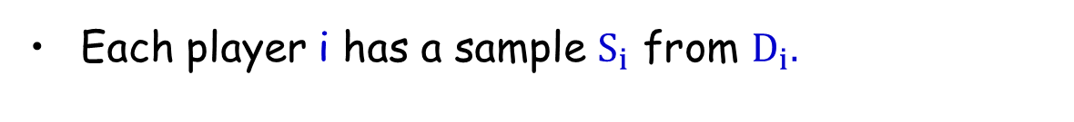
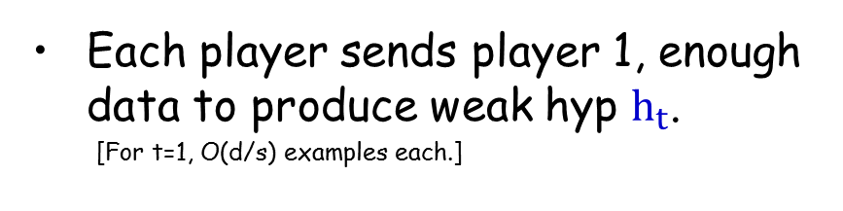
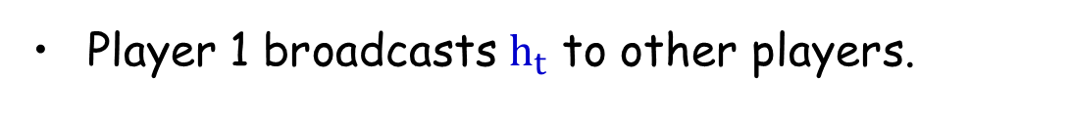
Distributed Adaboost
Each player i has a sample $S_{i}$ from $D_{i}.$
For t=1,2, … ,T
S_{i}
S_{j}
Each player sends player 1, enough data to produce weak hyp $h_{t}$.
[For t=1, O(d/s) examples each.]
h_{t}
h_{t}
Player 1 broadcasts $h_{t}$ to other players.
h_{t}
h_{t}
S_{k}
Notes:
Initially O(d/(k) examples
For reweighted assume epsilon_t

Slide 25
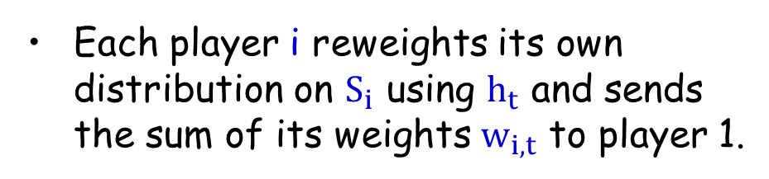
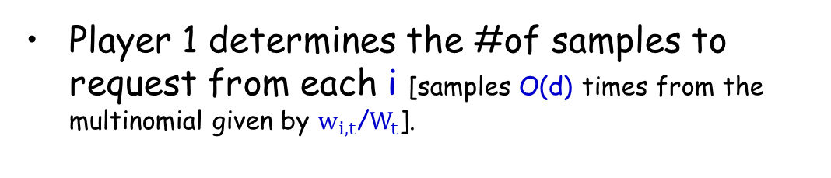
Distributed Adaboost
Each player i has a sample $S_{i}$ from $D_{i}.$
For t=1,2, … ,T
S_{i}
S_{j}
Each player sends player 1, enough data to produce weak hyp $h_{t}$.
[For t=1, O(d/s) examples each.]
n_{i,t+1}
n_{j,t+1}
w_{i,t}
h_{t}
w_{j,t}
h_{t}
Player 1 broadcasts $h_{t}$ to other players.
h_{t}
Each player i reweights its own distribution on $S_{i}$ using $h_{t}$ and sends the sum of its weights $w_{i,t}$ to player 1.
h_{t}
w_{k,t}
n_{k,t+1}
S_{s}
Player 1 determines the #of samples to request from each i [samples O(d) times from the multinomial given by $w_{i,t}$/$W_{t}$].
Notes:
Initially O(d/(k) examples
For reweighted assume epsilon_t

Slide 26
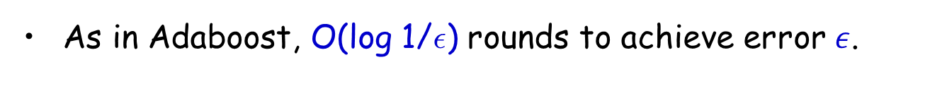
Distributed Adaboost
Can learn any class C with O(log(1/²)) rounds using O(d) examples + O(s log d) bits per round.
[efficient if can efficiently weak-learn from O(d) examples]
Proof:
As in Adaboost, O(log 1/²) rounds to achieve error $ε$.
Per round: O(d) examples, O(s log d) extra bits for weights, 1 hypothesis.
Notes:
Can be shown to be optimal!

Slide 27
Dependence on 1/², Agnostic learning
Distributed implementation of Robust halving [Balcan-Hanneke’12].
error O(OPT)+$ε$ using only O(s log|C| log(1/²)) examples.
Not computationally efficient in general.
D₁ D₂ … D_{s}
Distributed Implementation of Smooth Boosting (access to agnostic weak learner).
[TseChen-Balcan-Chau’15]

Slide 28
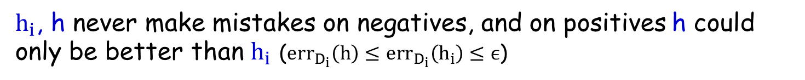
Better results for special cases
Intersection-closed when fns can be described compactly .
+
+
-
-
+
+
-
-
-
-
-
-
C is intersection-closed, then C can be learned in one round and s hypotheses of total communication.
Algorithm:
Each i draws S_{i} of size O(d/² log(1/²)), finds smallest h_{i} in C consistent with S_{i} and sends h_{i} to player 1.
Player 1 computes smallest h s.t. h_{i} µ h for all i.
Key point:
$h_{i}$, h never make mistakes on negatives, and on positives h could only be better than $h_{i}$ ($err_{D_{i}}\left(h\right)≤err_{D_{i}}\left(h_{i}\right)≤ϵ$)
Notes:
$h_{i}$ and h never make mistakes on negatives because all h_i’s are subsets of the target and so is h, and on positives h can only be better than h_i’s

Slide 29
Better results for special cases
E.g., conjunctions over {0,1}^{d} [f(x) = x₂x₅x₉x₁₅ ]
Only O(s) examples sent, O(sd) bits.
1101111011010111
1111110111001110
1100110011001111
1100110011000110
Each entity intersects its positives.
Sends to player 1.
Player 1 intersects & broadcasts.
[Generic methods O(d) examples, or O(d²) bits total.]

Slide 30

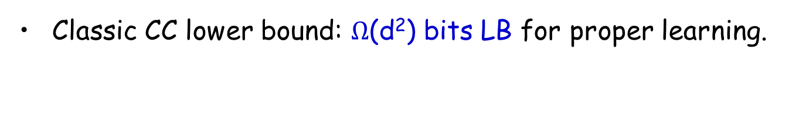
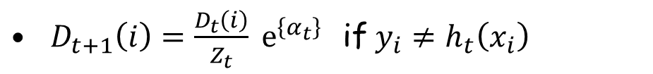
Interesting class: parity functions
$s=2, X={\left\{0,1\right\}}^{d}$, $C$ = parity fns, $f\left(x\right)=x_{i_{1}}XOR{ x}_{i_{2}}… XOR x_{i_{l}}$
Generic methods: O(d) examples, O($d^{2}$) bits.
Classic CC lower bound: $Ω$(d²) bits LB for proper learning.
Improperly learn C with O(d) bits of communication!
Key points:
S
h 2 C
Can properly PAC-learn C.
[Given dataset S of size O(d/²), just solve the linear system]
S
Can non-properly learn C in reliable-useful manner [RS’88]
f(x)
x
??
[if x in subspace spanned by S, predict accordingly, else say “?”]

Slide 31
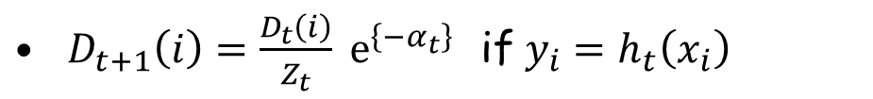
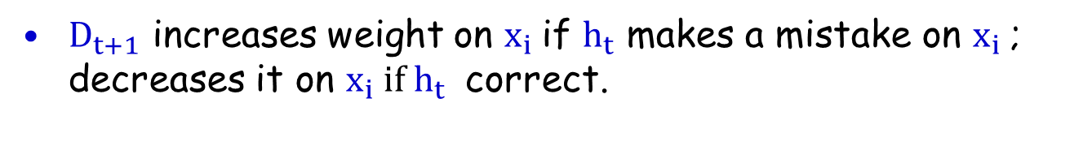
Interesting class: parity functions
Improperly learn C with O(d) bits of communication!
Algorithm:
Player i properly PAC-learns over D_{i} to get parity h_{i}. Also improperly R-U learns to get rule g_{i}. Sends h_{i} to player j.
Player i uses rule $R_{i}$: “if g_{i} predicts, use it; else use h_{j}“
Use my reliable rule first, else other guy’s rule
h_{i}
Use my reliable rule first, else other guy’s rule
g_{i}
g_{j}
h_{j}
Key point: low error under $D_{j}$ because $h_{j}$ has low error under $D_{j}$ and since $g_{i}$ never makes a mistake putting it in front does not hurt.
Notes:
This rule has low error under D_i due to g_i; and it has low error under D_j because h_j has low error under d_j and since g never makes a mistake putting it in front does not hurt.

Slide 32
Distributed PAC learning: Summary
First time consider communication as a fundamental resource.
General bounds on communication, communication-efficient distributed boosting.
Improved bounds for special classes (intersection-closed, parity fns, and linear separators over nice distributions).

Slide 33
Distributed Clustering
[Balcan-Ehrlich-Liang, NIPS 2013]
[Balcan-Kanchanapally-Liang-Woodruff, NIPS 2014]
s
c₃
y
c₁
z
x
c₂

Slide 34
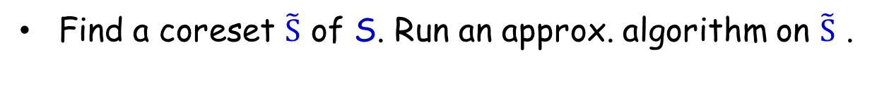
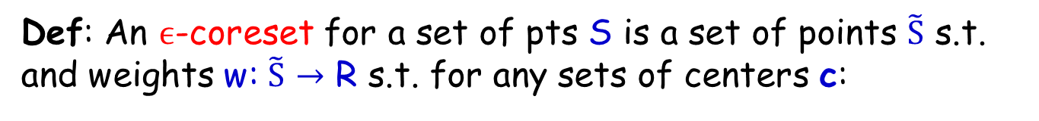
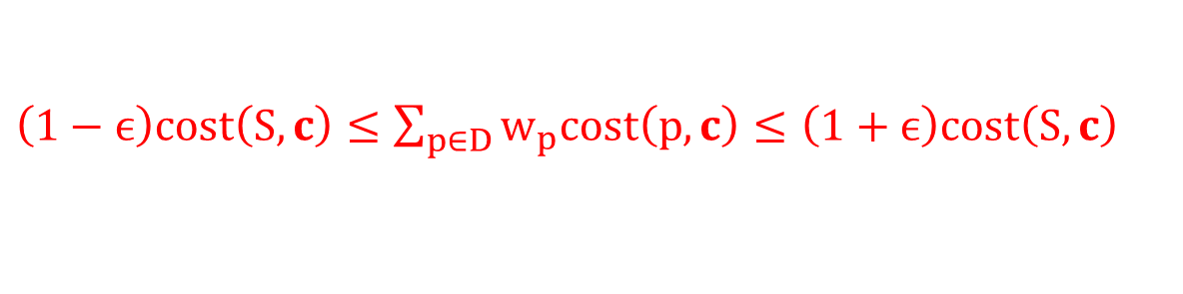
Center Based Clustering
k-median: find center pts c₁, c₂, …, c_{k} to minimize ∑_{x} min_{i} d(x,c_{i})
k-means: find center pts c₁, c₂, …, c_{k} to minimize ∑_{x} min_{i} d²(x,c_{i})
s
Key idea: use coresets.
c₃
y
c₁
Coresets short summaries capturing relevant info w.r.t. all clusterings.
x
z
c₂
Def: An $ϵ$-coreset for a set of pts S is a set of points $\tilde{S}$ s.t. and weights w: $\tilde{S}$ $→$ R s.t. for any sets of centers c:
$\left(1−ϵ\right)cost\left(S,c\right)≤\sum_{p∈D}{w_{p}cost\left(p,c\right)}≤$ $\left(1+ϵ\right)cost\left(S,c\right)$
Algorithm (centralized)
Find a coreset $\tilde{S}$ of S. Run an approx. algorithm on $\tilde{S}$ .

Slide 35

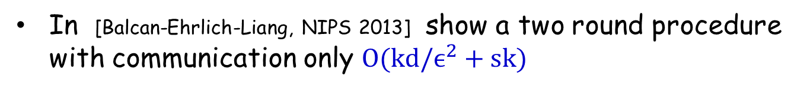
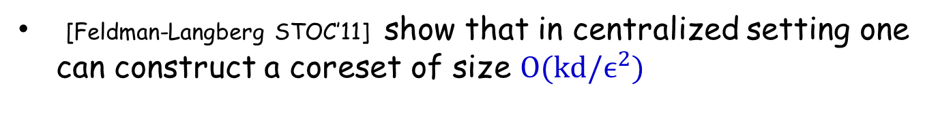
Distributed Clustering
[Balcan-Ehrlich-Liang, NIPS 2013]
k-median: find center pts c₁, c₂, …, c_{k} to minimize ∑_{x} min_{i} d(x,c_{i})
k-means: find center pts c₁, c₂, …, c_{k} to minimize ∑_{x} min_{i} d²(x,c_{i})
Key idea: use coresets, short summaries capturing relevant info w.r.t. all clusterings.
[Feldman-Langberg STOC’11] show that in centralized setting one can construct a coreset of size $O(kd/ϵ^{2})$
By combining local coresets, get a global coreset; the size goes up multiplicatively by s.
In [Balcan-Ehrlich-Liang, NIPS 2013] show a two round procedure with communication only $O(kd/ϵ^{2}+sk)$
[As opposed to $O(s kd/ϵ^{2})$]

Slide 36

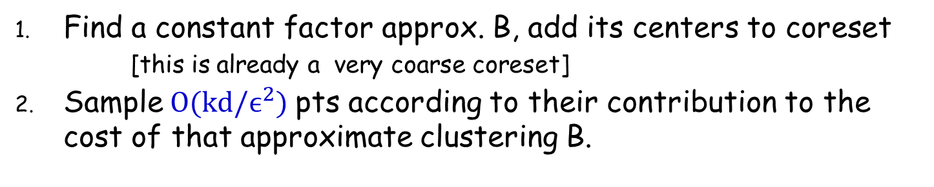
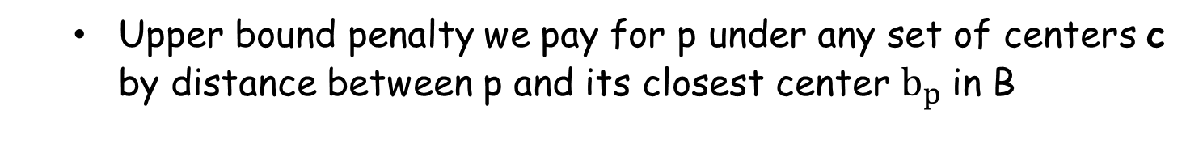
Clustering, Coresets
[Feldman-Langberg’11]
[FL’11] construct in centralized cases a coreset of size $O(kd/ϵ^{2})$.
Find a constant factor approx. B, add its centers to coreset
[this is already a very coarse coreset]
Sample$O(kd/ϵ^{2})$ pts according to their contribution to the cost of that approximate clustering B.
Key idea: one way to think about this construction
Upper bound penalty we pay for p under any set of centers c by distance between p and its closest center $b_{p}$in B
For any set of centers $c$, penalty we pay for point p
$$f\left(p\right)=cost\left(p,c\right)−cost(b_{p},c)$$
Note $f\left(p\right)∈\left[−cost\left(p,b_{p}\right), cost\left(p,b_{p}\right)\right]$.
This motivates sampling according to $cost\left(p,b_{p}\right)$

Slide 37
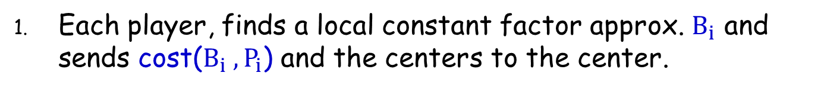
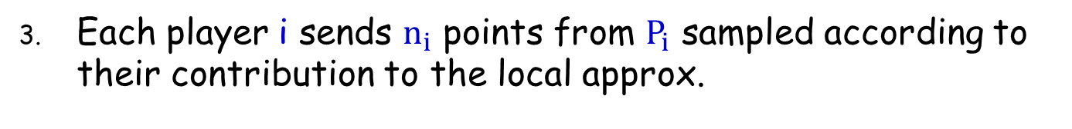
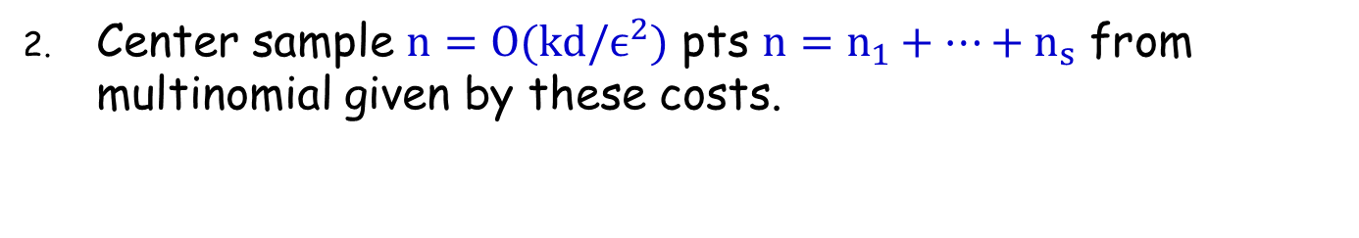
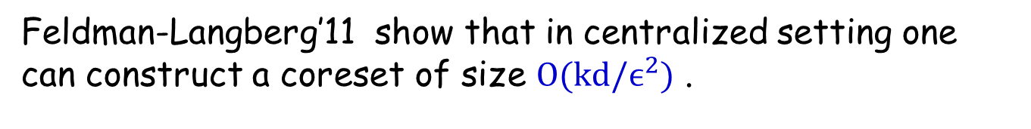
Distributed Clustering
[Balcan-Ehrlich-Liang, NIPS 2013]
Feldman-Langberg’11 show that in centralized setting one can construct a coreset of size $O(kd/ϵ^{2})$ .
Key idea: in distributed case, show how to do this using only local constant factor approx.
Each player, finds a local constant factor approx. $B_{i}$ and sends cost($B_{i} ,P_{i}$) and the centers to the center.
Center sample $n=O(kd/ϵ^{2})$ pts $n=n_{1}+…+n_{s}$ from multinomial given by these costs.
Each player i sends $n_{i}$ points from $P_{i}$ sampled according to their contribution to the local approx.

Slide 38
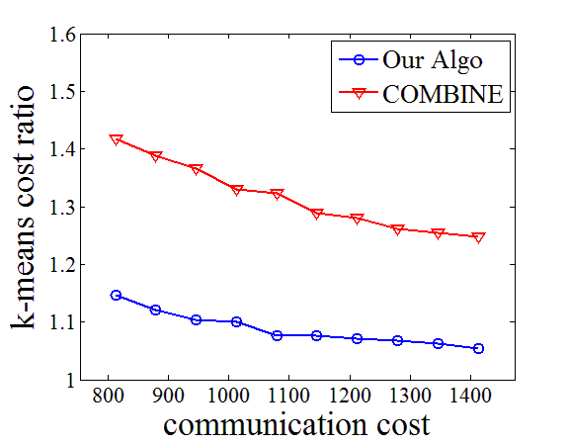
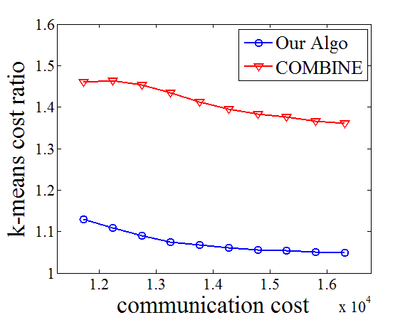
Distributed Clustering
[Balcan-Ehrlich-Liang, NIPS 2013]
k-means: find center pts c₁, c₂, …, c_{k} to minimize ∑_{x} min_{i} d²(x,c_{i})
Notes:
1. Data set
ColorHistogram: 68040 points in R^32. The data are the color features extracted from an image collection. The coreset size is about 1%-2% of the original data. The number of clusters is k=10.
YearPredictionMSD: 515345 points in R^90. The data are the timbre audio features extracted from a music collection. The coreset size is about 2%-3% of the original data. The number of clusters is k=50.
2. Communication graph and partition method
We use star graphs. Besides the central coordinator, there are 25 nodes for ColorHistogram, 100 nodes for YearPredictionMSD.
The numbers of points on the nodes decreases exponentially: 1/2 of the points are on the first node, 1/4 on the second, ..., (1/2)^5 on the fifth node; and the rest points are partitioned evenly among the rest nodes.
3. Results
The figures show the average results over 30 runs.
x axis: total communication cost on a star graph (which is equivalent to the coreset size)
y axis: k-means cost (normalized by the baseline k-means cost). More precisely, we run Lloyd's method on the coreset to get a solution, and then compute the k-means cost of this solution on the global data. We also run Lloyd's method directly on the global data to get the baseline k-means cost. The y axis is the ratio between the two.
The coreset size is about 2% of the original data, and the k-means cost increases less than 10%. As observed in both figures, the costs of our solutions consistently improve over those of COMBINE by 20%-30%. In other words, to achieve the same approximation ratio, our algorithm uses much less communication than COMBINE. This is because COMBINE algorithm builds coresets of the same size for all local data sets, while our algorithm builds a global coreset with different numbers of points from different local data sets. When the data sets are unbalanced, our algorithm leads to better approximation.

Slide 39
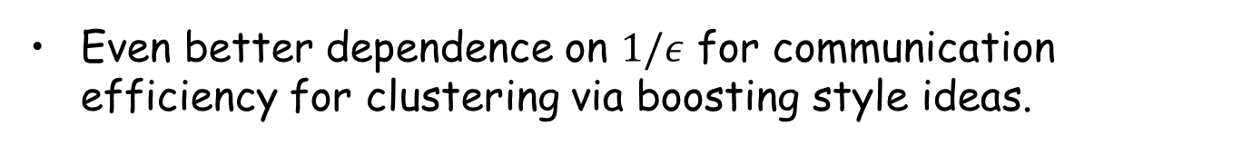
Open questions (Learning and Clustering)
Efficient algorithms in noisy settings; handle failures, delays.
Even better dependence on $1/ε$ for communication efficiency for clustering via boosting style ideas.
Can use distributed dimensionality reduction to reduce dependence on d.
[Balcan-Kanchanapally-Liang-Woodruff, NIPS 2014]
More refined trade-offs between communication complexity, computational complexity, and sample complexity.

