Slide 1
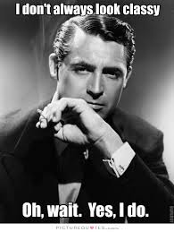
“Classy” sample correctors¹
Ronitt Rubinfeld
MIT and Tel Aviv University
joint work with Clement Canonne (Columbia) and Themis Gouleakis (MIT)
¹thanks to Clement and G for inspiring this classy title
Notes:
1
This is joint work with

Slide 2
Distributions on BIG domains
Given samples of a distribution, need to know, e.g.,
entropy
number of distinct elements
“shape” (monotone, bimodal,…)
closeness to uniform, Gaussian, Zipfian…
learn parameters
Considered in statistics, information theory, machine learning, databases, algorithms, physics, biology,…

Slide 3
Key Question
How many samples do you need in terms of domain size?
Do you need to estimate the probabilities of each domain item?
-- OR --
Can sample complexity be sublinear in size of the domain?
Rules out standard statistical techniques

Slide 4
Our usual model:
p is arbitrary black-box distribution over [n], generates iid samples.
p_{i} = Prob[ p outputs i ]
Sample complexity in terms of n?
p
samples
Test
Pass/Fail?
Notes:
In this model, we assume we have access to samples from a discrete distribution p on an n-element set. I will use integers 1 through n as the domain, and denote this set by [n]. I will call p to be a black-box distribution since we get only samples and have no other information on p. With a slight abuse of notation, I will use same p for the n-vector that describes the distribution. Therefore, p sub i will be the probability the distribution p outputs i. We will devise tests for some properties, which I am about to present in the next slide, and our main concern will be the sample complexity of the tests.

Slide 5
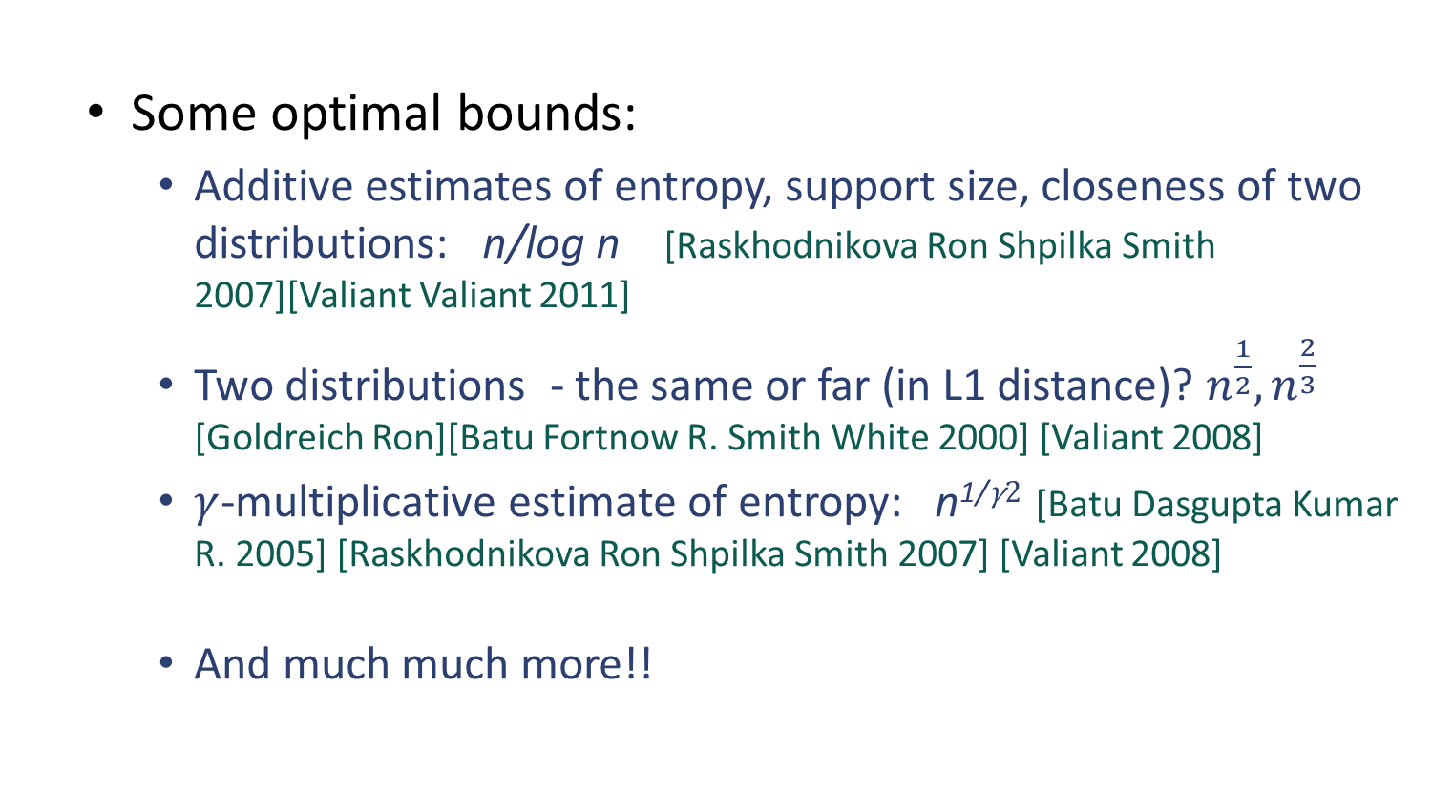
Great Progress!
Some optimal bounds:
Additive estimates of entropy, support size, closeness of two distributions: n/log n [Raskhodnikova Ron Shpilka Smith 2007][Valiant Valiant 2011]
Two distributions - the same or far (in L1 distance)? $n^{\frac{1}{2}}, n^{\frac{2}{3}}$ [Goldreich Ron][Batu Fortnow R. Smith White 2000] [Valiant 2008]
$γ$-multiplicative estimate of entropy: n^{1/}$\text{γ}2$ [Batu Dasgupta Kumar R. 2005] [Raskhodnikova Ron Shpilka Smith 2007] [Valiant 2008]
And much much more!!

Slide 6
So now what do you do?
You tested your distribution, and it’s pretty much ok,
BUT

Slide 7
What if your samples aren’t quite right?

Slide 8
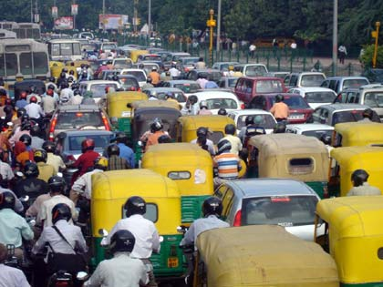
What are the traffic patterns?
Some sensors lost power, others went crazy!

Slide 9
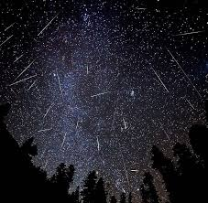
Astronomical data
A meteor shower confused some of the measurements

Slide 10

Teen drug addiction recovery rates
Never received data from three of the community centers!

Slide 11
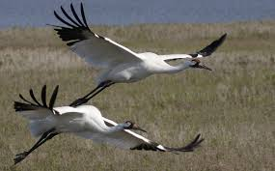
Whooping cranes
Correction of location errors for presence-only species distribution models
[Hefley, Baasch, Tyre, Blankenship 2013]

Slide 12
What is correct?

Slide 13
What is correct?

Slide 14
What to do?
Outlier detection/removal
Imputation
Missingness
…
What if you don’t know that the distribution
is supposed to be normal, Gaussian, …?

Slide 15
What to do?
SC
Is it a bird?
Is it a plane?
No! It’s a methodology for Sample Correcting

Slide 16
What is correct?
Sample corrector assumes that original distribution in class P
(e.g., P is monotone, Lipshitz, k-modal, k-histogram distributions)

Slide 17
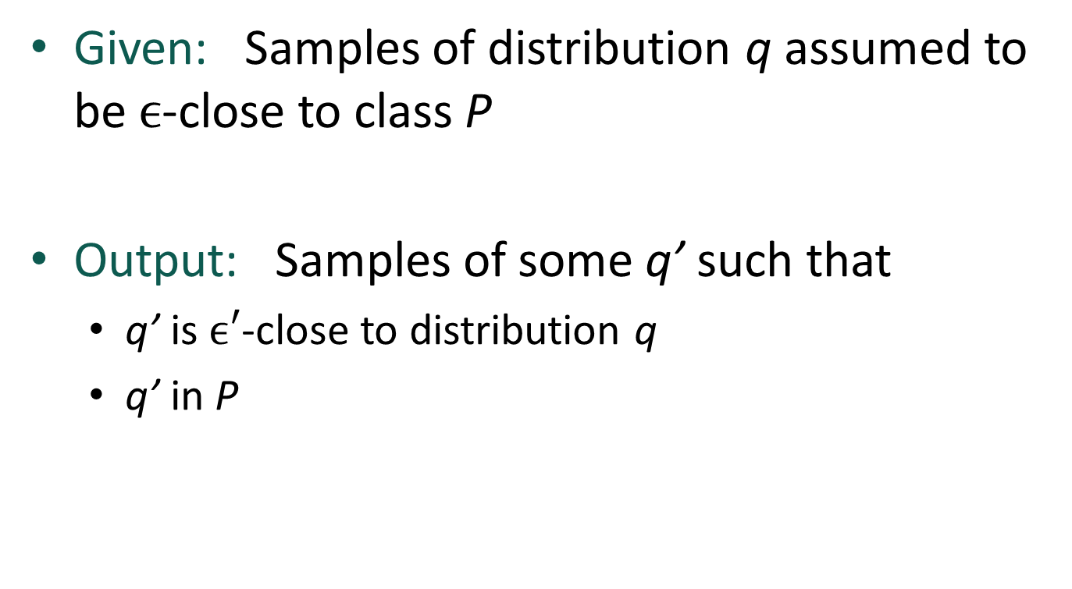
Classy Sample Correctors
Given: Samples of distribution q assumed to be $ϵ$-close to class P
Output: Samples of some q’ such that
q’ is $ϵ′$-close to distribution q
q’ in P
1. Sample complexity per output sample of q’?
2. Randomness complexity per output sample of q’?

Slide 18
An observation
Agnostic learner
Sample corrector
Corollaries: Sample correctors for
monotone distributions
histogram distributions under promises (e.g., distribution is MHR or monotone)

Slide 19
The big open question:
When can sample correctors be more efficient than agnostic learners?
Some answers for monotone distributions:
Error is REALLY small
Have access to powerful queries
Missing data errors
Unfortunately, not likely in general case (constant arbitrary error, no extra queries)

Slide 20

Learning monotone distributions
Learning monotone distributions requires $θ(log n)$ samples
[Birge][Daskalakis Diakonikolas Servedio]

Slide 21

Birge Buckets
Partition of domain into buckets (segments) of size ${\left(1+ε\right)}^{i}$ ($O(\log{n) }$buckets total)
For distribution $p$, let $\hat{p}$ be such that uniform on each bucket, but same marginal in each bucket
Then $\left|\left|p−\hat{p}\right|\right|≤ε$
Enough to learn the marginals of each bucket

Slide 22

A very special kind of error
Suppose ALL error located internally to Birge Buckets
Then, easy to correct to $\hat{p}$:
1. Pick sample x from p
2. Output y chosen UNIFORMLY from x’s Birge Bucket
“Birge Bucket Correction”

Slide 23
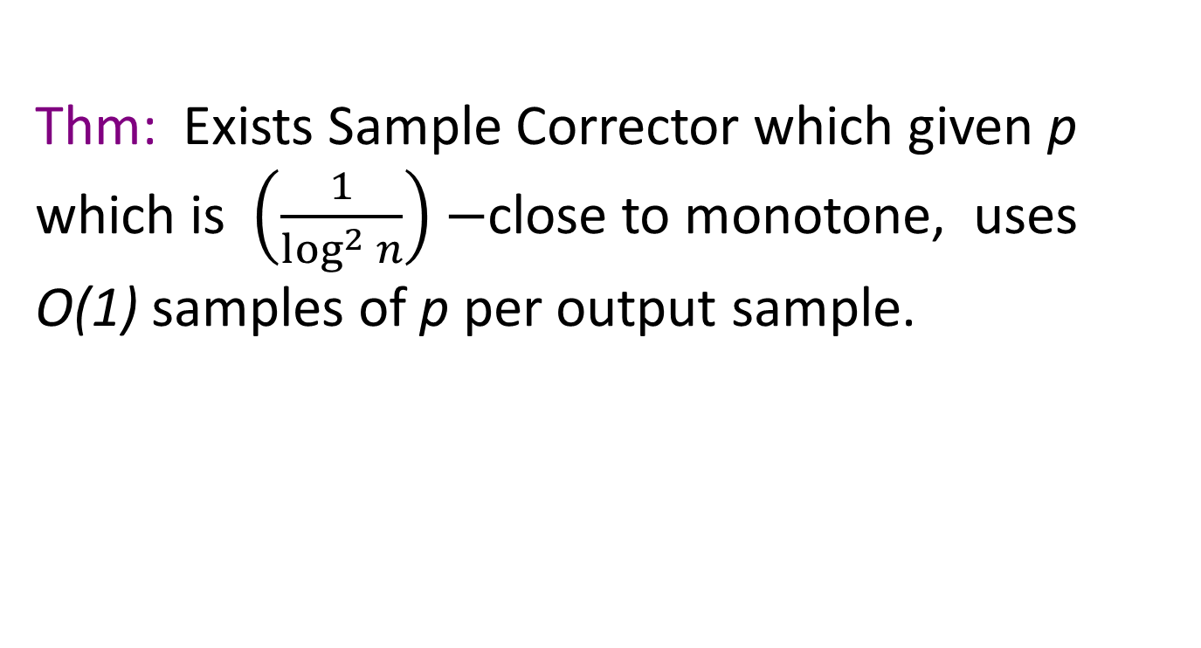
Learning monotone distributions
Thm: Exists Sample Corrector which given p which is $\left(\frac{1}{\log^{2} n}\right)−$close to monotone, uses O(1) samples of p per output sample.
OBLIVIOUS CORRECTION!!
Proof Idea:
Mix Birge Bucket correction with slightly decreasing distribution (flat on buckets with some space between buckets)

Slide 24

A recent lower bound [P. Valiant]
Sample correctors for $Ω\left(1\right)$-close to monotone distributions require $Ω(\log{n ) }$samples
What do we do now?

Slide 25
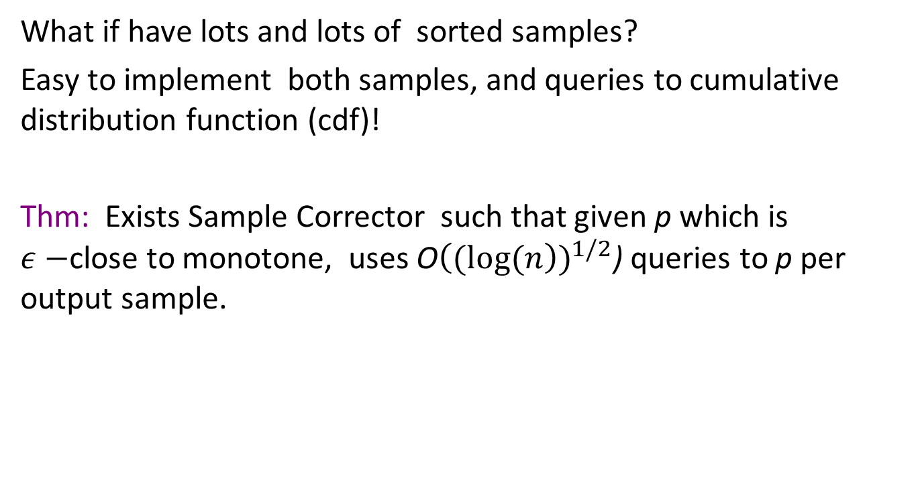
What about stronger queries?
What if have lots and lots of sorted samples?
Easy to implement both samples, and queries to cumulative distribution function (cdf)!
Thm: Exists Sample Corrector such that given p which is $ε−$close to monotone, uses O${\left((log(n\right))}^{1/2}$) queries to p per output sample.

Slide 26
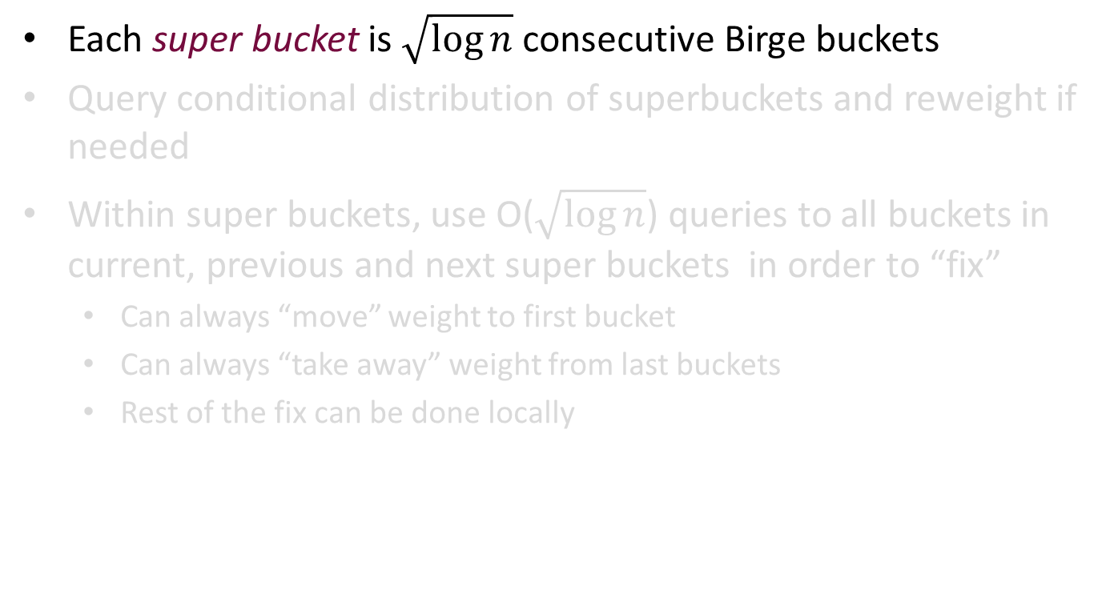
Fixing with CDF queries
Each super bucket is $\sqrt{\log{n}}$ consecutive Birge buckets
Query conditional distribution of superbuckets and reweight if needed
Within super buckets, use O($\sqrt{\log{n}}$) queries to all buckets in current, previous and next super buckets in order to “fix”
Can always “move” weight to first bucket
Can always “take away” weight from last buckets
Rest of the fix can be done locally
superbuckets

Slide 27

Fixing with CDF queries
Each super bucket is $\sqrt{\log{n}}$ consecutive Birge buckets
Query conditional distribution of superbuckets and reweight if needed (decide how using LP)
Within super buckets, use O($\sqrt{\log{n}}$) queries to all buckets in current, previous and next super buckets in order to “fix”
Can always “move” weight to first bucket
Can always “take away” weight from last buckets
Rest of the fix can be done locally
Remove some weight
Add some weight

Slide 28
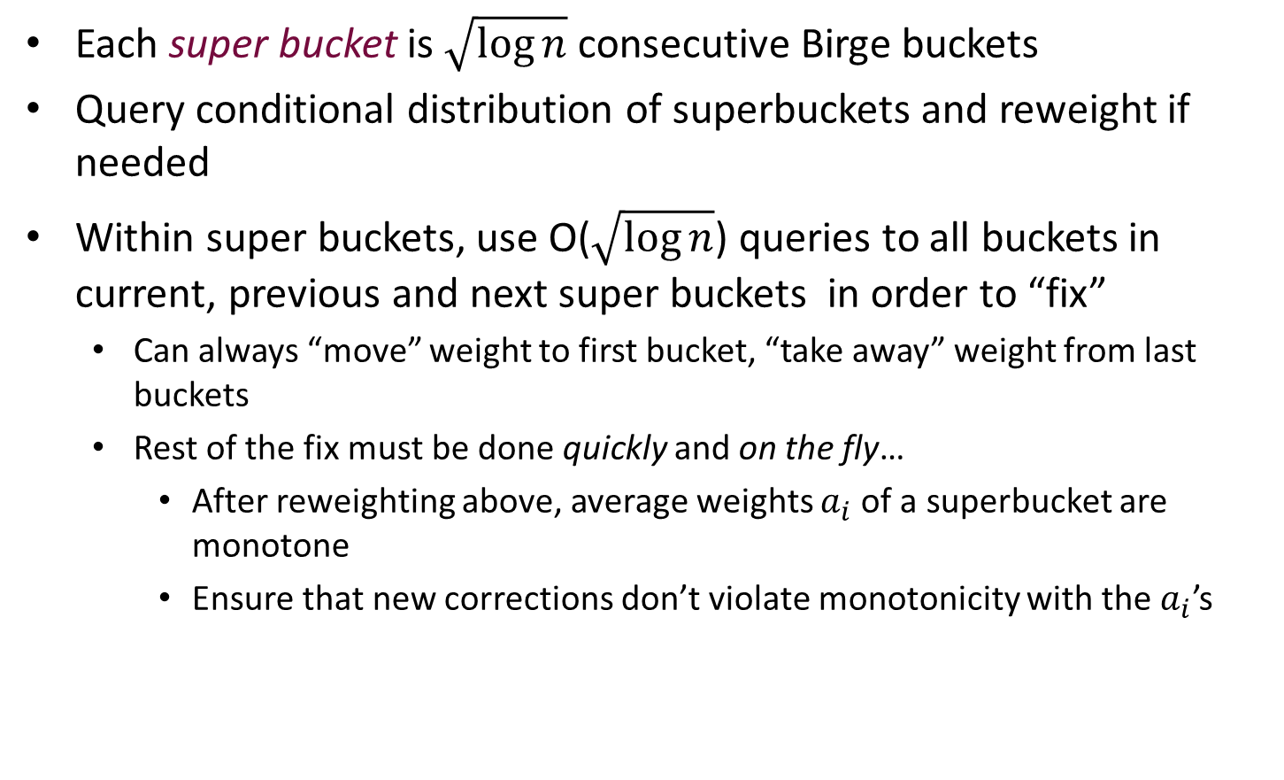
Fixing with CDF queries
Each super bucket is $\sqrt{\log{n}}$ consecutive Birge buckets
Query conditional distribution of superbuckets and reweight if needed
Within super buckets, use O($\sqrt{\log{n}}$) queries to all buckets in current, previous and next super buckets in order to “fix”
Can always “move” weight to first bucket, “take away” weight from last buckets
Rest of the fix must be done quickly and on the fly…
After reweighting above, average weights $a_{i}$of a superbucket are monotone
Ensure that new corrections don’t violate monotonicity with the $a_{i}$’s

Slide 29
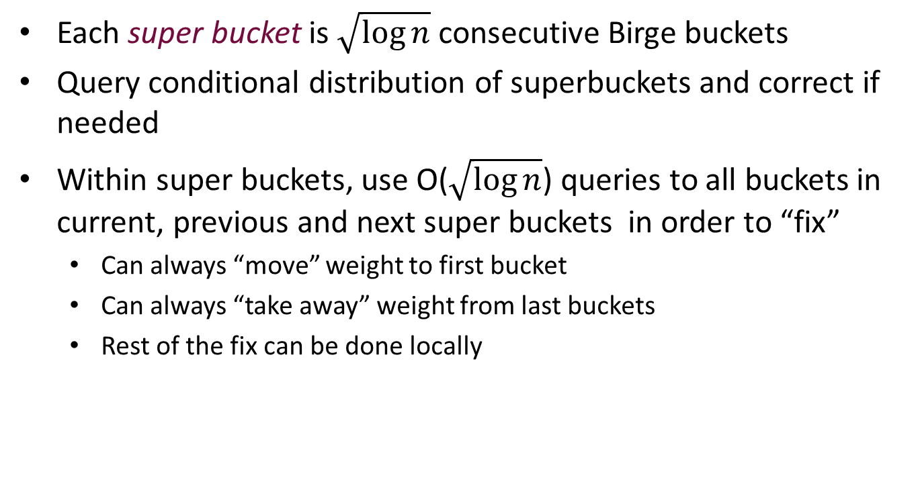
Fixing with CDF queries
Each super bucket is $\sqrt{\log{n}}$ consecutive Birge buckets
Query conditional distribution of superbuckets and correct if needed
Within super buckets, use O($\sqrt{\log{n}}$) queries to all buckets in current, previous and next super buckets in order to “fix”
Can always “move” weight to first bucket
Can always “take away” weight from last buckets
Rest of the fix can be done locally

Slide 30
Special error classes
Missing data errors – p is a member of P with a segment of the domain removed
E.g. one sensor failure in traffic data
More efficient sample correctors via learning missing part

Slide 31
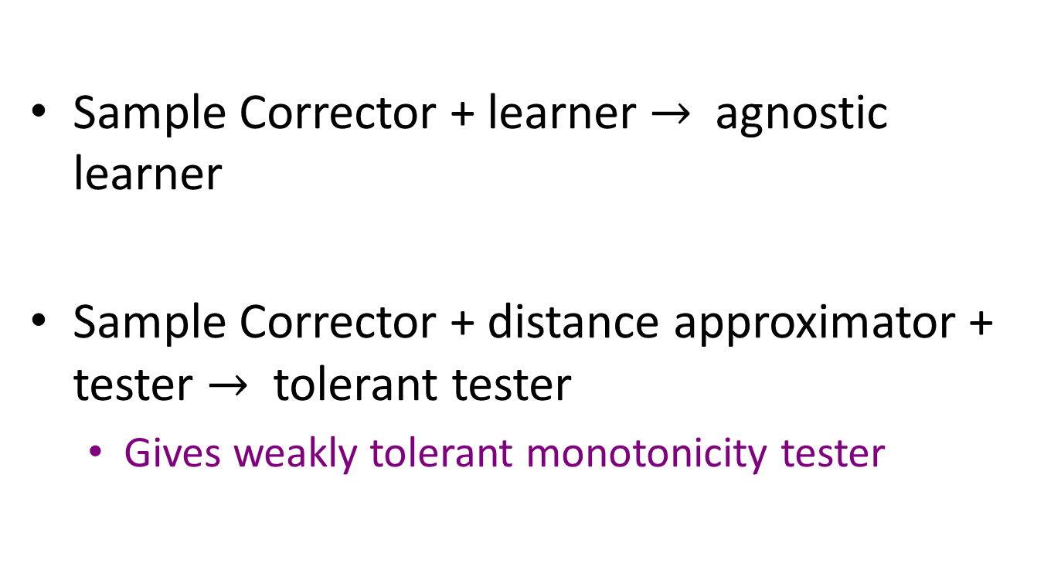
Sample correctors provide more powerful learners and testers:
Sample Corrector + learner $→$agnostic learner
Sample Corrector + distance approximator + tester $→$ tolerant tester
Gives weakly tolerant monotonicity tester

Slide 32
Randomness Scarcity
Can we correct using little randomness of our own?
Generalization of Von Neumann corrector of biased coin
Compare to extractors (not the same)
For monotone distributions, YES!

Slide 33
What next for correction?
When is correction easier than learning?

Slide 34
Thank you

