Slide 1
CSCI B609: “Foundations of Data Science”
Lecture 10/11: Random Walks and Markov Chains
Slides at http://grigory.us/data-science-class.html
Grigory Yaroslavtsev
http://grigory.us

Slide 2
Project Example: Gradient Descent in TensorFlow
Gradient Descent (will be covered in class)
Adagrad: http://www.magicbroom.info/Papers/DuchiHaSi10.pdf
Momentum (stochastic gradient descent + tweaks): http://www.cs.toronto.edu/~hinton/absps/naturebp.pdf
Adam (Adaptive + momentum): http://arxiv.org/pdf/1412.6980.pdf
FTRL: http://jmlr.org/proceedings/papers/v15/mcmahan11b/mcmahan11b.pdf
RMSProp: http://www.cs.toronto.edu/~tijmen/csc321/slides/lecture_slides_lec6.pdf

Slide 3







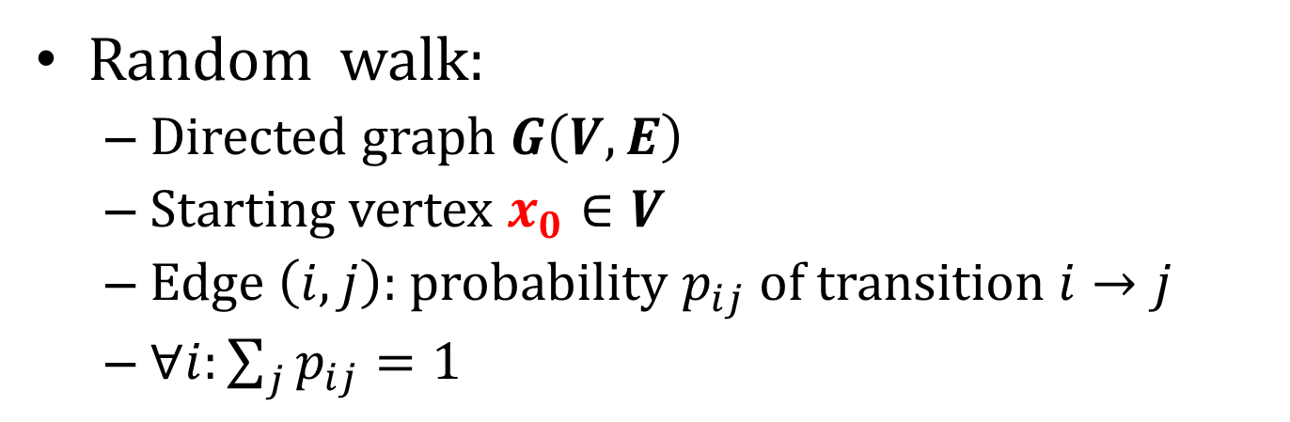










Random Walks and Markov Chains
Random walk:
Directed graph $G\left(V,E\right)$
Starting vertex $x_{0}∈V$
Edge $\left(i,j\right):$ probability $p_{ij}$ of transition $i→j$
$∀i:\sum_{j}{p_{ij}=1}$
$$0.5$$
$$0.5$$
$$x_{0}$$
$$0.5$$
$$1$$
$$0.4$$
$$0.5$$
$$0.5$$
$$0.9$$
$$0.5$$
$$0.5$$
$$0.1$$
$$0.5$$
$$0.5$$
$$1$$
$$1$$
$$0.1$$

Slide 4







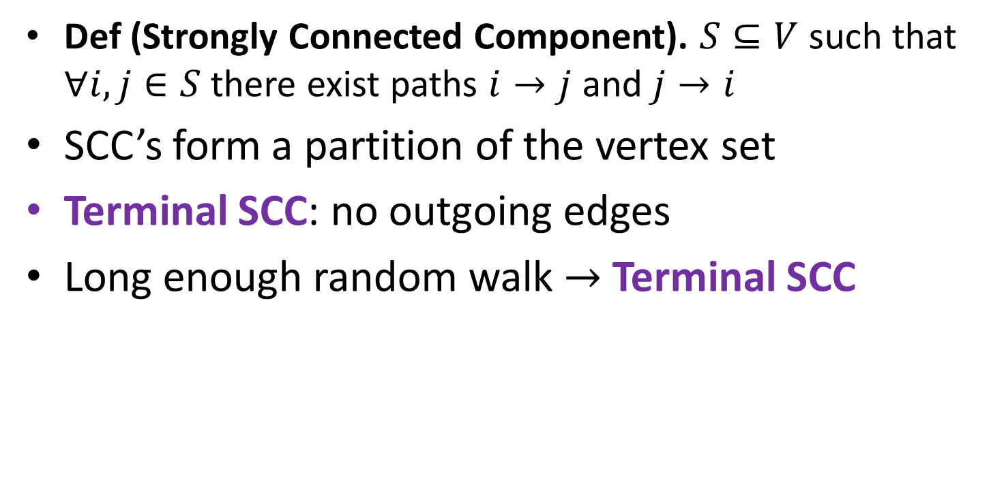










Strongly Connected Components
Def (Strongly Connected Component). $S⊆V$ such that $∀i,j∈S$ there exist paths $i→j$ and $j→i$
SCC’s form a partition of the vertex set
Terminal SCC: no outgoing edges
Long enough random walk $→$ Terminal SCC
$$0.5$$
$$0.5$$
$$x_{0}$$
$$0.5$$
$$1$$
$$0.4$$
$$0.5$$
$$0.5$$
$$0.9$$
$$0.5$$
$$0.5$$
$$0.1$$
$$0.5$$
$$0.5$$
$$1$$
$$1$$
$$0.1$$

Slide 5
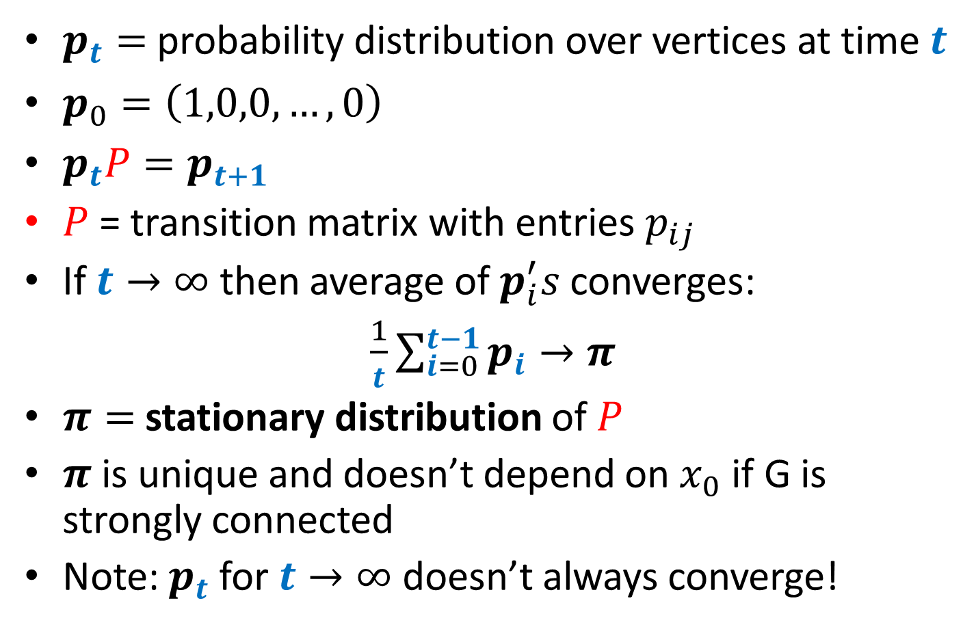
Matrix Form and Stationary Distribution
$p_{t}=$ probability distribution over vertices at time $t$
$p_{0}=\left(1,0,0,…,0\right)$
$p_{t}P=p_{t+1}$
$P$ = transition matrix with entries $p_{ij}$
If $t→∞$ then average of $p_{i}^{′}s$ converges:
$\frac{1}{t}\sum_{i=0}^{t−1}{p_{i}}→π$
$π=$ stationary distribution of $P$
$π$ is unique and doesn’t depend on $x_{0}$ if G is strongly connected
Note: $p_{t}$ for $t→∞$ doesn’t always converge!

Slide 6
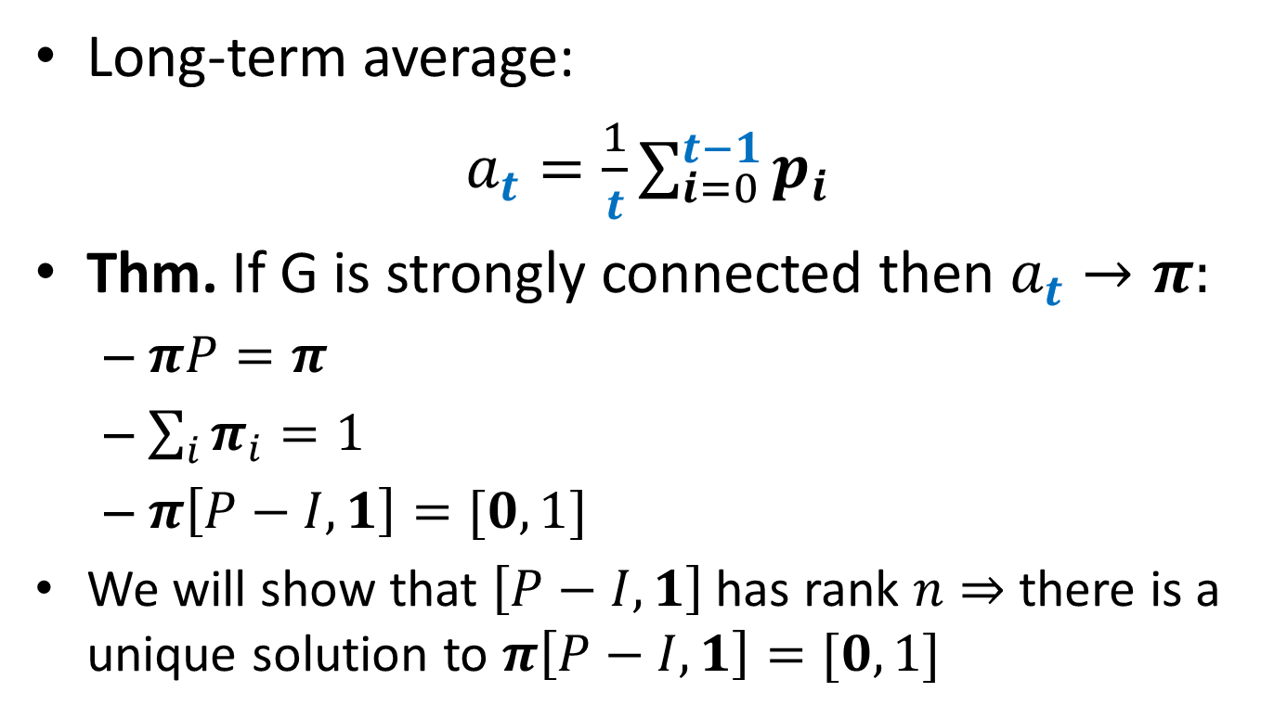
Stationary Distribution
Long-term average:
$a_{t}=\frac{1}{t}\sum_{i=0}^{t−1}{p_{i}}$
Thm. If G is strongly connected then $a_{t}→π:$
$πP=π$
$\sum_{i}{π_{i}=1}$
$π\left[P−I,1\right]=[0,1]$
We will show that $\left[P−I,1\right]$ has rank $n⇒$ there is a unique solution to $π\left[P−I,1\right]=[0,1]$

Slide 7
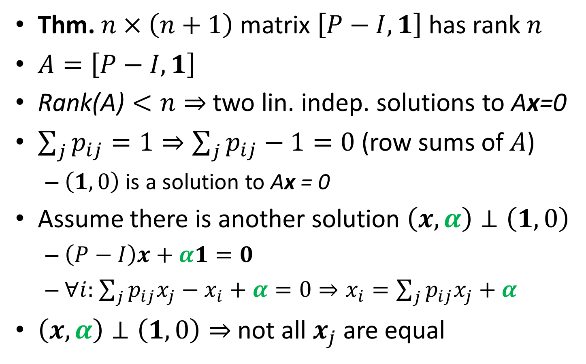
Stationary Distribution Theorem
Thm. $n×\left(n+1\right)$ matrix $\left[P−I,1\right]$ has rank $n$
$A=\left[P−I,1\right]$
$\text{Rank}\text{(}\text{A}\text{)}<n⇒$ two lin. indep. solutions to $\text{A}\text{x}\text{=0}$
$\sum_{j}{p_{ij}=1}⇒\sum_{j}{p_{ij}}−1=0$ (row sums of $A$)
$\left(1,0\right)$ is a solution to $\text{A}\text{x}\text{ = 0}$
Assume there is another solution $\left(x,α\right)⊥\left(1,0\right)$
$\left(P−I\right)x+α1=0$
$∀i:$ $\sum_{j}{p_{ij}x_{j}−x_{i}+α=0}⇒x_{i}=\sum_{j}{p_{ij}x_{j}+α}$
$\left(x,α\right)⊥\left(1,0\right)⇒$ not all $x_{j}$ are equal

Slide 8
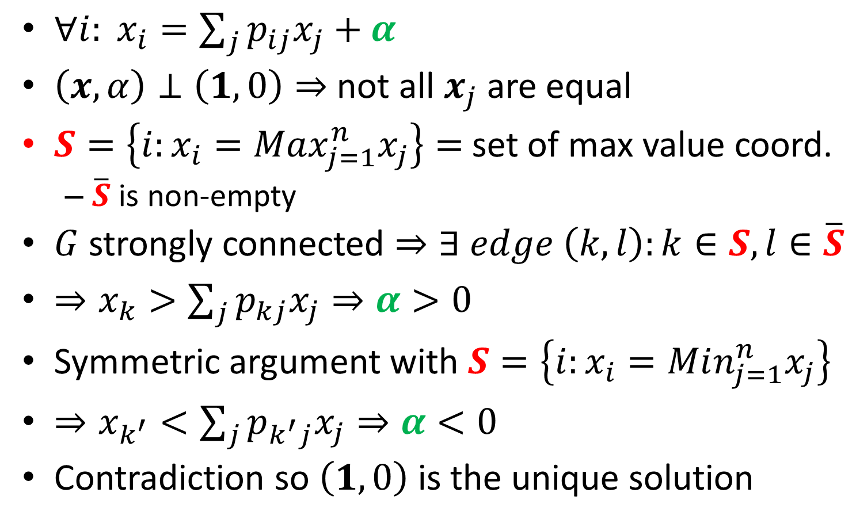
Stationary Distribution Theorem Cont.
$∀i: x_{i}=\sum_{j}{p_{ij}x_{j}+α}$
$\left(x,α\right)⊥\left(1,0\right)⇒$ not all $x_{j}$ are equal
$S=\left\{i:x_{i}=Max_{j=1}^{n}x_{j}\right\}=$ set of max value coord.
$\overline{S}$ is non-empty
$G$ strongly connected $⇒∃ edge \left(k,l\right):k∈S, l∈\overline{S}$
$⇒x_{k}>\sum_{j}{p_{kj}x_{j}}⇒α>0$
Symmetric argument with $S=\left\{i:x_{i}=Min_{j=1}^{n}x_{j}\right\}$
$⇒x_{k^{′}}<\sum_{j}{p_{k^{′}j}x_{j}}⇒α<0$
Contradiction so $\left(1,0\right)$ is the unique solution

Slide 9
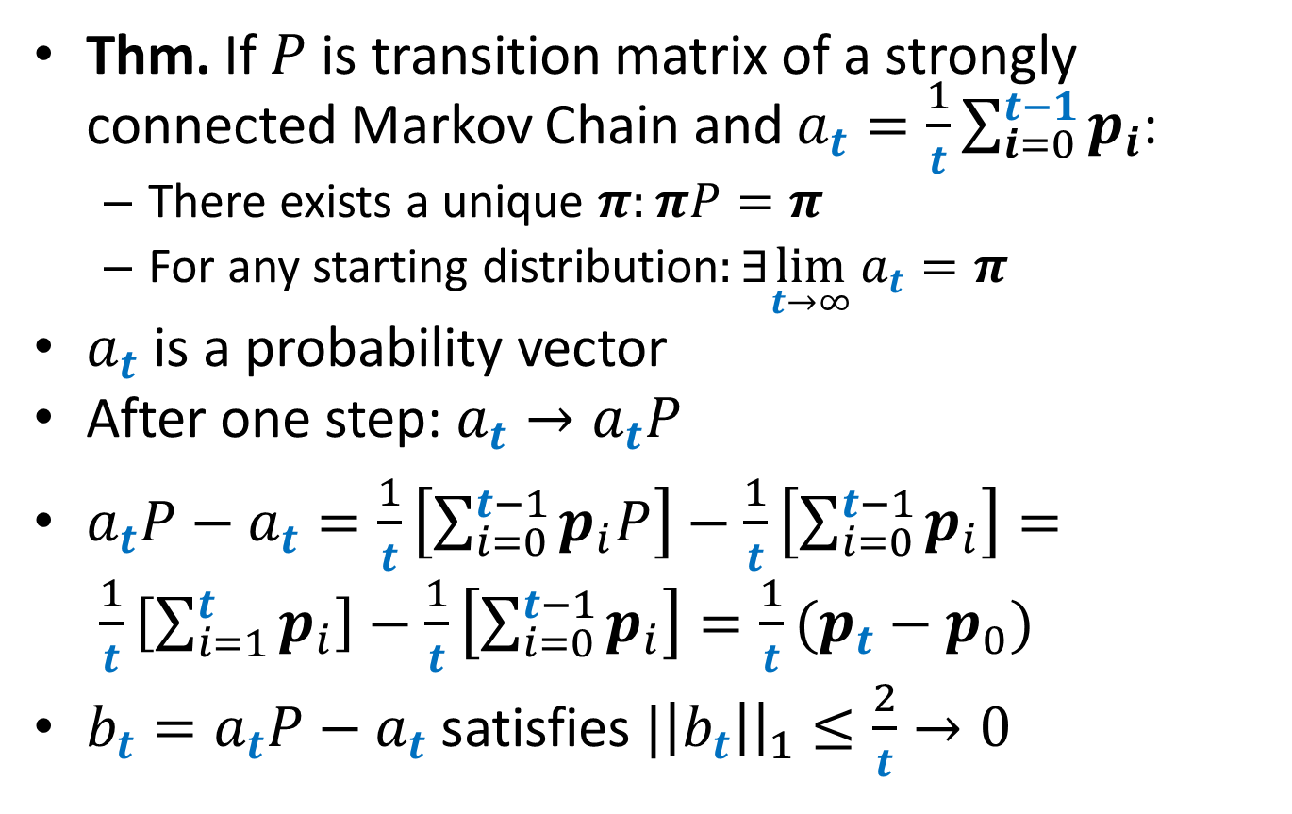
Fundamental Theorem of Markov Chains
Thm. If $P$ is transition matrix of a strongly connected Markov Chain and $a_{t}=\frac{1}{t}\sum_{i=0}^{t−1}{p_{i}}$:
There exists a unique $π:πP=π$
For any starting distribution$:∃\lim_{t→∞}a_{t}{=π}$
$a_{t}$ is a probability vector
After one step: $a_{t}→a_{t}P$
$a_{t}P−a_{t}=\frac{1}{t}\left[\sum_{i=0}^{t−1}{p_{i}P}\right]−\frac{1}{t}\left[\sum_{i=0}^{t−1}{p_{i}}\right]= \frac{1}{t}\left[\sum_{i=1}^{t}{p_{i}}\right]−\frac{1}{t}\left[\sum_{i=0}^{t−1}{p_{i}}\right]=\frac{1}{t}(p_{t}−p_{0})$
$b_{t}=a_{t}P−a_{t}$ satisfies $|\left|b_{t}\right|{\left.​\right|}_{1}≤\frac{2}{t}→0$

Slide 10
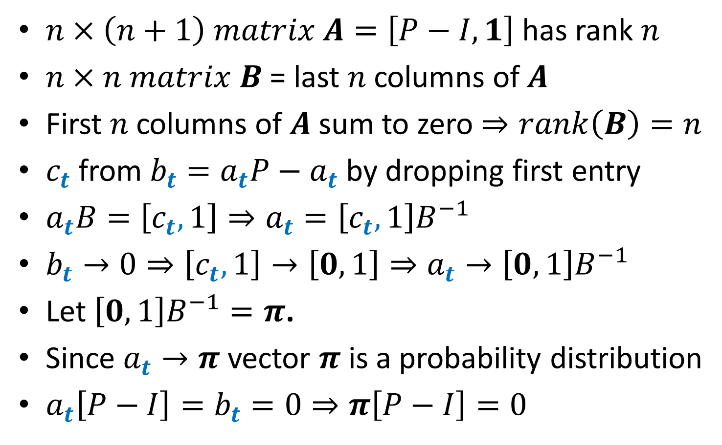
Fundamental Theorem of Markov Chains
$n×\left(n+1\right) matrix A=\left[P−I,1\right]$ has rank $n$
$n×n matrix B$ = last $n$ columns of $A$
First $n$ columns of $A$ sum to zero $⇒rank\left(B\right)=n$
$c_{t}$from$b_{t}=a_{t}P−a_{t}$ by dropping first entry
$a_{t}B=\left[c_{t},1\right]⇒a_{t}=\left[c_{t},1\right]B^{−1}$
$b_{t}→0⇒\left[c_{t},1\right]→\left[0,1\right]⇒a_{t}→\left[0,1\right]B^{−1}$
Let $\left[0,1\right]B^{−1}=π$.
Since $a_{t}→π$ vector $π$ is a probability distribution
$a_{t}\left[P−I\right]=b_{t}=0⇒π\left[P−I\right]=0$

